Slide 1
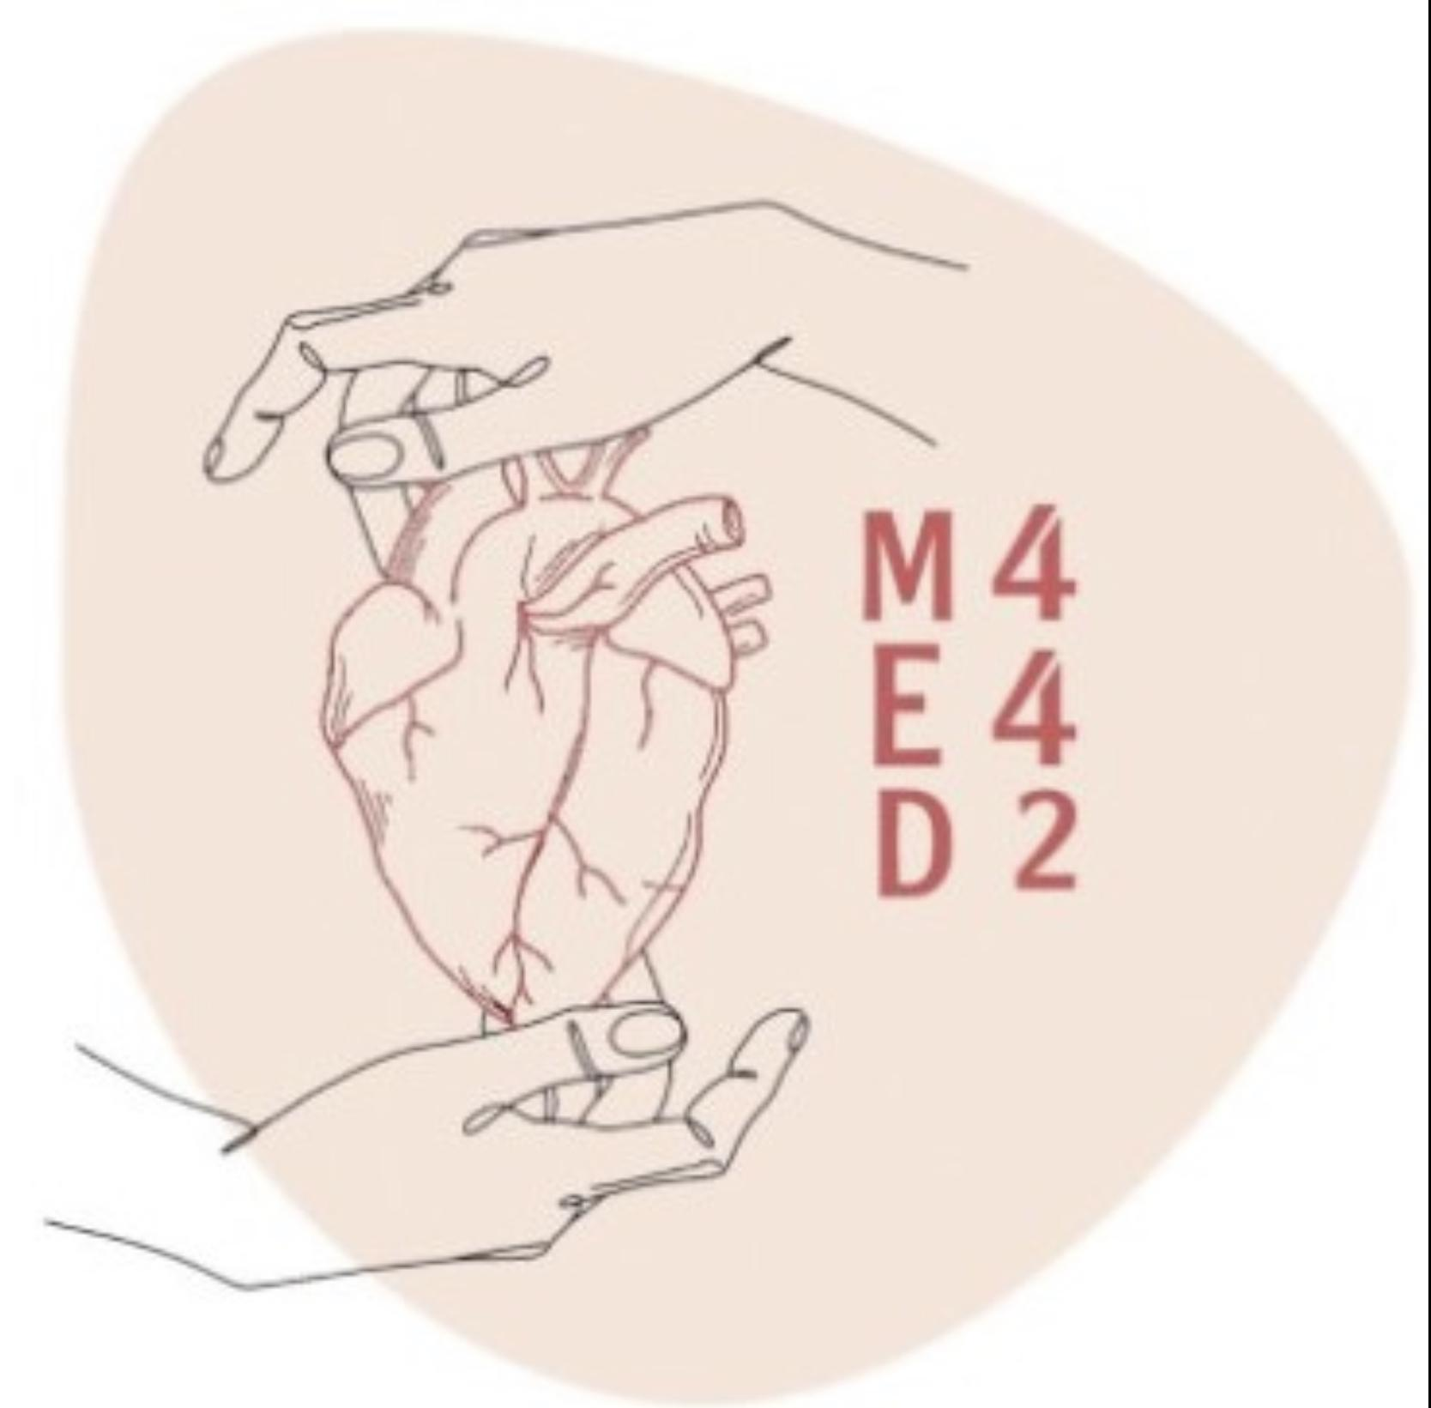
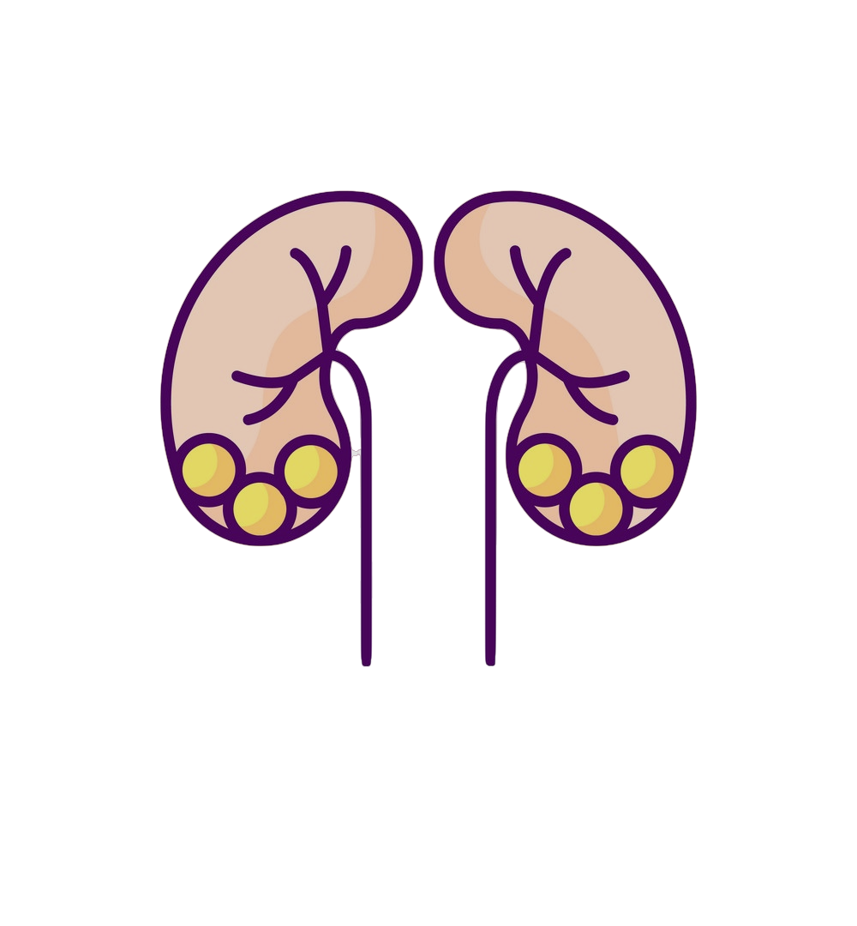
Pathology
L7
Pathology of Renal Allograft
Editing File
- Color Index:
Main Text
Male’s Slides
Female’s Slides
Important
Doctor’s Notes
Extra Info

Slide 2
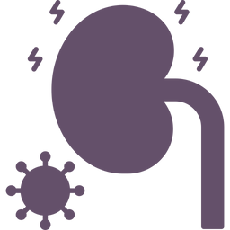
Objectives
Recognize the concept of renal allograft.
Describe the pathology of rejection and differentiate acute cell-mediated and antibody-mediated rejection.
Differentiate between acute and chronic rejection.
Recognize the pathology of the principal infections inherent to renal transplantation.
Recognize the pathology of acute and chronic drug toxicity

Slide 3
1
Kidney Transplant
Any cause that lead to End-stage renal disease Is treated by renal replacement therapy (e.g. hemofiltration, hemodialysis, peritoneal dialysis) or renal transplant.
Kidney transplantation is now a routine procedure in most large hospitals in the world.
The first kidney transplant between humans was conducted in 1933 by a Russian surgeon in Ukraine. The kidney was implanted in the groin under local anesthesia an the host survived four days.
donor: The patient who donates the kidney.
recipient: The patient who receives the “new” transplant kidney.
alloantigens: The antigens present in the allograft kidney
donor kidney or allograft or graft:The transplanted (“new”) kidney
alloantibodies: The antibodies that are against alloantigens (that target the alloantigens) are anti-allograft antibodies
The donor kidney is placed in the recipients iliac fossa or groin region. The donor ureter is inserted into the bladder. The blood
vessels are anastomosed. The donor of the kidney can be from a living or a deceased person.(death)

Slide 4
Pathology of injury in kidney transplant
Harvest injury
Infections in the renal allograft
Recurrence of primary disease
Rejection:
hyperacute, acute and chronic
Drug toxicity, acute & chronic
De-novo (new) disease
-Harvest injury
1
At the time of transplant there can be tubular injury to the transplanted
allograft kidney.
It is generally due to cold ischemia time or the mode of death of the donor.
It can lead to non-functioning kidney immediately after transplant (the patient develops anuria).
The good thing is that harvest kidney usually recover with appropriate management.
2-Rejection
Rejection is a major complication seen post-transplantation.
Transplant rejection occurs when transplanted tissue is rejected by the recipient's immune system and the recipient's immune system destroys the transplanted tissue.
Rejection has been classified by a system called as th Banff Classification.

Slide 5
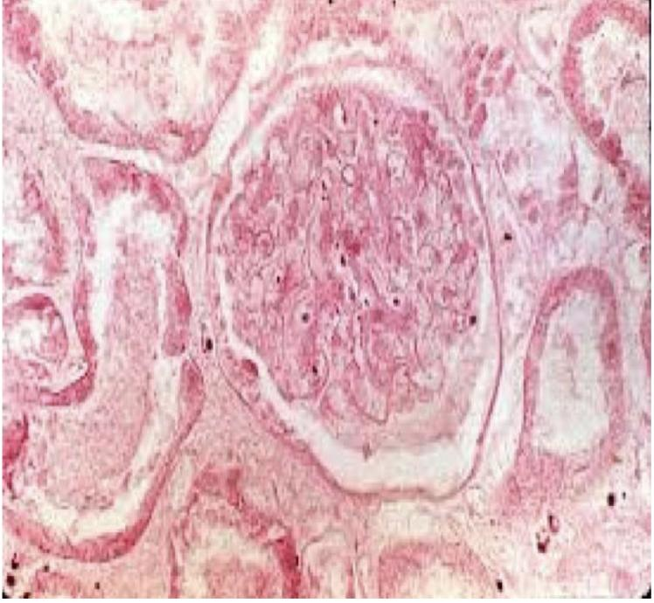
There are different types of rejection:
A) Hyperacute rejection
B) Acute rejection | acute T-cell mediated rejection acute antibody-mediated rejection
C) Chronic | chronic T-cell mediated rejection and chronic antibody-mediated rejection.
hyperacute rejection
Rare Rejection of the allograft occurring immediately after implantation and perfusion of graft. Occurs within minutes to hours after transplantation.
Morphology | Gross | Cyanosis of graft minutes to hours after perfusion Graft becomes swollen, hemorrhagic, and necrotic
 | Microscopic | Vasculitis, thrombosis, ﬁbrinoid necrosis of blood vessels Thrombi in glomeruli Interstitial edema and hemorrhage Infarct of the kidney (coagulative necrosis) and loss of graft

Slide 6
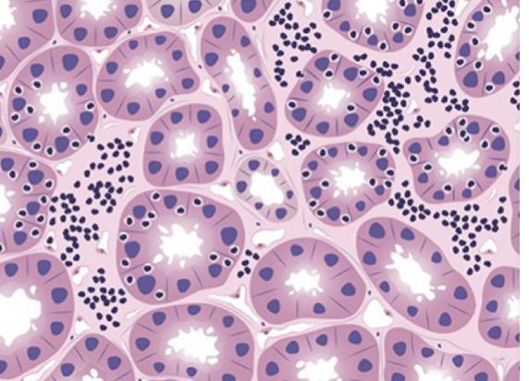
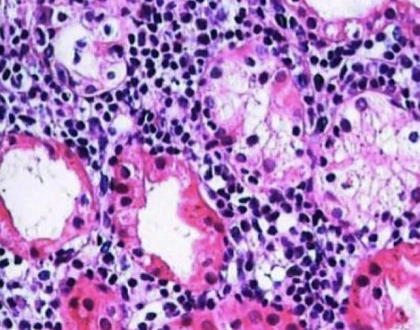
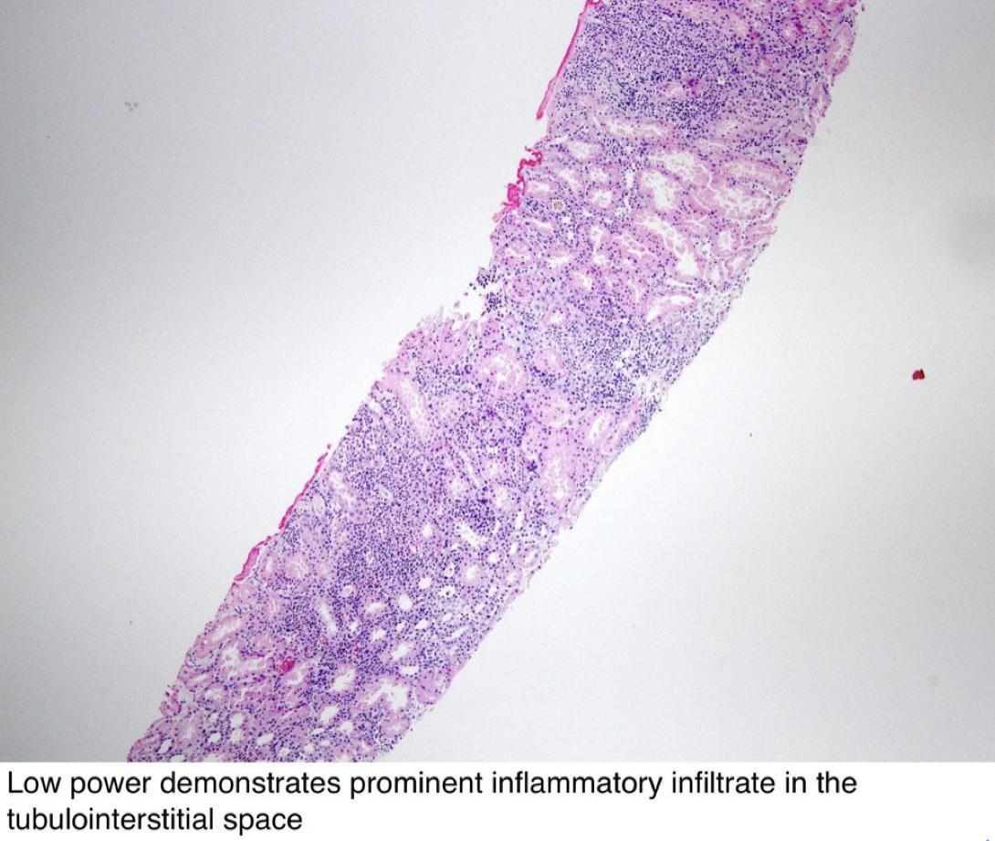
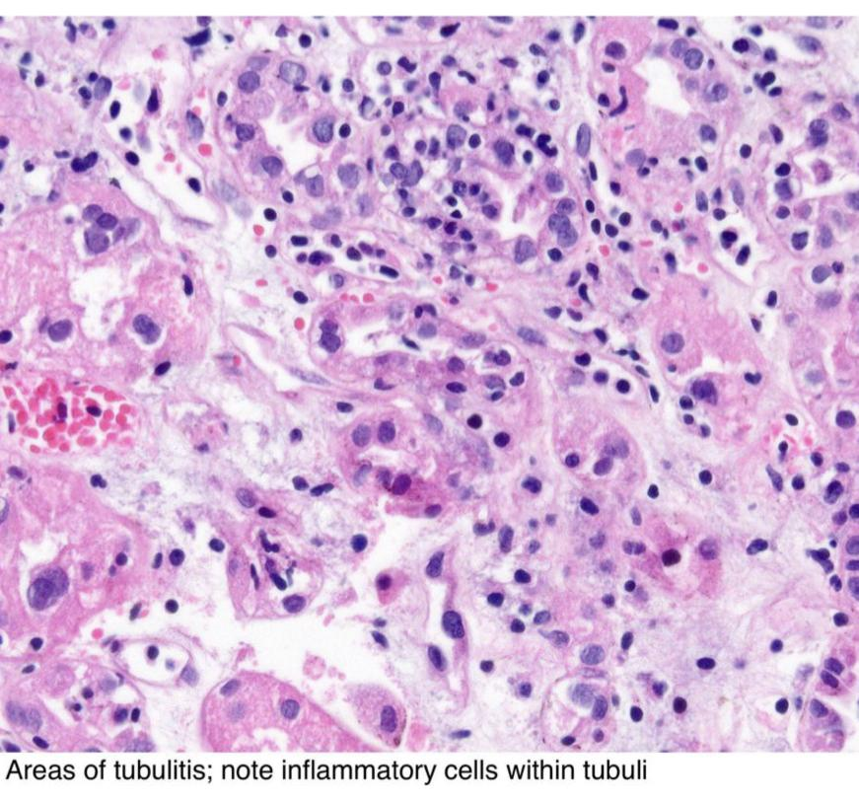
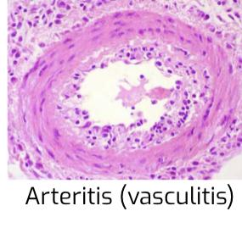
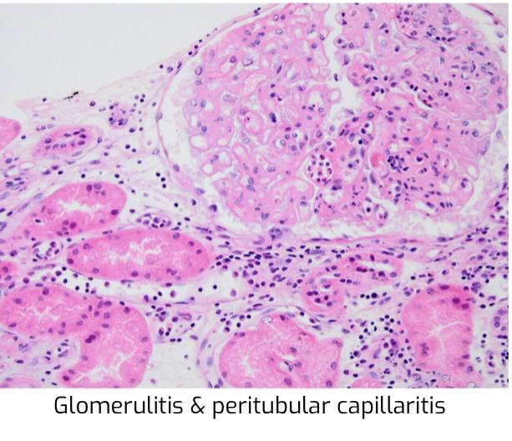
B
Acute rejection Most common type of rejection in the newly transplanted kidney patient. It can occur within days or the ﬁrst few months after surgery. Sometimes it can occur after years.
Types Of acute rejection | Acute T-cell mediated rejection ( acute TCMR )/Acute Cellular Rejection | Acute antibody-mediated rejection (acute ABMR)
Overview | Common form of rejection. An acute immune reaction by the recipient against the antigens present in the allograft ( alloantigens) Mediated by T cells. Classically it develops in the ﬁrst 3 months after transplantation, but may erupt at any time, even after many years. | Also called as acute humoral rejection. An acute antibody mediated immune reaction. Mediated by the anti-allograft antibodies (alloantibodies) called donor speciﬁc antibodies (DSA)
Characteristics | There is inﬁltration of allograft by lymphocytes (mainly T-cells) and other inﬂammatory cells. The inﬂammation is primarily in the tubules (tubulitis) and the interstitium (together called tubulointerstitial inﬂammation) and may also involve the arteries called vasculitis/arteritis (not always present) (+/- ﬁbrinoid necrosis of arteries). Acute TCMR responds well to immunosuppressive drug therapy. | The recipient already has pre-formed (i.e.present before transplantation) circulating anti-donor speciﬁc antibodies (DSA). These antibodies are directed against the endothelial cells in the allograft kidney they attack the allograft endothelial cells in the blood vessels (esp. the endothelial cells of the glomeruli and peritubular capillaries) resulting in rejection. The microvasculature of the kidney (i.e. glomeruli and peritubular capillaries) is the main target.
Clinical features | Clinically there is loss of graft function and it presents as rising creatinine.
Microscopy NOTE: arteritis/ vasculitis can be seen in both acute TCMR and acute ABMR. | Tubulointerstitial inﬂammation (T Lymphocytes seen) with or without arteritis Interstitial edema and sometimes hemorrhage. Note:glomerular usually not involved unlike ABMR. | Glomerulitis, capillaritis of the peritubular capillaries (peritubular capillaritis). Positive C4d immunostain in the peritubular capillary Acute tubular injury/ necrosis. Arteritis +/- ﬁbrinoid necrosis. Acute thrombotic microangiopathy like picture

Slide 7
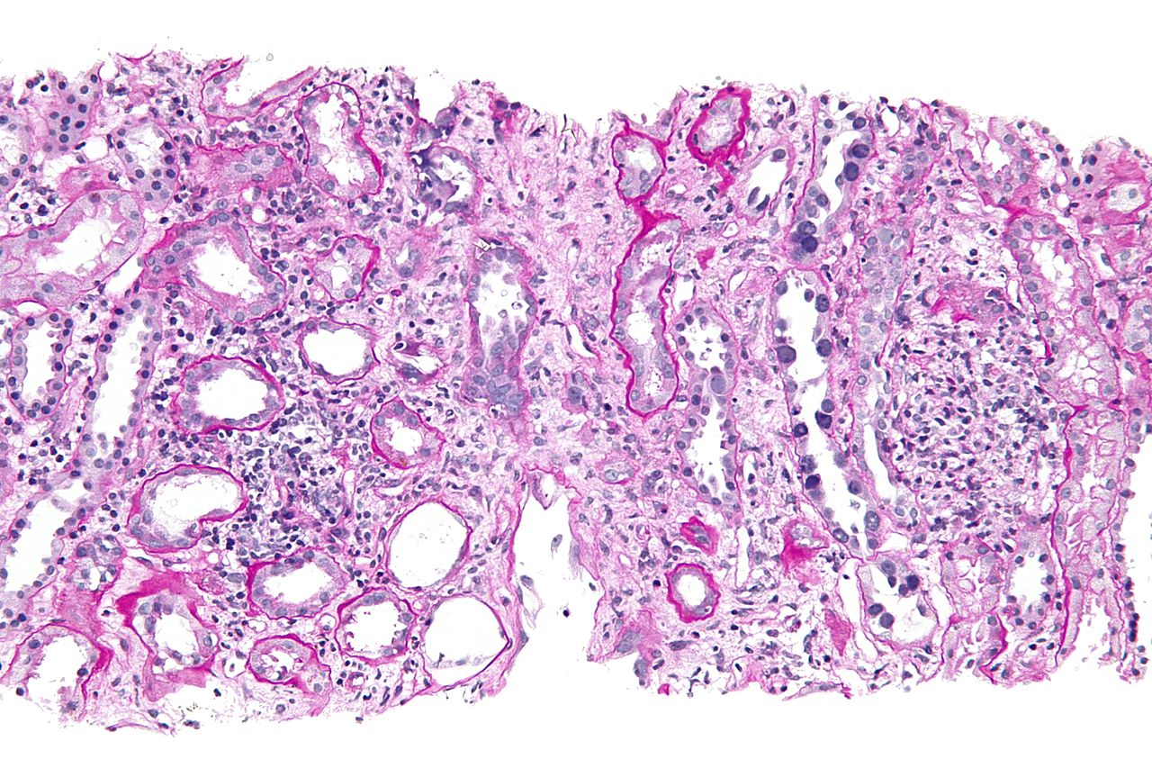
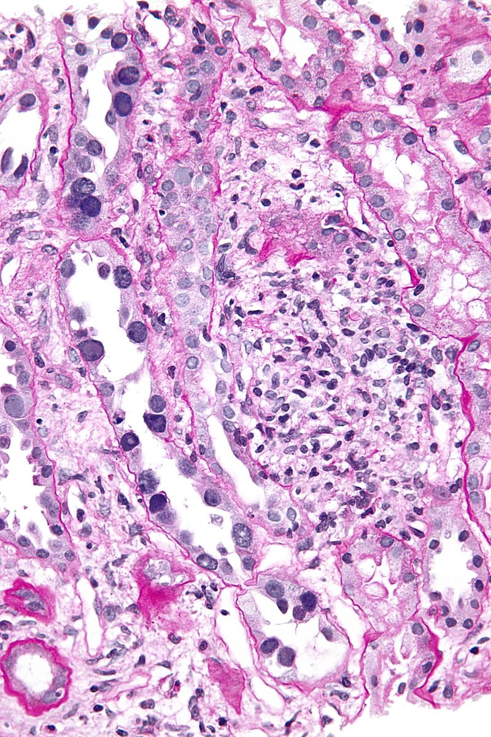
chronic rejection :Chronic rejection is the type of rejection that happens over an extended period of time and can eventually lead to loss of the graft if it wasn’t treated properly
Characteristics | ● Persistent or recurrent episodes of TCMR or ABMR → chronic changes in allograft → chronic rejection (chronic TCMR and chronic ABMR) → end stage allograft Characteristics kidney (graft loss). It does not respond to immunosuppressive therapy. Usually occurs after the first year of transplantation.
Clinical features | Gradual rise in serum creatinine Patients presents with chronic graft dysfunction/ chronic renal failure Proteinuria And hypertension
Morphology (additional info.) | Tubulitis and tubular atrophy. Interstitial inﬂammation and ﬁbrosis. Arteries show intimal ﬁbrosis with chronic inﬂammation called chronic transplant arteriopathy. Glomeruli: global or focal segmental glomerulosclerosis Chronic ABMR also shows a unique type of glomerular injury called transplant glomerulopathy.
3- Infections of the renal allograft
The patients who are recipients of allograft kidney are given various immunosuppressive drugs are therefore immunosuppressed (immunocompromised).
These patients are predisposed to various renal infections like: | Polyomavirus (Sv40 virus) Adenovirus Cytomegalovirus Epstein Barr virus (EBV)
● They primarily infect the tubules and cause tubulointerstitial inflammation and acute tubular injury. The infected tubular epithelial cells show viral nuclear changes. ● These infections can lead to graft loss ● Infection with EBV can also lead to post transplant lymphoproliferative disorder (PTLD) (may develop lymphoma) Useful video about PTLD
RENAL TUBULES SHOWING POLYOMAVIRUS INFECTION IN ALLOGRAFT KIDNEY (ARROWS)

Slide 8
8
4-Drug toxicity
Calcineurin inhibitors (CNIs): immunosuppressive drugs given to the recipient to decrease their immune system response to the transplanted kidney and therefore help suppress acute rejection.
Examples of CNIs: cyclosporine and tacrolimus
The problem is that CNIs are also nephrotoxic and can cause acute or
chronic damage to the graft. They can cause acute CNI toxicity & chronic CNI toxicity in the kidney
Blood tests show:
● Rising serum creatinine
● Elevated levels of CNI in blood
Acute CNI toxicity shows:
acute tubular injury
isometric vacuolization of proximal tubules
acute thrombotic microangiopathy like picture.
Chronic CNI toxicity shows:
striped interstitial fibrosis
tubular atrophy
Microcalcifications
nodular arteriolar hyalinosis
chronic thrombotic microangiopathy like picture.
All in grey is Additional information (Dr said you will not be asked about this).
5- Recurrence of primary disease
The primary disease which lead to end stage kidney and eventual transplant can recur as early as 6 months post-transplant.
6- De novo (new) disease / glomerulonephritis
It is the development of another kidney disease in the renal allograft, different from the disease the patient originally suffered from, (it is rare)

Slide 9
Summary
Harvest injury | Tubular injury to the transplanted allograft kidney, due to cold ischemia time or the mode of donor death. It can lead to non-functioning kidney immediately after engraftment in which the patient will have anuria. usually recover.
Rejection is a major complication seen post-transplantation Types of Rejection:
Hyperacute rejection | Acute rejection | Chronic rejection
Immediately. Minutes to hours after transplantation. | The most common type of Rejection. Days or the first few months after surgery. Sometimes it can occur after years. | Usually occurs after the first year of transplantation. Lead to loss of the graft. Doesn’t respond to immunosuppressive therapy.
Infection Of The Renal Allograft | The renal allograft immunosuppressed & predisposed to renal infections like adenovirus, cytomegalovirus and polyomavirus (SV40) and (EBV). They can lead to graft loss.
Drug Toxicity | CNI are immunosuppressive drugs used to decrease the recipients immune system's response to the transplanted kidney and therefore helps suppress acute rejection. Examples of CNI drugs: Cyclosporine , Tacrolimus. Blood test show: Elevated of serum creatinine. Elevated blood/ serum CNI levels.
Recurrence of primary disease | The primary disease which lead to end stage kidney. It is not very common.
De-novo (new) disease / glomerulonephritis | It is the development of another kidney disease in the renal allograft. It is very rare.

Slide 10
Quiz
Q1
A patient who had a transplant 2 months ago is now having rising creatinine, biopsy is done showing Glomerulitis and capillaritis, CD4 stain is positive. What is your diagnosis?
A.Hyperacute rejection
B.TCMP
C.Acute ABMR
D.Chronic Rejection
Gradual rise in serum creatinine in:
Q2
A.chronic rejection
B.hyper acute rejection
C.TCMR
D.ABMR
One of them is right (hyperacute rejection)
Q3
A .Rejection of the allograft occurring immediately after implantation
B. Rare
C. Occurs within minutes
D. All above
One of them is false of clinical features of chronic rejection
Q4
Gradual rise in serum creatinine
Patients presents with chronic graft dysfunction
Hypotension
Proteinuria

Slide 11
Quiz
Q5
A patient came to the hospital a week after kidney Transplantation, He came with fever, vomiting, night sweats, weight loss, enlarged cervical lymph nodes. The Doctor diagnosed him with PTLD caused by viral infection. What is the most likely Virus?
A. EBV
B. Cytomegalovirus
C. Adenovirus
D. SV40
Q6
Which of the following is/are an example/s of Calcineurin inhibitors?
A. Cyclosporin
B. tacrolimus
C. Prednisone
D.Both A&B
1) C 2)A 3(D 4)c 5)A 6)D

Slide 12
Members
Members
Team Leaders
Female Leader
Male Leader
Team Members
Hoor Aloraini
Farah alhalafi
Shahad Alsalahi
Nouf Aldhalaan
Jana alhazmi
Mayssar Alshobaki
Rahaf Almutairi
layan Aldoukhi
Atheer Alahmari
WalaaAlMutawa
Fatima Halawi
Omar Alkadhi
Emad Almutairi
Rakan Alromayan
Ali Alzahrani
Saad Alahmari
Malik halees
Khalid Alrasheed
Nawaf Alturki
Pathology442@gmail.com
Theme was done by Shatha Almutib

