Slide 1
By : Faisal AlOmar
Editing File
Renal Excretion
of Drugs
Main Text
Male’s Slides
Female’s Slides
Important
Doctor’s Notes
Extra Info
Helpful video
Objectives:-
Identify main and minor routes of excretion including renal elimination and biliary excretion
Describe its consequences on duration of actions of drugs.
Identify the different factors controlling renal excretion of drugs.
Know the meaning of urinary ion trapping.
Know how we can prescribe drugs in patients with renal impairment.

Slide 2
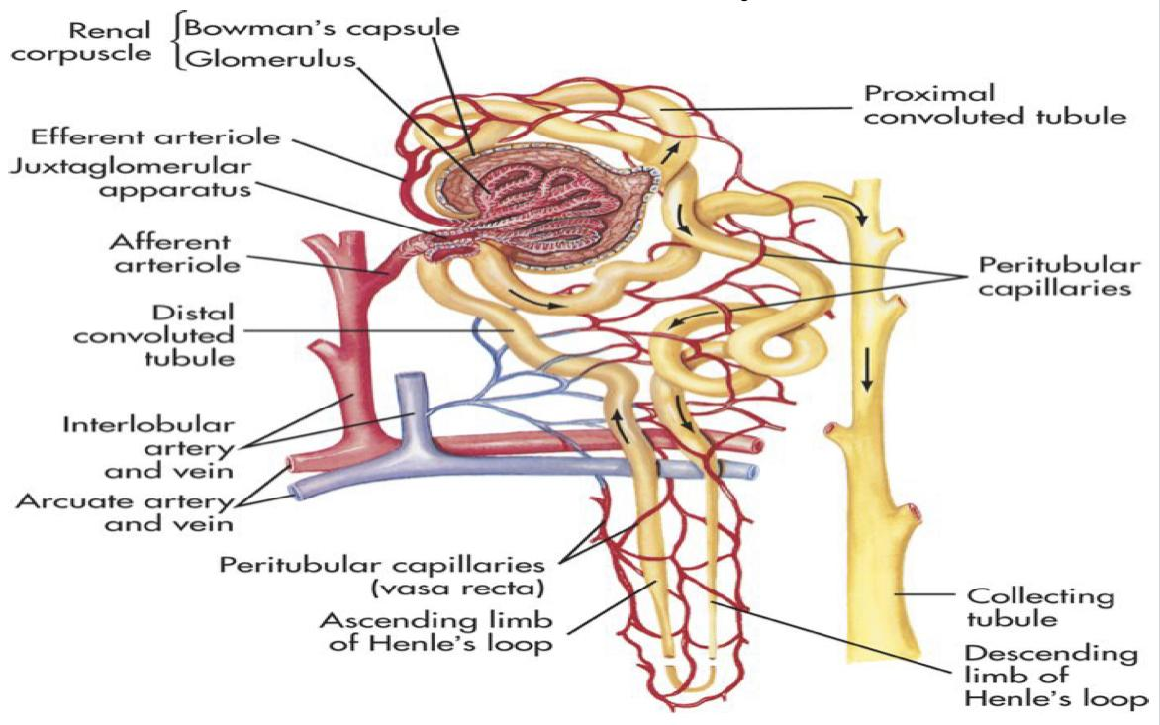
Major routes of excretion
Route of Excretion
Minor routes of excretion
1-Renal excretion (most common)
1-Pulmonary excretion
2-Biliary excretion
2-Salivary excretion
3-Mammary excretion via
milk
4-Skin / Dermal excretion
via sweat
5-tears
Structure of kidney
The structural unit of kidney is nephron that consists of :
1
Glomerulus
2
Proximal Convoluted tubules
3
Henle’s loop (Ascending-Descending)
4
Distal Convoluted tubules
5
Collecting ducts

Slide 3
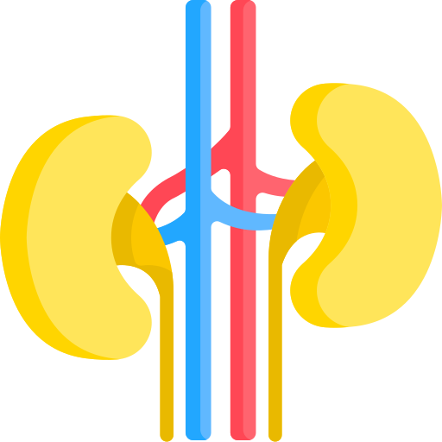
Normal Kidney Functions: (Female’s slides only) -not pharma-
1
Regulation of electrolytes (aldosterone).
2
Regulation of water balance (anti-diuretic hormone).
3
Excretion of wastes & drug metabolites such as (Urea ,Uric acid ,Creatinine).
4
The most important organ for drug excretion is the kidney.
Renal excretion:
Urinary excretion of drugs occurs through three processes:
1
2
3
Glomerular filtration
Active Tubular secretion
Passive or active tubular reabsorption
1- Glomerular filtration (GF):
Girl’s dr: It is physiology -not important-
01
Depends upon renal blood flow (Normal GFR = 125-130 ml/min)
02
Most drugs are filtered through glomerulus.
03
Blood is filtered across a semi-permeable membrane into the Bowman’s Capsule.
04
Filtrate contains water, glucose, amino acids, sodium bicarbonates, organic solutes and electrolytes (sodium, potassium, chloride).
05
Blood cells, platelets, and plasma proteins are retained in the blood and not filtered.
06
Driving force for GF is hydrostatic pressure of blood flowing in capillaries.

Slide 4
Glomerular filtration Rate (GFR):
Girl’s dr: It is physiology -not important-
1
The amount of blood filtered by the glomeruli in a given time.
2
Normal GFR = 125 ml/min.
3
GFR is used as a marker or indicator for kidney function.
4
Creatinine clearance (CrCl) is used as a marker instead of GFR.
5
GFR is determined by creatinine, inulin (inulin is easily filtered by kidney not reabsorbed).
Glomerular filtration of drug occurs to:
1
Low molecular weight drugs (most proteins have high MW and are not filtered)
2
Polar or ionized Water soluble drugs e.g. aminoglycosides,tubocurarine
3
Free form of the drugs (not bound to plasma proteins)
4
Drugs with low volume of distribution (Vd)
If the drugs have low VD that means they have low conc.in tissue and high conc. on blood

Slide 5
2-Active Tubular Secretion of Drugs :
01
occurs mainly in proximal tubules
02
It increases drug concentration in the filtrate (because the drug will be secreted from the blood to the filtrate)
03
Drugs undergo active secretion have excretion rate values greater than normal GFR.
04
Secretion of ionized (water soluble) drugs into the lumen e.g. penicillin G
Characters of active tubular secretion:
needs
energy
transports
drugs against
concentration
gradients
between blood
and filtrate
requires
carriers
(transporters)
Saturable
Not
specific
(competition
may
happens)
med439: we don’t have specific carriers for each type of drug, we only have acidic carriers and basic carriers and a competition may happen if 2 acidic or 2 basic drugs were taken at the same time
1-Transporters for organic acids
Penicillin, aspirin, uric
acid, sulfonamides,
Probenecid
probenecid can inhibits active tubular
secretion of acidic drugs
Types
of
Transporters
2-Transporters for organic bases
morphine,
catecholamines,
atropine, quinine
usually basic drugs end with (-ine)

Slide 6
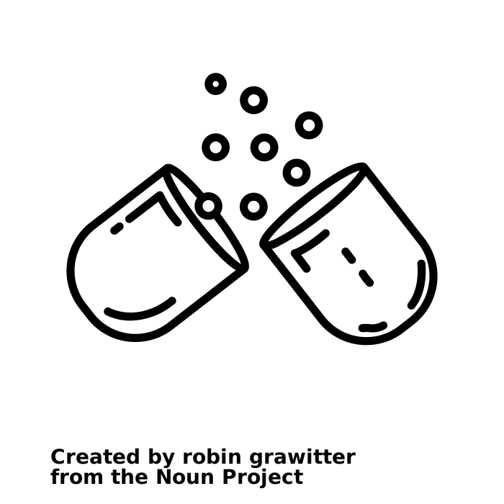
Competitive active tubular secretion of drugs: (Female’s slides only)
Two structurally similar drugs having similar ionic charge
and employing
the same carrier- mediated
process for excretion enter
into competition
A drug with greater rate
of excretion will retard
the excretion of other
drug with which it
competes.
The half life of both drugs is
increased since the total sites for active secretion are limited.
Examples of two drugs compete for the same carrier:
Probenecid & penicillin
Probenecid & nitrofurantoin
Probenecid drug min 24:34
 | Beneficial competition | Harmful competition
Example | Probenecid & Penicillin G | Probenecid & nitrofurantoin “Nitrofurantoin”: is one of the drugs used to treat UTI
How? | Probenecid competes with or retards renal tubular secretion of (organic acids) penicillin G and thus less amount of penicillin G will be excreted → prolonged duration of action (by 2 folds) of penicillin G & increase in its antibacterial action | Probenecid inhibits renal tubular secretion of nitrofurantoin → decreases its efficacy in urinary tract infections (UTIs) Med439: nitrofurantoin’s site of action is in the lumen to treat UTI, probenecid will inhibit the secretion of nitrofurantoin therefore decreases its efficacy

Slide 7
3-Tubular reabsorption of drugs:
Female’s Slides
It takes place along all the renal tubules.
After glomerular filtration, drugs may be reabsorbed back from tubular lumen into
systemic blood circulation.
Reabsorption increases half life of a drug(duration of action)
Reabsorption may be passive or active
Passive
Tubular
reabsorption
of drugs
1- In distal convoluted tubules & collecting ducts.
2- Only lipid soluble drugs (non-ionized) undergo passive tubular
re-absorption from tubular lumen back into blood (not excreted in the urine,
urinary excretion will be low).
3- Ionized drugs (water soluble) are poorly reabsorbed, excreted easily in the
urine, and urinary excretion will be high.
Active
Tubular
reabsorption
of drugs
1-It occurs with endogenous substances or nutrients that the
body needs to conserve e.g: glucose,
electrolytes, amino acids, uric acid, vitamins.
2- Probenecid inhibits active tubular re-absorption of uric acid
So, It increases excretion of uric acid in urine.
(That’s why we use it im treatment of gout)
3- Probenecid acts as a uricosuric agent in the treatment of gout.
“Uricosuric agent is an increase in urinary excretion of uric acid”

Slide 8
Factors affecting renal excretion of drugs:
01
Blood flow to the kidney
➢ Adequate renal function depends upon renal blood flow.
➢ Decline in renal blood flow can decrease excretion of drugs.
➢ NSAIDS e.g. aspirin and ibuprofen inhibit the production of prostaglandins and therefore reduces renal
perfusion and GFR.
➢ Irrespective of the mechanism of excretion, Increased perfusion leads to increased contact of drug with
secretary site and thus increased excretion.
➢ Important for drugs excreted by Glomerular filtration
02
Physicochemical properties of drugs
Molecular weight of the drug: | Larger MW drugs are difficult to be excreted than smaller MW especially by glomerular filtration.
Lipid solubility of drugs | ➢ Urinary excretion is inversely related to lipophilicity. ➢ Increased lipid solubility increases volume of distribution of drug (Vd) and decreases renal excretion.
Degree of ionization of drugs: | ➢ Increased ionization of drug increases its water solubility and thus enhances its renal excretion. ➢ Polar or water soluble drugs are easily filtered e.g aminoglycosides, tubocurarine.
Volume of distribution (vd): | ➢ Renal clearance is inversely related to volume of distribution of drugs (Vd). ➢ Drugs with large Vd “Lipid soluble” are poorly excreted in urine. ➢ Drugs restricted to blood (low vd) have higher renal excretion rates. “Drugs with large Vd are distributed in the tissue so less amounts are present in the blood which leads to a decrease in the renal excretion”
Plasma protein binding : | ➢ Drugs that are bound to plasma proteins behave as macromolecules and cannot be filtered through glomerulus ➢ Only unbound form of drug (free form) appears in glomerular filtrate. ➢ Protein bound drugs have long half lives. ➢ The renal clearance of drugs which are extensively bound to plasma proteins is increased after displacement with another drugs. E.g. Gentamicin-induced nephrotoxicity by Furosemide (Furosemide displaces gentamicin from protein)

Slide 9
Cont...
Factors affecting renal excretion of drugs:
Biological factor
03
Female’s Slides
➢ Age can affect renal clearance.
➢ Renal clearance is reduced in neonates and elderly due to pharmacokinetic changes.
➢ Dose reduction is advisable otherwise toxicity may occur. “The number of nephrons decline by aging (decline of renal function)”
Disease states -Decreased renal clearance-
04
Impairs the elimination of drugs thus may increase half-life (t 1/2 ) of drugs
This may occur due to:
1-Reduced renal blood flow
2-Decreased renal excretion
➢ Congestive heart failure
➢ Hemorrhage
➢ Cardiogenic shock
➢ Renal disease (e.g.
glomerulonephritis)
Urine PH
05
Urine pH varies from 4.5 to 8 depending upon the diet e.g. meat causes more acidic urine and
carbohydrates rich food may increase urinary pH
Plasma concentration
06
Male’s Slides
Glomerular filtration and reabsorption are directly affected by plasma concentration of drug.

Slide 10
Renal excretion of drugs and pH of urine
01
Most drugs are weak acids or weak bases
02
Normal urine (pH 5.3 ) slightly acidic and favors excretion of
basic drugs. Basic drug + acidic urine = ionized (so easily excreted )
03
Most of acidic drugs will be reabsorbed back into body.
Acidic drug + acidic urine = not ionized ( so hard to excrete)
04
Changing the pH of urine can inhibit or enhance the passive
tubular re-absorption of drugs.
05
Urine pH varies from 4.5 to 8 depending upon the diet e.g.
meat decreases urinary pH (more acidic urine) and
carbohydrates rich food may increase urinary pH.
Urinary pH trapping (Ion trapping)
It is used to enhance renal clearance of drugs during toxicity
Urine acidification
Urine alkalization
By ammonium chloride (NH4Cl)
increases excretion of basic drugs :
amphetamine, gentamicin
Basic drugs favors acidic urine
By sodium bicarbonate (NaHCO3)
increases excretion of acidic drugs:
aspirin,barbiturates
Acidic drugs favors basic urine

Slide 11
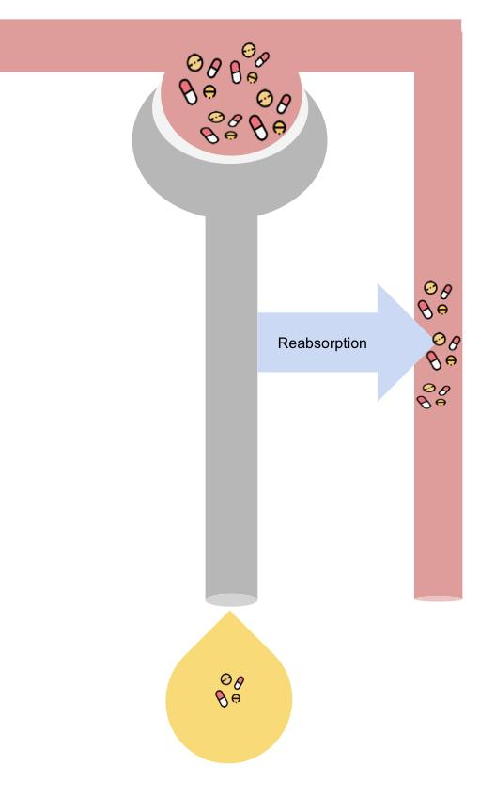
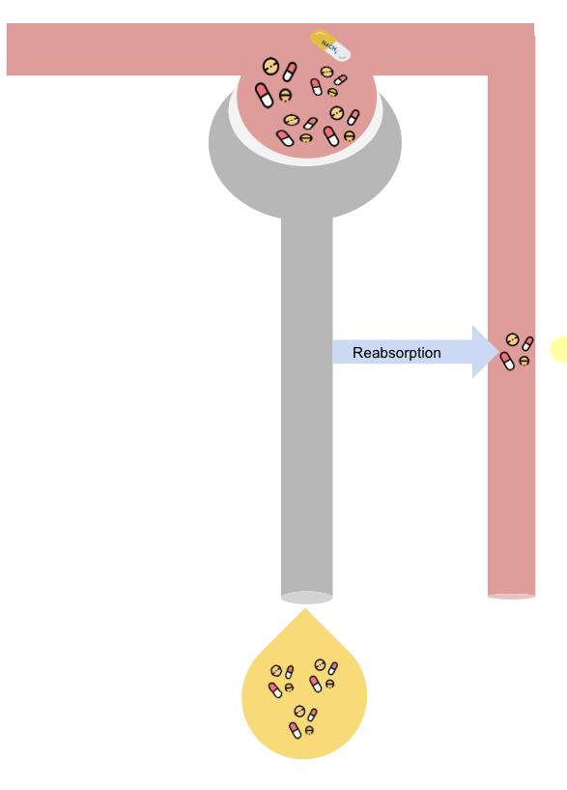
Cont…Urinary pH trapping (Ion trapping)
Example of urine alkalinisation:
Special thanks to team439
1- Consider a barbiturate (weak acidic drug Ex: aspirin) overdose
This is an example of a patient with an overdose of acidic drug.
Urine
Ph 5.3
Normally acidic
Blood
Ph 7.4
Aspirin will be:
More non-ionized portion
+
Less ionized portion
lipid solubility = reabsorption
Weak acid drug
The Drug is acidic and medium is acidic as well->
non-ionized-> lipid soluble-> reabsorption
More
Less
Most of acidic drug will be reabsorbed back into body
2- In presence of sodium bicarbonate, urine is alkaline and more excretion of acidic drug Ex: aspirin into urine.
Same patient, after taking sodium bicarbonate
Urine
Ph 8
Alkaline
Blood
Ph 7.4
Aspirin will be:
Less non-ionized portion
+
More ionized portion
Less
Weak acid drug
The Drug is acidic and the medium is alkaline ->
Ionized-> water soluble-> not absorbed
More
Most of acidic drug will be eliminated into alkaline urine
439:Notice that in ( 1 ) the urine PH still the same , so the excretion of barbiturate is low . While in (2) after the addition of NaHCO3 the excretion of barbiturate is increased.

Slide 12
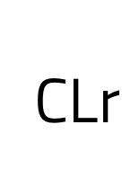
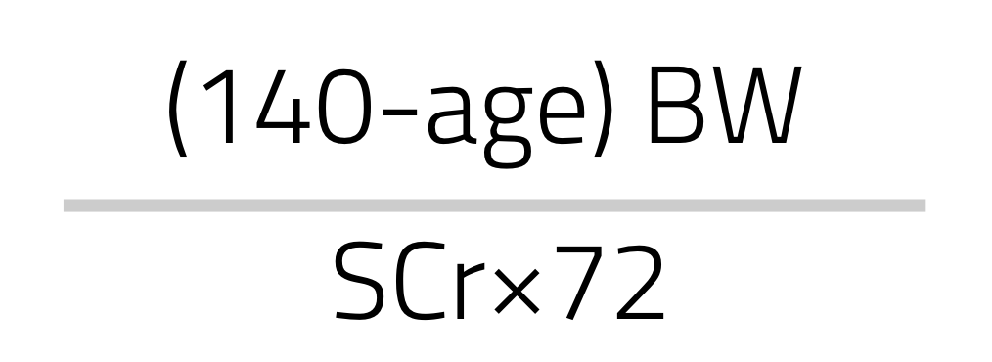
Drugs Excreted Mainly by The kidney:
1
Antibiotics
NSAIDs
Penicillins
Aminoglycosides (gentamicin)
Cephalosporins
Sulfonamides
Vancomycin
Imipenem
2
Aspirin
3
Immunosuppressants
4
Anticancer Drugs
cyclosporine
Cisplatin
5
Lithium
6
Digoxin
Be careful upon prescribing those drugs , they may be contraindicated or need dose adjustment in:
● Renal failure patients(renal disease) ● Elderly patients
 | Drug renal clearance | Creatinine clearance Rate (CrCl)
Deﬁnition | is the unit volume (ml) of plasma cleared by the kidney per unit time (min)
Importance | Depends on adequate renal function. If renal clearance is impaired, this may increase t ½ of drugs and may result into drug toxicity. ● Important for drugs: ➔ With narrow therapeutic index e.g. lithium, digoxin, warfarin ➔ Excreted mainly by the kidney. (Girl’s dr only focused on this) | Used to estimate GFR WHY? ➔ Because it’s produced from muscles and freely filtered. (low MW, water soluble, and is not protein bound).
Equation name |  | Cockcroft-Gault equation for estimation of creatinine clearance
Equation
Unit | (ml/min)
For better understanding Check physiology 3rd lecture good luck 🤍
Min 49:30
For our information
SCr=serum creatinine
BW= body weight

Slide 13
So what should we do in this situation ?
01
Dose reduction of drugs is required to prevent toxicity especially
with a narrow therapeutic index drugs (therapeutic drug monitoring).
02
Keep the usual dose but prolong the dosing intervals E.g Gentamicin
03
Decrease the dose without changing dosing intervals E.g Digoxin
04
dose adjustment is needed when creatinine clearance is below 60 ml/min
Minor dose adjustment if CrCl = 30-60 mL/min.
Major dose adjustment if CrCl < 15 mL/min
05
Monitor blood levels of drugs (therapeutic drug monitoring).
When does reduction is not required in renal impairment ?
➔ Occurs to few drugs that are excreted mainly into feces (Biliary excretion) e.g. ceftriaxone and doxycycline doesn’t need dose adjustment in renal impairment.
➔ Some drugs undergo enterohepatic circulation back into systemic circulation
Risk Factors for NSAIDs-Associated Acute Renal Failure: girl’s dr: It’s for our information.
Prostagalndins (PGs) have major role in the preservation of renal function when pathologic states compromise physiologic kidney processes.
PGI2 and PGE2 antagonize the local effects of circulating angiotensin || , endothelin,vasopressin, and catecholamines that reduce renal circulation.
Prostaglandins preserve GFR by antagonizing arteriolar vasoconstriction.
A significant reduction in GFR can occur following administration of an NSAID to a patient with any underlying disease states (NSAIDs inhibit production of PGs)

Slide 14
Orders of Elimination:
Important male doctor focused on | Zero order | First-order
Half- life | Is NOT EQUAL at two places on the curve | Is EQUAL at two places on the curve
Lose per unit time | Constant AMOUNT | Constant PERCENTAGE
The rate of excretion | is independent of the concentration of drugs in plasma. (constant amount is eliminated per unit time). | increased with increased in concentration of drug in plasma directly proportional (constant percentage is eliminated per unit time).
Examples | Ethanol(alcohol) phenytoin aspirin | Penicillin aminoglycoside quinolones
Q from Dr slides for the First order of elimination
Q: If a drug with a 2-hour half life is given with an initial dose of 8 mcg/ml, assuming first-order kinetics, how much drug will be left at 6 hours?
A) 8 mcg/ml. B) 4 mcg/ml
C) 2 mcg/ml D) 1 mcg/ml
Answer :
50% is lost every 2h
First 2h : 8mg → 4mg.
Second 2h : 4mg →2mg.
Third 2h : 2mg → 1mg

Slide 15
Summary
From the slides
★ Polar drugs are readily excreted and poorly reabsorbed.
★ Lipid soluble drugs are reabsorbed back and excretion
will be low
★ Acidic drugs are best excreted in alkaline urine (sodium
bicarbonate).
★ Basic drugs are best excreted in acidic urine (ammonium
chloride).
★Enterohepatic circulation prolongs half life of the
drug.
★ Inulin and creatinine are used to assess renal function.
★ Competition for active secretion prolongs half life of
some drugs e.g penicillin and probenecid.
★ Protein binding of drugs inhibits renal excretion of drugs
except those that are actively secreted.
★ NSAIDS e.g aspirin and ibuprofen inhibits the production
of PGs and therefore reduces renal perfusion and GFR.
★ Irrespective of the mechanism of renal excretion of
drugs, decreased renal blood ﬂow decrease excretion of
drugs.

Slide 16
MCQs
1-Which one of the following is retained in the blood and not filtered?
A-amino acid
B-glucose
C-protein
D-water
2-Probenecid inhibit renal tubular secretion of……….?
A-quinine
B-atropine
C-inulin
D-nitrofurantoin
3- Which of the following increase the renal excretion?
A-High molecular weight
B-Binding to plasma proteins
C-High Vd
D-increase ionization
4- Which elimination method involve a constant amount of drug eliminated per unit time...?
A-Zero-order elimination
B-first-order elimination
C-Major order elimination
D- All of the above
5-Glomerular filtration (GFR) depends on:
A-blood flow
B-PH
C-creatinine level
D-total body fluid
6- If a drug with a 3-hours half life is given with an initial dose of 10mg/ml, assuming first-order kinetics, how much drug will be left after 6 hours?
A-1.5mg/ml
B-2mg/ml
C-2.5mg/ml
D-0mg/ml
SAQs
a patient used atropine for a period of time then he noticed some toxic effects.
(for question 1 to 3)
1-what method should we use to increase the clearance of atropine?
2-what is the name of drug used ?
3-what is the mechanism of action ?
4- what should we do to prevent drug toxicity in patients with impaired renal clearance ?
SAQs Answers:
1-Urine acidification method of Ion trapping
2-Ammonium chloride
3-it will increase basic drug excretion by urine acidification.
4- 1-Decrease dose 2-Dose adjustment 3-Prolong drug dosing intervals 4-Monitor drug level in blood
MCQs Answers:
1-c 4-a
2-d 5-a
3-d 6-c

Slide 17
Pharmacology Team 442
Team Leaders
Mishal Alsuwayegh
Dena Alsuhaibani
Team Members
Faris Alseraye
Mohammad Alrashed
Abdullah Alsalem
Faisal Alomar
Saif Alotaibi
Rakan Alromayan
Ahmed Alemam
Saad Almogren
Farah Alfayez
Atheer AlKanhal
Shaden albassam
Aljazi AlBabtain
Rahaf Almotairi
Mayssam Aljaloud
Farah Alqazlan
Nourah Alfawaz
Rand Jarallah
Naif Alobeily
Abdullah Almawash
Theme was done by Mohammad Alrashed

