Slide 1
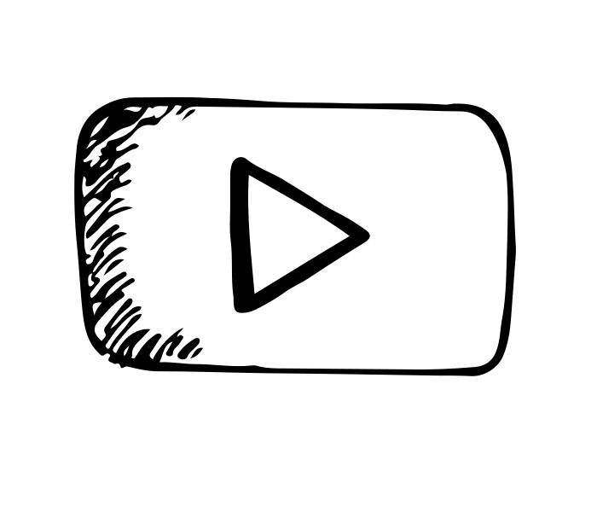
By : Faisal AlOmar
Editing File
Antibiotics in UTI
Main Text
Male’s Slides
Female’s Slides
Important
Doctor’s Notes
Extra Info
Helpful videos:
1-
2-
Min:
6:50
Click here for d.Foda’s video timestamps

Slide 2
EXTRA (Respiratory Block, team438)
Aminoglycosides
Suffix: mycin
Beta-Lactams
E.g. Cephalosporins
Prefix: Cef or Ceph
Sulfanilamide
Suffix: sulfa
Antibiotics Classification
Tetracyclines
Suffix: cyclin
Quinolones
Suffix: floxacin
(Not mentioned in this lecture) Macrolides
Suffix: thromycin
Antibiotics Mechanism of Action
Bactericidal
Kills the bacteria by destroying:
Bacteriostatic
Stops the growth by:
Affecting Protein Synthesis e.g.
- Tetracyclines
- Macrolides
- Aminoglycosides
EXCEPTION:
Aminoglycosides affects the protein synthesis but is
considered bactericidal
2- Nucleic acid
(DNA or RNA)
e.g.
- Quinolones (DNA)
- Rifampin (RNA)
- TMP-SMX (Folate)
1- Cell wall
e.g. Cephalosporins

Slide 3
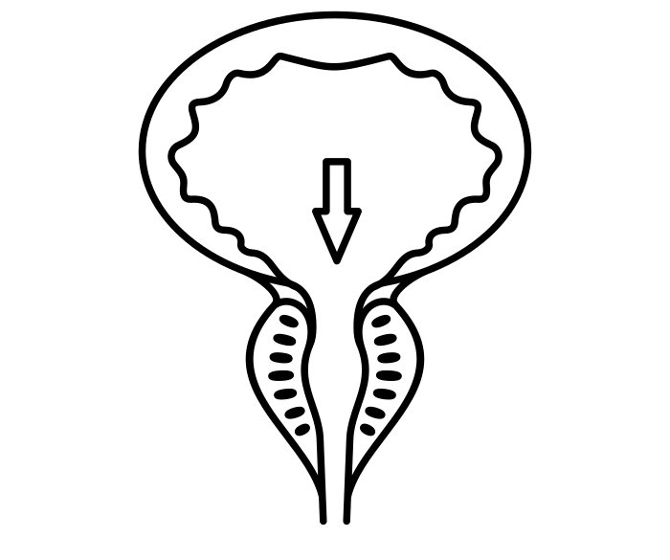
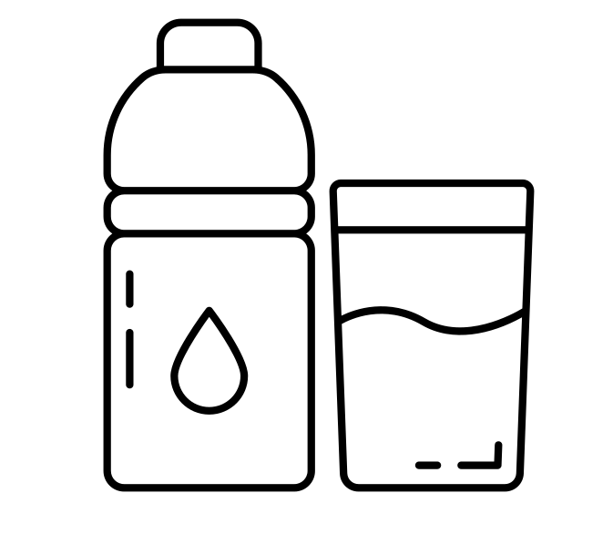
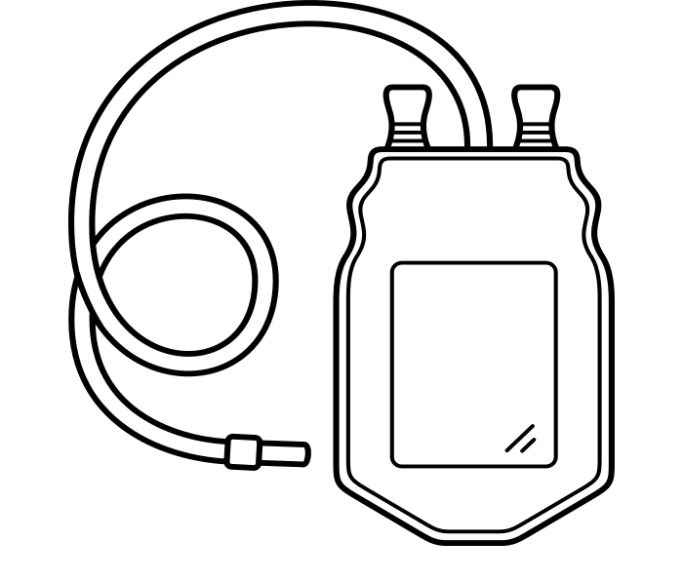
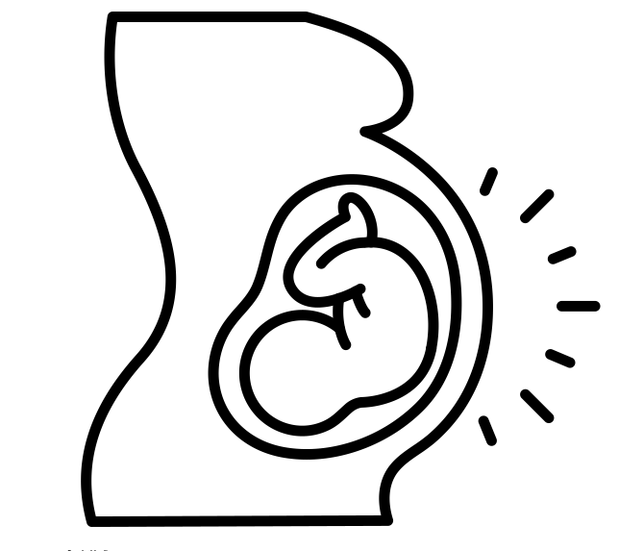
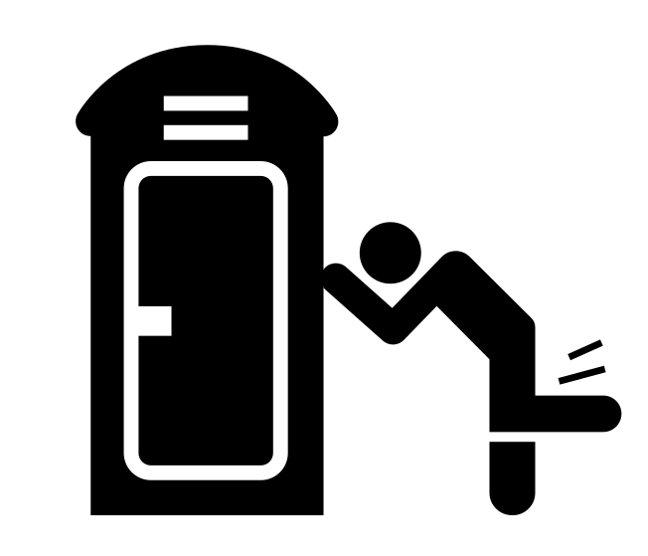
Urinary Tract Infection
1
2nd most common infection (after RTIs).
2
Often associated with some obstruction of the flow of urine.
3
More common in women more than men 30:1 (Why?) short urethra in women.
4
Incidence of UTI increases in old age (10% of men & 20% of women).
Classification:
Upper UTIs (kidney & Ureters):
Pyelonephritis
More serious & difficult to treat
Lower UTIs (Bladder, Urethra & Prostate):
Cystitis, Urethritis & Prostatitis
More common & easier to treat
Causes of UTI:
Normally urine is sterile. Bacteria comes from digestive tract to opening of the urethra
Enlargement of prostate gland in men (common cause)
Obstruction of the flow of urine
(e.g. kidney stone)
Not drinking enough fluids
Because water flushes bacteria away
Catheters placed in urethra & bladder
Large uterus in pregnant women presses on the bladder
Waiting too long to urinate
Disorders that suppress the immune system (diabetes & cancer chemotherapy).
Poor toilet habits (wiping back to front for women)

Slide 4
UTI Can Be
Complicated
Simple
Infections spread to other parts of the body and resistant to many antibiotics. Thus more difficult to cure, {due to hospital-acquired bacteria (E.coli , Klebsiella , Proteus , Pseudomonas ,
Enterococci , Staphylococci)}
Infections do not spread to other parts of the body and go away readily with treatment (due to E.coli in most
cases).
Bacteria Responsible for UTIs
Gram -ve (Most common) | ● Mainly E.coli (approx. 80% of cases) ● Proteus mirabilis ● Klebsiella ● Pseudomonas aeruginosa ● Mycoplasma, Chlamydia trachomatis, & N.gonorrhea. ○ Limited to urethra, unlike E.coli may be sexually transmitted.
Gram +ve (less common) | ● Staphylococcus Saprophyticus (approx. 20%)
Treatment of UTIs
01
Co-trimoxazole (SMX/TMP). P.o.
Two drugs combination in one tablet
P.o.= taken orally
02
Nitrofurantoin P.o.
03
Tetracyclines E.g. Doxycycline
(P.o.)
04
Aminoglycosides E.g. Gentamicin
(I.M , I.V)
05
Cephalosporins E.g. Ceftriaxone & Ceftazidime.
(I.V)
06
Quinolones E.g. Ciprofloxacin
(P.o.)

Slide 5
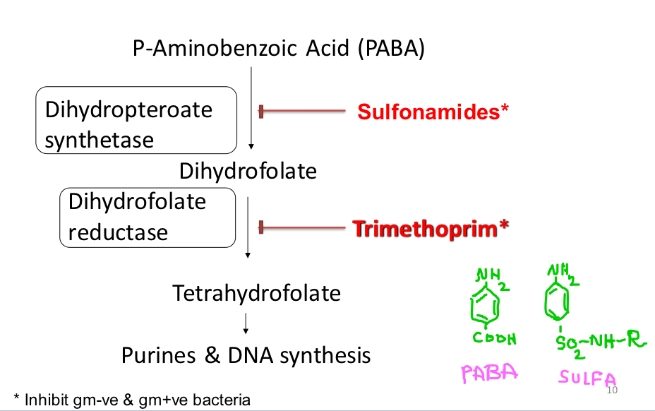
Co-trimoxazole (TMP-SMX) Trade names: Bactrim and Septra
Drug |  | Sulfamethoxazole | Trimethoprim
Overview |  | ● Inhibit gram-ve & gram+ve bacteria ● Alone, each drug is bacteriostatic but together they are bactericidal (synergism) potentiate the efficacy. ● The optimal ratio of TMP to SMX in vivo is 1:20. ● formulated 1(TMP): 5(SMX). Ex: 160 mg TMP + 800 mg SMX; 80 mg TMP + 400 mg SMX; 8 mg TMP + 40 mg SMX) not important
Mechanism of action |  | ● Both drugs stop folic acid production in microorganisms. ● in microorganisms: PABA is turned into dihydrofolate by dihydropteroate synthetase (SMX disturbs this step). ● dihydrofolic acid is turned into tetrahydrofolate by dihydrofolate reductase (TMP inhibits this enzyme). PABA: para aminobenzoic acid
General Information |  | - | ● More lipid soluble. ● A weak base, concentrates in prostatic and vaginal fluid (> acidic than plasma).
 | Absorption and Distribution | ● Mainly given orally or IV Distribution. ● Rapidly absorbed from stomach and small intestine. ● Widely distributed to tissues and body fluids (including CNS, CSF), placenta & fetus. | ● Usually given orally or IV, alone or in combination with SMX. ● Well absorbed from the gut. ●Widely distributed in body fluids & tissues (including CSF).
 | Protein binding | 70% of absorbed SMX is bound to serum proteins. | 40% protein bound.
 | Metabolism and excretion | ● Metabolized by acetylation in the liver. ● Eliminated in urine partially unchanged and partially acetylated. | 60% of TMP or its metabolite is excreted in the urine.
ADRs |  | 1- GIT: Nausea, vomiting 3- Hematologic: A- Acute hemolytic anemia. 2- Allergy* (caused by: hypersensitivity, G6PD** deficiency). *Common sulfonamides ADR B- Megaloblastic anemia (in TMP).
Drug Interactions |  | ● Displace bilirubin- if severe – kernicterus displace bilirubin from its albumin-binding sites in plasma → crosses BBB → brain damage for the neonates. ● Potentiate warfarin, oral sulfonylurea hypoglycemics (Anti-diabetic group).
Contraindications |  | 1. Pregnancy. 4. Infants under 6 weeks. 2. Nursing mother. 5. Renal or hepatic failure. 3. Blood disorders.
**
**Sulfamethoxazole is an example of sulfonamide group.
Pharmacokinetics
**Critical for the proper function of RBCs
(المرضعة)

Slide 6
Drug | Nitrofurantoins
Antibacterial spectrum | ● Bactericidal for gram -ve and gram +ve bacteria. ● Effective against E.coli & Staph. Saprophyticus. ● Other common UT gram -ve bacteria may be resistant.
Mechanism of action | ● Sensitive bacteria reduce (convets) the drug to an active agent (by bacterial reductase) that inhibits various enzymes and damages DNA.
Pharmacokinetics | ● Complete and rapid oral absorption. ● 75% metabolized & is excreted so rapidly that no systemic antibacterial action can be achieved. ● Concentrated in urine (25% excreted unchanged) ● Urine pH is kept <5.5 (acidic) to enhance drug activity, so we should avoid anything that makes the urine alkaline such as antacids. ● Urine turns to dark orange-brown (harmless).
Therapeutic uses | ● Used as urinary antiseptic. It’s usefulness is limited to lower uncomplicated UTI’s and cannot be used for upper UT or systemic Infections, because it has weak systemic absorption
Dose | ● Long acting: 100mg twice daily. ● 50-100mg, orally, 6h/7 days.
Side effects | ● GI disturbances: (Must be taken with food)* 1. Bleeding of the stomach 2. Nausea 3. Vomiting 4. Diarrhea ● Headache & Nystagmus (Involuntary eye movements) ● Hemolysis (in patients with G6PD deficiency).
Contraindications | ● Patients with G6PD deficiency → Anemia. ● Neonates interferes with immature enzyme systems in RBCs → hemolytic anemia. ●Pregnant women especially towards the end of pregnancy (after 38 wks of pregnancy), risk of hemolytic anemia in newborn.
Not important

Slide 7
Tetracyclines
Drug | Doxycycline (long acting tetracycline)
Mechanism of action | ● Bacteriostatic, inhibits protein synthesis by binding reversibly to 30s ribosomal subunit. ● Against gram +ve and gram -ve bacteria.
Pharmacokinetics | ● Long acting ● Usually given orally ● Absorption is 90-100% ● Absorbed in the upper small intestine and best in absence of food ● Food, divalent & trivalent cations (Ca2+, Mg2+, Fe2+, AL3+) impair absorption and reduce its effectiveness (avoid dairy products) ● Protein binding 40-80% ● Distributed well, including CSF (Cerebrospinal fluid) ● Cross placenta and excreted in milk ● Largely metabolized in the liver ● Easily binds to calcium
Therapeutic uses | ● Treatment of UTIs due to many gram -ve and gram +ve bacteria including Mycoplasma and Chlamydia. ● Prostatitis
Dose | ● 100mg orally, twice a day for 7 days.
Side effects | ● GIT: Nausea, vomiting, diarrhea and epigastric pain (give with food that doesn’t contain calcium) ● Thrombophlebitis – I.V ● Hepatic toxicity (prolonged therapy with high dose) ● Brown discolouration of teeth – children ● Deformity or growth inhibition of bones – children ● Phototoxicity (sensitivity to sunlight) ● Vertigo ● Superinfections (alter the intestinal flora due to broad spectrum activity)
Contraindications | ● Pregnancy ● Breast feeding ● Children (below 10 years) because it binds to Calcium in bones and teeth
Not important
Thanks to 439!

Slide 8
Aminoglycosides
Drug | Gentamicin
Mechanism of action | ● Inhibit protein synthesis by binding to 30S ribosomal subunits irreversibly. ● Bactericidal, active against gram-ve aerobic bacteria.
Pharmacokinetics | ● poorly absorbed orally (highly charged). ● Given I.M or I.V ● Excreted unchanged in urine. ● More active in alkaline medium. ● Cross placenta (Contraindicated in Pregnancy).
Therapeutic uses | ● Severe infections caused by gram negative organisms (pseudomonas or enterobacter) infection.
Adverse effects | ● Ototoxicity ● Nephrotoxicity ● Nerve damage (e.g. vestibular nerve damage ) ● Neuromuscular blocking effect
Grey text is not in the slides but females’ Dr said: you should know the details.
Cephalosporins
Drug | 1st generation: Cephalexin | 2nd generation: Cefuroxime-Cefaclor | 3rd generation: Ceftriaxone and Ceftazidime
Spectrum | Gram +ve Bacteria | Mainly Gram -ve Bacteria | Mainly effective against gram-ve bacteria
Mechanism of action | ● Acts by inhibition of cell wall synthesis ● Bactericidal
Route of administration | Orally |  | Parenterally
Therapeutic uses | - |  | ● Given in severe/complicated UTIs. ● Given in acute prostatitis.
Pharmaco- kinetics | ●Given parenterally & orally ●Relatively lipid insoluble (like penicillins). ●do not penetrate cells or the CNS except for 3rd generation. ●Mostly excreted unchanged by the kidney (glomerular & tubular secretion). ●Probenecid slows their elimination & prolongs their half lives. ●Half-life: 30-90 min, except ceftriaxone (4-7 hr).
ADRs | ●Hypersensitivity reactions ●Thrombophlebitis ●Superinfections ●Diarrhea
Tri= 3rd generation.

Slide 9
Fluoroquinolones
Drug | Ciprofloxacin |  |  | Moxifloxacin, Gatifloxacin, Levofloxacin
Spectrum | Active against gram-ve aerobic organisms. |  |  | ●G-ve & G+ve bacteria. ●Highly active against Pseudomonas species.
P.K | ●Given oral or parenteral ●Concentrates in many tissues (kidney, prostate, lung, and bones/joints) ●Excreted mainly through kidney ●Relatively long half-life ●Given once daily, except Ciprofloxacin is given twice daily
Mechanism of action | ● Inhibits DNA gyrase enzyme* and cell division resulting in bacterial cell death. *An enzyme involved in DNA supercoiling
Therapeutic uses | ● UTI caused by multidrug resistance organisms as pseudomonas. ● Prostatitis (acute/chronic) |  |  | -
Adverse effects | ● GIT: Nausea, vomiting, diarrhea. ● CNS effects: (confusion, insomnia, headache, anxiety). ● Damage of growing cartilage (reversible arthropathy). ● Phototoxicity (avoid excessive sunlight).
Contraindications | ●Not recommended for patients younger than 18 years ●Pregnancy ●Breast feeding women
Grey text is not in the slides but females’ Dr said: you should know the details.

Slide 10
MCQs
1- A 3-weeks infant diagnosed with UTI, which of the following is contraindicated?
A-Gentamicin
B-Ceftazidime
C-Ceftazidime
D-Co-trimoxazole
2- Which one of the following drugs has Megaloblastic anemia as an adverse effect?
A-Sulfamethoxazole
B-Trimethoprim
C-Ciprofloxacin
D-Gentamicin
3- Which one of the following Antibiotics enhance the efficacy of Warfarin?
A-Co-trimoxazole.
B-Gentamicin.
C-Nitrofurantoins.
D-Ceftriaxone
4- Which of these is NOT true about gentamicin?
A- Mainly effective against anaerobic gram -ve bacteria
B- Can be given through IV
C- May cause nerve damage
D- Contraindicated in pregnant women
5- A patient contracted a UTI which spread to other parts of the body, what is a good antibiotic to give?
A- Doxycycline
B- Nitrofurantoin
C- Ceftriaxone
D- Trimethoprim
6- An antibiotic was given to a 15 year old and they came back to the hospital with pain in their joints, what antibiotic was given?
A- Nitrofurantoin
B- Sulfamethoxazole
C- Gentamicin
D- Ciprofloxacin
SAQs
1- What is the mechanism of action of Trimethoprim?
3- List the uses of 3rd generation cephalosporins
2- List 3 ADRs of Nitrofurantoins
4- What reduces the effectiveness of tetracyclines?
SAQs Answers:
1- Slide 5
2- Slide 6
3- Severe/complicated UTIs and Acute prostatitis
4- Food, trivalent and divalent cations
MCQs Answers:
1-D 4-A
2-B 5-C
3-A 6-D

Slide 11
MCQs
7- A 31-year-old pregnant woman diagnosed with UTI, which of the following is contraindicated in her condition?
A- Gentamicin
B- Ciprofloxacin
C- Doxycycline
D- All of them
8- What is the mechanism of action of Doxycycline?
A- Inhibits protein synthesis by binding to 30s ribosomal subunit
B- Inhibits DNA gyrase enzyme
C- Inhibits cell wall synthesis
D- Inhibits protein synthesis by binding to 50s ribosomal subunit
9- Which one of the following drugs is the best choice in case of UTI caused by multidrug resistance organisms?
A- Gentamicin
B- Doxycycline
C- Nitrofurantoins
D- Ciprofloxacin
10- Which one of the following drugs is bactericidal ?
A-Trimethoprim
B-Tetracyclines
C-Ceftazidime
D-Sulfamethoxazole
11- Which one of the following drugs is Bacteriostatic?
A-Doxycycline
B-Quinolones
C-Rifampin
D-Ceftriaxone
12- one of the common causes of UTI in men is?
A-over-drinking fluids
B-Large uterus
C-short urethra
D-Enlargement of prostate gland
SAQs
5- Mention the mechanism of action of Doxycycline and two possible side effects?
6- Mention two drugs that act by inhibiting protein synthesis and 2 of their side effects?
7-give me two examples of antibiotics that Kills the bacteria by destroying Nucleic acid ?
8- List 3 ADRs of Aminoglycosides?
SAQs Answers:
5- Inhibits protein synthesis by binding reversibly to 30s ribosomal subunit / Phototoxicity and vertigo
6- a) Gentamicin; Ototoxicity and nephrotoxicity
b) Doxycycline; Nausea and hepatic toxicity
7- Quinolones (DNA) - Rifampin (RNA)
8- Ototoxicity - Nephrotoxicity -Neuromuscular blocking effect
MCQs Answers:
7- C 10-C
8- A 11-A
9- D 12-D

Slide 12
Pharmacology Team 442
Team Leaders
Mishal Alsuwayegh
Dena Alsuhaibani
Team Members
Faris Alseraye
Mohammad Alrashed
Abdullah Alsalem
Faisal Alomar
Saif Alotaibi
Rakan Alromayan
Ahmed Alemam
Saad Almogren
Farah Alfayez
Atheer AlKanhal
Shaden albassam
Aljazi AlBabtain
Rahaf Almotairi
Mayssam Aljaloud
Farah Alqazlan
Nourah Alfawaz
Rand Jarallah
Naif Alobeily
Abdullah Almawash
Theme was done by Mohammad Alrashed
Special thanks to Shatha Alshabani & Arob Alasheikh

