Slide 1
By : Faisal AlOmar
Editing File
Diuretics
Main Text
Male’s Slides
Female’s Slides
Important
Doctor’s Notes
Extra Info
Objectives :
1- Define and classify diuretics.
2-Identify the site of action of each
class of diuretics in the nephron.
3-Describe the mechanisms of action
of diuretics.
4-Detail on the pharmacodynamic actions and pharmacokinetic aspects of diuretics.
5-List ADRS, therapeutic uses,contraindications
and drug- drug interactions of diuretics.
Dr.Foda’s Videos:
1-
Review (very recommended for better understanding).
2-
Loop diuretics and thiazides.
3-
K sparing and CAI and Osmotic diuretics.
4-
Uses of diuretics.
You can find the timestamps in each video’s comments

Slide 2
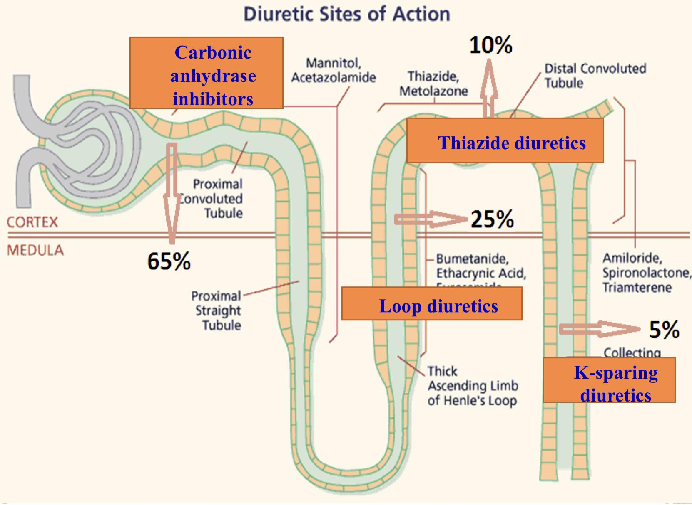
Diuretics
Definitions
Diuretics: are drugs that increase (urine volume) renal flow rate. They act by
↑the quantity of sodium in urine (natriuretic diuretics).
Used to remove excess extracellular fluid (oedema)→ water diuresis
Diuresis: is the process of excretion of water in the urine. Water can be used as diuretic.
Water↑ blood volume→ ↑ renal blood flow→ ↑GFR→ ↑urine excretion
Natriuresis: is the process of sodium excretion in water. All diuretics have natriuretic effect
Indications
-Edema of any origin Ex:pulmonary edema
-Congestive heart failure
-Hypertension
-Elimination of toxins
MAO
Most diuretics act by interfering with the normal sodium reabsorption by the renal tubules resulting into sodium and water excretion.
Site of action
Target molecules for diuretics are carriers or transporters in luminal membrane of renal tubular cells required for tubular reabsorption of sodium from filtrate back into blood
so diuretics inhibit these carriers therefore inhibit reabsorption
Main Classes of Diuretics
1
2
3
Carbonic Anhydrase
inhibitors
Loop Diuretics
Thiazide Diuretics
4
K+ sparing Diuretics
5
Osmotic
Diuretics
Loop diuretics
Transporter
Thiazides
Target protein
Triamterene
Ion channel
Amiloride
Classification of diuretics According to protein
Enzyme
Carbonic Anhydrase inhibitors
Receptor
Spironolacton
No target protein
Osmotic
Diuretics

Slide 3
Loop diuretics
High efficacy
Moderate
efficacy
Thiazides
Classification of diuretics According to efficacy
K+ sparing
Osmotic
Low efficacy
Carbonic
anhydrase
inhibitors
Site of Action of Diuretics
Segment | Functions | transporters | Diuretics
Proximal convoluted tubules | Re-absorption of 66%, Na, K, Ca, Mg, 65% NaHCO3 100% glucose & amino acids | Na/H transporter Carbonic anhydrase enzyme | Carbonic anhydrase inhibitors
Proximal Straight Tubules | Secretion and re-absorption of organic acids and bases | Acid & base transporter | None
Thick ascending loop of Henle | Active reabsorption Of 25% Na, K, Cl Ca, Mg reabsorption | Na/K/2Cl transporter | Loop diuretics
Distal convoluted tubules | Active tubular reabsorption of 5%Na, Cl, Ca | Na and Cl cotransporter | Thiazide diuretics
Collecting tubules | Na reabsorption Na channels K & H secretion | Na channels K & H transporter | K-sparing diuretics

Slide 4
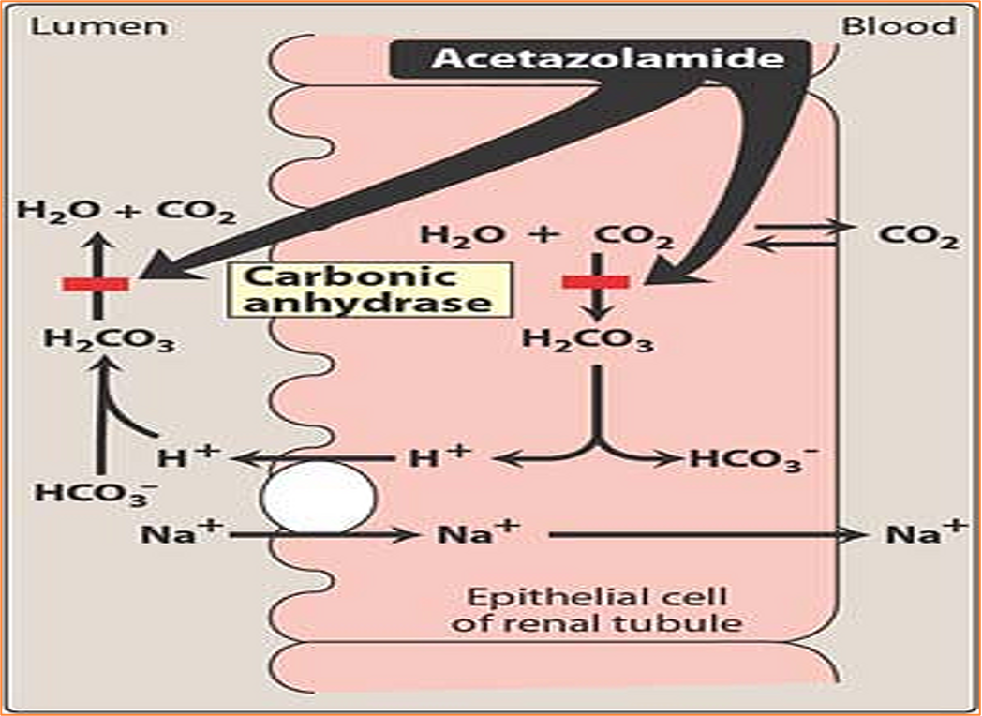
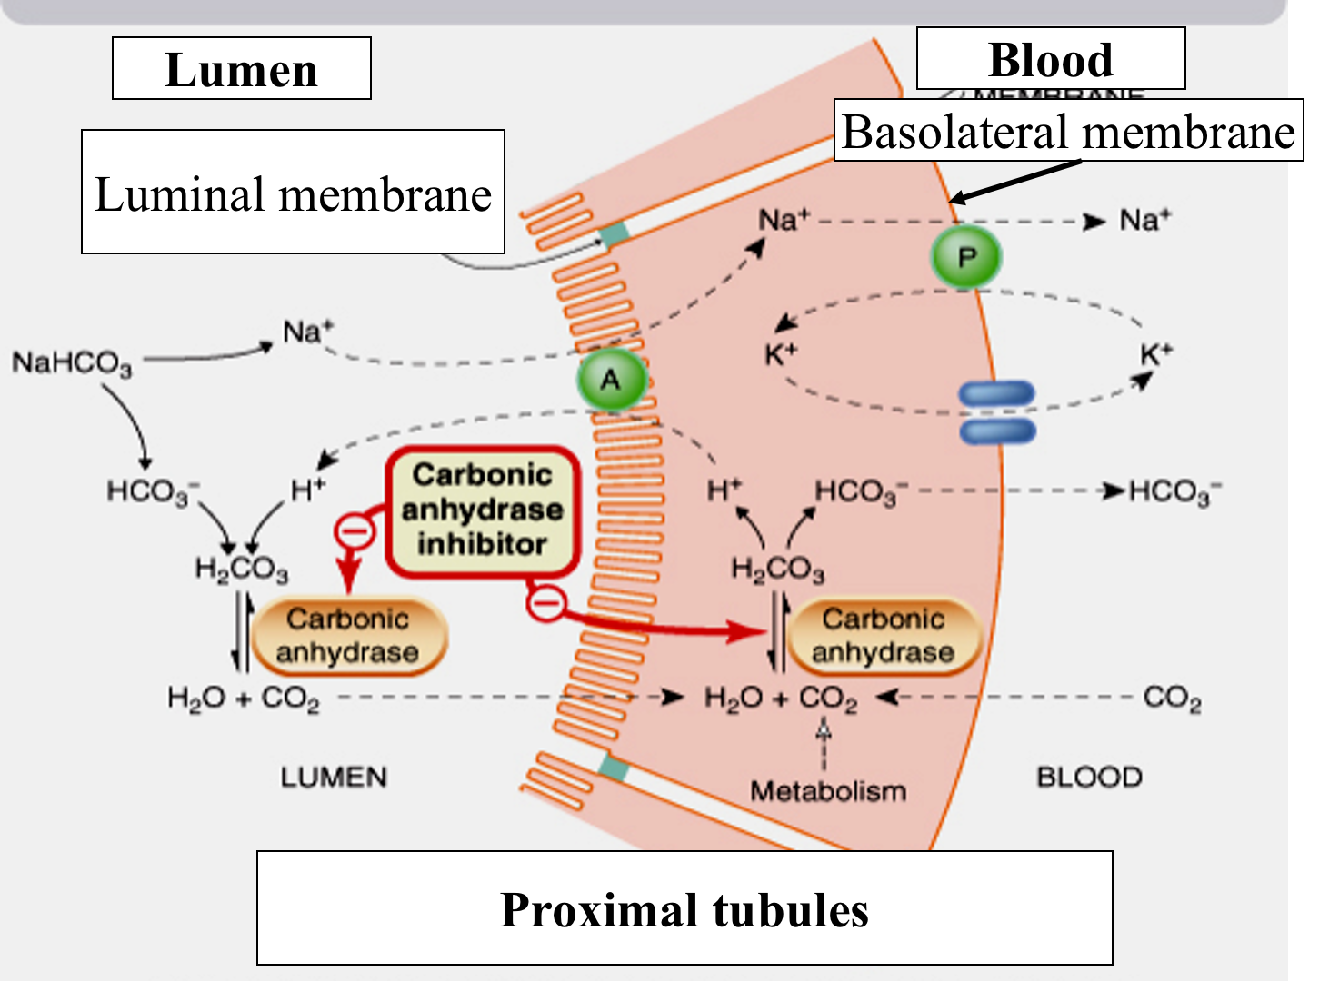
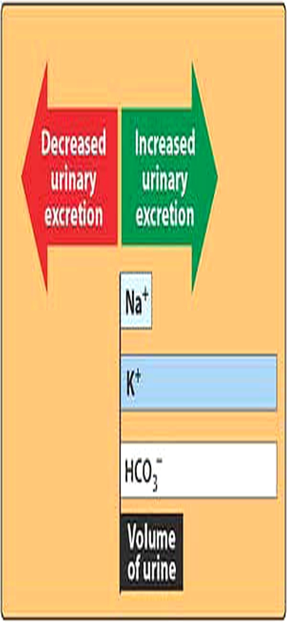
Carbonic Anhydrase Inhibitors
Drug | 1-Acetazolamide
M.O.A (common with Dorzolamide) | Inhibits carbonic anhydrase enzyme in proximal convoluted tubules thus interferes with NaHCO3 re-absorption and causes diuresis. Carbonic anhydrase required for reversible reaction (accelerates the attainment of equilibrium in the reaction), in which CO2+ H2O ⇋ H2CO3 ⇋H+ HCO3-
P.K | Given orally once a day so it has a long duration of action -Onset of action is rapid (30 min) Duration of action (9-12h) t 1⁄2 6-9h Excreted by active secretion in proximal convoluted tubule Produces alkaline urine because NaHCO3 is an alkaline and it is being excreted ( only CA inhibitors cause alkaline urine)
P.D | Potent specific inhibitor of carbonic anhydrase, enzyme inhibition is non competitive. It ↓ reabsorption of bicarbonate in the proximal tubule & prevent the acidification of urine in the distal tubule Self- limiting action of acetazolamide restrict its use to mild oedema.
Pharmacological actions | ↑mild increase in urine volume ↑urinary excretion of sodium,potassium, bicarbonate (alkaline urine) Metabolic acidosis due to the continuous loss of NaHCO3 from the blood ↑ Urinary phosphate excretion. Phosphate excretion increases with acidosis of the blood Promotes K+ excretion by ↑ the load of Na delivered to the distal tubules Na will be reabsorbed again in distal tubules in an amount that does not influence the diuretics action
Notes | Why do CA inhibitors have weak diuretic properties? Diuretic properties decreases after several days as the blood bicarbonate falls. with repeated dosage the diuretic action is lost → loss of HCO3- & development of Acidosis, because as we know, the main target for carbonic anhydrase inhibitors is the bicarbonate and when there’s a constant usage of Acetazolamide the amount of bicarbonate decreases after a period of time thus decreasing the efficacy. (Team 438)

Slide 5
Drug | 2-Dorzolamide
Is a carbonic anhydrase inhibitor
Used topically for treatment of ↑ IOP in open-angle glaucoma.
no diuretic or systemic side effects (Why? ) because it’s topical
IOP : Intraocular pressure
CSF : Cerebrospinal fluid
Carbonic anhydrase inhibitors family
Therapeutic uses | Open angle glaucoma: Aqueous humor contains a high concentration of bicarbonates, carbonic anhydrase inhibitors ↓ Carbonic Anhydrase ↓ rate of aqueous humor has HCO3 formation ↓ IOP by reducing aqueous humor formation in ciliary body of eye (tolerance does not develop to this effect) Urinary alkalinization to enhance renal excretion of acidic substances: (uric acid, methotrexate and cysteine in cystinuria) are relatively insoluble in acid urine. Renal excretion can be ↑by ↑ urinary bicarbonate excretion. Effect is short lived & require bicarbonate infusion. In benign intracranial hypertension: ↓ of carbonic anhydrase in the choroid plexus→↓formation of CSF. Hyperphosphatemia Metabolic alkalosis Useful for correcting a metabolic alkalosis, especially an alkalosis caused by diuretic-induced increases in H+ excretion & metabolic alkalosis of heart failure As prophylactic therapy, in acute mountain sickness ↓ CSF of brain: given nightly 5 days before the ascent ↓ weakness, breathlessness, dizziness, nausea, cerebral & pulmonary oedema Adjunct for treatment of epilepsy glial cells contain carbonic anhydrase. Nerves are highly responsive to rise in pH. ↑7.4→ 7.8 causes convulsions. ↓of neuronal carbonic anhydrase →↓ pH in the vicinity of neurons→↓ convulsions.
ADR’s | ● Hypokalemia (potassium loss). ● Metabolic acidosis.(loss of bicarbonate will increase H+ and decrease PH (acidosis). ● Renal stone formation (calcium phosphate stones). ● Hypersensitivity reaction. Because the drug is similar in structure to sulfonamides and sulfonamides are known to cause allergic reactions. ● Drowsiness ● Numbness ● Disturbance of vision ● Tingling sensation of the face & extremities
Contraindications | Contraindicated in patients with liver cirrhosis (alkaline urine ↓excretion of NH4→ hyperammonemia & hepatic encephalopathy

Slide 6
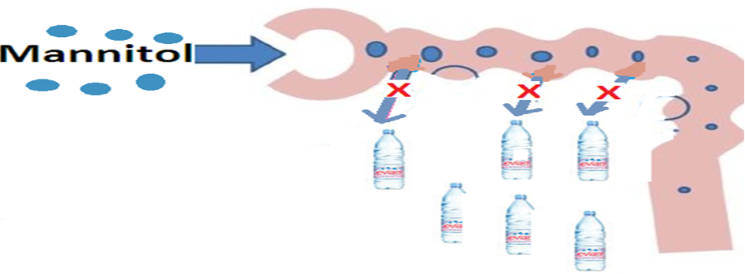
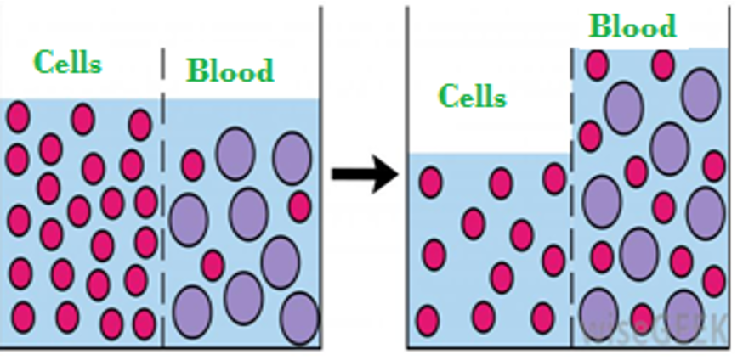
Osmotic Diuretics
Mannitol (A sugar)
P.K | -Poorly absorbed -If given orally osmotic diarrhea -Mainly excreted unchanged in urine -Given intravenously -little/Not metabolized -Mannitol, IV, not absorbed from the GIT, water excretion with relatively less effect on Na+ [aquaretic] -Excreted by glomerular filtration without being reabsorbed or secreted within 30-60 min -T½ 0.25-1.7h, prolonged in renal failure to 36h -it’s usually used in emergency (10min onset of action)
P.D | In systemic circulation: 1-Mannitol increases urine output by osmosis, drawing water out of cells and into the bloodstream. 2-Expand the extracellular fluid volume, decrease blood viscosity, and inhibit renin release, ↑renal blood flow→ ↑GFR→ ↑urine volume. | In the kidney tubule: 1-Acts in proximal tubules & descending loop of Henle by osmotic effect. 2-IV administration of any solute filtered by glomeruli may produce osmotic diuresis when the amount delivered to tubules exceeds their absorptive capacity exert an osmotic pressure→↓ water & Na+ reabsorption. 3-↑water excretion with relatively less effect on Na+.
Therapeutic uses | Acute renal failure due to shock or trauma (maintain urine flow- preserve kidney function) To maintain urine volume & prevent anuria resulting from large pigmentation load to the kidney e.g. hemolysis, rhabdomyolysis In acute drug poisoning: To eliminate drugs that are reabsorbed from the renal tubules e.g. salicylates, bromides, barbiturates. To ↓ intracranial & intraocular pressure before ophthalmic or brain procedures (cerebral edema). To prevent acute renal necrosis after severe injury , haemorrhage, hypovolaemia, →↓ GFR, absorption of water & salts is complete , distal part dries up→ irreversible damage
Adverse Effects | Headache, nausea, vomiting → hyponatremia Extracellular volume expansion, complicates heart failure & pulmonary oedema Excessive use → dehydration & hypernatraemia¹ (Adequate water replacement is required). 1- because the drug only will drag water from ECF (without sodium) and sodium will be retained in ECF
Contraindication | Chronic heart failure Anuric patients or patients not responding to a test dose of mannitol

Slide 7
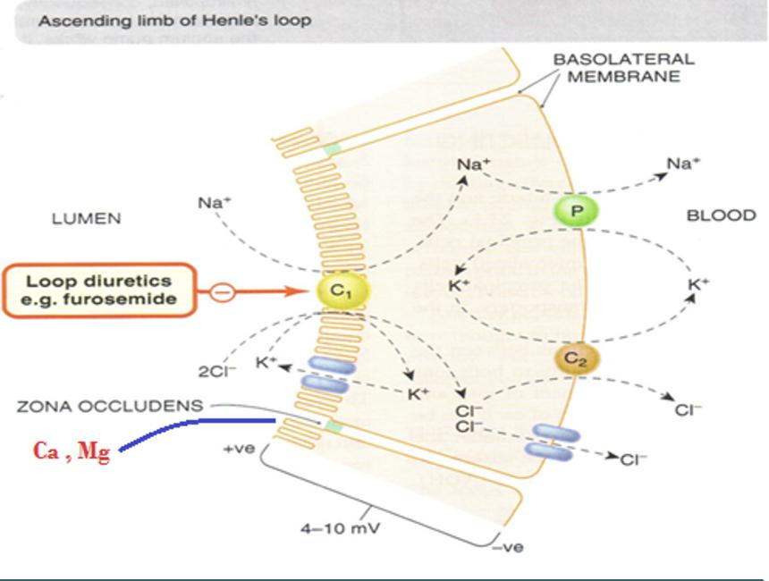
Loop Diuretics (High Ceiling Diuretics)
Drug | Bumetanide (Most Potent) | Torsemide (Longest Duration) | Furosemide | Ethacrynic Acid
Potency, t 1⁄2 | Potency 40, t1⁄2 0.8 hrs | Potency 3, t1⁄2 3.5 hrs | Potency 1, t1⁄2 1.5 hrs | Potency 0.7, t1⁄2 1hr
Efficacy | - High natriuresis as 25-30% of glomerular filtrate of Na+ is reabsorbed. - The most potent diuretic, termed “high ceiling diuretic” used in emergency state
M.O.A | - Inhibit Na+ /K+ /2Cl-Co-transporter in the luminal membrane of the thick segment of the ascending loop of Henle (TAL). - Inihbit Ca++ and Mg++ reabsorption.(via paracellular pathway)
P.K | - Given orally or I.V (reserved for emergency situations) - Have fast onset of action (for emergency) - Have short duration of action - Excreted by active tubular secretion of weak acids into urine (avidly bound to plasma proteins) - Interfere with uric acid secretion (hyperuricemia) contraindicated in gout
Pharmacological Actions | - ↑ Urinary excretion of Na , K+ , Ca++ and Mg++. - ↑ Urine volume - Induce expression of COX, PGE↓, salt transport in TAL. - ↓ Renal vascular resistance & ↑renal blood flow (which increases the urine volume) because of PG (Increase prostaglandin E2 and I2) - Furosemide and ethacrynic acid reduce pulmonary congestion and left ventricular filling pressure in heart failure →↑venous capacitance
Uses | Drugs of choice for emergency (acute) situations such as : - severe edema associated with congestive heart failure, nephrotic syndrome. - Increase venous capacitance → Acute Pulmonary Edema - Increase Ca excretion → Acute Hypercalcemia - Increase K+ excretion → Acute Hyperkalemia - Increase Na Excretion to 25% of Filtered Load → Treatment for Severe Edema - Increase urine volume → Oliguric ARF - Anion overdose → Toxicity of Br, F & I (anion overdose)
ADRs | Hypo: Hyper: - Postural Hypotension - Volemia - Glycemia¹ - Allergic Reactions - Kalemia - Uricemia² - Ototoxicity (aminoglycosides ↑the risk) - Magnesemia - Metabolic Alkalosis - Calcemia - Profound ECFV Depletion - Natremia Dietary k supplementation or k-sparing diuretics should be used to avoid hypokalemia 1-Potassium stimulates the release of insulin, so because of hypokalemia the insulin release will be reduced
Contra-indications | - Severe Na and volume depletion - Hypersensitivity to sulfonamides (Thiazides and loop diuretics are sulfonamide derivatives, except ethacrynic acid.). - Anuria unresponsive to a trial dose of loop diuretic - Gout: Increase blood uric acid and gout attack
Drug-Drug Interactions | - NSAIDs → ↓ Diuretic response (loop diuretics increase PGs, while NSAIDs decrease PGs) - Digitalis → Arrhythmias (both cause hypokalemia) - Aminoglycosides → ↑ Ototoxicity of loop diuretic - Loop diuretic →↑Nephrotoxicity of aminoglycosides

Slide 8
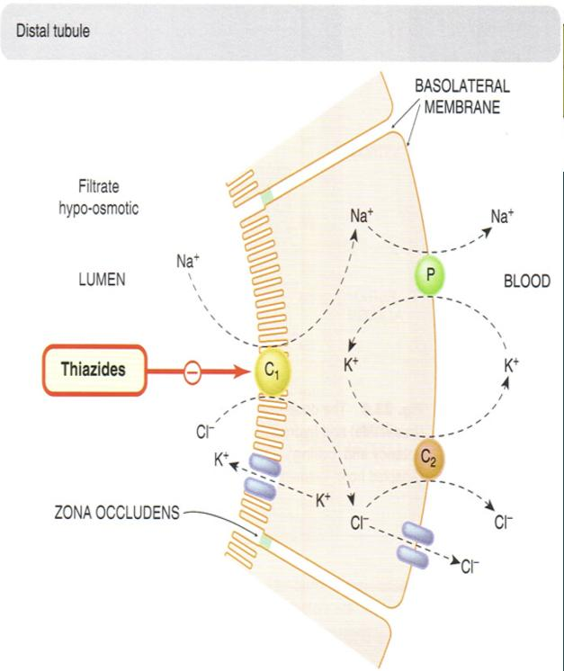
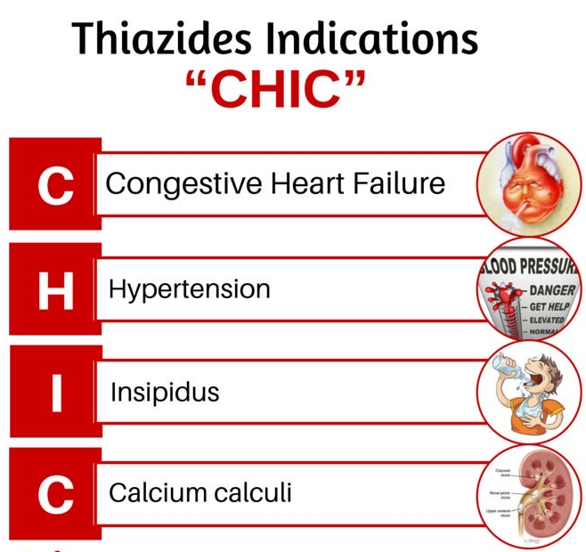
Thiazide Diuretics
Drug | Chlorothiazi-de | Hydrochloro-thiazide | Metolazone | Chlorthalido-ne | Indapamide
Potency, t 1⁄2 | Potency = 0.1 t 1⁄2 =2h | Potency = 1 t 1⁄2 = 3h | Potency = 5 t 1⁄2 = 5h | Potency = 10 t 1⁄2 = 26h | Potency = 20 t 1⁄2 = 16h
M.O.A | Acts on luminal membrane of early distal tubule via inhibition of Na/Cl co-transporter (NCC) (This will activates Na/Ca exchanger, so the Ca will be reabsorbed) Efficacy: moderate natriuresis not for emergency (5-10% of filtered load os Na is reabsorbed) Week inhibitors of carbonic anhydrase, but this does not contribute to their action
P.K | - Given orally, efficiently absorbed from the GIT - Slow onset, with Long duration of action (40h) (unlike loop diuretics 1- short duration 2- used for emergencies) - Eliminated by glomerular filtration & active tubular secretion (in the proximal tubules), some is reabsorbed - May interfere with uric acid secretion and cause Hyperuricemia. (caution with gout patients). Same mechanism in loop diuretics (competition..) - Lipid soluble
Pharmacological Actions | - ↑Urinary excretion of: 1-NaCl 2-K+ 3-Mg++ - ↓Urinary excretion of: 1-Uric acid 2-Ca++ (With increase reabsorption) - May give rise to hypokalemic alkalosis. - Cause vasodilatation, non diuretic thiazide is a potent vasodilator. - ↓Of urine volume in case of diabetes insipidus.
Uses | - Treatment of essential Hypertension (cheap-well tolerated) - Treatment of mild heart failure ( to reduce extracellular volume) - Treatment of Osteoporosis (decreased Ca excretion) - Ineffective when the GFR is less than 30 to 40 ml/min, except metolazone & indapamide - Calcium nephrolithiasis due to hypercalciuria (decreased Ca excretion) (to increase calcium reabsorption and decrease renal calcium stones) - Nephrogenic diabetes insipidus* (decrease blood volume and GFR) Thiazide→↓Distal tubular Na+ reabsorption→↑urinary excretion (initially)→↓extracellular volume as a result →↑proximal Na+ & water reabsorption due to↓renal blood flow and GFR→↓distal delivery of Na+ & water→↓Urinary volume - Treatment for mild edema
ADRs | Hypo: Hyper: - Metabolic Alkalosis - Volemia - Glycemia - Fluid and Electrolyte imbalance - Kalemia - Lipidemia (LDL) - ECFV Depletion - Magnesemia - Uricemia (Gout) - Impotence - Natremia - Calcemia
Drug-Drug Interactions | ● Uricosuric, Sulphonylurea (girl’s dr said remove it from the slide) → Thiazide diminish effect ● Digitalis, Diazoxide (439: not important)→ Thiazide increase effect ● NSAID → Reduce thiazide efficacy (PGs maintain renal blood flow, NSAIDs decrease PGs)

Slide 9
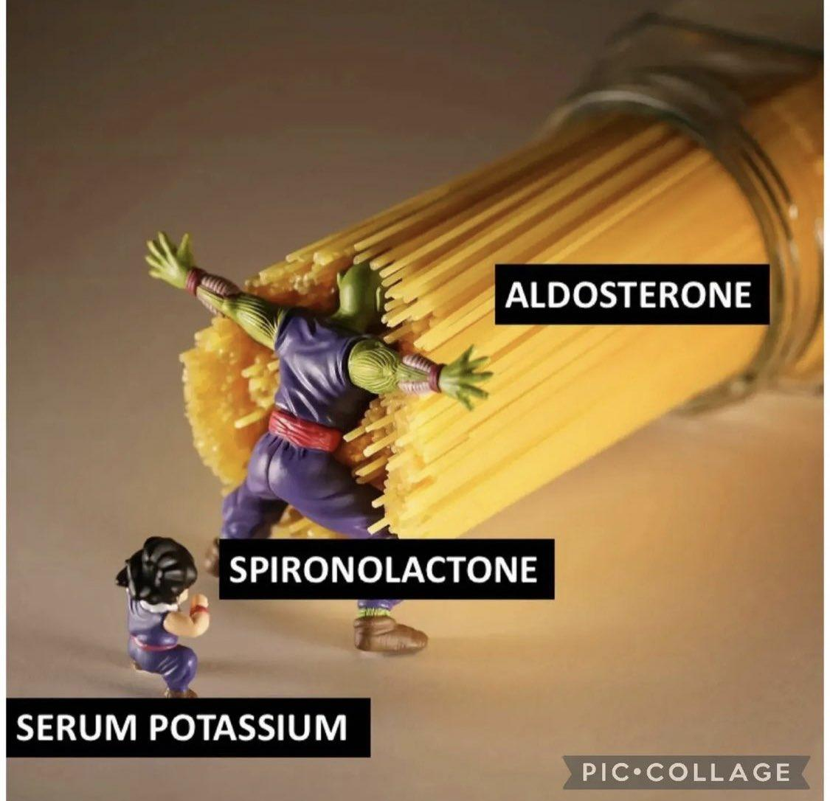
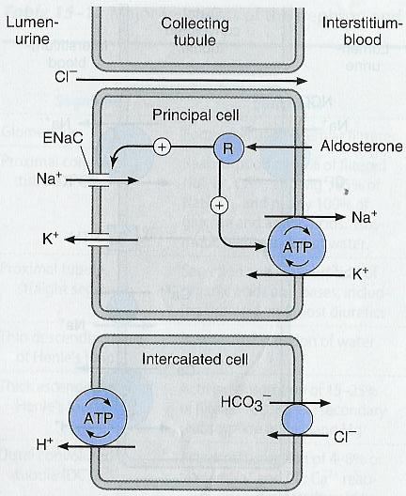
SEAT:
Spironolactone
Eplerenone
Amiloride
Triamterene
Potassium sparing diuretics
1
Steroids
Competitive aldosterone antagonists
also called
Mineralocorticoid receptor antagonists
-Spironolactone
-Eplerenone
Mineralocorticoid is a class of steroid hormones
2
Non steroids
Na+ channels inhibitors
-Amiloride
-Triamterene
A) Aldosterone Antagonist
Drug | 1) Spironolactone
M.O.A | - Acts at the cortical collecting duct by competitive inhibition of cytoplasmic aldosterone receptors →↑ Excretion of Na+,Cl & ↓Excretion of K+,H+ -its structure similar to steroid
P.k | Well absorbed from the GIT , t½=16h - Highly protein-bound - Undergoes enterohepatic recycling long duration of action - Delayed onset of action(nuclear receptor), take time to form new genes -maximum diuretic action 4 days - Converted in gut & liver to (active metabolite), t½=16h
P.D | - ↑urinary Na+ excretion - ↓ H+ excretion (Acidosis) - ↓urinary K+ excretion (Hyperkalemia) - Has antiandrogenic action* *Aldosterone antagonists structure is similar to testosterone → blockage of testosterone receptors
Uses | - Treatment of hypertension ;usually used combined with thiazide or loop diuretics to : 1- Enhance natriuresis caused by other diuretics 2- Correct / prevent hypokalemia Uses - Treatment of primary**hyperaldosteronism (Conn's syndrome) - Treatment of secondary hyperaldosteronism in diseases as CHF -Edema of hepatic cirrhosis and Nephrotic syndrome. - Treatment of hirsutism***(mainly in female), acne due to the antiandrogenic effects **hyperaldosteronism means excessive aldosterone secretion from adrenal cortex ; primary ( due to tumors in the adrenal gland) , secondary ( due to overstimulation to RAAS) ***overproduction of hair in inappropriate places.
ADRs | - Hyperkalaemia. - Metabolic acidosis - Gynecomastia (male breast enlargement) - GIT upset and peptic ulcer. - Impotence(sexual dysfunction ). - Menstrual irregularities.
Contraindication Important | - Hyperkalemia : ● Chronic renal failure. ● beta-blocker ● K+ supplement use. ● ACEI. - Liver disease ( dose adjustment is needed). (metabolized in liver)
Drug - drug Interaction | ACEI β-blocker K+ supplement , K+ sparing diuretic →↑Hyperkalemia-induced by K+ Sparing diuretics
Normally: - In the principal cells sodium is reabsorbed by stimulating a nuclear receptor which stimulates sodium reabsorption in exchange for potassium. - in the intercalated cells the excretion of sodium is accompanied by loss of hydrogen

Slide 10
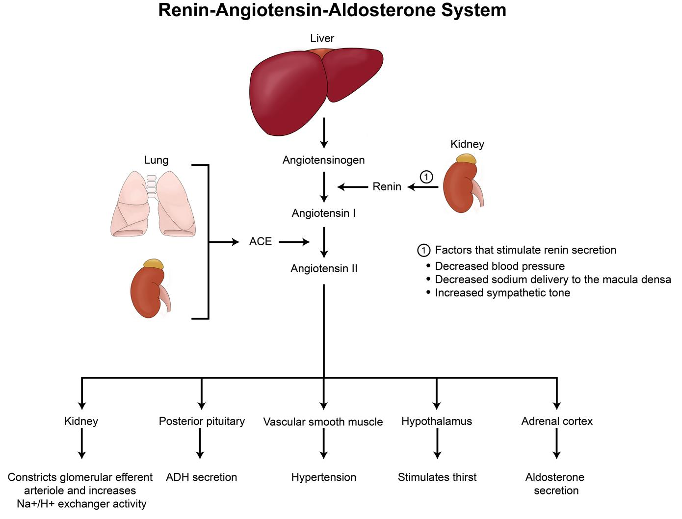
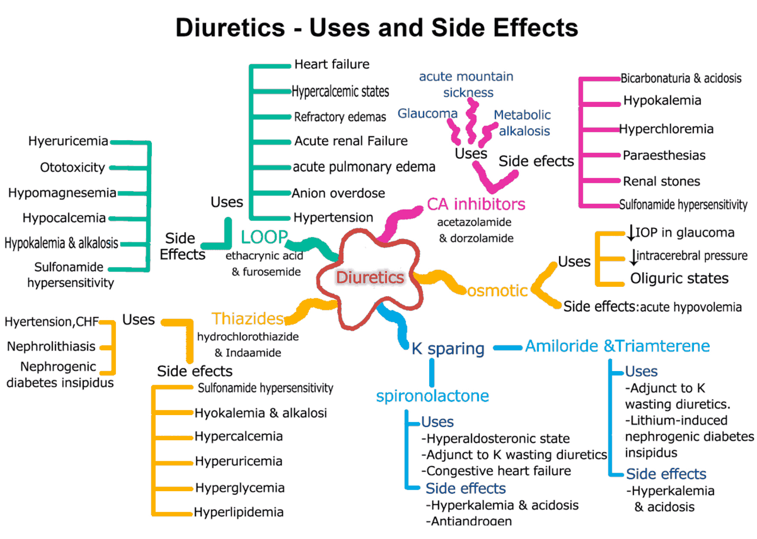
Potassium Sparing Diuretics
B) Na+ Channels Inhibitors
Drug | Triamterene تراي مترين | Amiloride امل ورائد
Potency | 0.1 | 1
T ½ | 4.2h | 21h
M.O.A | Na+ channel inhibitors: Inhibition of Na influx through direct blockade of the epithelial sodium channel (ENaC) on the lumen side of the kidney collecting tubules
Therapeutic uses | -Used in Combination with Loop & Thiazide Diuretics -Treatment for lithium-Induced Diabetes Insipidus
Adverse Effects | Hyperkalemia
 | Renal Stones | —
Drug-Drug Interactions | The risk of developing hyperkalemia is increased in patients who are also on: - ACE inhibitors - angiotensin II receptor antagonists, - other potassium-sparing diuretics, -any potassium-containing supplements.

Slide 11
Therapeutic applications of diuretics
hypertension
Edema States
Thiazide diuretics
-used alone or in combination with beta-blockers at low- dose
(fewer side effects)
-In presence of renal failure,
loop diuretic is used.
- Thiazide diuretic is used in mild edema with normal renal function.
- Loop diuretics are used in cases with impaired renal function.
Congestive Heart Failure
Renal failure
- Thiazides may be used in only mild cases with well-preserved renal function.
- Loop diuretics are much preferred in severe cases especially when GFR is lowered.
- In life-threatening acute pulmonary edema, furosemide is given IV.
- Thiazides are used till GFR ≥ 40-50 ml/min.
- Loop diuretic are used below given values, with increasing the dose as GFR goes down.
Hepatic cirrhosis
with ascites
Diabetes inspidus
Diabetes insipidus: Large volume (>10 L/day) of dilute urine
- Thiazide diuretics reduces urine volume
Spironolactone is the drug of choice.

Slide 12
Summary
Girls slides
Diuretic classification in order of site of action : COLT P
Class | M.O.A | Effects | Uses | ADR
CA inhibitors Acetohexamide Dorzolamide (topically for glaucoma) | Inhibition of NaHCO3 re-absorption in PCT. | -↑Urinary NaHCO3, K -Urinary alkalosis - Metabolic acidosis | - Glaucoma - Epilepsy - Mountain sickness -Alkalosis - Phosphatemia | - Metabolic acidosis -Urinary alkalosis -Hypokalemia
Osmotic diuretic Mannitol | Osmotic effect in PCT | - ↑Urine excretion -↑Little Na | - Cerebral edema - Glaucoma - Acute renal failure -Drug toxicities | - Extracellular water expansion -Dehydration - Hypernatremia
Loop diuretics Furosemide | Na/K/2Cl transporter in TAL the most effective | Urinary Na, K, Ca, Mg | -Acute pulmonary edema (Drug of choice) -Heart failure -Hyperkalemia -Hypercalcemia | -Hypokalemia -hypovolemia -hyponatremia -hypomagnesemia -hypocalcemia -Precipitate gout -alkalosis
Thiazide diuretics hydrochlorothiazide | Na and Cl cotransporter in DCT | Urinary Na, K, Mg BUT↓ urinary Ca (hypercalcemia) Metabolic alkalosis | Commonly used -Hypertension -mild heart failure -nephrolithiasis -diabetes inspidus | -Hypokalemia -Hyponatremia -Hypovolemia -Hypomagnesemia -Hypercalcemia -Alkalosis -precipitate gout -Hyperlipidemia -Hyperglycemia
K-sparing diuretic Spironolactone. | competitive antagonist of aldosterone in CCT | ↑ Urinary Na ↓ K, H secretion Metabolic acidosis | Hepatic cirrhosis (Drug of choice) | -Gynaecomastia -Hyperkalaemia -Metabolic acidosis. -GIT upset and peptic ulcer

Slide 13
Thanks to Pharmacology team439
MCQs
1-a 62 year old woman who is diagnosed with hypercalcemia related to a parathyroid hormone secreting tumor. Other than cancer chemotherapy, a temporary treatment for her hypercalcemia could include administration of:
A-acetazolamide
B-furosemide
C-hydrochlorothiazide
D-spironolactone
2-A drug that acts on the proximal tubule, has a relatively low efficacy in blocking the reabsorption of Na, but is useful in the treatment of glaucoma, and as a prophylactic to prevent acute mountain sickness:
A-acetazolamide
B-hydrochlorothiazide
C-spironolactone
D-furosemide
3- One of the most powerful "high ceiling" diuretics that has a short duration of action, inhibits the Na/K/Cl transporter, and can block reabsorption of up to 30% of filtered sodium
A-ethacrynic acid
B-spironolactone
C-acetazolamide
D-hydrochlorothiazide
4- Acts on the collecting duct and can block reabsorption of only 3% of filtered sodium.
A-hydrochlorothiazide
B-acetazolamide
C-ethacrynic acid
D-triamterene
5- Which of the following drugs can be used in lithium induced diabetes insipidus
A-Mannitol
B-Furosemide
C-Amiloride
D-Dorzolamide
6- A patient suffers from hypertension and renal failure. What group of diuretics is appropriate?
A-K+ sparing
B-Loop
C-Thiazide
D-Osmotic
SAQs
1-What is the MOA of carbonic anhydrase inhibitors? Mention 2 ADRs and 2 therapeutic
uses.
3- A patient with kidney failure has a GFR of 30 ml/min. What is the best group of diuretics to be used? What is their MOA? Mention 2 of these drugs.
2- A 34 years old Asian male was diagnosed with diabetes insipidus, his doctor decided to treat him with Diuretics. What is the best group of Diuretics in this case? What’s their M.O.A? Mention 4 ADRs of this group.
SAQs Answers:
1-They inhibit carbonic anhydrase enzyme at the proximal convoluted tubule so they interfere with NaHCO3 reabsorption and cause diuresis.
ADRs: 1) hypersensitivity 2)hypokalemia. Uses: 1) metabolic alkalosis 2) open angle glaucoma.
2-Thiazide diuretic., M.O.A:Inhibits Na /Cl cotransporter in DCT,
ADRs:1-Hyper: calcemia, lipidemia, glycemia 2-Hypo: kalemia, natremia, volemia, magnesemia. 3-Precipitate gout 4-Alkalosis
3-Loop diuretics. MOA: ● Inhibit Na+ /K+ /2 Cl- co-transporer in the luminal membrane of the thick ascending loop of Henle (TAL).
● Inihbit Ca++ and Mg++ reabsorption.
e.g. Bumetanide, Torsemide
MCQs Answers:
1-b 2-a
3-a 4-d
5-c 6-b

Slide 14
Thanks to Pharmacology team439
important MCQs made by male’s doctor(team439).
ClickHere
MCQs
7- Potassium-sparing diuretics can cause a potentially harmful interaction if taken with ACE inhibitors.
A-true
B-false
C-
D-
8- Which class of diuretics work by acting on the proximal tubule?
A-loop
B-thiazide
C-K+ sparing
D-Carbonic anhydrase inhibitors
9- which of the following agents is best avoided in CHF?
A-Furosemide
B-Triamterene
C-Mannitol
D-Hydrochlorothiazide
10- What kind of acid base change acetazolamide use can produce in urine?
A-Alkalization
B-Acidification
C-no change
D-little acidification
11- Which of the following agents decrease excretion of chloride ions?
A-Furosemide
B-Acetazolamide
C-Triamterene
D- Chlorothiazide
12- MOA of Spironolactone
A-osmotic effect
B-inhibition of co-transporters
C-enzyme inhibition
D-interaction with hormonal receptors
SAQs
4- A 45 years old patient came to the clinic with symptoms of fatigue, jaundice and oliguria. After investigations, he was diagnosed to have hemolytic anemia. The doctor was worried about his kidneys functions
1-What is the drug of choice to preserve kidneys function
2- describe its mechanism of action
3-mention 3 ADRs
5- A male patient is placed on a new medication and notes that his breasts have become enlarged and tender to the touch. Which medication is the most likely taking?
SAQs Answers:
4- slide 6
5- Spironolactone or Eplerenone, An adverse efect to them is gynecomastia due to its efects on androgens and progesterone in the body.
MCQs Answers:
7-A 8-D
9-C 10-A
11-B 12-D

Slide 15
Pharmacology Team 442
Team Leaders
Mishal Alsuwayegh
Dena Alsuhaibani
Team Members
Faris Alseraye
Mohammad Alrashed
Abdullah Alsalem
Faisal Alomar
Saif Alotaibi
Rakan Alromayan
Ahmed Alemam
Saad Almogren
Naif Alobeily
Abdullah Almawash
Farah Alfayez
Atheer AlKanhal
Shaden albassam
Aljazi AlBabtain
Rahaf Almotairi
Mayssam Aljaloud
Farah Alqazlan
Nourah Alfawaz
Rand Aljarallah
Theme was done by Mohammad Alrashed

Slide 16
A big Thanks to Year 1 Pharmacology Team
Who has done 44 lectures this year
Leaders
Foundation block:
Khalid Al Rasheed - Reema Alquraini
Musculoskeletal and Respiratory block:
Saif alotaibi - Mayssam Aljaloud - Rahaf Almotairi (RES block)
Cardiovascular block:
Hassan Alabdullatif Othman - Alabdullah
Arob Alasheikh - Dena Alsuhaibani
Renal block:
Mishal Alsuwayegh - Dena Alsuhaibani
Members
-Abdullah Alsalem
-Mohammed Alrashed
-Faisal Alomar
-Saud Al Taleb
-Mohammed aloraini
-Musaed almutairi
-Mohammed al-zeer
-Ibrahim alharbi
-Hamad Alotaibi
-Ahmed Abdualaziz
-Azzam Alotaibi
-Talal Alharbi
-Rakan Alromayan
-Abdulaziz Alshalhoub
-Yazeed Alshehry
-Abdullah Alsubaie
-Mohammed Alrashod
-Hassam Alabdullatif
-Meshari alshathri
-Nasser Alghaith
-Alwaleed Faqihi
-Malik halees
-Nawaf Alrefaei
-Saad Alahmari
-Khaled bin arbeed
-Fahad Alhelelah
-Emad Almutairi
-Salem alrasheed
-Mohammed Almajhadi
-Faisal adel
-Khalid alrasheed
-Faris Alseraye
-Omar Alkadhi
-Abdullah Alsalem
-Ahmed Alemam
-Saad Almogren
-Naif Alobeily
-Abdullah Almawash
-Luay Almutair
-Shahad Aljeri
-Fatima Halawi
-Norah Alrashoud
-Aljazi AlBabtain
-Atheer Alkanhal
-Nouf Aldhalaan
-Noura Alshafi
-Tharaa Alhowaish
-shaden albassam
-Mayssam Aljaloud
-Farah Alqazlan
-Rand Aljarallah
-Shahed Bukhari
-Kadi aldossari
-Hend Almogary
-Razan Almohanna
-razan almanjomi
-Noura bin hammad
-Lina alyahya
-Reema Aljubreen
-Reema Alhussien
-Rahaf Almotairi
-Layan Aldoukhi
-Farah Alfayez
-Reema Alqurani
-Alhnouf Alyami
-Alhatoun Alhawyan
-Refal Alamry
-Shatha Alshabani
-Sara Alsuwaidan
-Jana Alhazmi
-Alanoud Almarzuqi
-Nourah Alfawaz

