Slide 1
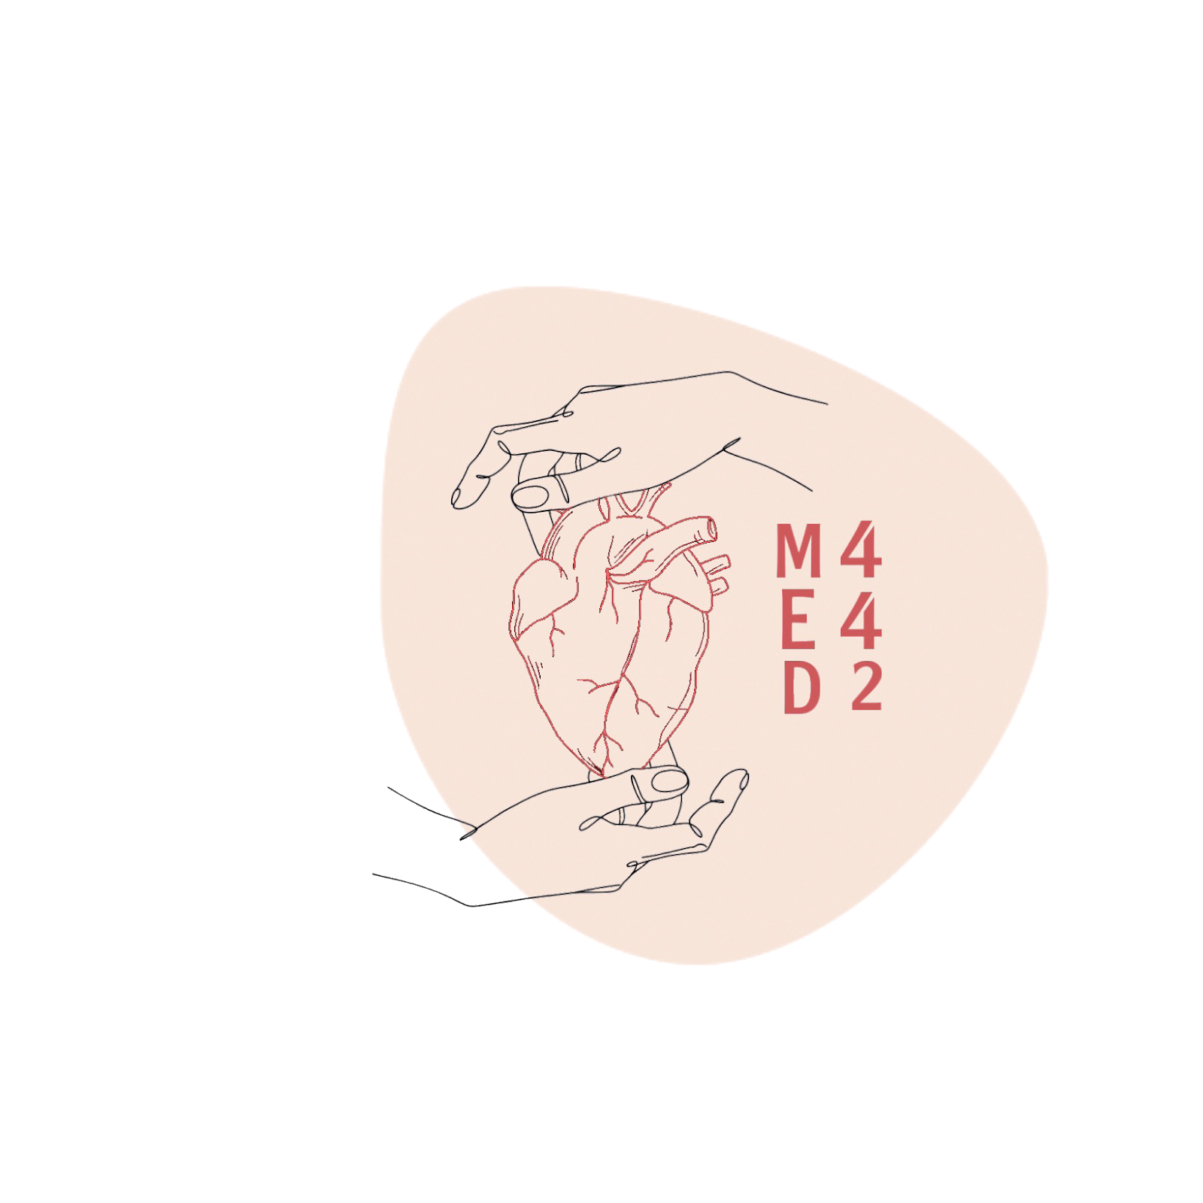
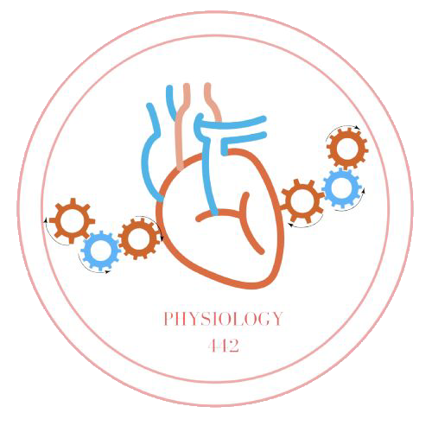
Renal Functions and Glomerular Filtration
L1
Renal Physiology
Editing File
- Color Index:
Main Text
Male’s Slides
Female’s Slides
Important
Doctor’s Notes
Extra Info

Slide 2
Objectives
Enumerate general functions of the kidney.
Describe the functional anatomy of urinary system and nephron.
Identify and describe that the nephron is the structural and function unit of the kidney.
Explain glomerular filtration membrane & filtration forces.
Describe mechanism of filtration & composition of the glomerular filtrate
Calculate the net filtration pressure using parameters of Starling forces.
Identify and describe the factors controlling GFR in terms of starling forces, permeability with respect to size, shape and electrical charges and filtration coefficient
https://youtu.be/SVqSqPOcahY

Slide 3
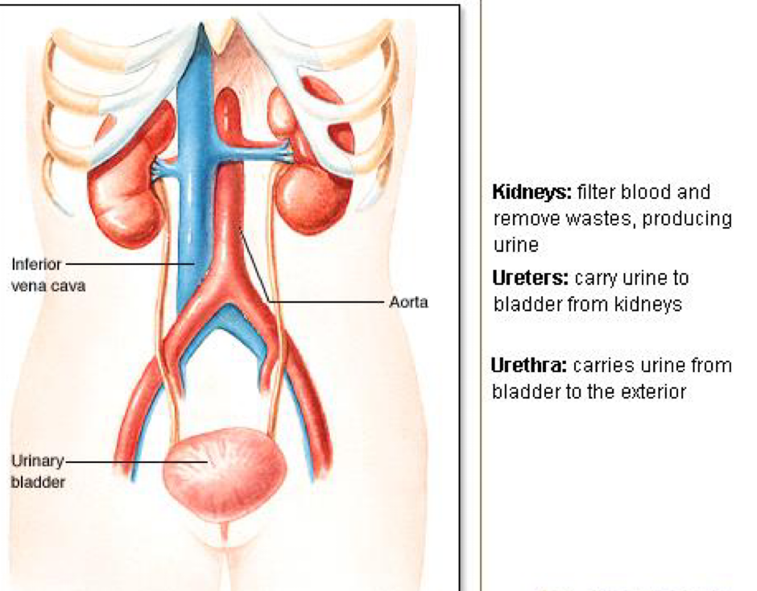
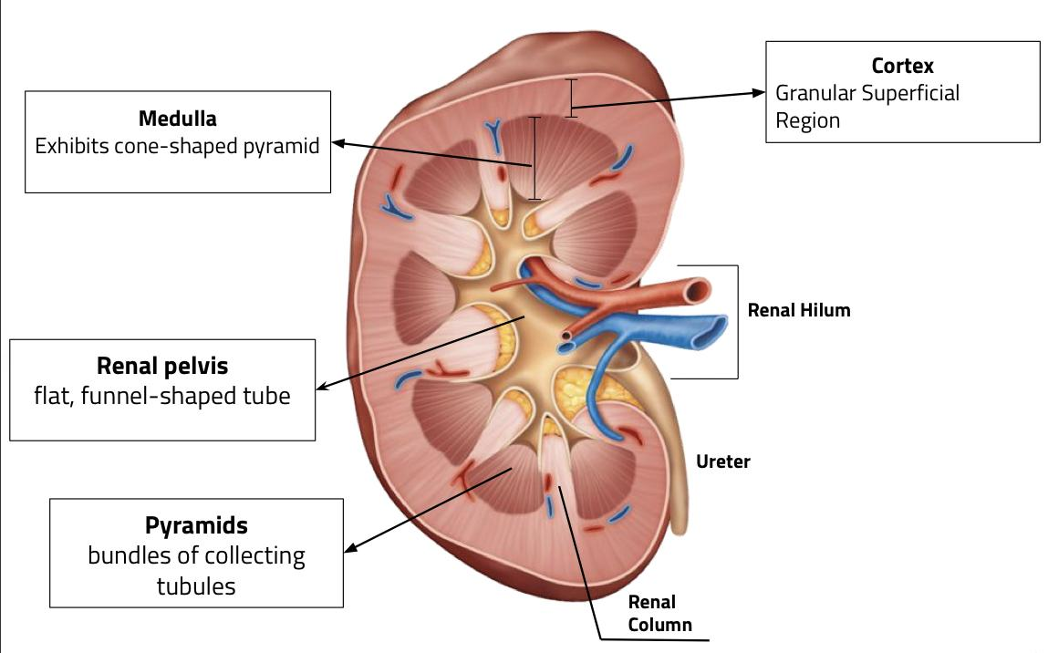
1
Functions of the Kidney
Excretion
Synthetic Function
Regulation
Glucose (Gluconeogenesis)
1,25-dihydroxy Vitamin D3 activation (calcitriol)
Hormone production:
Erythropoietin (Acts on bone marrow)
Renin (Acts in kidneys)
Hormone secretion, metabolism, & excretion:
Water (extracellular fluid volume)
Electrolytes (Na+, K+, HCO 3-, Ca++)
Acid-base
Arterial BP
Blood pH
Blood with metabolic waste products
e.g. Urea, Creatinine, Benzoate, Penicillin, Saccharin, Uric Acid and Bilirubin
Ingested Toxins
e.g. Drugs & Pesticides
Male’s slides only
Naturally occurring vitamin D (cholecalciferol) Vit D1
Liver hydroxylation
25-hydroxycholecalciferol (25-OHD3) Vit D2
Kidneys 1α-hydroxylase enzyme PTH
1,25-dihydroxycholecalciferol (1,25-(OH)2D3)
So with kidney failure patients might get osteoporosis due to decreased VIt D
team 439

Slide 4
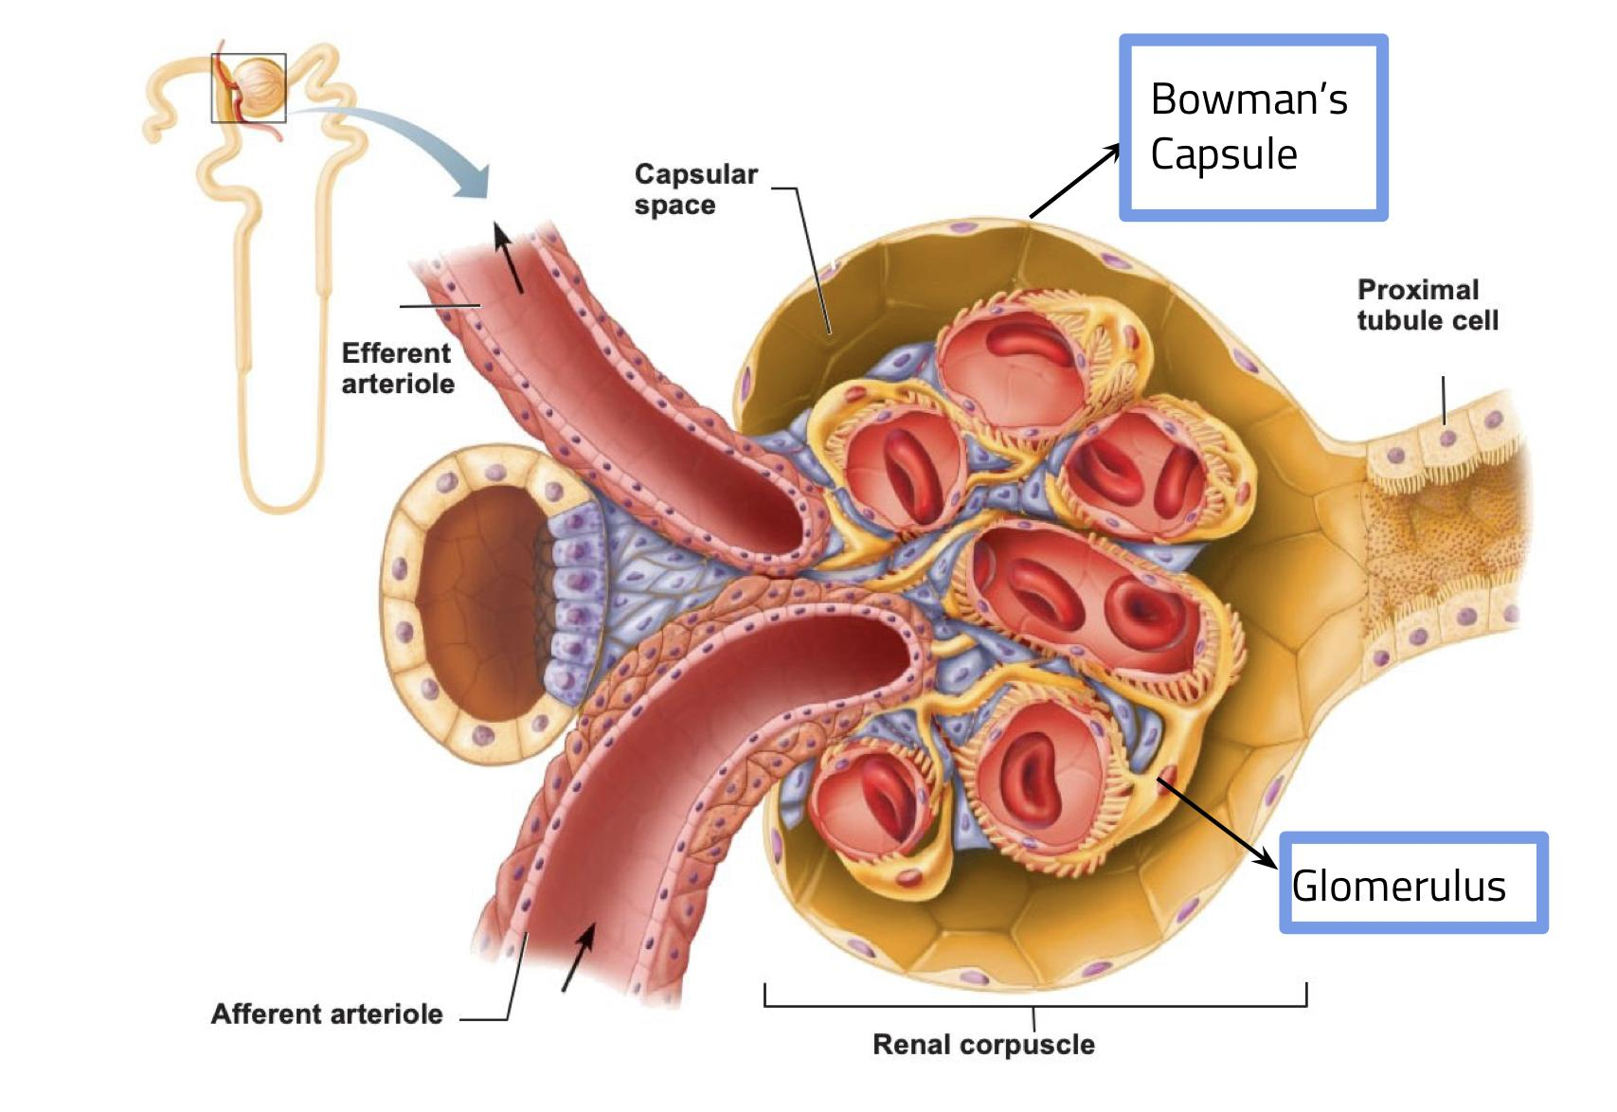
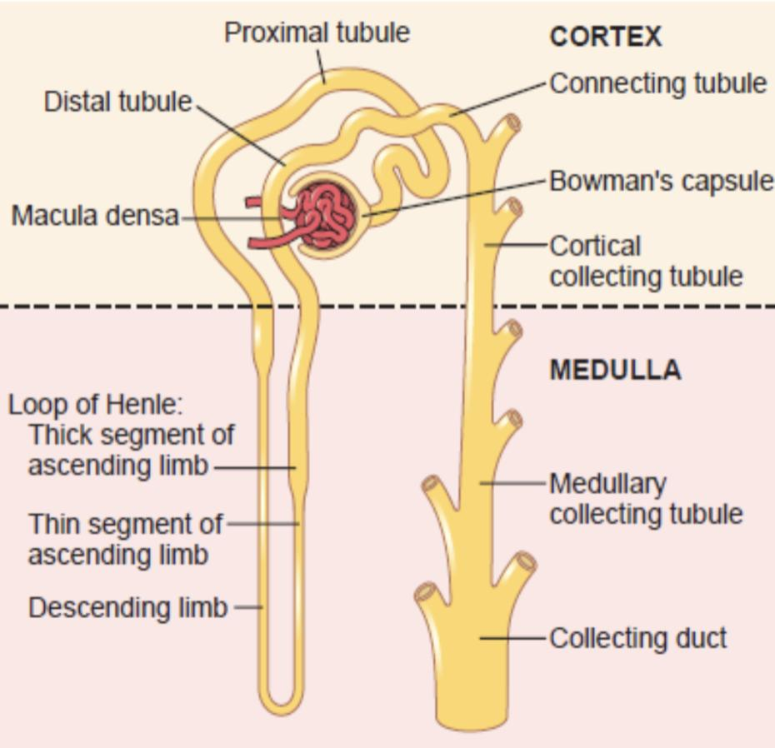
2
The Nephron
It is the functional and structural unit of the kidney
Each kidney has 1 Million nephrons, each nephron is capable of urine formation
The kidney cannot regenerate new nephrons.
After age 40, the number of functioning nephrons usually decreases about 10 per cent every 10 years; thus, at age 80, many people have 40 percent fewer functioning nephrons than they did at age 40.
Not all nephrons work ideally, remember this for Lec4
Structure of Nephron
The Glomerulus: | Bowman’s Capsule: | Tubules:
A capillary tuft associated with a renal tubule, In which large amount of fluid is filtered from blood. Filtrate collects in capsular space, flows into renal tubule. | Blind end of the tubules, completely surrounds the glomerulus and receives the filtrate. | In which filtered fluid eventually is converted into urine, they’re divided into different sections with different structural and functional characteristics: Proximal tubules (in cortex) Loop of henle Distal tubule (in cortex) Connecting tubule, cortical collecting, and the cortical collecting ducts, which run downward in the medulla and become: medullary collecting ducts
Only in males’ slides
Parts of nephron
8 to 10 cortical collecting ducts join to form a single larger collecting duct (about 250) that runs downward into the medulla and becomes the medullary collecting duct.
The collecting ducts merge to form larger ducts that eventually empty into the renal pelvis through the tips of the renal papillae.

Slide 5
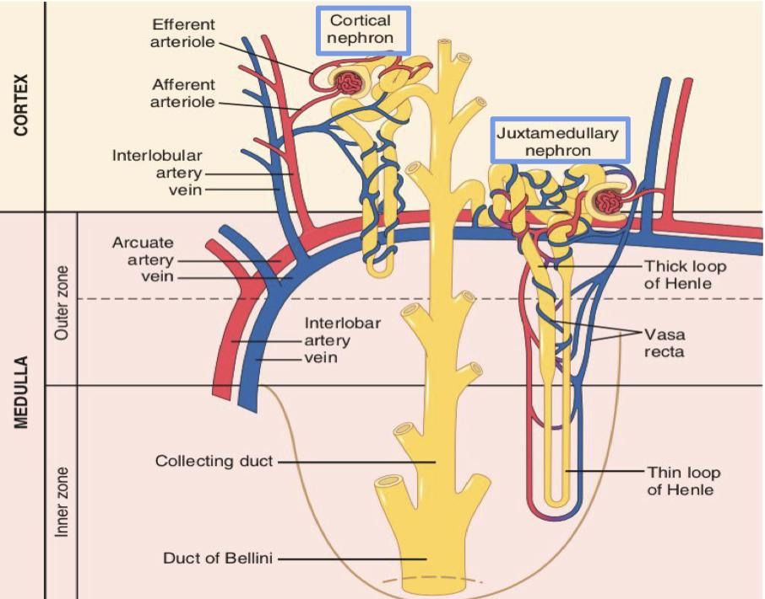
3
The Nephron
Types of nephron
 | Superficial (Cortical) (85%) | Juxtamedullary (15%)
Site | Originate in outer ⅔ of cortex. | Originate in Inner ⅓ of cortex.
features | have short loops of Henle | have long loops of henle extended into the medulla
Function | used daily except in case of dehydration | maints salt gradient, helps conserve water (due to vasa recta) only in dehydration 1-2% of blood flows through juxtamedullary nephrons (will be explained in next lectures)
Capillary Type | Peritubular capillaries | Peritubular capillaries Vasa Recta
Urine Formation | Dilute urine | Concentrated urine
Osmolality | < 300 mOsm/kg | > 300 mOsm/kg
Renal corpuscle comprises 4 main cell types:
Endothelial cells: are fenestrated.
Visceral epithelial cells (podocytes): which support the delicate glomerular basement membrane by pseudopodia.
Parietal epithelial cells: cover the Bowman's capsule.
Mesangial cells: contractile cells
Type I Medullary Interstitial Cells secrete PGE2

Slide 6
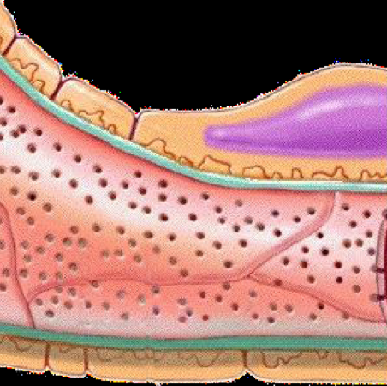
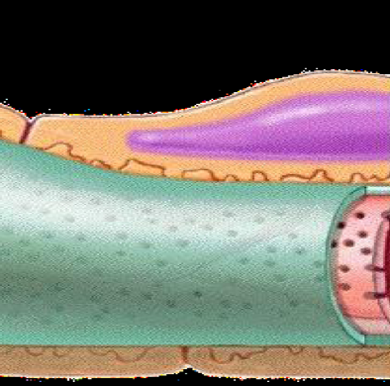
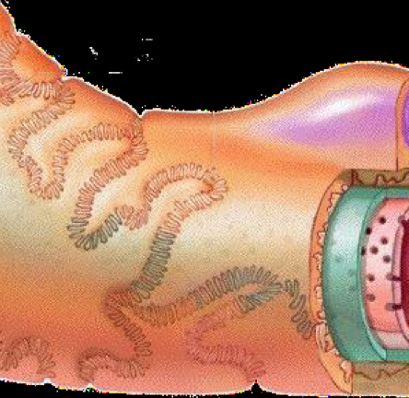
4
Glomerular membrane
Female slides
الكلام من سلايدات البنات بس دكتور العيال شرحها على صور
Blood in the Glomerulus is separated from the fluid in the Bowman’s space by a filtration barrier (Glomerular membrane) / (filtration membrane).
Ultrafiltration occurs at the barrier between the blood and the in the renal corpuscle or Bowman's capsule in the kidneys.
It allow the passage of molecules up to 70,000 D. (Due to the higher pressure).
Albumin (proteins in general) does not normally pass as they are repelled by the negative charge of Glycoproteins (the material of Basement membrane).
Blood cells don't normally pass because of their large size.
It consists of Three layers
(All are negative)
Single layer with endothelial fenestrations (70-90nm)
prevents: blood cells
allows: all component of blood plasma.
Capillary
Endothelium
Basement
Membrane
Between endothelium and epithelium w/o visible gaps
prevents: larger proteins.
Podocytes
Single epithelial lining of Bowman’s Capsule, During
filtration the fluid moves between their foot processes
(pseudopodia) in filtration slits (25 nm)
prevents: medium-sized proteins.
*4-8 nm size particles can be easily filtered*.

Slide 7
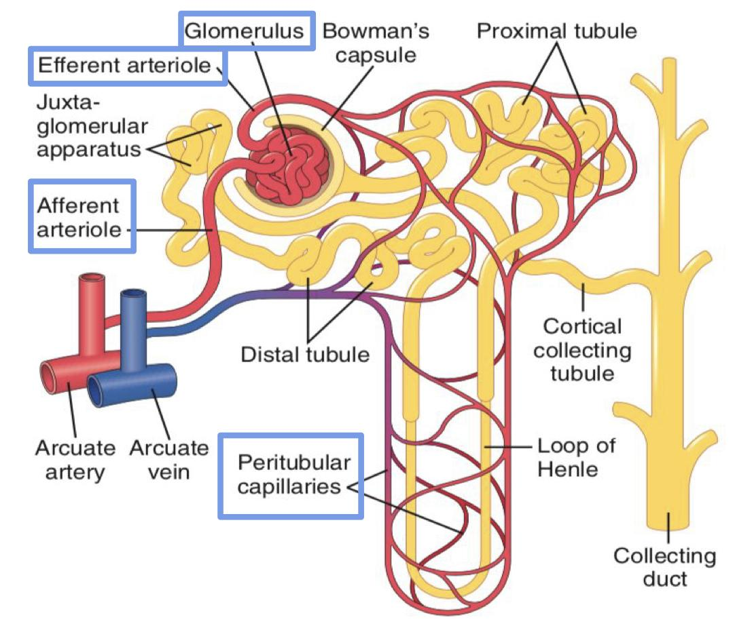
5
Renal Blood Flow
Renal blood flow to the kidney = 20% of cardiac output.
And the blood flows to each kidney through a renal artery.
Features of renal circulation:
1- High blood flow rate (1200 ml/min). 20% × 5 L = 1 L/min ≈ 1200 ml/min
2- Presence of two capillary beds: glomerular and peritubular.
Efferent and afferent arterioles are major sites of renal resistance.
they have high blood pressure.
Blood flow: 1200 ml
We use in filtration process: 625 ml
Amount filtered: 125 ml
20%
Renal blood vessels
Delivers blood into the glomeruli. It has a bigger diameter compared to Efferent, it has high pressure.
Delivers blood from glomeruli to peritubular capillaries has high pressure
Afferent arteriole
(Arrive)
Glomeruli
Efferent arteriole
(Exit)
Peritubular capillaries
Capillary network that produces filtrate that enters the urinary tubules. Higher pressure than all the other capillaries of the body because it’s located between two arterioles with high pressure and this high pressure = favor filtration
Vasa recta.(vasa= blood vessels , recta=مستقيم)

Slide 8
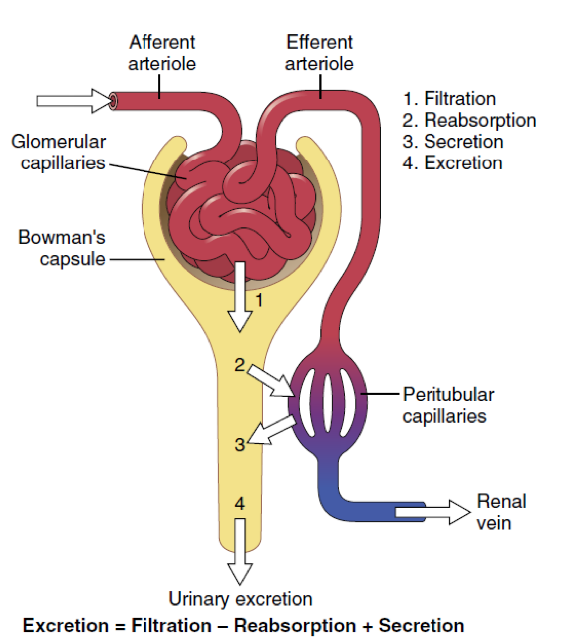
6
Urine Formation
The primary function of kidney is to clear unneeded substances from the blood to be excreted in urine.
Urinary excretion rate = Filtration - Reabsorption + Secretion
Steps of Urine Formation / renal processes :
Glomerular filtration 1st step of urine formation
Filtration of fluid from glomerular capillaries into renal tubules and creates a plasma-like filtrate of the blood. It contains all substances present in plasma, except blood cells and protein
Tubular reabsorption
Removes useful solutes from the filtrate, and returns them to the blood.
Tubular Secretion
Removes additional wastes from the blood, adds them to the filtrate.
Water conservation: (happens before excretion and it’s only for juxtamedullary) Removes water from the urine and returns it to blood, concentrates wastes.
Excretion
Components of GF:
Extra
Organic molecules: Glucose, Amino acids. (but not proteins)
Nitrogenous waste:
Urea, Uric acid, Creatinine.
Ions: Sodium, Potassium, Chloride.
Water

Slide 9
7
Filtration fraction
Boys’ Slides
Ff: Fraction of renal plasma that becomes Glomerular Filtrate.
GFR
Ff =
Renal Plasma Flow (RPF)
125 ml/min
= = 19.2 or approximately 20%
650 ml/min
20% of the plasma flowing through the kidney is filtered through glomerular capillaries.
Boys’ Slides
Why Are Large Amounts of Solutes Filtered and Then Reabsorbed by the Kidneys?
It allows the kidneys to rapidly remove waste products from the body that depend primarily on glomerular filtration for their excretion. Most waste products are poorly reabsorbed by the tubules and, therefore, depend on GFR for effective removal from the body.
It allows all the body fluids to be filtered and processed by the kidneys many times each day. Because the entire plasma volume is only about 3 liters, whereas the GFR is about 180 L/day, the entire plasma can be filtered and processed about 60 times each day.

Slide 10
8
Glomerular Filtration Rate (GFR)
GFR: The amount of glomerular filtrate formed in one minute, represents the filtration of fluid from the glomerular capillaries into the renal tubules.
normally = 125 ml/min or 180 L/day = 20% renal plasma flow.
GFR= Kf x NFP= 12.5 x 10= 125 ml/min
The sum of the forces acting across the membrane (starling forces)
Net Filtration Pressure (NFP)
across glomerular capillaries
GFR is determined by :
Permeability
Capillary filtration coefficient (Kf)
Factors related to the membrane itself
Filtering surface area
Kf: measure of the product of the Permeability and surface area of the glomerular capillaries. It cannot be measured directly
Net Filtration Pressure (NFP)
NFP: The net filtration pressure represents the sum of the hydrostatic and colloid osmotic forces that either favor or oppose filtration across the glomerular capillaries.
 | Forces Opposing Filtration | Forces Favoring Filtration
Hydrostatic | Bowman’s capsule hydrostatic pressure (PB) = 18 mmHg. If it increases = GFR decreases. It can increases in urinary obstruction e.g. stones. | Glomerular hydrostatic pressure (PG) = 60 mmHg. If it increases = GFR Increases.
Osmotic | Glomerular capillary colloid osmotic pressure (πG) = 32 mmHg. If it increases = GFR decreases. It can increase due to decrease in renal blood flow (increased plasma proteins). (Due to an increase in either FF or PP) | Bowman’s capsule colloid osmotic pressure (πB) = 0 mmHg
Net filtration pressure = 60 − 18 − 32 = +10 mm Hg

Slide 11
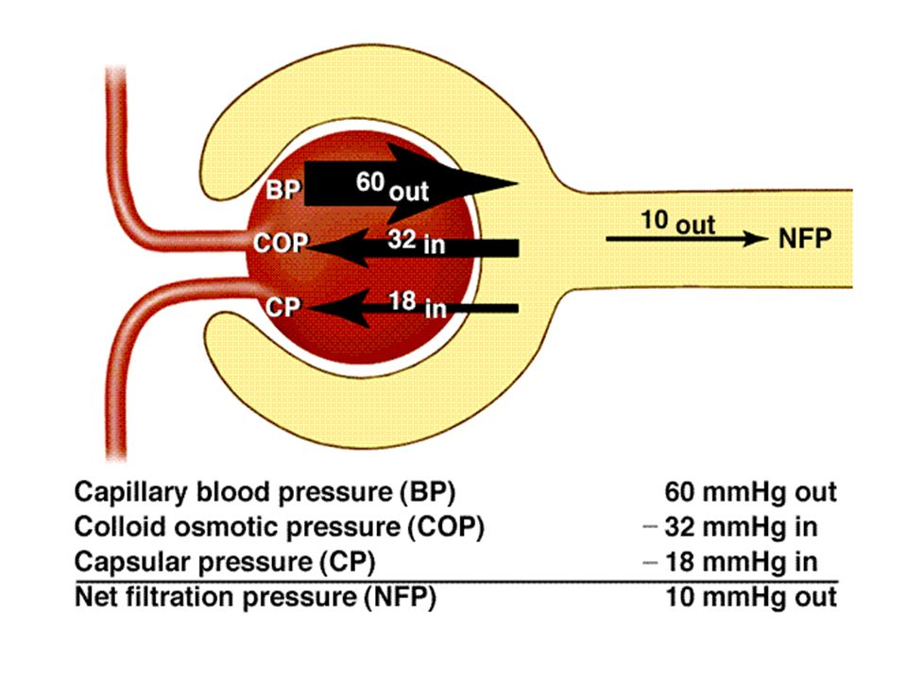
9
Glomerular Filtration Rate (GFR)
The GFR can therefore be expressed as
GFR= Kf × (PG −PB −πG +πB)
Any factor that affect the parameters in the equation will affect the GFR.
However, Physiologic regulation of the GFR involves mechanism that affect mainly the PG (hydrostatic pressure in glomerular capillaries).
Kf, πG and PB can all get affected in disease conditions causing changes in GFR.
PG Depends on:
Arterial BP
Afferent arterioles resistance
Efferent arteriole resistance
Calculations from males’ slides:
GFR: 125 ml/min or 180 L/day
Normal urinary output: 1.5 L/day
Daily reabsorption: 180 - 1.5 = 178.5 L/day
Percent reabsorbed: 178.5/180x100 = 99.2%
Percent excreted: 100-99.2 = 0.8%
(Less then 1% becomes urine)
Obligatory urinary output: 0.5-0.6 L
Oliguria: <300 ml/day
Anuria: <50 ml/day
RBF (Renal blood flow): 1100 ml/min
RPF (Renal plasma flow): 1100x0.55= 620 ml/min
137x60x24 = 190L/day ,If tubular reabsorption remains constant urine volume will increase from 1.5 to 19.5 L/day.

Slide 12
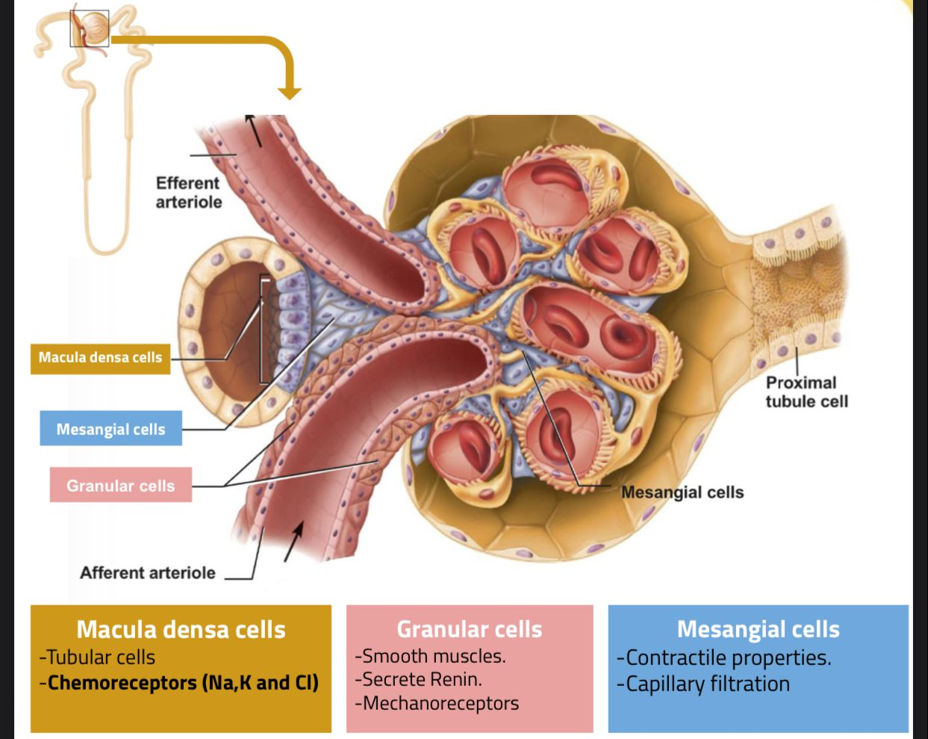
11
Juxtaglomerular Apparatus
team 439

Slide 13
Quiz
Q1
which of the following Factor is constricting the Efferent?
A. Angiotensin II
B. Epinephrine
C. Sympathetic stimulation
D. Endothelin
Which cell is the sensor elemen Chemoreceptors (Na,K and Cl)?
Q2
A. Granular cells
B. Macula densa cells
C. Mesangial cells
D. Epithelial Cells
Q3
Which type of nephron have Vasa Recta capillary?
A. Cortical
B.Afferent arteriole
C. Juxtamedullary
D. Pyramids
Which one of the following removes the additional wastes from the blood,adds them to the filtrate.
Q4
A.Glomerular Filtration
B. Tubular reabsorption
C.Excretion
D.Tubular secretion

Slide 14
Quiz
Q5
Filtrate contains all plasma except:
A. Blood cells
B. Albumin
C. Plasma proteins
D. A and C
Q6
Which of the following prevents medium-sized protein filtration?
A. Fenestration (pore) of glomerular endothelial cells
B. Basal lamina of glomerulus
C. Slit membrane between pedicels
D. The great wall of China
Answers: 1-A , 2-B, 3-C, 4-D , 5-D, 6-C
SAQs
Explain the biphasic effect in Efferent arteriole constriction
If constriction is moderate the PG would increase and increase the GFR.
But if the constriction is Severe the πG which decreases the GFR.
SAQs
Enumerate the Forces Opposing Filtration
Answer: Bowman’s capsule hydrostatic pressure,Glomerular capillary colloid osmotic pressure

Slide 15
Members
Team Leaders
Razan Almohanna
Khalid Alrasheed
Raneem Alwatban
Othman Alabdullah
Team Members
Hadeel alsaiari
Shahad alhemiden
Azzam Alotaibi
Theme was done by Shatha Almutib
physio442@gmail.com

