Slide 1
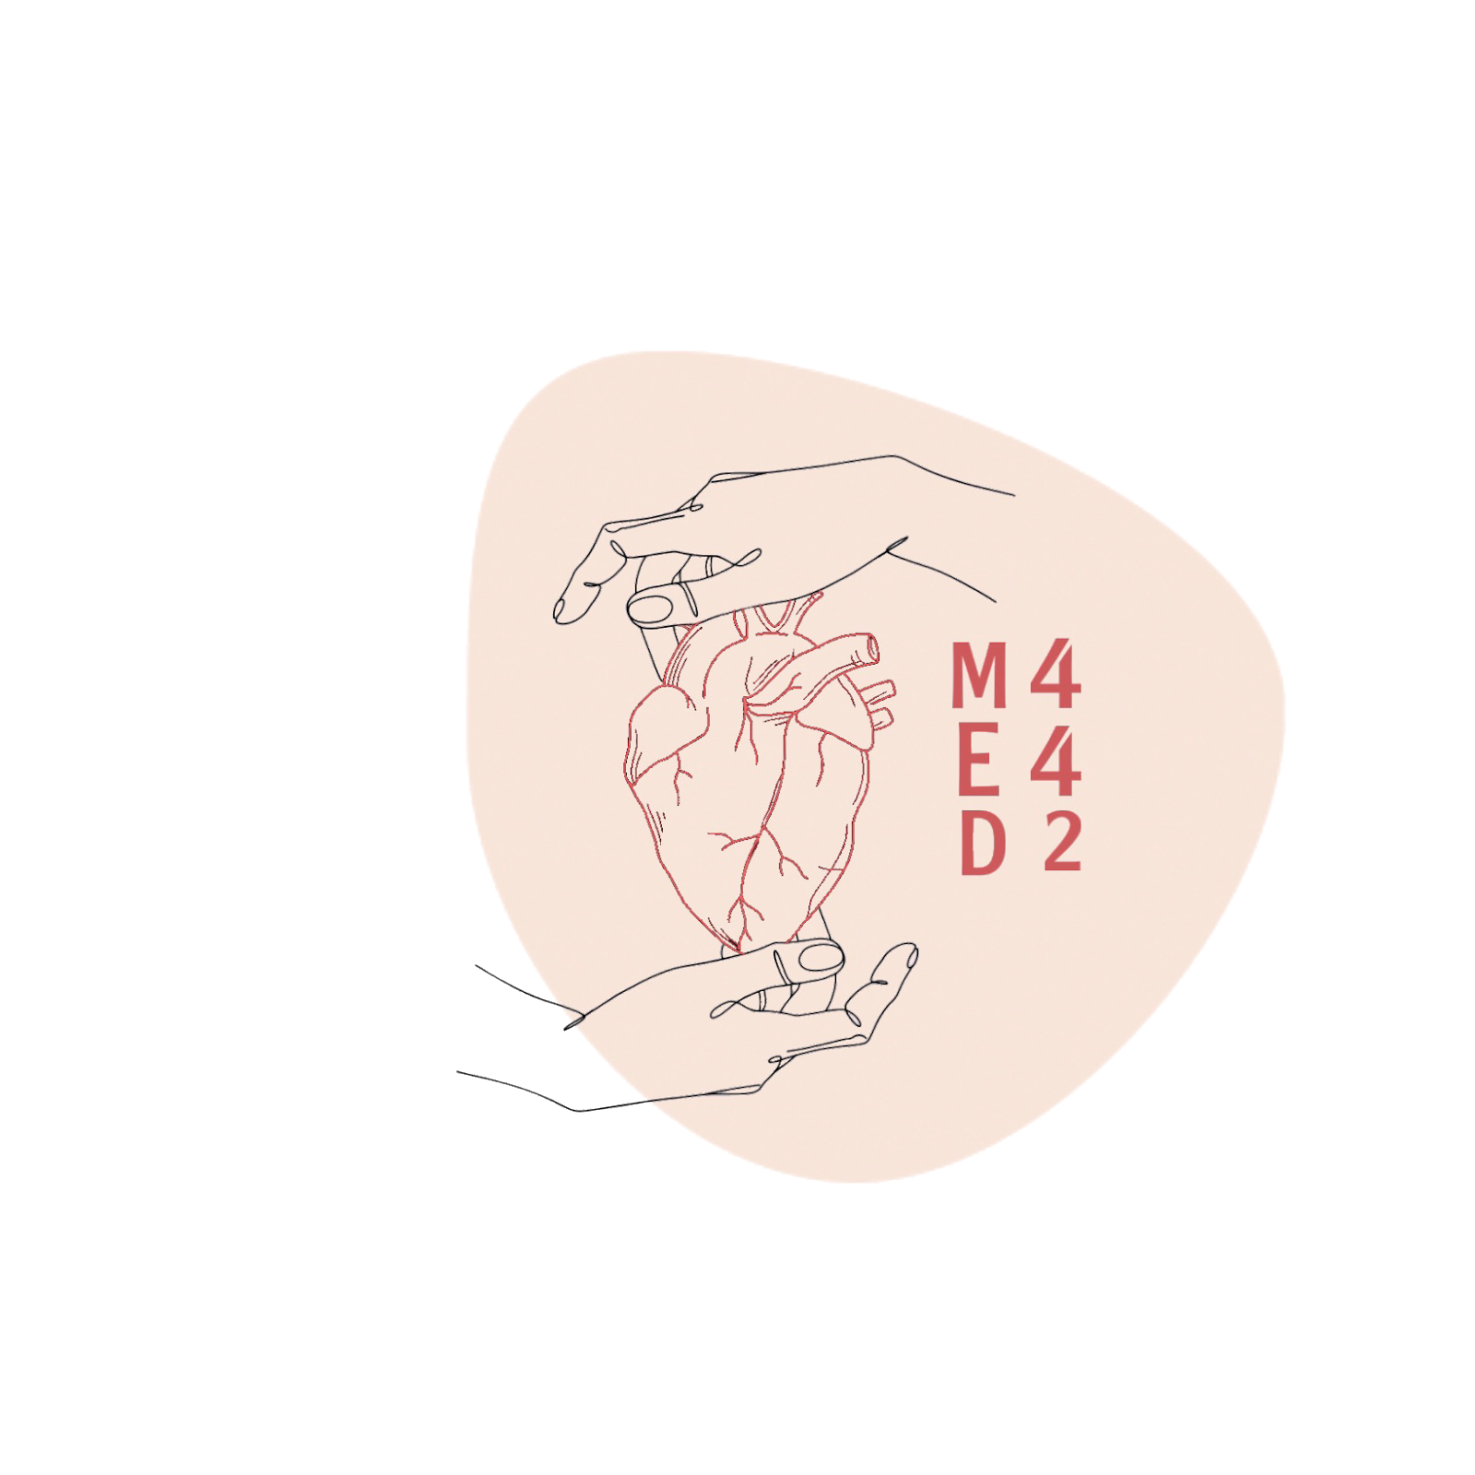
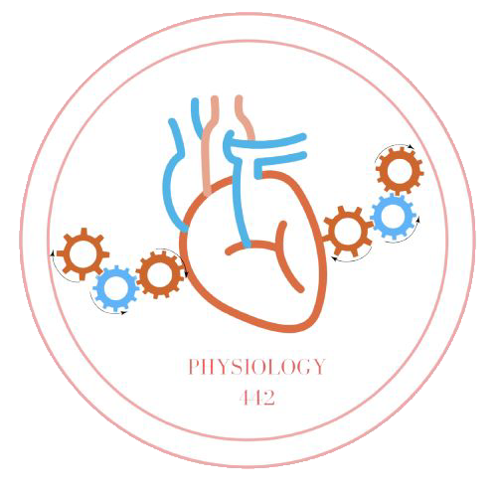
Regulation of Glomerular Filtration
L2
Physiology renal
Editing File
- Color Index:
Main Text
Male’s Slides
Female’s Slides
Important
Doctor’s Notes
Extra Info

Slide 2
Objectives
Describe Intrinsic and extrinsic mechanism that regulate GFR.
Describe autoregulation of GFR & tubuloglomerular feedback mechanism.
Explain glomerular filtration membrane & filtration forces. In both l1 and l2 but it’s explained better in l1

Slide 3
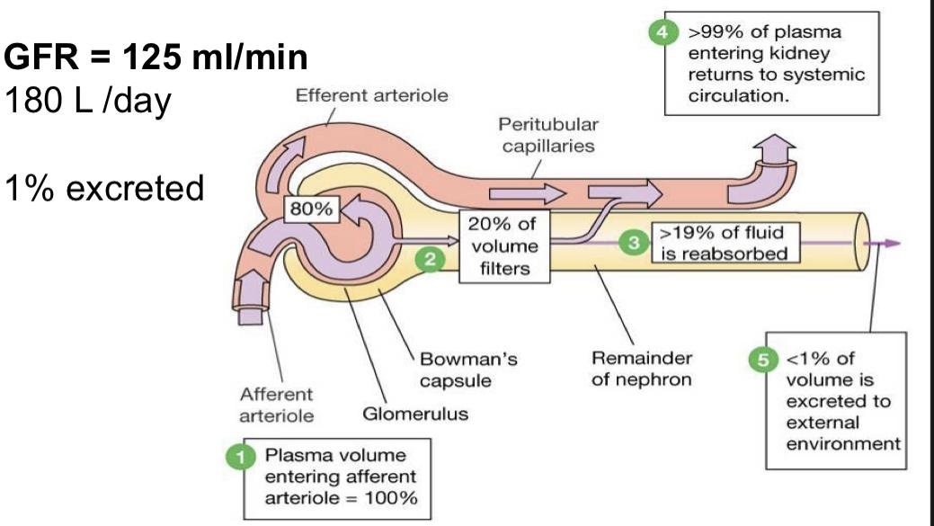
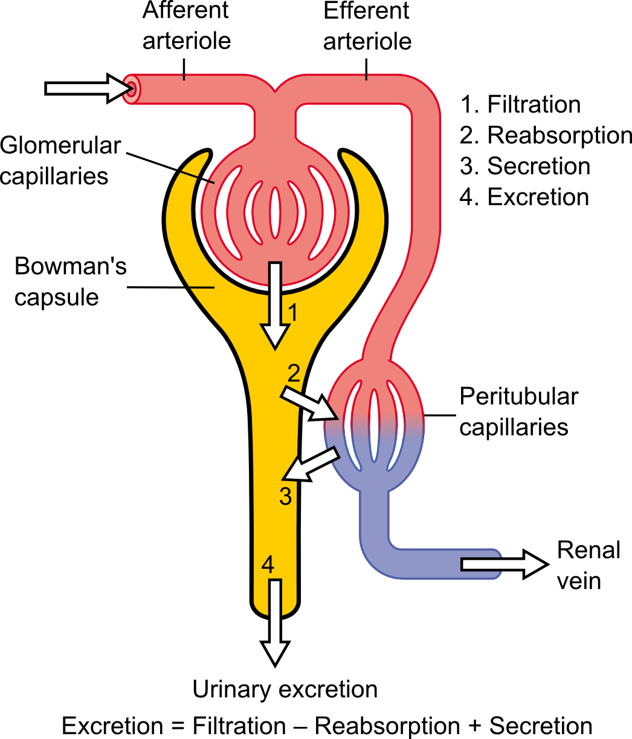
1
GFR (Glomerular Filtration Rate)
Defined as: The volume of filtrate produced by both kidneys per min
Averages 125 ml/min
Totals about 180L/day (45 gallons)
So most filtered water must be reabsorbed or death would ensue
from water lost through urination
GFR= 125 ML/MIN
• OR 125X60X24=180000=180 L/DAY
• Normal Urinary Output = 1.5 L/day
• Daily Reabsorption 180-1.5=178.5 L/day
• Percent Reabsorbed =178.5/180x100=99.2%
• Percent Excreted = 100-99.2=0.8%
(Less than 1 % becomes urine)
20% of the cardiac output (5 L) goes to the kidneys. So 20% of 5 Liters is 1000 ml of blood. Blood composed of plasma and cells . And because cells don’t get filtered due to they are large in size. So 1000 ml of blood composed of 400 ml are cells, and 600 ml is plasma.
1)600 ml of Plasma will go to the kidneys.
2)Only 20% will get filtered (Note that 600 ml x 20% = 120-125 ml/min, which is the GFR).
3)19% will get reabsorbed .
4. 1% will be excreted in urine.

Slide 4
2
This slide only in boys
Boy’s slide
SUBSTANCE | MOLECULAR WEIGHT | MOLECULAR SIZE nm | FILTERABILITY
Water | 18 | 0,15 | 1.0
Sodium | 23 | 0,1 | 1.0
Glucose | 180 | 0,33 | 1.0
Inulin | 5,500 | 1.48 | 1.0
Myoglobin | 17,000 | 1.88 | 0.75
Albumin (6 nm) | 69,000 | 3.55 | 0.005
Filterability of Solutes Is Inversely Related to Their Size
Negatively Charged Large Molecules Are Filtered Less Easily Than Positively Charged Molecules of Equal Molecular Size.
Dextrans are polysaccharides that can be manufactured as
neutral molecules or with negative or positive charges.
IgA Nephropathy is a kidney disease that occurs when an antibody called immunoglobulin A (IgA) builds up in your kidneys. This results in local inflammation that, over time, can hamper your kidneys' ability to filter waste from your blood.
CONTROL OF GFR
GFR = Kf x [(PG-PB)-(G- B)]
OR
GFR = Kf x [(60-18)-(32- 0)]
(1)Hydrostatic pressure inside the glomerular capillaries (glomerular hydrostatic pressure, PG), which promotes filtration
(2)The hydrostatic pressure in bowman's capsule (PB) outside the capillaries, which opposes filtration
(3)The colloid osmotic pressure of the glomerular capillary plasma proteins (πg), which opposes filtration
(4)The colloid osmotic pressure of the proteins in bowman's capsule (πb), which promotes filtration

Slide 5
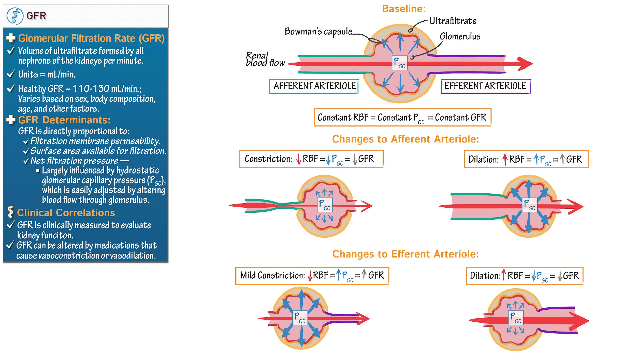
3
Physiological regulation of GFR
PB= GFR
If the constriction is extreme it obstructs the arteriole completely leading to accumulation of blood in Glomerulus so GFR will increase first and then it would decline due to Increased in proteins (oncotic pressure).
دكتور العيال ركز عالنقطة هذي
Factors that constrict the Afferent & decrease PG:
Sympathetic stimulation, will decrease GFR and RBF.
Epinephrine, will decrease GFR
Norepinephrine, will decrease GFR and RBF
Endothelin, will decrease GFR decreased VIt D
Factors that constrict the Efferent:
Angiotensin II, will constrict Eff more than Aff, and will decrease RBF. (prevents decrease of GFR)
Other factors affecting Renal blood flow and GFR:
High protein diet increases GFR. because πB has increased.
Hyperglycemia increases RBF and GFR.
Fever increases RBF and GFR.
Aging decreases RBF and GFR.
Dehydration decreases RBF and GFR

Slide 6
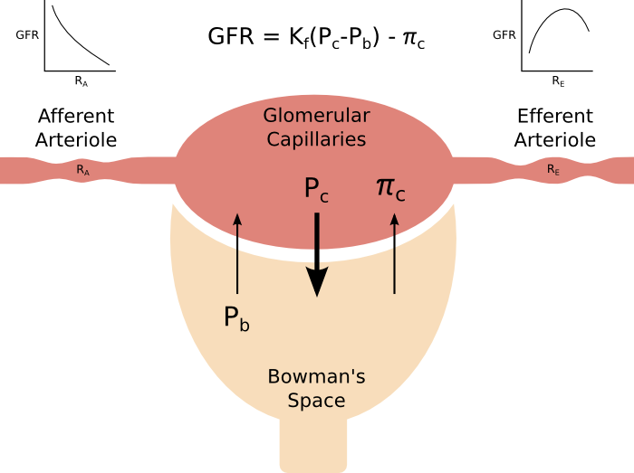
4
Physiological Regulation of GFR
Constriction of afferent arteriole
Constriction of efferent arteriole
↓PG
Moderate
Sever
↓GFR
↑PG
↑πG
↑GFR
↓GFR
Sympathetic stimulation
Epinephrine
Norepinephrine
Endothelin
Angiotensin II

Slide 7
5
Boy’s slide
Factors That Can Decrease the GFR
Physical Determinants* | Physiologic/Pathophysiologic Causes
↓ Kf → ↓ GFR | Renal disease, diabetes mellitus, hypertension, aging
↑ PB → ↓ GFR | Urinary tract obstruction (e.g., kidney stones)
↑ πG → ↓ GFR | ↓ Renal blood flow, increased plasma proteins
↓ PG → ↓ GFR | —
↓ AP → ↓ PG | ↓ Arterial pressure (has small effect due to autoregulation)
↓ RE → ↓ PG | ↓ Angiotensin II (drugs blocking angiotensin II formation)
↑ RA → ↓ PG | ↑ Sympathetic activity, vasoconstrictor hormones (e.g., norepinephrine, endothelin)
Kf, glomerular filtration coefficient; PB, Bowman's capsule hydrostatic
pressure; πG, glomerular capillary colloid osmotic pressure; PG, glomerular capillary hydrostatic pressure; AP, systemic arterial pressure; RE, efferent arteriolar resistance; RA, afferent arteriolar resistance.
* Opposite changes in the determinants usually increase GFR.
Increased Glomerular Capillary Filtration Coefficient (Kf) Increases GFR
The Kf is a measure of the product of the Permeability and surface
area of the glomerular capillaries. The Kf cannot be measured directly
Increased Kf raises GFR and decreased Kf reduces GFR

Slide 8
6
Girl’s slide
GFR is directly proportional to the NFP
-An increase in NFP GFR
-A decrease in NFP GFR
Changes in GFR normally result from changes in glomerular blood pressure.
NFB = Net foltiration rate
Girl’s slide
If the GFR is too high:
Fluid flows through tubules too rapidly to be absorbed.
Urine output rises
Creates threat of dehydration and electrolyte depletion.
If the GFR is too low:
Fluid flows sluggishly through tubules.
Tubules reabsorb wastes that should be eliminated.
Azotemia develops (high levels of nitrogen-containing substances in the blood).
Factors affecting GFR
Boy’s slide
Renal blood flow (Autoregulation effect also). | flow GFR flow GFR
Glomerular Capillary hydrostatic pressure | Pr GFR Pr GFR
Hydrostatic pressure in bowman’s Capsule | GFR
Sympathetic Nervous system | GFR
Hormonal & Autocoid Control | Variable effect
in plasma colloid osmotic pressure | GFR
Changes in kf (Permeability and Surface Area) | Kf GFR Kf GFR
Misc: High Protein Diet increase , Hyperglycemia increase , Glucocorticoids increase , Fever increase , Aging decrease , Dehydration decrease

Slide 9
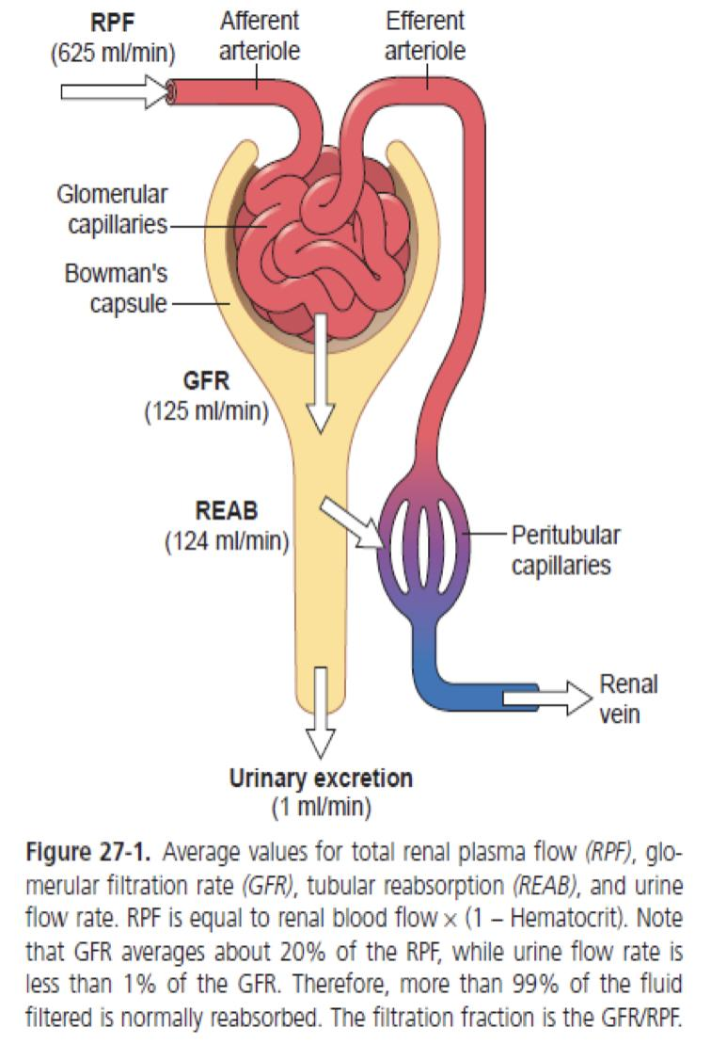
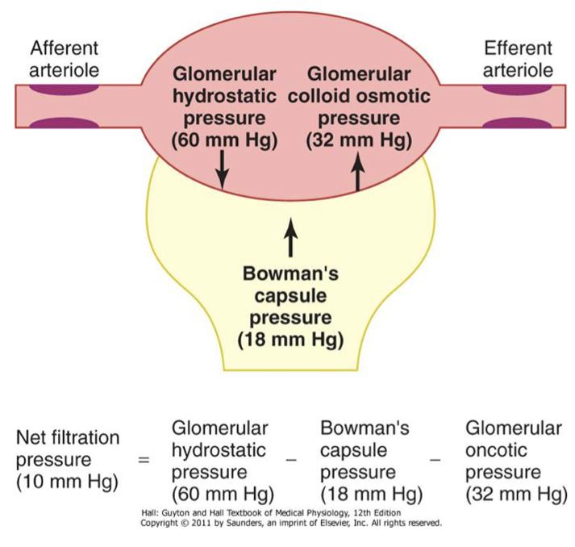
7
FILTRATION FRACTION
Boy’s slide
-Fraction of renal plasma that becomes Glomerular Filtrate.
-Ff = GFR/Renal Plasma Flow =
125 ml per min/650 ml per min= 19.2 or approximately 20%
-About 20 percent of the plasma flowing through the
kidney is filtered through the glomerular capillaries.
Boy’s slide
Why Are Large Amounts of Solutes Filtered and Then Reabsorbed by the Kidneys?
It allows the kidneys to rapidly remove waste products from the body that depend primarily on glomerular filtration for their excretion. Most waste products are poorly reabsorbed by the tubules and, therefore, depend on a high GFR for EFFECTIVE REMOVAL from the body.
It allows all the body fluids to be FILTERED AND PROCESSED BY THE KIDNEY MANY TIMES EACH DAY. Because the entire plasma volume is only about 3 liters, whereas the GFR is about 180 L/day, the entire plasma can be filtered and processed about 60 times each day.
Boy’s slide
Net Filtration Pressure (NFP)
-The net filtration pressure represents the sum of the hydrostatic and colloid osmotic forces

Slide 10
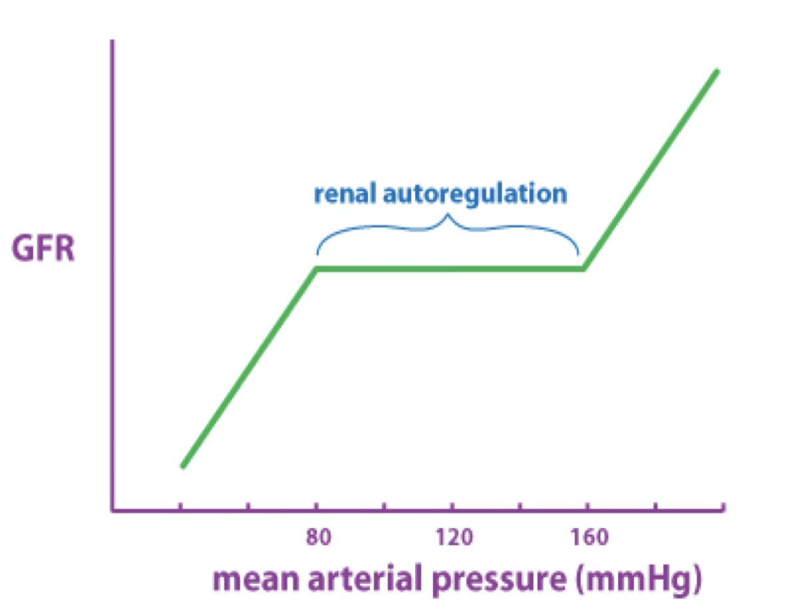
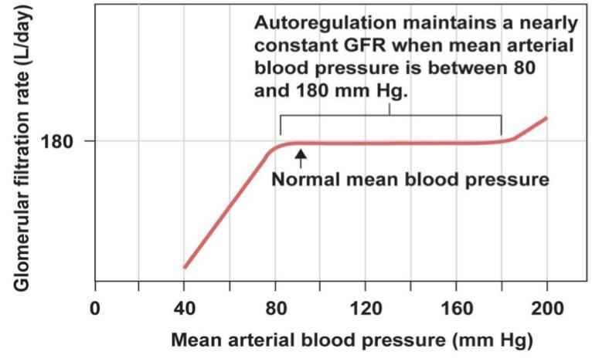
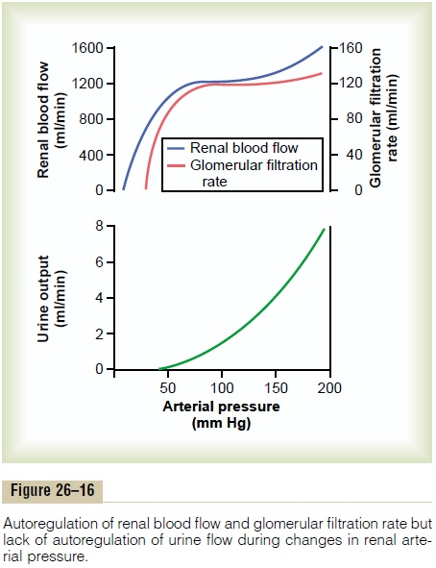
8
Why is it important to have the GFR regulated?
Effect of Arterial BP on GFR:
↑ ABP → ↑ GFR.
However, the body maintains constant GFR over an ABP range of 75-160 mmHg.
Why ? And how? By autoregulation, explained next slide
Autoregulation largely occurs by the regulation of Renal Vascular resistance
This does not happen in the body because of tubuloglomerular 70/75-160/180 mmHg feedback and glomerulotubular balance.
Autoregulation of renal blood flow and glomerular filtration rate but lack of autoregulation of urine flow during changes in renal arterial pressure in blood- perfused kidneys that have been removed from the body.
regulation of GFR:
GFR controlled by adjusting glomerular blood pressure through the following mechanisms:
Myogenic autoregulation.
Autoregulation
Tubulo-glomerular feedback mechanism.
Sympathetic control
Hormonal mechanism: renin and angiotensin

Slide 11
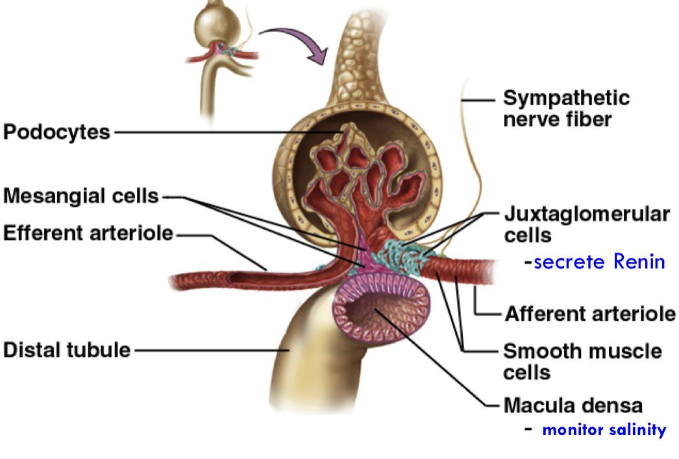
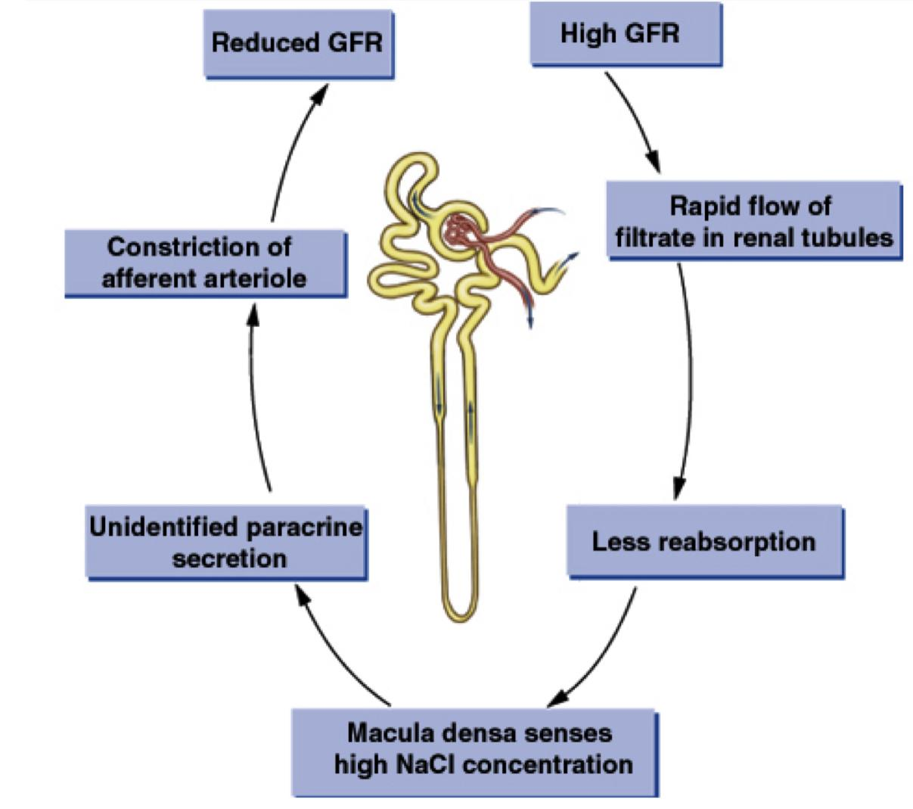
9
Autoregulation of GFR
-Refer to feedback mechanisms intrinsic to the kidney that keep the renal blood flow and GFR relatively constant despite fluctuations in ABP.
-These mechanisms operate over an ABP ranging
between 75-160 mmHg.
Achieved by 2 major mechanisms:
1. Myogenic autoregulation.
2. Tubulo-glomerular feedback mechanism.
Renal Autoregulation of GFR
- BP ->constrict afferent arteriole, & dilate efferent.
- BP ->dilate afferent arteriole, & constrict efferent .
-Stable for BP range of 75 to 160 mmHg (systolic) .
-Cannot compensate for extreme BP changes
­
Juxtaglomerular
Apparatus
Example of
autoregulation

Slide 12
10
Mechanism of GFR AutoRegulation
Mechanism of GFR AutoRegulation
Intrinsic
Extrinsic
MYOGENIC:
-Intrinsic property of mesangial (smooth muscle)
cells and in afferent arteriole
-Reflex contraction induced by increased blood
pressure reduces filtration
TUBULOGLOMERULAR FEEDBACK:
-Flow rate sensed by macula densa & sends signals to alter afferent arteriole resistance.
SYMPATHETIC INNERVATION:
-Cause arteriole vasoconstriction and reduced GFR.
ANGIOTENSIN II:
-Produced as a result of renin release from kidney
-Constricts efferent ↑ arteriole; prevent decrease in GFR
NITRIC OXIDE (NO):
-Causes arteriolar vasodilation.
Arterial Pressure
Explained in next slide
Glomerular Hydrostatic Pressure
-
Macula densa NaCl sends 2 signals
-
Renin
Angiotensin ll
Afferent Arteriolar Arteriolar resistance
Efferent arteriolar resistance

Slide 13
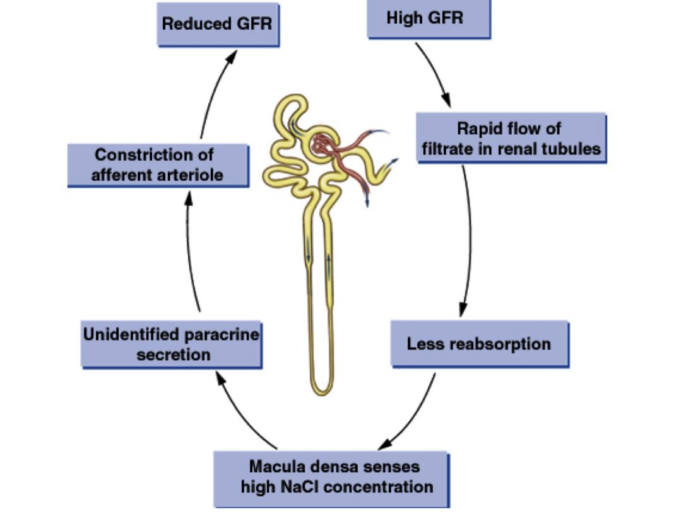
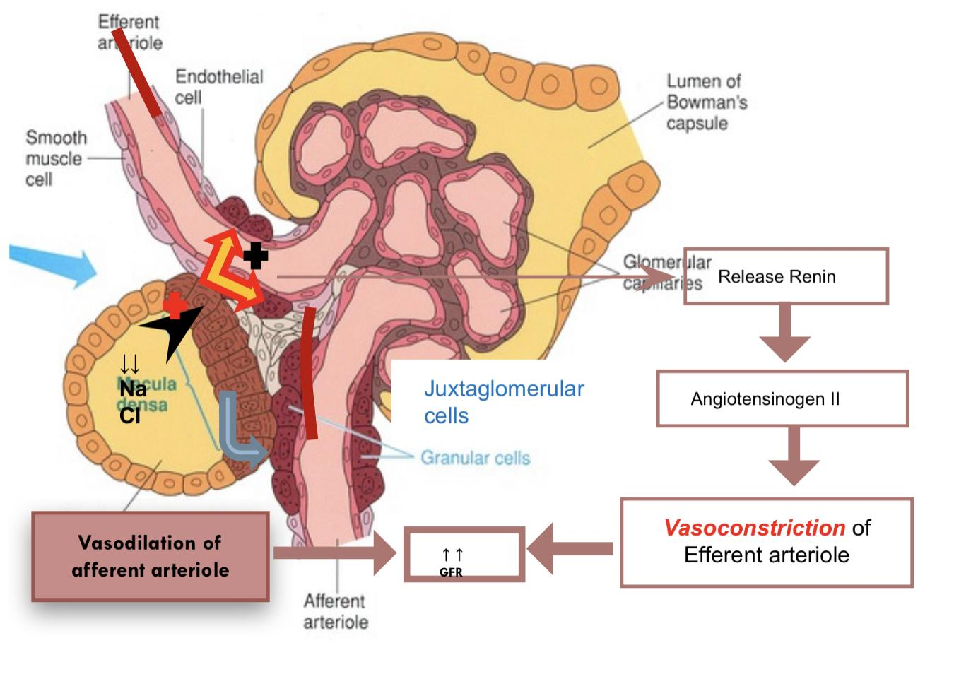
11
Tubuloglomerular Feedback
A feedback mechanism that links changes in sodium chloride concentration at the macula densa with the control of renal arteriolar resistance
Two components that act together to control GFR:
(1)An afferent arteriolar feedback mechanism
(2)An efferent arteriolar feedback mechanism.
In the absence of autoregulation, a relatively small increase in blood pressure (from 100 to 125 mm Hg) would cause a similar 25 per cent increase in GFR (from about 180 to 225 L/day)
GFR explanation
Example:
Decreased ABP of high protein diet
• decrease in NaCl delivery The macula densa cells, which are capable of sensing this change, this will cause two effects to restore GFR:
1- Decrease in resistance of Afferent arterioles (i.e.Vasodilation) lead to increase glomerular hydrostatic pressure to normal levels.
2- increase in renin release from JG cells > Ang II >constrict Efferent arterioles leads to increase glomerular hydrostatic pressure & GFR back to normal

Slide 14
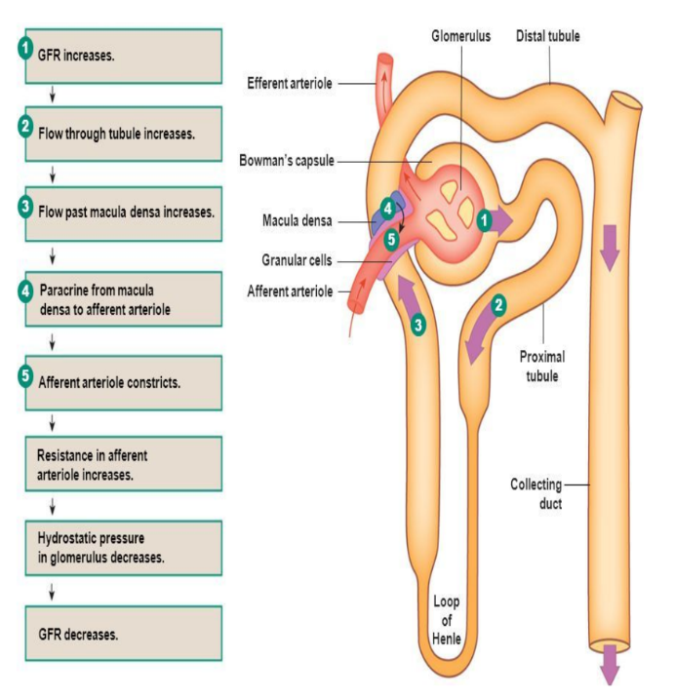
12
GFR
Example:
Increase ABP
• increase in NaCl delivery to DCT
•The macula densa is alerted
•GFR is restored by:
Vasoconstriction of Afferent Release of adenosine
• GFR is back to normal
Boy’s slide
renal Arteriolar Pressure
glomerular capillary Pressure
GFR
Tubuloe- glomerular feedback
Tubule-glomerular balance
Solutes reabsorption in proximal tubule
Solutes reabsorption in thick ascending limb
Salt and fluid delivery to the distal tubule
An increase in GFR causes an increase in the reabsorption of solutes, and consequently of water, primarily in the proximal tubule, so that in general the percentage of the solute reabsorbed is held constant. This process is called glomerulotubular balance , and it is particularly prominent for Na +
Signals from the renal tubule in each nephron feed back to affect filtration in its glomerulus.

Slide 15
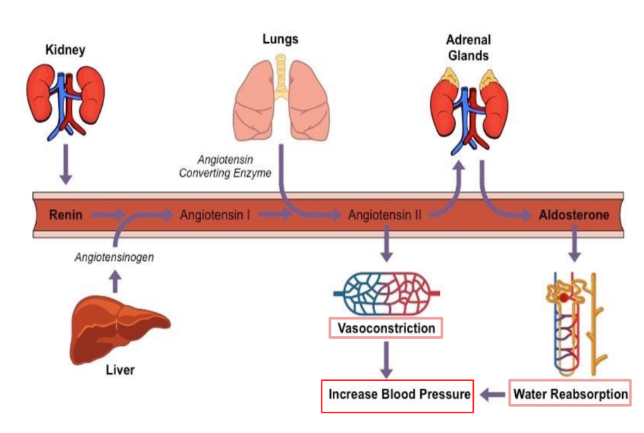
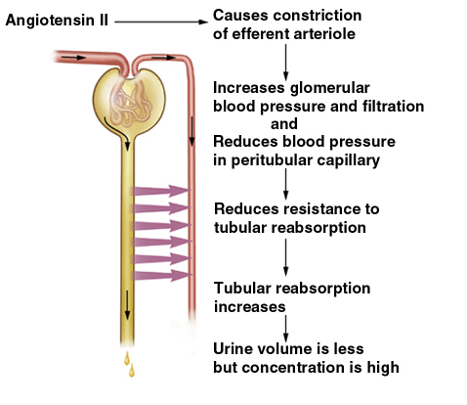
13
Myogenic system
● It is the intrinsic capability of blood vessels to constrict when blood pressure is increased.
● → When BP is high, renal blood vessels constrict to prevent an increase in GFR by decreasing renal flow
● → When BP is low, renal blood vessels dilate to prevent a drop in GFR by reducing arterial resistance and increasing blood flow.
Hormonal Control of GFR
Renin release
Renin will convert Angiotensinogen to Angiotensin I
Angiotensin I will be converted to Angiotensin II
Angiotensin II will do many things but in the kidney will do two things:
Vasoconstriction on Efferent arterioles -> decrease fluid that goes to peritubular capillary -> decrease in blood pressure -> increase reabsorption -> fluid will back to the body -> blood pressure back to normal -> GFR also back to normal -> urine will decrease

Slide 16
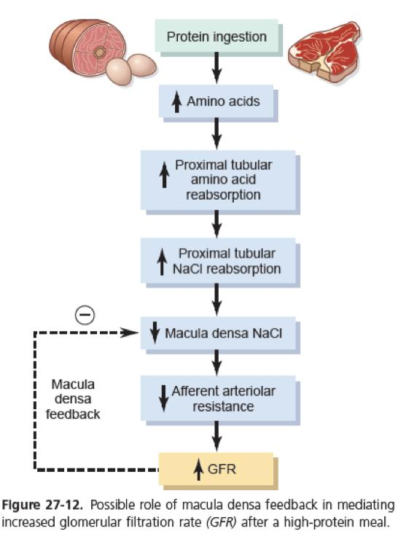
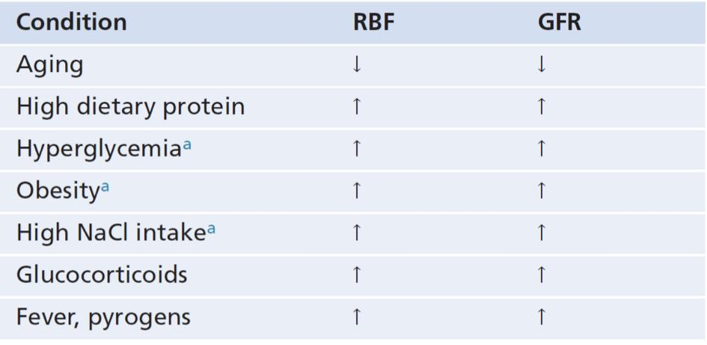
14
Sympathetic Control of GFR (Extrinsic)
Girl’s slide
When the sympathetic nervous system is
at rest:
Renal blood vessels are maximally dilated
Autoregulation mechanisms prevail (overcome)
Under stress:
Norepinephrine is released by the sympathetic nervous system
Epinephrine is released by the adrenal medulla
Afferent arterioles constrict and filtration is inhibited
Note: during fight or flight blood is shunted away from kidneys *more blood
to your brain and muscles
The sympathetic nervous system also stimulates the renin-angiotensin
mechanism *by stimulating B1 receptors in
juxtaglomerular cells this induces vasoconstriction of efferent arteriole.
Note: there’s no parasympathetic effect on the kidney
Boy’s slide
Boy’s slide
Some Conditions That Influence Renal Blood Flow (RBF) and the Glomerular Filtration Rate (GFR).
a Refers to early effects, prior to development of glomerular injury that may occur with chronic hyperglycemia, obesity, and high salt intake.
High Protein Intake and Hyperglycemia Increase Renal Blood Flow and Glomerular Filtration Rate.

Slide 17
15
Summary
GFR (Glomerular Filtration Rate)
Defined as: The volume of filtrate produced by both kidneys per min
Averages 125 ml/min
GFR is proportional to NFP
Regulation of GFR
Autoregulation
Hormonal
Sympathetic
Tubuloglomerular Feedback
the macula densa were sensory cells that can sense changes in ions .
-GFR NaCl —> vasoconstriction of affront.
-GFR NaCl —> vasodilation of affront.
Under stress:
Norepinephrine is released by the sympathetic nervous system
-Epinephrine is released by the adrenal medulla -Afferent arterioles constrict and filtration is inhibited
Myogenic system
capability of blood vessels to constrict when blood pressure is increased.
-BP high —>renal blood vessel constrict .
-BP low —>renal blood vessel dilate.

Slide 18
Quiz
Q1
What is the average of GFR?
A. 175 ml/min
B. 200 ml/min
C. 125 ml/min
D. 80 ml/min
Q2
Which of the following is correct ?
A. GFR is indirectly proportional to the NFP
B. GFR is directly proportional to the NFP
C. GFR is indirectly inversely proportional to the NFP
D. GFR is directly inversely proportional to the NFP
Q3
Which of the following factors has a variable effect?
A. Hormonal control
B. Autocoid control
C. both A and B
D. none of them
Q4
Which of the following is an autoregulation of GFR ?
A. Myogenic auto-regulation.
B. Tubulo-glomerular feedback mechanism.
C. Sympathetic control
D. both A and B

Slide 19
Quiz
Q5
Which of the following is extrinsic mechanism of GFR autoregulation
A.myogenic
B.Nitric oxide NO
C.tubuloglomerular
D. A&C
Answers: 1-C , 2-B, 3-C, 4-D, 5-B
SAQs
Define Glomerular Filtration Rate.
The volume of filtrate produced by both kidneys per min
SAQs
What are the factors affecting GFR?
Slide 4

Slide 20
Members
Team Leaders
Razan Almohanna
Khalid Alrasheed
Raneem Alwatban
Othman Alabdullah
Team Members
Lina almohsen
Saad Alahmari
Theme was done by Shatha Almutib
physio442@gmail.com

