Slide 1
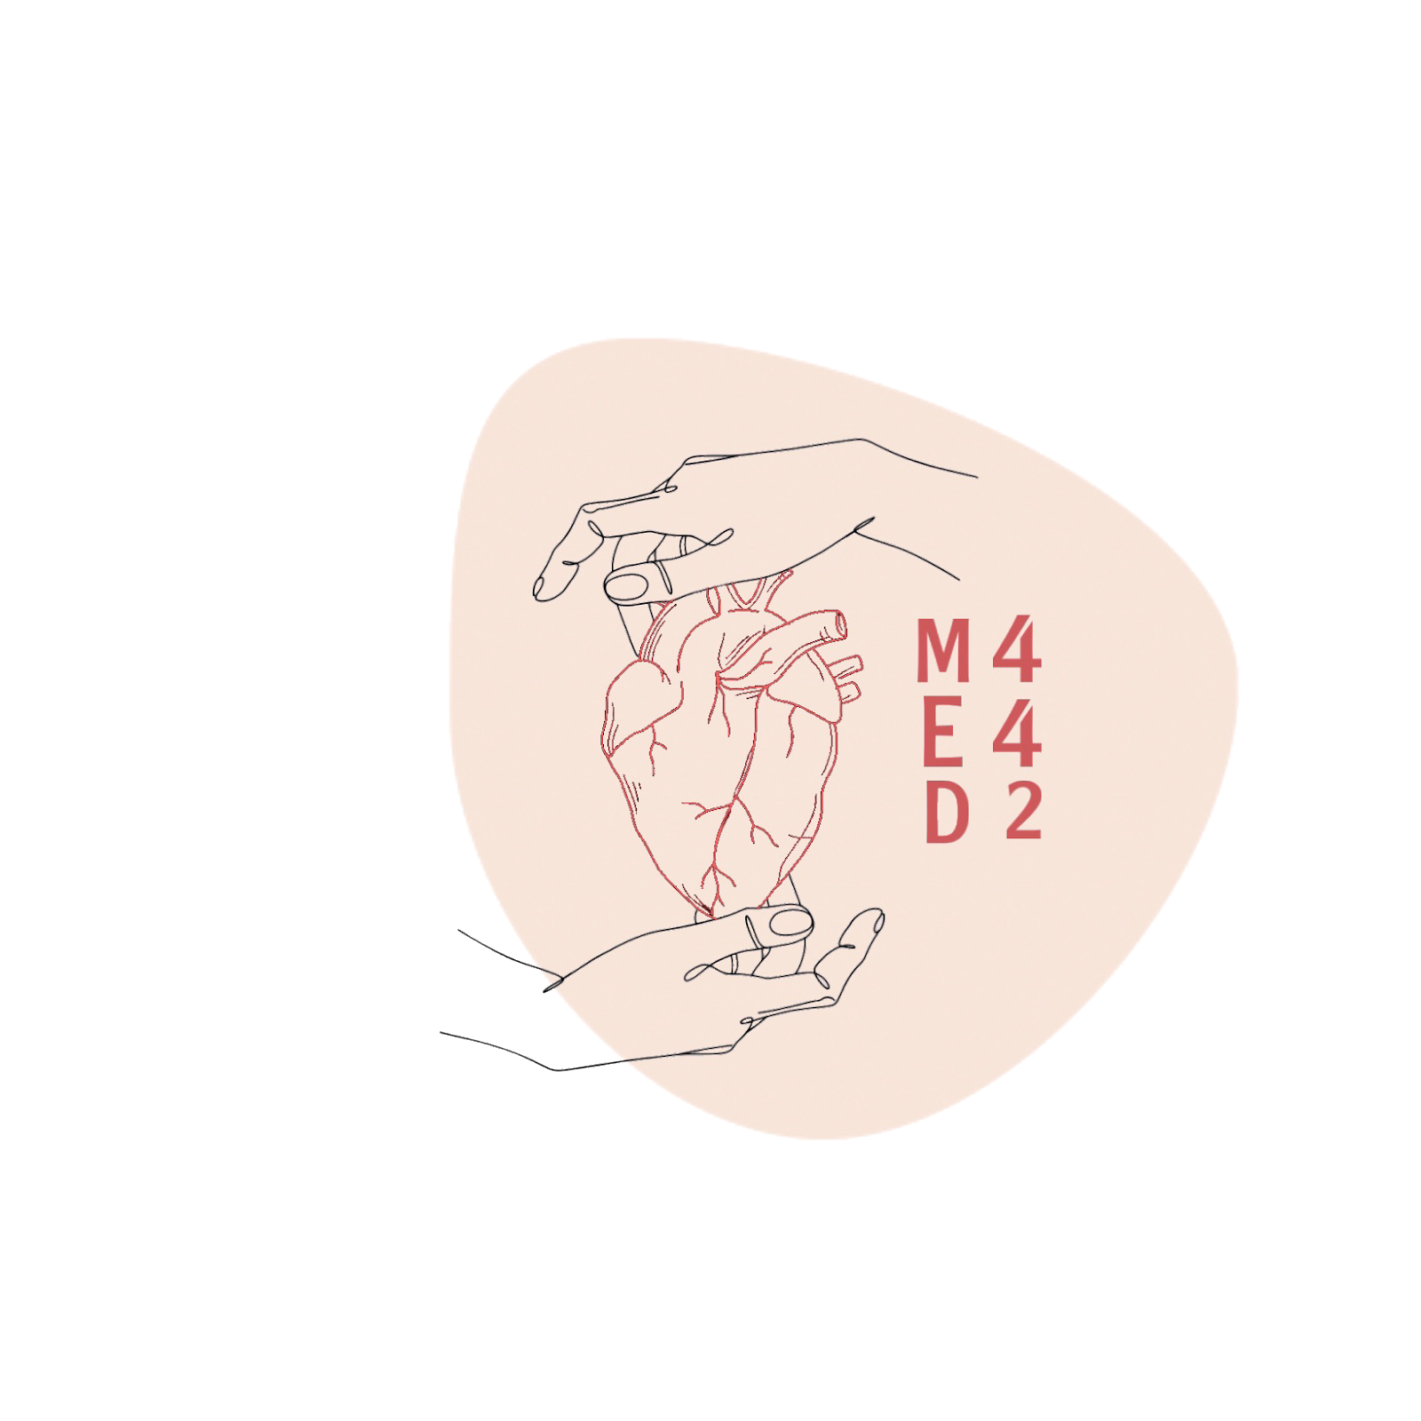
Renal clearance
L3
Renal physiology
Editing File
- Color Index:
Main Text
Male’s Slides
Female’s Slides
Important
Doctor’s Notes
Extra Info

Slide 2
Objectives
Describe the concept of renal plasma clearance
Use the formula for measuring renal clearance
Use clearance principles for inulin, creatinine etc. for determination of GFR
Explain why it is easier for a physician to use creatinine clearance instead of Inulin for the estimation of GFR
Describe glucose and urea clearance
Explain why we use of PAH clearance for measuring renal blood flow
Osmosis | Renal clearance (Nephrology) - YouTube
Dr.nagi
40:56 - 1:29:07

Slide 3
1
Concept of clearance
Definition:
Clearance is the volume of plasma that is completely cleared of a substance each minute. It gives an indication of kidney function
Equation:
Renal clearance of substance X (ml/min)
Cx =
(Ux * V)
Execration rate of substance X:
Ux: concentration of x in urine
V: urine flow rate (ml/min)
Px
Plasma concentration of x (mg/ml)
Example:
Renal clearance of Substance X is defined as the ratio of excretion rate of substance X to its concentration in the plasma:
CX = (UX X V)/ PX
Importance
Provides a way of quantifying excretory function of the kidneys.
GFR
Rate of blood flow
Severity of renal damage
Tubular reabsorption
Tubular secretion
Clearance tests
Females’ slides only
Endogenous
Exogenous
Urea
Uric acid
Para-amino hippuric acid (PAHA)
Inulin
Creatinine
Diodrast (di-iodo pyridone acetic acid)

Slide 4
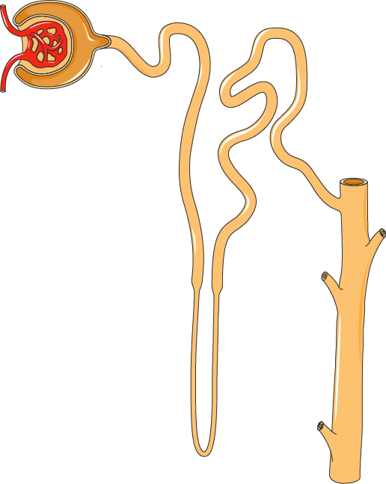
2
Nephron Excretion and Clearance
Extra
Extra:
Arterial/True Renal Plasma Flow(ARPF)/(TRPF):
The amount of plasma that Enters the kidney.
(Which is 700ml/min).
But 10% of it will go to other non functioning structures like the capsule, so the actual Effective Renal Plasma Flow (ERPF) = 625ml/min which we will substitute to this rectangle that holds
1/5 =125
Filtrated
4/5=500
Stayed in blood

Slide 5
3
Clearance method
Ux . V = GFR . Px ± Tx
Tubular activity:
- absorption
+secretion
Excretion rate
amount excreted per minute =
Ux . V
Filtered load
amount filtered per minute =
GFR . Px
amount excreted = filtered – reabsorbed + secreted
Criteria of a substance used for GFR measurement:
Amount filtered per minute = amount excreted per minute
1
Freely filtered
2
not secreted by tubular cells
3
should not be metabolized
4
should not be toxic
5
not reabsorbed by tubular cells
6
Easily measurable
Creatinine
(endogenous)
practical
Examples:
Inulin
(exogenous)
Ideal
It is a byproduct of skeletal muscle metabolism and is cleared almost entirely by glomerular filtration. It is a test of renal function to estimate GFR
It is a polysaccharide, is found in the roots of certain plants and must be administered intravenously to a patient to measure GFR with a molecular weight of about 5200 and it fits all the above requirements.

Slide 6
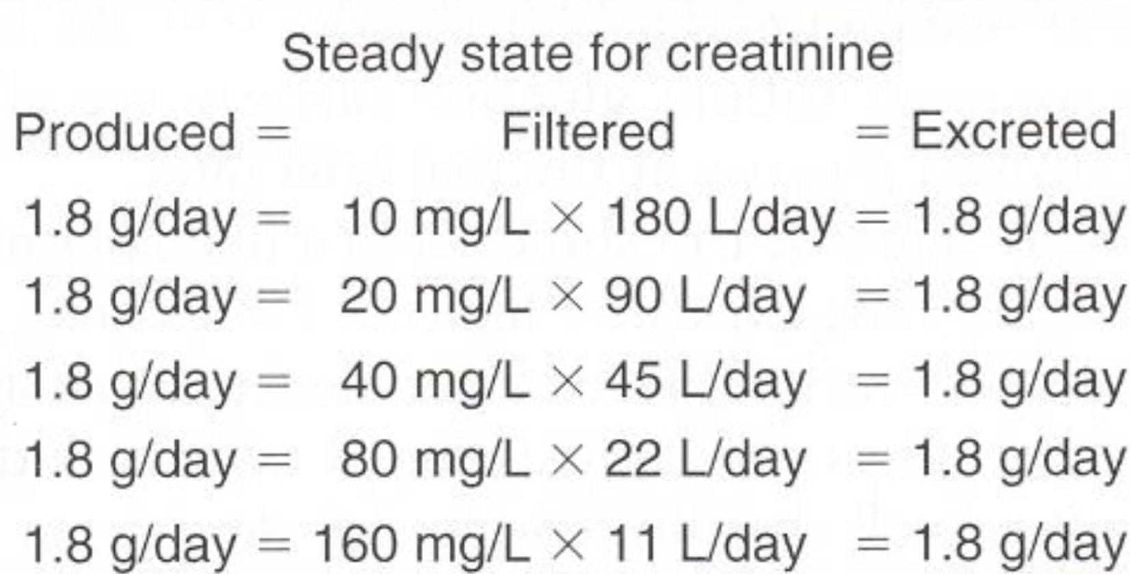
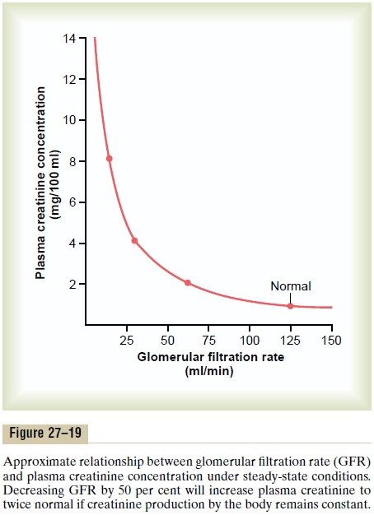
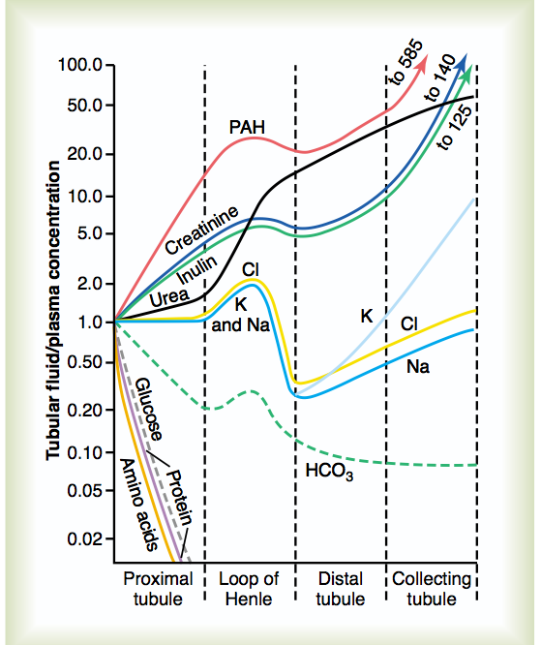
4
Processes of GF, Reabsorption and Secretion
Males’ Slides
Substances | Amount Filtered | Amount Reabsorbed | Amount Excreted | % Filtered Load Reabsorbed
Glucose | 180 | 180 | 0 | 100
Bicarbonate | 4,320 | 4,318 | 2 | >99.9
Sodium | 25,560 | 25,410 | 150 | 99.4
Chloride | 19,440 | 19,260 | 180 | 99.1
Potassium | 756 | 664 | 92 | 87.8
Urea | 46.8 | 23.4 | 23.4 | 50
Creatinine | 1.8 | 0 | 1.8 | 0
Changes in average concentrations of different substances at different points in the tubular system relative to the concentration of that substance in the plasma and glomerular filtrate.
A value of 1.0 indicates that the concentration of the substance in the tubular fluid is the same as the concentration in the plasma.

Slide 7
5
Renal blood flow (RBF)
Substance used for measurement of GFR are not suitable for the measurement of Renal Blood Flow. Why ?
Because Inulin clearance only reflects the volume of plasma that is filtered and not that remains unfiltered (RBF) and yet passes through the kidney.
It is known that only ⅕ of the plasma that enters the kidneys gets filtered. Therefore other substances to be used with special criteria
Example of such substance is Para-aminohippuric acid (PAH) 90% of plasma flowing through the kidney is completely cleared of PAH
To measure renal blood flow we will have to measure renal plasma flow first and then the hematocrit value we calculate the actual blood flow
Criteria of a substance used for renal plasma flow measurement:
1
Freely filtered
2
Rapidly secreted by tubular cells
3
Easily measurable
4
should not be toxic
5
not reabsorbed by tubular cells

Slide 8
6
After a substance is freely filtered, there are 4 possibilities:
Inulin
Urea
Glucose
PAH
Neither reabsorbed
Nor secreted
Partially reabsorbed
but not secreted
All is reabsorbed
but not secreted
Not reabsorbed
but it is secreted
How much we see in urine | Clearance ml/min | Renal mechanism | Example
 | 125 | Neither reabsorbed nor secreted | inulin
 | Less than 125 | Partially reabsorbed | K+ Urea
 | 0 | Completely reabsorbed | glucose Amino acids
 | More than 125 | Partially secrested | Creatinine
 | 90% of plasma flowing is cleared | Completely secreted | PAH Diodrast
 | More than 625 | Formed and secreted | NH3

Slide 9
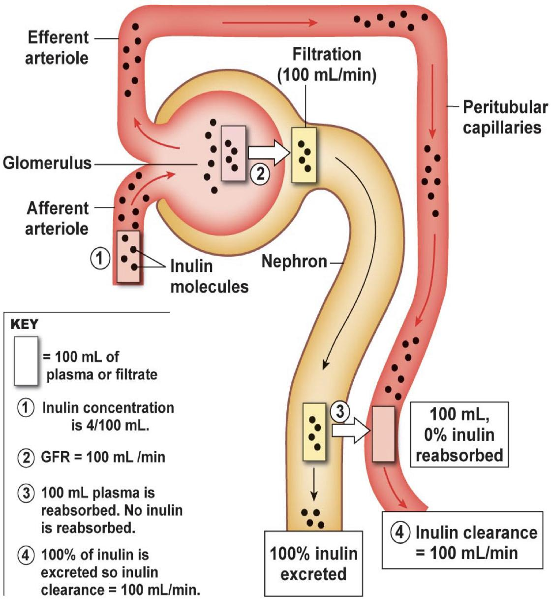
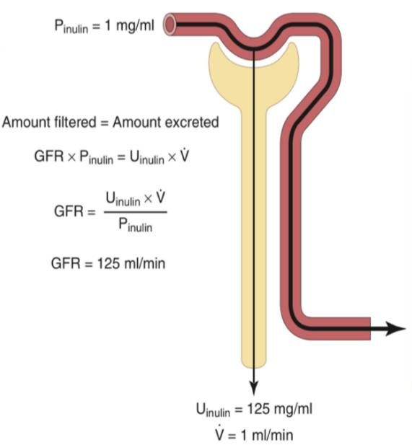
7
Table from males’ slides:
Substances | Clearance rate ml/min
Glucose | 0
Sodium | 0.9
Chloride | 1.3
Potassium | 12
Phosphate | 25
Inulin | 125
Creatinine | 140
Inulin clearance
A plant product that is filtered but not absorbed or secreted Used to determine GFR and therefore nephron function.
Inulin is not produced in the body. Thus must be administered intravenously to measure GFR.
if Plasma conc. of inulin = 1mg/100ml
● Urinary conc of Inulin = 125/120 mg/100ml
● Urine flow (UV) = 1 ml /min
then, the clearance of inulin will be?
Calculation:
Amount filtered per minute = Amount excreted per minute
= (125/120) x 1
1
C = (125 or 120) ml/min = GFR

Slide 10
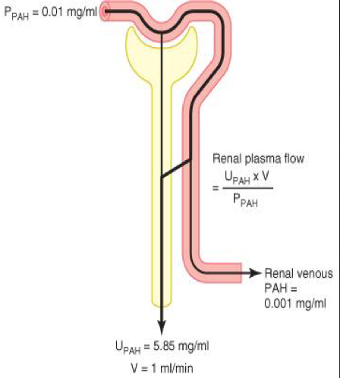
8
Example from males’ slides
Can you correlate it to renal plasma flow?
Clearance (CPAH) = urine conc. (UPAH) x volume of urine (V)
plasma conc. (PPAH)
= 5.85 x 1 / 0.01
= 585 = Effective renal plasma flow (ERPF)
Actual renal plasma flow (ARPF) = Effective renal plasma flow (ERPF)
Extraction ratio (EPAH)
= 585/0.9
= 650 ml/min
UPAH x V
ERPF
EPAH =
PPAH - VPAH
CPAH =
PPAH
ARPF =
EPAH
PPAH
Extraction ratio (EPAH) is calculated as:
the difference between the renal arterial PAH (PPAH) and renal venous PAH (VPAH) concentrations, divided by the renal arterial PAH concentration
Can you calculate renal blood flow now?
650 / 1 – 0.45 = 1182 ml/min
Renal blood flow (RBF) =
RPF
(1 - hematocrit)

Slide 11
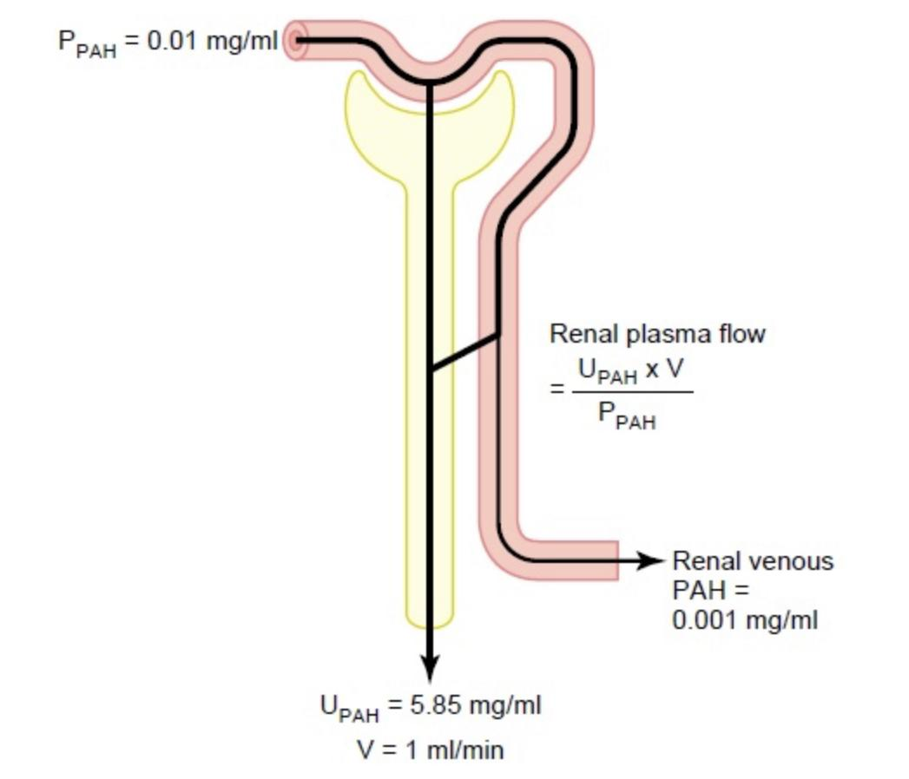
9
.
Use of PAH Clearance to Estimate Renal Plasma Flow then using it get RBF:
Para Aminohippuric acid (PAH): freely filtered and secreted and is almost completely cleared from the renal plasma
Females’ slides
1. amount enter kidney =
RPF * PPAH
2. amount entered = amount excreted
3. ERPF*PPAH =UPAH*V
ERPF =
UPAH*V
= Clearance PAH
PPAH
ERPF
ARPF =
PPAH - VPAH
PPAH
Extraction ratio
RBF =
ARPF
(1-Hematocrit%)
RPF= Renal Plasma Flow PPAH= concentration of PAH is measured in one arterial blood plasma ERPF= Effective Renal Plasma Flow UPAH= concentration of PAH is measured in one urine sample ARPF= Arterial renal plasma flow
PAH clearance: example
If the concentration of PAH in the urine and plasma and the urine flow are as follows:
Concentration of PAH in urine = 25.5 mg/min
Urine flow = 1.1 ml/min
Concentration of PAH in the arterial blood = 0.05 mg/ml
Then CPAH or Renal Plasma Flow =
Let’s say the hematocrit is 45%, then renal blood flow will be:
25.5*1.1
= 560 ml/min
0.05*
560x100
= 1018 ml/min
100-45

Slide 12
10
Use of inulin Clearance
Females’ slides only
Clearance can also be used to determine renal handling of a substance.
Clearance values can also be used to determine how the nephron handles a substance filtered into it. In this method the clearance for inulin or creatinine is calculated and then compared with the clearance of the substance being investigated.
1
2
3
Comparison of clearance of a substance with clearance of inulin
= inulin clearance; only filtered not reabsorbed or secreted
< inulin clearance; reabsorbed by nephron tubules
> inulin clearance; secreted by nephron tubules
Calculation of reabsorption or secretion from renal clearance
Excretion rate < filtered rate
Clearance < GFR
Excretion rate > filtered rate
Clearance > GFR
Reabsorption
Secretion
Reabsorption* = (GFR X P*)-(U* X V)
* indicate assessed substance.
Secretion* = (U* X V)- (GFR X P*).
* indicate assessed substance.

Slide 13
11
Question from females’ slides
Q: Given the following information for a freely filterable substance
GFR = 120 mL/min
Plasma concentration = 3 mg/mL
Urine flow rate = 2 mL/min
Urine concentration = 10 mg/mL
we can conclude that:
a) The kidney tubules reabsorbed 340 mg/min
b) The kidney tubules reabsorbed 200 mg/min
c) The kidney tubules secreted 200 mg/min
d) The kidney tubules secreted 340 mg/min
e) Net transport is 0 mg/min
Amount filtered per minute = ( GFR X P* )
= 120 ml/min X 3 mg/ml = 360 mg/min
Amount excreted per minute = ( U* X Urine flow rate )
= 2 ml/min X 10 mg/ml = 20 mg/min
Amount Filtered per minute > Amount excreted per minute
(That means we are calculating the reabsorption)
Amount transported per minute = Filtered – Excreted
= 360 - 20 = 340 mg/min
Answer = a

Slide 14
Quiz
Q1
The maximum clearance rate possible for a substance that is totally cleared from the plasma is equal to which of the following?
GFR
Filtered load of that substance
Urinary excretion rate of that substance
Renal plasma flow
Q2
How do you calculate the rate of excretion by kidneys?
Rate of filtration – Rate of secretion – Rate of reabsorption
Rate of filtration + Rate of secretion – Rate of reabsorption
Rate of filtration + Rate of secretion + Rate of reabsorption
Rate of filtration – Rate of secretion + Rate of reabsorption
Q3
Which substance can be used to most accurately assess the GFR
Inulin
Urea
Glucose
Para-aminohippurate
Q4
What will be the renal clearance if the rate of urinary excretion is 625 ml/min and plasma drug concentration is 4.2 ng/ml?
148.80ml2/ng min
150ml2/ng min
152ml2/ng min
140ml2/ng min

Slide 15
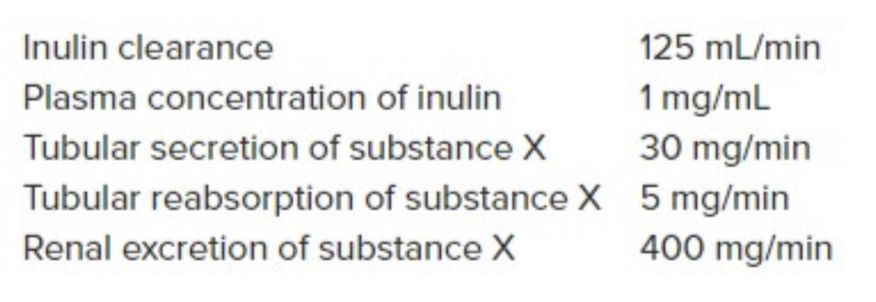
Quiz
Q5
What is the plasma concentration of substance X?
125 ml/min
3 mg/ml
5 gm/ml
25 mg/ml
Q6
Which one of these substances is completely reabsorbed and has zero clearance?
Creatinine
Glucose
Inulin
PAH
Answers: 1-D, 2-B, 3-A, 4-A 5-B, 6-B
A freely filterable substance have:
GFR = 120 mL/min
Plasma concentration = 2.5 mg/mL
Urine flow rate = 3 mL/min
Urine concentration = 13 mg/mL
Find the excretion rate and the filtration rate.
SAQs
Filtration rate= (GFR X P*)
= 120 ml/min X 2.5 mg/ml = 300 mg/min
Excretion rate= (U* X urine flow rate)
= 3 ml/min X 13 mg/ml = 39 mg/min
SAQs
Based on the previous question, choose if it undergone reabsorption or secretion then find its value.
Excretion rate < filtration rate
Then it undergone reabsorption
Reabsorption = filtered - excreted
= 300 mg/min - 39 mg/min = 261 mg/min

Slide 16
Members
Team Leaders
Razan Almohanna
Khalid Alrasheed
Raneem Alwatban
Othman Alabdullah
Team Members
Safia Aldkhyyl
Lana Alhumaidhi
Theme was done by Shatha Almutib
physio442@gmail.com

