Slide 1
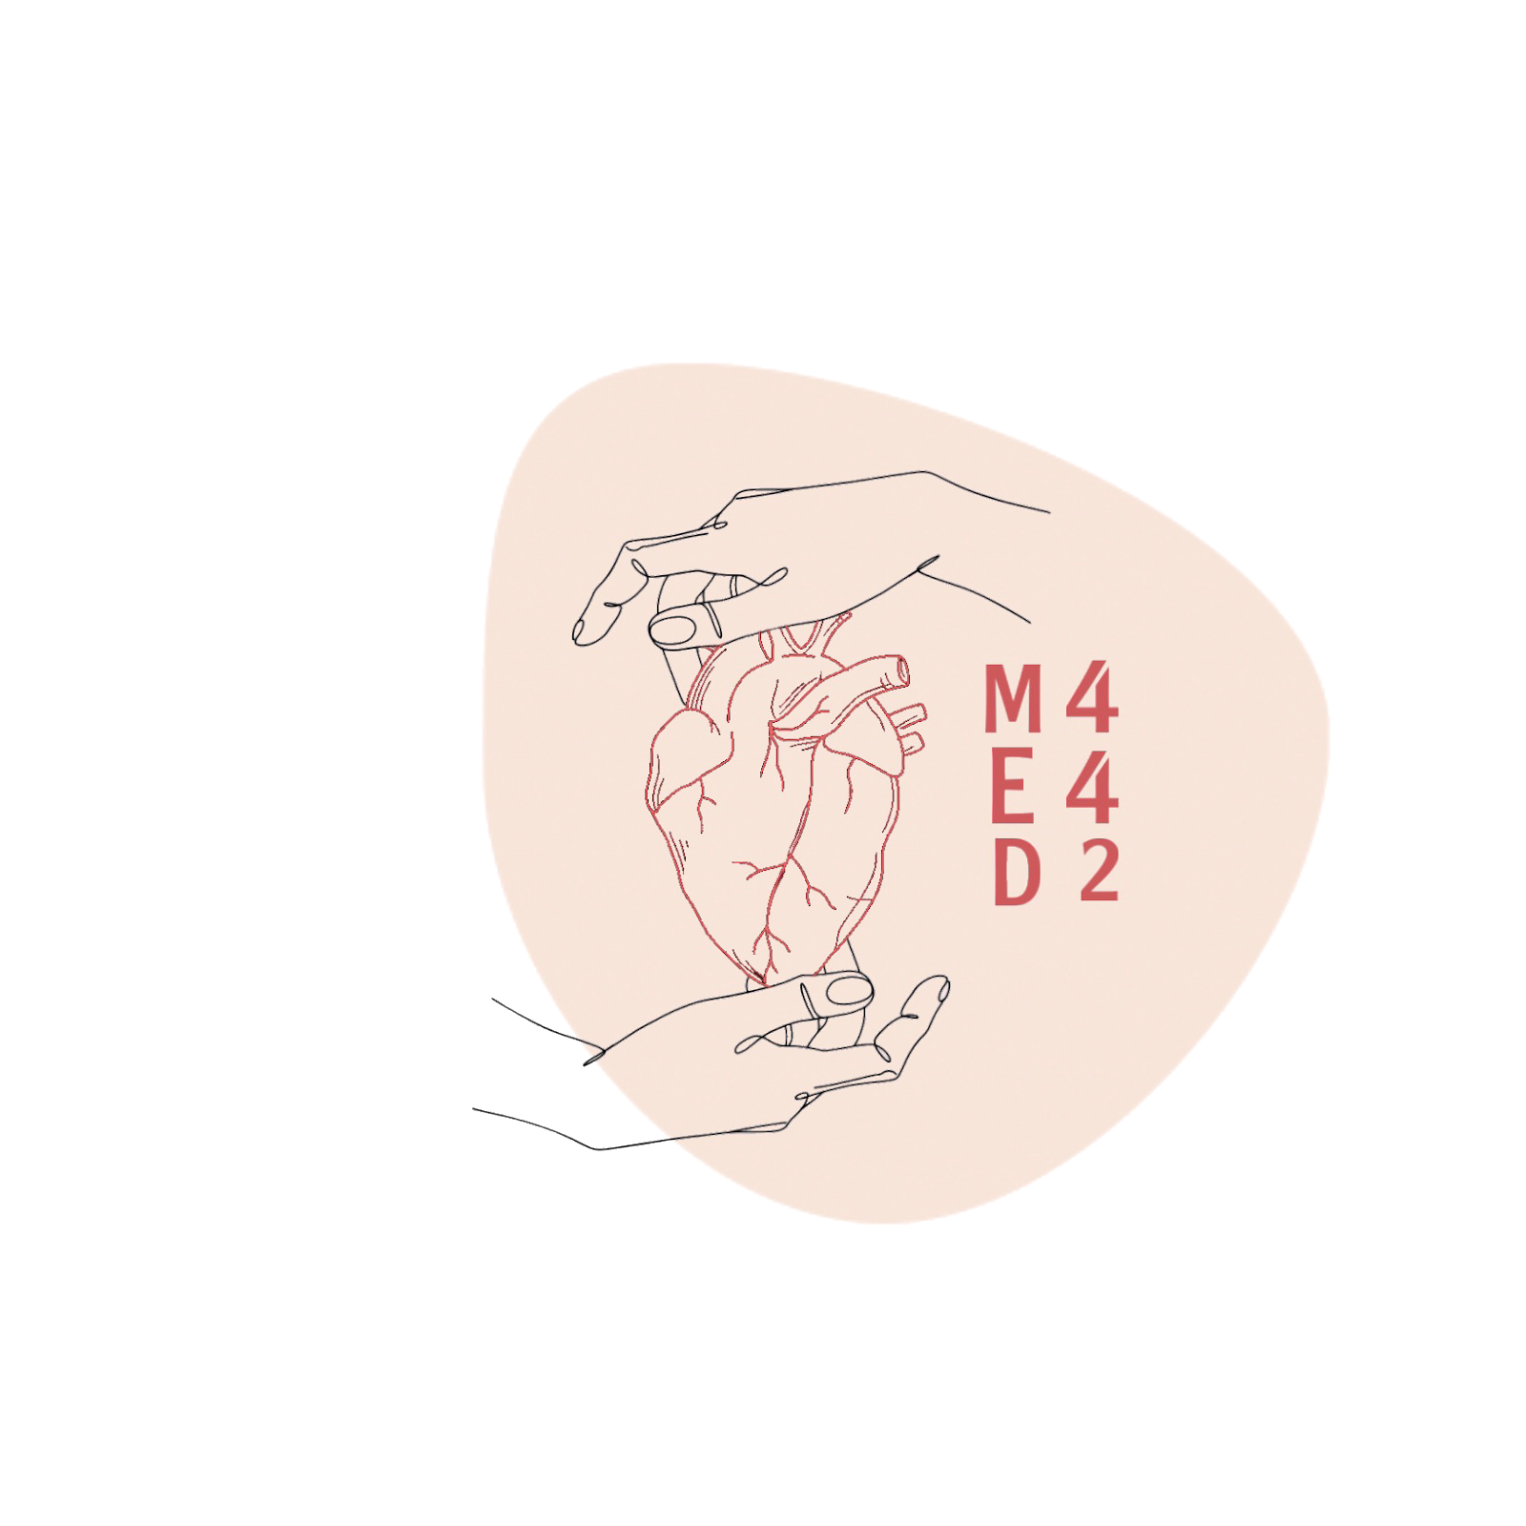
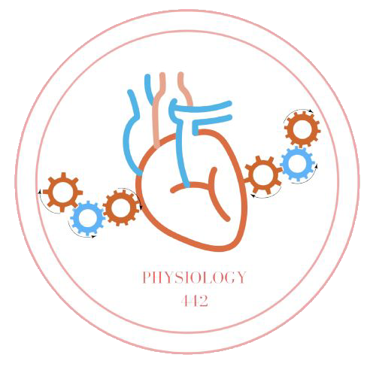
Tubular Reabsorption,Secretion
L4,5
Renal physiology
Editing File
- Color Index:
Main Text
Male’s Slides
Female’s Slides
Important
Doctor’s Notes
Extra Info

Slide 2
Objectives
Absorptive Characteristics of different parts of nephrons
Define tubular reabsorption, tubular secretion, transcellular and paracellular transport.
Identify and describe mechanisms of tubular transport
Describe tubular reabsorption of sodium and water
Revise tubulo-glomerular feedback and describe its physiological importance
Identify and describe mechanism involved in Glucose reabsorption
Study glucose titration curve in terms of renal threshold,
tubular transport maximum, splay, excretion and filtration
Identify the tubular site and describe how Amino Acids, HCO3 - , P04 - and Urea are reabsorbed
K + Regulation

Slide 3
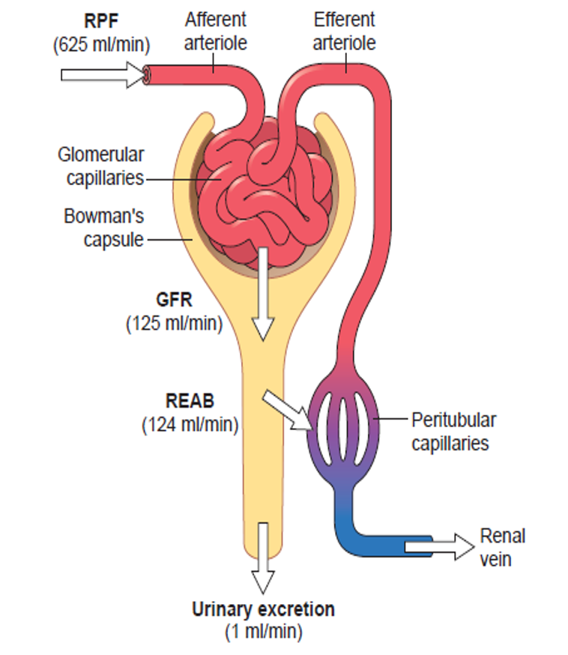
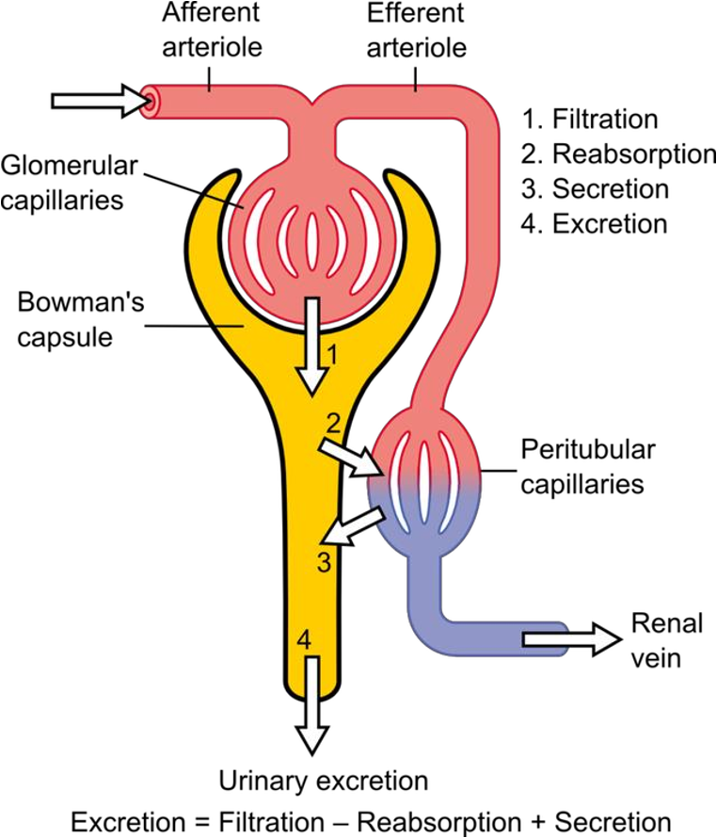
Team 439
Introduction
• The renal processes can be summarized in 4 steps:
1-filtration
2-reabsorption
3-Secretion
4-excretion
Urinary Excretion Rate = Filtration Rate – Reabsorption Rate + Secretion Rate
What did we discuss earlier ?
First step of urine formation; the filtrate is reached bowman’s capsule
(Glomerular filtration) and now it will travel along the nephron as traveling along the nephron it will not be excreted in the urine the way it was filtered this is IMPOSSIBLE!
What are we going to discuss in this lecture ?
It will undergo processing called Tubular Processing; the tubule of the nephron will change the filtrate How? -it will return the important substance into the blood. this is called Reabsorption. -it will secrete the non important or waste products that stays in the blood, even further the filtrate. this is called secretion
The kidney filters around 180L/day of protein & cell-free filtrate by the glomerulus.
• Neverthless, humans normally excrete around 0.5-1.5L of
Urine daily
• What happened to the remaining 178.5L of filtered Fluid?
It will be reabsorbed

Slide 4
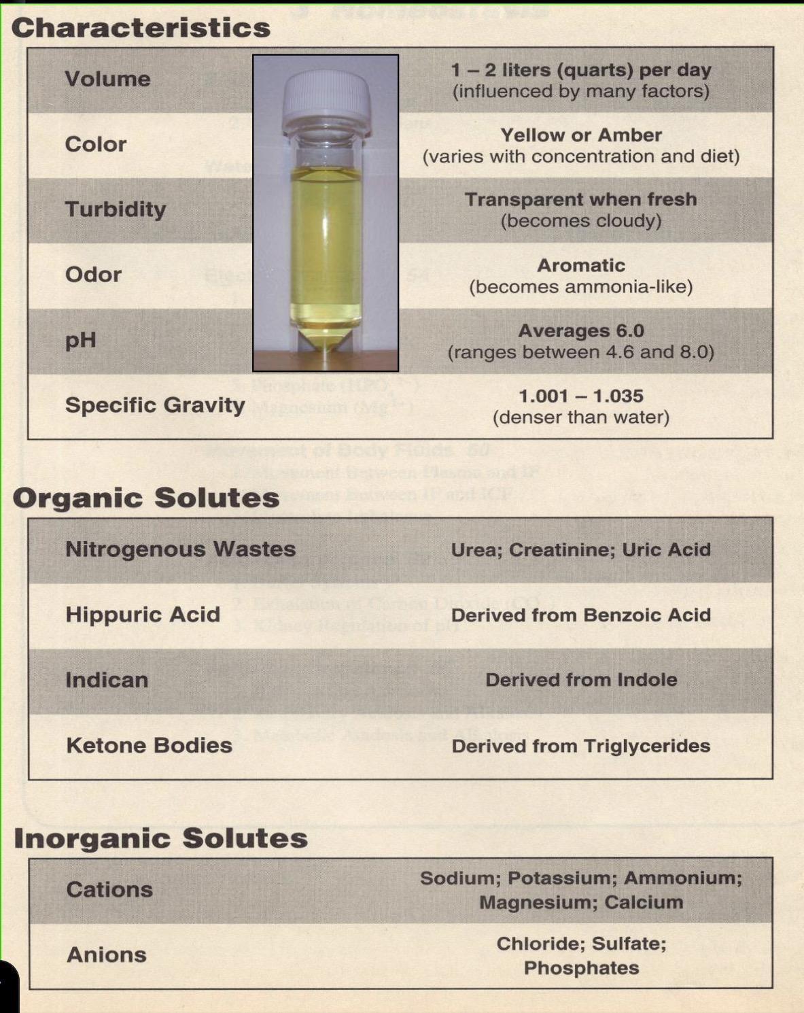
Female’s slides
Important points
Osmolality : Volume of particles per kg of solvent (moles of solute/kg of solvent)
So in renal physiology : Urine osmolality is used to measure the number of dissolved particles [solutes (i.e. ions, electrolytes)] per unit of water in the urine.
What changes osmolality in filtrate and then resulting urine? Glomerular filtration + tubular processing (i.e. reabsorption and secretion)
osmolality of the glomerular filtrate upon / glomerular filtration = 300mOsm/L
What about the osmolality in the different parts of the nephron?
How does it change and what substances move across and how?
-That’s what we are going to focus on in this lecture how the reabsorption and secretion is going to affect the osmolarity in the different parts of the Nephron
Urine composition
Boys
Urine composition
PH | freshly voided urine is usually acidic (around pH 6), range=4.8 and 7.5
color | Bright Yellow & transparent
volume | 1-2 L per day
albumin | 20 μg of albumin per minute (<30 mg in 24 hours)
Glucose | none

Slide 5
Male’s slides
introduction
Dr’s explain
This diagram is explaining the pathway for different substances
Inulin will be freely filtered and 100% will be excreted
Urea will be filtered and some of it will be reabsorbed
Glucose will be filtered and 100% will be reabsorbed
Para-aminohippurate (PAH) will be filtered and 100% secreted
Processes of GF, Reabsorption,secretion
Substances | Amount Filtered | Amount Reabsorbed | Amount excreted | % filtered load reabsorbed
Glucose | 180 | 180 | 0 | 100
Bicarbonate | 4,320 | 4,318 | 2 | >99.9
sodium | 25,560 | 25,410 | 150 | 99.4
Chloride | 19,440 | 19,260 | 180 | 99.1
potassium | 756 | 23.4 | 23.4 | 50
urea | 46.8 | 23.4 | 23.4 | 50
creatinine | 1.8 | 0 | 1.8 | 0

Slide 6
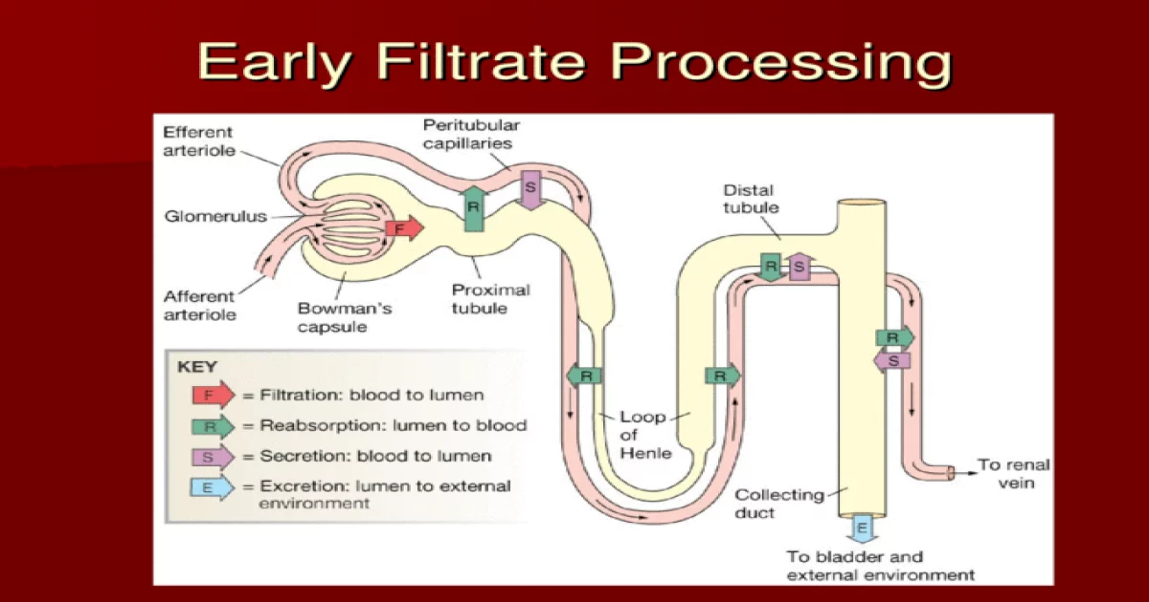
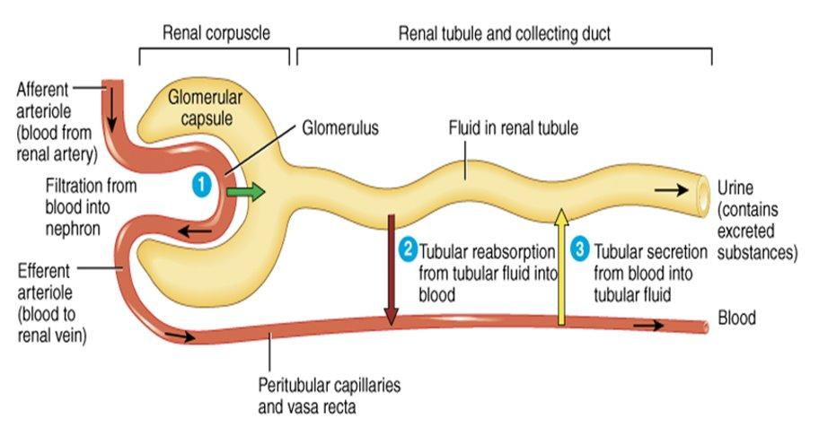
Femael’s slides
Tubular processing of ultrafiltrate
The ultrafiltrate gets modified as it passes through the nephron tubules until excretion(ultrafiltration occurs at the barrier between the blood and the filtrate in the glomerular capsule in the kidneys)
Definitions:
1
Tubular reabsorption
-Reabsorption of substances from the glomerular filtrate to the peritubular capillaries e.g ( H+, Creatinine, K+, Ammonium ions, Urea, Drugs & hormones ) to return essential ions and water to blood.
-Glomerular filtration is nonselective process while tubular processing is highly selective
2
Tubular secretion
secretion of substances from the peritubular capillary blood to the tubular fluid. E.g ( water, Solutes ) to clean the blood
3
Excretion
removal of water and solutes from body in urine

Slide 7
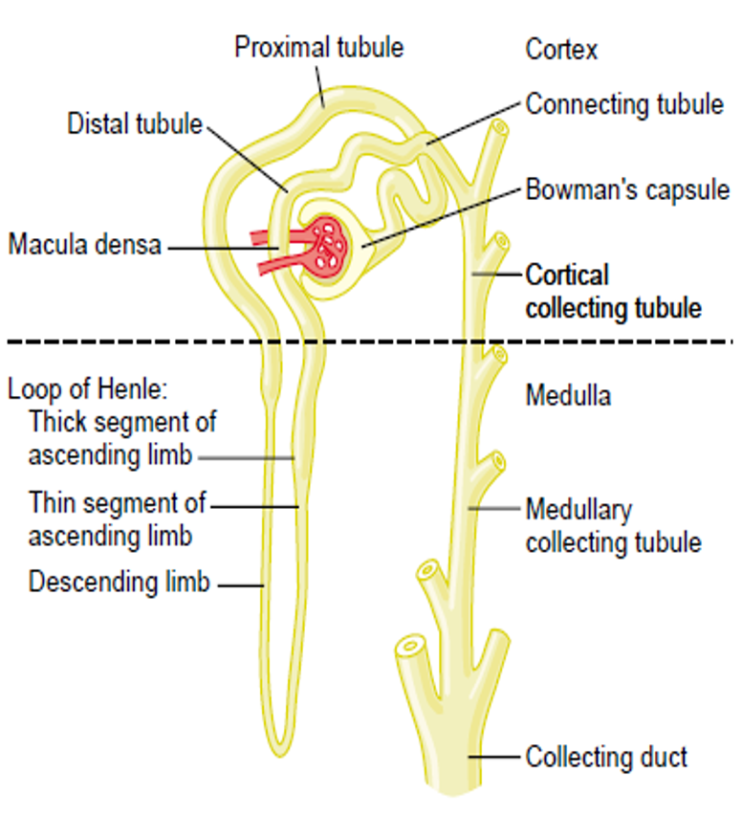
CLASSIFICATION OF TRANSPORT MECHANISMS
Simple diffusion
Facilitated diffusion
Primary active transport
Secondary active transport
Pinocytosis
Bulk flow
PRIMARY ACTIVE TRANSPORTERS
Sodium-potassium ATPpase
Hydrogen ATPpase
Hydrogen-potassium ATPpase
Calcium ATPpase.
Male;s slides
PARTS OF NEPHRON
Proximal Convoluted Tubule
Loop of Henle
Distal Convoluted Tubule
(Early & Late)
Collecting Tubule
Collecting Duct

Slide 8
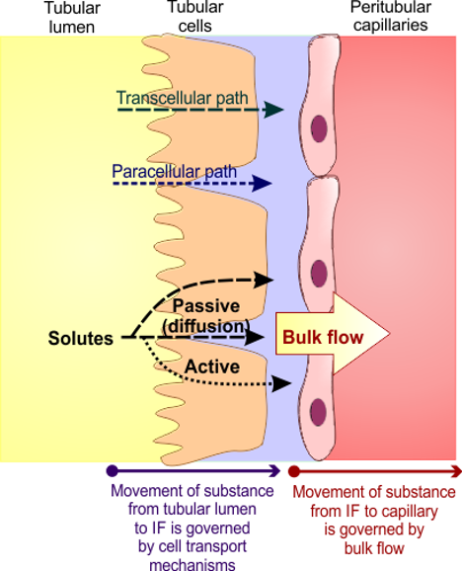
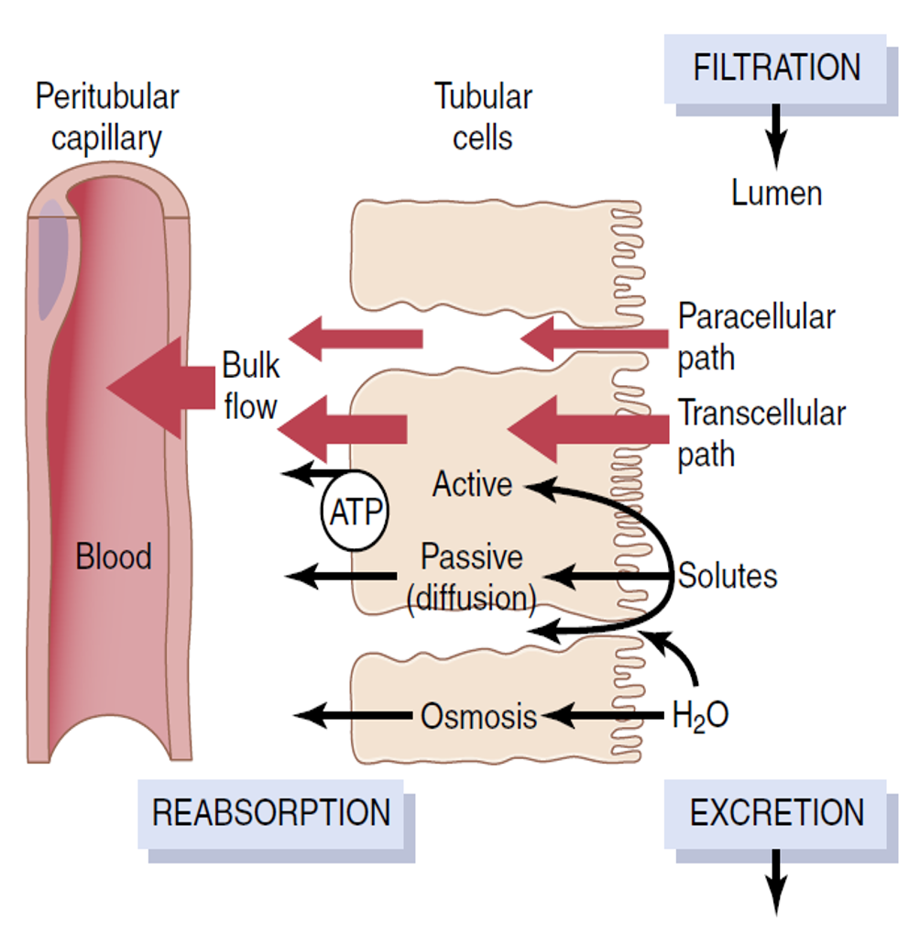
Nephron reabsorption
Reabsorption is a 2 step processes:
1- transport from From tubular lumen to interstitial fluid (IF)
2-Transport substances from IF to the peritubular capillaries(capillary blood)
Transport involve Active and passive process (can be transcellular and/or paracellular routes:
Transcellular transport: substances travel through the cell, passing through both the apical membrane and basolateral membrane
Paracellular transport: the transfer of substances across an epithelium by passing through the intercellular space (tight junctions) between the cells
By ultrafiltration
(Bulk Flow)
After absorption across the tubular epithelial cells into the interstitial fluid, water and solutes are transported the rest of the way through the peritubular capillary
walls into the blood by
ULTRAFILTRATION (BULK FLOW) that is mediated by
hydrostatic and colloid osmotic forces.
Active transport
Passive transport
-requires energy
-Substances move against their chemical gradient
-requires no energy
-Substances move down their chemical gradient
Primary active
Directly coupled to energy
E.g Na+K+ atpase
Passive diffusion:
Osmosis. E.g
( water and solutes like Cl- and urea )
Secondary active indirect energy source carrier protein
E.g Glucose & Amino acid

Slide 9
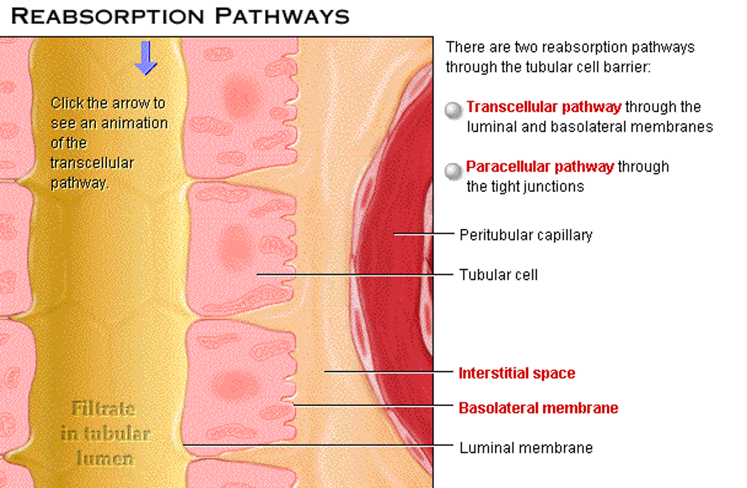
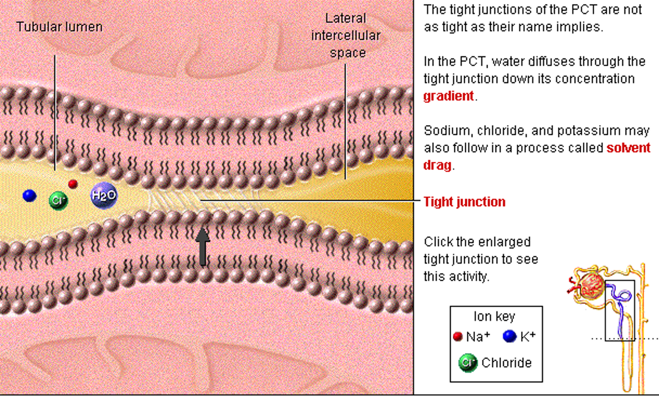
REABSORPTION PATHWAYS
Male’s slides
Obligatory 80 %
Hormonally Regulated 20 %
Meaning that 80% of water reabsorption is obligatory absorbed meanwhile 20% is hormonally absorbed by ADH
PCT PARACELLULAR PATHWAY
PCT : Proximal Convoluted Tubule

Slide 10
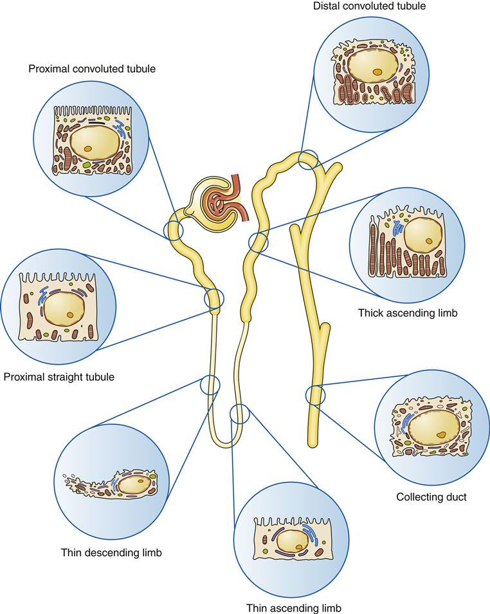
REABSORPTION OF WATER IN DIFFERENT SEGMENTS OF TUBULES
Male’s slides
PART OF NEPHRON | PERCENTAGE REABSORBED
Proximal tubules | 65
Loop of Henle | 15
Distal tubules | 10
Collecting ducts | 9.3
Passing into urine | 0.7
PART OF NEPHRON | AMOUNT REABSORBED
Glomerular Filtrate | 125
Flowing into the loops of Henle | 45
Flowing into the distal tubules | 25
Flowing into the collecting tubules | 12
Flowing into the urine | 1
The histological structure of each part of the nephron is designed to fit its function

Slide 11
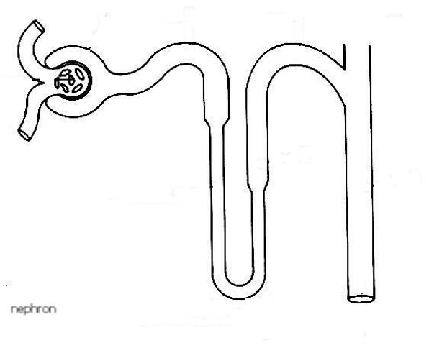
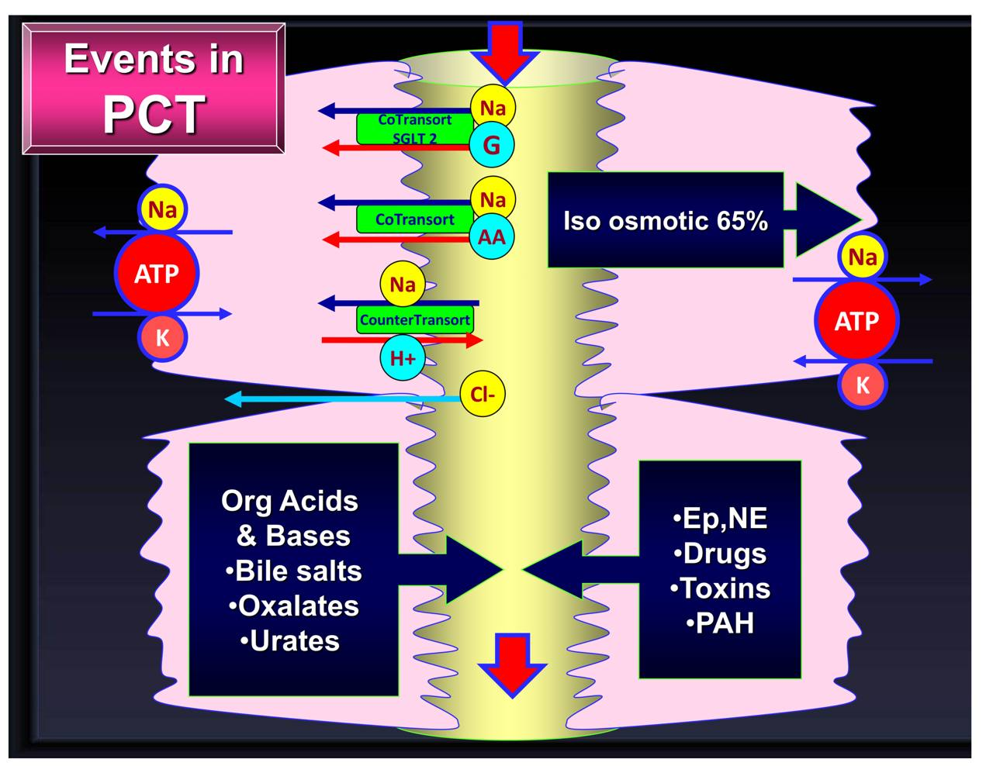
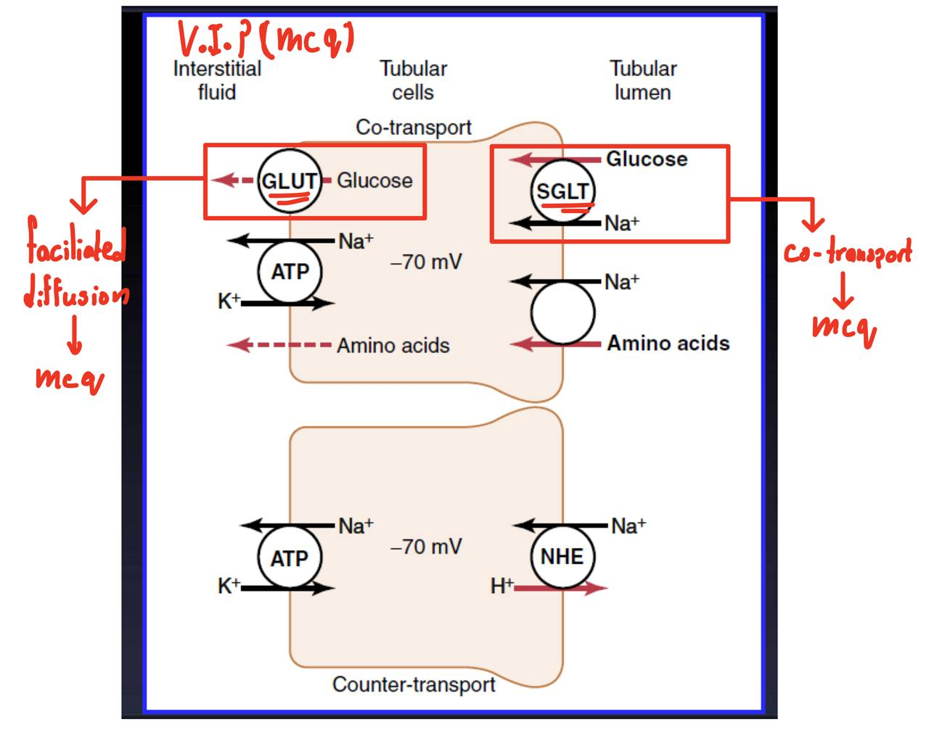
1:Filtrate processing in PCT
Most reabsorption occurs in PCT Because :
Glucose and Amino acids (aa) 100%
Water and Na+ 65%
reabsorption
Highly metabolic cells
Extensive brush border
Multiple the surface area 20 folds
Lots of mitochondria
Tight junction
Lateral intercellular space
Secretion
Bile salts
Urea
Toxins
PAH
Catecholamines
drugs

Slide 12
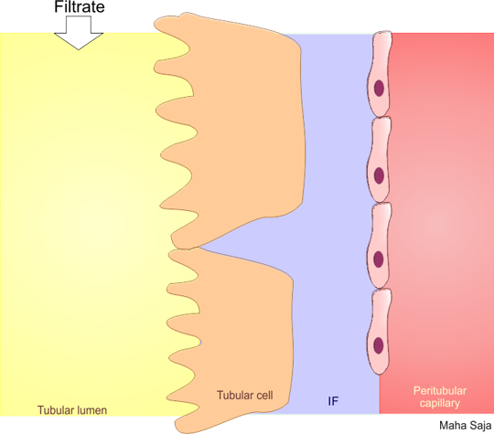
A-Na+ reabsorption in PCT
Basolateral Na+-K+ ATPase pumps 3Na+ out and 2 K+ inside the cell
Na+
Na+
Na+
3 Na+
ATPase
Na+
Na+
Na+
2 K+
Na+
Na+
Decrease Na+ concentration inside the cell
Na+
Na+
Na+
HCO3-
NBC
Na+
paracellular
This gradient favors passive entry of Na+ into the tubular cell across the apical membrane via transporter protein
transcellular
Different types of transporter proteins:
co transporter (same direction as Na+ movement)
Exchangers (opposite direction of Na+ movement
As 65-70% of Na+ reabsorbed in PCT, H2O is obligated to follow (osmosis) (65-70% of H2O+ reabsorbed in PCT)..this is called obligatory water reabsorption

Slide 13
B-Glucose reabsorption in pct
Basolateral Na+-K+ ATPase pumps 3Na+ out and 2 K+ inside the cell
Na+
Na+
3 Na+
Na+
SGLT
ATPase
Gluc
Gluc
2 K+
Na+
Gluc
Gluc
Decrease Na+ concentration inside the cell
Na+
Na+
GLUT
Gluc
This gradient favors passive entry of Na+ into the tubular cell across the apical membrane via SGLT carrying Glucose with it
transcellular
Amino acids (also lactate, phosphate) are reabsorbed the same way as glucose
But each have their own cotransporter specific for them. High selectivity and specificity int in this process.
Amazing explanation from 439 !
Large amounts (65% of filtered load) of Na+ through the glomeruli.
• Na+ is reabsorbed out of all portions of the tubule except the thin descending limb of loop of Henle.
• 96 - 99% of filtered Na+ is reabsorbed.
• 90% of the Kidney energy consumption is due to active Na+ transport which depends on (Na+/K+ pump).
Na+ can be transported in two pathways:
1. Paracellular (Passive movement).
2. Transcellular Path:
by Na-K pump (primary active transport) —> 3Na go out and 2Ka go in So,
conc. of K+ inside the cell will be High.
conc. of Na+ inside the cell will be Low.
But conc. of Na+ in the filtrate will be higher than in the tubular cell Why? because as we learned the amount of filtration of substances in filtrate is almost Equal its conc. in the plasma which is Na=140.
Therefore, Gradient of Na will favor what? Reabsorption (from high to low).
and because of the charge of Na+ it can’t pass plasma membrane so it needs a channel or carrier called Glucose cotransporter (will talk about it in the next slide) to be reabsorbed from lumen into the cell Down its conc. Gradient.
Once Na+ come inside the cell its pumped out by (Na+/K+ ATPase) into the interstitial fluid or by another transporter. Once it reaches interstitial fluid it will go to the blood by Bulk flow. There are many types of transporter proteins: -Co-transporters. (Both substances are moving in the same direction) -Exchangers (counter transporters). (Both substances are moving in opposite direction) Although it is an active transport, it has no tubular maximum. Because the rate of its pumping outside at the basolateral border is greater than the rate of diffusion at luminal border

Slide 14
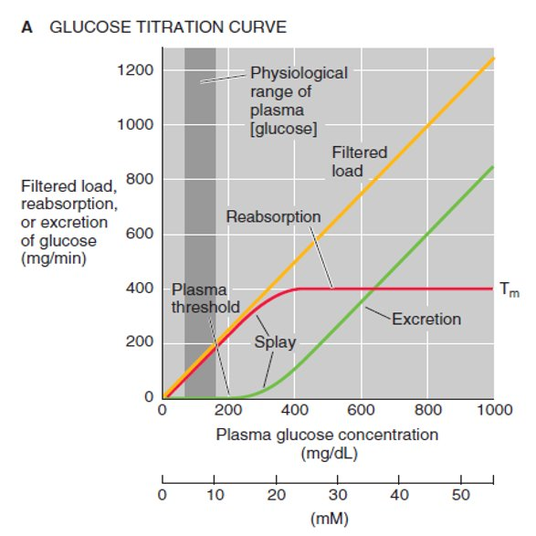
B-Glucose reabsorption
Male’s sldies
1-Normal plasma glucose:
Glucose at normal plasma level(range 60-120 mg/dl) is completely reabsorbed in proximal convoluted tubule(pct) by Na+/glucose cotransport.
2-Renal threshold for glucose +Tmax:
The plasma level of glucose at which it starts to appear in urine is termed the RENAL THRESHOLD FOR GLUCOSE(Renal Threshold for Glucose: 200mg/dl)
The Maximum limit/rate at which a solute can be transported across the tubular cells of kidneys is called TUBULAR TRANSPORT MAXIMUM
(Tmax for Glucose is 375 mg/min)
3-Splay phenomenon-Tmax:
Splay phenomenon-Tmax for glucose is reached gradually rather than sharply due to the heterogeneity of nephrons(ie,different Tmax points );represented by the portion of the titration curve between threshold and Tmax
mcq
why?

Slide 15
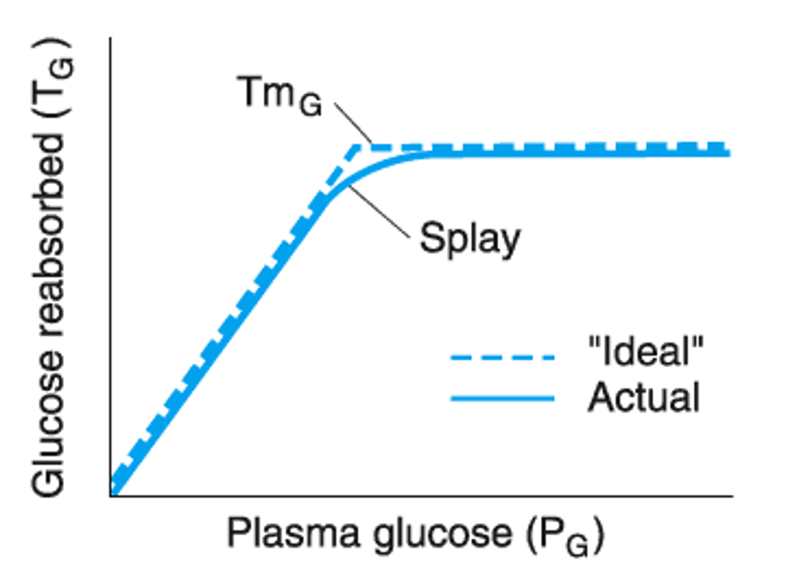
B-Glucose reabsorption
Male’s slides
4-TUBULAR TRANSPORT MAXIMUM FOR REABSORPTION OF DIFFERENT SUBSTANCES
Substance | Tmax ( Transport Maximum )
glucose | 375 mg/min
Phosphate | 0.1 mM/min
sulphate | 0.06 mM/min
Amino acid | 1.5 mM/min
Urate | 15 mg/min
Plasma protein | 30 mg/min
Hemoglobin | 1 mg/min
Lactate | 75 mg/min
Acetoacetate | Variable
craetinine | 16 mg/min
Para-aminohippuric acid | 80 mg/min
The “ideal” curve shown in this diagram would be obtained if the Tmax for
glucose (TmG) in all the tubules was identical and if all the glucose were
removed from each tubule when the amount filtered was below the TmG
Amazing explanation from 439 !
Reabsorption of Glucose is Against its gradient so it requires energy to move, from where it will get the energy?
from the gradient of Na+ that was created by (Na+/K+ ATPase).
The movement of Na+ down its gradient into the cell it will carry Glucose with it by using special carrier protein called (Sodium Glucose Transporter SGLT) this carrier will move Na+ down its conc. gradient and glucose against its concentration gradient at the same time by using ATP from (Na+/K+ ATPase pump) once Glucose reaches into the cell —> it will pass by facilitating diffusion into the interstitial fluid then from IF into the blood.
Amino acids and other substances are absorbed in a similar way using transporters specific for the substrate being transported.
-Normally all filtered glucose is reabsorbed at the early portion of PCT.
-At luminal border: Common carrier with Na+, SGLT2 Can be blocked by
1.Oubain which blocks Na+ -K+ ATPase.
2.Phlorhizin which competes for the carrier
. -At basolateral border: Glucose is carried by facilitated diffusion down chemical gradient by carrier GLUT2.

Slide 16
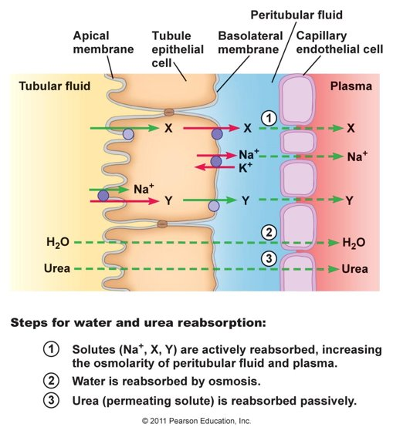
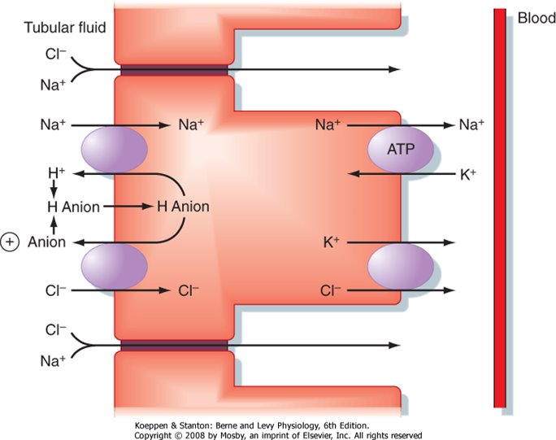
C-Water reabsorption in PCT
Female’s slides
Water is reabsorbed via:
-transcellular route
-paracellular route
Transcellular transport of water is facilitated by water channels aquaporins (AQP1)
D-Na+ Cl- reabsorption in 2nd half of PCT
Team 439
Cl− Reabsorption can be:
1) Intracellularly: Cl−-formate− anion exchanger, which is driven by the high tubular fluid Cl− concentration. The combined function of the two exchangers is to transport
NaCl from the lumen into the cell. Na+ then is extruded into blood by (Na+-K+ ATPase), and Cl− moves into blood by diffusion.
2)Paracellularly: The paracellular component also depends on the high tubular fluid Cl− concentration. The tight junctions between cells of the proximal tubule are, in fact,
not tight: They are quite permeable to small solutes, such as NaCl, and to water. Thus, the Cl− concentration gradient drives Cl− diffusion between the cells, from lumen to
blood. This Cl− diffusion establishes a Cl− diffusion potential, making the lumen positive with respect to blood. Na+ reabsorption follows, driven by the lumen-positive
potential difference. Like the cellular route, the net result of the paracellular route is reabsorption of NaCl.

Slide 17
Female's slides
E-HCO3- reabsorption
in PCT
CO2 in blood diffuses via the basolateral membrane inside the epithelial cells
Na+
Na+
3 Na+
+
HCO3-
H+
NHE3
ATPase
Na+
Na+
2 K+
Na+
CA
H+
About 90%
it combines with H2O present inside the cell. It will form H2CO3 via CA. This reaction is weak so H2CO3 dissociates to H+ and HCO3-. HCO3- will be pushed to the blood via the basolateral membrane
Na+
H2CO3
HCO3-
HCO3-
CO2
H2CO3
+
H2O
CA
diffusion
CO2
+
CO2
H2O
NA+/K+ causes Na+ conc to fall inside cell so Na+ enters cell down its gradeint via specialized channel in exchange of H+ which leaves cells against its gradient
H+ binds to HCO3- inside the tubule then same reaction happens to form H2CO3 as it reacts with CA present on basolateral membrane.
CO2 and H2O leave while HCO3- made indirectly inside the cell get reabsorbed inside of filtered

Slide 18
F-Hydrogen ions secretion in PCT
Female’s slides
Basolateral Na+-K+ ATPase pumps 3Na+ out and 2 K+ inside
the cell
3 Na+
Na+
Na+
H+
NHE3
ATPase
Na+
Na+
2 K+
Na+
H+
HCO3-
Decrease Na+ concentration inside the cell
Na+
H2CO3
+
H2O
CO2
This gradient favors passive entry of Na+ into the tubular cell across the apical membrane via NHE in exchange with H+
G-Organic cations and anions
secretion
 | Organic cations | Organic anions
Endogenous | creatinine, dopamine, Epinephrine, norepinephrine | Bile salts, oxalate, urate, vitamins (ascorbate, folate).
Exogenous | Atropine, Morphine, Amiloride, procainamide | Acetazolamide, furosemide, salicylates, penicillin

Slide 19
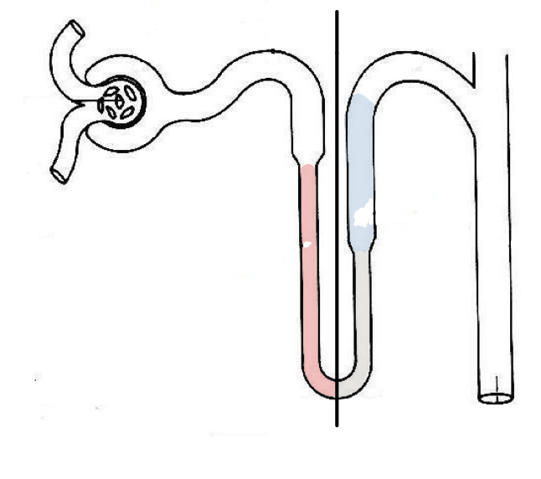
2:Loop of Henle
Descending limb
Ascending limb
25% of Na+,Cl-, K+
H +
Thin descending limb of loop of Henle:
-highly permeable to water
but moderately permeable to solutes.
-few mitochondria
-Flattened with microvilli
To remember!:
describing =drinking water
Ca+2 Mg+2
20% H2O
Thick Ascending limb of loop of Henle and early dct:
-impermeable to water
and solutes are reabsorbed
-many mitochondria and microvilli,but fewer than in PCT
25% of Na+,Cl-, K+ reabsorbed
by Active transport
Cl- 1-Na+, 2-Cl-, 1-K+ co-transporter
1
Ca+2 Mg+2 reabsorbed by diffusion
2

Slide 20
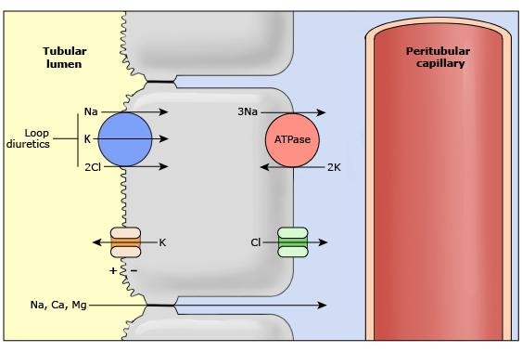
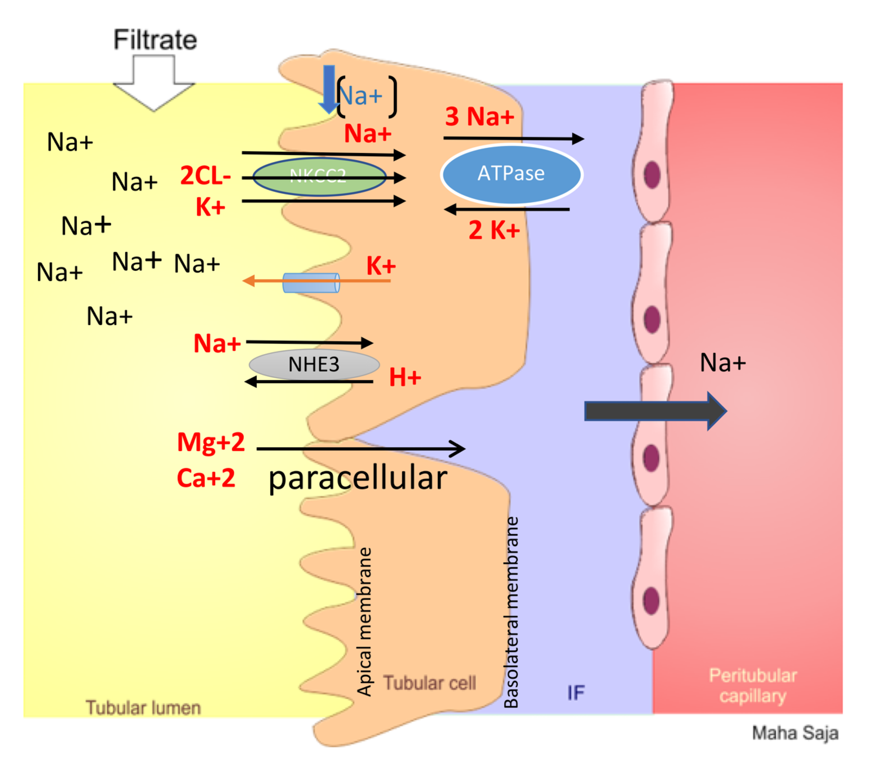
A-Transport mechanism in the TAL
Loop diuretics block NKCC2
1-Basolateral Na+ k+ATPase pumps 3Na+ out and 2K+ inside the cell
e.g. Lasix blocking 25% of filtered load (bcus triple transporter)
2-decrease Na+ conc inside
The cell
The positive charge (+8 mV) of the tubular lumen relative to the interstitial fluid forces cations such as Mg++ and Ca++ to diffuse from the lumen to the interstitial fluid via the paracellular pathway.
3-This gradient favors
passive entry of Na+ into
the tubular cell across the apical membrane via NKCC2 along with CL- and K+

Slide 21
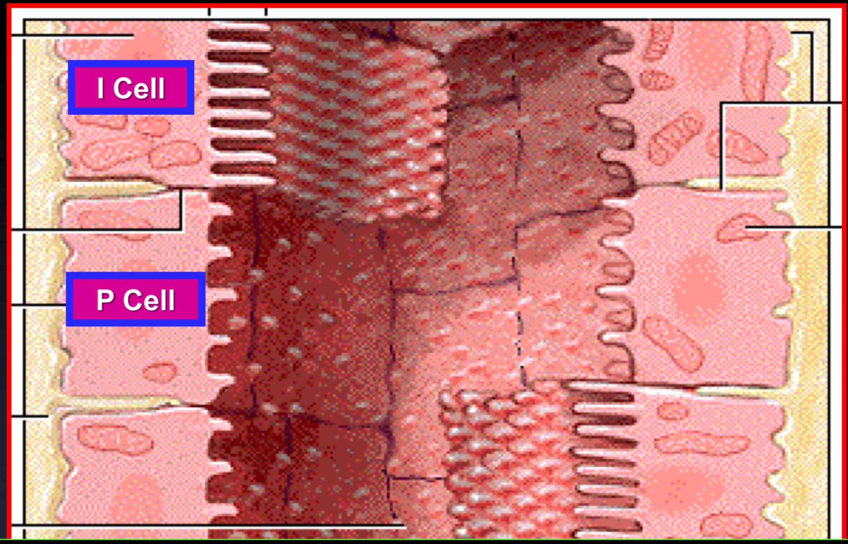
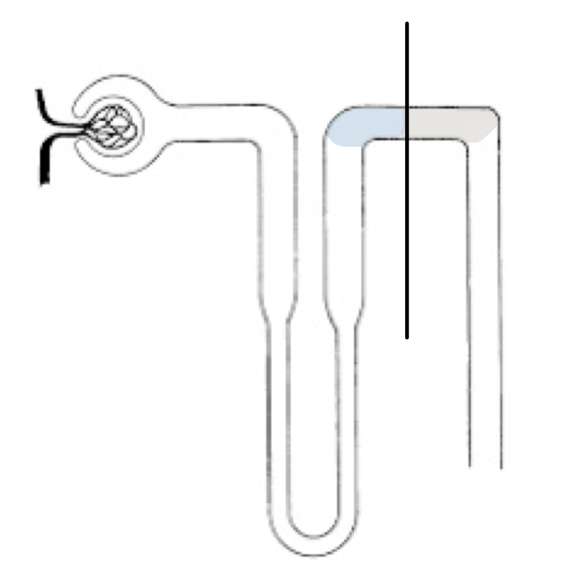
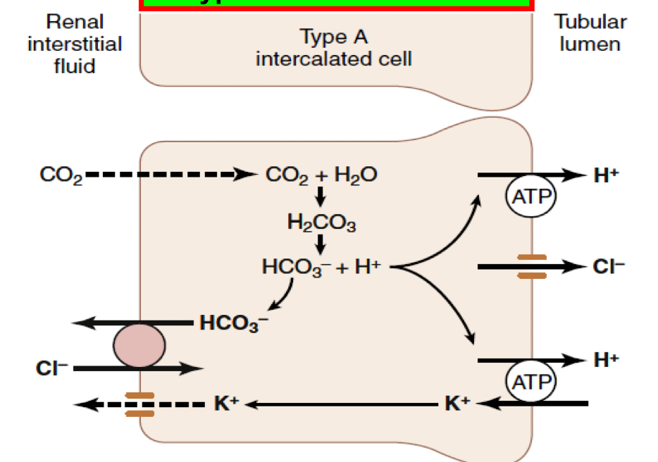
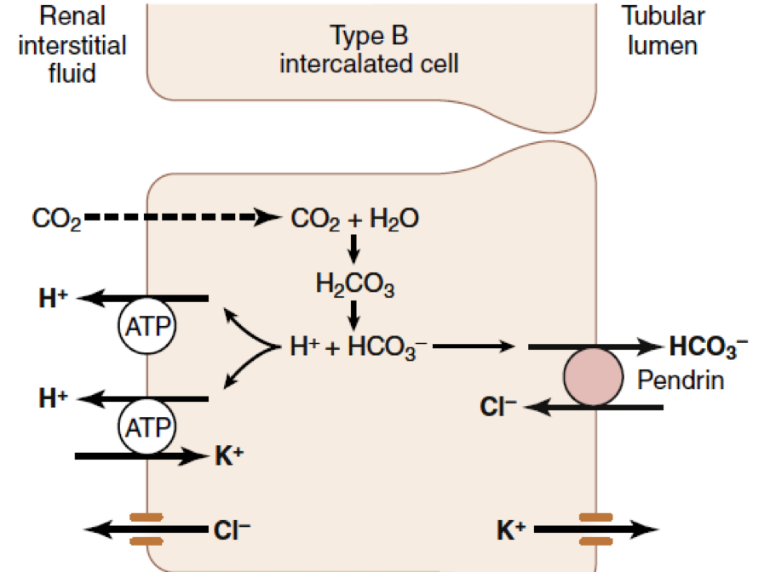
3-DCT and Cortical collecting tubule(CT)
• Mitochondria and microvilli decrease
• Principal Cells (Na Abs and ADH related Water abs)
• Intercalated Cells (Acid Sec and HCO3- Transport)
early part
Late part
A-The early part of the DCT
resembles the thick ascending
loop of Henle.
Its impermeable to water but pumps solutes actively
its called the diluting segment.
5% Na+ is reabsorbed here
Impermeable to urea
B-The late part of the DCT resembles cortical CD as it has two important kinds of cells:
1-Principle cells: which
reabsorbs Na+ and H2O while secreting K+.
-controlled by aldosterone.
2-Intercalated cells TypeA: which reabsorbs K+
and secretes H+
-regulate acid-base balance.
In the late part of the DCT,
H2O permeability is controlled by ADH

Slide 22
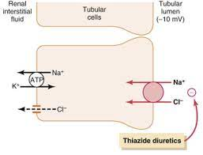
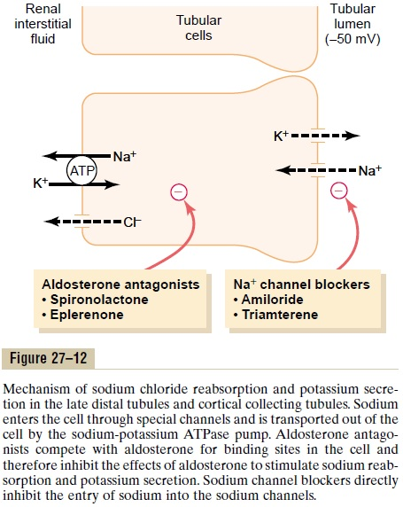
A-Transport mechanism in the early part of DCT
B-Transport mechanism in the late part of DCT
Mechanism of sodium chloride transport in the early distal tubule
1-Basolateral Na+ k+ATPase pumps 3Na+ out and 2K+ inside the cell
Thiazide
diuretics block NCC
2-decrease Na+ conc inside
The cell
Blocks transporter carrying 5% of
filtered load
3-This gradient favors
passive entry of Na+ into Apical filtered load
the tubular cell across the apical membrane via NCC along with CL-
Female Dr. Question:Which Diuretic Loop or Thiazide has the Powerful diuretic effect (amount of urine)?
Loop diuretic Why? because it blocks the Triple transporter and Triple reabsorbed 25% of the filtered load Therefore the amount of solutes that get trapped is MORE —> amount of water will get trapped is MORE also.
But Thiazide blocks NCC.
early distal tubule is contribute only 5% to the Reabsorption of filtered load.
Aldosterone
Stimulates the pump
+
Principle cells use channels for Na+ and K+ specific to each which is different than other parts of the nephron that use carrier
1-Aldosteorne anatgonists
(e.g. spironolactone)
-K+ sparing diuretics
2-Na+ channel blockers
It's a diuretic that blocks Na channel
→ Na will be trapped
→ Water will be trapped
→diuresis happen.

Slide 23
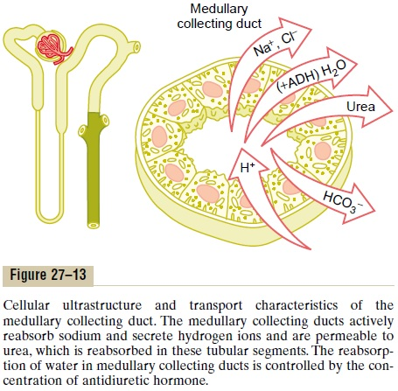
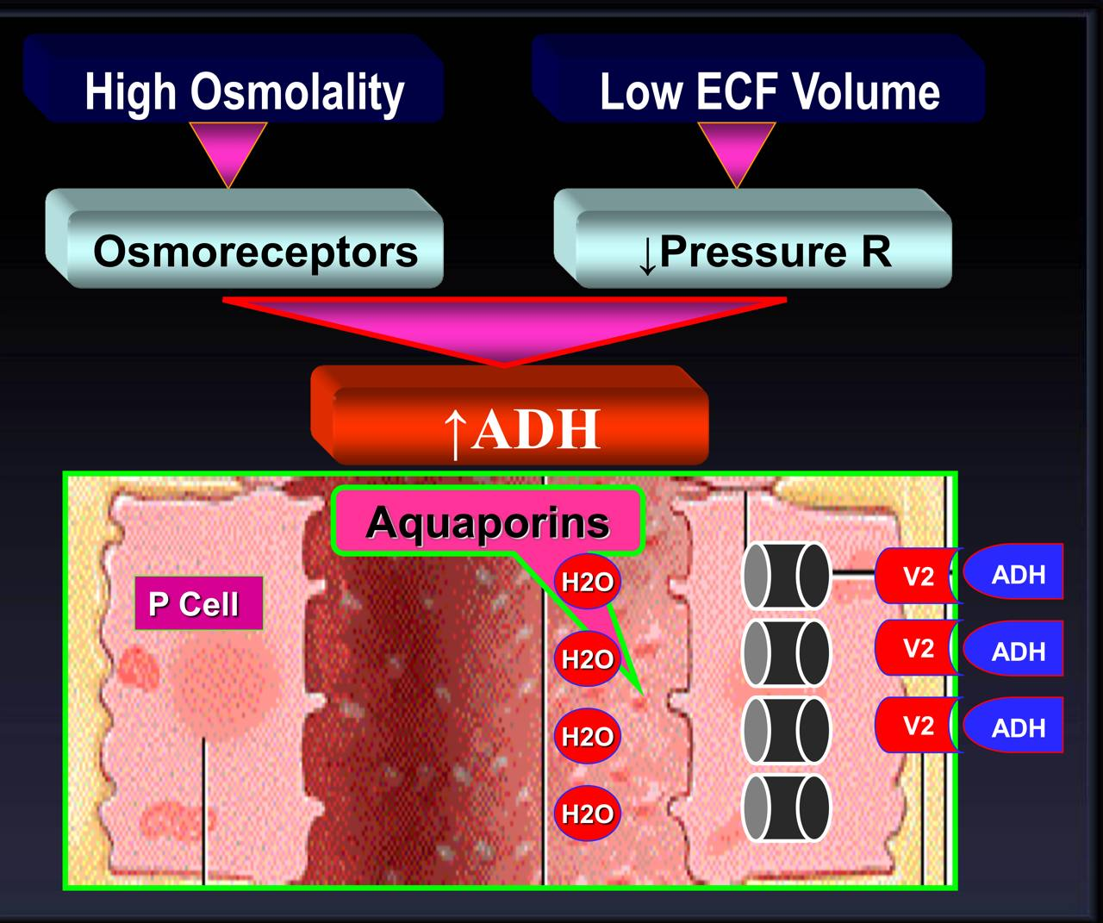
Medullary
collecting duct
• Reabsorbs about 3% of filtered Na+
• ADH controls permeability to H2O
(ADH affects since late DCL)
• Permeable to urea
• Secretes H+

Slide 24
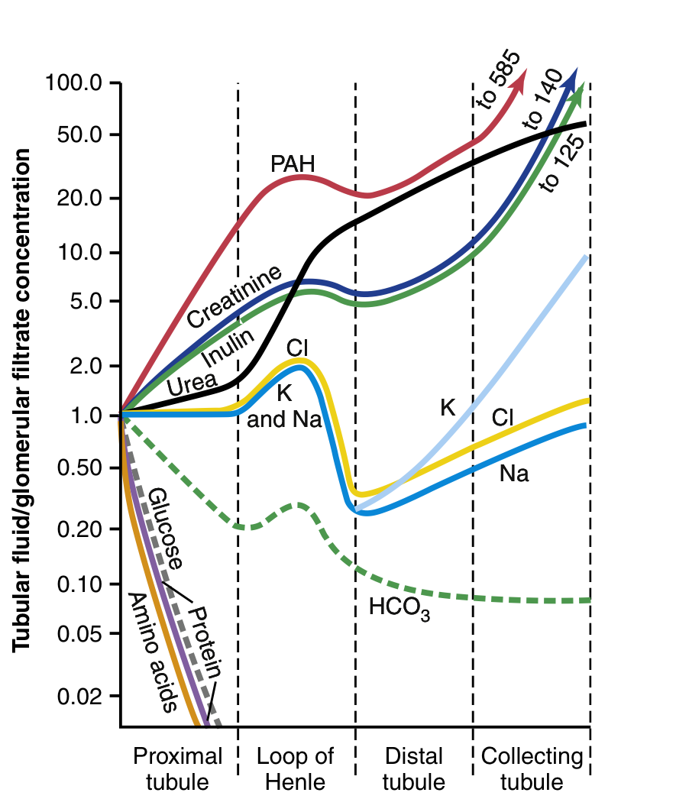
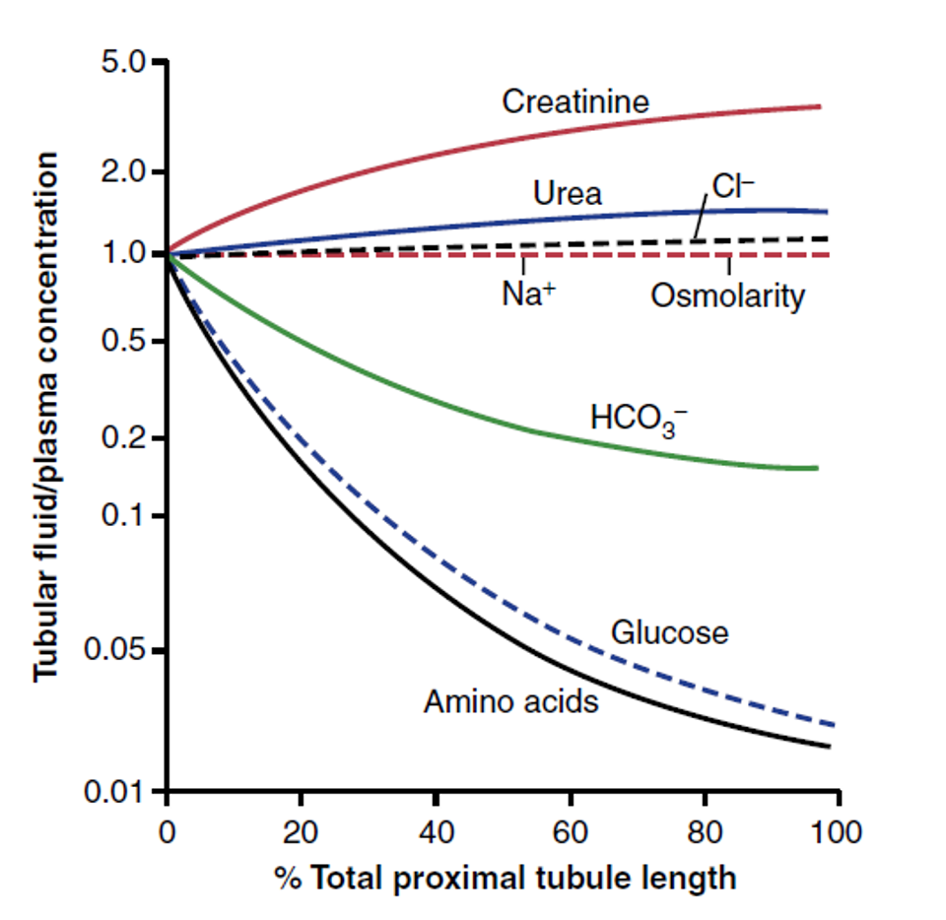
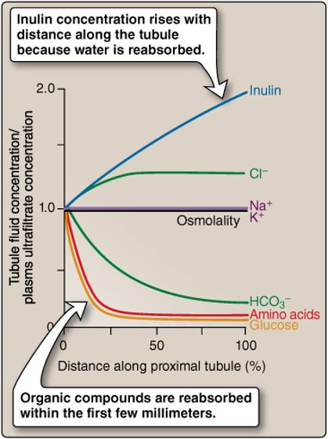
Conc. of substances at diff points in tubules
What does the diagram represent ?
-The Changes in average concentrations of different substances at different points in the tubular system relative to the concentration of that substance in the plasma and glomerular
filtrate.
Female Dr focus on it!!
-A value of 1.0 indicates that the concentration of the substance in the
tubular fluid is the same as the
concentration in the plasma.
Values above 1.0 indicate that the substance is reabsorbed to a lesser extent than water or is secreted into the tubules
A value of 1.0 indicates that the concentration
of the substance in the tubular fluid is the same as the concentration in the plasma
Values below 1.0indicate that the substance is reabsorbed more avidly than water

Slide 25
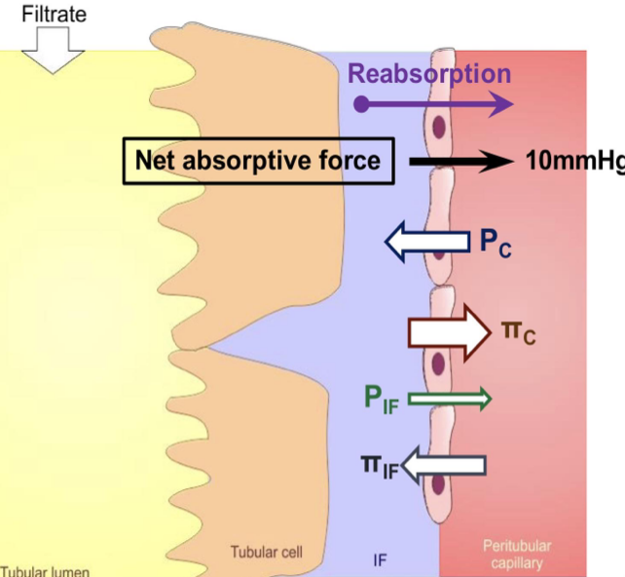
Regulation of tubular reabsorption
Female slide:
Factors influencing tubular reabsorption regulations:
1
physical forces that govern reabsorption (bulk flow)
Tubules can increase their reabsorption in response to increased tubular load→ glomerulo-tubular balance
That’s mean when filtration increase the reabsorption will increase also
PC is influenced by:
• ABP(if it increases —> Pc will increase)
• Afferent & Efferent arteriolar resistance
πC is influenced by:
• Filtration fraction
• Systemic plasma colloid osmotic pr.
(amount of proteins found systemically in plasma).
Hydrostatic pressure(p)
which pushes fluid out
Oncotic pressure (П)
which pushes fluid in
Reabsorption
Favouring | Opposing
πC=32 PIF=6 | Pc=13 mmHg πIF=15
38 | 28
Result: net absorptive force =38-28=10mmhg
Dr. Explanation: team39
Efferent vasoconstriction: Efferent arteriole is located before peritubular capillary so when it constricted —> blood that flows into peritubular capillary will decrease —> GFR (amount of filtered) will Increase —> Pc will Decrease —>
Reabsorption will increase.
Afferent vasodilation: If there is vasodilation in afferent arterioles —> Pc will increase —> More blood flows to the kidney.
Filtration Fraction (FF): If FF increases —> Oncotic pressure in peritubular capillary ( πC ) will increase why? because there is more water get filtered and proteins get concentrated in the vessel. vica versa.

Slide 26
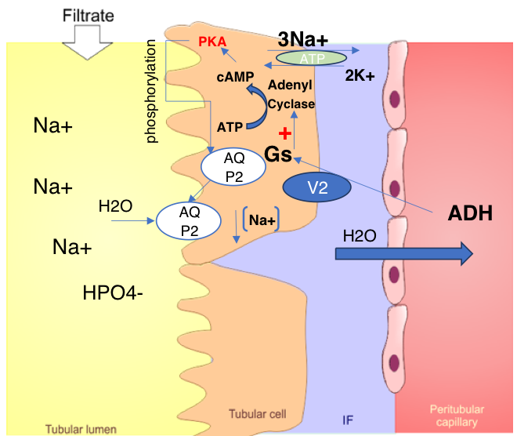
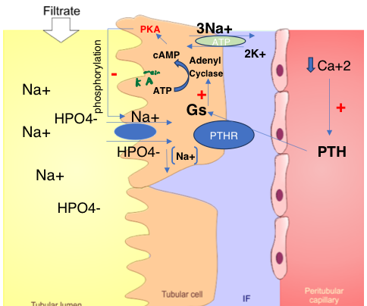
2
Hormonal regulation of tubular reabsorption
Female slide
Hormone | Stimulated by | Actions
Angiotensin II | -Renin -low APB -Low BV -Low NaCl | 1- Stimulates Na+ and H2O reabsorption in PCT. 2- increases efferent vasoconstriction, so : a. it reduced peritubular capillary hydrostatic pressure increasing net tubular reabsorptive force b. Reduces renal blood flow and hence increases filtration fraction in the glomerulus which increases colloid pressure in the peritubular capillaries (this process increases tubular reabsorption) 3- It stimulated Aldosterone production stimulating Na+ reabsorption and K+ secretion
Aldosterone | Angiotensin II | P Cells to reabsorb Na+ and secrete K+ in DCT/CD
ADH | -low ABP -low BV | H2O reabsorption in CD (AQP2) Remember ADH bind with V2 - openAQP2
ANP | Stretch sensors stimulated to high BV | Blocks Na+/ H2O reabsorption in distal parts of nephron DCT and CD. It is opposite of aldosterone.
PTH | Low Ca+2 | Lowers PO4- reabsorption while increasing Ca+2 reabsorption
ADH (late part of DCT and CD)
PTH influence in HPO4- secretion
PTH- HPO4- which
is accompanied by
increase Ca+2
reabsorption in the DCT
collecting dust as well as increase in Mg+ reabsorption in loop of Henle

Slide 27
Regulation of K+
Potassium Overview
• One of the most abundant cations in the body
• 98% in ICF and 2% in ECF
[K]I>[K]o 150mEq/L>3.5-5mEq/L
Both reabsorbed and secreted
-67% is reabsorbed by PCT(solvent drag)
-Secreted by Thick Asc LOH, early distal tubule/collecting tubule
correlated with dietary intake
-80% of filtered load appears in urine if dietary content high
-1% if dietary content low
• Excretion is controlled by Aldosterone
Importance of K+
Female slide only
Cell volume regulation
Cardiac and neural activity
Cell PH regulation
Resting membrane potential
Roles of intracellular K+
Cell-volume maintenance | Net loss of K+→cell shrink Net gain of K+→cell swelling
Intracellular pH regulation | Net loss of K+→cell acidosis Net gain of K+→cell alkalosis
Cell enzyme functions | K+ dependence of enzymes (e.g some ATPases, succinic dehydrogenase)
DNA/protein synthesis, growth | Lack of K+ → reduction of protein synthesis, stunted growth
Roles of transmembrane K+ ratio
Resting cell membrane potential | Reduced [K+]I > [K+]o → membrane depolarization Increased [K+]I > [K+]o → membrane hyperpolarization
Neuromuscular activity | Low plasma K+: muscle weakness, muscle paralysis, intestinal distention, respiratory failure. High plasma K+: increased muscle excitability, muscle weakness (paralysis).
Cardiac activity | Low plasma K+: slow conduction of pacemaker, arrhythmias High plasma K+: conduction disturbances, ventricular arrhythmias , and ventricular fibrillation

Slide 28
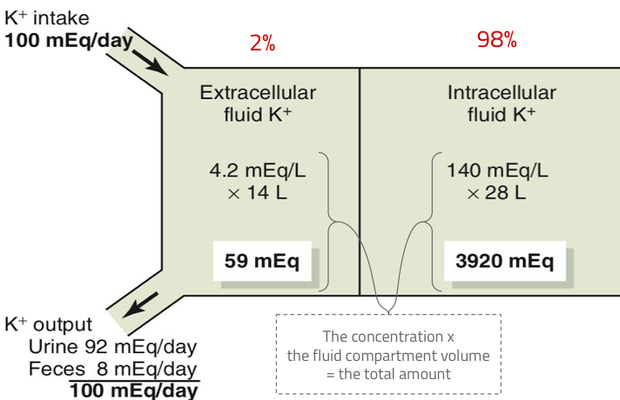
Potassium Homeostasis
Body protection against hyperkalemia after meals
Diet 50 and 200 mEq/day
Absorption of 40 mEq of K+
If K+ concentration increases in ECF to about 2mEq/L difference this is dangerous so we need to regulate and control!
K+ output:
1) GI loss about 5-10%
2) Renal excretion about 90-95%
EFFECT OF INCREASED DIETARY K INTAKE ON K EXCRETION
K directly stimulates aldosterone secretion and leads to an increase in cell [K] in collecting duct principal cells. Both of these lead to enhanced secretion and, hence, excretion, of K.
Increase K+ intake
Male slide
Increased plasma conc of K+
Increase Aldosterone secretion
Increase uptake of K+ by collecting duct principal cells
Increase plasma Aldosterone
Increase luminal membrane permeability to Na+/K+-ATPase activity In collecting duct principal cells
Increase K+ secretion
Increase K+ excretion

Slide 29
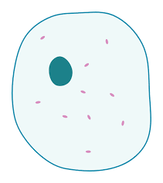
Cellular defense mechanism against K+ abnormalities
Factors that can shift K+ in and out of the cell
Female slide only
1
Renal excretion
Next slide
2
Cellular shift
Increased excretion in case of high K+ concentration
Decreased excretion in case of low K+ concentration
Conc of K+ is high in ECF will shift K+ into the cell
Conc of K+ is low in ECF will shift K+ out of the cell
Renal regulation of K+ concentration takes time so what does the body do to regulate this vital ion as quickly as possible?
Solution
Cellular shift
1st Line of defense
shift K+ in
shift K+ out
Insulin
Insulin deficiency
Aldosterone
H+
Aldosterone deficiency
K+
H+
β-adrenergic stimulation
K+
β-adrenergic blockers
Alkalosis (low H+ coc)
Acidosis (high H+ coc)
Physiologic factors affecting K+ distribution between ICF and ECF:
1-Aldosterone
2-Insulin
3-Epinephrine
Pathophysiologic factors affecting K+ distribution between ICF and ECF:
1 - Acid base disturbance
2 - Change in plasma osmolality
3 - Cell lysis
4 - Exercise
Cell lysis,high ECF osmolatity
Strenuous exercise

Slide 30
Renal K+ excretion
Female slide only
1-K+ reabsorption along the proximal tubule is largely passive and follows the movement of Na+ and fluid
(in collecting tubules, may also rely active transport).
• In the PCT , K+ reabsorption is a passive process how?
• Water reabsorption is through paracellular route
and drags K+ with it ( solvent drag).
2-K+ handling by TAL:
by Secondary active transport via the apical triple transporter (NKCC2)
3-K+ handling by the distal portions of the nephron
K+ secretion occurs in cortical collecting tubule (principal cells)which is Na+ and water reabsorption &
K+ secretion,and relies upon active transport of K+
across basolateral membrane and passive exit across apical membrane into tubular fluid
High K+ intake:increase K+ secretion
Low K+ intake:decreased K+ secretion
When K+ depletion:
Increase K+ reabsorption via α-intercalated cells:
Which secrete H+ and reaabsorbe K+
About 65% reabsorbed by PCT
About 25-30%
reabsorbed by TAL 5-10% enters the distal portions of the nephron
Factors stimulating K+secretion:
1-increase ECF K+ conc
2-increase Aldosterone
3-increase tubular flow rate
Factors decreasing K+ secretion -Acidosis(increase H+)
If K+ intake is low,
only 1-3% of filtered K+ will be excreted
If K+ intake is normal to high,
10-15% of filtered K+will be excreted .

Slide 31
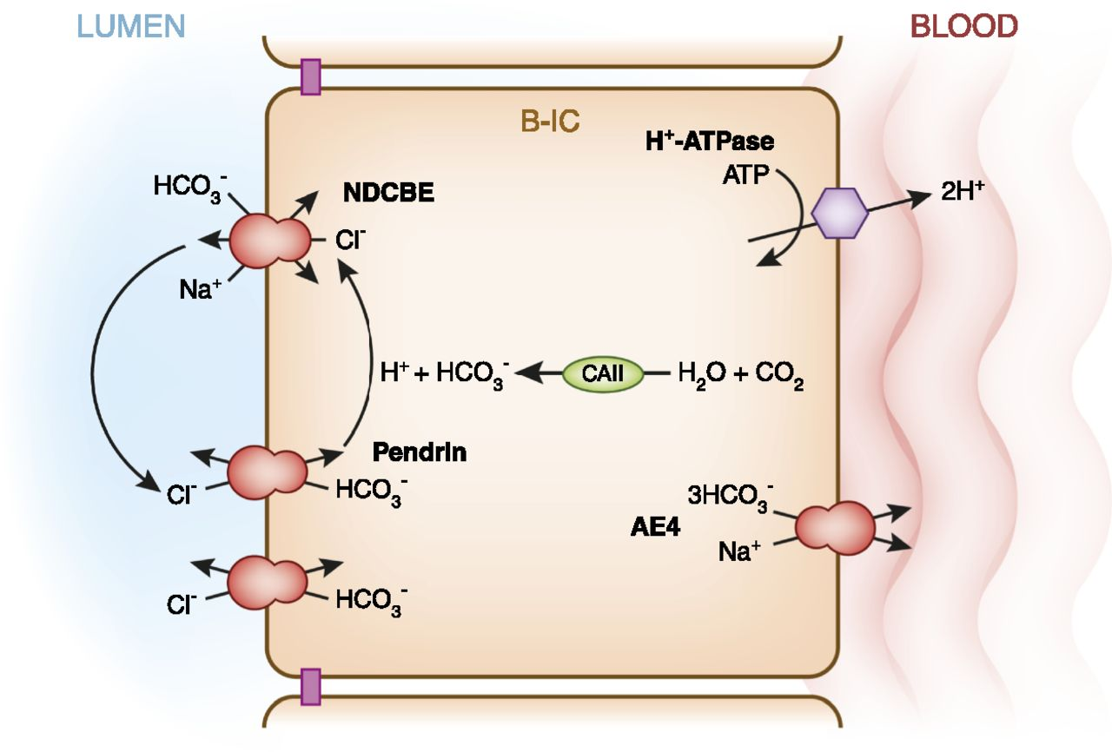
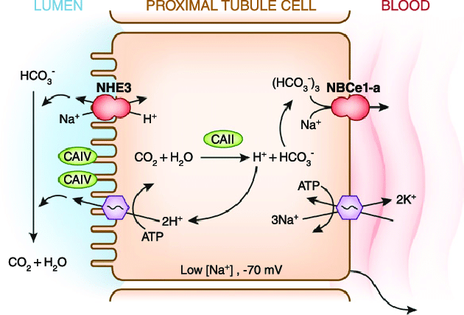
UREA | • Plasma concentration is 2.5 – 7.5mmol/L • 50 % is reabsorbed in PCT passively with water • It is the only waste to be reabsorbed • Creatinine and Phenol are not reabsorbed.
CALCIUM | • Ionized Calcium is freely filtered and reabsorbed in PCT • It moves into tubular cells passively (downhill) • It moves out of the cell by Ca/Na Counter Transport or Actively by Ca ATP ase Mechanism. • Its reabsorption is Hormonally controlled
PHOSPHATE | • It is reabsorbed by cotransport with Na in PCT in luminal border (Na/Pi). • Its reabsorption is Hormonally controlled • It is increased by Vit D and decreased by Parathyroid Hormone
SULPHATE | • Like PHOSPHATE reabsorbed with Na
HYDROGEN | •Secreted in Proximal Tubule and Thick ascending LOH by Counter Transport with Na •Secreted in DCT by H+ ATP ase
Intercalated cell
Na-H COUNTER TRANSPORT
Luminal Membrane

Slide 32
Transport proteins involved in the movement of Na + and Cl – across the apical membranes of renal tubular cells.
Male slide only
CALCIUM REABSORPTION IN NEPHRON
Lumen
Channels Transient receptor potential
vanilloid type5 Ca
(TRPV5)
Peri tubular capillary
Sodium/Calcium
Exchanger or
Calcium-ATPase
Epithelial Cells
PCT 60%
Asc LOH 25-30% DCT & CT 4-9%
Intracellular Ca protein calbindin-d9k
98–99% of the filtered Ca2+ is reabsorbed
Site | Apical transporter | Function
Proximal tubule | Na/glucose CT Na+/pi CT Na+/amino acid CT Na+/lactate CT Na/H exchanger Cl/base exchanger | Na+uptake,glucose uptake Na+uptake,Pi uptake Na+uptake,amino acids uptake Na+uptake,lactate uptake Na+uptake,H+extrusion Cl- uptake
Thick ascending limb | Na-K-2Cl CT Na/H exchanger K+ channels | Na+uptake,Cl-uptake ,K+ uptake Na+uptake,H+extrusion K+extrusion (recycling)
Distal convoluted tubule | NaCl CT | Na+uptake,Cl-uptake
Collecting duct | Na+ channel(ENaC) | Na+ uptake

Slide 33
Quiz
Q1
Which one of the following factor stimulates K+ secretion :
A.increase tubular flow ate
B.Beta blockers
C.Aldosterone deficiency
D.acidosis
Q2
Which one of the following cells are controlled by Aldosterone:
A.macula densa
B.Intercalated cells Type A
C.Principle cells
D.juxtamedullary cells
Q3
Which part of the nephron absorbs the most water?
A.PCT
B.Descending limb of LOH
C.Ascending limb of LOH
D.DCT
Q4
Where do we find NKCC2 cotransporter?
A.PCT
B.Descending LOH
C.thin ascending LOH
D.thick ascending LOH

Slide 34
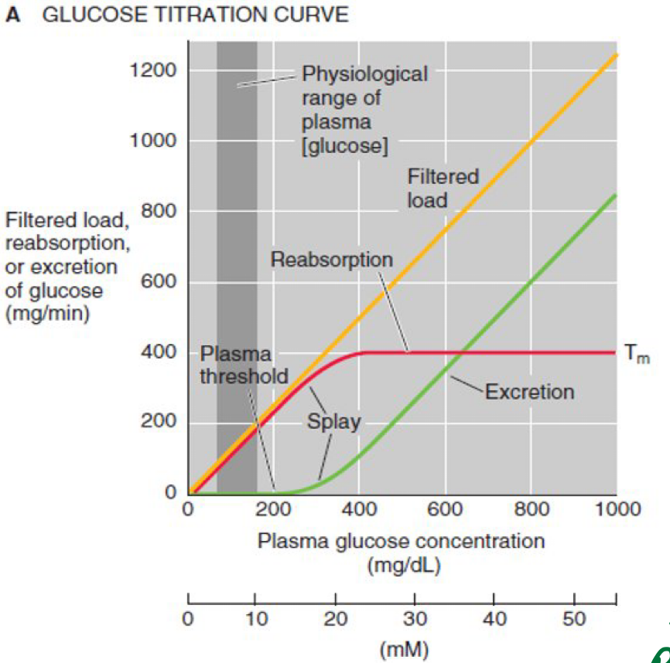
Quiz
Q5
All of the following substances passively transport except:
A.urea
B.Cl-
C.H2O
D.glucose
Q6
Why Na+ reabsorption is coupled
to Cl- in 2nd half of PCT?
A.Requires ATP
B.existence Of chloride channels in the 2nd par
C. conc of Cl- will increase in the lumen
D.Both B-C
Answers: 1-A , 2-C, 3-A, 4-D,5-D,6-D
SAQs
According following Titration curve:
A-What does the plasma threshold represent?
B-What happened for glucose transporters when
the plasma glucose conc reaches 400 mg/min?
A- it is the concentration of plasma after which glucose start appearing in the urine.
B- it become saturation (transport maximum)
SAQs
numerate the ways to potassium regulation :
1-Renal excretion
2-cellular shift

Slide 35
Members
Team Leaders
Razan Almohanna
Khalid Alrasheed
Raneem Alwatban
Othman Alabdullah
Team Members
Mayssam aljaloud
Saif Alotaibi
Theme was done by Shatha Almutib
physio442@gmail.com

