Slide 1
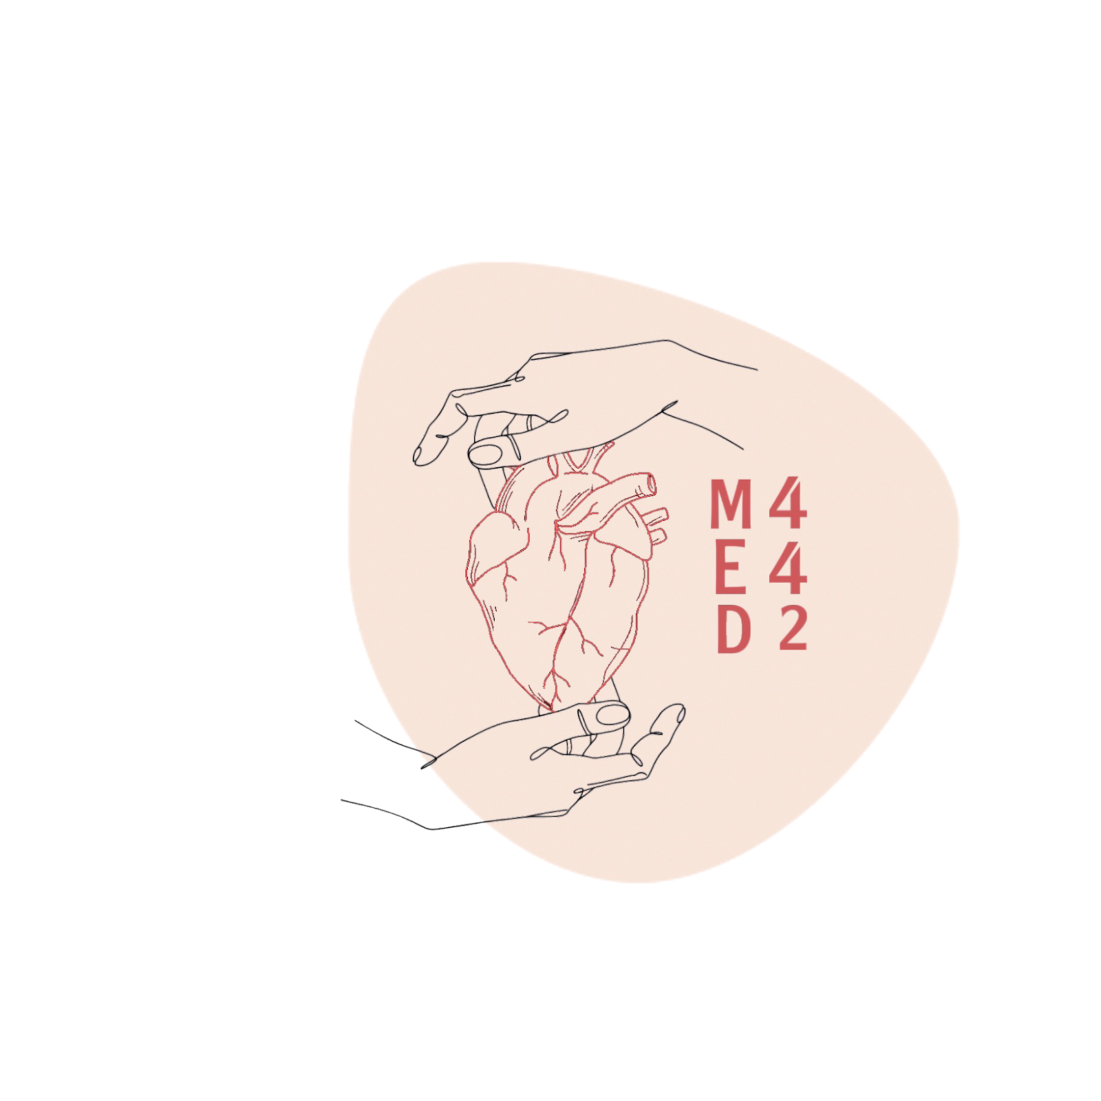
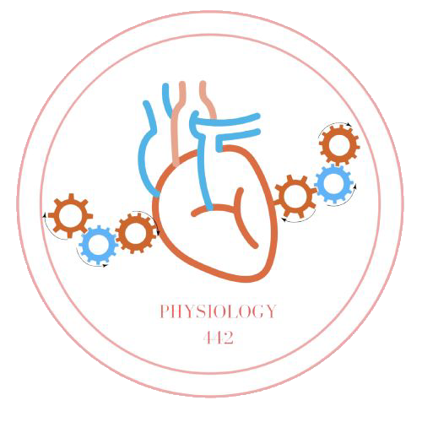
Concentration of urine
L6
Physiology renal
Editing File
- Color Index:
Main Text
Male’s Slides
Female’s Slides
Important
Doctor’s Notes
Extra Info

Slide 2
Objectives
Identify and describe: how the loop of Henle is a “countercurrent multiplier” while the vasa recta is a “countercurrent exchanger” and their roles in concentrating urine and diluting urine.
Explain: what happens to the osmolarity of tubular fluid in different segments of loop of Henle upon concentrated urine production.
Explain: the factors that enable the loop of Henle to make concentrated medullary gradient.
Differentiate: between water diuresis and osmotic diuresis.
Learn about: the clinical correlates of diabetes mellitus and diabetes insipidus.

Slide 3
1
Kidney Regulation of H2O Excretion
In case of water excess in the body.
“When ADH levels are very Low
Large volume of diluted (مخفف) urine.
50mOsm/L
(Urine osmolarity).
In case of water deficit in the body.
“When ADH levels are very high”
Small volume of concentrated (مركز) urine
1200mOsm/L
(Urine osmolarity).
(ADH is activated due to water deficit),
Obligatory Urine Volume
1
The minimal volume of urine that needs to be excreted to get rid of the metabolism waste products from the body = 600 mmol
2
It is determined by the maximal concentrating ability of the kidney.
3
70kg human needs to excrete 600mOsm of solutes per day.
How to calculate the obligatory urine volume?
(600mOsm/day)
= 0.5 L/ day
(1200mOsm/L)
0.5 is the Minimum Volume
20L is a maximum volume.

Slide 4
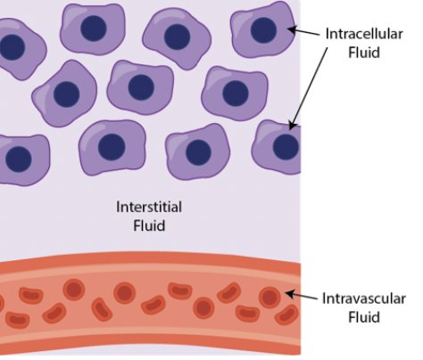
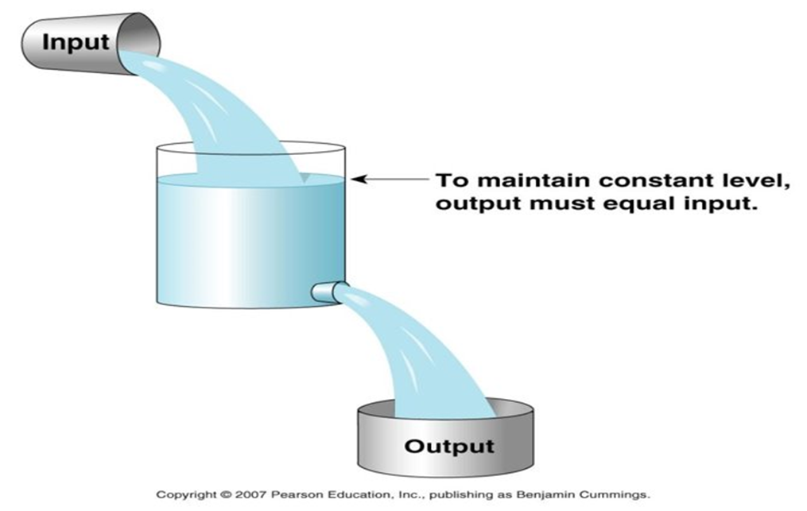
2
The Importance of Regulating Water Independent of Solute
Female’s Slides
1
Such as Pathophysiological factors affecting K+ distribution between ICF & ECF ( lecture tubular processing of filtrate.
To maintain a constant solute concentration in ECF.
2
To keep ECF osmolarity contant.
Which is 300 mOsm/L
Why is Keeping ECF Osmolarity Important?
To keep a constant concentration of solutes & electrolytes in the ECF is important for normal cellular function.
Water Balance
Female’s Slides
Daily intake:
Fluids ingested: (2100ml)
From metabolism: (200ml)
-------------------
Total intake: 2300ml
Daily loss:
Insensible loss: (700ml)
sweat: (100ml)
feces: (100ml)
Urine (1400ml)
-------------------
Total loss: 2300ml

Slide 5
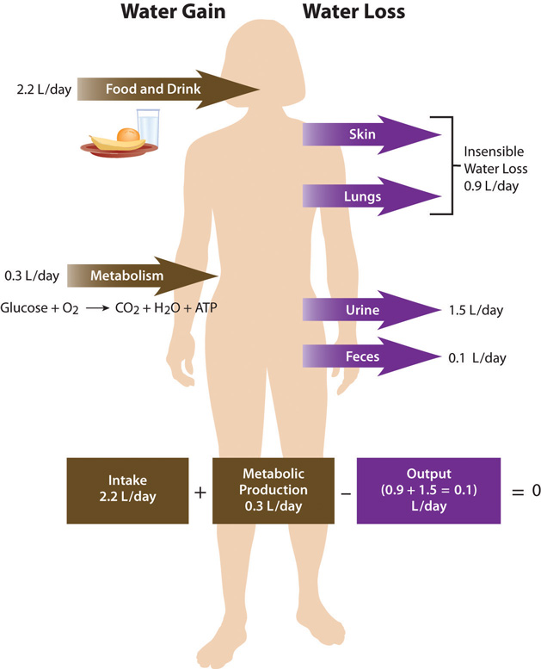
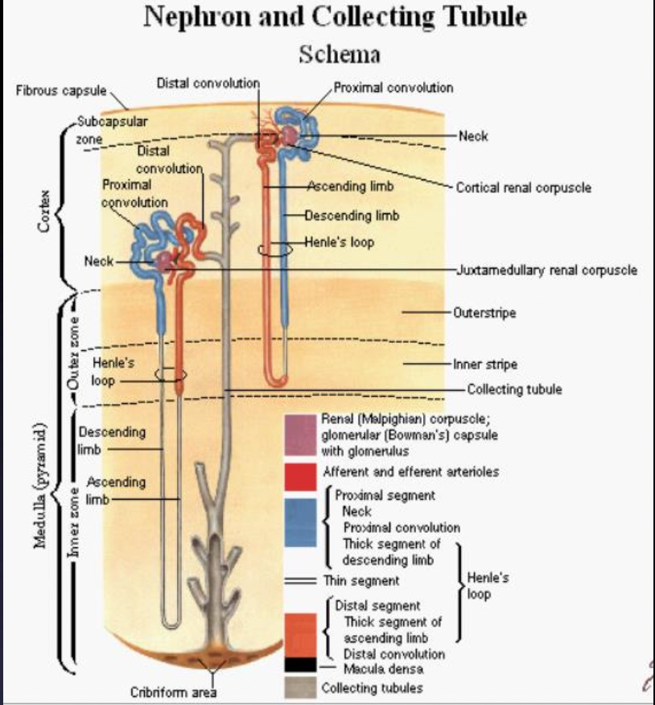
3
Female’s Slides
Maintenance of Water Balance
Nephron Types
Male’s Slides
Cortical (superficial) nephrons: | Juxtamedullary nephron:
Peritubular capillaries. | Vasa recta.
Capable of forming dilute urine. (85%) | Capable of forming concentrated urine (> 300 mOsm/kg).
1-2% of the blood flows through juxtamedullary nephrons.

Slide 6
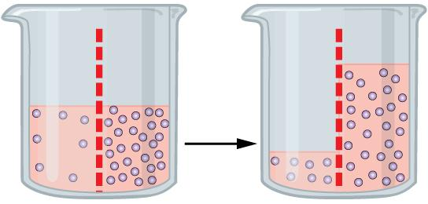
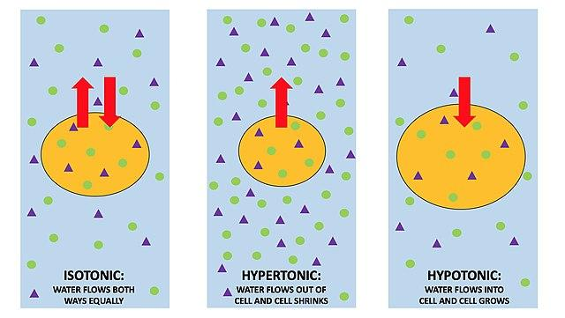
4
Female’s Slides
Osmolarity & Osmosis
Osmosis is the diffusion of water across a membrane. Like other molecules, water will move from an area of high concentration to an area of low concentration. The more solute there is in a solution, the lower concentration of water in that solution. There is terminology to describe concentration differences between 2 solutions. A solution with higher solute concentration is hypertonic relative to one with lower solute concentration. Conversely, a solution with lower solute concentration is hypotonic relative to one with higher solute concentration. If the two solutions have the same concentration, they are isotonic. Water will move from hypotonic to hypertonic.
Important to maintain water balance since water can cross most membranes freely.
Water balance determines osmolarity.
As osmolarity of ECF (extracellular fluid) changes → water moves into or out of cells→ changing intracellular volumes & cell function.
Excess water intake→ osmolarity decreases → water moves into cells → swell.
Na intake (osmolarity increases) → water out cells→ shrink.
Changes in cell volume impairs cell function.
Swelling: -May cause ion channels to open,
-Changing membrane permeability.

Slide 7
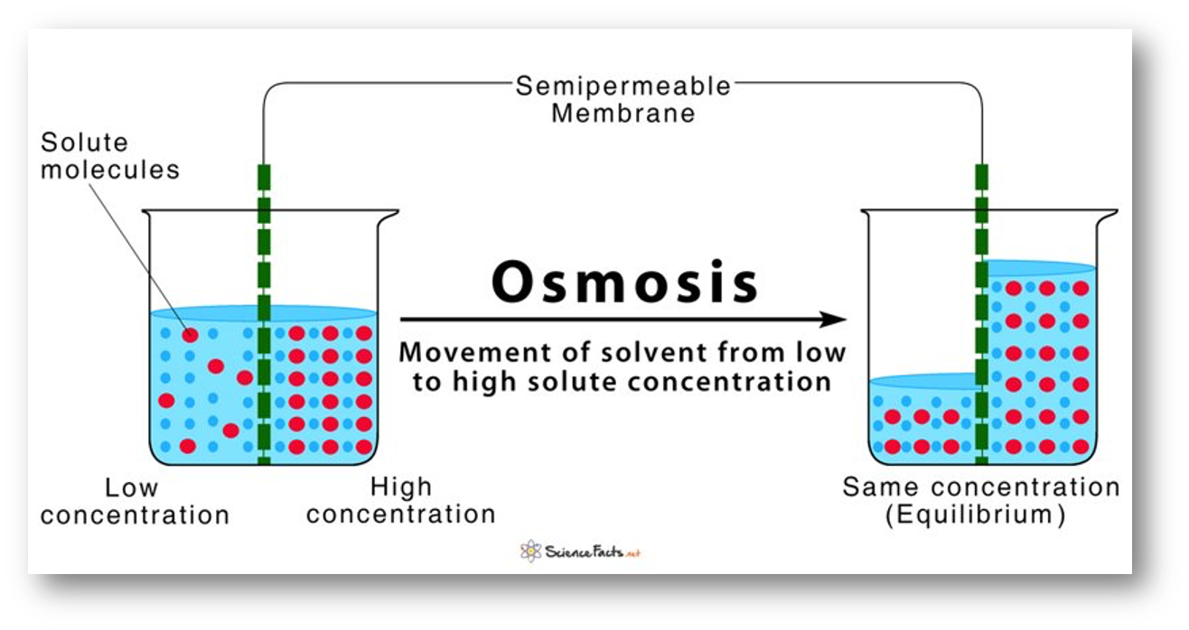
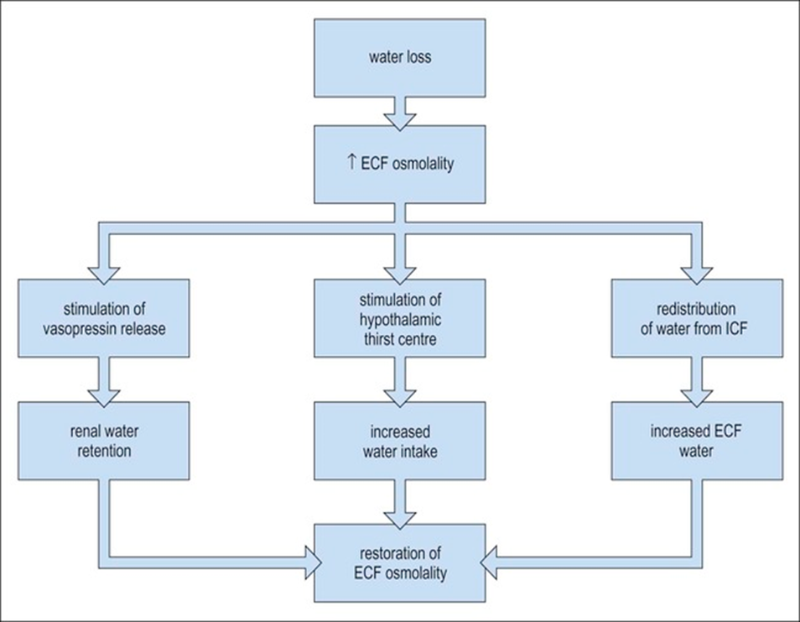
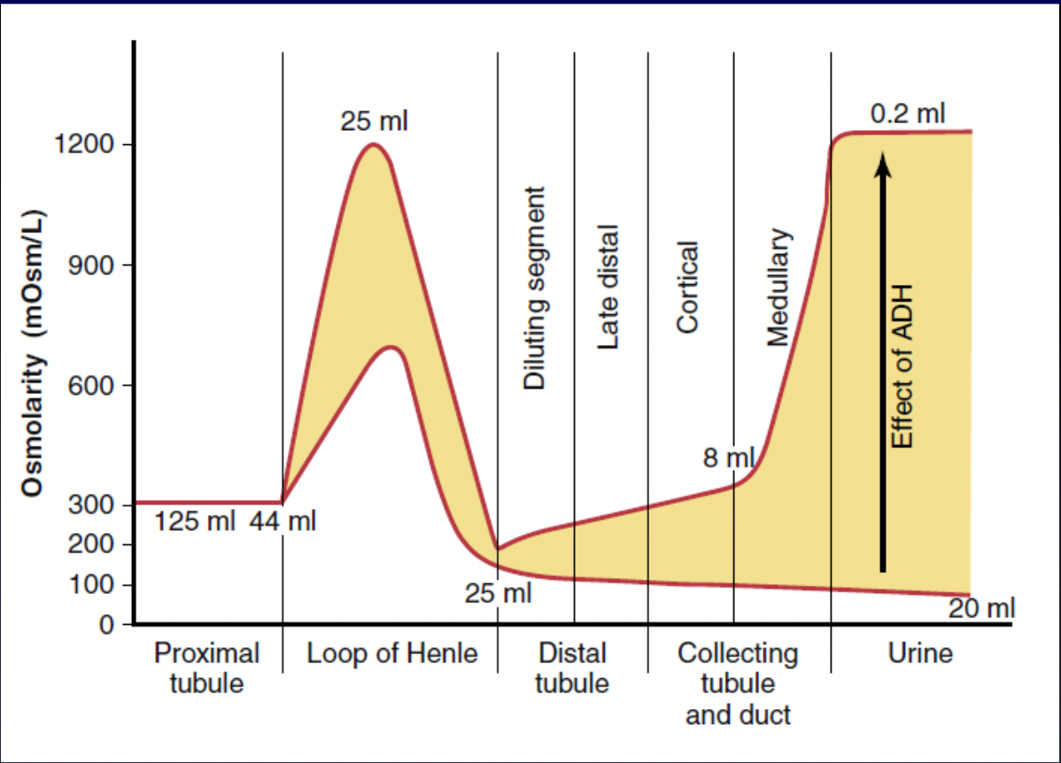
5
Female’s Slides
Osmolarity & Osmosis
Osmosis, if the movement of water across a semipermeable membrane from an area of low solutes concentration to high solutes concentration
It’s a passive mechanism.
Male’s Slides very important
Changes in osmolarity of the tubular fluid as it passes through the different tubular segments in the presence of high levels of ADH and the absence of ADH.

Slide 8
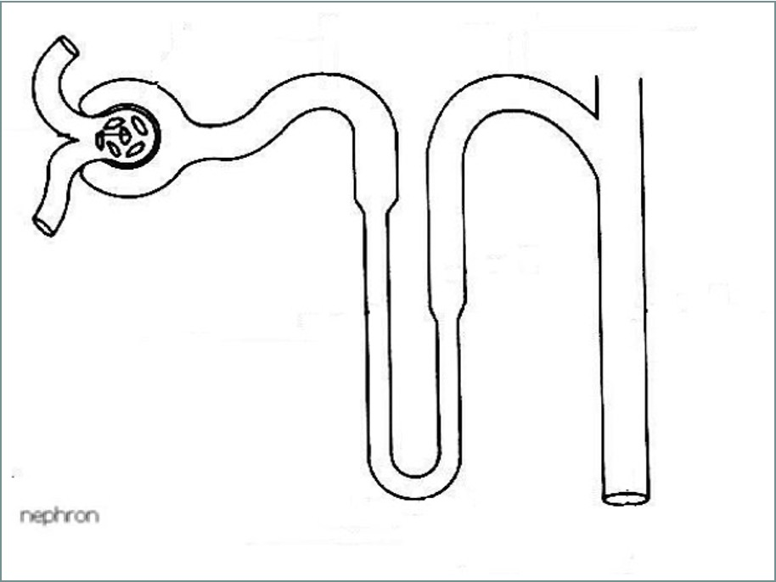
6
How the Kidney Handles H2O?
isotonic
ADH dependent
Water deficient, so we need water back to the system
300
65%
Hypo-osmotic
300
100
3
Cortex
1
H2O
Water excess conditions, no ADH→ water leaves
400
500
600
700
800
900
1000
1100
1200
Solute
ADH
H2O
Medulla is hypertonic
20%
2
1200
Hyper-osmotic
1
The reabsorption of H2O in the PCT is the same as the reabsorption of Na+ in PCT → recall Na+/k+ ATPase pump drags the water with it.
2
In the Thin descending loop of Henle further illustrate more reabsorption of water, which decrease the volume of ECF. Thus, according to the osmolarity equation, the osmolarity will increase (due to the slow increasement of solute- Hyper-osmotic) .
3
In ascending part of loop of Henle, the cell type changes (more mitochondria & brush border), which means it’s more permeable to reabsorb solute than water (Hypo-osmotic).
ADH is stimulated when it’s needed, such as in dehydration (decrease in osmolarity).
Hypertonic→ increase concentration of solute.

Slide 9
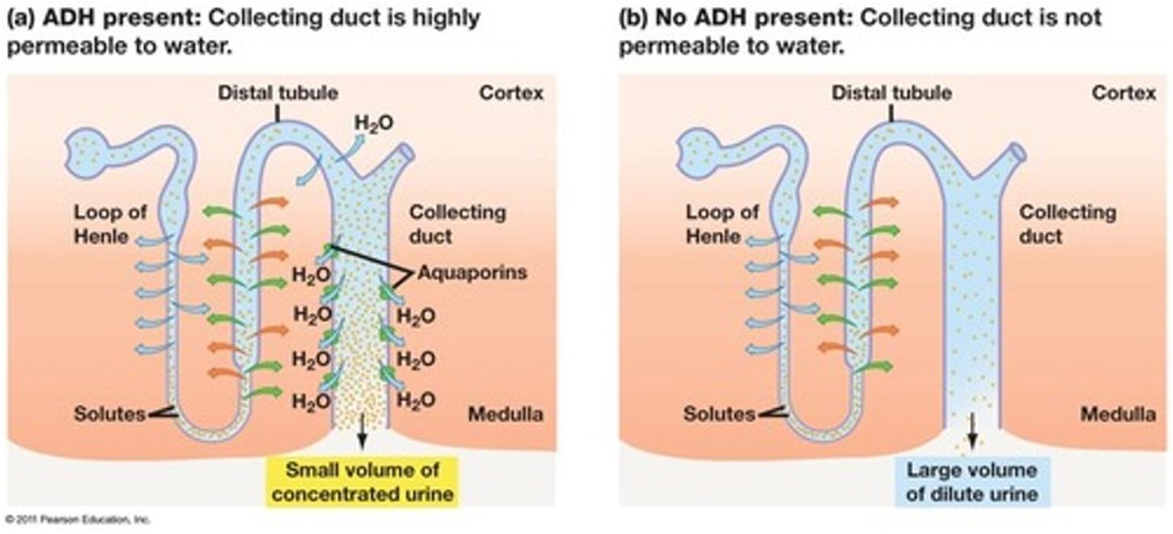
7
H2O Handling By the Kidney
Water deficit state
Water excess state
Concentrated Urine Formation
The hyperosmotic medullary interstitium.
There are 2 important factors (Requirements) in forming concentrated urine:
is maintained by discussed in slide 11&12
Countercurrent multiplier mechanism
Urea recirculation (recycling)
High ADH/AVP.
If the body osmolarity is around 300mOsm/L, how did the renal medulla interstitium become hyperosmotic ?
Due to accumulation of Na+ and urea in renal interstitium.
(Na+ reabsorption in TAL , basolateral Na+/K+ ATPase pumps 3Na+ put and 2K+ in.

Slide 10
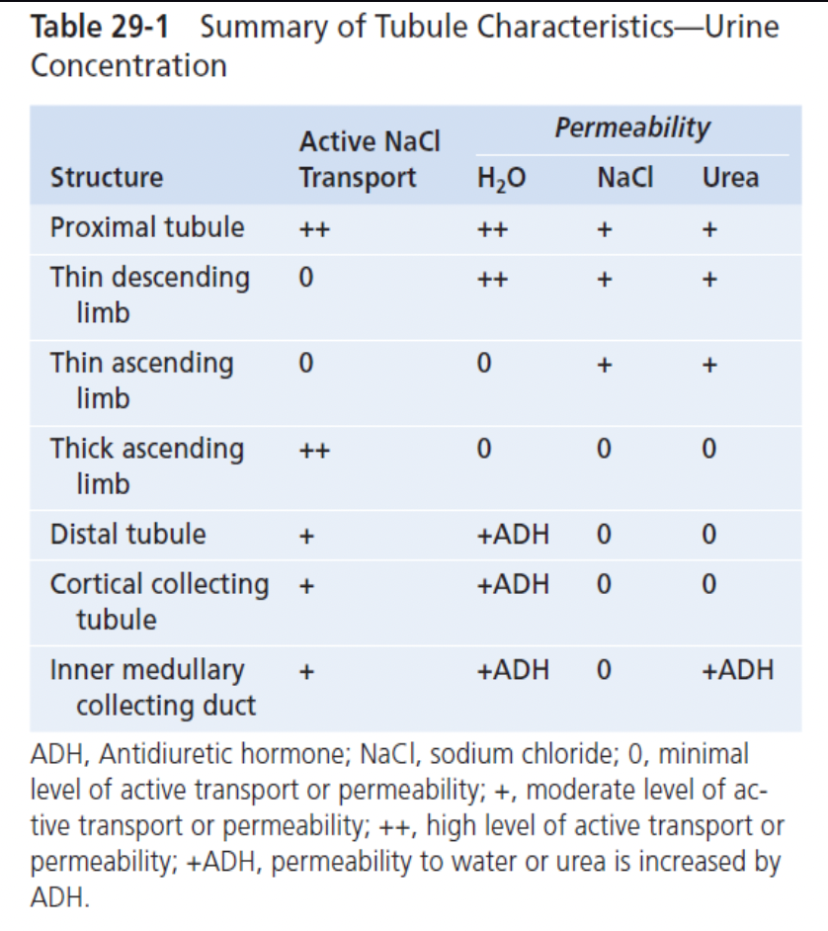
8
Male’s Slides
Loop of Henle
Descending Loop | Ascending Loop:
Highly permeable to water (flat cell, a little or no mitochondria as well as brush border). | Impermeable to water.
Impermeable to Na+. | Permeable to Na+ (mediated by Na+/K+/2Cl- apical carrier- inhibited by loop diuretics- furosemide (Lasix)).
Water exit promoted. | Na+/K+ ATPase actively pumps the sodium out of the cell into the interstitium.
Loop of Henle Characteristics that cause solutes to be trapped in the renal medulla
 | A major reason for high medullary osmolarity is active transport of Na and co-transport of K, Cl, and other ions from the thick ascending loop of Henle into the interstitium. 200-mOsm/L gradient. (Hypertonic environment, which is formed by countercurrent exchanger and maintained by countercurrent exchanger, explained in slide 10).

Slide 11
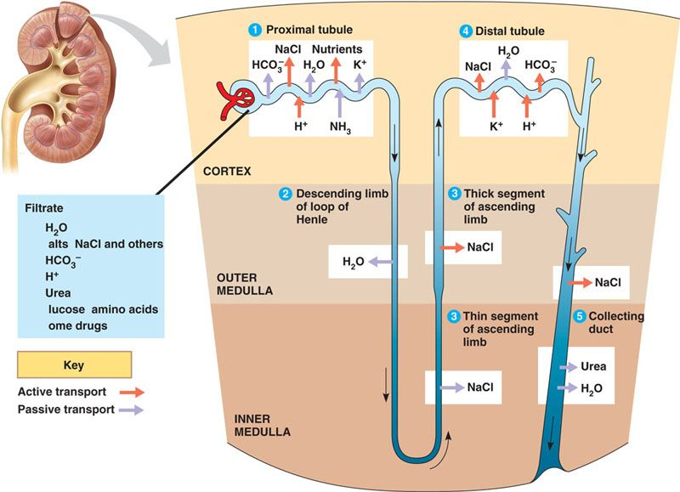
9
Male’s Slides
Buildup of Solute Concentration Into the Renal Medulla
1- Active transport of sodium ions and co-transporter of potassium, chloride, and other ions out of the thick portion of the ascending limb of the loop of the Henle into the medullary interstitium.
2- Active transport of ions from the collecting ducts into the medullary interstitium.
3- Facilitated diffusion of large amounts of urea from the inner medullary collecting duct into the medullary interstitium.
4- Diffusion of only small amounts of water from medullary tubules into the medullary interstitium, far less than the reabsorption of solute into the medullary interstitium (25% of solute is reabsorbed in the TAL) .

Slide 12
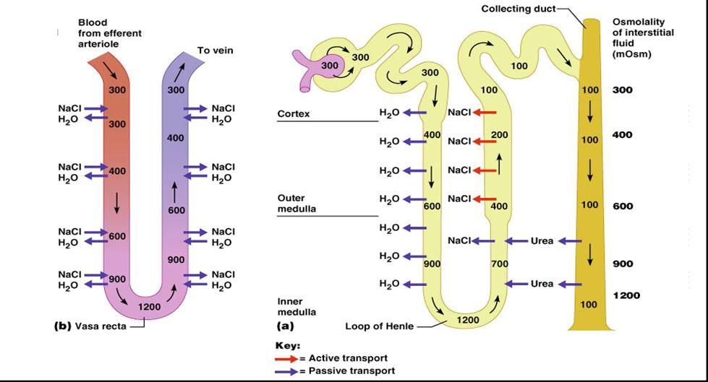
10
Counter- Current Mechanism
1- Mechanisms for excreting excess water.
3- Loops of henle of juxtamedullary nephrons establish hyperosmolality of interstitium of medulla, they’re called countercurrent multipliers
2- Mechanisms for excreting excess solutes.
4- Vasa recta maintain hyperosmolality established by countercurrent multipliers, they’re called countercurrent exchanger.

Slide 13
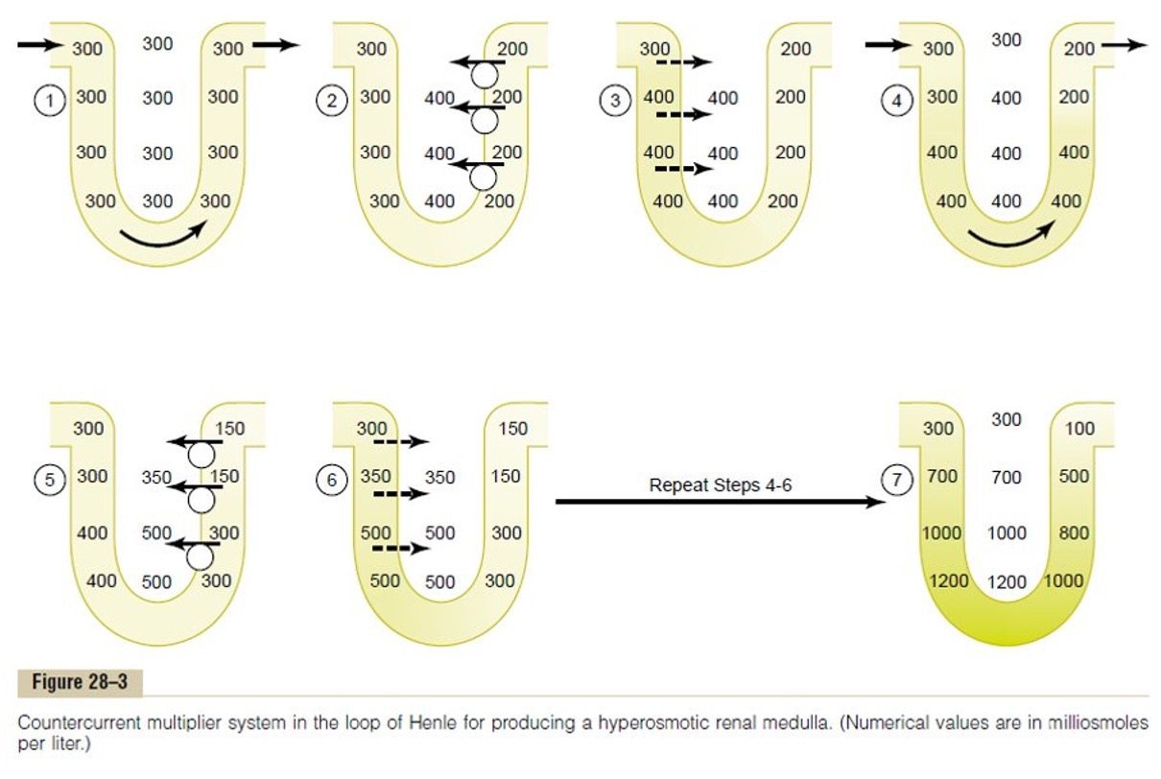
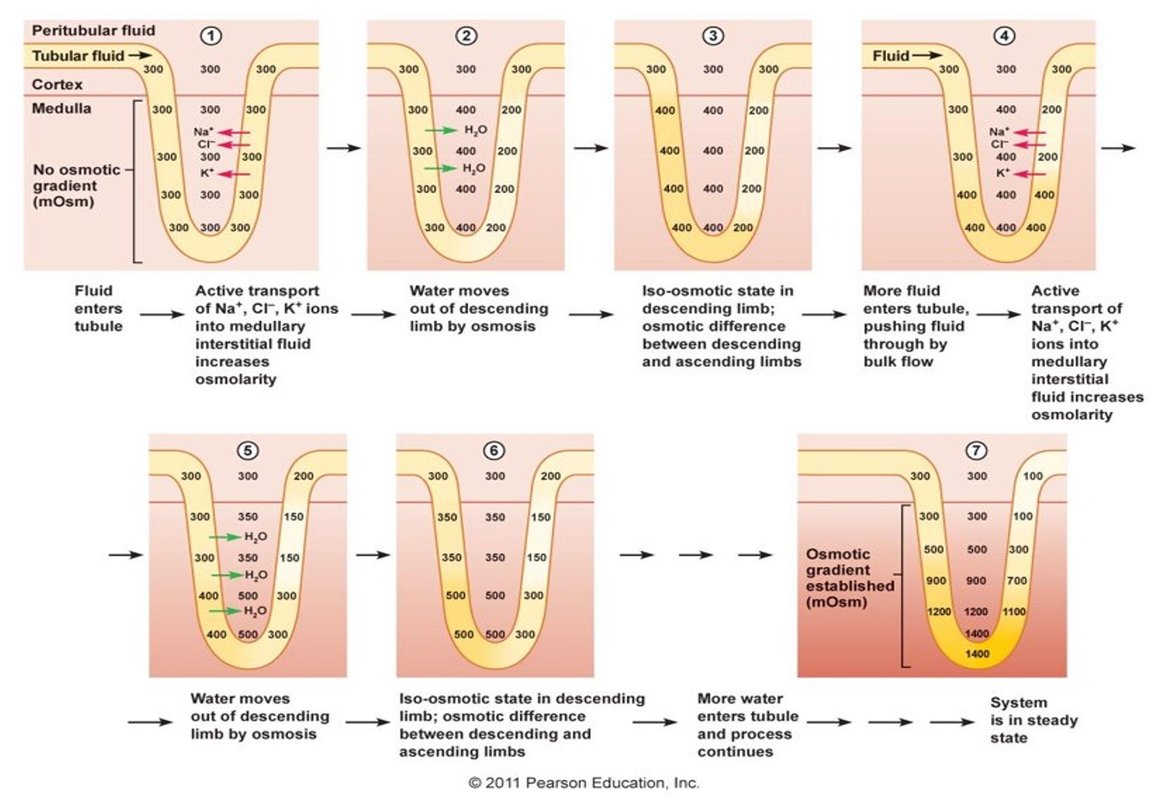
Countercurrent Multiplier Mechanism
11
Extra Click here
1
2
1
1- Pumps in the thick ascending limb can pump 100 mOsm/kg of Na+ and Cl– from the tubular fluid to the interstitium,
2
3
Water then moves out of the thin descending limb, and its contents equilibrate with the interstitium creating 200 gradien
5
3
4
additional flow of fluid into the loop of Henle from the proximal tubule
4
4
additional ions are pumped into the Interstitium making osm 500
5
once again, fluid in the descending limb reaches equilibrium with the hyperosmotic medullary interstitial fluid
1
The process can be explained using hypothetical steps, leading to the normal equilibrium condition, although the steps don’t occur in vivo.
2
The greater the length of the loop of Henle, the greater the osmolarity that can be reached at the tip of the medulla.

Slide 14
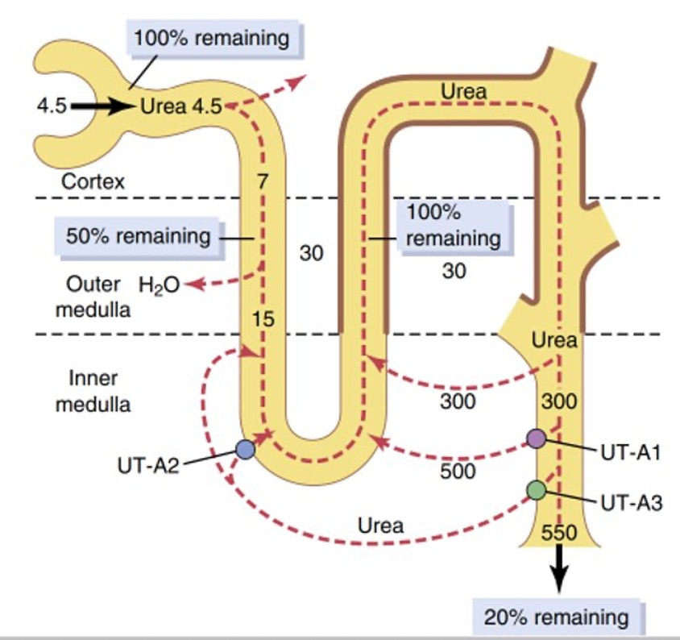
12
Urea Recirculation (Recycling)
Urea is the major nitrogen waste in the body.
It’s made in the liver by product of protein metabolism.
Female’s Slides
20-60% of urea is excreted in a healthy person depending on urine flow rate and hydration state
Urea contributes about 40 to 50 per cent of the osmolarity (500-600 mOsm/L) of the renal medullary interstitium when the kidney is forming a maximally oncentrated urine.
ADH causes water reabsorption
A specific urea transporters UT-AI & UT-A3 are activated by ADH,
PT reabsorbs about 50% urea.
TDH & TAH secrete about 50% urea.
ADH causes water and urea reabsorption
Recirculation of UREA

Slide 15
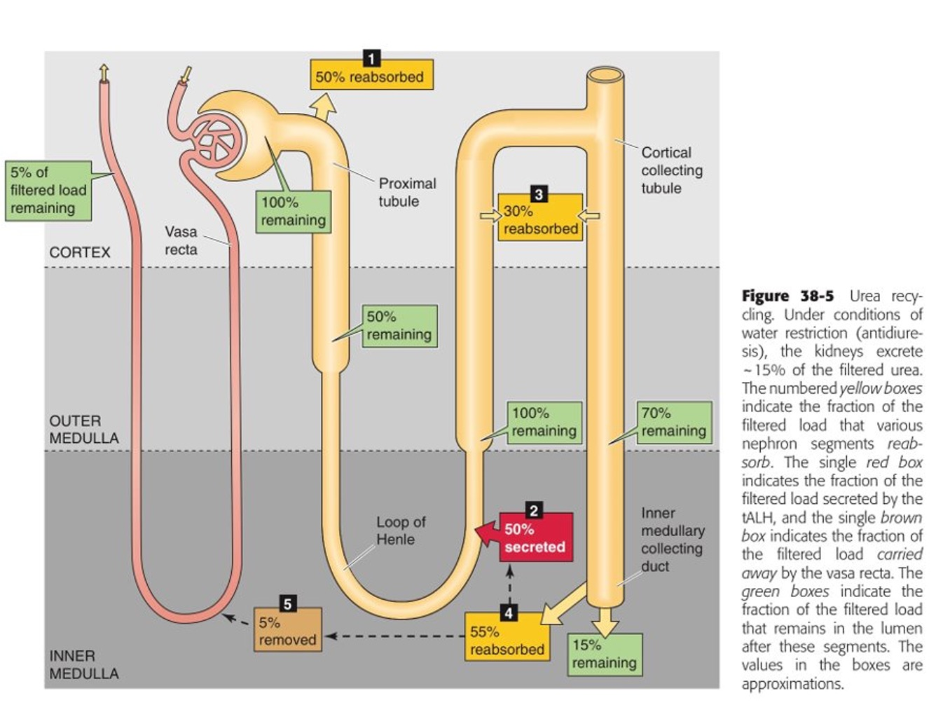
13
Urea Recirculation (Recycling)
Urea: Freely filtered across kidneys’ glomerular capillaries, travels through renal tubule.
Part of reabsorbed urea secreted back into loop of Henle→ “urea recycling”
Four steps to urea recycling:
50% of urea reabsorbed by simple diffusion in proximal convoluted tubule (leaving 50% of the initial urea).
Urea from medullary interstitium secreted into the tubule in descending limb of loop (100% remaining).
Ascending limb of loop of henle, early DCT is impenetrable to urea, water (urea levels stay the same). Thus, urea in cortical region (the heavy outline) shows a high conc. Of urea since the urea can’t be reabsorbed.
80% of the urea is reabsorbed in the juxtamedullary tubule, leaving 20% of the urea to be excreted.
From “Osmosis Notes”

Slide 16
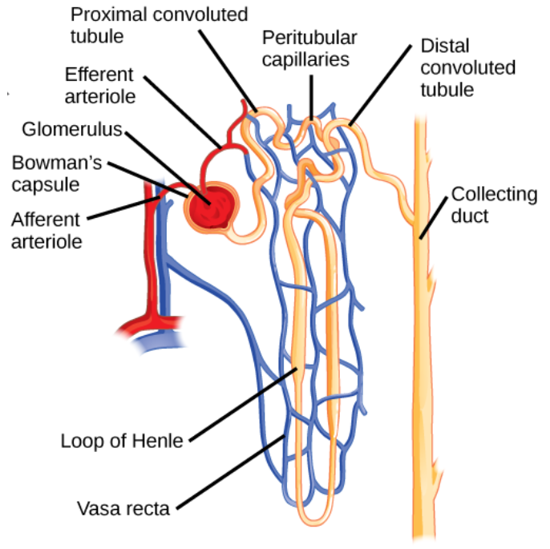
14
Two Special Features of the Renal Medullary Blood Flow
1
The medullary blood flow is low, accounting for less than 5% of the total renal blood flow. This sluggish blood flow is sufficient to supply the metabolic needs of the tissues but helps to minimize solute loss from the medullary interstitium.
2
The vasa recta serve as countercurrent exchangers, minimizing washout of solutes from the medullary interstitium.
Absorbed water is returned to the circulatory system via the vasa recta, which surrounds the tips of the loops of Henle. Because the blood flow through these capillaries is very slow, any solutes that are reabsorbed into the bloodstream have time to diffuse back into the interstitial fluid, which maintains the solute concentration gradient in the medulla. This passive process is known as countercurrent exchange. (From Khan Academy).

Slide 17
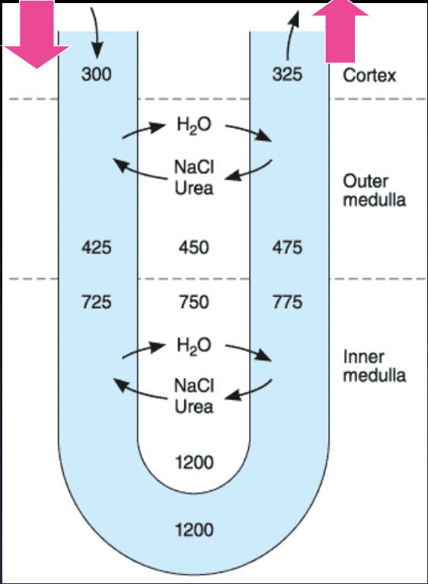
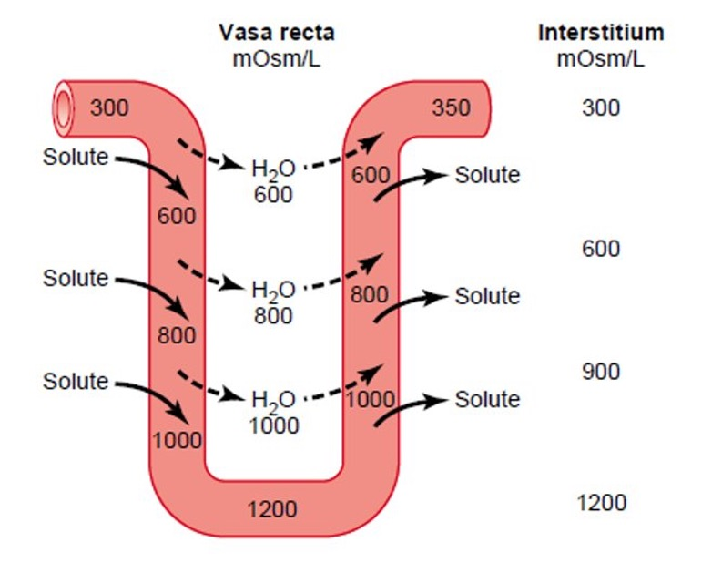
15
The Vasa Recta Is a Countercurrent Exchanger
1- Sluggish blood flow (1-2%).
Countercurrent exchangers have:
2- Close proximity..
3- High permeability
passive process
The solutes diffuse use out of the vessels conducting the blood the cortex and into the vessels descending into the pyramids (medulla). Conversely, water diffuses out of the descending vessels and into the fenestrated ascending vessels. Thus, the solutes tend to recirculate in the medulla and water tends to bypass it, so the hypertonicity is maintained.

Slide 18
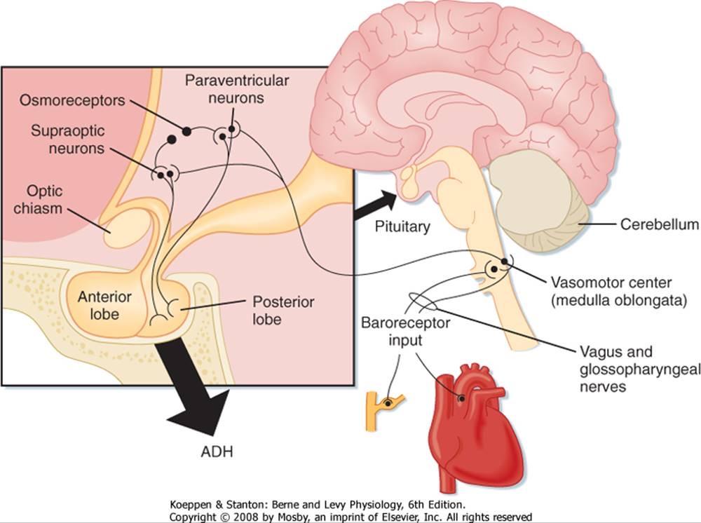
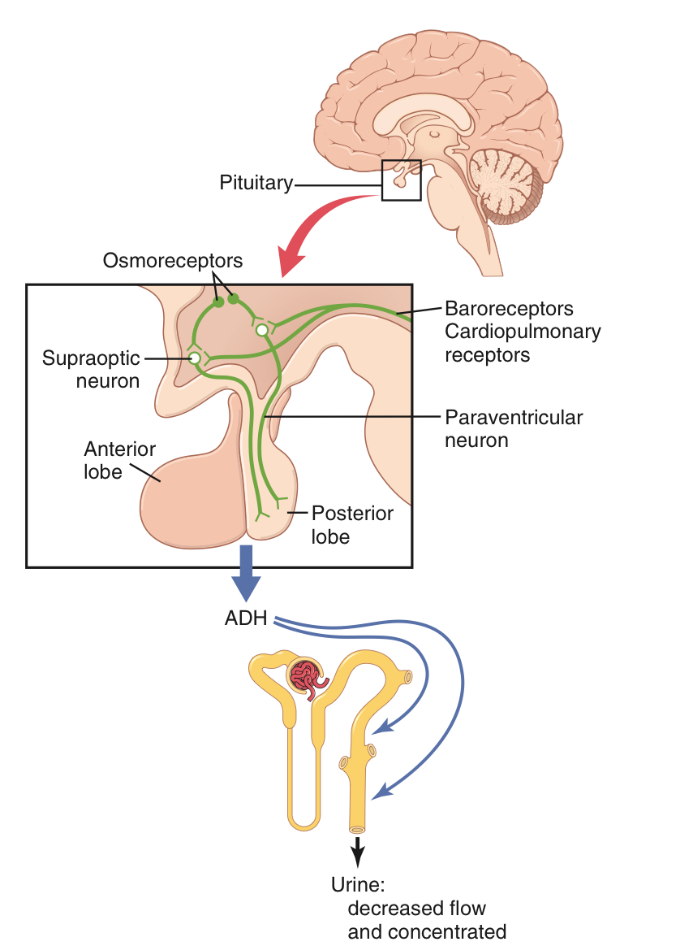
Female’s Slides
16
The regulation of ECF Osmolarity
Osmolarity =
Amount of solutes/volume of ECF (Water).
ECF osmolarity is governed by two main mechanisms
1
Osmoreceptor ADH feedback system
By modifying urine excretion which is the major output route of water
-MED439
2
Thirst mechanism
By modifying ingestion of water which is the major input route of it.
Thirst mechanism is activated by the same system that activates ADH secretion
Thirst mechanism
By modifying ingestion of water which is the major input route of it.
-MED439
-MED439
What is ADH/VP (AntiDiuretic Hormone)?
-MED439
1
ADH is hormone that’s produced (synthesized) in the
hypothalamus, stored (and released from) in posterior
lobe of the pituitary gland.
2
The hypothalamus contains two types of magnocellular large neurons that synthesize ADH:
The supraoptic and paraventricular nuclei of the hypothalamus.
3
Route of Synthesis:
➢ Both of these nuclei have axonal extensions to the posterior pituitary.
➢ Then ADH is transported down the axons of the neurons to their tips, terminating in the posterior pituitary gland to be released from there.
4
How is it released?
➢ When the supraoptic and the paraventricular ventricular nuclei are stimulated by increased osmolarity or other factors, nerve impulses pass down these nerve endings.
➢ ADH stored in the secretory granules (also called vesicles) of the nerve endings and is released in response to changes that occurred in the nerve endings membrane.

Slide 19
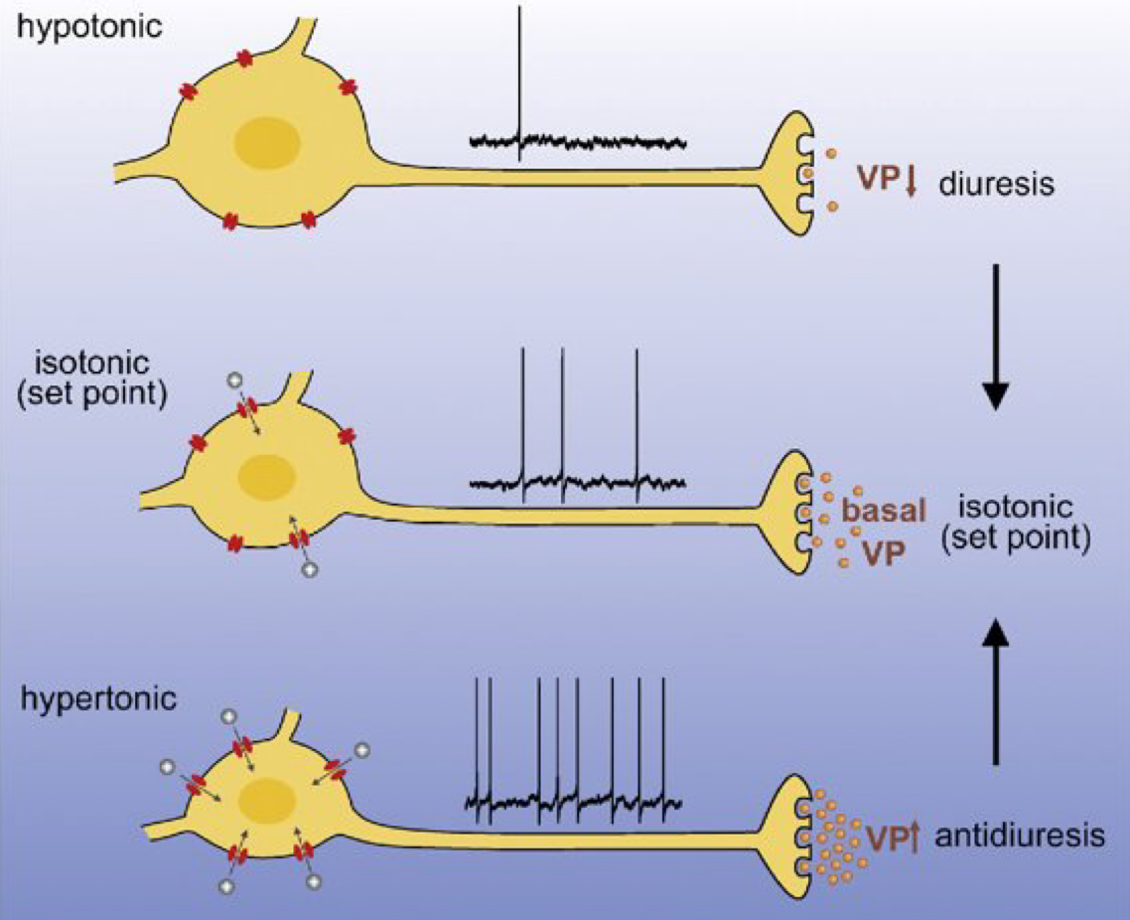
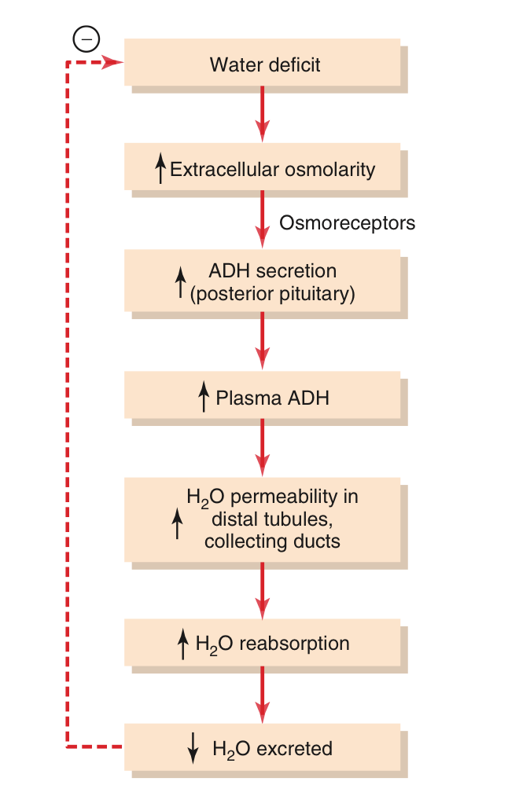
17
How osmoreceptors detect change in osmolarity?
1
An increase in extracellular fluid osmolarity
(which in practical terms means an increase in
plasma sodium concentration) causes the special
nerve cells called osmoreceptor cells, located in the anterior hypothalamus near the supraoptic nuclei, to shrink.
2
Shrinkage of the osmoreceptor cells causes them to
fire, sending nerve signals to additional nerve cells in the supraoptic nuclei, which then relay these signals down the stalk of the pituitary gland to the posterior pituitary.
3
These action potentials conducted to the posterior
pituitary stimulate the release of ADH, which is stored in secretory granules (or vesicles) in the nerve endings.
Hypertonic state | Hypotonic state
The osmoreceptors will shrink with the cell due to the osmolarity changes that occured in the ECF → increasing the firing rate to the nerve endings → stimulating the release of ADH. ^Based on girls doctor’s Notes ↑ Osmolality ➨ ↑ ADH release and ↑ H2O reabsorption in collecting ducts | The osmoreceptors will swell with the cell due to osmolarity changes in the ECF → decreasing the firing rate to the nerve endings → inhibiting the release of ADH. ^Based on girls doctor’s Notes ↓ Osmolality ➨ ↓ ADH release and ↓ H2O reabsorption in collecting ducts
4
ADH enters the bloodstream and is transported to
the kidneys, where it increases the water permeability of the late distal tubules, cortical collecting tubules, and medullary collecting ducts.
5
The increased water permeability in the distal
nephron segments causes increased water reabsorption and excretion of a small volume of concen­trated urine.
-MED439
-Guyton and Hall
Female’s slides
Osmoreceptor-ADH feedback mechanism for regulating ECF osmolarity

Slide 20
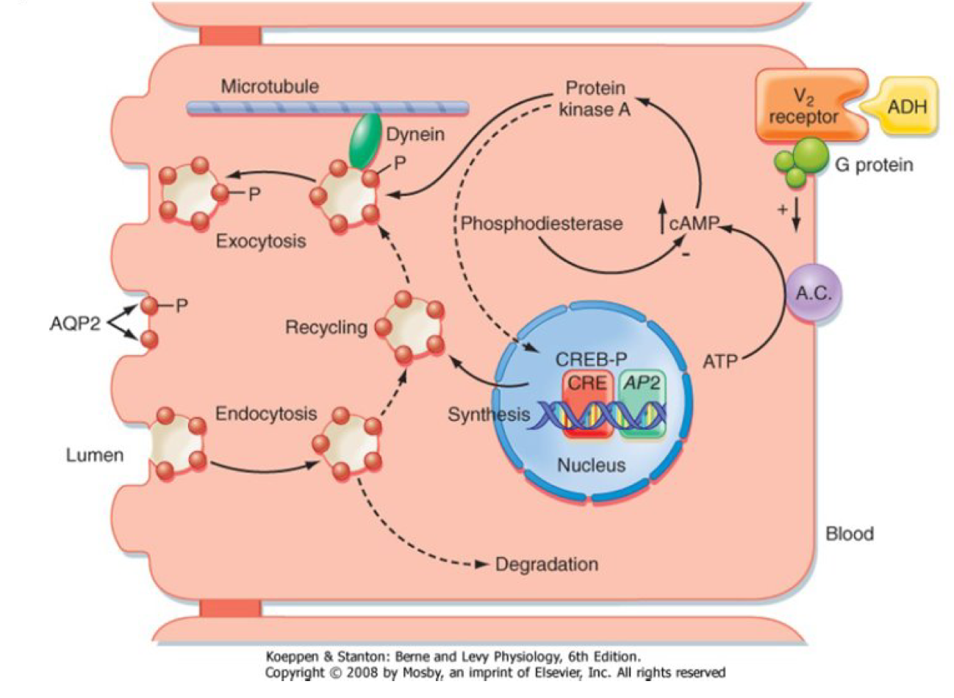
ADH Mechanism of action
18
Female’s slides
After ADH is released from the posterior pituitary gland, It will bind to V2 receptor that is present on the principal cells within the late distal tubule & collecting ducts, this will lead to multiple changes inside the cells that causes translocation of Aquaporins type II channel (AQP2) to the surface of the principal cells, which will allow water to move passively into the cell guided by the osmotic gradient.
Female’s slides
ADH secretion stimulants
Osmotic
Hemodynamic
Most important
Osmolarity of ECF
1% change in ECF osmolarity can significantly change ADH secretion.
Secretion of ADH in response to an osmotic stimulus is rapid, so plasma ADH levels can increase several folds within minutes, A decrease in blood pressure
thereby providing a rapid means for altering renal excretion of
water.
Blood volume and arterial blood pressure in the vascular system
5-10% in BV and/or ABP is required for ADH release.
-MED439
ADH is more sensitive to osmotic changes than hemodynamic changes (1% change stimulates ADH while hemodynamic differences need to reach 5- 10% to stimulate ADH

Slide 21
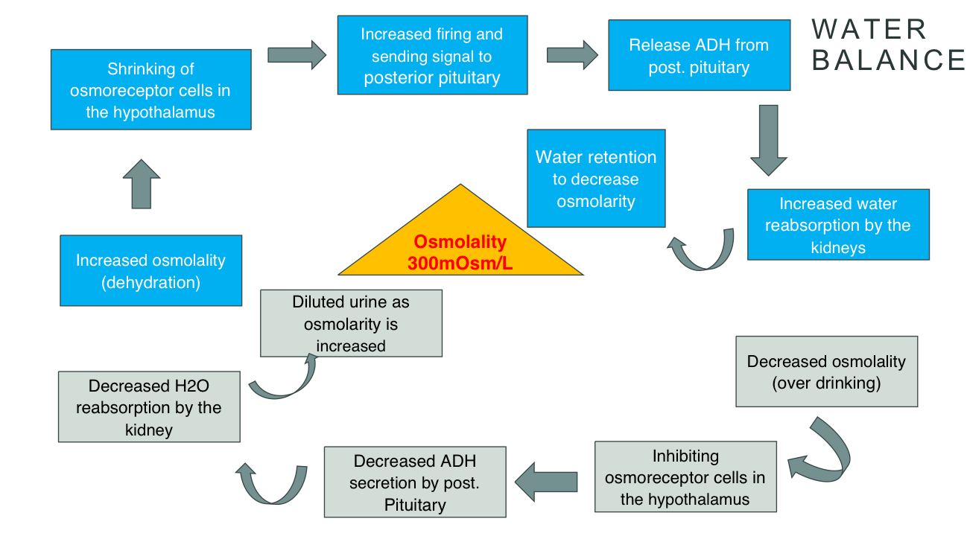
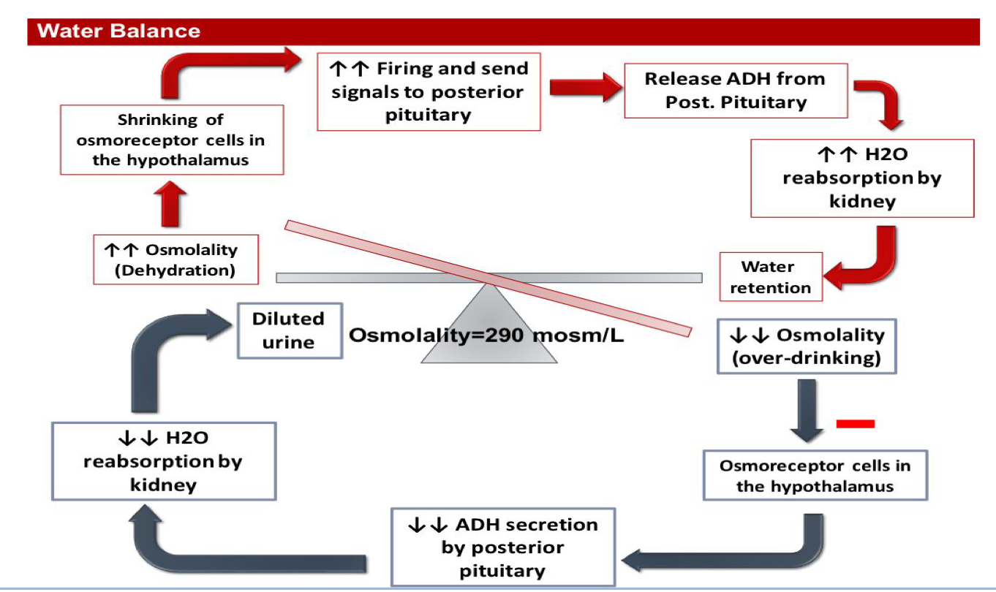
19
Factors that can alter ADH secretion
Increase ADH
Decrease ADH
Nausea
Hypoxia
Angiotensin II
Increase plasma osmolarity
Decrease blood volume
Decrease blood pressure
Drugs:
Morphine
Nicotine
Cyclophosphamide
ANP (Atrial natriuretic peptide)
Decrease plasma osmolarity
Increase blood volume
Increase blood pressure
Drugs:
Alcohol
Clonidine
Halopreidol (dopamine blocker)
Female’s slides

Slide 22
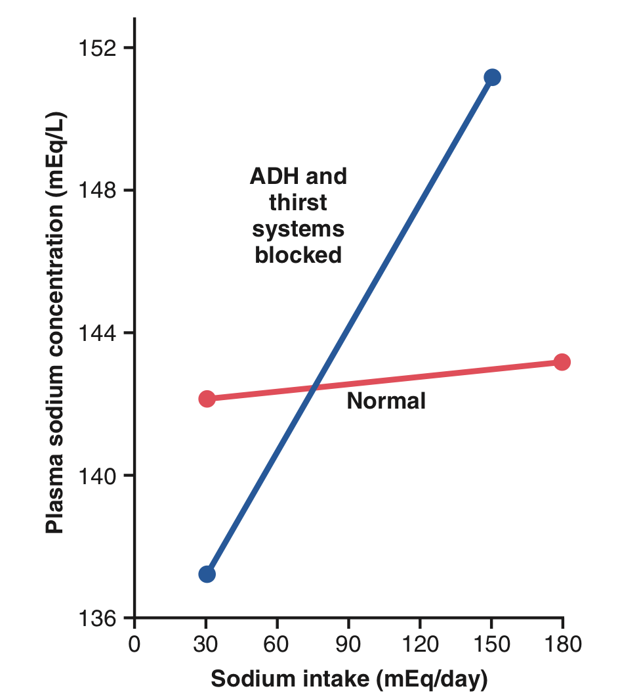
20
Abnormalities of ADH secretion
Excessive ADH
E.g. SIADH
Leads to:
•High ADH levels. •Water retention.
•ECF hypo-osmotic
•Urine-hyperosmotic
Female’s slides
Means that the urine will have a small volume but it’s highly concentrated
Inadequate ADH
E.g. Diabetes insipidus
Nephrogenic Due
to Mutations in
V2 receptors or AQP2 that Cannot respond
to ADH.
Leading to
•Polyuria
•Polydipsia
Central due to decreased release of ADH from posterior pituitary. E.g. Trauma
Leading to
•Polyuria
•Polydipsia
Diabetes insipidus : A condition where the permeability of the distal tubules and collecting ducts to water is low, causing the kidneys to excrete large amounts of dilute urine.
-Guyton and Hall
2.Thirst mechanism
Definition
Thirst is the conscious desire for water
Importance of thirst and ADH mechanisms in regulating ECF osmolarity
Factors that increase thirst
Factors that decrease thirst
Increased osmolarity
Increased Angiotensin II
Decreased blood volume/pressure
Mouth dryness
Decreased osmolarity
Decreased Angiotensin II
Increased blood volume/pressure
Gastric distention
Effect of large changes in sodium intake on extracellular fluid sodium concentration in dogs under normal conditions.
(red line) and after the antidiuretic hormone (ADH) and thirst feedback systems had been blocked (blue line).
Note that control of extracellular fluid sodium concentration is poor in the absence of these feedback systems.
-MED439

Slide 23
21
Female’s slides
Water diuresis vs Osmotic diuresis
Water diuresis | Osmotic diuresis
Increased urine flow rate but NO change in urine solutes excretion | Increased urine flow rate AS WELL AS urine solutes excretion
Causes: Excess water intake Lack of ADH Defect in ADH receptor in the distal segment of the nephron (nephrogenic diabetes insipidus) | Causes: Increased plasma glucose level (DM) Increased levels of poorly reabsorbed solutes and anions Diuretic drugs (Lasix)
Diuresis is mainly due to decreased water reabsorption in distal segment of the nephron. No change in water reabsorption proximally. | Diuresis is mainly due to decreased solutes reabsorption in the distal segment of the nephron. reabsorption in PCT or LOH. This solute No change in water reabsorption proximally. reabsorption reduction causes water reabsorption reduction proximally and distally
Increased urine volume is a result from increased excretion of pure water. | Increased urine volume is a result from increased excretion of osmotically active solutes which pulls water with them.
Urine osmolality falls far below plasma osmolality | Urine osmolality falls but remains above plasma osmolality
Only about 15% filtered load of water reaching distal segments may remain unabsorbed and excreted in urine (max urine volume 20 ml/min) | Due to decreased water in all segments of the nephron, a much greater fraction of filtered water maybe excreted volume more than 20 ml/min
ADH administration will stop diuresis if due to lack of ADH. ADH administration will not be effective in nephrogenic diabetes insipidus. | ADH administration will not stop diuresis.

Slide 24
22
Countercurrent Multiplier Mechanism Extra
Countercurrent multiplication moves sodium chloride from the tubular fluid into the interstitial space deep within the kidneys. Although in reality it is a continual process, the way the countercurrent multiplication process builds up an osmotic gradient in the interstitial fluid can be thought of in two steps:
The single effect. The single effect is driven by active transport of sodium chloride out of the tubular fluid in the thick ascending limb into the interstitial fluid, which becomes hyperosmotic. As a result, water moves passively down its concentration gradient out of the tubular fluid in the descending limb into the interstitial space, until it reaches equilibrium.
Fluid flow. As urine is continually being produced, new tubular fluid enters the descending limb, which pushes the fluid at higher osmolarity down the tube and an osmotic gradient begins to develop.
As the fluid continues to move through the loop of Henle, these two steps are repeated over and over, causing the osmotic gradient to steadily multiply until it reaches a steady state. The length of the loop of Henle determines the size of the gradient - the longer the loop, the greater the osmotic gradient.
For more detailed information, you can visit the link

Slide 25
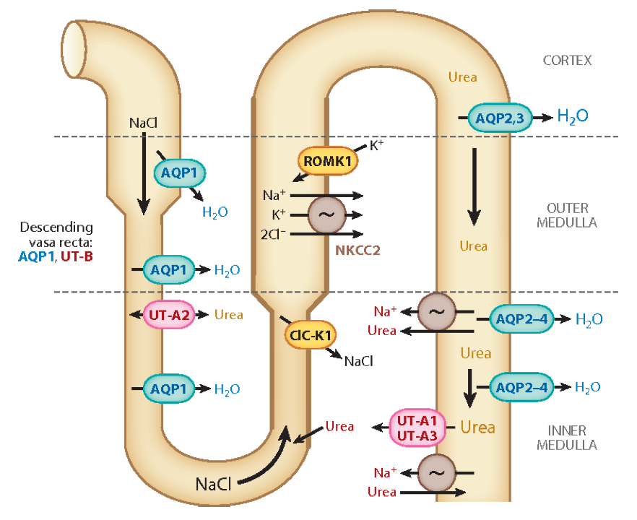
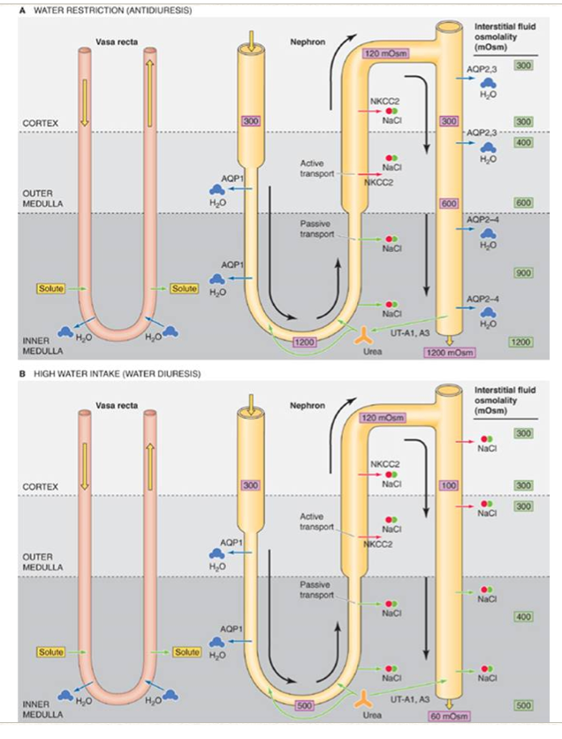
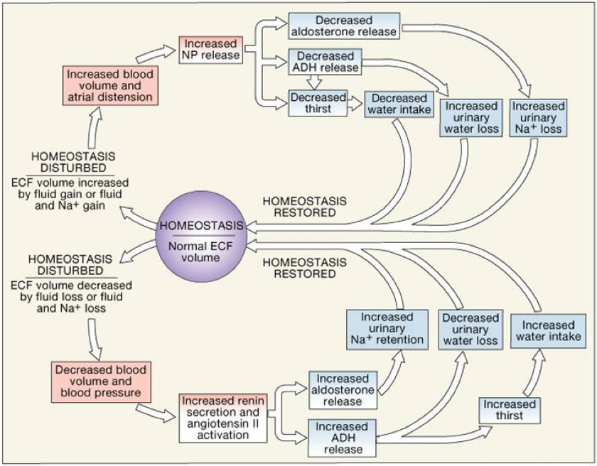
23
Female’s slides
Review
Summary

Slide 26
Quiz
Q1
What’s the significance of the proximity of Henle’s loop and Vasa Recta?
Maintain Osmolarity.
Maintain the concentration of water.
For reabsorption of nutrients.
No proximity at all.
Q2
What’s meant by the counter-current?
When the blood flow in the same direction in the two limbs of Henle’s.
When the blood flow in the opposite direction in the two limbs of Henle’s
When the blood doesn’t flow through loop of Henle’s limbs.
When the blood flow is the same in the vasa recta and the loop of henle’s.
Q3
How did the renal medulla interstitium become hyperosmotic?
By countercurrent multiplier mechanism.
By ADH/AVP (Urea recirculation- recycling).
A & B.
Countercurrent exchanger.
Q4
Which one of the following abnormalities causes ECF-Hypo-osmotic?
SIADH
Diabetes insipidus
Diabetes mellitus
IDK

Slide 27
Quiz
Q5
Which one of the following stimuli increase ADH?
Decrease blood volume
Increase blood volume
Alcohol
Decrease osmolarity
Q6
The type of Diabetes insipidus that is caused due to mutation in V2 receptors or AQP2 is ……
Central
SIADH
Nephrogenic
None of the above
Answers: 1-A , 2-B, 3-C, 4-A, 5-A, 6-C
SAQs
What’s obligatory urine volume? If a person excretes 800mOsm/ day of solutes, calculate his obligatory urine volume.
Answers:
P1 of the question is in slide 1 as well as for the equation required to answer p2 of the question. Answer is 0.67 l/day.
SAQs
why doesn’t the blood that flow through the vasa recta wash out the medullary hyperosmotic gradient?(from slides)
Answers:
1-medullary blood flow is low(<5% of renal blood flow
2-the vasa recta serve as a counter current exchanger

Slide 28
Members
Team Leaders
Razan Almohanna
Khalid Alrasheed
Raneem Alwatban
Othman Alabdullah
Team Members
Nawaf Alrefaei
Nouf aldhalaan
Theme was done by Shatha Almutib
physio442@gmail.com

