Slide 1
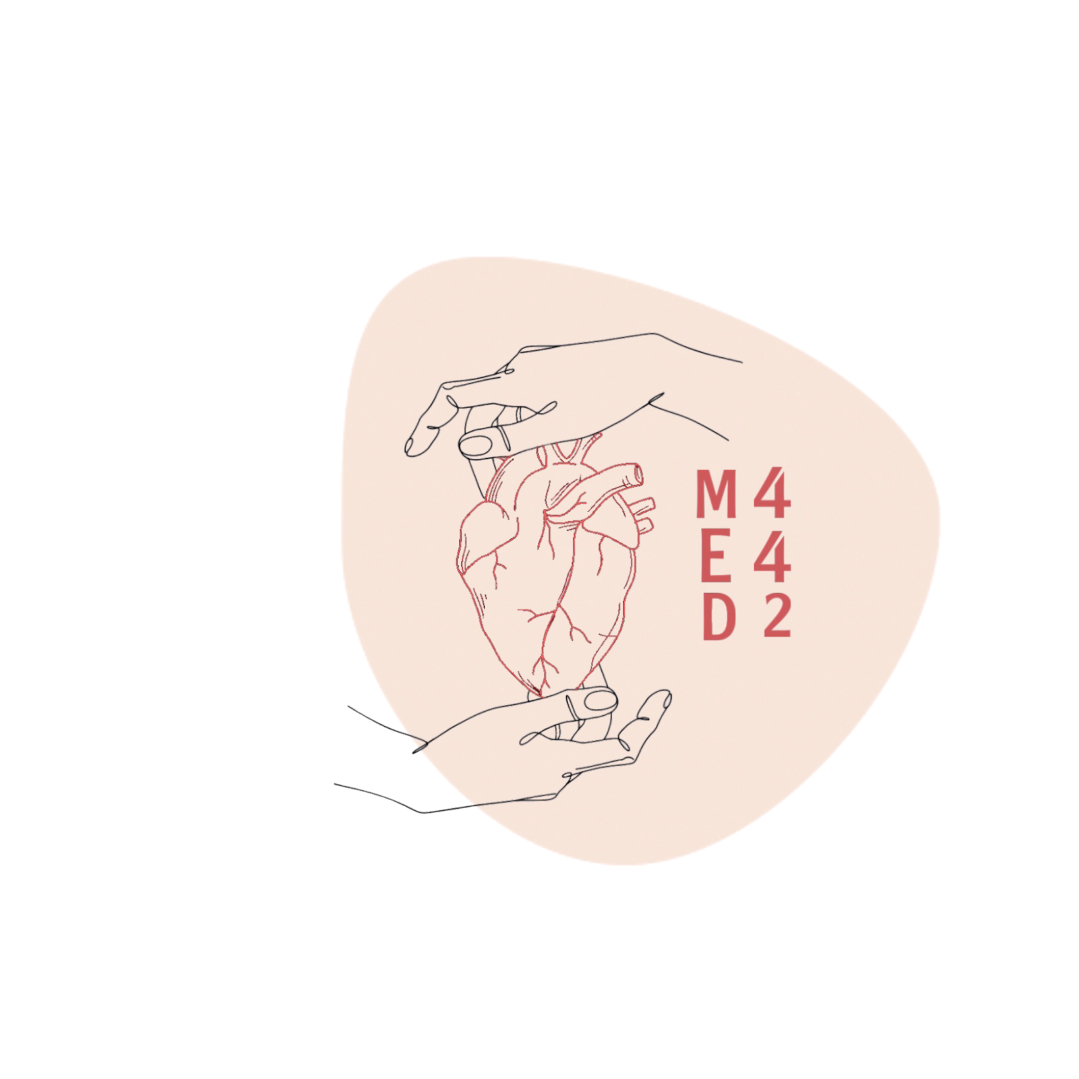
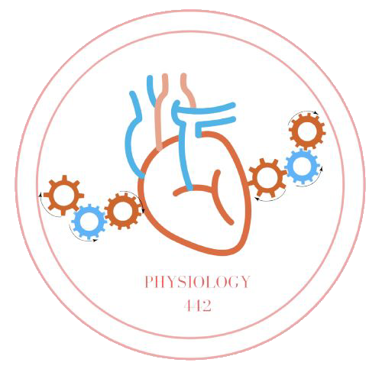
Regulation of Body Fluids
L8
Renal Physiology
Editing File
- Color Index:
Main Text
Male’s Slides
Female’s Slides
Important
Doctor’s Notes
Extra Info

Slide 2
Objectives
Identify and describe the role of the sensors and effectors in the renal regulation of body fluid volume.
Describe the role of the kidney in regulation of body fluid volume & osmolality.
Identify the site and describe the influence of aldosterone on
reabsorption of Na+ in the late distal tubules.
Understand the role of ADH in the reabsorption of water
and urea

Slide 3
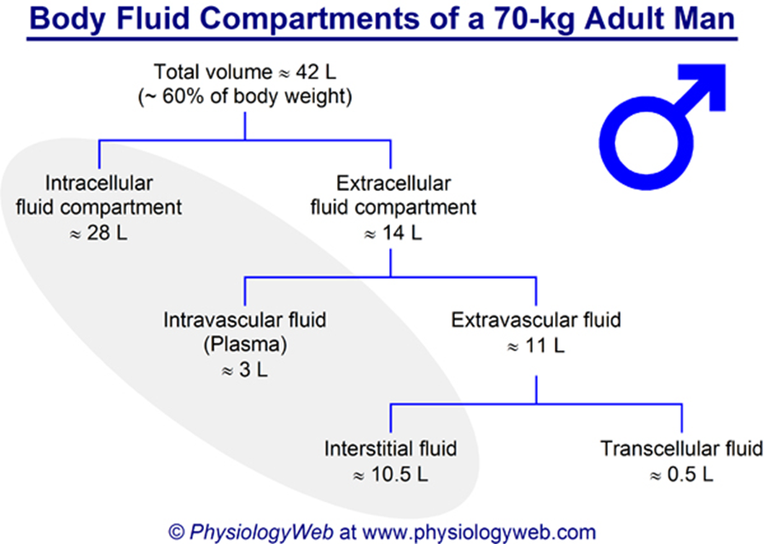
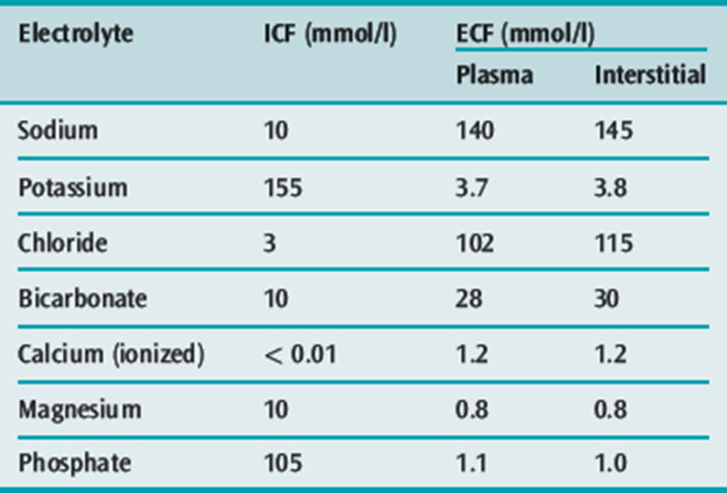
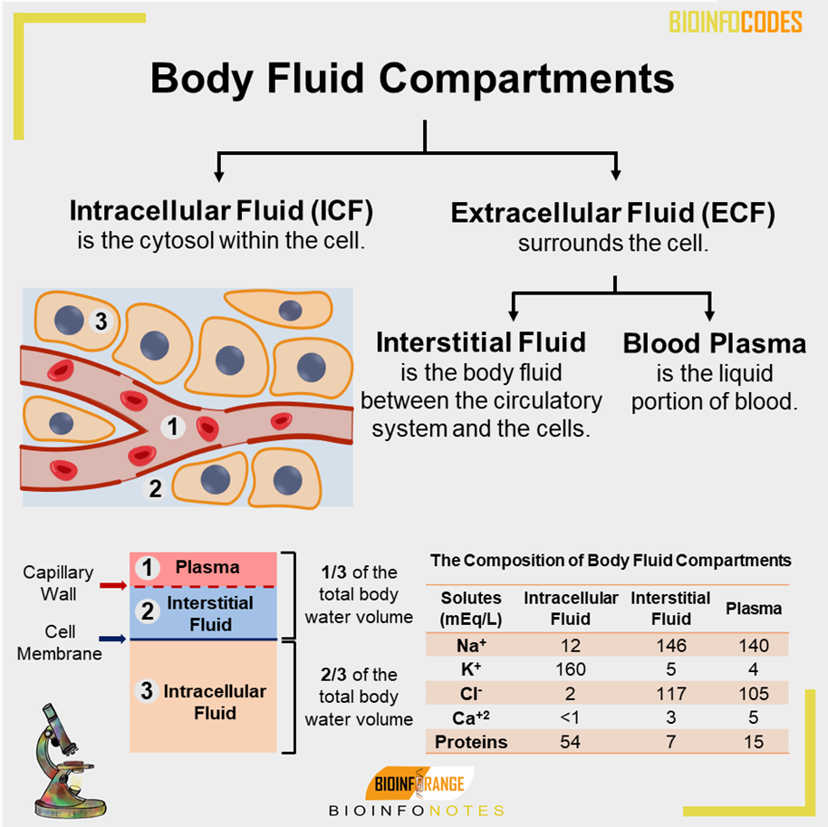
1
Body Fluids
Females’ Slides
Body fluid compartments :
1
intracellular fluid
2
Extracellular fluid (interstitial fluid and blood plasma)
3
Transcellular fluid (synovial, peritoneal, pericardial, and intraocular spaces, cerebrospinal fluid)
In a 70-kilogram adult man, the total body water is about 60 percent of the body weight, or about 42 liters.
This percentage depends on age, gender, and degree of obesity
Na+ is the main osmotic component of ECF

Slide 4
2
Regulation of ECF
Males’ Slides
Renal Regulation of ECF Volume & Osmolality:
Is a reflex mechanism in which variables reflecting total body sodium and ECV are monitored by appropriate sensors.
•Regulation of ECF volume
•Regulation of body Na+
•Regulation of BP
Thus, regulation of Na+ is also dependent upon baroreceptors.
Female slide
Regulation of ECF
Control of ECF
volume
The two systems use different;
Sensors
Hormonal transducers
Effectors
Control of ECF
osmolarity
Regulated by:
Adjusting total body Na+ content (Na Excretion-either ↑ or ↓ )
Regulated by: Adjusting total body H2O content (H2O Excretion-either ↑ or ↓)
Why is it important to regulate ECF volume & osmolarity ?
Determines;
blood pressure
→ tissue perfusion
Affect;
Cell volume → cell
function
Why Na+ regulates ECF?
Na+ is the most abundant solutes in the ECF & when we move Na from one compartment to another, water moves with it. This is due to the osmotic gradient created by the movement of Na.

Slide 5
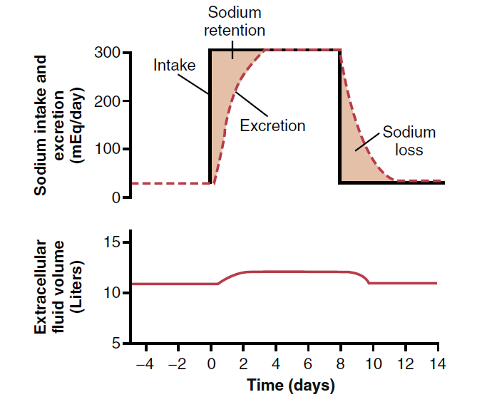
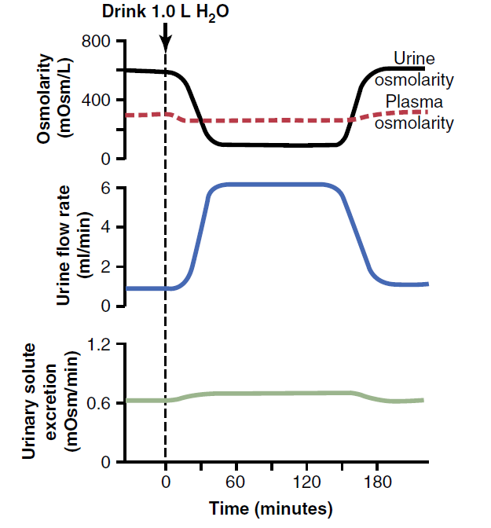
6
ECF Volume
Females’ Slides
the most abundant cation in ECF is Na
The most abundant anions in ECF are Cl and HCO3
How is the body volume linked to Na+ regulation?
Na+ is the main osmotic constituent of ECF, when Na+ moves, it drags water with it.
↑↑Na in ECF
1-↑↑H2O kidney reabsorption
2-stimulate thirst
↑↑ECF osmolarity
Increase ECF volume
Sodium in Fluid and Electrolyte Balance :
The role of sodium in controlling ECF volume and water distribution in the body is a result of:
-Sodium being the only cation to exert significant osmotic pressure.
-Sodium ions leaking into cells and being pumped out against their electrochemical gradient.
Sodium concentration in the ECF normally remains stable
Male slide
Increase in sodium intake
Control of salts take days unlike the water which can be controlled in 3 hours
However, during the 2 to 3 days of renal adaptation to the high sodium intake, there is a modest accumulation of sodium that raises extracellular fluid volume slightly and triggers hormonal changes and other compensatory responses that signal the kidneys to increase their sodium excretion.
Increase in water intake

Slide 6
7
Sodium Balance
Female slide
Sodium Balance
input | output
Dietary intake | Kidney most important
RDA=1.5-2.3 g/day ( RDA= Recommended Dietary Allowance ) | GI loss (minor pathway under normal condition)
Actual content in western diet = 7g/day | Sweat (minor pathway under normal condition)
Distribution of the Na+ in the body:
The body of an average adult male contains about 4000mEq of Na+ distributed as follows:
1-Intracellular: Intracellular Na+ concentration is 10mEq/L.28L of ICF would contain 280mEq of Na+.
2-Extracellular: Na+ concentration in ECF is about 145mEq/L,14L of ECF would contain 2100m Eq,the bone contains 2500mEq
Body sodium distribution
ECF
(65%)
Exchangeable
ICF
(5-10%)
Exchangeable
Bones
(25-30%)
as Na apatite salts

Slide 7
4
Fluid Ingestion
Fluid ingestion
Males’ Slides
Isotonic Fluid
Hypo-osmotic Fluid
Hyper-osmotic Fluid
isotonic infusion
Sudden decrease in ECF Osmolality
Sudden rise in ECF Osmolality
Increase ECF = Extracellular Expansion
Increase ICF = Cellular Edema
Decrease ICF
= Cellular Dehydration
Increase ECF
=Extracellular Expansion
Potential risk
Changes in Osmolality: Infusion Isotonic Fluid
before
ICF
280mOsm/kg
3360mOsmoles
12 liter
ECF
280mOsm/kg
1680mOsmoles
6 liter
1L Isotonic NaCl (280 mOsmol/L)
(NaCl 0.9%)
H2O
18kg = liter
after
ICF
280mOsm/kg
3360mOsmoles
12 liter
ECF
280mOsm/kg
1960mOsmoles
ECF expansion
7 liter
H2O
19kg = liter
ANP
It will take 24 hours to excrete 1 liter of isotonic saline ingested by them.

Slide 8
8
ECF Volume Regulation
Female slide
1.What does the body sense ?
The body does not sense ECF volume But it senses Effective circulating volume (ECV).
ECV: a functional blood volume that reflects the extent of tissue
perfusion in specific regions,as evidenced by the pressure in their blood volume.
ECV reflects adequacy of circulation.Fullness & pressure in the vessels.
Effective circulating Volume
Increase in
ECF volume
Increase in
ECV
Increase in
ABP & tissue
perfusion
Normal ECF
Volume
Normal ECV
Normal ABP and Adequate tissue perfusion
Decrease in
ECF volume
Decrease in
ECV
Decrease in
ABP & tissue
perfusion

Slide 9
9
ECF volume regulation
2.What are the sensors?
Changes in ECV: All down to Na+ balance i.e. absorption & excretion
Baroreceptors
CNS
Vascular “Central”
Liver
Low pressure sensors :
(Cardiac atria , Pulmonary vasculature)
High pressure sensors:
1- carotid sinus 2- aortic arch 3- juxtaglomerular apparatus (Renal afferent arteriole).
3.What are the effectors?
Stimulated Baroreceptors (due to change in ECV) will generate:
Neural pathway
Hormonal pathway
A-Sympathetic Nervous system:
B-RAAS
C-ANP
D-ADH
↓ECV→↑ ADH
Its role is thought to be especially important during stressful conditions, e.g. hemorrhage.
↓ ECV → ↓Blood pressure → Stimulate SNS through baroreceptors:
Direct effect:
↑ Na+ reabsorption by PCT
Indirect effect:
Stimulate renin release from JGA:
↑aldosterone ↑angiotensin II
↑ Renal vascular resistance

Slide 10
10
B-The Renin-Angiotensin-Aldosterone System (RAAS)
↓ABP,
↓NaCl concentration at macula densa, ↓renal perfusion
↓ ECV
Occurs during: Hemorrhage, Dehydration, Shock, Hypotension
↑Renal Na+ counteracts ↓ ECV
↓Stretch of baroreceptors in the afferent arterioles due to low BP
Angiotensin-II Long Term Regulation of Arterial Pressure Negative feedback
ACE
(lung)
Angioten-
sinogen
–Renin→
Angiotensin-I
Causes granular cells in JGA to release Renin
Angiotensin II causes increased vasoconstriction and stimulates adrenal gland (via AT1 receptors) to increase ADH secretion, retaining water, and increasing aldosterone causing Na+ reabsorption; eventually increasing ABP.
Aldosterone↑ Na reabsorption (Na+ permeability) in exchange with K or H excretion (k secretion) at the principle cells of DCT & CD by:
↑Number of Na+ channels at the apical membrane.
Increase and Stimulate Na-K pump at basolateral membrane.
↑K+ & Na+ permeability at luminal plasma membrane
↑Cell metabolism
All of these result in k secretion.
Sweat glands respond slow to aldosterone, requiring several days, unlike the kidneys,
↓ECF → Hypothalamus stimulation → ↑ADH (vasopressin) → ↓water excretion by kidney → ↑ECF

Slide 11
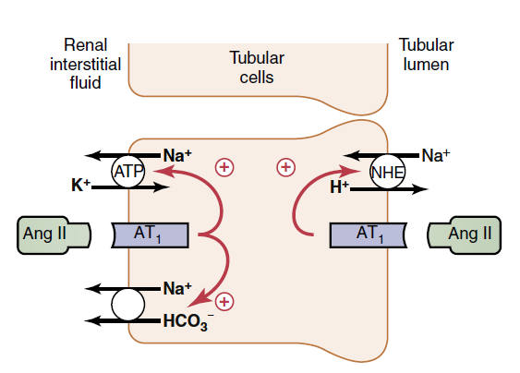
11
Actions of Angiotensin II
↑reabsorption of Na+ at PCT, loops of henle, and distal tubules, and collecting tubules.
direct stimulation of Na-K ATPase and Na-H countertransport at luminal membrane and sodium-bicarbonate cotransporter at basolateral membrane
Angiotensin II constricts the efferent arterioles; peritubular capillary dynamics → ↑sodium +water reabsorption.
↑Aldosterone (Mineralocorticoids)↓↓Na+ excretion↑↑ Na+ reabsorption
Vasoconstriction
lead to↑ BP
↑ ADH ↑water absorption
Released from posterior pituitary gland
↑thirst
In hypothalamus
Renin secreted by:
1-↓perfusion pressure
2- Sympathetic stimulation via B1
3-↓Na+ reaching macula densa
Angiotensin II
Adrenocorticotropic hormone
High potassium
Sodium deficiency
Atrial natriuretic hormone
High sodium concentration
Potassium deficiency
Stimulatory agents
ALDOSTERONE
Inhibitory agents

Slide 12
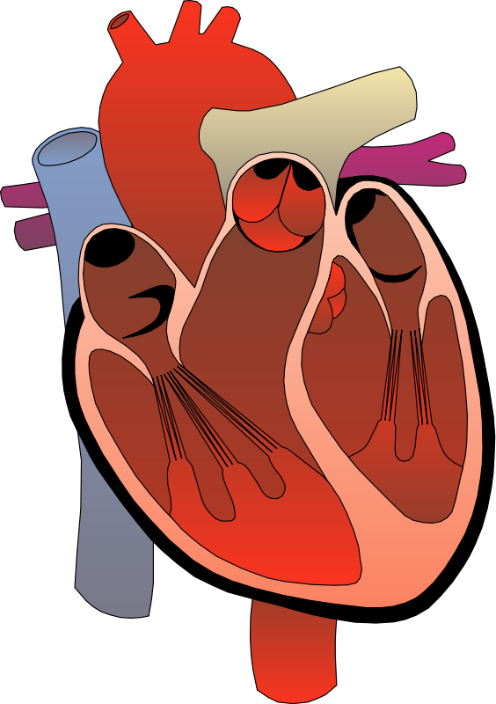
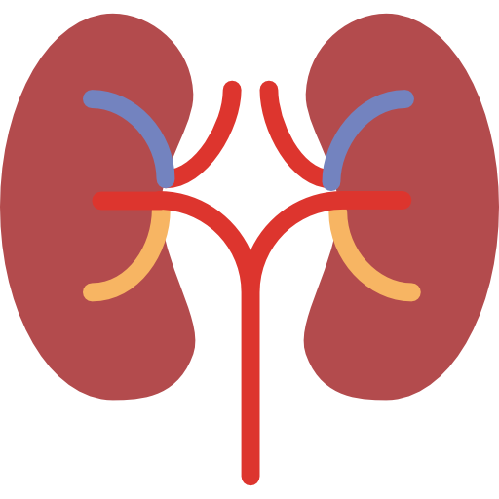
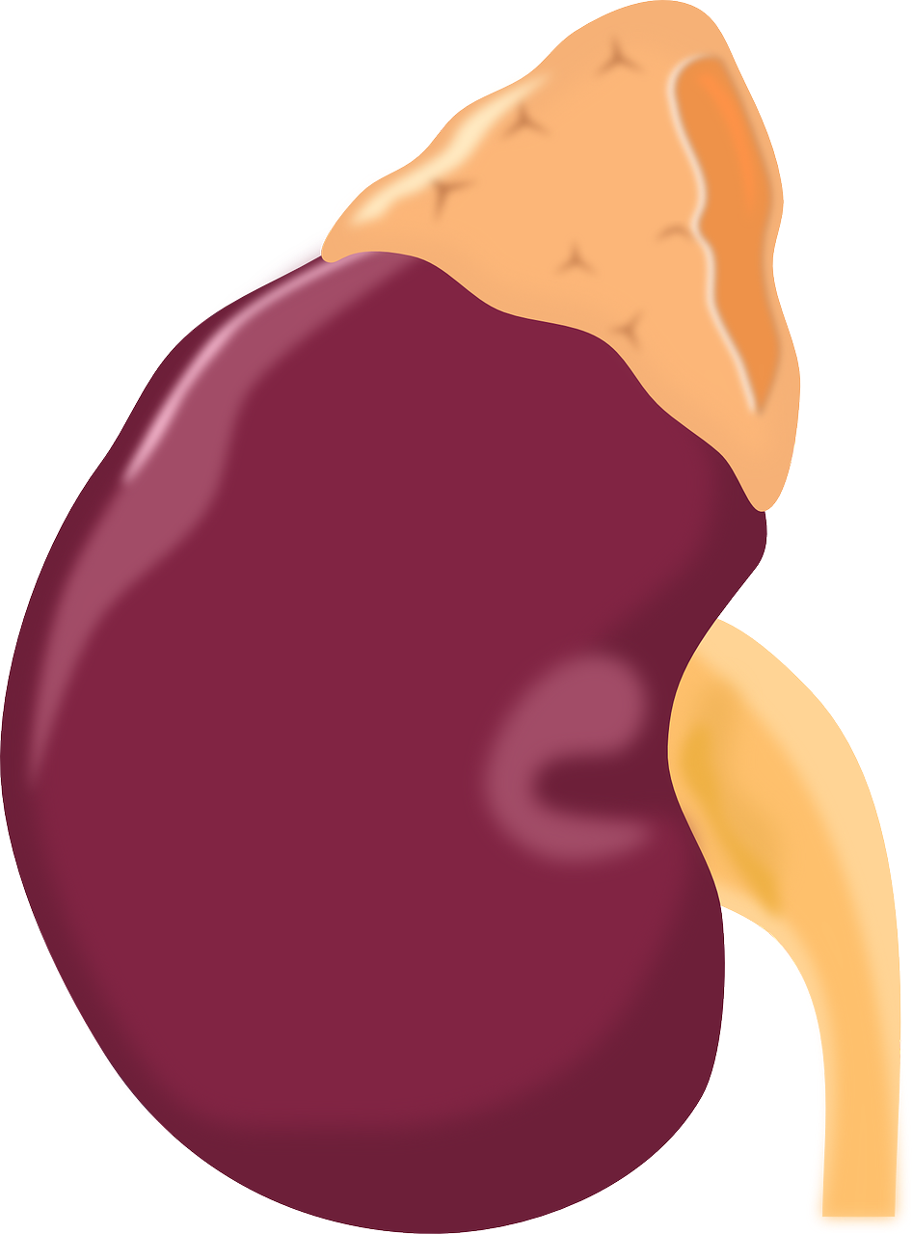
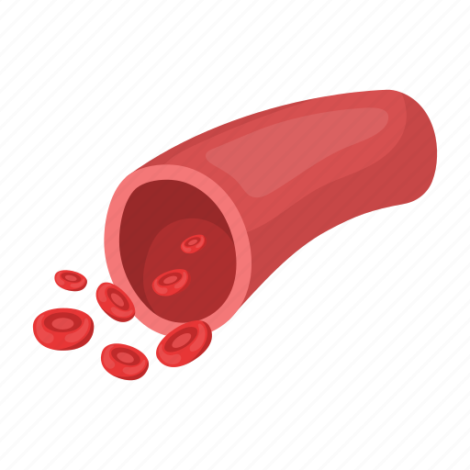
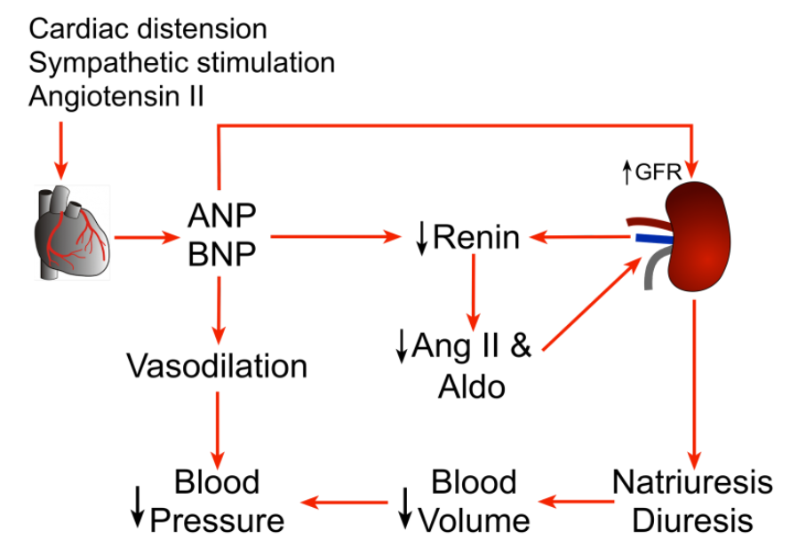
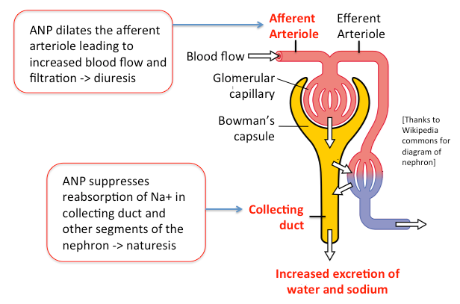
12
C-Atrial Natriuretic Peptide (ANP)
ANP promotes natriuresis (Na+ excretion)
Secreted by atrial myocytes in response to stretch
1
relaxation of mesangial cells, vasodilation of afferent arteriole and
vasoconstriction of efferent →↑GFR
2
↓ADH release
3
↓renin release (inhibition)
4
↓Na+ reabsorption at CD→natriuresis by inhibiting: -Na+ channels at
apical membrane. -Na+-K+ ATPase at basolateral membrane
5
↓direct aldosterone release (inhibition)
6
↑capillary permeability→extravasation of fluid +↓blood pressure.
7
Relaxation of smooth muscle in arterioles and venules → vasodilation
8
Dilation of afferent arterioles → ↑ blood flow and filtration →diuresis
Male’s slide
↑ECV
↑ANP release
Atria is stretched
Natriuresis, Diuresis + ↓Renin
↓Aldosterone→ ↓Angiotensin II
Female’s slide
Vasodilation

Slide 13
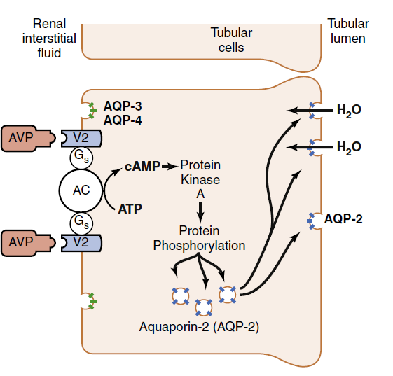
13
D-Antidiuretic hormone (ADH)/ Vasopressin
↓ECV→↑ ADH
water reabsorption
stimulate thirst center
1
2
↑Osmolarity and ↓ECV (↓blood volume), hypoxia
Stimuli for thirst is similar to osmoreceptors which produce and release ADH.
Major mechanism for causing sensation of thirst is an “intracellular dehydration” mainly due to ↑Osmolality of extracellular fluid
Stimulate Osmoreceptor in the lateral Hypothalamus (stimulate thirst)
Low Pressure Receptors;
Atria Aortic Carotid Pulmonary
Posterior pituitary gland release ADH
Mechanism of action of arginine vasopressin (AVP) on the epithelial cells of the late distal tubules, collecting tubules, and collecting ducts.
V2 receptors Antidiuretic action Water retention Via Aquaporin II channels
V1 receptors Vasopressor action
↑H2O permeability, reabsorption
↓H2O excretion
Monitoring water intake by GIT
(Gastric distention)
↓Blood volume
↓Plasma Osmolarity
↑Plasma Osmolarity
↑Blood volume
Thirst
↓Blood pressure
↑Blood pressure
Dryness of mouth and throat
Renin
↓Angiotensin II
Angiotensin II

Slide 14
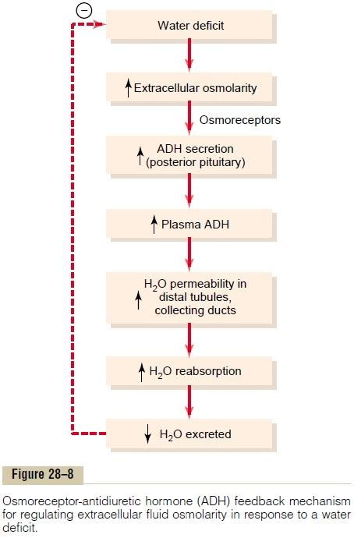
13
D-Antidiuretic hormone (ADH)/ Vasopressin
↓ECV→↑ ADH
Females’ Slides
Dr. said to study information about ADH from previous lecture
Males’ Slides

Slide 15
14
D-FACTORS AFFECTING ADH
Increase ADH | Decrease ADH
↑Osmolarity | ↓Osmolarity
↓ Blood volume | ↑ Blood volume
↓ Blood pressure | ↑ Blood pressure
Renal Sympathetic
ECV renal sympathetic activity stimulate Na absorption by direct tubular effect mediated through alpha-receptors on renal tubules (mainly PCT) to correct for low ECV
H2O permeability & control of intake
The permeability of the distal tubule to H2O is regulated by ADH for example:
H2O diuresis and ↑H2O intake
↓permeability in distal tubule and produce dilute urine
Dehydration
↑H2O reabsorption resulting in concentrated urine (max of 1200 mOsm
Other hormones that control Na reabsorption
Glucocorticoids
• Have weak mineralocorticoid activity
Sex hormones
• Estrogen↑ Na+ reabsorption
↑ Na+ excretion through:
• Inhibit apical Na+ channels
• Inhibit Na+ -K+ ATPase (Action similar to ANP and opposite to aldosterone)
PGE 2

Slide 16
15
Male’s slides
Clinical Correlations
Conditions That Cause Large Increases in Blood Volume and Extracellular Fluid Volume
• Heart Diseases
• Increased Capacity of Circulation
Increases in Extracellular Fluid Volume but with Normal Blood Volume
• Nephrotic Syndrome
• Liver Cirrhosis
Sodium Handling
Site | APICAL TRANSPORTER | FUNCTION
Proximal Tubule | •Na/Gluc CT •Na/Pi CT •Na/Amino Acid •Na/Lactate •Na/H Exchanger •Cl/Base Exchanger | •Na & Gluc Uptake •Na & Pi Uptake •Na & AA Uptake •Na & Lactate Uptake •Na Uptake and H Extrusion •Cl Uptake
Thick Ascending Limb | • Na, 2 Cl,, K CT •Na/H Exchanger •K Channels | •Na, 2 Cl,, K Uptake •Na Uptake and H Extrusion •K Extrusion
Early DCT | NaCl CT | Na & Cl Uptake
Late DCT Collecting Duct | Na Channel (ENaC) | Na Uptake

Slide 17
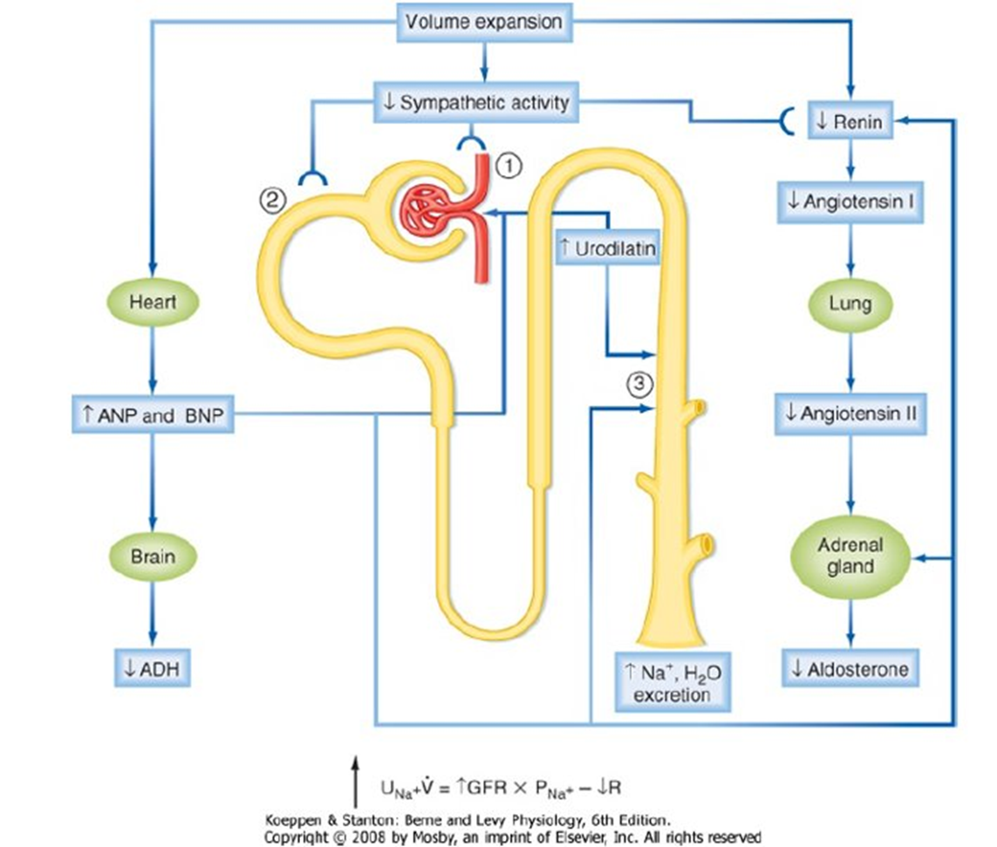
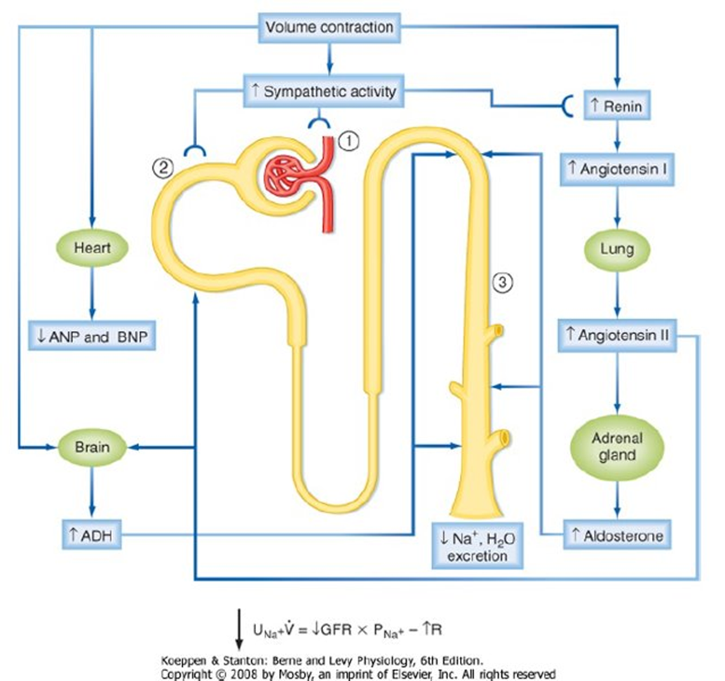
16
Summary
Body fluid compartments :
1- intracellular fluid 2-extracellular fluid 3-transcellular fluid
The most abundant cation in ECF is Na and The most abundant anions in ECF are Cl and HCO3
Na+ is the main osmotic constituent of ECF, when Na+ moves, it drags water with it
Na+ distribution in the body :
65% ECF exchangeable
5-10% ICF
25-30% Bones
What does the body sense? The body doesn’t sense ECF volume but in fact it senses effective circulating volume (ECV)
•Normal ECF normal ECV normal ABP and adequate tissue perfusion
•Decrease in ECF decrease in ECV decrease in ABP and tissue perfusion
•Increase in ECF increase in ECV increase in ABP and tissue perfusion
Important images :

Slide 18
Quiz
Q1
Atrial natriuretic peptide causes which of the following effects?
A.Reduced renal tubular sodium reabsorption
B.Reduced renin secretion
C.Increased renal sodium excretion
D.All of the above
Q2
Which of the following changes would be expected in a patient with diabetes insipidus due to a lack of ADH secretion, assuming free access to water and normal thirst mechanisms for controlling water intake?
Q3
Which change would you expect to find in a dehydrated person deprived of water for 24 hours?
A. Decreased plasma renin activity
B. Increased water permeability of the collecting duct
C. Increased plasma atrial natriuretic peptide concentration
D.Decreased plasma antidiuretic hormone concentration
Q4
What decreases sodium reabsorption?
A. Stimulates ANP
B. Decreased renal plasma flow
C. Decreased glomerular hydrostatic pressure
D. Increased renin
Answers: 1-D 2-C 3-B 4-A

Slide 19
Quiz
Q5
Which of the following will increase if volume increases?
A.ADH
B.ANP
C.Sympathetic
D.All of the above
Q6
Which increases secretion of ANP?
A.Decrease BP
B.Decrease ECF
C.Increase ECF
D.All of the above
Q7
When we drink a lot of water, what happens?
A.Decrease ADH
B.Increase renin
C.Decrease ANP
D.B and C
Q8
What is the most abundant anion in ECF ?
A.Cl
B.Na
C.HCO3
D.(A+C)
Answer: 5-B 6-C 7-A 8-D

Slide 20
Quiz
SAQs
Explain the pathway of the sympathetic nervous system, what are its effects?
↓ ECV → ↓Blood pressure → Stimulate SNS through baroreceptors:
Direct effects: increase sodium reabsorption in PCT and increased renal vascular resistance
Indirect effect: stimulate renin release
SAQs
What increases ADH?
↑Osmolarity and ↓ECV (↓blood volume)

Slide 21
Members
Team Leaders
Razan Almohanna
Khalid Alrasheed
Raneem Alwatban
Othman Alabdullah
Team Members
Shahad bukhari
Nasser Alghaith
Theme was done by Shatha Almutib
physio442@gmail.com

