Slide 1
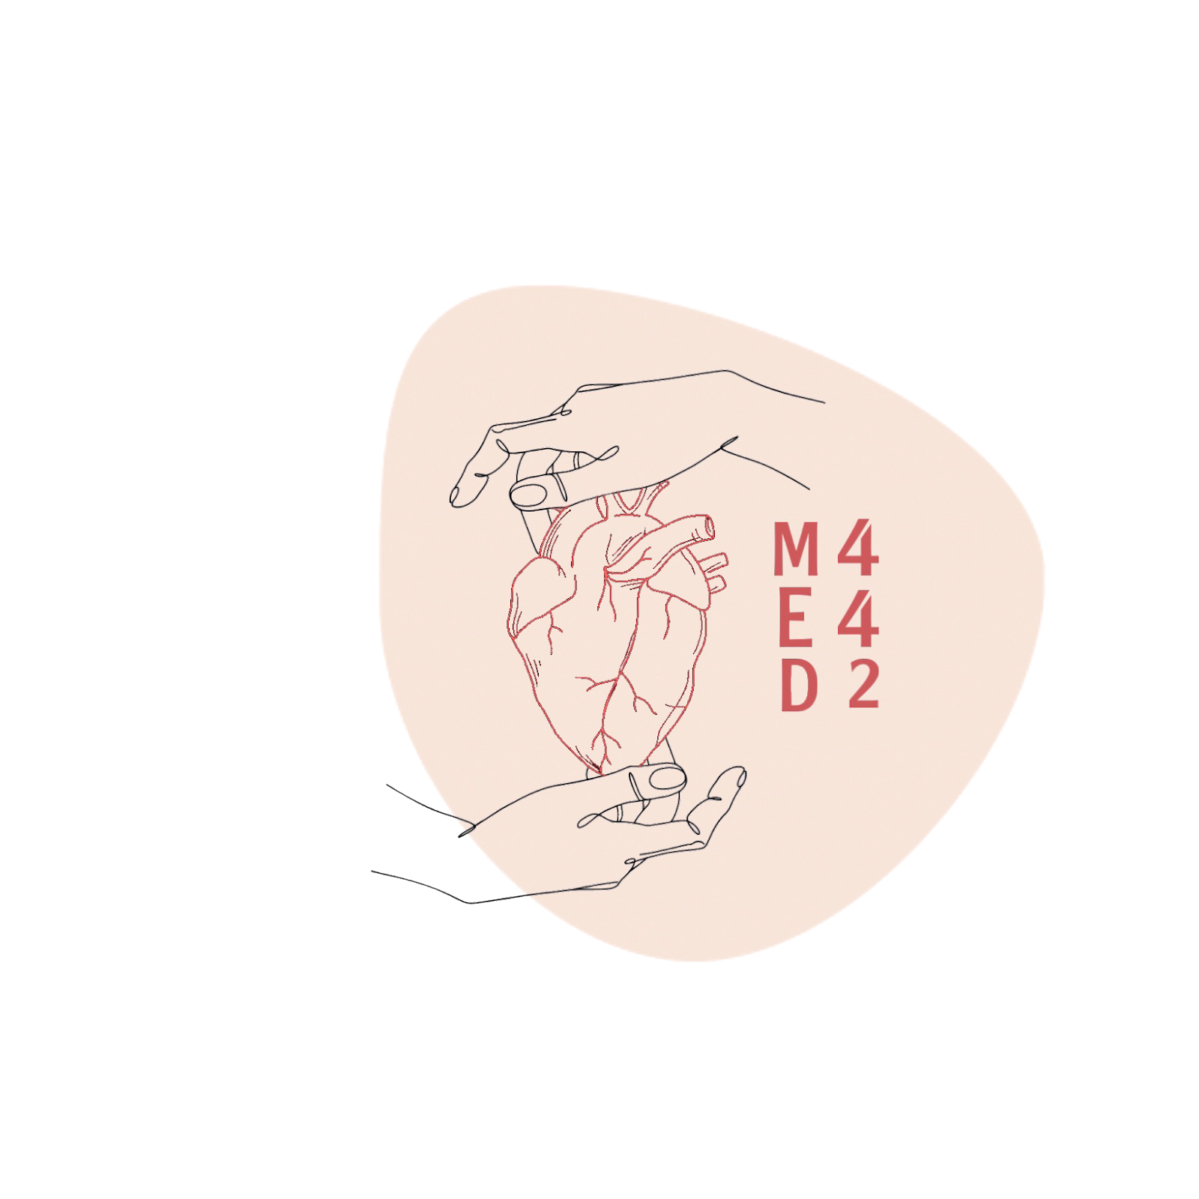
Basics of Acid-Base
And Buffer system
L9,10
Physiology renal
Editing File
- Color Index:
Main Text
Male’s Slides
Female’s Slides
Important
Doctor’s Notes
Extra Info

Slide 2
Objectives
Define: acid and base.
Explain what is meant by strong and weak acids and bases.
List and identify the names/formulas for the common strong acids and strong bases.
To explain the role of Henderson-Hasselbalch equation in acid base regulation.
To define buffer system and discuss the role of blood buffers and to explain their relevant roles in the body.
To describe the role of kidneys in the regulation of acid-base balance.
To describe the role of lungs in the regulation of acid-base balance.
Contents
What are acids and bases?
What is meant by a weak and a strong acid or base?
What is the normal pH of body fluids?
Why is it important to keep body fluid pH within certain limits?
What are the body’s defense mechanisms against changes in blood pH: body buffers, the lungs and the kidney.
Understand the role of the kidney in regulating pH of body fluids

Slide 3
1
Acids and Bases
Helpful video
Acid-Base Balance
Acid-base balance is concerned with the precise
regulation of free (unbound) hydrogen ion (H +)
concentration in body fluids.
Normally, [H+] = 0.00004 mEq/L (40 nEq/L).
Why Should [H+] be Tightly Controlled?
Slight deviations in [H +] have profound effects on enzyme
and protein activity and thus the body’s metabolic activity
in general.
• Changes in [H+] affects K+ levels in the body.
A number of processes can alter [H +] concentration in the body, such as;
1
Generation of acids & bases from
amino acid/protein metabolism.
Metabolism of ingested food.
Example: glycolysis
3
Changes in CO2 production.
GI secretions.
4
2
Acid-Base Fundamentals
 | Acid | Base
Definition | a molecule that can release H + in a solution. The free H [H+] is the one how can change the pH | a molecule that accepts H+ in a solution.
Examples | H2CO3 (carbonic acid) HCl (hydrochloric acid) | Bicarbonate ions (HCO3-). Hydrogen phosphate (HPO4-2)

Slide 4
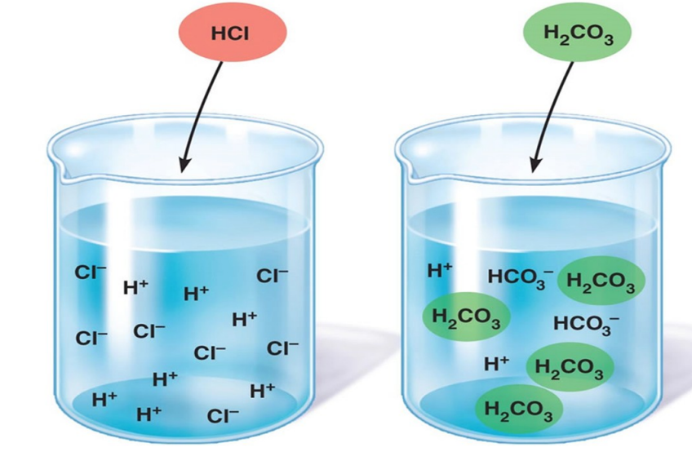
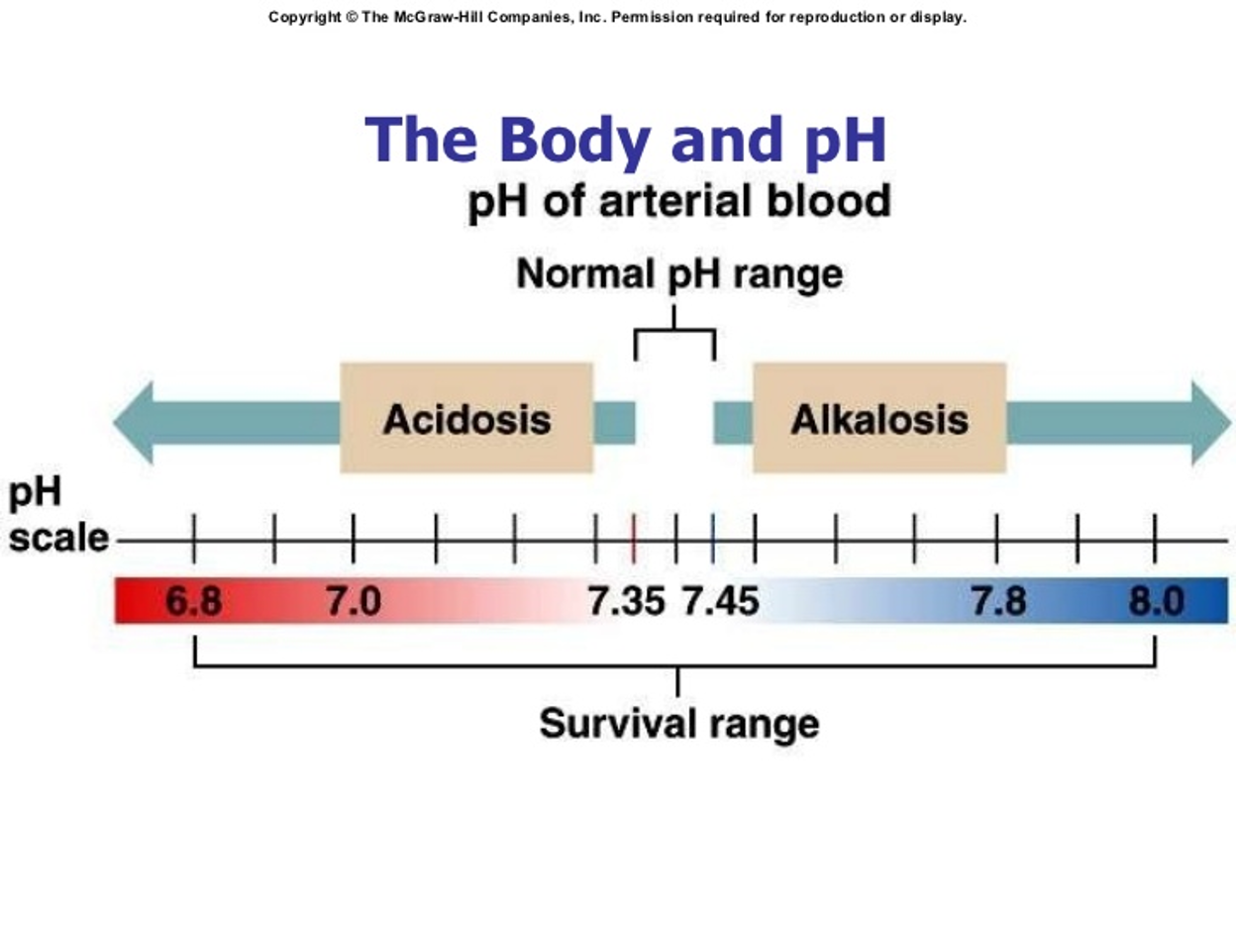
2
Strong VS Weak Acids & Bases
Strong acids : dissociate rapidly and release large amounts of H+ in solution
Weak acids: dissociate incompletely and less strongly releasing small amounts of H+ in solution
Weak Acids
AH A- + H+
Acid Conjugate base + H+
The extent to which a given acid dissociates in solution is constant. Also known as the Dissociation constant ( K ).
K = [ H+ ][ A- ]
[ AH ]
H2CO3 ⇆ HCO3- + H+ K= [H+][HCO3 -]
[H2CO3]
What is pH?
pH is a way of expressing H + ion concentrations.
pH = log 1
Or pH = -log [H+] [H+]
• If the [H+] increase → pH will decrease (more acidic)
• If the [H+] decrease—> pH will increase (more alkaline)
What is the normal pH of the ECF?
Normally pH= 7.35-7.45
pH < 6.8 Acidosis (Death)
pH > 8 Alkalosis (Death)
 | [H+] (mEq/L) | pH
Extracellular fluid
Arterial blood | 4.0 X 10-5 | 7.4
Venous blood | 4.5 X 10-5 | 7.35
Interstitial fluid | 4.5 X 10-5 | 7.35
Intracellular fluid | 1 X 10-3 to 4 X 10-5 | 6-7.4
Urine | 3 X 10-2 to 1 X 10-5 | 4.5-8
Gastric HCl | 160 | 0.8

Slide 5
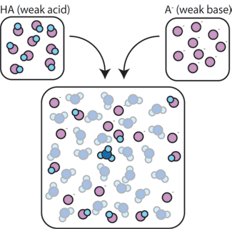
3
Acid Production by the Body
The body produces large amounts of acids on daily basis as by products of metabolism.
Metabolism of dietary proteins.
Anaerobic metabolism of carbs and fat.
Acids in the body are of two kinds:
1. Volatile (CO2)
2. Non-volatile “fixed” (sulfuric acid, lactic acid) (daily acid load ≈50-100 mEq/day) (0.8 mEq/kg/d).
The Body’s Defense Against Changes in [H]
Three main systems:
1. Body fluid buffers: Works within seconds.It doesn’t take rid of the H+ it just hides them until the kidney or the lungs(if it’s a volatile acid )start to work
2. Lungs: Works within minutes. It has a limitation—> cannot take rid all of the body’s acids ,just the volatile aids
3. Kidneys: Works within hours-days ,The most powerful of the three.
What is a Buffer?
A buffer = a solution that resists changes in pH upon addition of small amount of acids or bases.
Neutralizes small additions of bases/acids
pH remains constant
How do Buffers work?
A buffer is a mixture of a weak acid and a weak base that are in equilibrium.
To be more accurate, its either made of:
A weak acid and its conjugated base (H2CO3 & NaHCO3 /HCO3-).
A weak base and its conjugated acid (NH3 & NH4+).

Slide 6
4
How does a buffer do its job?
Weak acid
The conjugated base (weak base)
In female slides only
The weak acid will dissociate incompletely into H+ and HCO3-
And the weak base (NaHCO3) some of them will remains as NaHCO3 and some of them will dissociate incompletely into Na+ and HCO3-
But if you add strong acid as HCl it will dissociate completely into Cl- and H+
So if the H+ will stay free it will lower the pH BUT the buffer will do its work by :
The H+ from HCl will bind to HCO3- = H2CO3
The Cl- can combine to the Na = NaCl (اساسا الكلور مو مشكله بالنسبه لنا لانه ماراح يأثر في ال pH)
Because of this the strong acid is converted into a weaker acid
So the buffer hide the H+ بس مايتخلص منه بالواقع
(The same concept but here we added a strong base )
The weak acid will dissociate incompletely into H+ and HCO3-
And the weak base (NaHCO3) some of them will remains as NaHCO3 and some of them will dissociate incompletely into Na+ and HCO3-
But if you add strong base as NaOH it will dissociate completely into OH- and H+
So if the H+ will stay free it will lower the pH BUT the buffer will do its work by :
OH- will bind to H+ = H2O
Na+ will bind to HCO3- = NaHCO3
Because of this the strong Base is converted into a weaker base
So the buffer hide the H+ بس مايتخلص منه بالواقع
Chemical Buffer Systems in the Body
There are 3 chemical buffers in the body:
1. The Bicarbonate buffer system.
2. The phosphate buffer system.
3. Proteins.
• They are the 1st line of defence against changes in pH i.e.[H+], act within seconds.
• Some are more powerful extracellularly and others are more powerful intracellularly.
The Bicarbonate Buffer System
Composed of:
• A weak acid (H2CO3).
• Its conjugated base (NaHCO3 / HCO3-).
CO2 + H2O H2CO3 H+ + HCO3-
NaHCO3 Na+ + HCO-3
CA
CA: carbonic anhydrase

Slide 7
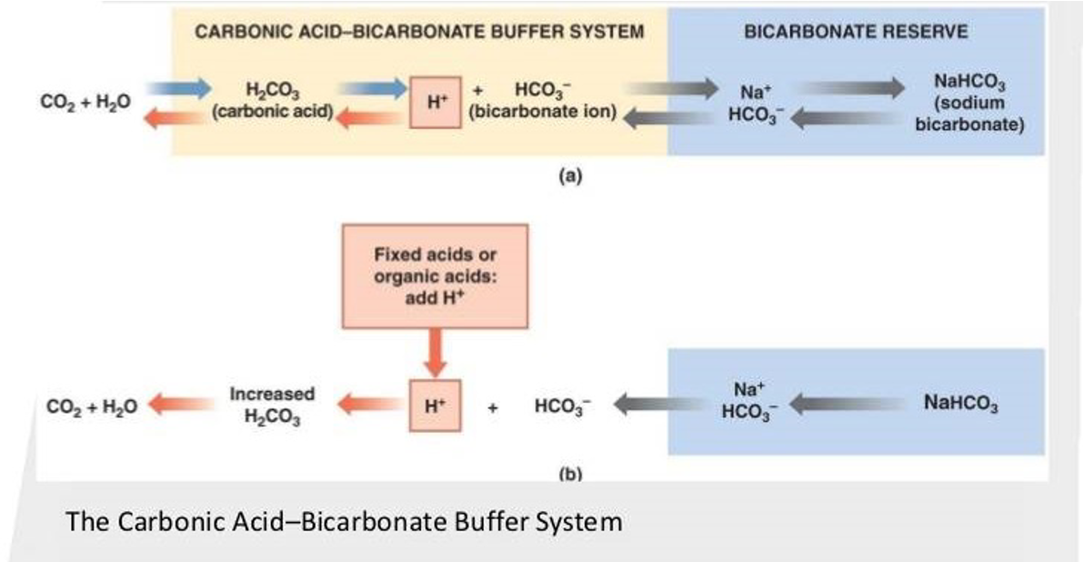
5
The Bicarbonate Buffer System
1
H2CO3 forms in the body by the reaction of CO2 &H2O
CO2 +H2O H2CO3
2
H2C 3 ionizes weakly to form small amounts of H+ & HCO-3
H2CO3 H+ & HCO3-
3
The second component is NaHCO3 which dissociates to form
Na+ & HCO3-
NaHCO3 Na+& HCO3-
Putting all together ;
This is the main ECF buffer system
What happens if you add a base or an acid to the system?

Slide 8
6
The Henderson-Hasselbalch Equation
What is the HHE?
• It is an equation that enables the calculation of pH of a solution.
What is it?
pH= pK + log
K = dissociation constant, pK = 6.1
solubility of CO2= 0.03
HCO3-
0.03 X PCo2
(Conjugate base )
(Weak acid)
How was it derived?(Not important just for your understanding)
H2CO3 H+ + HCO3-
1
H2CO3 and its dissociated ions are always in equilibrium → the products of the reaction on one side of the equation are proportional to the product on the other side.
[H2CO3] α [H+ ] X [HCO3-]
2
Since H2CO3 is a weak acid, it will not dissociate completely and the concentration of its products will depend on its dissociation constant (K)
K X [H2CO3] = [H+ ] X [HCO3-]
How was it derived?
Both doctors said you only have to memorize the final formula, not the derivation it is not with us
H2CO3 ⇆ HCO3- + H+ K= [H+][HCO3 -]
[H2CO3]
[H+] = 𝑲 𝑿 [H2CO3]
[HCO3−]
Taking log and * by-1
−𝐥𝐨𝐠𝑯+ =−𝐥𝐨𝐠𝑲−𝒍𝒐𝒈[H2CO3]
[𝑯𝑪𝑶𝟑−]
𝑝𝐻 = 𝑝𝐾 + log[𝑯𝑪𝑶𝟑−]
[H2CO3 ]
𝑝𝐻 = 𝑝𝐾 + log [𝑯𝑪𝑶𝟑−]
[H2O+CO2]
𝑝𝐻 = 𝑝𝐾 + log[𝑯𝑪𝑶𝟑−]
[CO2 ]
𝑝𝐻 = 𝑝𝐾 + log [𝑯𝑪𝑶𝟑−]
[S.CO2 PCO2]
solubility of CO2 (0.03 mmol/mmHg) 24𝑚𝐸 𝑞/𝐿
0.03𝑋40
𝑝𝐻 = 𝑝𝐾 + log [24mEq/L]
[0.03X40]
𝑝𝐻 = 𝑝𝐾 + log [24mEq/L]
[1.2mEq/L]
pK is dissociation constant of carbonic acid in the blood = 6.1
𝑝𝐻 = 6.1 + log [24mEq/L]
[1.2mEq/L]
Blood pH = 7.4

Slide 9
7
Cont
3
Based on the previous equation, [H +] can be expressed as follows;
[H+]=K X [H2CO3]
[HCO3−]
4
Because H2CO3 can rapidly dissociate into CO2 and H2O. And since CO2 is much easier to measure it can replace H2CO3 in the equation
[H+]=K X [CO2]
[HCO3−]
This is Henderson’s equation
(1908)
It means that;
↑ [CO2] →↑ [H +]
↑ [HCO3-] → ↓ [H+]
5
In 1909, Sorensen created the pH scale to express [H + ]
pH = - log [H+]
6
In 1916, Hasselbalch decided to merge Henderson’s equation with Sorensen’s pH scale creating what we now know as the “Henderson-Hasselbalch equation”.
[H+] = K X [CO2]
[HCO3-]
-log[H+]= -log K X [CO2]
[HCO3-]
-log[H+]= -logK -log [CO2]
[HCO3-]
This is Henderson-Hasselbalch equation (1908)
pH =pK + log [HCO3-]
[CO2]
7
Since it is much easier to measure PCO2 rather than dissolved
[CO2] and because dissolved CO2 is proportional to PCO2
multiplied by the solubility of CO2 (0.03 mmol/mmHg) → [CO2] was
replaced by PCO2 X 0.03
pH =pK + log [HCO3-]
0.03 X PCO2
Ta-Da

Slide 10
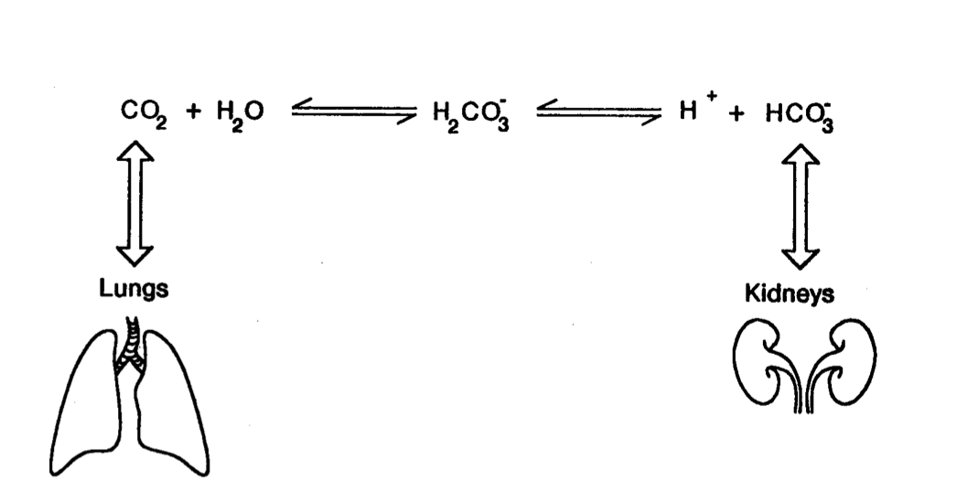
8
Buffering Systems
Buffer systems work together in body fluids (not independently)
A change in the balance of one buffer system, causes a change in the other systems
Buffers do not reverse the pH change, they only limit it
Buffers do not correct changes in [H+] or [HCO3-], they only limit the effect of change on body pH until their concentration is properly adjusted by either the lungs or the kidney.
The Bicarbonate Buffer system
The most important buffer system in the ECF
CA: Carbonic Anyhydraze
Regulated by the kidney
HCO3-
pH α
PCo2
Regulated by the lungs
HCO3-
Ratio = 20:1 • ↑↑ HCO3− will ↑↑ pH • ↑↑ PCO2 will ↓↓ pH
PCO2
The Phosphate Buffer
• Plays a major role in buffering intracellular & renal tubular fluid.
Composed of:
• H2PO4- (dihydrogenphosphate) (as weak acid)
• HPO4-2 (Hydrogen phosphate) (as its conjugated base)
Proteins
• Contributes to buffering inside cells.
• E.g. Hb.
لأن اغلب البروتينات تعتبر سالبة الشحنه لذلك تجذب ايون الهيدروجين الموجب

Slide 11
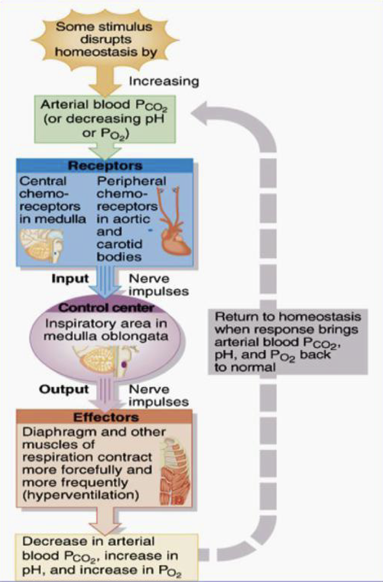
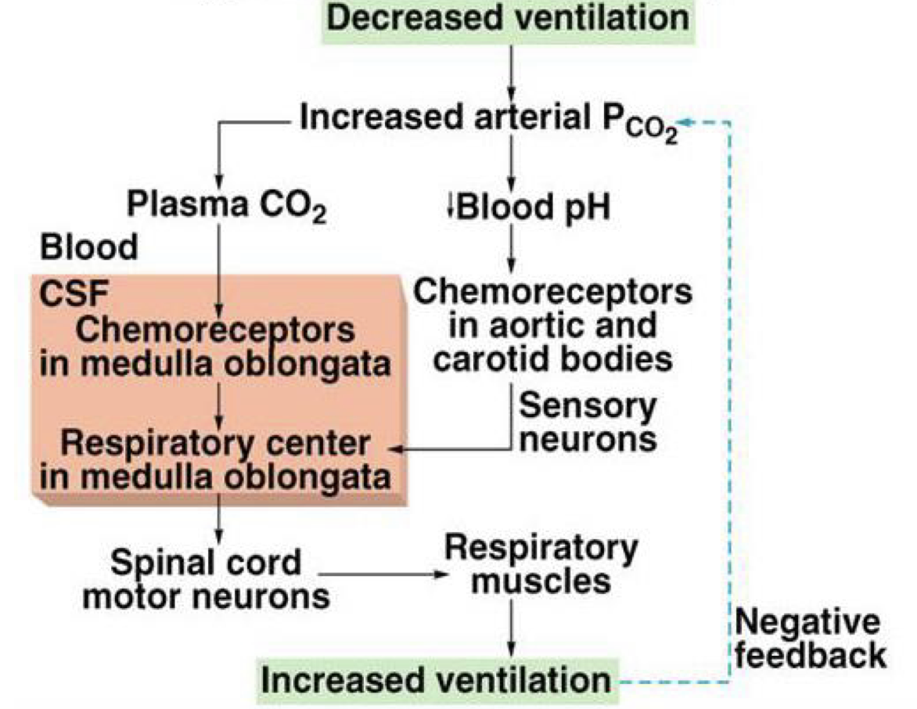
9
Respiratory Regulation of CO2
2nd line of defence against acid-base disturbances in the body.
It does this by:
By modulating CO2 excretion.
↑↑ ventilation (RR) → ↓↓ PCO2 → ↓↓ [H+]
↓↓ ventilation (RR) → accumulation of CO2→↑↑PCO2 → ↑↑ [H+]
Normally, PCO2 = 40 mmHg (35-45 mmHg)
Female’s slides
In case of acidosis or alkalosis:
Acidosis: (↑↑ [H+]in ECF)→ ↑↑ ventilation → ↓↓PCO2 → ↓↓ [H+]
Alkalosis (↓↓ [H⁺] in ECF) → inhibit ventilation → ↓↓ ventilation (RR) → accumulation of CO2→↑↑ PCO2 → ↑↑ [H⁺]

Slide 12
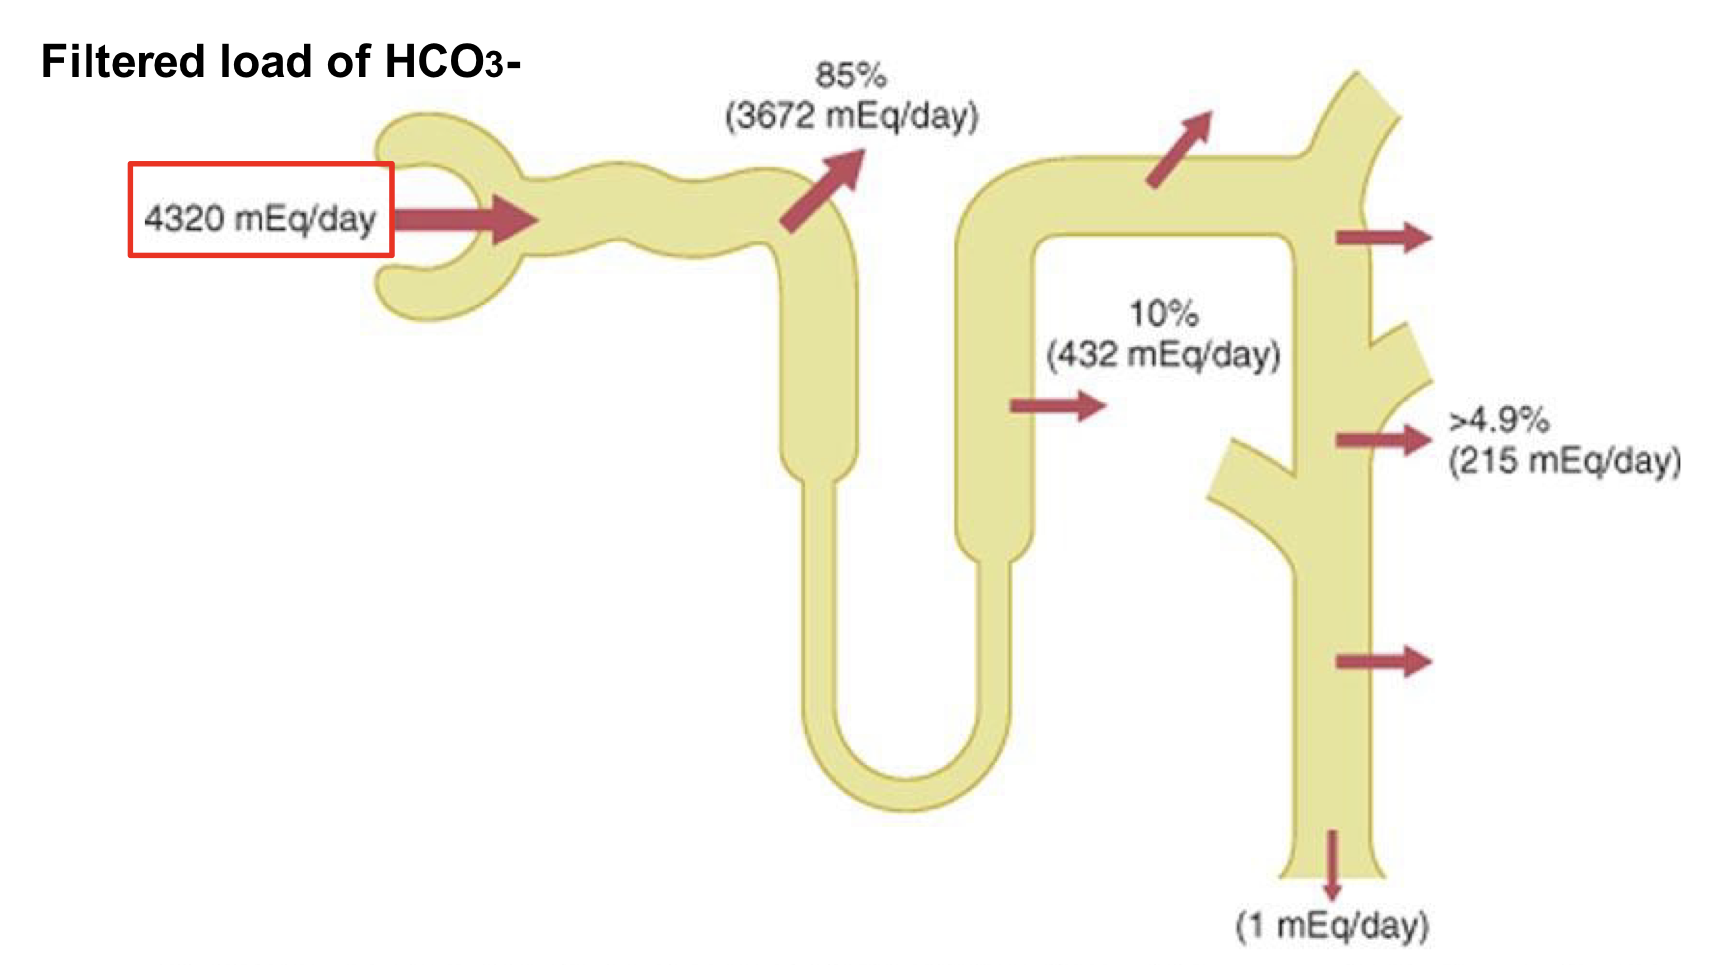
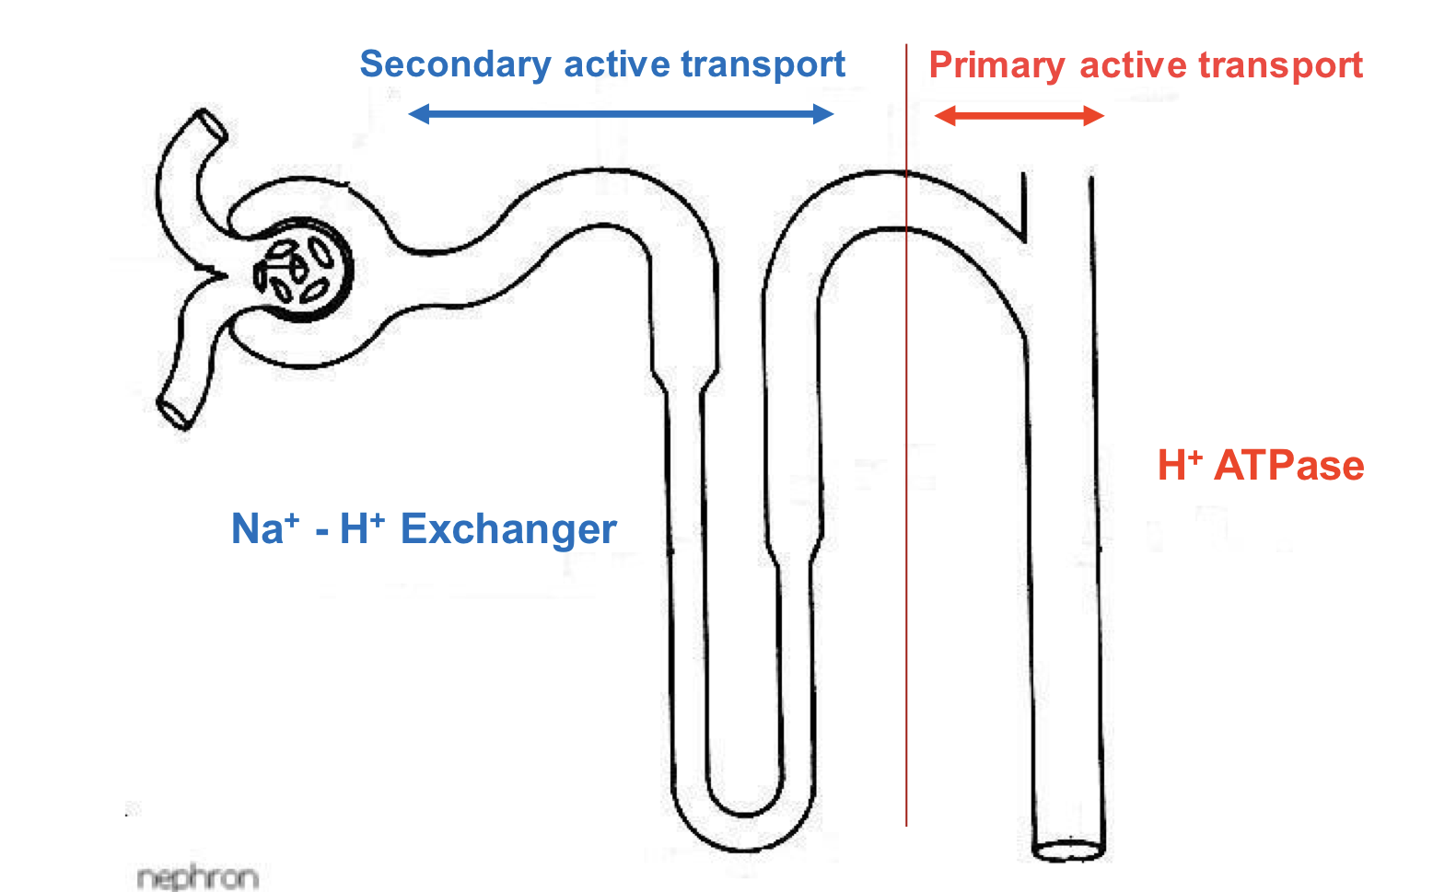
10
Overview of Reabsorption and Excretion in Tubules
Reabsorption of HCO3- is linked to H+ secretion
H+ secretion occurs in all tubular segments except thin descending & ascending loops of Henle

Slide 13
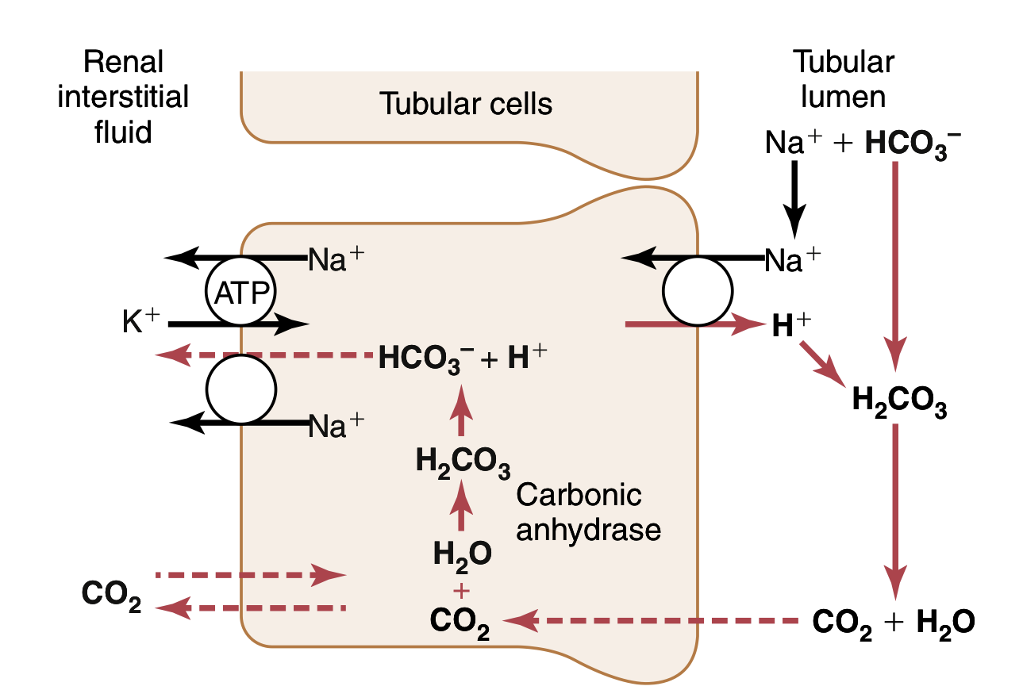
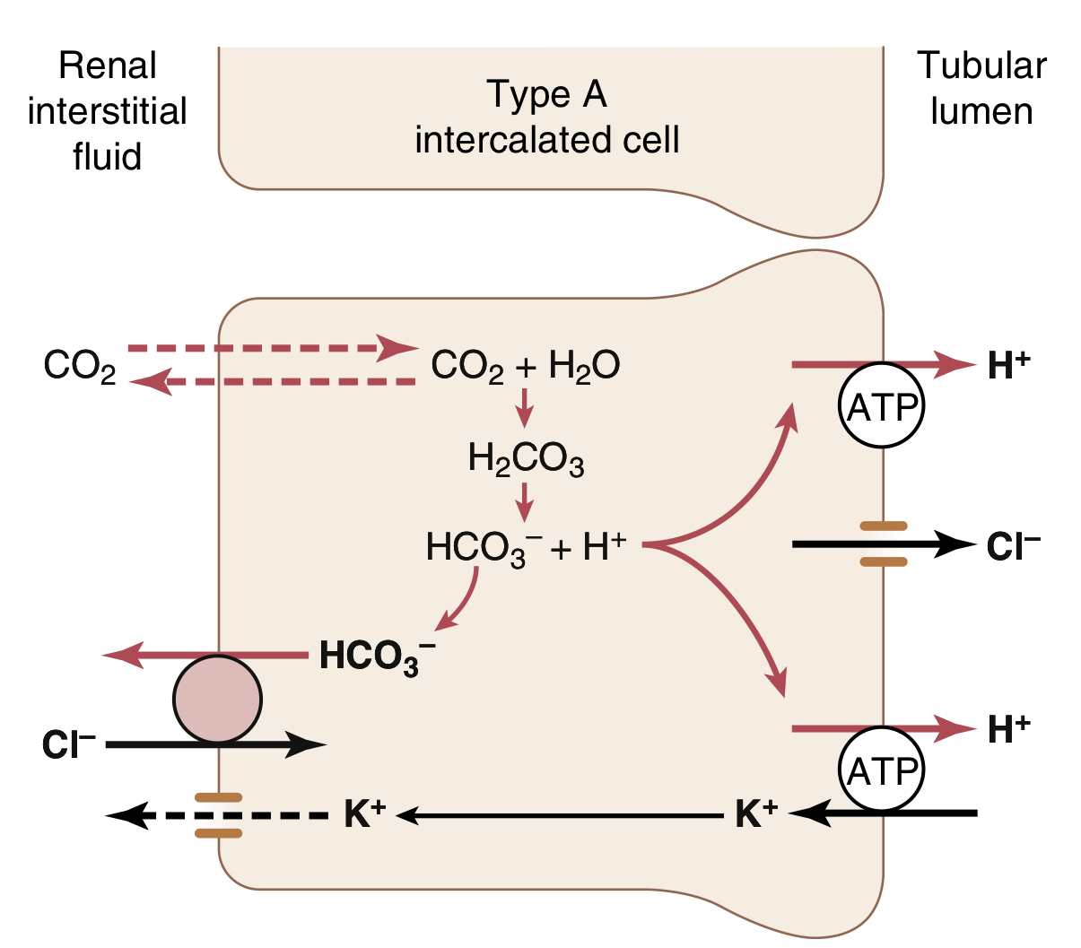
11
Renal Regulation
3rd line of defence against acid-base disturbances and the most powerful.
It regulates by excreting either an acidic or basic urine.
It does this by:
Secreting H+
Reabsorbing HCO3
Generating “new” bicarbonate ions.
PCT reabsorption of HCO3-
Secreted H+ binds to filtered HCO3- in the tubular lumen
Forming H2CO3 which dissociates into H2o and CO2
CO2 diffuses through tubular cell membrane and react with water for min H2CO3 inside the cell
2ndary active transport
here no loss for H+
I can’t reabsorbe HCO3- if I don’t have H+
H+ secretion = HCO3- reabsorbing
Here I reabsorber HCO3- but not the same molecule that have been filtered (indirectly
Late DCT & CT reabsorption of HCO3-
The filtrate arriving at the DCT & CT is low in HCO3-.
The distal segments of the nephron are characterized by the
presence of “intercalated cells” capable of actively secreting
H+ through H+-ATPase and H+-K+ ATPase present on their apical
membrane (Type-A intercalated cells).
Only a limited number of H+ can be excreted in its free form in
urine.
Lowest possible urine pH=4.5 → ≈ 0.04 mmol/L of free H+.
Female’s doctor said “you have to know the intercalated cell type A only”

Slide 14
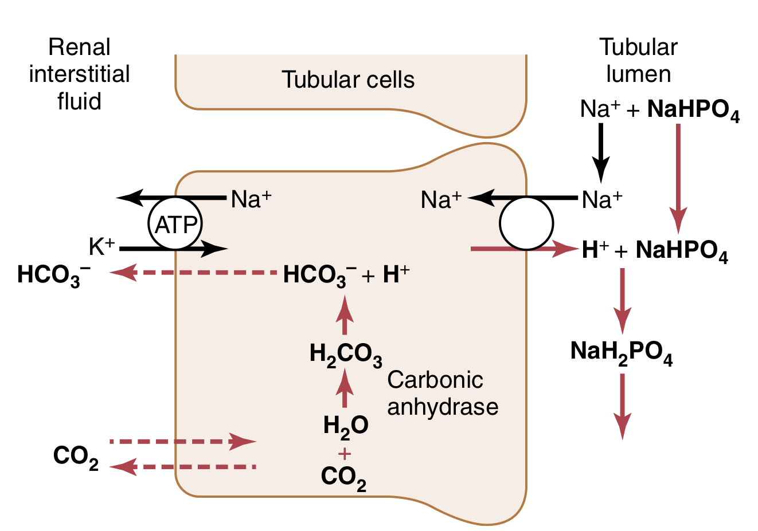
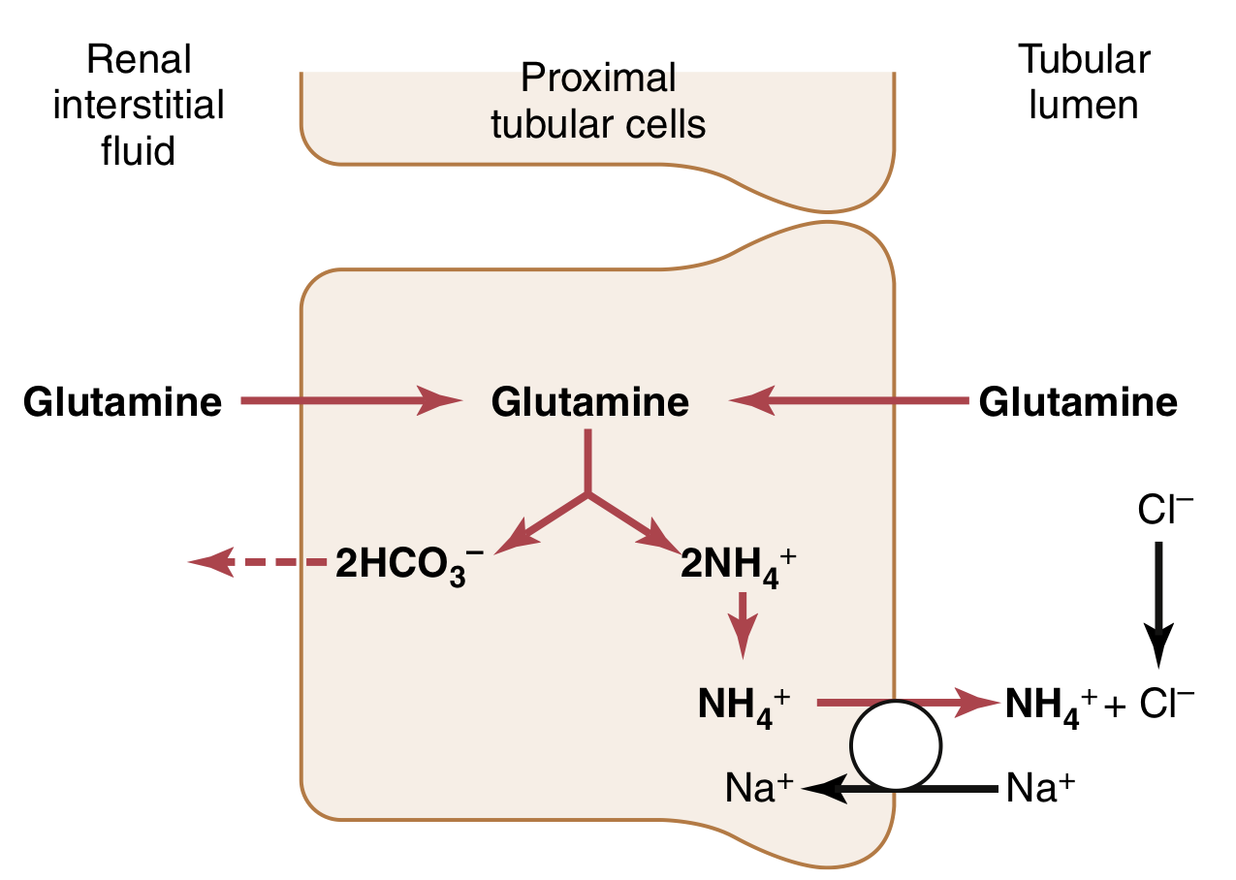
12
Renal Regulation
CO2 combines with H2O witching type A intercalated cells, forming H2CO3
H2CO3 splits forming H+ & HCO3-
H+ is secreted into the filtrate by H+ ATPase pump
For each H+ secreted, a HCO3- enters the peritubular capillary blood via antiport carriers in a HCO3-/Cl- exchange
H+ combines with (HPO4)2– forming H2PO4-
Which is then excreted
Phosphate buffer system
(Filtered)
Excretion of H+ as phosphate is capable of handling a limited amount of H+ and will not be enough to rid the body of its daily acid load nor if there is unusually high acid production.
Non-Bicarbonate Buffers in the Tubular lumen
NH3 Ammonia + H+ <————> NH4+ Ammonium
(Weak base). (Its conjugated acid)
Ammonia Buffer system
(Synthesized)
Renal tubular cells, especially PCT, are capable of ammoniagenesis (generating ammonium) which is then excreted in urine carrying with it H+.
The rate of ammoniagenesis can be modified according to the needs of the body.
Quantitatively, the ammonia buffer system is more important than the phosphate buffer system for H+ excretion in urine.
It is the most important system in case of acidosis.
Here we generate more HCO3- in comparison with phosphate buffer system

Slide 15
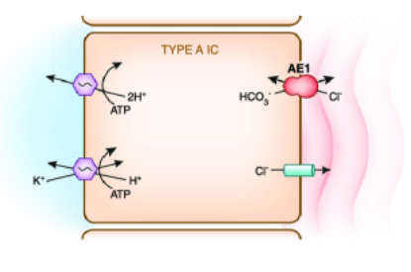
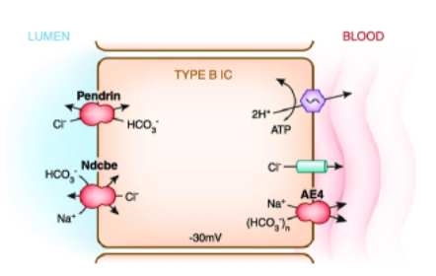
13
Types of intercalated cells
Female’s slides
α-IC (type A-IC)→ secrete hydrogen
β-IC (type B-IC)→ secrete bicarbonate

Slide 16
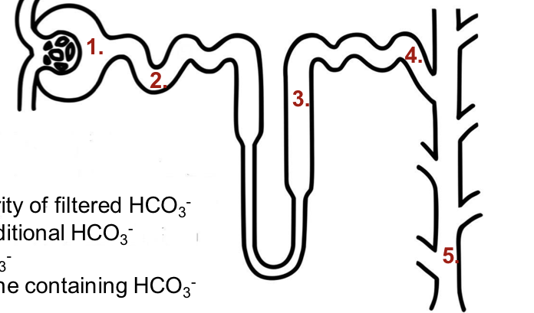
14
Renal Regulation
The overall scheme of renal excretion of acids & bases
To excrete acids |  | To excrete bases
Freely filter HCO3- |  | Freely filter HCO3-
2. Reabsorb the majority of filtered HCO3 |  | 2. Reabsorb the majority of filtered HCO3
3. Reabsorb some additional HCO3- |  | 3. Reabsorb some additional HCO3-
4. Secrete H+ (titration filtered bases, i.e. HPO42-) |  | 4. Secrete some HCO3-
5. Excrete acidic urine containing NH4+ |  | 5. Excrete alkaline urine containing HCO3-
Factors affecting H+ Secretion and HCO3- Reabsorption
Increase H+ secretion and HCO3- Reabsorption |  | Decrease H+ secretion and HCO3- Reabsorption
Increase PCO2- |  | Decrease PCO2-
Increase H+, Decrease HCO3- |  | Decrease H+, Increase HCO3-
Decrease Extracellular fluid volume |  | Increase Extracellular fluid volume
Increase Angiotensin II |  | Decrease Angiotensin II
Increase Aldosterone |  | Decrease Aldosterone
Hypokalemia |  | Hyperkalemia

Slide 17
15
summary
Buffer System
• Buffer systems do not work independently in body fluids but actually work together.
• A change in the balance in one buffer system, changes the balance of the other systems.
• Buffers do not reverse the pH change, they only limit it.
•Buffers do not correct changes in [H+] or [HCO3 -], they only limit the effect of change on body pH until their concentration is properly adjusted by either the lungs or the kidney.
Here is a file that contains pages from guytone textbook about our lecture

Slide 18
Quiz
Q1
What is a buffer made of?
A. A weak acid only
B. A weak acid and its conjugate acid
C. A weak acid and a weak base
D. A weak acid and a conjugate base
Q2
Which of the following is not a buffer system in the kidneys?
A. The bicarbonate buffer system
B. Proteins
C. The phosphate system
D. The ammonium system
Q3
What is a normal pH level for humans?
A. 6.9
B. 7.0
C. 7.4
D. 6.5
Q4
What is the most important system for acidosis?
A. The ammonium system
B. The bicarbonate system
C. The lungs
D. Proteins

Slide 19
Quiz
Q5
What is the ratio of HCO3-/PCo2?
A. 12:5
B. 6:5
C. 20:1
D. 7:45
Q6
What is organ regulates HCO3-?
A. Lungs
B. Kidney
C. Heart
D. Stomach
Answers: 1-D, 2- B, 3- C, 4-A, 5-C , 6-B
SAQs
Name a few factors that increase H+ secretion and HCO3- reabsorption:
Increase PCO2-, Increase H+, Decrease HCO3-, Decrease Extracellular fluid volume, Increase Angiotensin II, Increase Aldosterone, Hypokalemia
SAQs
What are the types of acids in the body?
Volatile and non volatile

Slide 20
Members
Team Leaders
Razan Almohanna
Khalid Alrasheed
Raneem Alwatban
Othman Alabdullah
Team Members
Hassan AlAbdullatif
Razan Alotaibi
Theme was done by Shatha Almutib
physio442@gmail.com

