Slide 1
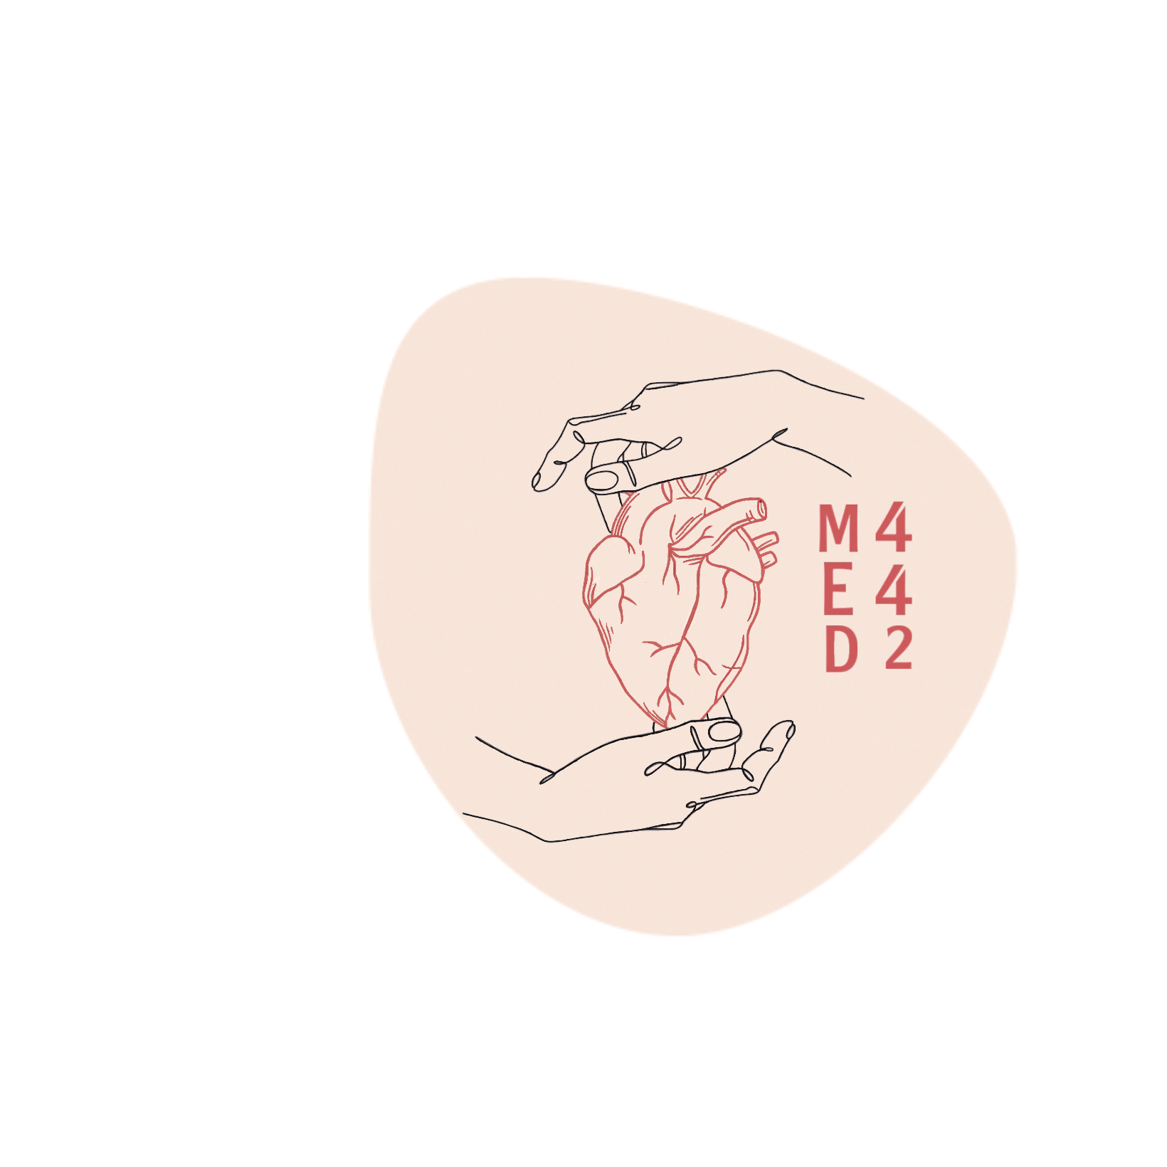
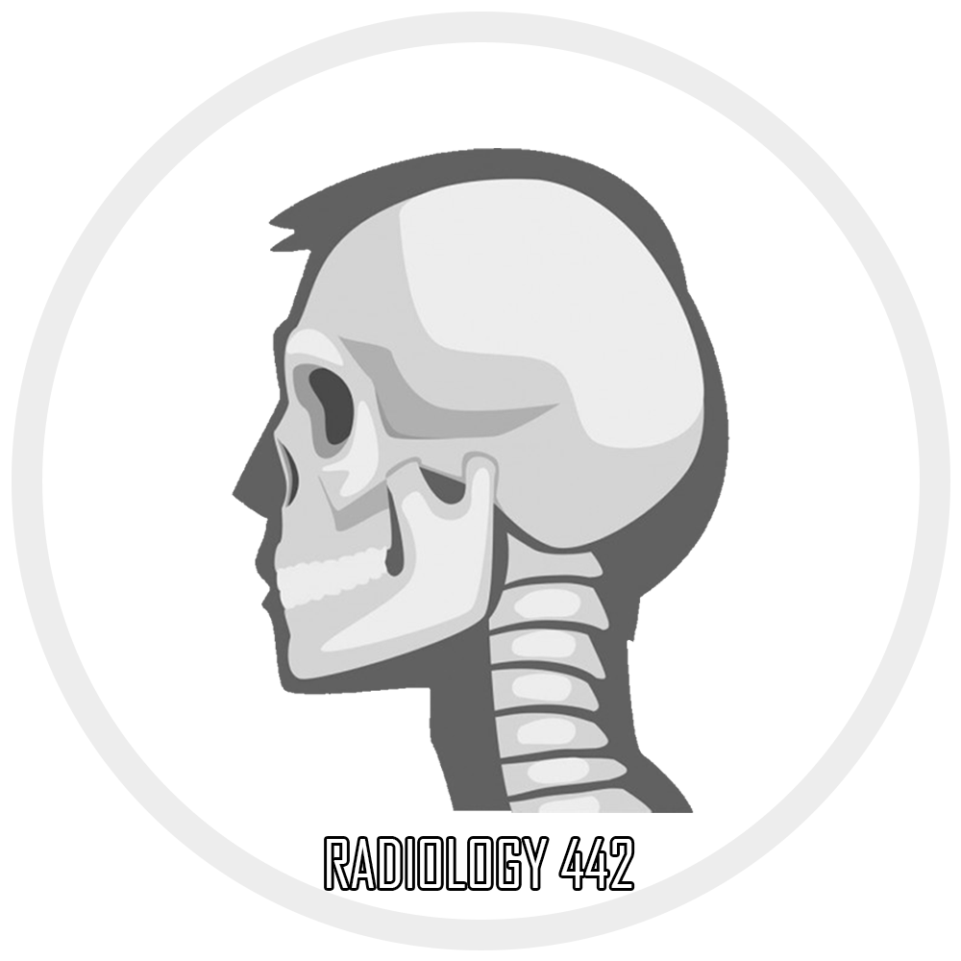
RADIOLOGY
Of the renal system
Color index:
●Main Text
● Important
● Girls’ Slides
● Boys’ Slides
● Dr’s Notes
● Extra Info
Editing File

Slide 2
OBJECTIVES:
1.Normal anatomy
2.Modality used for assessment of the urinary system
1- X-ray 2- Ultrasound (US) 3-MRI 4- CT scan 5- Nuclear
3.Common pathologies

Slide 3
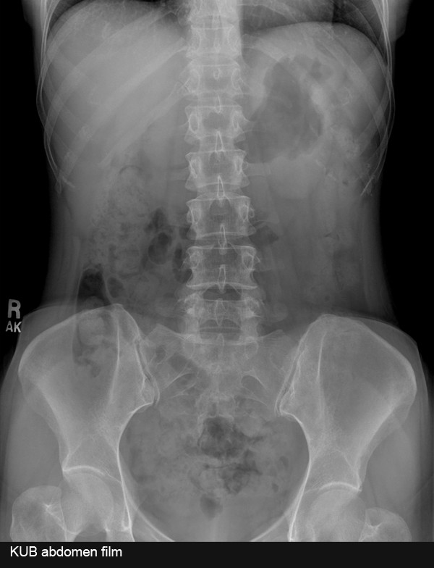
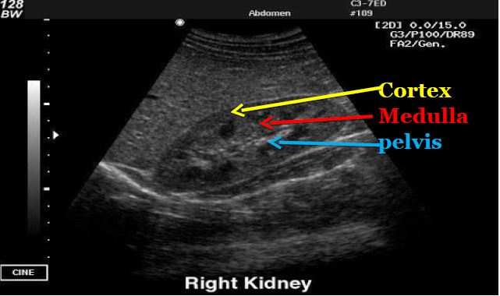
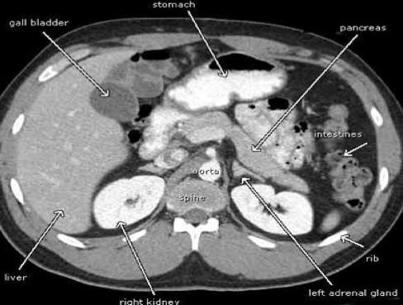
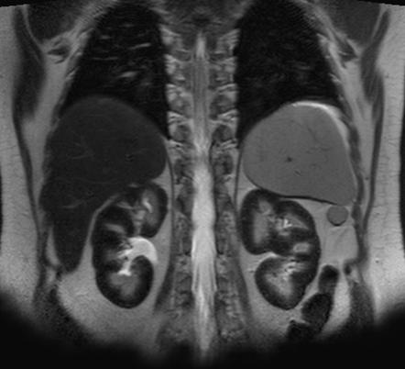
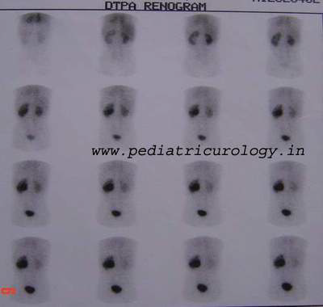
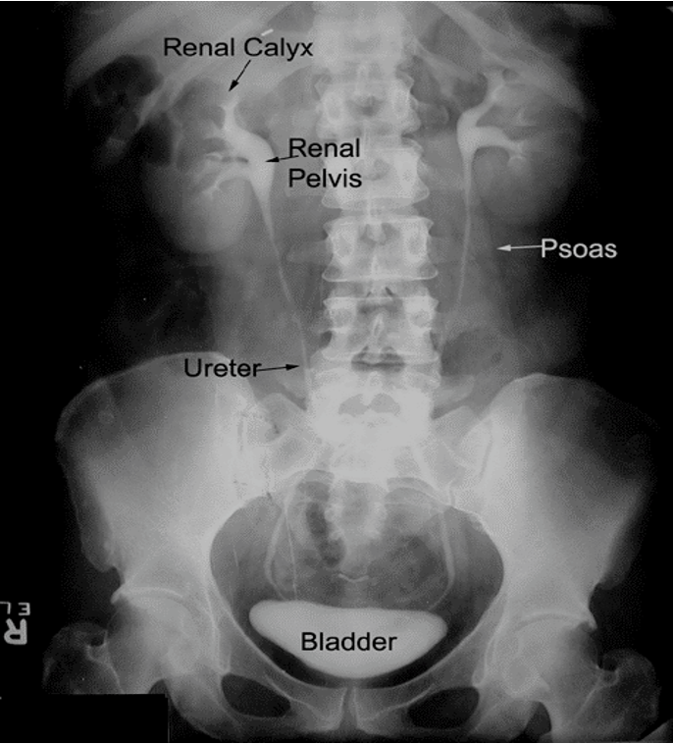
Modalities used
1
Don't skip the information in the pictures of CT+US
 | X-RAY | US | CT most used | MRI | NUCLEAR
Images
Image key
Pros
Cons
White:bone & calcification. Grey:soft Tissue. Black:air | White= stones and Calcification, Grey=soft tissue. Black=fluid Note: renal fat hyperechoic on US | White= bone & calcification. Grey=soft Tissue. Black=air | White =high Intensity. Grey to black = low intensity. | Dark gray to black is the nuclear fluid flow pathway
Inexpensive, quick | no ionizing radiation, inexpensive portable |  |  | assess the function NOT the Anatomy
Ionizing radiation, not definitive ( doesn’t give that much of information ) | Operator dependent* , time consuming | ionizing radiation , expensive | expensive , time consuming about 30-60 min | time consuming , radioactive Materials Highest radiation dose
Quick ,
a lot of information
2 - 3 min
no ionizing
Radiation
, a lot of
Information
Of soft tissue
IVP |  | intravenous pyelogram is an x-ray examination of kidneys, ureters and Urinary bladder that uses iodinated Contrast material injected into veins. (used to asses the excretion function)
KUB stands for : kidney , ureter , bladder
Operator dependent : The assessment depends on the report that provided by the operator only

Slide 4
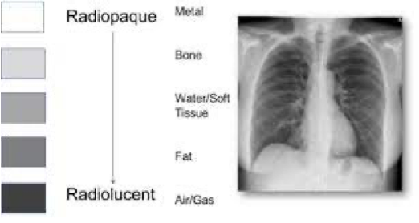
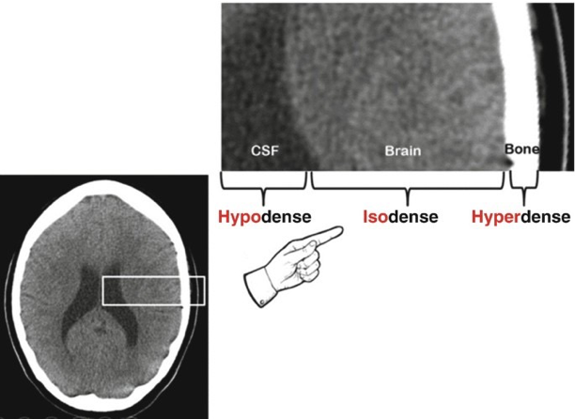
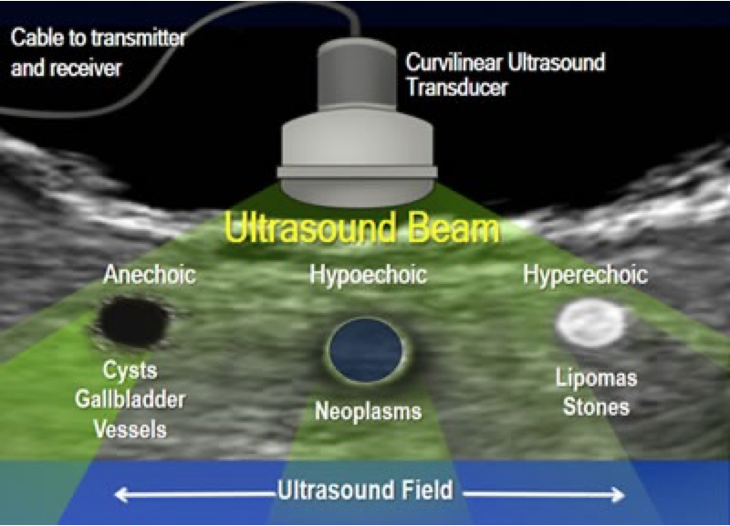
Radiological descriptive terms
EXTRA
Modality | Bright (white) on Image | dark (black) on image
X ray | Opacity / Density Radio-opaque | Lucency Radio-lucent
CT | Hyperdense / High attenuation | Hypodense / Low attenuation
US | Hyperechoic / Echogenic | Hypoechoic / Anechoic (fluid)
MRI | Hyperintense | Hypointense
Enhancement
structures or lesions becoming brighter on imaging after an intravenous contrast medium has been injected

Slide 5
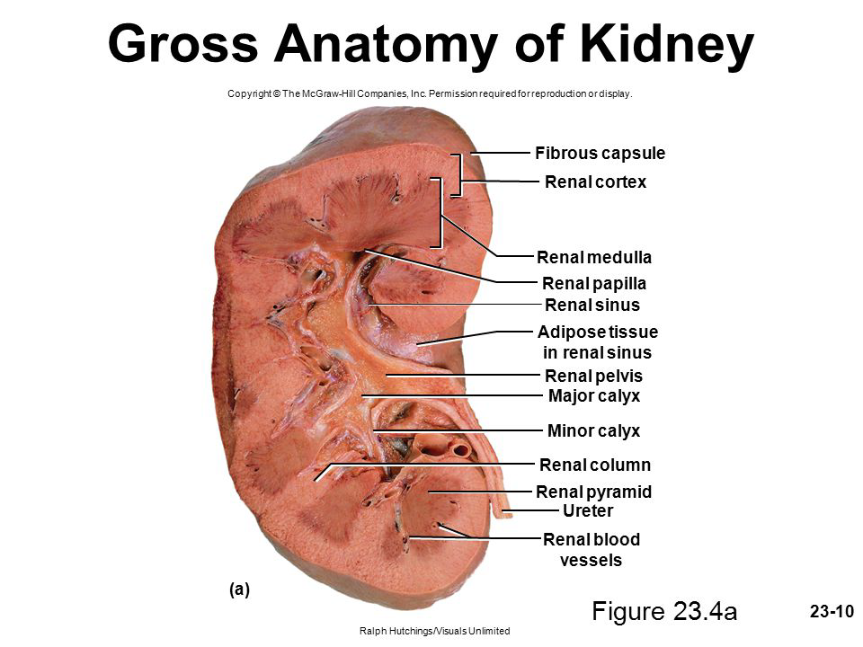
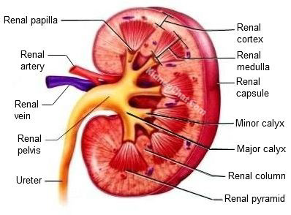
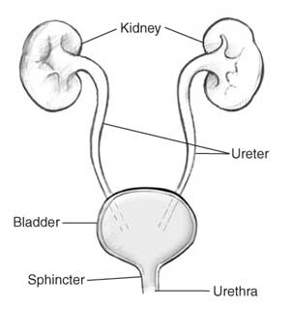
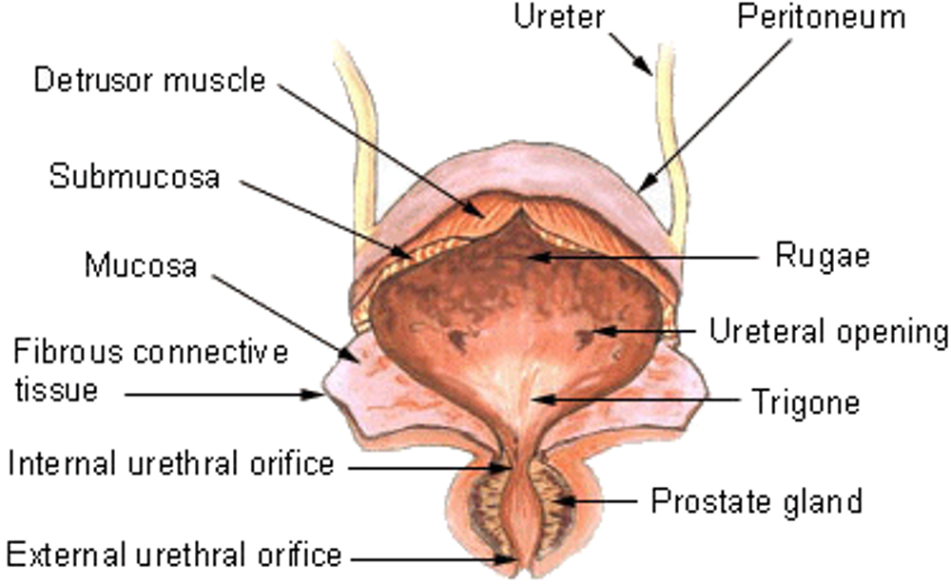
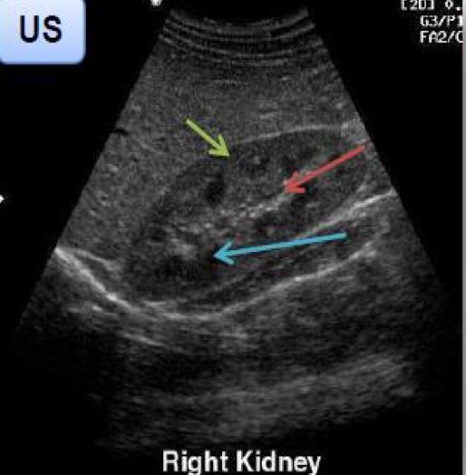
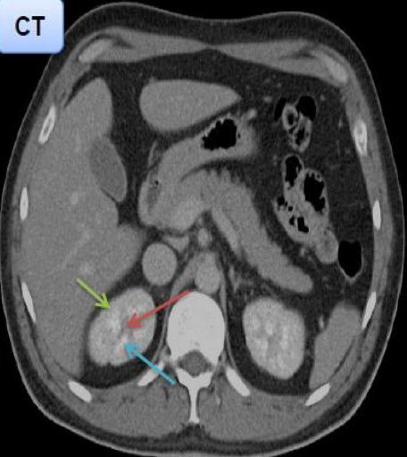
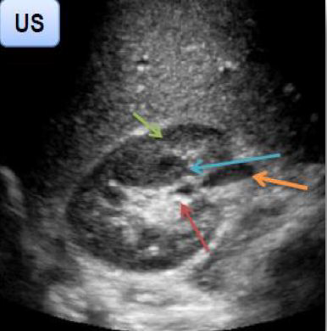
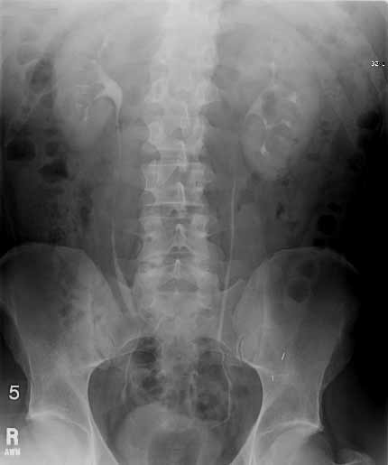
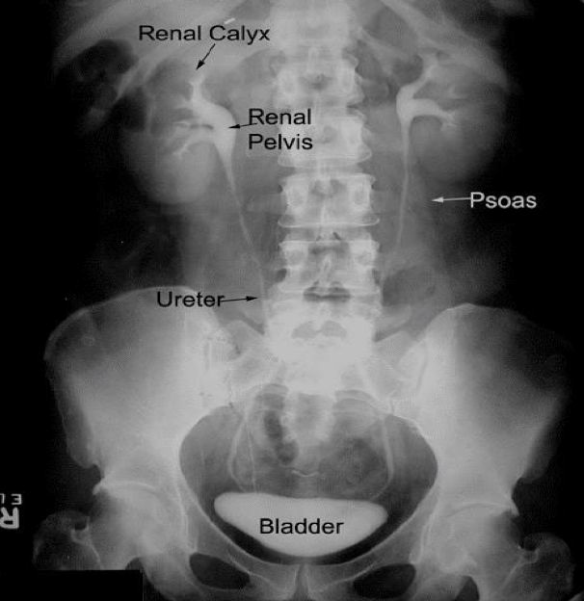
Structures
2
Normal anatomy
Kidney
Renal cortex (moderate echogenicity)
Renal permed or medulla (least echogenic)
Ureter
Hilum or pelvis (most echogenic appear as a slit)
Ureter (IVP)

Slide 6
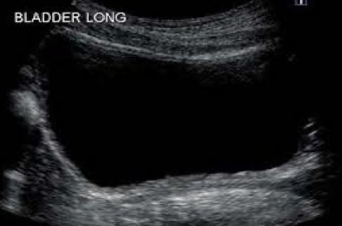
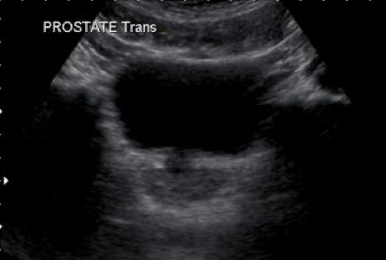
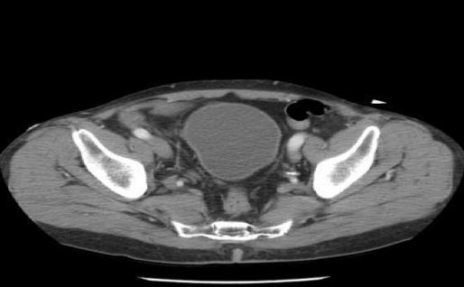
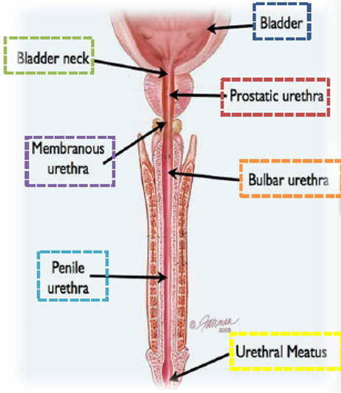
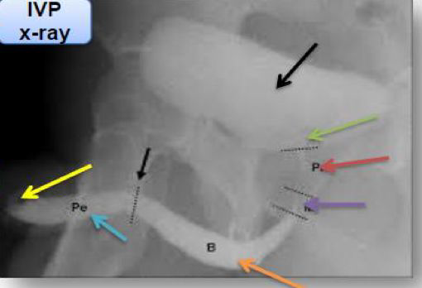
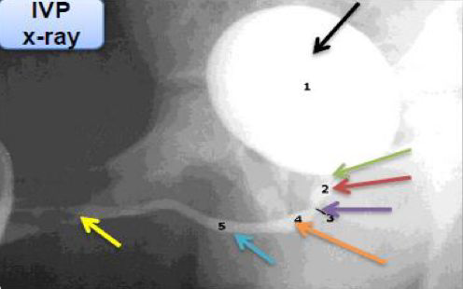
Cont..
3
Urinary Bladder (US, CT)
The darkness in the middle of bladder indicates the fluid
Urethra (IVP)
Bladder bladder neck prostatic urethra Membranous urethra bulbar urethra penile urethra Urethra meatus
X-ray ( IVP ) used for patients that have urethral injury Showing a Cut off in the urethra

Slide 7
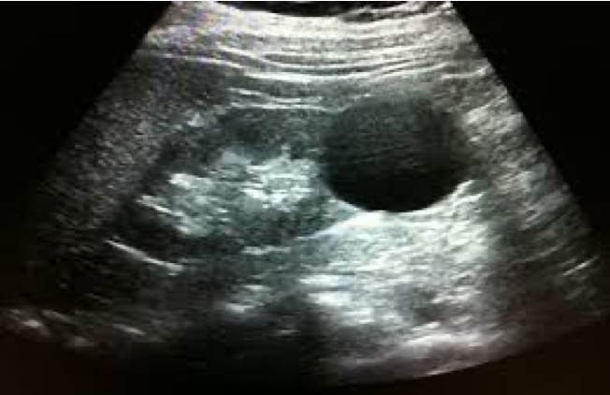
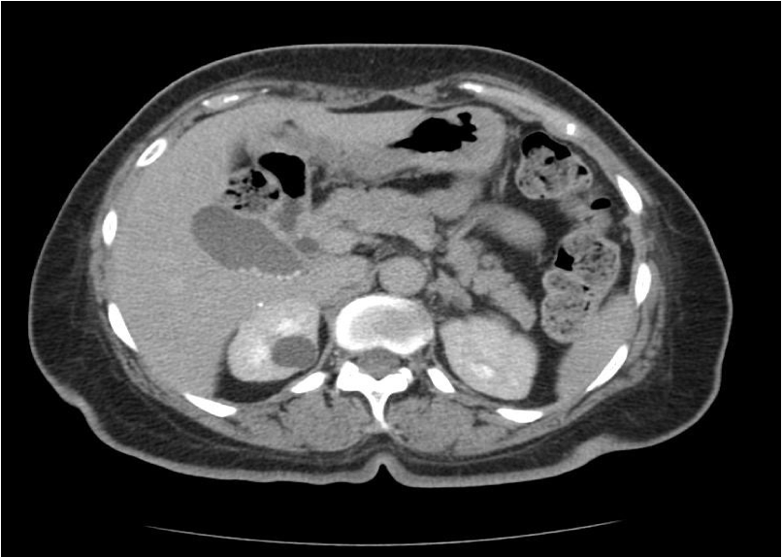
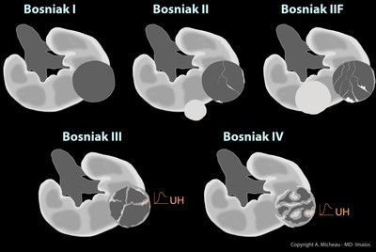
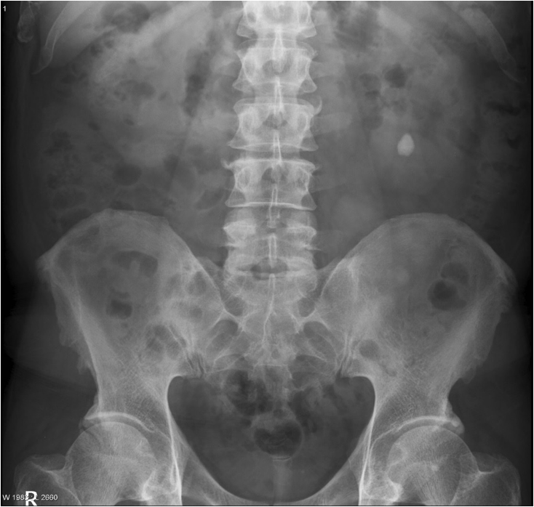
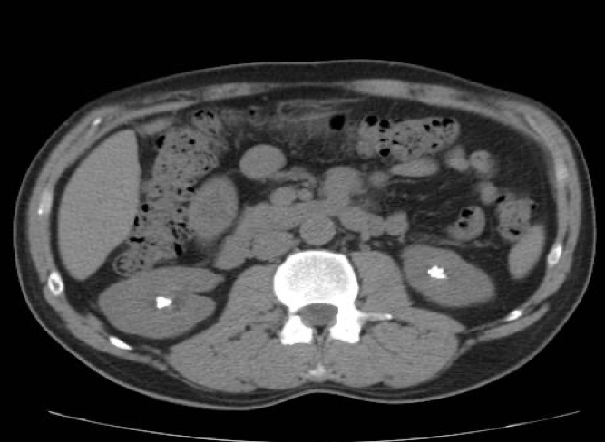
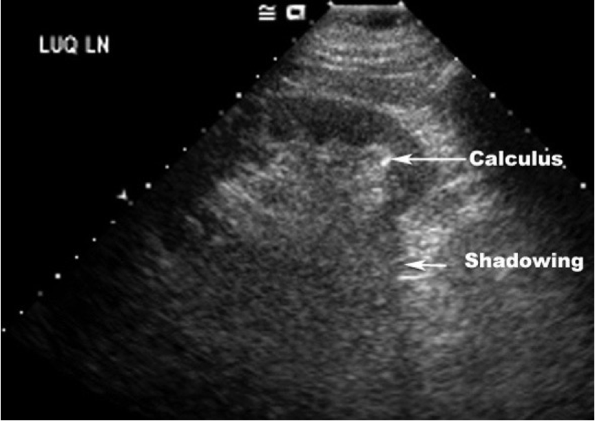
Common kidney pathologies
4
Cysts: fluid-filled sac
DON’T confuse it with cystitis
 | benign ,common , type I bosniak classification*
US
CT
Notice the well circumscribed anechoic (dark/black) lesion on the kidney which indicates the fluid filled sac
US of normal kidney VS with cyst
Right kidney: Notice also the well circumscribed lesion which is relatively hypodense(darker) to the rest of the kidney “indicates the cyst”
Left kidney: appears normal
Remember: fluids appear darker
*Bosniak classification
it divides renal cystic masses into five categories based on imaging characteristics. It’s helpful in predicting a risk of malignancy, as the first type is the most benign while the fifth is the most malignant + complex+ involved with calcification
Kidney stones
Stones will be either: (remember: stones appear lighter)
Radio-opaque (calcium , struvite)
Can be seen in x-ray (light)
Radio-lucent (uric acid , cysteine)
Can’t be seen in x-ray
X-ray | CT | US commonly used
KIDNEY
Unilateral Radio-opaque stone
Bilateral hyperdense stones (appear dense as much as the bone)
In US: If it’s difficult to detect the stone, always look for the shadowing because it’s an indication for it

Slide 8
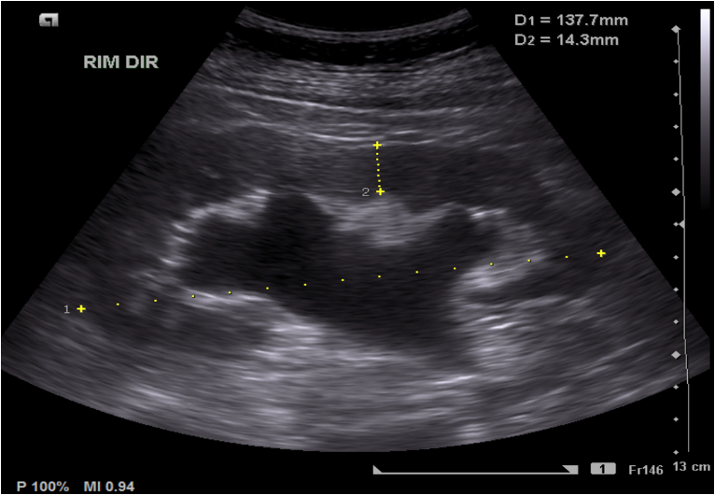
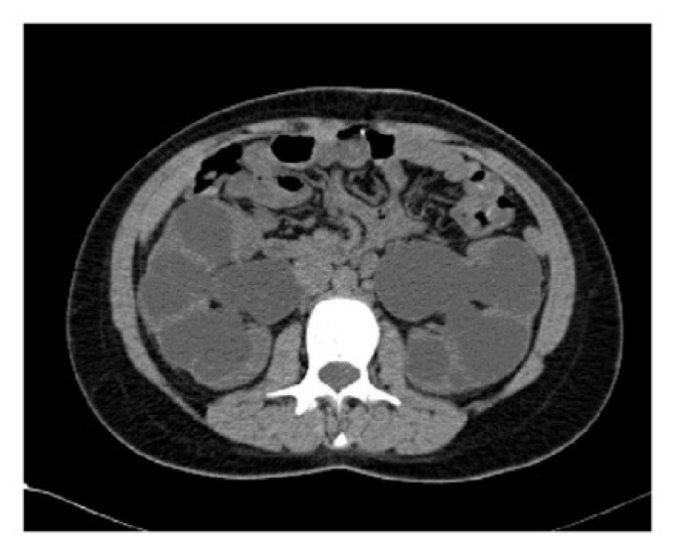
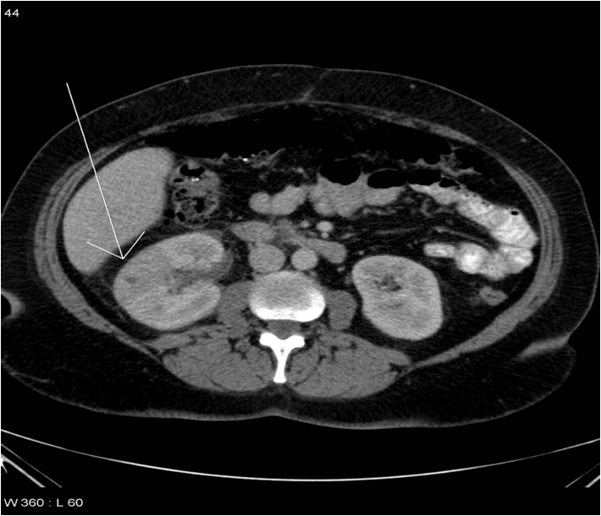
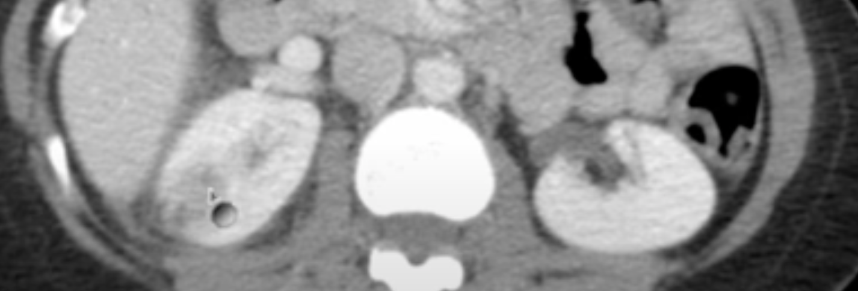
Common kidney pathologies
5
Hydronephrosis
 | occurs when the kidney swells and the renal pelvis dilate due to the failure of drainage of urine from the kidney to the bladder
US
CT
- hypoechoic and dilated renal pelvis as it’s filled with urine (the normal pelvis appear as a slight slit)
-thinning of the cortex
EXTRA:
Pyelonephritis
the infection of the kidney that results from bacterial invasion of the renal parenchyma. Bacteria usually reach the kidney by ascending from the lower urinary tract.
CT scan Is done only if the patient doesn’t respond to the treatment or he had a recurrent pyelonephritis
CT
Right kidney: shows focal area( wedge shape) of low attenuation (hypodense/dark) lesion + enlargement.
The normal kidney should show uniform enhancement throughout the renal cortex
EXTRA:
INFECTED KIDNEY:
FOCAL AREA OF HYPODENSITY
HEALTHY KIDNEY:
NICELY UNIFORMED CORTICAL ENHANCEMENT

Slide 9
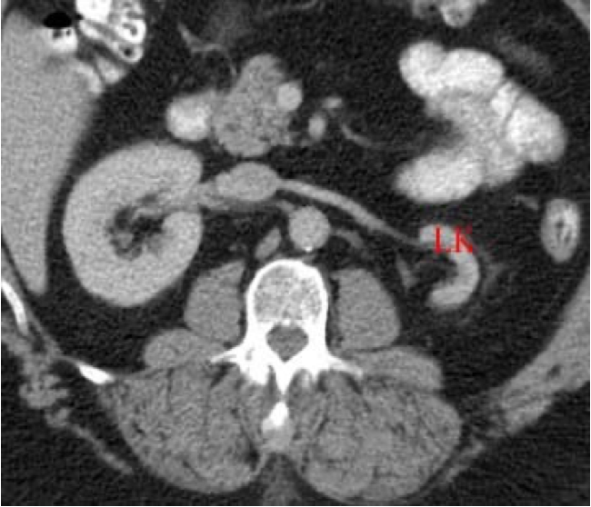
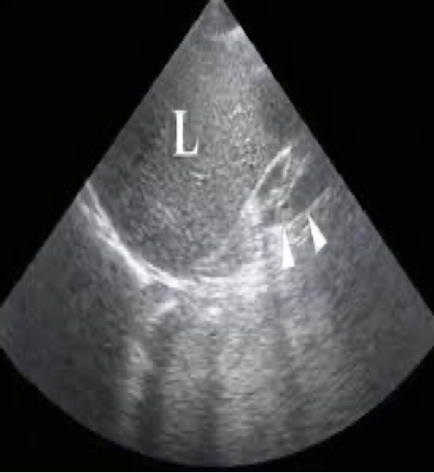
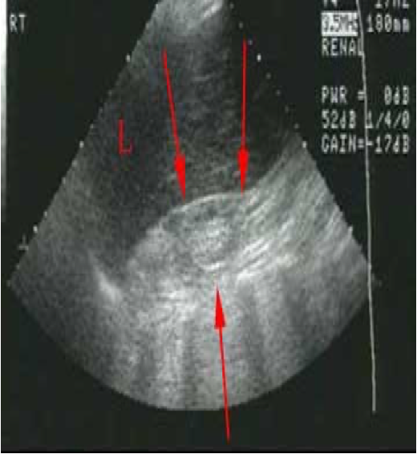
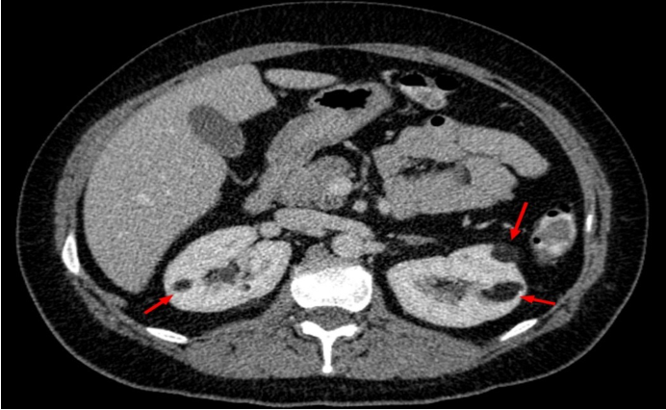
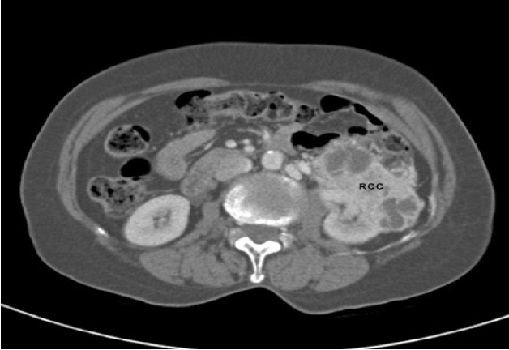
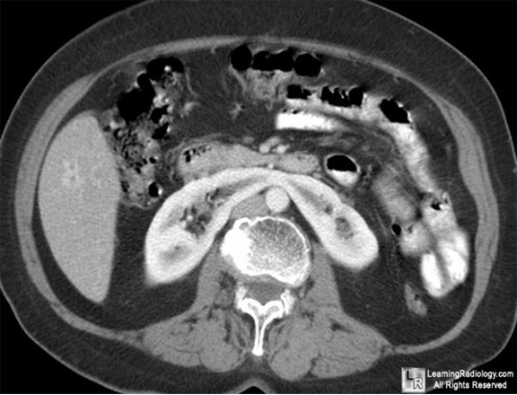
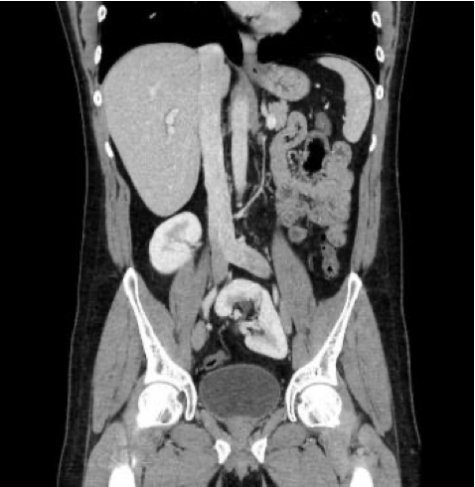
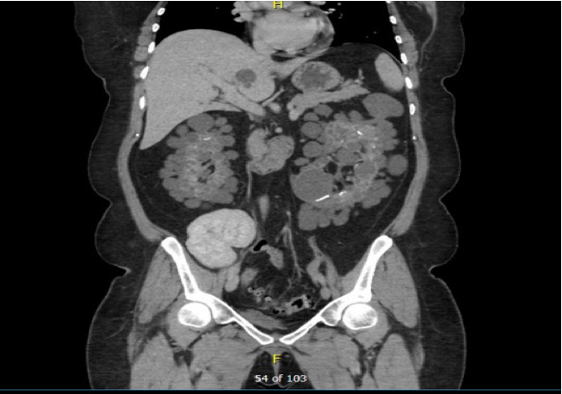
Common kidney pathologies
6
ESRD
(End-Stage Renal Disease)
last stage of chronic kidney disease, causes Atrophy of the kidney
CT | US
Female dr’s
Left kidney: atrophied
Right kidney: normal
atrophied L kidney
Tumors
Benign | Malignant
most common:
Angiomyolipoma
Contains fat so appears hypodense
most common:
renal cell carcinoma, appears heterogeneous with hypo/hyperdense areas
What is the tumor that mimic renal cell carcinoma on imaging ? go study pathology :) oncocytoma
Congenital anomalies
Horseshoe Kidney | Ectopic Kidney | Polycystic Kidney Disease
Fusion of the lower poles of two kidneys
Abnormal kidney position

Slide 10
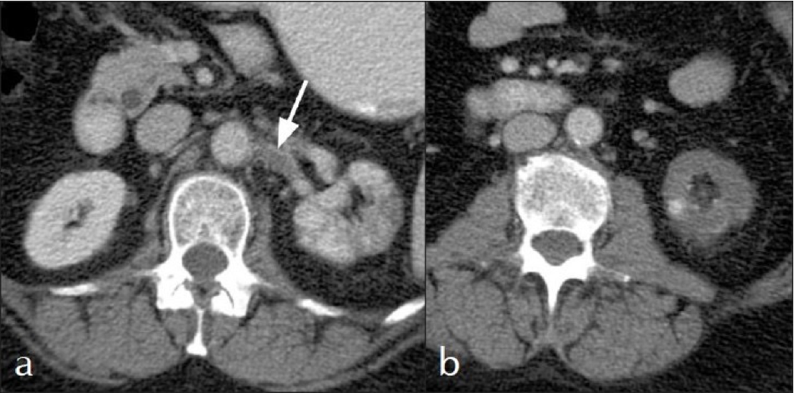
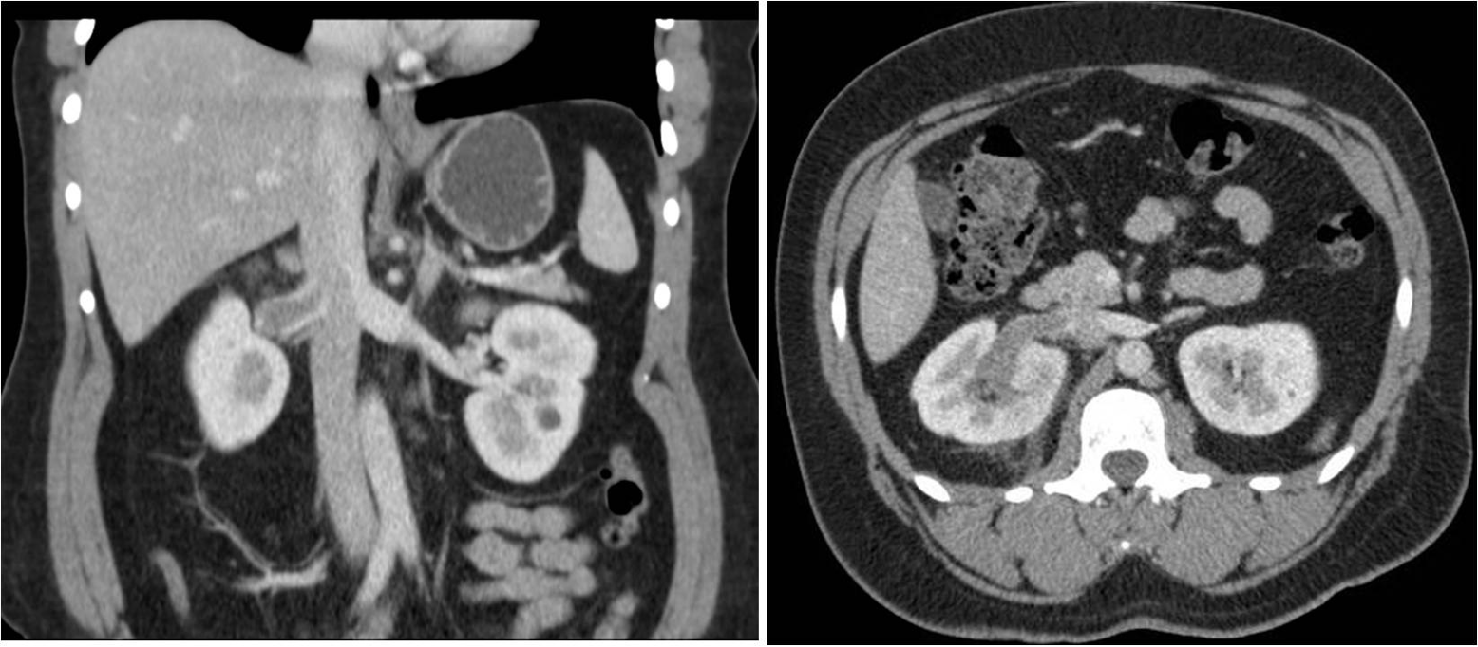
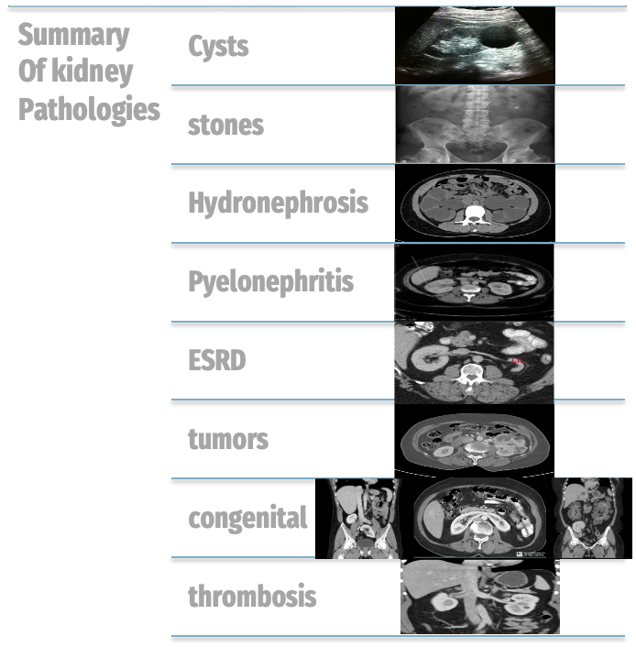
Common kidney pathologies
7
Renal thrombosis
Renal artery thrombosis
(a) left renal artery thrombus (arrow)
(b) focal area(wedge shape) of cortical hypodensity on the left kidney*
*left kidney appear darker and hypodense due to the infarction
Renal vein thrombosis
-right renal vein dilatation
- right kidney is hypodense with persistent enhancement of its cortex (bright) while the parenchyma is not enhanced (dark)

Slide 11
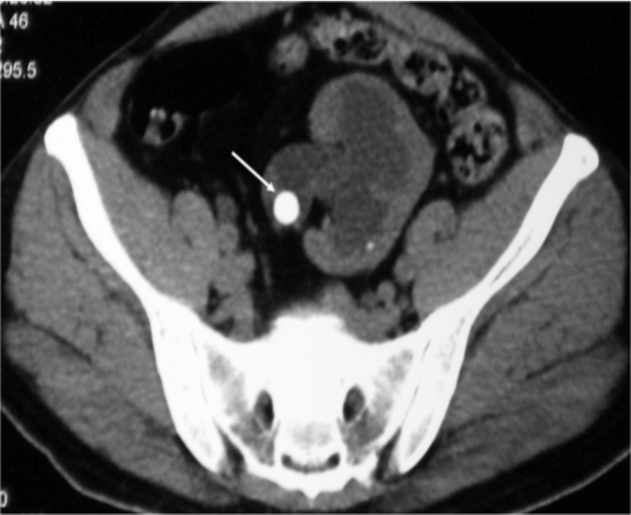
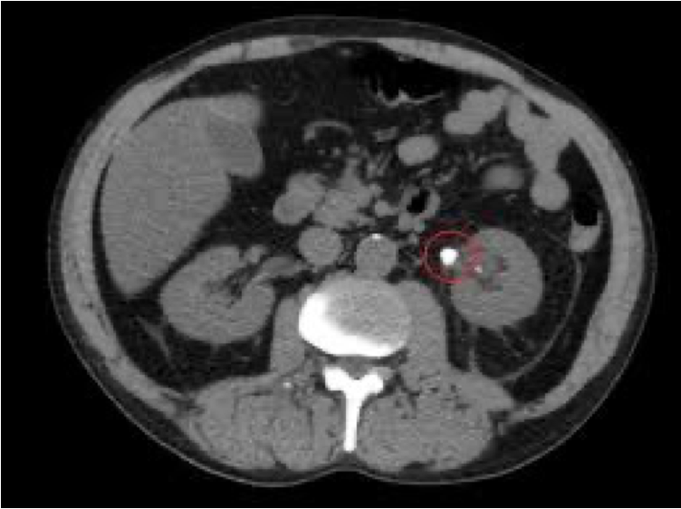
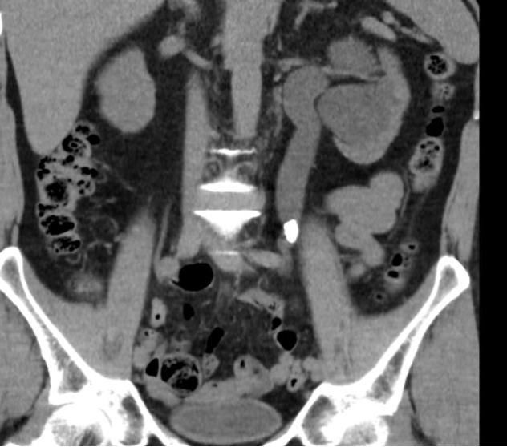
Common ureter pathologies
8
Ureteric stones
stones in the ureter will make a obstruction and block the urines way to the bladder, which may cause Hydronephrosis.
CT (remember: solid particles appear white/hyperdense)
vesicoureteral reflux disease
Retrograde of urine flow from the bladder to the ureter due to congenital valve defect (seen in children with UTI)
IVP
dilated, tortuous ureter, with reflux involving the kidney parenchyma
Duplicating Collecting System
IVP
Extra ureter

Slide 12
Common bladder pathologies
9
Cystitis
Initially the bladder was called a cyst, thus its inflammation is known as cystitis
CT
inflamed urinary bladder (thick surrounding walls)
This bladder has gas bubbles that could be due to inflammation or infection from ‘gas producing’ bacteria
Benign Prostate Hypertrophy
CT | US
Bladder
Hypertrophied prostate compress the bladder
prostate
Bladder
prostate
Bladder rupture
The abdomen is lined with the peritoneum from inside, The bladder is located below the membrane of the peritoneum
Extra peritoneum | Intra peritoneum
-any rupture or leakage to the content of the bladder does not enter the peritoneum. - Patient does not need surgery | -there is a rupture in both bladder and peritoneum. -Patient will need surgery.
The extravasated contrast media ( the whitish material) isn't leaking to the peritoneum
The extravasated contrast media ( the whitish material) is leaking to the peritoneum
Bladder
Bladder

Slide 13
Questions (SAQ)
?
Identify the following structures
The answers are in page 1,2,3

Slide 14
Team leaders
Hend Almogary Saad Almogren
Radiology442@gmail.com

