Slide 1
GRANULOMATOUS DISEASE
Emad Raddaoui,MD
FCAP, FASC

Slide 2
GRANULOMATOUS DISEASE
Granulomatous inflammation is a distinctive pattern of chronic inflammatory reaction characterized by focal accumulations of activated macrophages, which often develop an epithelial-like (epithelioid) appearance.

Slide 3
GRANULOMATOUS DISEASE
It is encountered in a limited number of immunologically mediated, infectious and some non-infectious conditions.
Its genesis is firmly linked to immune reactions.

Slide 4
GRANULOMATOUS DISEASE
Examples include:
tuberculosis,
sarcoidosis,
cat-scratch disease
Lmphogranuloma inguinale,
leprosy,
brucellosis,
syphilis,
some mycotic infections,
berylliosis, and reactions of irritant lipids are also included.

Slide 5
GRANULOMATOUS DISEASE
Recognition of the granulomatous pattern in a biopsy specimen is important because of the limited number of possible conditions that cause it and the significance of the diagnoses associated with the lesions.

Slide 6
Examples of Granulomas
Infectious granulomas:
Tuberculosis
Brucellosis
Lymphogranuloma venereum
Cat- scratch disease
Fungal infection
Syphilis
Parasitic infection eg. Schistosomiasis.

Slide 9
Examples of Granulomas
Foreign-body granulomas are typically non necrotic and form in the presence of the following:
Particulate matter(e.g., glass, soil, gravel, metal).
Synthetic material (e.g., surgical sutures).
Vegetable matter (e.g., cellulose, which may occur due to fecal contamination of tissues in the presence of a fstula or perforated bowel)

Slide 10
Examples of Granulomas
Unknown causes:
Sarcoidosis is caused by epithelioid granulomas and may involve lungs, liver, spleen, lymph nodes and skin. The granulomas are non-necrotic, uniformly sized and multiple.

Slide 11
Disease | Cause | Tissue Reaction
Tuberculosis | Mycobacterium tuberculosis | Noncaseating tubercle (granuloma prototype): a focus of epithelioid cells, rimmed by fibroblasts, lymphocytes, histiocytes, occasional Langhans giant cell; caseating tubercle: central amorphous granular debris, loss of all cellular detail; acid-fast bacilli
Leprosy | Mycobacterium leprae | Acid-fast bacilli in macrophages; non-caseating granulomas
Syphilis | Treponema pallidum | Gumma: microscopic to grossly visible lesion, enclosing wall of histiocytes; plasma cell infiltrate; central cells are necrotic without loss of cellular outline
Cat-scratch disease | Gram-negative bacillus | Rounded or stellate granuloma containing central granular debris and recognizable neutrophils; giant cells uncommon

Slide 12
Granuloma
A granuloma is a focus of chronic inflammation consisting of a microscopic aggregation of macrophages that are transformed into epithelium-like cells surrounded by a collar of mononuclear leukocytes, principally lymphocytes and occasionally plasma cells.

Slide 14
Morphology of Granuloma
In the usual hematoxylin and eosin stained tissue sections, the epithelioid cells have a pale pink granular cytoplasm with indistinct cell boundaries, often appearing to merge into one another.
Older granulomas develop an enclosing rim of fibroblasts and connective tissue.
Frequently, epithelioid cells fuse to form giant cells.These giant cells have a large mass of cytoplasm containing 20 or more small nuclei arranged either peripherally (Langhans-type giant cell) or haphazardly (foreign body-type giant cell)

Slide 17
Types of Granuloma
There are two types of granulomas, which differ in their pathogenesis.
Foreign body granulomas :
- Incited by relatively inert foreign bodies.
Typically, foreign body granulomas form when material such as talc (associated with intravenous drug abuse) sutures, or other fibers are large enough to preclude phagocytosis by a single macrophage.
Epithelioid cells and giant cells form and encompass the foreign body.
The foreign material can usually be identified in the center of the granuloma, particularly if viewed with polarized light, in which it appears refractile.

Slide 21
Types of Granuloma
2) Immune granulomas
form in response to a persistent antigen.
They are caused by insoluble particles, typically microbes, that are capable of inducing a cell-mediated immune response (type IV hypersensitivity reaction).
The inciting agent is usually a poorly degradable or particulate.
In these responses, macrophages engulf the foreign material and become activated.
The surrounding T cells produce cytokines, such as IL-2, which activates other T cells, and IFN-γ, which is important in activating macrophages and transforming them into epithelioid cells and multinucleate giant cells.

Slide 22
TUBERCULOSIS
Mycobacterium tuberculosis is responsible for most cases of tuberculosis.
Bacteria are aerobic rods
Waxy cell wall, which makes them acid fast.
Reservoir of infection is humans with active tuberculosis.
Oropharyngeal and intestinal tuberculosis contracted by drinking milk contaminated with M. bovis is rare and is seen in countries that have tuberculous dairy cows and unpasteurized milk.

Slide 23
Epidemiology of TB
Tuberculosis affects 1.7 billion individuals worldwide, with 8 to 10 million new cases and 1.7 million deaths each year.
After HIV, tuberculosis is the leading infectious cause of death in the world.
Flourishes wherever there is poverty, crowding, and chronic debilitating illness.
Mainly a disease of the elderly, the urban poor, and people with AIDS.

Slide 24
Epidemiology of TB
Increase risk:
Diabetes mellitus,
Hodgkin's lymphoma,
Chronic lung disease (particularly silicosis),
Chronic renal failure,
Malnutrition,
Alcoholism,
Immunosuppression

Slide 25
Pathogenesis of TB
The pathogenesis of tuberculosis in a previously unexposed, immunocompetent person depends on the development of anti-mycobacterial cell-mediated immunity, which confers resistance to the bacteria and results in development of hypersensitivity to tubercular antigens.

Slide 26
Pathogenesis of TB
The pathological manifestations of tuberculosis, such as caseating granulomas and cavitation, are the result of the hypersensitivity that is part and parcel of the host immune response.
Macrophages are the primary cells infected by M. tuberculosis.

Slide 27
Pathogenesis of TB
M. tuberculosis enters macrophages
Once inside the macrophage, M. tuberculosis replicates within the phagosome by blocking fusion of the phagosome and lysosome.
Thus the earliest stage of primary tuberculosis (<3 weeks) in the nonsensitized individual is characterized by proliferation of bacteria in the pulmonary alveolar macrophages and airspaces, with resulting bacteremia and seeding of multiple sites.

Slide 28
Pathogenesis of TB
Despite the bacteremia, most patients at this stage are asymptomatic or have a mild flulike illness.

Slide 29
Pathogenesis of TB
About 3 weeks after infection, a TH1 response against M. tuberculosis is mounted that activates macrophages to become bactericidal.
TH1 cells are stimulated by mycobacterial antigens drained to the lymph node.

Slide 30
Pathogenesis of TB
Mature TH1 cells, both in lymph nodes and in the lung, produce IFN-γ.
IFN-γ is the critical mediator which drives macrophages to become competent to contain the M. tuberculosis infection.
IFN-γ stimulates formation of the phagolysosome in infected macrophages, exposing the bacteria to an inhospitable acidic environment.

Slide 31
Pathogenesis of TB
IFN-γ also stimulates expression of inducible nitric oxide synthase (iNOS), which produces nitric oxide (NO). NO helps in the destruction of several mycobacterial constituents, from cell wall to DNA.

Slide 32
Pathogenesis of TB
In addition to stimulating macrophages to kill mycobacteria, the TH1 response orchestrates the formation of granulomas and caseous necrosis.
Activated macrophages, stimulated by IFN-γ, produce TNF, which recruits monocytes.
These monocytes differentiate into the "epithelioid histiocytes" that characterize the granulomatous response.

Slide 33
Pathogenesis of TB
In addition to the TH1 response, T cells which recognize mycobacterial antigens also make IFN-γ.
TH1 cells have a central role in this process as defects in any of the steps in generating a TH1 response results in absence of resistance and disease progression.

Slide 34
Pathogenesis of TB
In summary, immunity to M. tuberculosis is primarily mediated by TH1 cells, which stimulate macrophages to kill the bacteria. This immune response, while largely effective, comes at the cost of hypersensitivity and the accompanying tissue destruction.

Slide 35
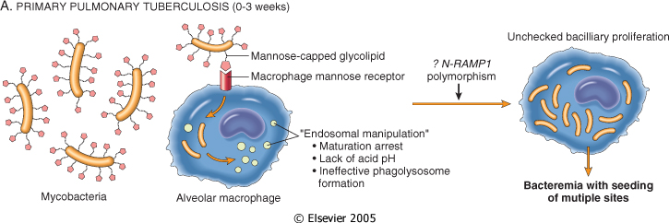
Figure 8-28 The sequence of events in primary pulmonary tuberculosis, commencing with inhalation of virulent M. tuberculosis and culminating with the development of cell-mediated immunity to the organism. A, Events occurring in the first 3 weeks after exposure. B, events thereafter. The development of resistance to the organism is accompanied by the appearance of a positive tuberculin test. Cells and bacteria are not drawn to scale. iNOS, inducible nitric oxide synthase; MHC, major histocompatibility complex; MTB, M. tuberculosis; NRAMP1, natural resistance-associated macrophage protein.
Downloaded from: Robbins & Cotran Pathologic Basis of Disease (on 24 September 2005 02:37 PM)
© 2005 Elsevier

Slide 36
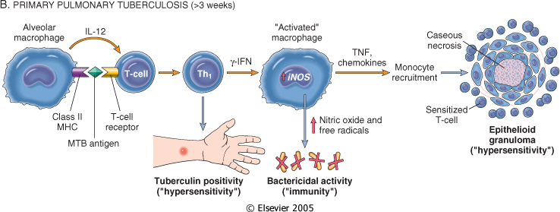
Figure 8-28 The sequence of events in primary pulmonary tuberculosis, commencing with inhalation of virulent M. tuberculosis and culminating with the development of cell-mediated immunity to the organism. A, Events occurring in the first 3 weeks after exposure. B, events thereafter. The development of resistance to the organism is accompanied by the appearance of a positive tuberculin test. Cells and bacteria are not drawn to scale. iNOS, inducible nitric oxide synthase; MHC, major histocompatibility complex; MTB, M. tuberculosis; NRAMP1, natural resistance-associated macrophage protein.
Downloaded from: Robbins & Cotran Pathologic Basis of Disease (on 24 September 2005 02:37 PM)
© 2005 Elsevier

Slide 37
Clinical Features of Tuberculosis
Primary tuberculosis :
- The form of disease that develops in a previously unexposed, and therefore unsensitized, person.
About 5% of newly infected people develop clinically significant disease.
With primary tuberculosis, the source of the organism is exogenous. While most patients with primary tuberculosis go on to have latent disease, progressive infection, with continued lung pathology, occurs in some.

Slide 38
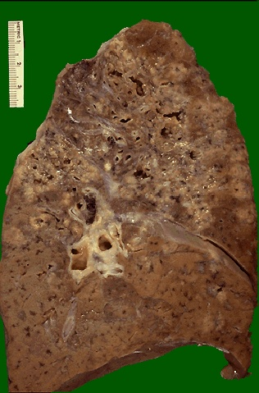

Slide 39
Clinical Features of Tuberculosis
The diagnosis of progressive primary tuberculosis in adults can be difficult.
It is more often resembles an acute bacterial pneumonia, with lower and middle lobe consolidation, hilar adenopathy, and pleural effusion;
Cavitation is rare, especially in patients with severe immunosuppression.

Slide 40
Clinical Features of Tuberculosis
Lymphohematogenous dissemination is a dreaded complication and may result in the development of tuberculous meningitis and miliary tuberculosis.
Similar lesions also occur following progression of secondary tuberculosis.

Slide 41
Clinical Features of Tuberculosis
Secondary tuberculosis :
- The pattern of disease that arises in a previously sensitized host.
It may follow shortly after primary tuberculosis,
- More commonly, it arises from reactivation of dormant primary lesions many decades after initial infection, particularly when host resistance is weakened.

Slide 42
Clinical Features of Tuberculosis
It may also result from exogenous reinfection because of waning of the protection afforded by the primary disease or because of a large inoculum of virulent bacilli.
Reactivation of tuberculosis is more common in low-prevalence areas
Reinfection plays an important role in regions of high contagion.

Slide 43
Clinical Features of Tuberculosis
Secondary pulmonary tuberculosis is classically localized to the apex of the upper lobes of one or both lungs.
Cavitation occurs readily in the secondary form, resulting in dissemination of mycobacteria along the airways.
It becomes an important source of infection because the patient now coughs sputum that contains bacilli.

Slide 44
Clinical Features of Tuberculosis
Localized secondary tuberculosis may be asymptomatic.
When manifestations appear, they are usually insidious in onset.

Slide 45
Clinical Features of Tuberculosis
Systemic symptoms: probably related to cytokines released by activated macrophages (e.g., TNF and IL-1), and include malaise, anorexia, weight loss, and fever.
Commonly, the fever is low grade and remittent (appearing late each afternoon and then subsiding), and night sweats occur.

Slide 46
Clinical Features of Tuberculosis
With progressive pulmonary involvement, increasing amounts of sputum, at first mucoid and later purulent, appear.
Hemoptysis is present in about half of all cases of pulmonary tuberculosis.
Pleuritic pain may result from extension of the infection to the pleural surfaces.
Extrapulmonary manifestations of tuberculosis depend on the organ system involved

Slide 47
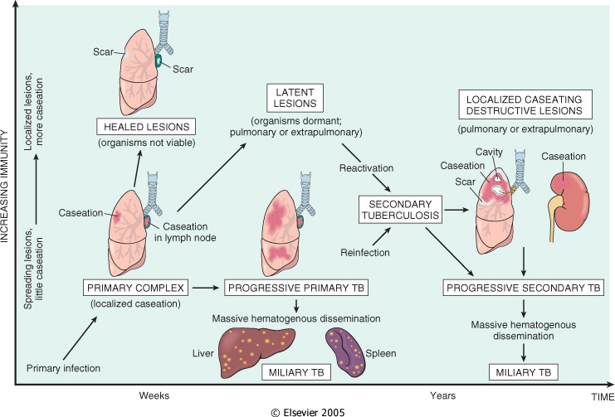
Figure 8-29 The natural history and spectrum of tuberculosis. (Adapted from a sketch provided by Dr. R. K. Kumar, The University of New South Wales, School of Pathology, Sydney, Australia.)
Downloaded from: Robbins & Cotran Pathologic Basis of Disease (on 24 September 2005 02:37 PM)
© 2005 Elsevier

Slide 48
Morphology of TB
Primary Tuberculosis:
In countries where bovine tuberculosis and infected milk have been eliminated, primary tuberculosis almost always begins in the lungs.
Typically, the inhaled bacilli implant in the distal airspaces of the lower part of the upper lobe or the upper part of the lower lobe,
Usually close to the pleura.

Slide 49
Morphology of TB
As sensitization develops, a 1- to 1.5-cm area of gray-white inflammatory consolidation emerges, known as the Ghon focus.
In most cases, the center of this focus undergoes caseous necrosis.
Tubercle bacilli, either free or within phagocytes, drain to the regional nodes, which also often caseate.
This combination of parenchymal lung lesion and nodal involvement is referred to as the Ghon complex.

Slide 50
Morphology of TB
During the first few weeks, there is also lymphatic and hematogenous dissemination to other parts of the body.
In approximately 95% of cases, development of cell-mediated immunity controls the infection. Hence, the Ghon complex undergoes progressive fibrosis, often followed by radiologically detectable calcification (Ranke complex), and despite seeding of other organs, no lesions develop.

Slide 51
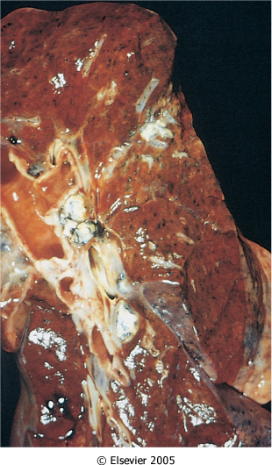
Figure 8-30 Primary pulmonary tuberculosis, Ghon complex. The gray-white parenchymal focus is under the pleura in the lower part of the upper lobe. Hilar lymph nodes with caseation are seen on the left.
Downloaded from: Robbins & Cotran Pathologic Basis of Disease (on 24 September 2005 02:37 PM)
© 2005 Elsevier

Slide 52
Morphology of TB
Histologically, sites of active involvement are marked by a characteristic granulomatous inflammatory reaction that forms both caseating and noncaseating tubercles.
When multiple granulomas coalesce that they become macroscopically visible.
The granulomas are usually surrounded by fibroblasts and lymphocytes.
Multinucleate giant cells are present in the granulomas.
Immunocompromised people do not form the characteristic granulomas

Slide 53
Morphology of TB
Secondary Tuberculosis:
The initial lesion is usually a small focus of consolidation, less than 2 cm in diameter, near the apical pleura. Such foci are sharply circumscribed, firm, gray-white to yellow areas that have a variable amount of central caseation and peripheral fibrosis.

Slide 54
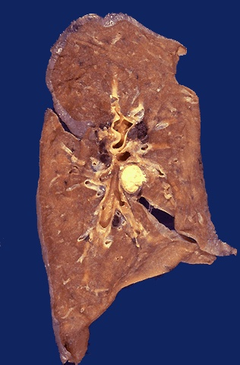

Slide 55
Morphology of TB
Histologically, the active lesions show characteristic coalescent tubercles with central caseation.
Localized, apical, secondary pulmonary tuberculosis may heal with fibrosis either spontaneously or after therapy, or
The disease may progress and extend along several different pathways.

Slide 56
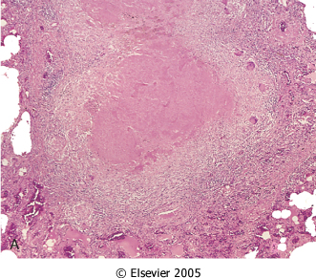
Figure 8-31 The morphologic spectrum of tuberculosis. A characteristic tubercle at low magnification (A) and in detail (B) illustrates central caseation surrounded by epithelioid and multinucleated giant cells. This is the usual response seen in patients who have developed cell mediated immunity to the organism. Occasionally, even in immunocompetent individuals, tubercular granulomas might not show central caseation (C); hence, irrespective of the presence or absence of caseous necrosis, special stains for acid-fast organisms need to be performed when granulomas are present in histologic section. In immunosuppressed individuals, tuberculosis may not elicit a granulomatous response ("nonreactive tuberculosis"); instead, sheets of foamy histiocytes are seen, packed with mycobacteria that are demonstrable with acid-fast stains (D). (D, Courtesy of Dr. Dominick Cavuoti, Department of Pathology, University of Texas Southwestern Medical School, Dallas, TX.)
Downloaded from: Robbins & Cotran Pathologic Basis of Disease (on 24 September 2005 02:37 PM)
© 2005 Elsevier

Slide 57
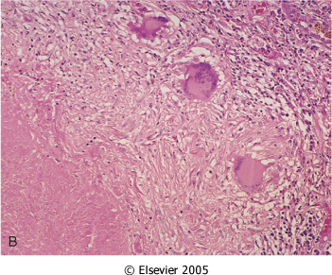
Figure 8-31 The morphologic spectrum of tuberculosis. A characteristic tubercle at low magnification (A) and in detail (B) illustrates central caseation surrounded by epithelioid and multinucleated giant cells. This is the usual response seen in patients who have developed cell mediated immunity to the organism. Occasionally, even in immunocompetent individuals, tubercular granulomas might not show central caseation (C); hence, irrespective of the presence or absence of caseous necrosis, special stains for acid-fast organisms need to be performed when granulomas are present in histologic section. In immunosuppressed individuals, tuberculosis may not elicit a granulomatous response ("nonreactive tuberculosis"); instead, sheets of foamy histiocytes are seen, packed with mycobacteria that are demonstrable with acid-fast stains (D). (D, Courtesy of Dr. Dominick Cavuoti, Department of Pathology, University of Texas Southwestern Medical School, Dallas, TX.)
Downloaded from: Robbins & Cotran Pathologic Basis of Disease (on 24 September 2005 02:37 PM)
© 2005 Elsevier

Slide 58
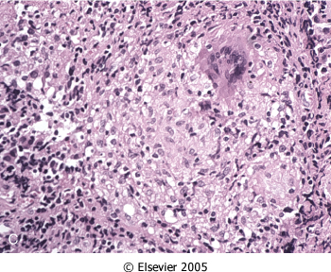
Figure 8-31 The morphologic spectrum of tuberculosis. A characteristic tubercle at low magnification (A) and in detail (B) illustrates central caseation surrounded by epithelioid and multinucleated giant cells. This is the usual response seen in patients who have developed cell mediated immunity to the organism. Occasionally, even in immunocompetent individuals, tubercular granulomas might not show central caseation (C); hence, irrespective of the presence or absence of caseous necrosis, special stains for acid-fast organisms need to be performed when granulomas are present in histologic section. In immunosuppressed individuals, tuberculosis may not elicit a granulomatous response ("nonreactive tuberculosis"); instead, sheets of foamy histiocytes are seen, packed with mycobacteria that are demonstrable with acid-fast stains (D). (D, Courtesy of Dr. Dominick Cavuoti, Department of Pathology, University of Texas Southwestern Medical School, Dallas, TX.)
Downloaded from: Robbins & Cotran Pathologic Basis of Disease (on 24 September 2005 02:37 PM)
© 2005 Elsevier

Slide 59
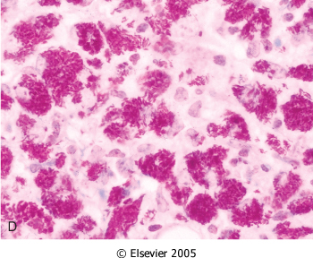
Figure 8-31 The morphologic spectrum of tuberculosis. A characteristic tubercle at low magnification (A) and in detail (B) illustrates central caseation surrounded by epithelioid and multinucleated giant cells. This is the usual response seen in patients who have developed cell mediated immunity to the organism. Occasionally, even in immunocompetent individuals, tubercular granulomas might not show central caseation (C); hence, irrespective of the presence or absence of caseous necrosis, special stains for acid-fast organisms need to be performed when granulomas are present in histologic section. In immunosuppressed individuals, tuberculosis may not elicit a granulomatous response ("nonreactive tuberculosis"); instead, sheets of foamy histiocytes are seen, packed with mycobacteria that are demonstrable with acid-fast stains (D). (D, Courtesy of Dr. Dominick Cavuoti, Department of Pathology, University of Texas Southwestern Medical School, Dallas, TX.)
Downloaded from: Robbins & Cotran Pathologic Basis of Disease (on 24 September 2005 02:37 PM)
© 2005 Elsevier

Slide 60
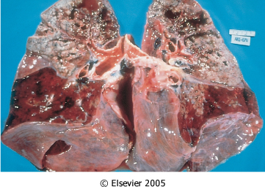
Figure 8-32 Secondary pulmonary tuberculosis. The upper parts of both lungs are riddled with gray-white areas of caseation and multiple areas of softening and cavitation.
Downloaded from: Robbins & Cotran Pathologic Basis of Disease (on 24 September 2005 02:37 PM)
© 2005 Elsevier

Slide 62
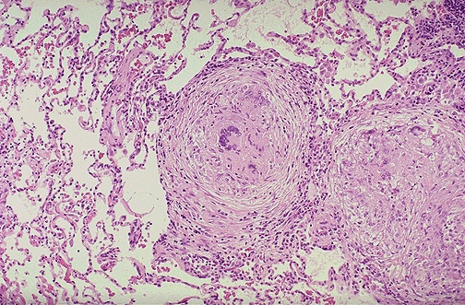

Slide 63
Progressive pulmonary tuberculosis
May ensue in the elderly and immunosuppressed.
The apical lesion enlarges with expansion of the area of caseation.
Erosion into a bronchus evacuates the caseous center, creating a ragged, irregular cavity lined by caseous material that is poorly walled off by fibrous tissue. Erosion of blood vessels results in hemoptysis.

Slide 64
Progressive pulmonary tuberculosis
With adequate treatment, the process may be arrested, although healing by fibrosis often distorts the pulmonary architecture.
If the treatment is inadequate or if host defenses are impaired, the infection may spread by direct expansion via dissemination through airways, lymphatic channels, or the vascular system.

Slide 66
Miliary pulmonary disease
Occurs when organisms drain through lymphatics into the lymphatic ducts, which empty into the venous return to the right side of the heart and thence into the pulmonary arteries.
Individual lesions are either microscopic or small, visible (2-mm) foci of yellow-white consolidation scattered through the lung parenchyma.

Slide 67
Miliary pulmonary disease
Miliary lesions may expand and coalesce to yield almost total consolidation of large regions or even whole lobes of the lung.
With progressive pulmonary tuberculosis, the pleural cavity is invariably involved, and serous pleural effusions, tuberculous empyema, or obliterative fibrous pleuritis may develop.

Slide 68
Miliary pulmonary disease
Ensues when infective foci in the lungs seed the pulmonary venous return to the heart; the organisms subsequently disseminate through the systemic arterial system.
Almost every organ in the body can be seeded.
Lesions resemble those in the lung.

Slide 69
Systemic miliary tuberculosis
Miliary tuberculosis is most prominent in :
the liver,
bone marrow,
spleen,
adrenals,
meninges, kidneys, fallopian tubes, and epididymis.

Slide 71
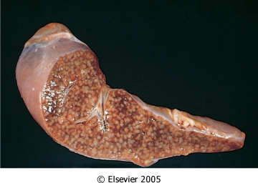
Figure 8-33 Miliary tuberculosis of the spleen. The cut surface shows numerous gray-white granulomas.
Downloaded from: Robbins & Cotran Pathologic Basis of Disease (on 24 September 2005 02:37 PM)
© 2005 Elsevier

Slide 72
Isolated-organ tuberculosis
May appear in any of the organs or tissues seeded hematogenously and may be the presenting manifestation of tuberculosis.

Slide 73
Isolated-organ tuberculosis
Organs that are typically involved include the meninges (tuberculous meningitis), kidneys (renal tuberculosis), adrenals (formerly an important cause of Addison disease), bones (osteomyelitis), and fallopian tubes (salpingitis).
When the vertebrae are affected, the disease is referred to as Pott's disease.
Paraspinal "cold" abscesses in these patients may track along the tissue planes to present as an abdominal or pelvic mass

Slide 74
Isolated-organ tuberculosis
Lymphadenitis is the most frequent form of extrapulmonary tuberculosis, usually occurring in the cervical region ("scrofula").
Intestinal tuberculosis contracted by the drinking of contaminated milk.
In developed countries today, intestinal tuberculosis is more often a complication of protracted advanced secondary tuberculosis, secondary to the swallowing of coughed-up infective material.

Slide 75
Diagnosis
is based on the history ,physical and radiographic findings of consolidation or cavitation in the apices of the lungs.
Ultimately, tubercle bacilli must be identified.
Acid-fast smears (using Zeil-Neilson stain) stain the organism pink/red.
Cultures of the sputum of patients suspected of having tuberculosis should be performed.

Slide 76
Diagnosis
Conventional cultures required up to 10 weeks, but liquid media-based culture can provide an answer within 2 weeks.
PCR amplification of M. tuberculosis DNA allows for even more rapid diagnosis. PCR assays can detect as few as 10 organisms in clinical specimens.
Culture remains the gold standard

Slide 77
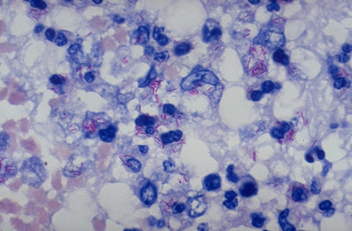

Slide 79
Prognosis
The prognosis is generally good if infections are localized to the lungs, except when they are caused by drug-resistant strains or occur in aged debilitated, or immunosuppressed persons, who are at high risk for developing miliary TB.
Amyloidosis may appear as a complication in persistent cases.

Slide 80
Tuberculin Test
It is a classic example of delayed hypersensitivity.
The tuberculin reaction, is produced by the intracutaneous injection of tuberculin, a protein-lipopolysaccharide component of the tubercle bacillus.

Slide 81
Tuberculin Test
In a previously sensitized individual, reddening and induration of the site appear in 8 to 12 hours, reach a peak in 24 to 72 hours, and thereafter slowly subside.
Morphologically, delayed type hypersensitivity is characterized by the accumulation of mononuclear cells around small veins and venules, producing a perivascular "cuffing" .

Slide 82
Tuberculin Test
Plasma proteins escape, giving rise to dermal edema and deposition of fibrin in the interstitium.
The latter appears to be the main cause of induration, which is characteristic of delayed hypersensitivity skin lesions.
In fully developed lesions, the lymphocyte-cuffed venules show marked endothelial hypertrophy and, in some cases, hyperplasia.

Slide 83
Mycobacterium Avium-Intracellulare
- MAC is common in soil, water, dust, and domestic animals.
Clinically significant infection with MAC is uncommon except among people with AIDS.
In AIDS patients, MAC causes widely disseminated infections, and organisms proliferate abundantly in many organs, commonly including the lungs and gastrointestinal system.Patients are feverish, with drenching night sweats and weight loss.

Slide 84
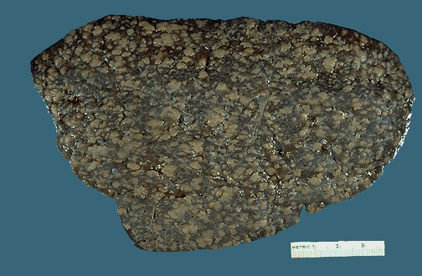

Slide 85
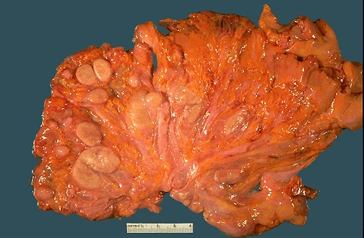

Slide 86
Mycobacterium Avium-Intracellulare
Morphology. The hallmark of MAC infections in patients with HIV is abundant acid-fast bacilli within macrophages.

Slide 88
Leprosy/Hansen disease
Is a slowly progressive infection caused by Mycobacterium leprae, affecting the skin and peripheral nerves and resulting in disabling deformities.
M. leprae is likely to be transmitted from person to person through aerosols from lesions in the upper respiratory tract.

Slide 89
Leprosy/Hansen disease
Inhaled M. leprae, like M. tuberculosis, is taken up by alveolar macrophages and disseminates through the blood, but grows only in tissues of the skin and extremities.
leprosy remains endemic among an estimated 10 to 15 million people living in poor tropical countries

Slide 90
Pathogenesis
M. leprae is an acid-fast obligate intracellular organism that grows very poorly in culture but can be grown in the armadillo.
It grows more slowly than other mycobacteria and grows best at 32° to 34°C, the temperature of the human skin and the core temperature of armadillos.

Slide 91
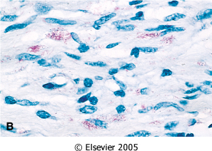
Figure 8-35 Leprosy. A, Peripheral nerve. Note the inflammatory cell infiltrates in the endoneural and epineural compartments. B, Cells within the endoneurium contain acid-fast positive lepra bacilli. (Courtesy of E.P. Richardson, Jr. and U. De Girolami, Harvard Medical School.)
Downloaded from: Robbins & Cotran Pathologic Basis of Disease (on 24 September 2005 02:37 PM)
© 2005 Elsevier

Slide 92
Pathogenesis
Like M. tuberculosis, M. leprae secretes no toxins, and its virulence is based on properties of its cell wall.
The cell wall is similar enough to that of M. tuberculosis.
Cell-mediated immunity is reflected by delayed type hypersensitivity reactions to dermal injections of a bacterial extract called lepromin

Slide 93
Pathogenesis
Leprosy has two strikingly different patterns of disease.
Patients with the less severe form, tuberculoid leprosy, have dry, scaly skin lesions that lack sensation. They often have large, asymmetric peripheral nerve involvement.

Slide 94
Pathogenesis
2- The more severe form of leprosy, lepromatous leprosy, includes symmetric skin thickening and nodules. This is also called anergic leprosy, because of the unresponsiveness (anergy) of the host immune system.

Slide 95
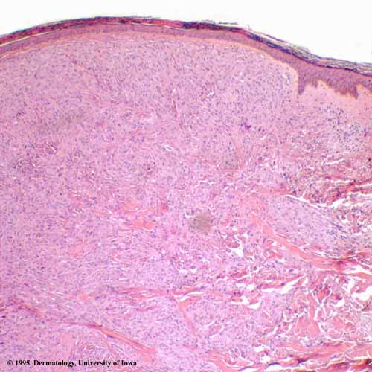

Slide 96
Pathogenesis
- In lepromatous leprosy, damage to the nervous system comes from widespread invasion of the mycobacteria into Schwann cells and into endoneural and perineural macrophages.
- In advanced cases of lepromatous leprosy, M. leprae is present in sputum and blood.

Slide 97
Pathogenesis
3- People can also have intermediate forms of disease, called borderline leprosy.

Slide 98
Morphology of Tuberculoid leprosy
Begins with localized skin lesions that are first flat and red but enlarge and develop irregular shapes with indurated, elevated, hyperpigmented margins and depressed pale centers (central healing).

Slide 99
Morphology of Tuberculoid leprosy
Neuronal involvement dominates tuberculoid leprosy.
Nerves become enclosed within granulomatous inflammatory reactions.
Nerve degeneration causes skin anesthesias and skin and muscle atrophy that render the patient liable to trauma of the affected parts, with the development of indolent skin ulcers.

Slide 101
Morphology of Tuberculoid leprosy
Contractures, paralyses, and autoamputation of fingers or toes may ensue.
Facial nerve involvement can lead to paralysis of the eyelids, with keratitis and corneal ulcerations.

Slide 102
Morphology of Tuberculoid leprosy
On microscopic examination, all sites of involvement disclose granulomatous lesions closely resembling those found in tuberculosis, and bacilli are almost never found.
The presence of granulomas and absence of bacteria reflect strong T-cell immunity.
Because leprosy pursues an extremely slow course, spanning decades, most patients die with leprosy rather than of it.

Slide 104
Morphology of Lepromatous leprosy
Involves the skin, peripheral nerves, anterior chamber of the eye, upper airways (down to the larynx), testes, hands, and feet.
The vital organs and central nervous system are rarely affected, presumably because the core temperature is too high for growth of M. leprae.

Slide 106
Morphology of Lepromatous leprosy
Lepromatous lesions contain large aggregates of lipid-laden macrophages (lepra cells), often filled with masses of acid-fast bacilli (globi).
No granulomas are formed and it reflects failure of the immune response.

Slide 107
Morphology of Lepromatous leprosy
Macular, papular, or nodular lesions form on the face, ears, wrists, elbows, and knees.
With progression, the nodular lesions coalesce to yield a distinctive leonine facies.
Most skin lesions are hypoesthetic or anesthetic. Lesions in the nose may cause persistent inflammation and bacilli-laden discharge.
Nodular lesions of the face may coalesce to produce a lion-like appearance (leonine facies).

Slide 108
Morphology of Lepromatous leprosy
The peripheral nerves, particularly the ulnar and peroneal nerves where they approach the skin surface, are symmetrically invaded with mycobacteria, with minimal inflammation.
Loss of sensation and trophic changes in the hands and feet follow the nerve lesions.

Slide 109
Morphology of Lepromatous leprosy
Lymph nodes show aggregation of foamy macrophages in the paracortical (T-cell) areas, with enlargement of germinal centers.
In advanced disease, aggregates of macrophages are also present in the splenic red pulp and the liver.
The testes are usually extensively involved, with destruction of the seminiferous tubules and consequent sterility.

Slide 110
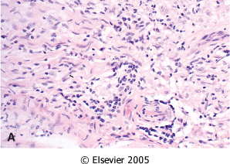
Figure 8-35 Leprosy. A, Peripheral nerve. Note the inflammatory cell infiltrates in the endoneural and epineural compartments. B, Cells within the endoneurium contain acid-fast positive lepra bacilli. (Courtesy of E.P. Richardson, Jr. and U. De Girolami, Harvard Medical School.)
Downloaded from: Robbins & Cotran Pathologic Basis of Disease (on 24 September 2005 02:37 PM)
© 2005 Elsevier

Slide 111
Diagnosis
Skin biopsy, scraping of lesions or nasal smears.
Use of acid fast Fite Stain: it will stain the bacteria pink/red.
Lepromin test.

Slide 112
Treatment
Multidrug antileprosy medication.
With adequate treatment prognosis is excellent.

Slide 113
Schistosomiasis
Schistosomiasis infects approximately 200 million persons and kills approximately 280,000 annually.
Schistosoma mansoni in Latin America, Africa, and the Middle East
Schistosoma japonicum and Schistosoma mekongi in East Asia.
Schistosoma haematobium, found in Africa, causes hematuria and granulomatous disease of the bladder, resulting in chronic obstructive uropathy.

Slide 114
Pathogenesis
Schistosomiasis is transmitted by freshwater snails that live in the slow-moving water of tropical rivers, lakes, and irrigation ditches, ironically linking agricultural development with spread of the disease.
Infectious schistosome larvae (cercariae) swim through fresh water and penetrate human skin with the aid of powerful proteolytic enzymes that degrade the keratinized layer. Within the skin, schistosome larvae shed a surface glycocalyx that protects the organisms from osmotic shock
this glycocalyx, however, activates complement by the alternative pathway and human antibodies.

Slide 115
Pathogenesis
Schistosomes migrate into the peripheral vasculature, traverse to the lung, and settle in the portal or pelvic venous system, where they develop into adult male and female schistosomes.
Females produce hundreds of eggs per day, around which granulomas and fibrosis form.
Some schistosome eggs are passed from the portal veins through the intestinal wall into the colonic lumen, are shed with the feces, and release into freshwater miracidia that infect the snails to complete the life cycle.

Slide 116
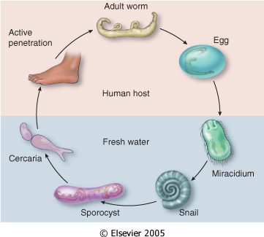
Figure 8-59 Schistosome life cycle.
Downloaded from: Robbins & Cotran Pathologic Basis of Disease (on 24 September 2005 02:37 PM)
© 2005 Elsevier

Slide 117
Morphology
In mild S. mansoni or S. japonicum infections, white, pinhead-sized granulomas are scattered throughout the gut and liver.
At the center of the granuloma is the schistosome egg, which contains a miracidium; this degenerates over time and calcifies.
The granulomas are composed of macrophages, lymphocytes, neutrophils, and eosinophils.
The liver is darkened by pigments from the schistosome gut.

Slide 118
Morphology
In severe S. mansoni or S. japonicum infections, inflammatory patches or pseudopolyps may form in the colon.
The surface of the liver is bumpy, whereas cut surfaces reveal granulomas and a widespread fibrous portal enlargement without distortion of the intervening parenchyma by regenerative nodules. Because these fibrous triads resemble the stem of a clay pipe, the lesion is named pipe-stem fibrosis.
This results in the development of portal hypertension and severe congestive splenomegaly, esophageal varices, and ascites.

Slide 119
Morphology
Schistosome mansoni and japonicum eggs, diverted to the lung through portal collaterals, may produce granulomatous pulmonary arteritis with intimal hyperplasia, progressive arterial obstruction, and ultimately heart failure (cor pulmonale).
On histologic examination, arteries in the lungs show disruption of the elastica layer by granulomas and scars, luminal organizing thrombi, and angiomatoid lesions similar to those of idiopathic pulmonary hypertension

Slide 120
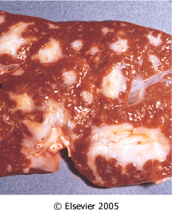
Figure 8-61 Pipe-stem fibrosis of the liver due to chronic Schistosoma japonicum infection.
Downloaded from: Robbins & Cotran Pathologic Basis of Disease (on 24 September 2005 02:37 PM)
© 2005 Elsevier

Slide 121
Morphology
In S. haematobium infection, bladder inflammatory patches due to massive egg deposition and granulomas appear early, and when they erode, they cause hematuria.
Later, the granulomas calcify and develop a "sandy" appearance, which, if severe, may line the wall of the bladder and cause a dense concentric rim (calcified bladder) on radiographic films.
The most frequent complication of S. haematobium infection is inflammation and fibrosis of the ureteral walls, leading to obstruction, hydronephrosis, and chronic pyelonephritis.
There is also an association between urinary schistosomiasis and squamous cell carcinoma of the bladder.

Slide 122
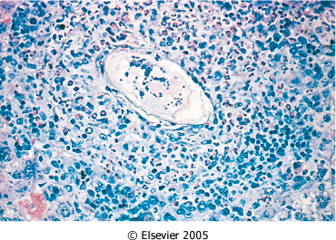
Figure 8-60 Schistosoma mansoni granuloma with a miracidium-containing egg (center) and numerous, adjacent, scattered eosinophils.
Downloaded from: Robbins & Cotran Pathologic Basis of Disease (on 24 September 2005 02:37 PM)
© 2005 Elsevier

Slide 123
Sarcoidosis
Is a systemic disease of unknown cause characterized by noncaseating granulomas in many tissues and organs.
Sarcoidosis presents many clinical patterns, but bilateral hilar lymphadenopathy or lung involvement is visible on chest radiographs in 90% of cases.
Eye and skin lesions are next in frequency.

Slide 124
Sarcoidosis
Since other diseases, including mycobacterial or fungal infections and berylliosis, can also produce noncaseating (hard) granulomas, the histologic diagnosis of sarcoidosis is made by exclusion.
The prevalence of sarcoidosis is higher in women and in American blacks than in whites.
Although the etiology of sarcoidosis remains unknown, evidence suggest that it is a disease of disordered immune regulation in genetically predisposed individuals exposed to certain environmental agents

Slide 125
Morphology
Histologically, all involved tissues show the classic noncaseating granulomas, each composed of an aggregate of tightly clustered epithelioid cells, often with Langhans or foreign body type giant cells. Central necrosis is unusual.
With chronicity, the granulomas may become enclosed within fibrous rims or may eventually be replaced by hyaline fibrous scars.

Slide 126
Morphology
Two other microscopic features are often present in the granulomas:
laminated concretions composed of calcium and proteins known as Schaumann bodies an
(2) stellate inclusions known as asteroid bodies enclosed within giant cells found in approximately 60% of the granulomas.
Pathologic involvement of virtually every organ in the body has been cited at one time or another.

Slide 127
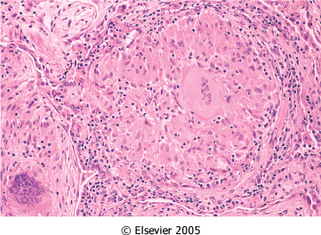
Figure 15-23 Characteristic sarcoid noncaseating granulomas in lung with many giant cells. (Courtesy of Dr. Ramon Blanco, Department of Pathology, Brigham and Women's Hospital, Boston, MA.)
Downloaded from: Robbins & Cotran Pathologic Basis of Disease (on 24 September 2005 02:37 PM)
© 2005 Elsevier

Slide 128
Morphology
The lungs are common sites of involvement.
Macroscopically, there is usually no demonstrable alteration, although at times, the coalescence of granulomas may produce small nodules that are palpable or visible as 1- to 2-cm, noncaseating, noncavitated consolidations.

Slide 129
Morphology
Histologically, the lesions are distributed primarily along the lymphatics, around bronchi and blood vessels, although alveolar lesions are also seen.
The granulomas are seen in the bronchial submucosa and with healing fibrosis and hyalinization are often found.
The pleural surfaces are sometimes involved.

Slide 130
Morphology
Lymph nodes are involved in almost all cases, specifically the hilar and mediastinal nodes, but any other node in the body may be involved.
Nodes are characteristically enlarged, discrete, and sometimes calcified.
The tonsils are affected in about one quarter to one third of cases.

Slide 131
Morphology
The spleen is affected microscopically in about three quarters of cases, but it is enlarged in only one fifth. On occasion, granulomas may coalesce to form small nodules that are barely visible macroscopically. The capsule is not involved.
The liver is affected slightly less often than the spleen. It may also be moderately enlarged and may contain scattered granulomas, more in portal triads than in the lobular parenchyma. Needle biopsy may permit the identification of these focal lesions.

Slide 132
Morphology
The bone marrow is an additional favored site of localization.
Skin lesions are encountered in one third to one half of cases. Sarcoidosis of the skin assumes a variety of macroscopic appearances (e.g., discrete subcutaneous nodules; focal, slightly elevated, erythematous plaques; or flat lesions that are slightly reddened and scaling and resemble those of lupus erythematosus).

Slide 133
Morphology
Lesions may also appear on the mucous membranes of the oral cavity, larynx, and upper respiratory tract.
Bilateral sarcoidosis of the parotid, submaxillary, and sublingual glands completes the combined uveoparotid involvement designated as Mikulicz syndrome.

Slide 134
Morphology
The eye, its associated glands, and the salivary glands are involved in about one fifth to one half of cases. The ocular involvement takes the form of iritis or iridocyclitis, either bilaterally or unilaterally. Consequently, corneal opacities, glaucoma, and total loss of vision may occur. These ocular lesions are frequently accompanied by inflammation of the lacrimal glands, with suppression of lacrimation.

Slide 135
Morphology
Muscle involvement may be asymptomatic or symptomatic
muscle weakness, aches, tenderness, and fatigue.
In one study, 22 patients presenting with bilateral hilar adenopathy and a variety of symptoms underwent biopsies of asymptomatic gastrocnemius muscle. All 22 were found to have noncaseating granulomas. These findings suggest that muscle biopsy could be a useful tool in the diagnosis of sarcodosis.

Slide 136
Morphology
Sarcoid granulomas occasionally occur in the heart, kidneys, central nervous system, and endocrine glands, particularly in the pituitary, as well as in other body tissues.

Slide 137
Morphology
Whereas presence of noncaseating granulomas is suggestive of sarcoidosis, other identifiable causes of granulomatous inflammation (e.g., tuberculosis, fungal infections) must be excluded before the diagnosis of sarcoidosis is made

Slide 138
Clinical Course
Because of its varying severity and the inconstant distribution of the lesions, sarcoidosis is difficult to diagnose.
Sarcoidosis may be discovered unexpectedly on routine chest films as bilateral hilar adenopathy or may present with peripheral lymphadenopathy, cutaneous lesions, eye involvement, splenomegaly, or hepatomegaly.

Slide 139
Clinical Course
Hypercalcemia, hypergamma-globulinemia and hypercalciuria.
In the great majority of cases, however, patients seek medical attention because of the insidious onset of respiratory abnormalities (shortness of breath, cough, chest pain, hemoptysis) or of constitutional signs and symptoms (fever, fatigue, weight loss, anorexia, night sweats).

Slide 140
Clinical Course
Sarcoidosis follows an unpredictable course characterized by either progressive chronicity or periods of activity interspersed with remissions, sometimes permanent, that may be spontaneous or induced by steroid therapy.
Overall, 65% to 70% of affected patients recover with minimal or no residual manifestations.
Some die of cardiac or central nervous system damage, but most succumb to progressive pulmonary fibrosis and cor pulmonale.

Slide 141
Diagnosis
For a typical case diagnosis is made by acombination of clinical,radoigraphic and histological findings.
The Kviem-Siltzback skin test consists of the intradermal injection of a heat treated suspension of a sarcoidosis spleen extract which is biopsied 4 to 6 weeks later, yeilds sarcoidosis like lesions in80% of individuals with sarcoidosis.
Other investigations: chest x-ray, estimation of calcium and globulin levels in blood, biopsy of affected organs.
Treatment is with corticosteroids and prognosis is generally good.

