Slide 1
DR. SHIHAB AL-MASHHADANI
LYMPHOPROLIFERATIVE
DISORDERS

Slide 2
LYMPHOPROLIFERATIVE DISORDER
Diseases characterized by increased lymphocyte mass or “lymphocytosis”.
LYMPHOCYTOSIS: Lymphocyte count
exceeding 4x10⁹/ (4000/ul).
The normal count is usually higher in
childhood reaching up to 8.5/10⁹/L.
Cause of Lymphocytosis:
Benign : 1. Acute infections: usually viral e.g. infectious mononucleosis, mumps, rubella
Bacterial e.g. pertussis.
2. Chronic infections: e.g. tuberculosis,
syphilis.
2. Malignant : e.g. chronic lymphocytic leukaemia.

Slide 3
Non-malignant causes of lymphocytosis
Viral infections: infectious lymphocytosis; infectious mononucleosis; cytomegalovirus infection; occasionally: rubella, hepatitis, adenoviruses, varicella, HIV, human herpes virus-6, mumps, chickenpox, dengue
Bacterial infections: pertussis; occasionally: healing tuberculosis, brucellosis, secondary and congenital syphilis, cat scratch fever, typhoid fever, diphtheria
Protozoal infections: toxoplasmosis; occasionally: malaria
Other conditions: serum sickness; allergic drug reactions; splenectomy; dermatitis herpetiformis; metastatic melanoma; hyperthyroidism; congenital adrenal hyperplasia.

Slide 4
Classification of lymphoproliferative disorders

Slide 5
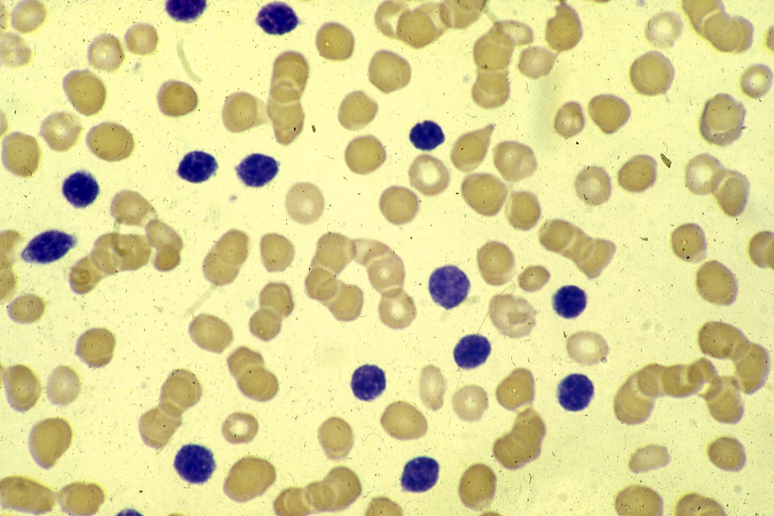

Slide 6
INFECTIOUS MONONUCLEOSIS
Etiology : Infection with Epstein-Barr (EB) virus,
(a virus from the herpes group of viruses)
Pathogenesis : 1. EB virus enters into epithelial cells of oropharynx or into B lymphocytes or Waldeyer’s ring.
2. B lymphocytes proliferation.
3. T lymphocytes proliferation and the T lymphocytes will appear in the peripheral blood as atypical lymphocytes.
4. T lymphocytes are of the cytotoxic type.
They will attack the B lymphocytes causing
severe pharyngitis.
5. Involvement of other lymphotid tissues.
6. Viremia.

Slide 7
Clinical Features of Infectious Mononucleosis:
* Incubation period 5 – 8 weeks.
* More common in females
* Usually in young patients 15-25 years.

Slide 8
Clinical Features of IM (continue):
1. Fever
Pharyngitis, follicular tonsillitis (sore throat).
Lymphodenopathy: usually cervical, but can be generalized.
Splenomegaly: in about 50%.
Hepatomegaly.
Rash.
Bleeding: in severe cases.
Tachycardia and ECG abnormalities.
CNS symptoms e.g. convulsions, rare.
Eye symptoms: photophobia, conjunctivitis.
Acute abdomen: acute abdominal pain due to involvement of mesentric lymph nodes.

Slide 9
Laboratory Findings in Infectious Mononucleosis:
Leukocytosis with lymphocytosis:
WBC usually 10-20,000/µl with lymphocytes forming >50%. * Atypical lymphocytes are seen.)
Anaemia: Can be due to cold autoimmune hemolytic anaemia.
Thrombocytopenia: Autoimmune.
Liver enzymes: ↑ due to hepatitis.
Serological tests (Antibodies): Types of antibodies seen in infectious mononucleosis are:
A. EB virus specific.
B. Heterophile
C. Autoimmune.

Slide 10
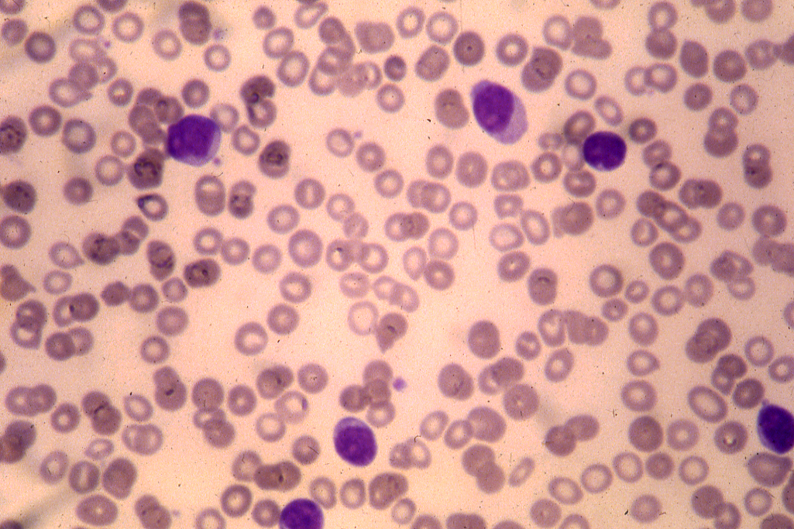

Slide 11
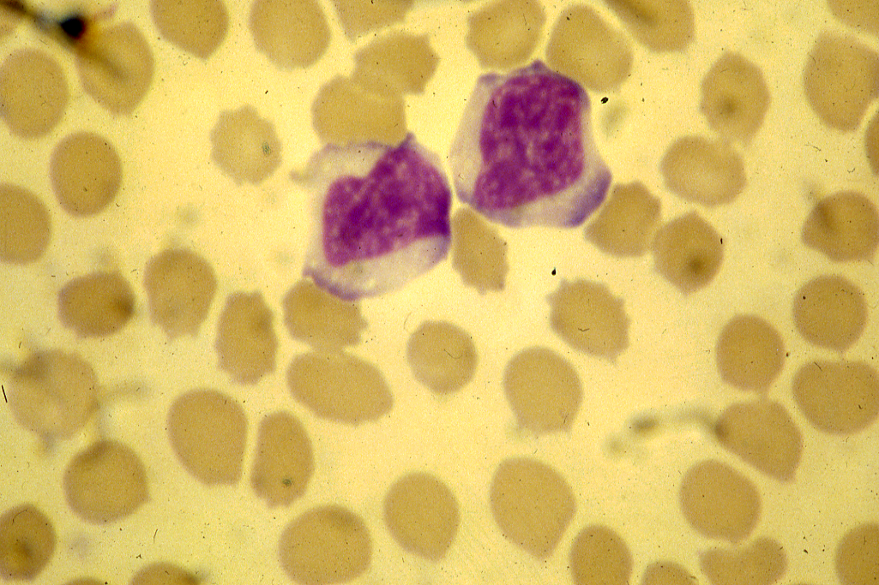

Slide 12
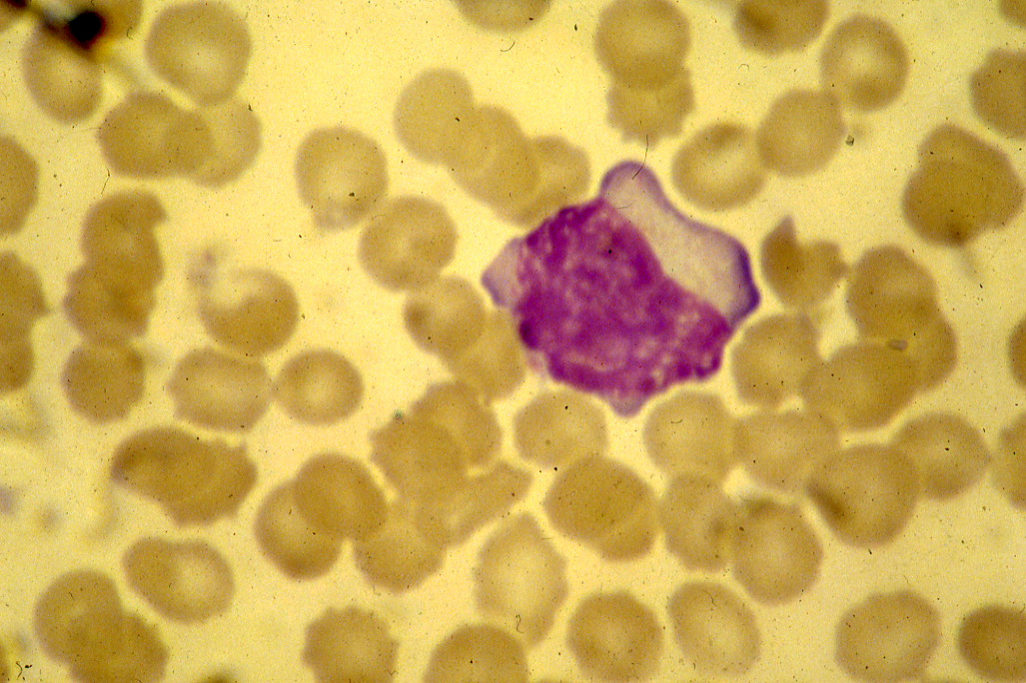

Slide 13
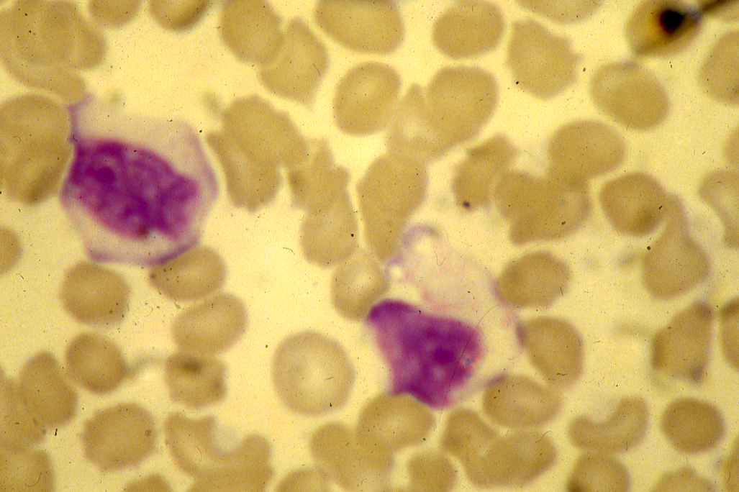

Slide 14
Virus specific antibodies:
1. IgM : Develop early in the disease and lasts for few months.
2. IgG : a. One type against capsid antigen
(VCA). Appears early in the acute phase and used to diagnose new infections.
b. Against nuclear antigen (EBNA). Develops after the acute phase and persists for life. Usually indicates old infection.
B. Heterophile Antibodies:
Antibodies that are produced as a result of the infection but react with an antigen different from the causative agent.

Slide 15
Paul Bunnel Test:
* To detect antibodies that can agglutinate sheep red cells.
* Can also be positive in other disease e.g. serum sickness ot leukemia (Forsemann antibody). To differentiate it from IM (Infectious mono). Guinea pig kidney cells are used. Forsemann antibodies react with the kidney cells. IM antibodies do not.
Monospot Test:
* Replaced the Paul Bunnel test.
* Serum mixed with guinea pig kidney cells and then with horse RBCs.

Slide 16
C. Autoimmune Antibodies:
1. Autoimmune cold hemolytic anemia.
2. Immune thrombocytopenia.
Differential Diagnosis:
A similar clinical syndrome and atypical lymphocytes can be seen in other disease e.g. toxoplasmosis and cytomegalo-virus. However, these can be differentiated by serology. (IM) is + while these disease are negative.

Slide 17
Course and Prognosis of IM:
* Most patients recover in 4 – 6 weeks.
* Unusual complications are hepatitis, encephalitis, hepatic failure, glottic oedema and splenic rupture.

Slide 18
Chronic Lymphocytic Leukaemia
Neoplastic proliferation of mature lymphocytes usually B lymphocytes.
Usually seen in the elderly. More common in the west and more common in males. Accounts for about 25% of all leukaemias.

Slide 19
Clinical Features of Chronic Lymphocytic Leukaemia:
1. Accidental: about 25% of cases are diagnosed on routine blood exams.
Pallor: Due to anemia.
Lymphadenopathy.
Splenomegaly.
Hepatomegaly.
Bruising and purpura: due to thrombocytopenia.
Herpes Zoster and simplex infection.
Pruritis.
Skin infiltration.
Depressed immunity, both cellular and humoral.

Slide 20
Laboratory Features of CLL:
1. Lymphocytosis: > 5,000/µl is required for diagnosis. The lymphocytes are mature, small round lymphocytes. Another feature seen on peripheral blood are smudge (smear) cells.
2. Anemia: can be due to:
a. Warm autoimmune hemolytic anemia seen in (seen in 10% of
cases).
b. Bone marrow failure (indicates poor prognosis).
Thrombocytopenia: can be due to:
a. Autoimmune (seen in 5% of cases).
b. Bone marrow failure (indicates poor prognosis).
4. Bone Marrow and Lymph Node: Infiltration by mature lymphocytes.
Immunoglobulins:
* Monoclonal band on serum protein electrophoresis.
* ↓ Immunoglobulin levels.
6. Uric Acid: ↑

Slide 21
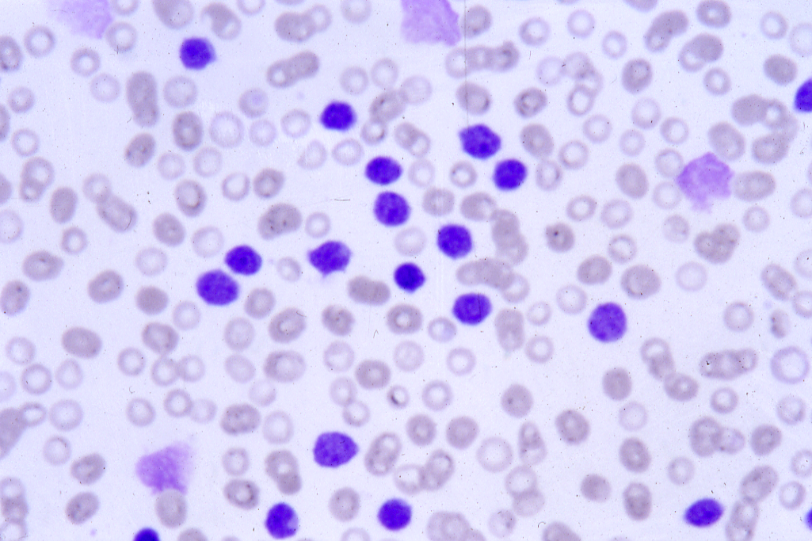

Slide 22
Classification of the chronic lymphoid leukaemias and leukaemia/lymphoma syndrome
B-cell T-cell
---------------------------------------------------------------------------------------------------------------------------------------------------------------------------------------------------------------------------------------------------------------
Chronic lymphoid leukaemias
---------------------------------------------------------------------------------------------------------------------------------------------------------------------------------------------------------------------------------------------------------------
B-cell chronic lymphocytic Large granular lymphocytic leukaemia
Leukaemia (B-CLL,CLL)
B-cell prolymphocytic T-cell prolymphocytic leukaemia
leukaemia (B-PLL) (T-PLL)
Hairy cell leukaemia (HCL)
Plasma cell leukaemia
---------------------------------------------------------------------------------------------------------------------------------------------------------------------------------------------------------------------------------------------------------------
Leukaemia/Lymphoma syndromes
---------------------------------------------------------------------------------------------------------------------------------------------------------------------------------------------------------------------------------------------------------------
Splenic lymphoma with villous Sézary syndrome
Lymphocytes Adult T-cell leukaemia/lymphoma
Follicular lymphoma Large cell lymphoma
Mantle cell lymphoma
Lymphoplasmacytic lymphoma
Large cell lymphoma

Slide 23
Immunophenotype of the chronic B-cell leukaemias/lymphomas (all cases CD19+)
---------------------------------------------------------------------------------------------------------------------------------------------------------------------------------------------------------------------------------------------------------------
CLL PLL HCL FL MCL
---------------------------------------------------------------------------------------------------------------------------------------------------------------------------------------------------------------------------------------------------------------
SIg Weak ++ ++ ++ +
CD5 + - - - +
CD22/FMC7 - + + + +
CD79b - ++ -/+ ++ ++
---------------------------------------------------------------------------------------------------------------------------------------------------------------------------------------------------------------------------------------------------------------
CLL, chronic lymphocytic leukaemia; FL, follicular lymphoma; HCL, hairy cell leukaemia; MCL, mantle cell lymphoma; PLL, prolymphocytic leukaemia.
NB. CD103 is positive only in HCL.

Slide 27
Prognostic factors in chronic lymphocytic leukaemia
Favourable Unfavourable
---------------------------------------------------------------------------------------------------------------------------------------------------------------------------------------------------------------------------------------------------------------
Stage Binet A Binet, BC
(Rai 0-1) (Rai II-IV)
Sex Female Male
Lymphocyte doubling time Slow Rappid
Bone marrow biopsy Nodular Diffuse
appearance
Chromosomes Deletion 13q14 Trisomy 12
p53 mutations (17p 13.3)
deletion 11q23
VH genes Hypermutated Unmutated
ZAP-70 <20% >20%
LDH Normal Raised
CD38 expression Negative Positive
---------------------------------------------------------------------------------------------------------------------------------------------------------------------------------------------------------------------------------------------------------------
LDH, lactate dehydrogenase.

Slide 28
Staging of chronic lymphocytic leukaemia (CLL)
Rai classification
---------------------------------------------------------------------------------------------------------------------------------------------------------------------------------------------------------------------------------------------------------------
0 Abdolute lymphocytosis > 15X10⁹/1*
I As stage 0 + enlarged lymph nodes (adenopathy)
II As stage 0 + enlarged liver and/or spleen ± adenopathy.
III As stage 0 + anaemia (Hb<10.0g/d)* ± adenopathy ± organomegaly
IV As stage 0 + thrombocytopenia (platelets <100x10⁹/l)* ± adenopathy ± organomegaly

Slide 29
Staging of chronic lymphocytic leukaemia (CLL) (continued)
b) International Working Party classification (from J.L. Binet et al. 1981).
---------------------------------------------------------------------------------------------------------------------------------------------------------------------------------------------------------------------------------------------------------------
Organ Haemoglobin+ Platelets+
Stage Enlargement (g/dl) (x10⁹/l)
---------------------------------------------------------------------------------------------------------------------------------------------------------------------------------------------------------------------------------------------------------------
A (50-60%) 0,1, or 2 areas
B (30%) 3,4 or 5 areas ≥ 10 ≥ 100
C (<20%) Not considered < 10 and / or < 100
---------------------------------------------------------------------------------------------------------------------------------------------------------------------------------------------------------------------------------------------------------------
One area = lymph nodes> 1 cm in neck, axilae, groins or spleen, or liver enlargement.
+ Secondary causes of anaemia (e.g. iron deficiency) or autoimmune haemolytic anaemia or autoimmune thrombocytopenia must be treated before staging.

Slide 30
STAGING SYSTEM:
RAI SYSTEM: 5 STAGES:
0 : Lymphocytosis
I : Lymphocytosis + Lymphadenopathy
II : Lymphocytosis + Splenomegaly +/or Hepatomegaly.
III : Lymphocytosis + anemia (not autoimmune). ± lymphadenopathy.
IV : Lymphocytosis + Thrombocytopenia (not autoimmune).
± Lymphadenopathy.

Slide 31
International System:
A. Lymphocytosis + < 3areas of nodal involvement (nodal includes liver, spleen and lymph nodes).
3 or more nodal areas involvement.
Anemia +/or thrombocytopenia.
Course and Prognosis:
Stage O or A may remain stable for many years and they may not require treatment.
Advances stages may terminate in marrow failure with consequent infection, or in a high grade type of lymphoma (Rechter’s syndrome).

Slide 32
Prognosis : Related to:
Stage:
Age: worse if >70 years.
WBC: Worse if> 50,000.
Pattern of bone marrow involvement: diffuse involvement.

Slide 33
Acute lymphoblastic leukaemia
L1
L2
L3

Slide 34
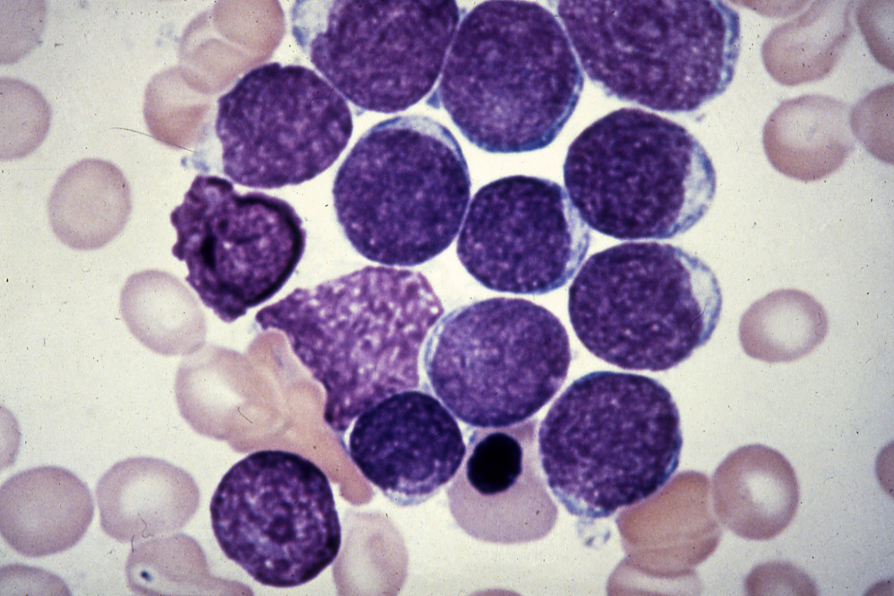

Slide 35
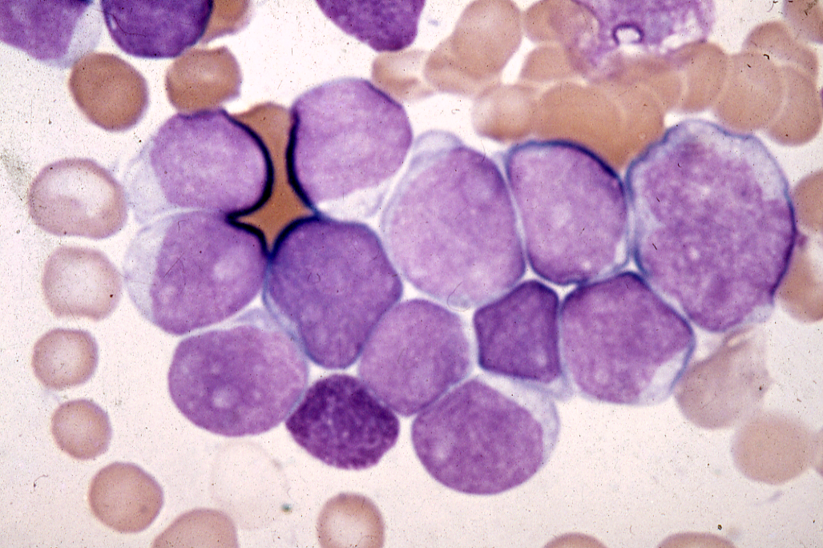

Slide 36
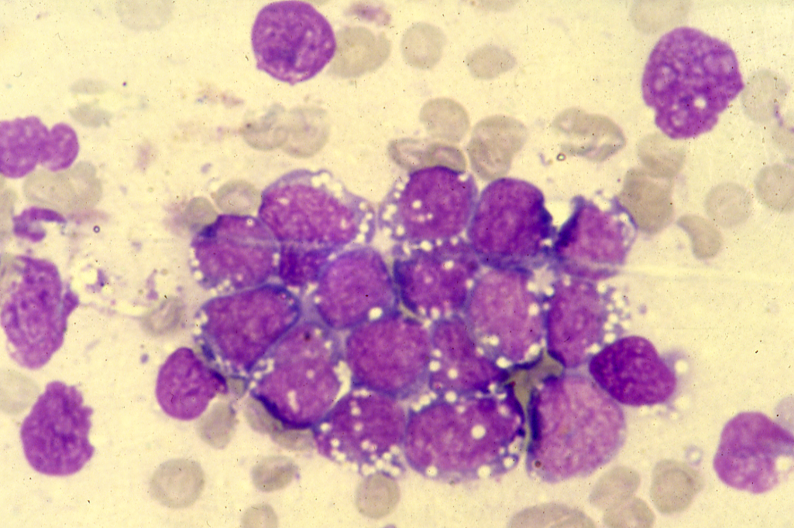

Slide 37
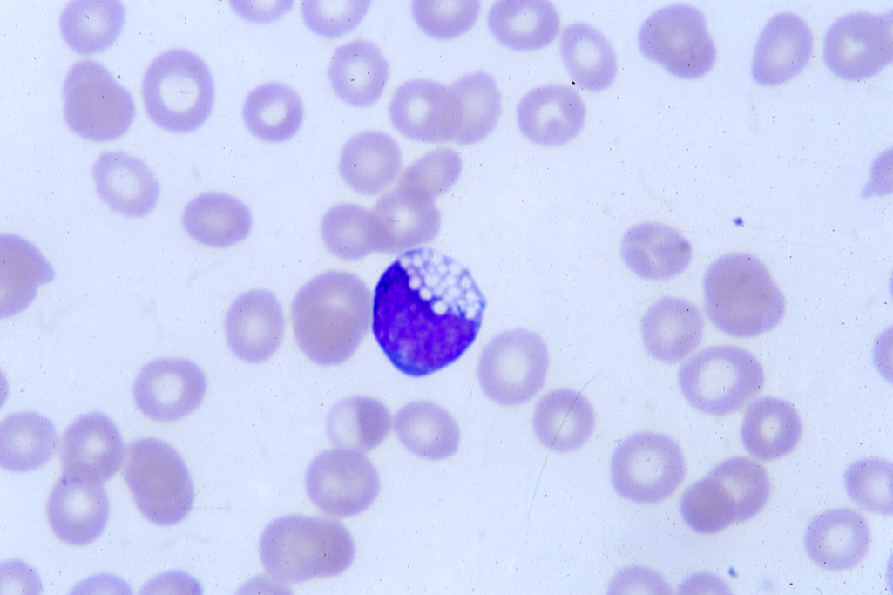

Slide 38
Pro-lymphocytic Leukaemia

Slide 39
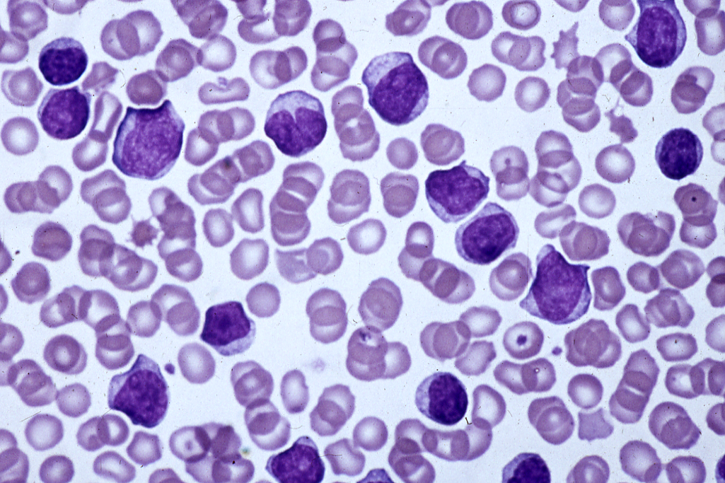

Slide 40
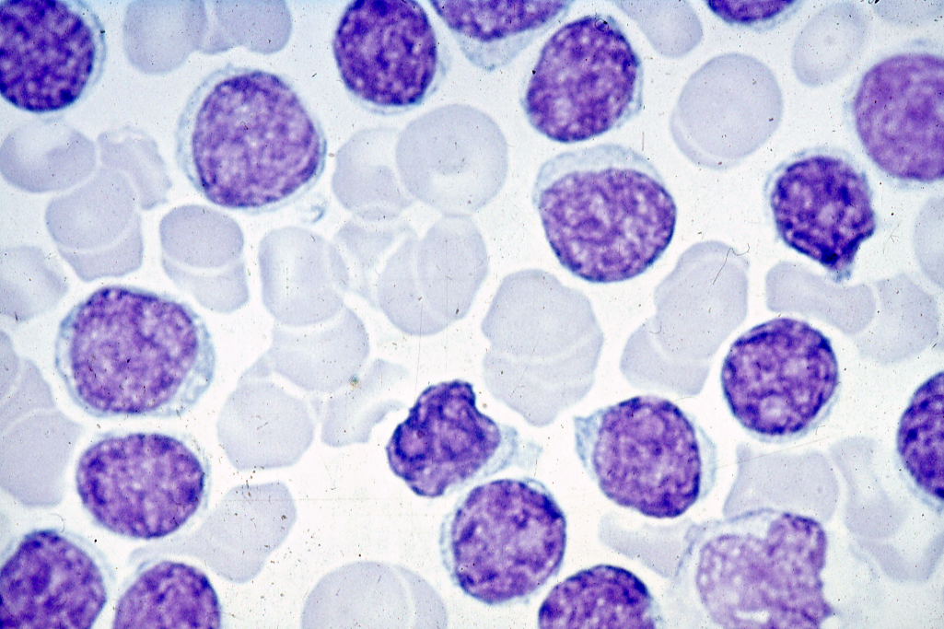

Slide 41
Hairy Cell Leukaemia

Slide 42
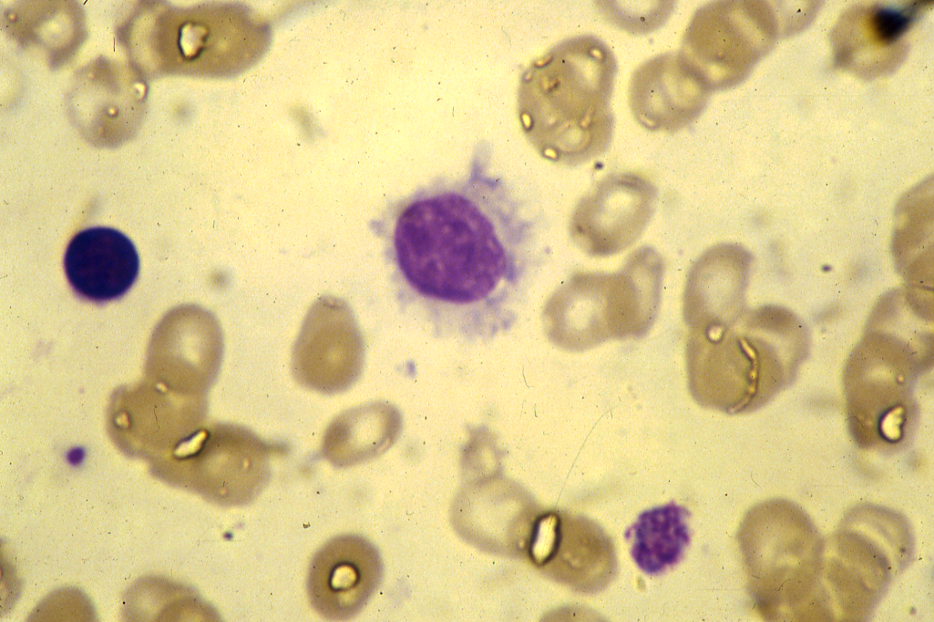

Slide 43
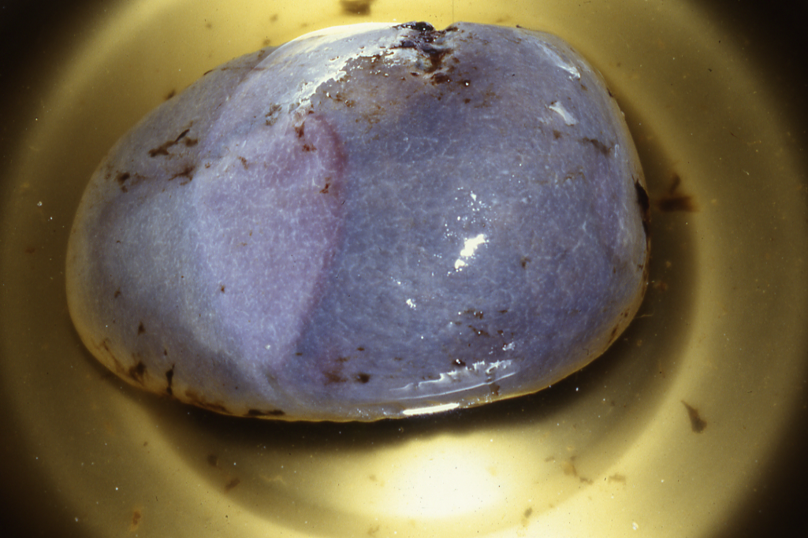

Slide 44
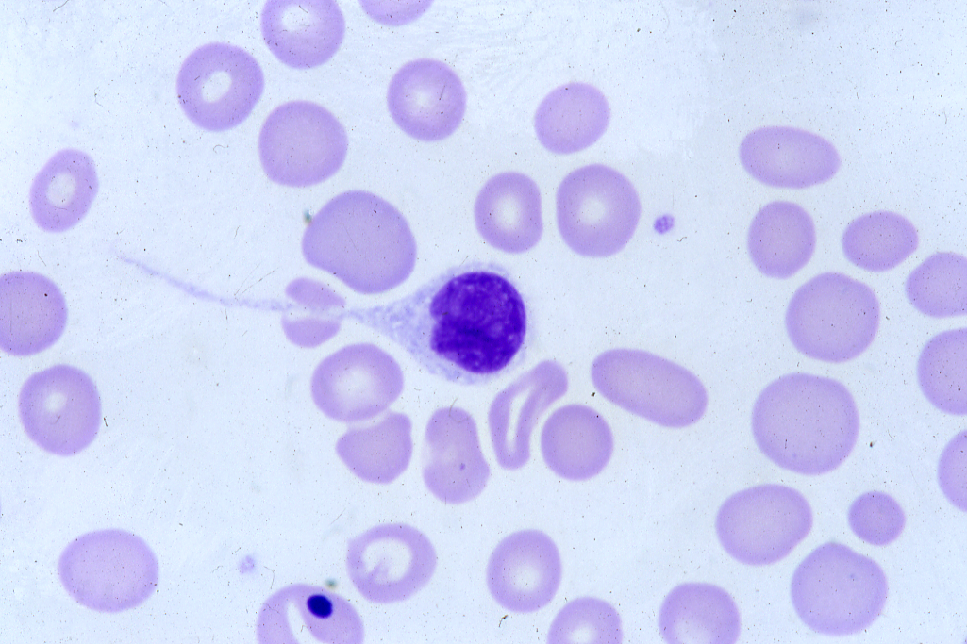

Slide 45
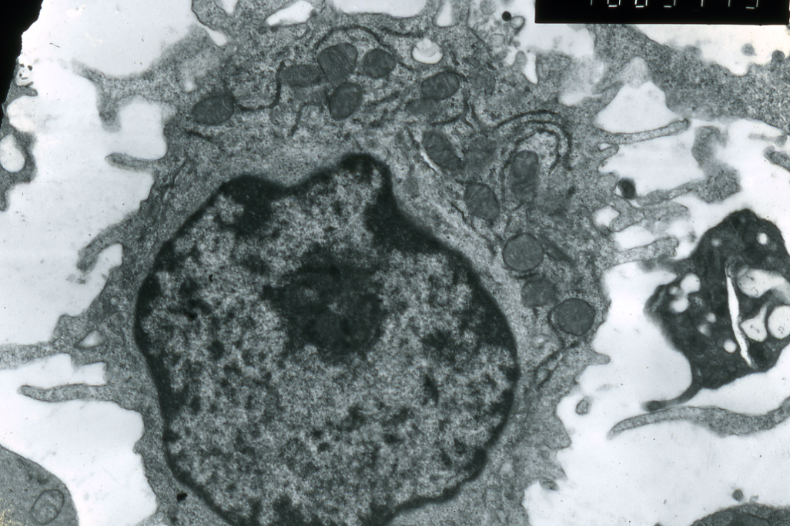

Slide 46
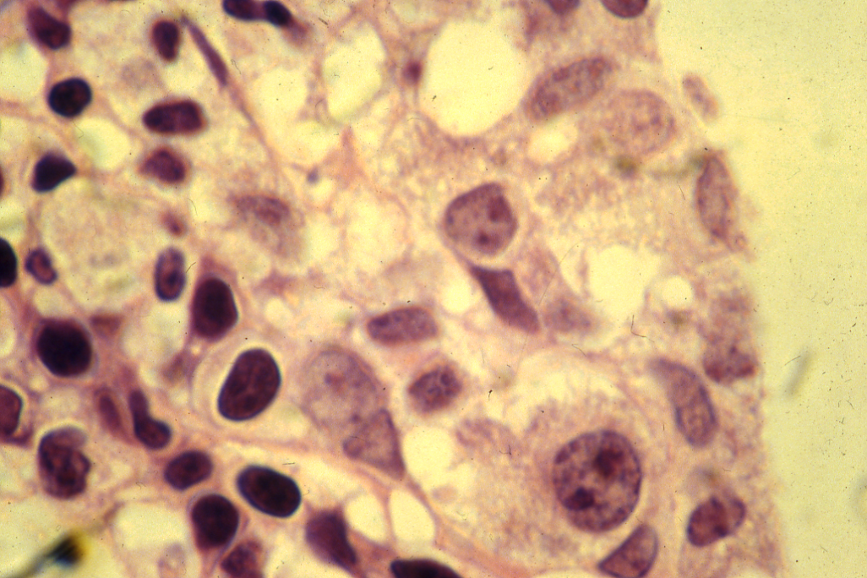

Slide 47
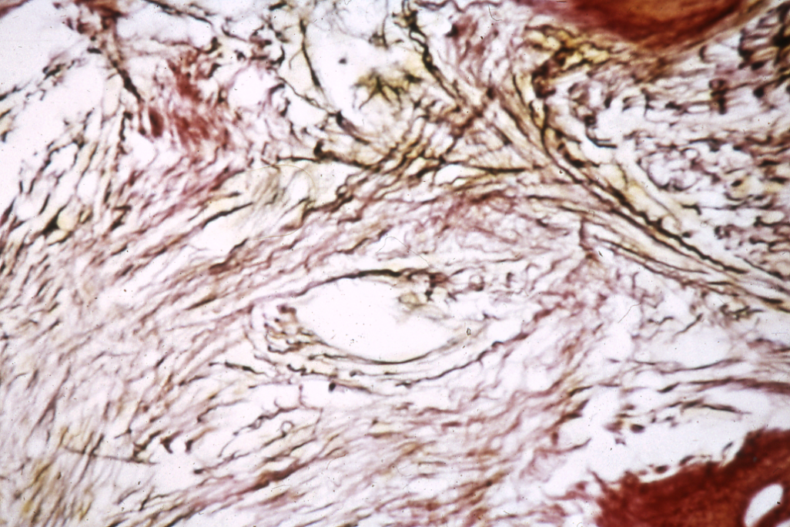

Slide 48
Lymphoma
Hodgkin’s Lymphoma
Non-Hodgkin’s Lymphoma

Slide 49
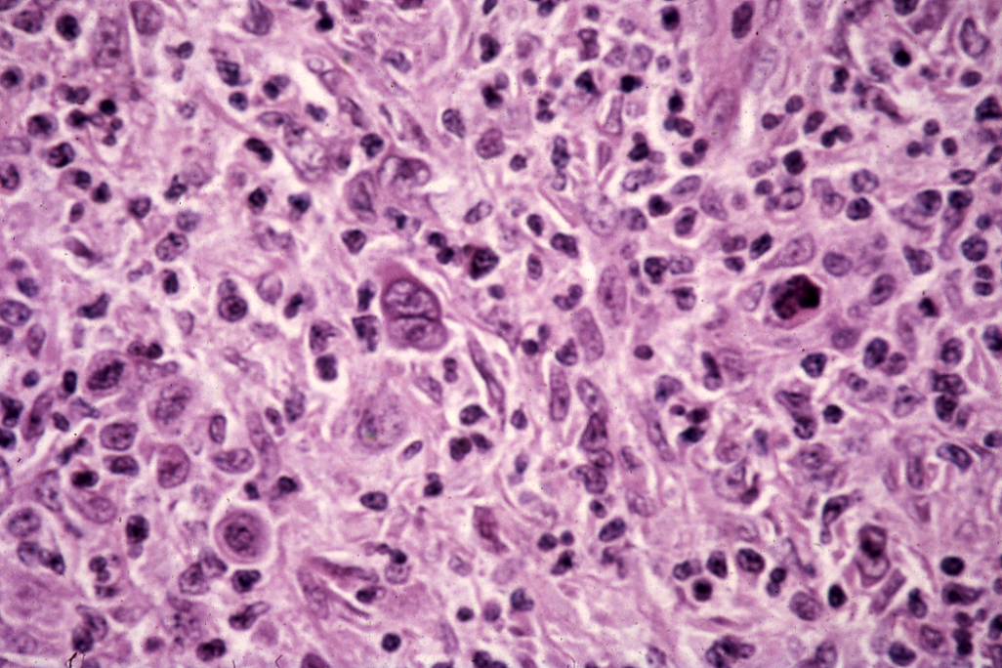

Slide 50
Multiple Myeloma

Slide 51
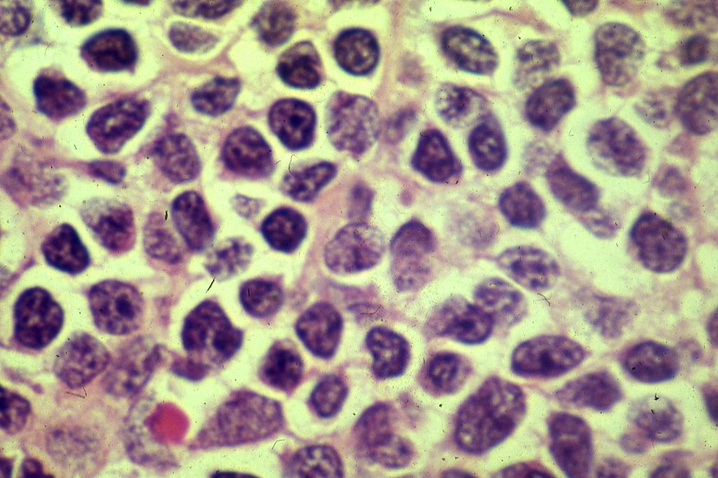

Slide 52
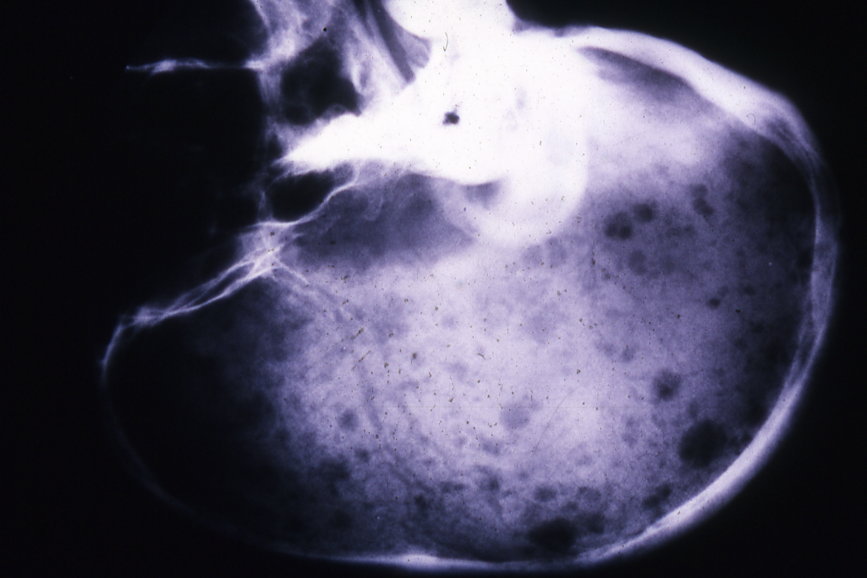

Slide 53
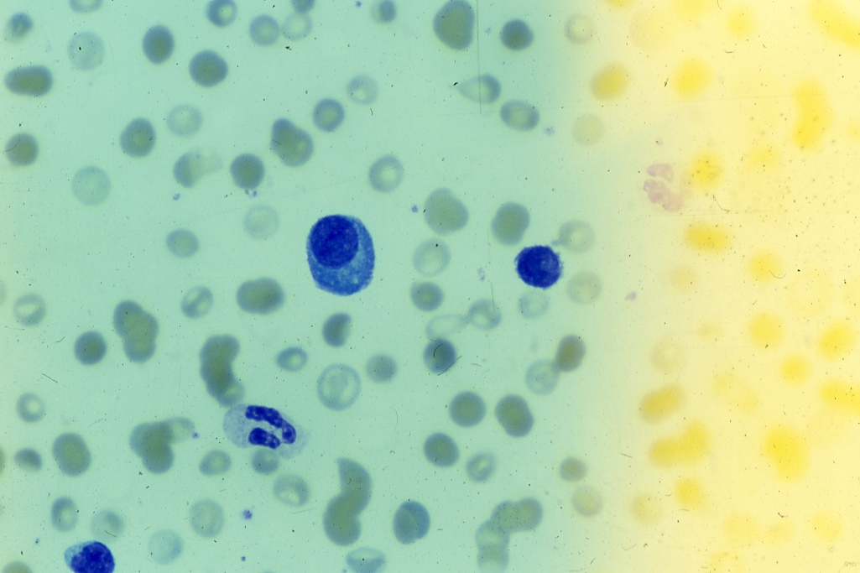

Slide 54
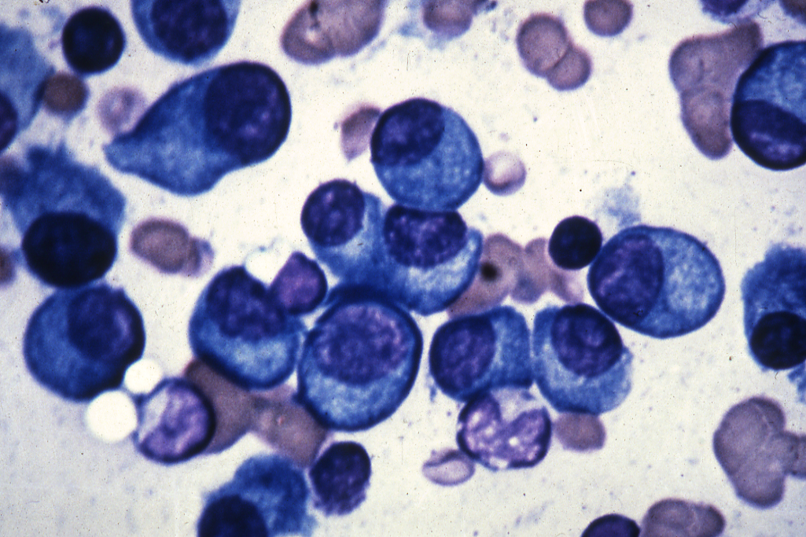

Slide 55
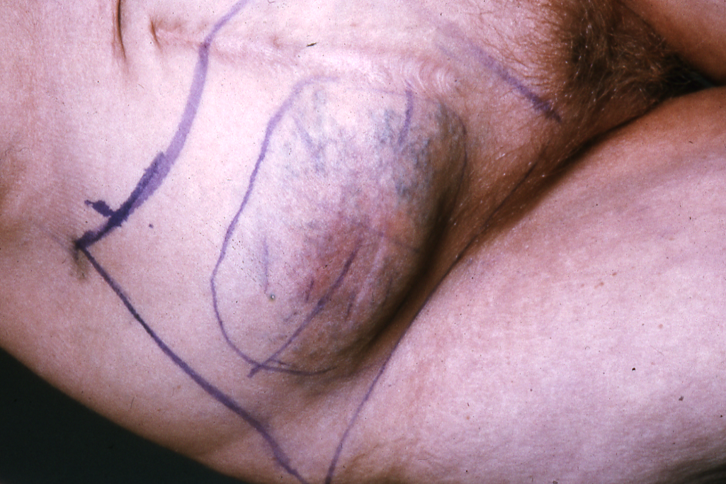

Slide 56
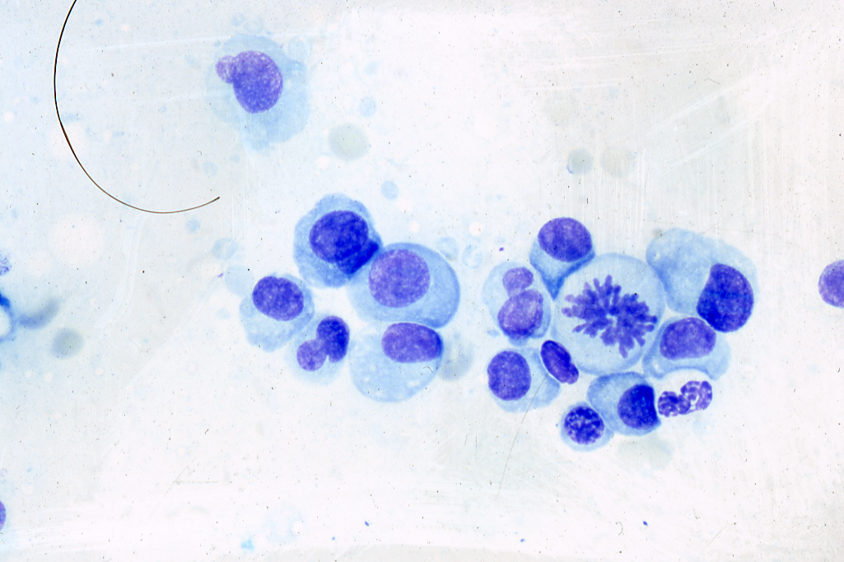

Slide 57
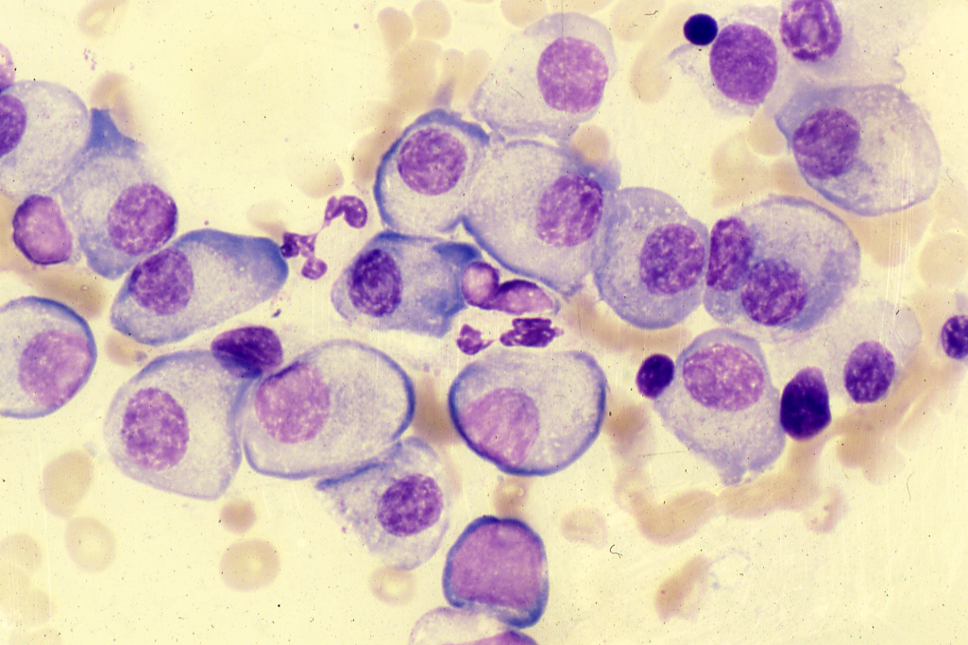

Slide 58
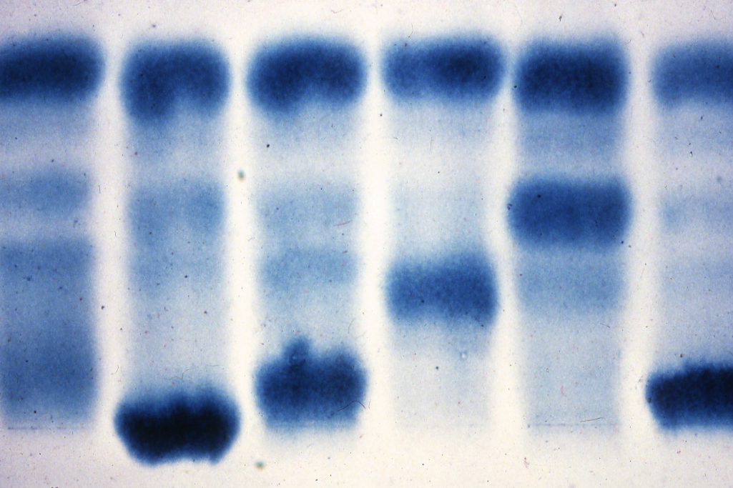

Slide 59
Sezary syndrome
T cell Cateneous lymphoma

Slide 60
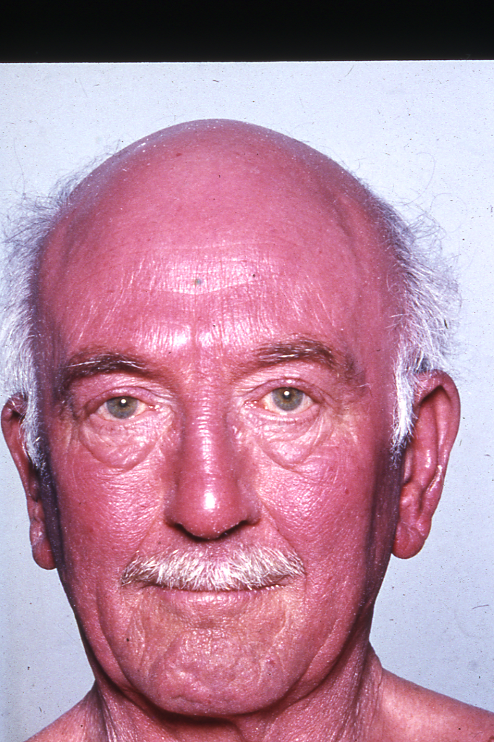

Slide 61
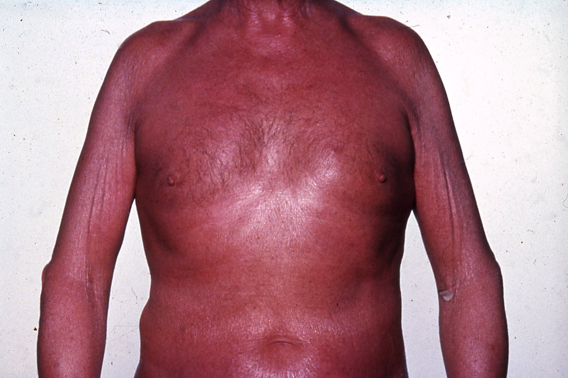

Slide 62
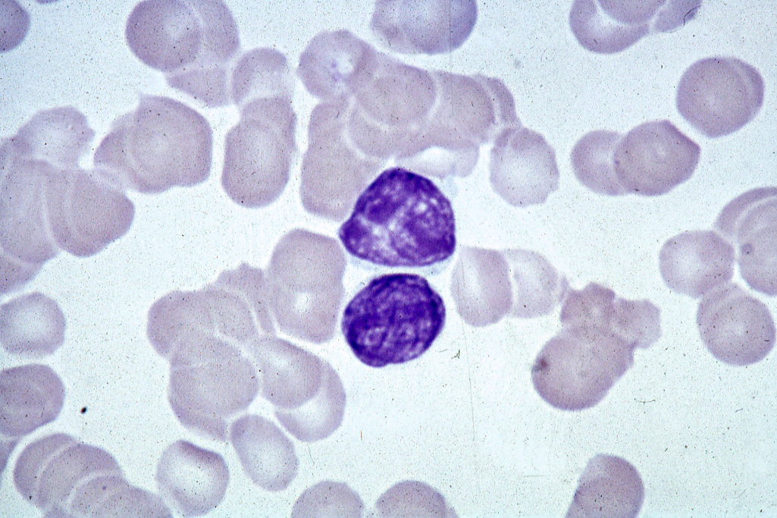

Slide 63
