Slide 1
Sterilization and disinfection
Dr Tahir Naeem
MBBS, MCPS, DipClinMicro (Lond), D(ABMM), FCCM
King Saud University

Slide 2
Introduction
Sterilization
A physical or chemical process that completely destroys or removes all microbial life, including spores.
Disinfection
It is killing or removing of harmful microorganisms
Disinfectant
Products used to kill microorganisms on inanimate objects or surfaces. Disinfectants are not necessarily sporicidal, but may be sporostatic, inhibiting germination or outgrowth
Antiseptic
A product that destroys or inhibits the growth of microorganisms in or on living tissue.
Aseptic
Characterized by the absence of pathogenic microbes.

Slide 3
Methods of Sterilization
1. Physical methods
Heat
Dry
Moist
Radiation
U.V. light
Ionizing radiation
Filtration
2. Chemical Methods

Slide 4
Modes of Action of sterilants and disinfectants
Damage to DNA
A number of physical and chemical agents act by damaging DNA. DNA lesions kill the cell mainly by interfering with DNA replication.
These include Ionizing radiations, Ultraviolet light, and DNA-reactive chemicals.
Radiations damage DNA in several ways:
UV light induces cross-linking between adjacent pyrimidines forming pyrimidine dimers.
Ionizing radiations produce breaks in single and double strands.
Among the last category are alkylating agents and other compounds that react covalently with purine and pyrimidine bases.

Slide 5
Modes of Action of sterilants and disinfectants
Protein Denaturation
Proteins exist in a folded, three-dimensional state determined by intramolecular covalent disulfide linkages and a number of non-covalent linkages such as ionic, hydrophobic, and hydrogen bonds. This state is called the tertiary structure of the protein.
It is readily disrupted by a number of physical or chemical agents, causing the protein to become nonfunctional.
The disruption of the tertiary structure of a protein is called protein denaturation.

Slide 6
Modes of Action of sterilants and disinfectants
Disruption of Cell Membrane or Wall
The cell membrane acts as
A selective barrier. Many compounds are actively transported thus becoming concentrated within the cell.
The membrane is also the site of enzymes involved in the biosynthesis of components of the cell envelope.
Substances that concentrate at the cell surface may alter the physical and chemical properties of the membrane, preventing its normal functions and therefore killing or inhibiting the cell.
The cell wall acts as a corseting structure, protecting the cell against osmotic lysis. Thus, agents that destroy the wall (e.g. lysozyme) or prevent its normal synthesis (e.g. penicillin) may bring about lysis of the cell.

Slide 7
Modes of Action of sterilants and disinfectants
Removal of Free Sulfhydryl Groups
Enzyme proteins containing cysteine have side chains terminating in sulfhydryl groups. Also the coenzymes (e.g. co-A) contain free sulfhydryl groups. Such enzymes and coenzymes cannot function unless the sulfhydryl groups remain free and reduced.
Oxidizing agents thus interfere with metabolism by forming disulfide linkages between neighboring sulfhydryl groups.
Many metals such as mercuric ion likewise interfere by combining with sulfhydryl groups:
As there are many sulfhydryl enzymes in the cell, the oxidizing agents and heavy metals do widespread damage.

Slide 8
Methods of Sterilization
Radiation:
U.V. light- Has limited sterilizing power because of poor penetration into most materials. Generally used in irradiation of air in certain areas eg. Operating Rooms and T.B. laboratories.
Ionizing radiation- e.g. Gamma radiation: Source Cobalt⁶⁰ has greater energy than U.V. light, therefore more effective. Used mainly in industrial facilities e.g. sterilization of disposable plastic syringes, gloves, specimens containers and Petri Dishes.

Slide 9
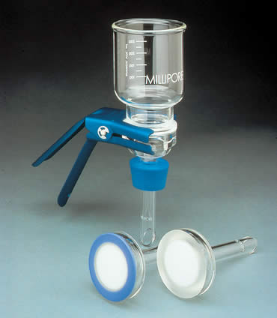
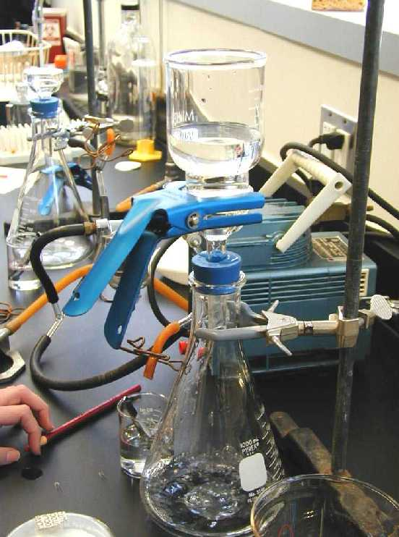
Methods of Sterilization
Filtration
May be done under either negative or positive pressure. Best known example is the membrane filter made from cellulose acetate. Generally removes most bacteria but viruses and some small bacteria e.g. Chlamydias & Mycoplasmas may pass through. Thus filtration does not technically sterilize items but it is adequate for circumstances under which it is used.
Main use: for heat labile substances e.g. sera, antibiotics.
The recommended size filter that will exclude the smallest bacterial cells is 0.22 micron

Slide 10
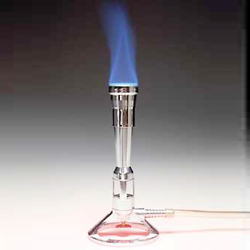
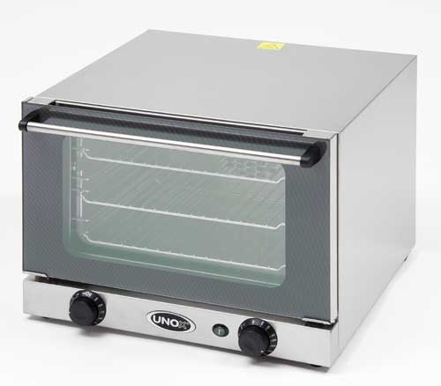
Methods of Sterilization
Sterilization by Heat: Most common method
Dry Heat
It kills microorganisms by destroying their oxidative processes.
Simplest method is exposing the item to be sterilized to the naked flame e.g. Bunsen burner- for sterilizing bacteriological loops, knives, blades.
Hot air oven expose items to 160°C for 1 hour. It has electric element in the chamber as source of heat plus a fan to circulate air for even distribution of heat in chamber. Oven without fan is dangerous.
Used for Metals, Glassware, Ointment, Oils, Waxes, Powders i.e. items that are lacking water

Slide 11
Methods of Sterilization
Moist Heat: Uses hot water. Moist heat kills microorganisms by denaturing proteins.
Boiling – quite common especially in domestic circumstances.
Tyndallization named after John Tyndall
Lengthy process designed to reduce the level of activity of sporulating bacteria that are left by a simple boiling water method.

Slide 12
Methods of Sterilization
Moist heat:
Tyndallization
The process involves boiling for a period (typically 20 minutes) at atmospheric pressure, cooling, incubating for a day, boiling, cooling, incubating for a day, boiling, cooling, incubating for a day, and finally boiling again.
The three incubation periods are to allow heat-resistant spores surviving the previous boiling period to germinate to form the heat-sensitive vegetative (growing) stage, which can be killed by the next boiling step.
The procedure only works for media that can support bacterial growth - it will not sterilize plain water.

Slide 13
Methods of Sterilization
Moist heat:
Pasteurization
It aims to reduce the number of viable pathogens in liquids so they are unlikely to cause disease
It uses heat at temperatures sufficient to inactivate harmful organism in milk. Does not achieve sterilization.
Temperature may be 138°C for a fraction of a second (flash method), 71.7°C for 15-20 seconds or 62°C for 30 minutes.

Slide 14
Methods of Sterilization
Moist heat:
Autoclaving – Standard sterilization method in hospitals.
The Autoclave works under the same principle as the pressure cooker where water boils at increased atmospheric pressure i.e. because of increased pressure the boiling point of water is >100°C.
The autoclave is a tough double walled chamber in which air is replaced by pure saturated steam under pressure.

Slide 15
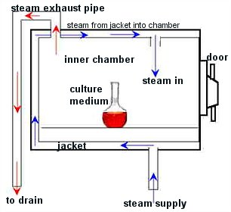
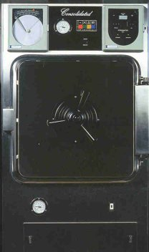
Methods of Sterilization
The air in the chamber is evacuated and filled with saturated steam. The chamber is closed tightly the steam keeps on filling into it and the pressure gradually increases.
The items to be sterilized get completely surrounded by saturated steam (moist heat) which on contact with the surface of material to be sterilized condenses to release its latent heat of condensation which adds to already raised temperature of steam so that eventually all the microorganisms in what ever form –are killed.
The usual temperature achieved is 121 °C at a pressure of 15 pps.i. at exposure time of only 15 mins. By increasing the temperature, the time for sterilizing is further reduced.

Slide 16
Methods of Sterilization
Advantages of Autoclave
Temperature is > 100°C therefore spores are killed.
Condensation of steam generates extra heat (latent heat of condensation).
The condensation also allows the steam to penetrate rapidly into porous materials.
Note: that autoclavable items must be steam permeable. Can not be used for items that are lacking water.

Slide 17
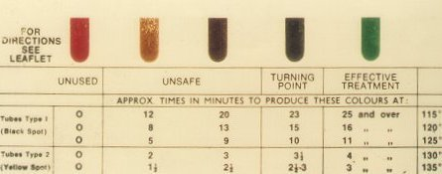
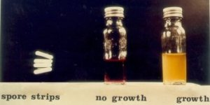
Methods of Sterilization
Monitoring of autoclaves
Physical- use of thermocouple to measure accurately the temperature.
Chemical- it consists of heat sensitive chemical that changes color at the right temperature and exposure time.
Autoclave tape
Browne’s tube.
Biological – where a spore-bearing organism is added during the sterilization process and then cultured later to ensure that it has been killed.

Slide 18
Methods of Sterilization
Sterilization by Chemical Methods
Useful for heat sensitive materials e.g. plastics and lensed instruments endoscopes).
Ethylene Oxide Chamber:
Ethylene oxide alkylates DNA molecules and thereby inactivates microorganisms.
Ethylene oxide may cause explosion if used pure so it is mixed with an inert gas e.g. Neon, Freon at a ratio of 10:90
It requires high humidity and is used at relative humidity 50-60% Temperature : 55-60°C and exposure period 4-6 hours.
Activated alkaline Glutaraldehyde 2%:
Immerse item in solution for about 20 minutes if organism is TB. In case of spores, the immersion period is extended to 2-3 hours.

Slide 19
DISINFECTANTS
Factors influencing activity of Disinfectants
Directly proportional to temperature.
Directly proportional to concentration up to a point – optimum concentration. After this level no advantage in further increases in concentration.
Time: Disinfectants need time to work.
Range of Action : Disinfectants are not equally effective against the whole spectrum of microbes. e.g. Chlorhexidine is less active against GNB than Gram Positive Cocci.
May be inactivated by
Dirt, organic matter
Proteins, Pus, Blood, Mucus, Faeces
Cork and some plastics.
Hypochlorites and Glutaraldehyde are more active against hepatitis viruses than most other disinfectants.

Slide 20
DISINFECTANTS
Types of Disinfectants
Phenol and phenolics
Phenol (carbolic acid) is seldom used today. Derivatives of the phenol molecule, however, are widely used.
Phenolics injure plasma membrane, inactivate enzymes, or denature proteins. They are stable, persistent, and are not sensitive to organic matter.
O-Phenylphenol
It is the main ingredient in most formulations of Lysol.
Hexachlorophene
It is main ingredient of a prescription lotion, pHisoHex, used in nurseries and for surgical and hospital microbial control procedures to control gram positive skin bacteria such as staphylococci and streptococci.
Excessive use can cause neurological damage.
Triclosan
It is a widely used found in many household products. It has broad spectrum of activity, especially against gram positive bacteria. It is also effective against gram negative bacteria and fungi.

Slide 21
DISINFECTANTS
Biguanides
Chlorhexidine, a member of the biguanide group, is not a phenol, but its structure and applications resemble hexachlorophene. It is frequently used for surgical skin preparation and surgical hand scrubs.
Halogens
Iodine is effective against all kinds of bacteria, many endospores, fungi, and some viruses. Its mechanism of activity may be its combination with the amino acid tyrosine in enzyme and cellular proteins.
An iodophore is a combination of iodine and an organic molecule. Iodophores do not stain and are less irritating than iodine. Examples are Isodine and Betadine.
Chlorine is used as a gas or in combination with other chemicals. Chlorine gas is used for disinfecting municipal water supplies, swimming pools, and sewage. Sodium hypochlorite – ordinary household bleach- is good disinfectant.
Chloramines consist of chlorine and ammonia. They are more stable than most chlorine. The U.S. military uses tablets for field disinfection of water.
Chlorine dioxide in gaseous form is used for area disinfection, most notably to kill endospores of anthrax bacteria.

Slide 22
DISINFECTANTS
Alcohols
Both ethanol and isopropanol (rubbing alcohol) are widely used, normally at a concentration of about 70%.
Concentrations of 60% to 95% are effective.
They are bactericidal and fungicidal but are not effective against endospores or non-enveloped viruses.
Alcohols enhance the effectiveness of other chemical agents.

Slide 23
DISINFECTANTS
Heavy metals and their compounds
Tiny amount of heavy metals (e.g. silver and copper) are effective antimicrobials. A silver coin on an inoculated nutrient medium will inhibit growth for some distance.
1% silver nitrate solution has been used to prevent gonorrheal ophthalmia neonatorum, which the infants might have contracted as they passed through the birth canal (recently been replaced by antibiotics).
Silver-sulfadiazine is used in wound dressings. Available as topical cream for use on burns.
Mercuric chloride is highly bactericidal, but is toxic and corrosive and is inactivated by organic matter. Organic mercury compounds such as Mercurochrome are less irritating and less toxic than inorganic mercury.
Copper sulfate is often used to destroy green algae in reservoirs or other water.
Zinc chloride is used in mouthwashes, and zinc oxide is used in paints as antifungal.

