Slide 1
Viral pathogenesis
Dr. Mohammed Arif.
Associate professor.
Consultant virologist.
Head of the virology unit.

Slide 2
Viral pathogenesis
The process by which a viral infection leads to disease.
This interaction between the virus and the host cell can be viewed at three levels.
1- The effect of viruses on the cells.
2- Disease progression .The way in which viruses spread through the body and cause disease ( from entry till viral shedding ).
3- The immune response to viral infection.

Slide 3
1 -- The effect of viruses on cells
There are five main effects of virus infection on the host cell:
1- Cytocidal (death of the infected cells ).
2- Formation of multi-nucleated giant cell ( syncytia formation ).
3- Formation of intracytoplasmic or intranuclear inclusion bodies.
4- Transformation of the infected cells.
5- No apparent changes .

Slide 4
The effect of viruses on host cells
1- Cytocidal effect :
The infected cells are destroyed.
In tissue culture, the cytocydal effect is known as cytopatheic effect ( c p e ).
It is due to insertion of viral protein in the plasma membrane of the infected cells, as a result, the cellular immune system attack these virally infected cells and cause their death.
In some cases, viruses synthesize early proteins , which shot down the synthesis of the cellular proteins and cause death of the infected cells.

Slide 5
The effect of viruses on host cells
2- formation of multi-nucleated giant cells (MNGC):
Fusion occurs as a result of insertion of viral proteins into the cell membrane.
The infected cells are then fuse together to form MNGC.
This is a characteristic feature of paramyxo and herpes viruses.

Slide 6
The effect of viruses on host cells
3- Formation of inclusion bodies:
Inclusion bodies are the site of viral replication.
All RNA-viruses, replicate in the cytoplasm and cause intra-cytoplasmic inclusion bodies
All DNA-viruses, replicate in the nucleus of the infected cell and cause intra- nuclear inclusion bodies.

Slide 7
The effect of viruses on host cells
4- Transformation of the infected cells to malignant.
Alteration in the morphology of the infected cells.
Chrosomal abnormalities.
May produce tumors when inoculated in experimental animals.
Can be passaged ( sub-cultured ) indefinitely.

Slide 8
Effect of viruses on host cells
5- No apparent changes :
The infected cells are not destroyed, nor transformed. Also, there is no MNGC formation.

Slide 9
2-- Disease progression
1- Route of entry & transmission .
A – Viruses that infect respiratory tract , enter the human body through the nose, by inhalation of respiratory droplets during sneezing and coughing .
B– Viruses that infect the gastrointestinal tract, enter the body through the mouth, by ingestion of food contaminated by infectious fecal material, or drinking contaminated water.

Slide 10
Disease progression
C – Viruses that are transmitted sexually enter the body through sexual contact. Example, HIV and hepatitis B virus .
D– Viruses that infect the skin, enter the human body through minor abrasion or cut on the skin. Example , human papilloma viruses, herpes simplex virus types 1 & 2 .

Slide 11
Disease progression
E– Blood born viruses, enter the body through using contaminated needled, surgical instruments and instrument used in the practice of tattooing , body piercing, cupping, etc . They also can be transmitted by direct contact with infected blood and through sexual route.
F– Arboviruses, enter the human body through the bite of infected vector such as mosquitoes, ticks and sand fly.

Slide 12
Disease progression
G– Zoonotic viruses such as rabies enter the body through the bite of rabid animal ( dogs and cats ).

Slide 13
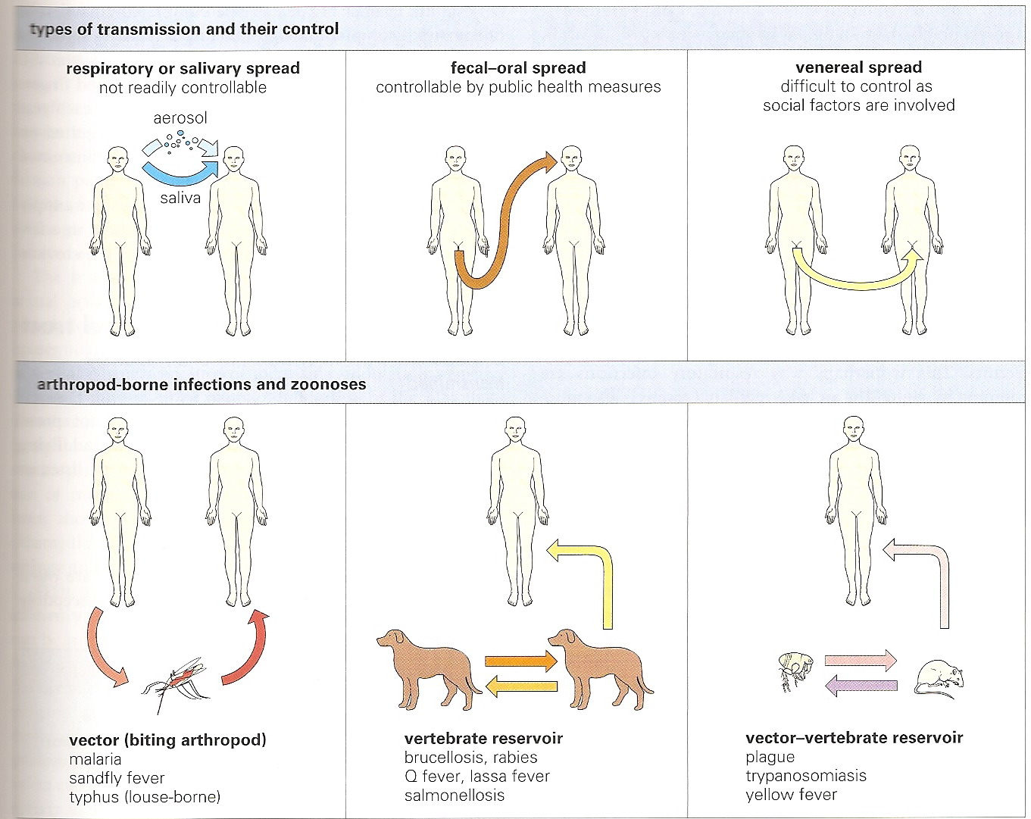
Modes of transmission

Slide 14
Virus spreads in the body
1- Localized infection.
2- Systemic infection ( generalized infection).

Slide 15
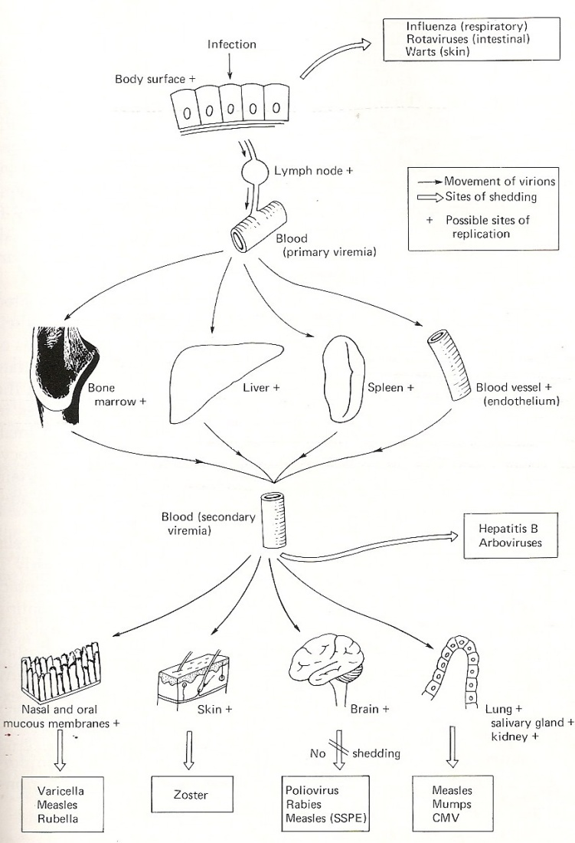
Locallized & systemic infection .

Slide 16
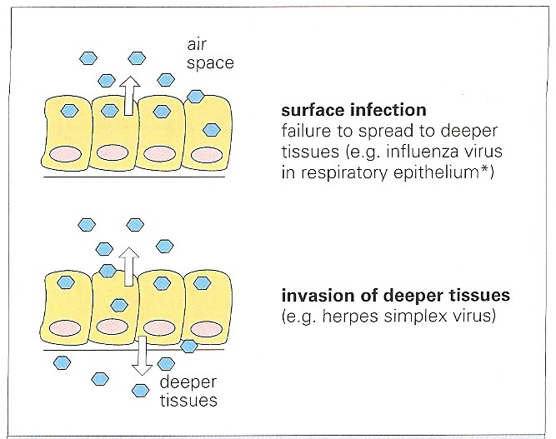
Localized and systematic infection.

Slide 17
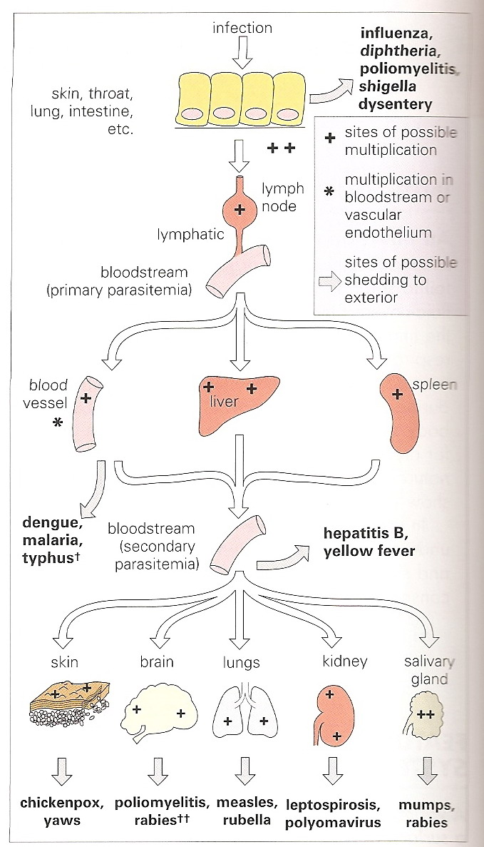
Systemic infection

Slide 18
Virus spreads in the body
After entry , viruses may cause localized or systemic infections .
1- Localized infection :
After entry the virus replicates locally at the site of entry.
There is no invasion to the sub-epithelial tissue.
The virus rarely reaches the lymphatic system and blood stream ( viremia is rare).
Recovery is usual.

Slide 19
Virus spreads in the body
2– Systemic infection:
After entry , the virus replicate locally at the site of entry.
The virus invades the sub-epithelial tissue and reaches the lymphatic capillaries and then to the local lymph nodes.
Inside lymph nodes, virions are exposed to the macrophages and are engulfed , processed and some of the viral proteins are expressed on the surface of macrophages.

Slide 20
Virus spreads in the body
Macrophages has dual functions, processing and presenting viral antigens.
Lymphocytes can now recognize viral antigens on the surface of macrophages.
Virions enter the blood stream and are carried to the liver spleen, (primary viremia), where they replicate there.

Slide 21
Virus spreads in the body.
Secondary viremia may occur, in which the virus is carried out by the blood to infect other organs such as the CNS, lungs, salivary glands , nasal or oral mucous membrane.

Slide 22
3- Outcome of viral infection
1- Acute infection.
The majority of viral infections are subclinical.
In the absence of serious complication recovery is usual.
In some cases acute infection may progress to chronic infection, as with hepatitis B and C.
In some cases , acute infection may leads to latent infection, as with herpes viruses.

Slide 23
Outcome of viral infection
2- Chronic infection.
In hepatitis B infection, about 90% of the infected individuals will recover and become immune.
The remaining, less than 10%, will progress to chronic hepatitis B.
Chronic hepatitis B is characterized by the presence of HBV-DNA in the blood for more than 6- months.
In chronic hepatitis B, the viral genome is integrated inside the human DNA in the hepatocytes.

Slide 24
Outcome of viral infection
In hepatitis C, only 20% of the infected individuals clear the virus from circulation and recover completely.
The remaining, about 80%, will progress to chronic hepatitis C.
Chronic hepatitis C is characterized by the presence of HCV-RNA in the blood for more than 6-months.
In chronic hepatitis C the viral genome is not integrated into the human DNA.

Slide 25
Outcome of viral infection.
Instead, the virus continue to mutate inside the human body. This continuous mutation occur in the envelope gene of the virus. As a result different strains of HCV are developed.
Using this strategy, the virus can escape the immune system. This phenomenon is known as quasi-species.

Slide 26
Outcome of viral infection
3- Persistent infection:
In HIV- infection, there is no recovery or immunity.
HIV infected patients remain infected for the rest of their life.
4- Latent infection:
The most important characteristic feature of herpes viruses is the latency.
After primary infection and recovery, the virus remains latent inside the human body for life.

Slide 27
Outcome of viral infection.
The latent virus may reactivated and produces a recurrent illness.
Recurrent infection is milder than primary infection and has short duration.

Slide 28
Outcome of viral infection .
5- development of human cancer:
Few viral infections are associated with the development of cancer in human .
Hepatitis B and C are associated with liver cancer
( hepatocellular carcinoma).
Epstein Barr virus (EBV) is associated with nasopharyngeal carcinoma and Burkit lymphoma.

Slide 29
Outcome of viral infection
Certain types of human papilloma viruses are associated with cervical cancer, together with herpes simplex virus type 2 (HSV-2).

Slide 30
Immune response to viral infection.
1- innate immunity:
Non- Ag specific defense mechanisms.
Play immediately or within hours of viral entry.
It does not confer long lasting immunity.
These mechanisms include the physical and chemical barriers that operate at the body surfaces to prevent attachment and penetration of viruses:
The human skin is not permeable to viruses and other microorganisms.

Slide 31
Immune response to viral infection
The membrane lining the inner surfaces of the body secret mucous, which acts as protective barrier , inhibiting attachment of viruses.
The acid and bile secretion in the gastrointestinal tract inactivate enveloped viruses.
Many of the secreted body fluids contain microbicidal factors such as zinc in semen, lactoperoxidase in breast milk and lysozymes in tears , saliva and nasal secretion.

Slide 32
immune response to viral infection
The respiratory tract is lined with ciliated epithelial cells covered with mucous to trap viruses, which are then removed by the cilliary action during sneezing and coughing.
Innate immunity also include interferon secretion , the phagocytic action of neutophils and macrophages and activation of complement system.

Slide 33
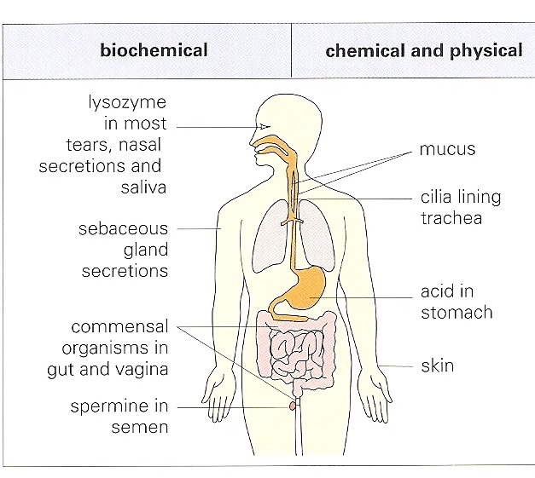
Physical and chemical barriers

Slide 34
Immune response to viral infection.
Interferons (IFN).
Interferons are cytokines, secreted by virally infected cells.
They bind to specific receptors on adjacent not infected cells and induce them to synthesize anti-viral molecules, which can degrade viral m-RNA and inhibit protein synthesis.
There are three types of interferons, alpha, beta and gamma.

Slide 35
Immune response to viral infection
Interferons also activate natural killer cells and macrophages.
They enhance expression of class I and class II MHC molecules.
They inhibit viral replication by degradation of the viral m-RNA and inhibiting protein synthesis.

Slide 36
Immune response to viral infection
Phagocytes:
There are two types of phagocytic cells. The polymorphonuclear neutophils and macrophages.
The neutrophils are the dominant phagocytic cells in the blood.
Their function is to engulf and destroy the bulk of invading viruses.
Macrophages are found in most tissues.

Slide 37
Immune response to viral infection.
They found in connective tissue, liver (kupffer cells), brain ( microglia), lungs ( alveolar macrophages) , lymph nodes, and the skin.
They have two functions:
A-They engulf viruses, degrade them inside and express part of the degraded antigens on the outer surface ( antigen presenting cell).
B- They secret interferons and lymphocytes activating factors.

Slide 38
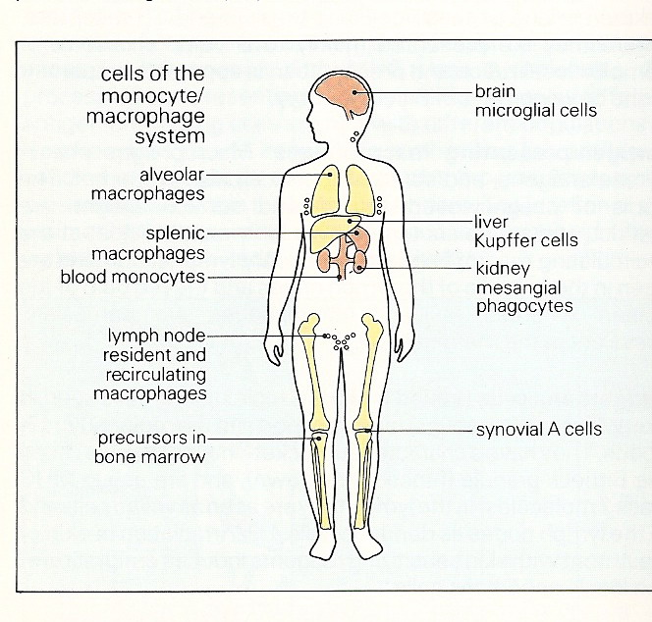
Macrophages

Slide 39
Immune response to viral infection
2-Adaptive immunity:
Refers to antigen – specific immune response.
More complex than innate.
It confers long lasting immunity.
It involves the following mechanisms:
A- Antigen presentation on the outer surface of macrophages.
B- Recognition of these antigens by T and B lymphocytes.

Slide 40
Immune response to viral infection
C- activation of cytotoxic T cell to kill vitally infected cells ( cellular immunity ).
D- activation of B lymphocytes to differentiate in to antibody secreting cells which secret antibodies (humoral immunity).
The main function of antibodies (Abs) is to neutralize extra cellular viruses. Abs cannot penetrate cells and neutralize intra-cellular viruses.

Slide 41
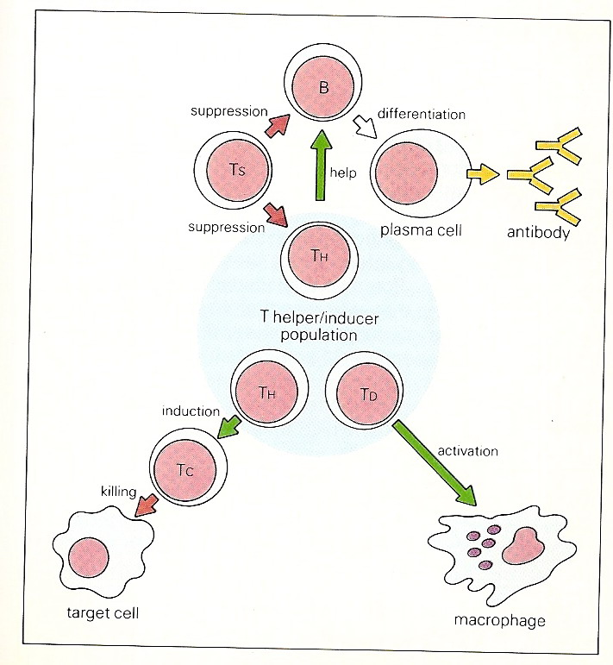
The interaction between cells of the immune system

