Slide 1
Viral gastroenteritis ( Viral diarrhea ).
Dr. Mohammed Arif
Associate professor
Consultant virologist
Head of the virology unit

Slide 2
Viral diarrhea .
The second most common infection after the respiratory tract .
Mainly disease of infants and young children .
Mostly self limiting disease. Recovery is usual .
Diarrhea, vomiting and abdominal pain are the major symptoms.
Viruses causing diarrhea replicate in the epithelial cells of the small intestine and shed freely in stools.

Slide 3
Viral etiology
Rota viruses (reoviridae), the major cause of infantile diarrhea.
Enteric adenoviruses types 40 & 41 (adenoviridae).
Astroviruses (astroviridae).
Norovirus (caliciviridae).
Sapovirus (caliciviridae) .

Slide 4
Rota viruses
Family: Reoviridae.
Icosahedral particles , 20-30 nm in diameter.
Unenveloped.
Two icosahedral capsids (wheel like).
The viral genome is ds-RNA, 11 segments.
Replicate in the cytoplasm.
They infect epithelial cells in the small intestine.
The major cause of diarrhea in infants & young children.

Slide 5
Astroviruses
Family: Astroviridae.
Icosahedral particles, 30-40 nm in diameter.
Unenveloped.
The viral genome is ss-RNA, plus strand.
Cause diarrhea in infants and children .

Slide 6
Noroviruses ( Norwalk virus ) & sapovirus .
Family: Caliciviridae .
Genus : norovirus ( 1968 ) .
Genus : sapovirus ( !977) .
Icosahedral particles, 30-40 nm in diameter, with cup- shaped depressions.
Unenveloped.
The viral genome is ss-RNA, plus strand.
Cause diarrhea in all age groups.

Slide 7
Adenoviruses
Family: Adenoviridae.
Icosahedral particles, 60-70 nm in diameter.
12-fibres one at each vertix.
The viral genome is ds-DNA.
Replicate in the nucleus.
49 distinct types, grouped into 6-subgenera (A-F).
Cause diarrhea in infants and young children .

Slide 8
Transmission
By the fecal oral route:
Person to person through contaminated hands.
Eating uncooked fruits and vegetables contaminated with infectious fecal material.
Drinking water contaminated with infectious fecal material.
Contamination of uncooked food, fruits and salads by food handlers.

Slide 9
Target group:
Mainly infants and young children .
Norovirus affects all age groups , often occurs in closed or semi-closed communities, such as hospitals, dormitories, prisons , etc.

Slide 10
Endemicity.
Viruses that are transmitted by the fecal oral route are endemic in areas with:
Low standard of hygiene and sanitation.
Primitive sewage system.
No adequate water pipe-line system.
Crowded living condition.
Low educational level.

Slide 11
Pathogenesis .
These viruses replicate in the epithelial cells lining the small intestine ( enterocytes ).
They replicate at the tips of the villi ( mature cells ), causing destruction of these cells .
They do not replicate in the crypt .
As a result, maladsorption of fluids and electrolytes occurs .

Slide 12
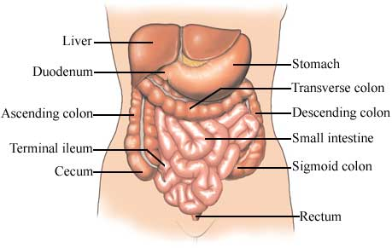
Small intestine

Slide 13
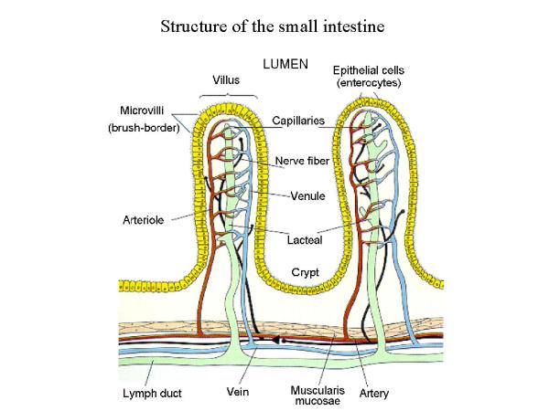
Small intestine

Slide 14
Clinical features
IP , 1-3 days.
The main symptoms are: diarrhea, vomiting, nausea, abdominal cramping and pain, fever.
Duration: 2-7 days.
Prognosis: in the absence of dehydration, the disease is mild and recovery is usual.
Complications: dehydration.

Slide 15
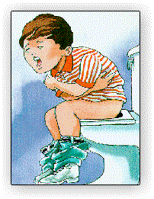
Infantile diarrhea .

Slide 16
Treatment
By replacement of fluids and electrolytes lost by diarrhea.
Children with diarrhea who are unable to take fluids by mouth because of nausea and vomiting may need interavenous fluids

Slide 17
Prevention measures
Washing hands with soap and water before preparing food and eating.
Washing hands with soap and water after toilet and changing diapers.
Disinfection of contaminated surfaces , such as toilets, carpet, floors, etc.

Slide 18
Laboratory diagnosis
By detection of these viruses in stool, using EIA.
These viruses shed freely in stool.

Slide 19
Rotavirus vaccine.
Live attenuated , oral vaccine.
Administered in two doses.
First dose at age of 2- months.
Second dose at age of 4- months

