Slide 1
Enterically transmitted hepatitis (Water-borne hepatitis)
Dr. Mohammed Arif.
Associate professor
Consultant virologist
Head of the virology unit

Slide 2
Viral hepatitis .
Inflammation of the liver .
Caused by hepatitis A , B, C , D, E, F and G viruses.
Hepatitis F has been reported in the literature but not confirmed .

Slide 3
Viral hepatitis .
Has been divided into two large groups, based on the mode of transmission .
1– Enterically transmitted hepatitis or water born hepatitis .
This group includes hepatitis A and E .
2– Parenterally transmitted hepatitis or blood born hepatitis .
This group includes hepatitis B, C, D & G .

Slide 4
Viral etiology
Hepatitis A virus (HAV).
Family: Picornaviridae.
Genus : Enterovirus.
Unenveloped, ss-RNA plus strand.
Hepatitis E virus (HEV).
Family : Hepeviridae.
Genus : Hepevirus.
Unenveloped, ss-RNA plus strand .

Slide 5
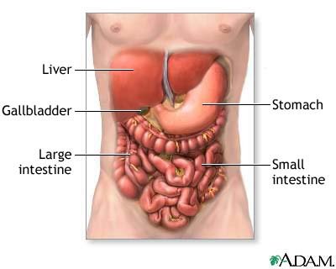
Liver

Slide 6
Transmission and target group
Both viruses are transmitted by the fecal oral route.
Person to person, through contaminated hands.
Contamination of drinking water with infectious fecal material.
Eating uncooked fruits and vegetables contaminated with infectious fecal material.
They affect all age groups, but children are the main target .

Slide 7
Transmission .
In addition to humans, hepatitis A infects chimps and some species of monkeys.
Hepatitis E also, infects pigs, cows, sheep, goats and rodents. There is a possibility of a zoonotic spread of the virus .

Slide 8
Clinical features
Both hepatitis A and E cause acute hepatitis with full recovery .
They are not associated with chronic liver diseases.
Fulminant hepatitis is very rare.

Slide 9
Symptoms of acute hepatitis .
The majority of infections are asymptomatic.
Anicteric cases are also very common.
Symptoms vary from sub-clinical, anicteric, mild cases to full range of symptoms with jaundice.
Infection in children usually asymptomatic or anicteric.
Infection in adults are severe with jaundice.
I.P 28- days .

Slide 10
Symptoms
Typical acute viral hepatitis, proceeds in three stages:
1 Anicteric phase:
Usually starts suddenly with anorexia, malaise , nausea , vomiting, fever, and right upper quadrant abdominal pain, with raised liver enzymes( ALT & AST ).

Slide 11
Symptoms
2- Icteric phase:
Characterized by jaundice, dark urine and pale stools.
Jaundice is yellow discoloration of the skin and sclera, due to increase of bilirubin in the blood .
3- Convalescent phase:
Symptoms disappear after 4-8 weeks.

Slide 12
Jaundice

Slide 13
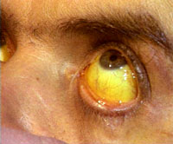
Jaundice

Slide 14
Complications
Fulminant hepatitis is rare..
Characterized by rapid clinical deterioration , massive necrosis, hepatic-encephalopathy and liver failure .

Slide 15
pathogenesis
Both hepatitis A & E enter the body by ingestion of contaminated food, replicate in the intestine and spread to the liver, where they multiply in hepatocytes.
Both hepatitis A & E shed in stool, only during the prodromal phase.

Slide 16
Prognosis
In the absence of complications recovery is complete.

Slide 17
Lab diagnosis
The best diagnostic method is detection of IgM antibdies to hepatitis A & E.

Slide 18
Prevention
There is inactivated vaccine is available for HAV.
The vaccine is recommended to travelers to endemic areas.
Also, it is recommended to children over the age of two, who live in endemic area.
The vaccine is immunogenic and induces protective immunity.
For hepatitis E, there is no vaccine available yet.

