Slide 1
Blood-borne hepatitis ( parenterally transmitted hepatitis)
Dr, Mohammed Arif
Associate professor
Consultant virologist
Head of the virology unit

Slide 2
Blood- born hepatitis , Viral etiology
Hepatitis B virus (HBV).
Hepatitis C virus (HCV).
Hepatitis D virus (HDV) or delta virus .
Hepatitis G virus ( HGV ) .

Slide 3
Hepatitis B virus, structure and classification .
Family : hepadnaviridae.
The complete virus particle is 42-nm in diameter, enveloped , with icosahedrai nucleocapsid .
It consists of an outer envelope containing hepatitis B surface antigen ( HBsAg).
And internal core ( nucleocapsid) composed of hepatitis B core antigen (HBcAg).
The viral genome is small partially circular ds-DNA.
There are eight known genotypes ( A – H ).
The virus contains the enzyme reverse transcriptase.

Slide 4
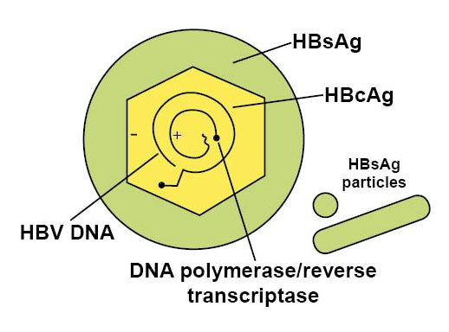
Hepatitis B virus.

Slide 5
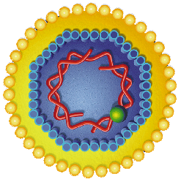
Hepatitis B virus

Slide 6
Types of hepatitis B particles .
The serum of infected individual contains three types of hepatitis B particles:
Large number of free 26-nm HBsAg particles.
Some of these HBsAg particles are linked together to take the form of filaments
In addition to the complete HBV-particles.

Slide 7
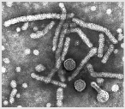
Type of hepatitis B particles.

Slide 8
Hepatitis C virus
Family : flaviviridae.
Genus : hepacivirus.
The virus is enveloped, 60 – 80 nm in diameter.
The viral genome is ss- RNA, with positive polarity.
There are six known genotypes ( 1 – 6 ).

Slide 9
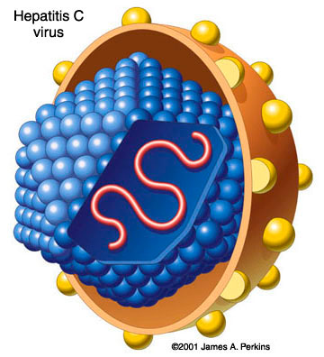
Hepatitis C virus

Slide 10
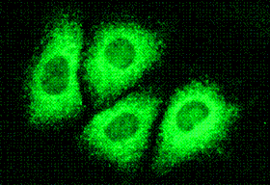
EM of HCV .

Slide 11
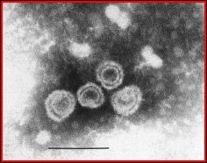
EM of HCV .

Slide 12
Hepatitis D virus
It is a defective virus, that cannot replicate by its own.
It require a helper virus.
The helper virus is HBV.
HBV provides the free HBsAg particles to be used as an envelope.
HDV is small 30 -40 nm in diameter.
Composed of small ss-RNA genome, surrounded by delta antigen that form the capsid

Slide 13
Hepatitis D virus ( delta virus ) .

Slide 14
Hepatitis G virus ( HGV ) .
Hepatitis G virus or GB-virus was discovered in 1995.
Share about 80% sequence homology with HCV.
Family: flaviviridae.
Enveloped, ss-RNA with positive polarity.
Parenteral, sexual and from mother to child transmission have been reported..
Causes mild cases of acute and chronic hepatitis.
Usually occurs as co-infection with HCV , HBV and HIV.

Slide 15
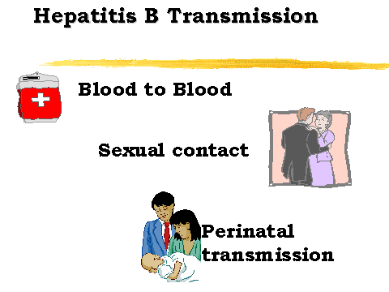
Transmission of blood – born viruses

Slide 16
Transmission of hepatitis B & C
1- Parenterally (percutaneosly):
Direct exposure to infected blood.
Use of contaminated needles, syringes, dental and surgical instruments.
Use of contaminated instruments in the practice of tattooing, body piercing, cupping, etc.
Sharing contaminated tooth brushes, razors, cuticle scissors and nail clippers.

Slide 17
Transmission of hepatitis B & C
2- Sexually:
By having sexual contacts with infected person.
The virus is present in semen and vaginal secretion.
The risk of sexual transmission increases , if one of the sexual partner has high viral load in the blood, HIV-infection, genital ulcers , vaginal/ rectal/ or urethral bleeding.
Unlike HBV, the risk of transmission of HCV through sexual contact is very low.

Slide 18
Transmission
3- From mother to child :
Mostly perinatally, during labor and delivery.
Neonate is infected during passage in the birth canal.
Neonate is infected by direct exposure to the infected maternal blood.

Slide 19
High risk groups
The following groups are at high risk of acquiring hepatitis B & C :
Intravenously drug users.
Hemodialysis patients.
Patients receiving clotting factors.
Individuals with multiple sexual partners.
Recipient of blood transfusion , before 1992.
Health care workers with frequent blood contact.
Individuals exposed to risk factors such as tattooing, body piercing and cupping.

Slide 20
Hepatitis B markers
1-- Hepatitis B surface antigen (HBsAg):
Marker of infection.
2-- Hepatitis B e antigen (HBeAg) :
Marker of active virus replication, the patient is highly infectious, high viral load, the virus is present in all body fluids.
3-- Antibody to hepatitis B e antigen (Anti-HBe):
Marker of low infectivity, the patient is less infectious.

Slide 21
Hepatitis B markers .
4-- Antibody to hepatitis B surface antigen (Anti-HBs):
Marker of immunity.
5-- Antibody to hepatitis B core IgG (Anti-HBc IgG )
It indicates previous exposure to hepatitis B infection.

Slide 22
Hepatitis C markers.
1– Hepatitis C virus – RNA .
Is the first marker that appears in circulation, it appears as early as one week after infection .
2– IgG Antibody to hepatitis C.
Antibodies to hepatitis C virus usually appear 3- 12 weeks after infection.

Slide 23
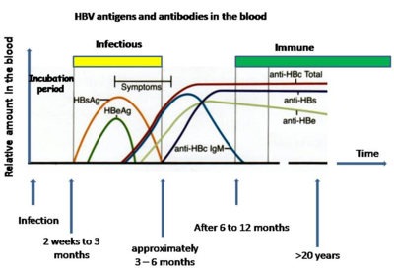
Serological profile of acute hepatitis B infection .

Slide 24
Serological profile of acute hepatitis B infection.
Hepatitis B surface antigen is the first marker that appears in the blood and persists for less than 6-months, then disappears.
Hepatitis B e-antigen ( HBeAg) is the second maker that appears in circulation and disappears before HBsAg .
Antibody to the core ( anti-HBc ) is the first antibody that appears in the blood and usually persists for several years .

Slide 25
Serological profile of acute hepatitis B infection .
with the disappearance of HBeAg, anti- HBe appears and usually persists for several weeks to several months .
Antibodies to hepatitis B surface antigen (anti-HBs) is the last marker that appears in the blood.
It appears few weeks after disappearance of HBsAg .
Anti-HBs persists for several years .
It indicates immunity to hepatitis B infection.

Slide 26
Serological profile of chronic hepatitis B infection.
Chronic hepatitis B infection is defined by the presence of HBV-DNA or HBsAg in the blood for more than 6-momths .
HBsAg may persists in the blood for life .
After disappearance of HBsAg, anti-HBs appears and persists for several years .

Slide 27
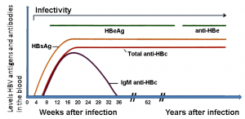
Serological profile of chronic hepatitis C infection.

Slide 28
Types of hepatitis B infection
About 90 % of infected individuals will develop acute hepatitis B infection and recover completely.
Less than 9 % of the infected individuals will progress to chronic hepatitis B.
Less than 1 % will develop fulminant hepatitis B , characterized by massive liver necrosis, liver failure and death.

Slide 29
Types of hepatitis C infection
About 20 % of the infected individuals will develop acute hepatitis C and recover completely.
About 80 % of the infected will progress to chronic hepatitis C.
Less than 1 % will develop fulminant hepatitis C , liver failure and death.

Slide 30
Types of hepatitis D infection
1-- Co-infection:
The patient is infected with HBV and HDV at the same time, leading to severe acute hepatitis .
Prognosis, recovery is usual.
2-- Super infection:
In this case, delta virus infects those who are already have chronic hepatitis B, leading to severe chronic hepatitis.

Slide 31
Acute viral hepatitis
Most acute hepatitis B & C are asymptomatic or anicteric.
When symptomatic, the initial symptoms are(Anicteric phase):
Low grade fever, anorexia, malaise, nausea, vomiting and right upper quadrant abdominal pain.
This is followed by the icteric phase, which is characterized by jaundice, dark urine and pale stool.
The icteric phase is followed by the convalescent phase.
Acute viral hepatitis usually lasts for several weeks.

Slide 32
prognosis
Acute viral hepatitis varies from asymptomatic to fatal liver failure.
Individuals with acute hepatitis B or C may become chronic carriers.
In case of hepatitis B, 90 % of all acute cases will recover completely.
In case of hepatitis C, about 20 % of all acute cases will recover completely.

Slide 33
Chronic viral hepatitis
Chronic hepatitis is limited to hepatitis B, C & D viruses.
The majority of patients with chronic hepatitis B and C are asymptomatic or have mild fatigue only.
Symptoms include, right upper quadrant abdominal pain, enlarged spleen, spider like blood vessels in the skin. Jaundice may or may not developed, fatigue.

Slide 34
complications
1- Cirrhosis:
is a chronic diffuse liver disease.
Characterized by fibrosis and nodular formation.
Results from liver cell necrosis and the collapse of hepatic lobules.
Symptoms includes, ascites, coagulopathy (bleeding disorder), portal hypertension, hepatic encephalopathy, vomiting blood, weakness, weight loss.

Slide 35
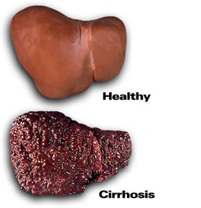
Cirrhosis .

Slide 36
Ascites .

Slide 37
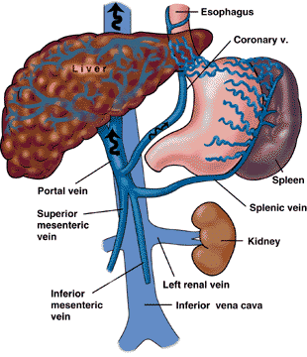
Portal hypertension.

Slide 38
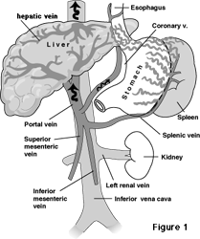
Portal hypertension.

Slide 39
Complications
2- Hepatocellular carcinoma (HCC ):
One of the most common cancer in the world.
One of the most deadly cancer if not treated.
Hepatitis B and C viruses are the leading cause of chronic liver diseases.
Symptoms include : abdominal pain, abdominal swelling, weight loss, anorexia, vomiting, jaundice.
Physical examination reveals hepatomegaly, splenomegaly and ascites.

Slide 40
HCC
Prognosis, without liver transplantation , the prognosis is poor and one year survival is rare.
Diagnosis: alpha-fetoprotein measurement with multiple CT-abdominal scan are the most sensitive method for diagnosis of HCC.
Treatment: surgical resection and liver transplant.

Slide 41
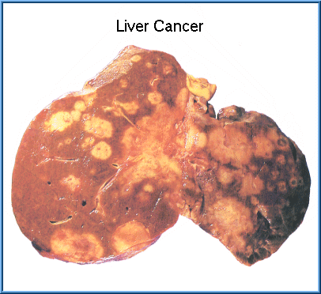
Hepatocellular carcinoma ( HCC ) .

Slide 42
Laboratory diagnosis of hepatitis B and C infections.
1-- Hepatitis B infection is diagnosed by detection of HBsAg in the blood.
Positive results must be repeated in duplicate.
Repeatedly reactive results must be confirmed by neutralization test .
2– Hepatitis C infection is diagnosed by detection of HCV-RNA in the patient blood, using PCR.

Slide 43
Hepatitis B vaccine .
it contains highly purified preparation of HBsAg particles , produced by genetic engineering in yeast.
It is a recombinant and sub-unit vaccine .
It is not live attenuated nor killed vaccine .
The vaccine is administered in three doses at 0.1 & 6 months.
The vaccine is safe and protective .

Slide 44
Hepatitis C vaccine .
At the present time, there is no vaccine available to hepatitis C .

Slide 45
Treatment of hepatitis B infection.
There are several approved anti-viral drugs.
1- pegylated alpha interferon, one injection per week, for 6- 12 months .
2- Lamivudine, anti-viral drug, nucleoside analogue . One tablet a day for at least one year .
3- Adefovir, anti-viral drug, nucleoside analogue. One tablet a day for at least one year .
Treatment is limited to patients having chronic hepatitis B, based on liver biopsy.

Slide 46
Treatment of hepatitis C infection .
The currently used treatment is the combined therapy, using pegylated alpha interferon and ribavirin .
The dose: for pegylated interferon, three injections per week.
For ribavirin, one tablet daily.
Duration of treatment: 48-weeks.
Treatment is limited to patients with chronic hepatitis C, based on liver biopsy .

