Slide 1
THE EAR

Slide 2
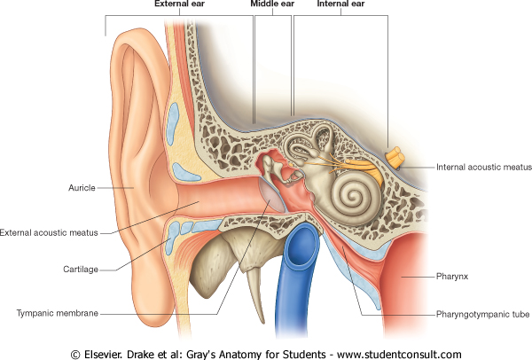
The ear consists of the external ear, the middle ear, or tympanic cavity, and the internal ear, or labyrinth, the last containing the organs of hearing and balance.

Slide 3
EXTERNAL EAR

Slide 4
The external ear has an auricle/pinna and an external auditory meatus.

Slide 5
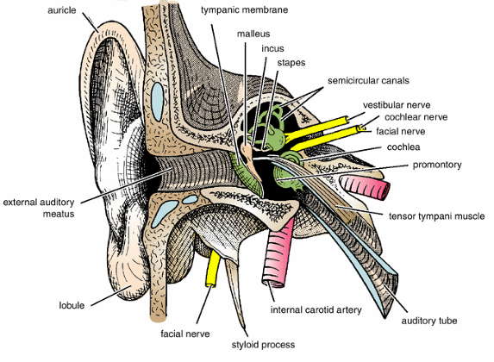
The auricle has a characteristic shape and collects air vibrations.
It consists of a thin plate of elastic cartilage covered by skin.
The external auditory meatus is a curved tube that leads from the auricle to the tympanic membrane, lined by skin, and its outer third is provided with hairs and sebaceous and ceruminous glands that secret wax.

Slide 6
MIDDLE EAR (TYMPANIC CAVITY)

Slide 7
The middle ear is an air-containing cavity in the petrous part of the temporal bone and is lined with mucous membrane.
It contains the auditory ossicles, whose function is to transmit the vibrations of the tympanic membrane (eardrum) to the perilymph of the internal ear.

Slide 8
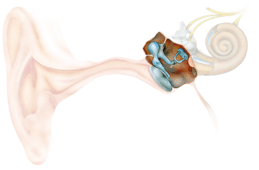
The middle ear has a:
roof,
floor,
anterior wall,
posterior wall,
lateral wall, and
medial wall.

Slide 9
The roof is formed by a thin plate of bone, the tegmen tympani, which is part of the petrous temporal bone
It separates the tympanic cavity from the meninges and the temporal lobe of the brain in the middle cranial fossa.

Slide 10
The floor is formed by a thin plate of bone, which may be deficient and may be partly replaced by fibrous tissue.
It separates the tympanic cavity from the superior bulb of the internal jugular vein

Slide 11
The anterior wall is formed below by a thin plate of bone that separates the tympanic cavity from the internal carotid artery

Slide 12
The lower and larger of these leads into the auditory tube
At the upper part of the anterior wall are the openings into two canals.

Slide 13
The upper and smaller opening is the entrance into the canal for the tensor tympani muscle.

Slide 14
The posterior wall has in its upper part a large, irregular opening, the aditus to the mastoid antrum

Slide 15
Post wall
Post. Wall
Med wall
Ant wall

Slide 16
The lateral wall is largely formed by the tympanic membrane.
It is a thin, fibrous membrane.
The membrane is obliquely placed, facing downward, forward, and laterally.

Slide 17
The tympanic membrane measures about 1 cm in diameter.
It is concave laterally, and at the depth of the concavity is a small depression, the umbo, produced by the tip of the handle of the malleus.
It is extremely sensitive to pain

Slide 18
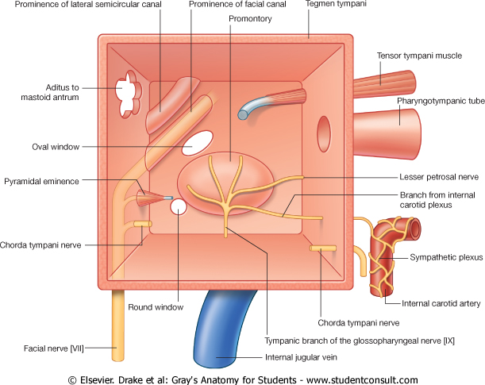
Medial Wall
The greater part of the medial wall shows a rounded projection, called the promontory, which results from the underlying cochlea.
Above and behind the promontory lies the fenestra vestibuli, which is oval shaped and closed by the base of the stapes.

Slide 19
Below the posterior end of the promontory lies the fenestra cochleae, which is round and closed by the secondary tympanic membrane.

Slide 20
A rounded ridge runs horizontally backward above the promontory and the fenestra vestibuli and is known as the prominence of the facial nerve canal.
On reaching the posterior wall, it curves downward behind the pyramid.

Slide 21
Auditory Ossicles

Slide 22
The auditory ossicles are the malleus, incus, and stapes.

Slide 23
Muscles of the Ossicles

Slide 24
Tensor Tympani

Slide 25
Origin: Auditory tube and the bony walls of its own canal.
Insertion: Handle of the malleus.
Nerve supply: Mandibular division of the trigeminal nerve.
Action: Damps down the vibrations the tympanic membrane

Slide 26
Stapedius

Slide 27
Origin: Pyramid.
Insertion: Neck of the stapes.
Nerve supply: From the facial nerve.
Action: Damps down the vibrations of the stapes.

Slide 28
Auditory Tube

Slide 29
The auditory tube extends from the anterior wall of the tympanic cavity downward, forward, and medially to the nasal pharynx.
Its posterior third is bony, and its anterior two-thirds is cartilaginous.

Slide 30
Mastoid Antrum

Slide 31
The mastoid antrum lies behind the middle ear in the petrous part of the temporal bone.
It communicates with the middle ear by the aditus, which may be as large as 1 cm in diameter.

Slide 32
Facial Nerve

Slide 33
On reaching the bottom of the internal acoustic meatus, the facial nerve enters the facial canal.
The nerve runs laterally above the vestibule of the internal ear until it reaches the medial wall of the middle ear.

Slide 34
Here, the nerve expands to form the sensory geniculate ganglion.
The nerve then bends sharply backward above the promontory.

Slide 35
It descends in the posterior wall of the middle ear, behind the pyramid, and finally emerges through the stylomastoid foramen.

Slide 36
The nerve to the stapedius arises from the facial nerve as it descends in the facial canal behind the pyramid.
It supplies the muscle within the pyramid.

Slide 37
Tympanic Nerve

Slide 38
The tympanic nerve arises from the glossopharyngeal nerve, just below the jugular foramen.

Slide 39
The tympanic nerve passes through the floor of the middle ear and onto the promontory.
Here it splits into branches, which form the tympanic plexus.
The tympanic plexus supplies the lining of the middle ear and gives off the lesser petrosal nerve.

Slide 40
THE INTERNAL EAR, OR LABYRINTH

Slide 41
The labyrinth is situated in the petrous part of the temporal bone, medial to the middle ear.

Slide 42
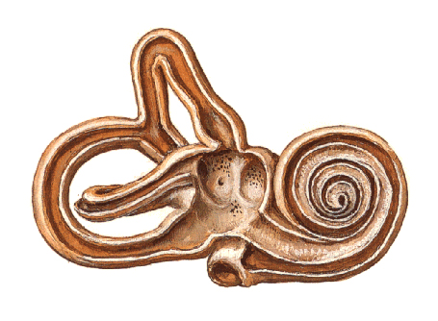
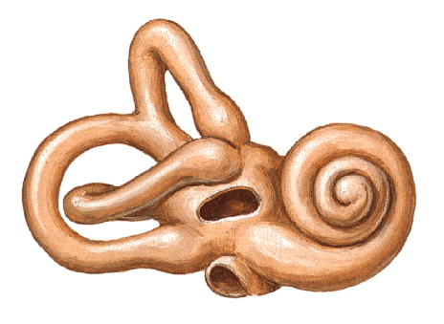
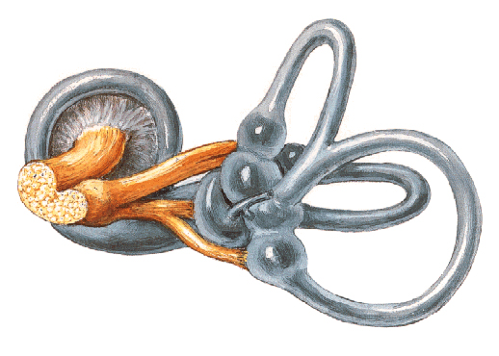
The labyrinth consists of:
the bony labyrinth, comprising a series of cavities within the bone, and
the membranous labyrinth, comprising a series of membranous sacs and ducts contained within the bony labyrinth.

Slide 43
Bony Labyrinth

Slide 44
The bony labyrinth consists of three parts:
the vestibule,
the semicircular canals, and
the cochlea.
These are cavities situated in the substance of bone.
They are lined by endosteum and contain a clear fluid, the perilymph, in which is suspended the membranous labyrinth

Slide 45
The vestibule, the central part of the bony labyrinth.

Slide 46
The three semicircular canals—superior, posterior, and lateral—open into the posterior part of the vestibule.
Each canal has a swelling at one end called the ampulla.
The canals open into the vestibule by five orifices, one of which is common to two of the canals.

Slide 47
The cochlea resembles a snail shell.
It opens into the anterior part of the vestibule.

Slide 48
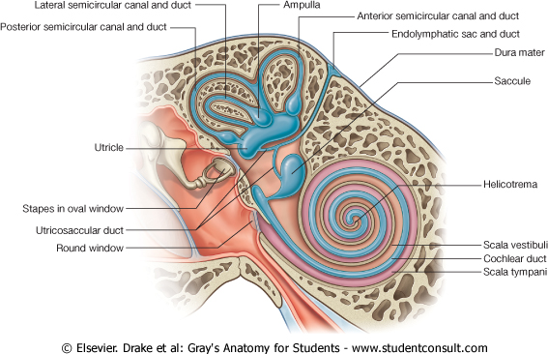
The membranous labyrinth is lodged within the bony labyrinth.
It is filled with endolymph and surrounded by perilymph.

Slide 49
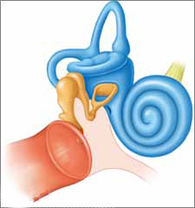
The membranous labyrinth consists of:
the utricle and saccule, which are lodged in the bony vestibule;
the three semicircular ducts, which lie within the bony semicircular canals; and
the duct of the cochlea, which lies within the bony cochlea.
All these structures freely communicate with one another.

Slide 50
Located on the walls of the utricle and saccule are specialized sensory receptors, which are sensitive to the orientation of the head to gravity or other acceleration forces.

Slide 51
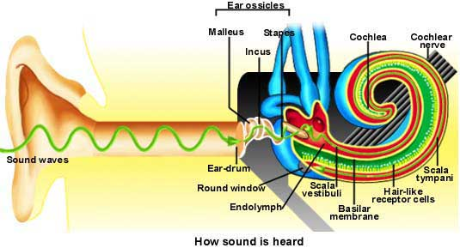
The highly specialized epithelium that lies on the basilar membrane forms the spiral organ of Corti and
contains the sensory receptors for hearing.

Slide 52
Vestibulocochlear Nerve

Slide 53
On reaching the bottom of the internal acoustic meatus, the nerve divides into vestibular and cochlear portions.

Slide 54
The vestibular nerve is expanded to form the vestibular ganglion.
The branches of the nerve then pierce the lateral end of the internal acoustic meatus and gain entrance to the membranous labyrinth, where they supply the utricle, the saccule, and the ampullae of the semicircular ducts.

Slide 55
Thank you

