Slide 1
Calcium homeostasis
Dr. Sumbul Fatma

Slide 2
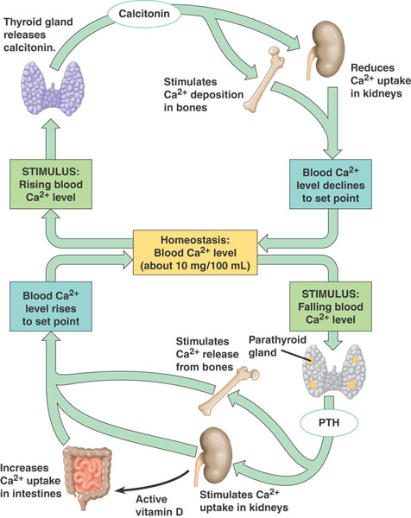
Calcium Homeostasis
Falling

Slide 3
Disorders of calcium
Hypocalcemia
Hypercalcemia
Ioniozed calcium is a more sensitive and specific marker for calcium disorders

Slide 4
Hypocalcemia
Primary hypoparathyroidism
Hypomagnesemia
Hypermagnesimia
Hypoalbuminemia
Acute pancreatitis
Vitamin D deficiency
Rhabdomyolysis
Pseudohypoparathyroidism

Slide 5
Primary Hypoparathyroidism
Absence of PTH
- parathyroid gland aplasia
- destruction/removal of parathyroid gland
No release of calcium from bone
Lack of vitamin D
Increased excretion of Ca⁺⁺

Slide 6
Hypomagnesemia
Occurs in hospitalized patients
Causes hypocalemia by
- inhibits glandular secretion of PTH
- impairs PTH action at its receptor site on bone
- vitamin D resistance

Slide 7
Hypermagnesemia
Inhibit PTH release, thereby inhibiting target tissue response
Leads to hypocalcemia and hypercalciuria

Slide 8
Hypoalbuminemia
Albumin is a major protein in the body, making up about 60% of total human plasma protein by mass
Albumin is synthesized in liver
Occurs in patients with chronic liver disease, nephrotic syndrome, and malnutrition
For 1g/dL decrease in serum albumin, there is a 0.2mmol/L (0.8mg/dL) decrease in total Ca⁺⁺ levels

Slide 9
Acute Pancreatitis
Intestinal lipase activity is increased during acute pancreatitis leading to increased intestinal binding of calcium

Slide 10
Vitamin D deficiency
Leads to decreased absorption of calcium
Increased PTH production leading to secondary hyperparathyroidism

Slide 11
Renal Disease
Renal disease caused by glomerular failure
Patients have altered Ca⁺⁺, PO₄⁻, albumin, Mg²⁺ and H⁺
During chronic renal disease, hypocalcemia occurs because of
- hyperphosphatemia (phosphate binds and lowers ionized calcium)
- altered vitamin D metabolism
- leading to secondary hyperparathyroidism

Slide 12
Rhabdomyolysis
A major crush injury or muscle damage results in release of phosphate from cells that binds to calcium leading to hypocalcemia

Slide 13
Pseudohypoparathyroidism
Is rare hereditary disorder
PTH target tissue response is decreased
- PTH production is normal but no response (decreased cAMP production)
- leads to increased excretion of Ca⁺⁺
- decreased release from bones
Patients have short stature, obesity, shortened metacarpals and metatarsals and abnormal calcification

Slide 14
Calcium during surgery and intensive care
Calcium- cardiac output and blood pressure
Critical in open heart surgery when the heart is restarted
Large volumes of citrated blood is given during liver transplantation
Hypocalcemia occurs in critically ill patients- renal failure, sepsis, thermal burns or cardiopulmonary insufficiency because of
- abnormalities of acid-base regulation
- loss of protein and albumin

Slide 15
Calcium in neonatal monitoring
Calcium in neonates is high and rapidly declines by 10-20% after 1-3 days
After about 1 week, ionized Ca⁺⁺ in neonates is stabilized at levels slightly higher than in adults
Hypocalcemia may occur in early neonatal period due to rapid loss of Ca⁺⁺ and poor reabsorption
(abnormal PTH and vit D metabolism, hypercholesterolemia, hyperphsphatemia, and hypomagnesemia)

Slide 16
Symptoms of hypocalcemia
Neuromuscular Irritability
- parasethesia
- muscle cramps
- tetany
- seizures
Cardiac Irregularities
- arrythmia/heart block
-
Symptoms oocur with severe hypocalcemia, in which total Ca⁺⁺ levels are below 7.5mg/dL

Slide 17
Treatment of hypocalcemia
Oral or parenteral Ca⁺⁺ therapy
Vitamin D with oral Calcium
In case of associated hypomagnesemia, Mg⁺⁺ therapy

Slide 18
Hypercalcemia
Primary hyperparathyroidism
Hyperthyroidism
Benign familial hypocalciuria
Malignancy
Increased vitamin D
Thiazide diuretics
Prolonged immobilization

Slide 19
Primary hyperparathyroidism
Main cause of hypercalcemia
Excess secretion of PTH
May be due to adenoma or glandular hyperplasia
Affects mainly older women
May show clinical symptoms or may be asymptomatic
Ionized Ca⁺⁺ is elevated in 90-95% cases whereas total Ca⁺⁺ in 80-85% of cases

Slide 20
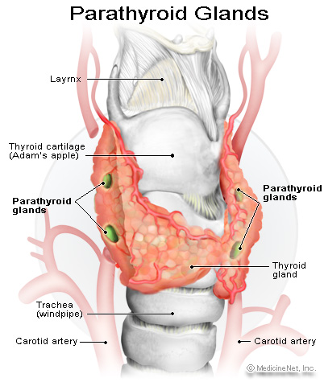
Hyperthyroidism
Because of the proximity of the parathyroid gland to the thyroid gland, hyperthyroidism can sometimes cause hyperparathyroidism

Slide 21
Malignancy
Second leading cause of hypercalcemia
Hypercalcemia is a biochemical marker for certain cancers
Tumors produce PTH-related peptide (PTH-rp), which binds to normal PTH receptors and causes increased Ca⁺⁺ levels
Assays are available

Slide 22
Thiazide Diuretics
Increase Ca⁺⁺ reabsorption leading to hypercalcemia

Slide 23
Prolonged Immobilization
Causes increased bone resorption
Further compounded by renal insufficiency

Slide 24
Symptoms of hypercalcemia
Mild hypercalcemia (10.5-12mg/dL) is asymptomatic
Moderate to severe calcium elevations include neurologic, GI and renal symptoms
Neurologic symptoms – drowsiness, weakness, depression, lethargy, and coma
GI symptoms- constipation, nausea, vomitting, anorexia and peptic ulcer
Renal symptoms- nephrolithiasis, nephrocalcinosis
calcium acts as a diuretic and impairs the ability of kidneys to concentrate urine. This can lead to dehydration, which further worsens hypercalcemia
Hypercalciuria can result in nephrogenic diabetes insipidus (polyuria-hypovolemia-hypercalcemia)

Slide 25
Treatment of hypercalcemia
Estrogen deficiency causes primary hyperparathyroidism in older women. ERT reduces calcium levels in post-menopausal women
Parathyroidectomy
Salt and water intake is encouraged to increase calcium excretion and avoid dehydration, which can compound hypercalcemia.
Discontinuation of thiazide diurectics
Biphosphonates and calcitonins are the main drug class used to lower calcium levels
Biphosphonates bind to bones and prevent bone resorption

