Slide 1
Human defense mechanisms. Natural Immunity.

Slide 2
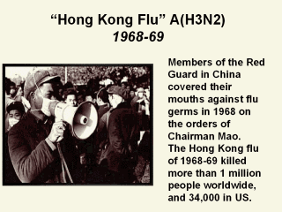

Slide 3
What mechanisms prevent infections ?
Important for survival .,infections can be devastating .

Slide 4
Historical observations .
1798 : Edward Jenner - vaccination (small pox ).
L. Pasteur - cholera & rabies vaccine.
1901 : von Behring - serum antitoxin .
( won the Noble prize in medicine )
1905 : Koch - cellular immunity to T.B.
1908 :Metchinkoff - phagocytosis .

Slide 5
Protective mechanisms : immunity.
The discipline : Immunology .

Slide 6
Mechanisms of protection ?
Various stimuli cause cell injury & induce a complex
vascular & cellular response called:
Inflammation.

Slide 7
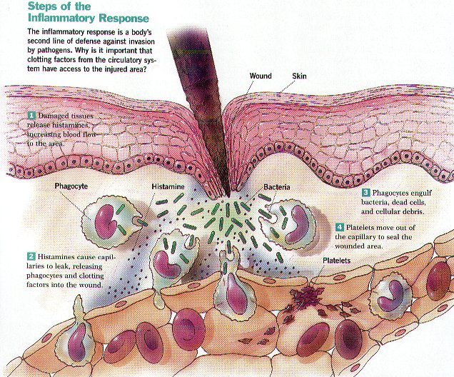
Inflammation : a complex vascular & cellular change

Slide 8
Cell injury can result from :
. Hypoxia.
Physical & chemical agents .
Microbial agents. (defective immunity).
Protective immune responses.
Immune reactions. (abnormal responses)
Genetic factors .
Nutritional imbalances.

Slide 9
Effectiveness of defense mechanisms determine pattern of infections.
Sub-clinical infections are common.
( no symptoms or signs ).
* important for maintenance of immunity
Clinical infections are quite rare.
( indicate failure to control infections).

Slide 10
All defense mechanisms are collectively called
immunity .
Natural ( innate )
non-specific.
Adaptive ( acquired )
Specific .
1. well-integrated.
2. Connected by many
inflammatory pathways.

Slide 11
Natural & Adaptive immunity differ in 3 main features :
1. Recognition of microbes.
cell receptors on phagocyte : limited.(fewer than 100 )
cell receptors on lymphocytes : diverse.( possibly up
to 10 / 18 different receptors )
2. Effector protective mechanisms .
natural immunity: non-specific .
adaptive immunity : specific .
3. Immunologic memory.
(no retention of memory with
natural immunity )

Slide 12
Effector mechanisms of natural immunity .
1. Anatomic barriers :
A. the skin : Mechanical barrier retards entry of microbes.
acidic environment (pH 3–5) retards growth microbes.
Normal flora compete with microbes for attachment sites and nutrients.
B. The mucus membranes :
* Mucus secreted by goblet cells entraps foreign bodies & microbes .
Cilia propel microorganisms out of the body by sneezing or coughing .
( mucocilliary - escalator system )

Slide 13
Effects of barrier disruptions :
* Burns , cut wounds , skin diseases (eczema)
(predispose to infections.)
* Aseptic techniques. ( taking a blood sample,
I / V catheters etc. )
* Disruption of the mucus membrane.
( dental procedures )

Slide 14
2. Physiologic barriers :
Temperature: Normal body temperature inhibits growth of some pathogens.
( fever inhibits growth of pathogens.)
Low pH Acidity: of stomach contents kills most ingested microbes.
Chemical mediators: Lysozyme cleaves bacterial cell wall.
Collectins : disrupt cell wall of pathogens.
Natural antibiotics : defensins , cryptidins.

Slide 15
Physiologic functions :
* Coughing , sneezing , voiding urine,
tears , saliva in oral cavity etc.
* Inability to cough ( chest trauma, muscle
disease )
* Urine retention .
( when absent predispose to infections).

Slide 16
Circulating effector cells
1. Neutrophils
.
2. Macrophages.
3. Natural killer (NK) cells. (viral immunity).
4. Eosinophils, (parasitic immunity).
5. Mast cells , (mediators of inflammation ).

Slide 17
6. platelets ( coagulation ). 7. B-1 cells ( distinct from B-2 cells ) found in fetus & neonates . Carry mainly IgM & CD5 . Found mainly in peritoneum & respond to bacterial antigens,( polysaccharides )

Slide 18
Toll - like receptors (TLRs) ,recognize Lipopolysaccharides (LPS)
on gram negative bacteria .
Phagocytic cells recognize pathogens by
surface receptors
Pattern-recognition receptors on phagocytic cells recognize
(PAMPs )
Pathogen - associated molecular patterns on microbes.

Slide 19
Neutrophils :
Mediate the early phase of
inflammation.
* They are recruited to the site of infections
by a process called chemotaxsis.
* Chemotactic agents , cytokines & adhesion
molecules are important factors in the
process of chemotaxis .

Slide 20
Neutrophils :
* comprise ( 60 -70 percent. O f the WBC.)
* Short - lived cells.
* phagocytose extra - cellular microbes .
* Contain enzymes.
* Perform killing by:
- Oxygen - dependent mechanisms.
- Oxygen - independent mechanisms.

Slide 21
Chemotaxis of phagocytic cells involve
the following steps :
1. Rolling ( loose adherence ) to
endothelium.
2. Activation of cells.
3. Stable adherence to endothelium.
4. Transmigration into tissue spaces.

Slide 22
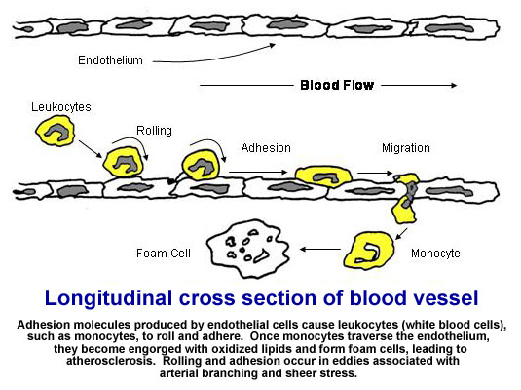

Slide 23
Mononuclear cells .
* Monocytes & Macrophages .
- Long - lived cells.
- Contain enzymes & secrete
many cytokines .
- phagocytose intra-cellular microbes.
* Professional phagocytic cells.
* Antigen – presenting cells
*important in both natural & adaptive immunity.

Slide 24
Circulating monocytes enter tissues & become
resident macrophages .
1. Sub- epithelial connective tissue.
2. Interstitia of organs .
3. Vascular sinusoids of the liver & spleen.
4. Lymph nodes .
(They constitute the mononuclear
phagocyte system )

Slide 25
Macrophages are strategically located at sites where
Microbes enter the tissues .
They recognize microbes first by their receptors (PRR )
become activated ,secrete cytokines and attract
Neutrophils .

Slide 26
Macrophages are activated by
Bacterial products.
LPS.
(gram neg. bacteria)
Bacterial DNA
Secrete cytokines, attract neutrophils
Induce local inflammation.

Slide 27
Macrophages produce many cytokines :
1. IL-1.
2. TNF.
3. IL-6.
4. IL-8.
5. IL-12.
Act on various
tissues & cells .

Slide 28
And perform multiple functions :
1. Induce local inflammation.
2. Perform phagocytosis.
3. Activate coagulation .
4. Enhance antigen presentation.
5. Initiate tissue repair .

Slide 29
Functions of macrophages :
Invading agent
Antigen presentation
Activated macrophage
Macrophage
Macrophage
Macrophage
Th
cell
Activate
Cytokines
Cytokines
Anti-microbial functions
Lymphokines
Anti-tumor function

Slide 30
Mechanism of intracellular killing by phagocytic cells
1. Lysosomal enzymes .
2. Production of reactive oxygen
intermediates .
3. Production of nitric oxide .

Slide 31
NK-cells are activated by :
1. IL-12.
2. IL-15.
Produced by macrophages.
Functions:
1. anti - viral activity.
2. anti – tumor activity.

Slide 32
The complement system
The complement system consists of more than 30 soluble & cell - bound proteins in normal human serum.
They are synthesized mainly by the liver,
monocytes , macrophages & epithelial cells.
They circulate in inactive forms as proenzymes
or zymogens.
Complement proteins are designated by numerals
C1 - C9 or by letters (factor D).

Slide 33
4. Circulating effector proteins :
The complement proteins .
Activation of the complement system lead to initiation of important effects which include :
1. Release of chemotactic factors .(C3a,
C5a )
2. Opsonization of microbes .(C3b ).
3. Lysis of target cells . (C8 & C9 ).

Slide 34
The complement system .
*on activation acquire enzymatic activity.
Become activated by 3 pathways :
1. classical pathway, require antigen antibody
2. alternative pathway , activated by bacterial
products (LPS ,DNA )
3. lectin pathway , activated by mannan-binding lectin.

Slide 35
Pathways of complement activation
Classical
Pathway.
Lectin
Pathway.
Alternative
Pathway.
antibody
dependent
antibody
independent
Activation of C3 and
Generation of C5 convertase
activation of C5.
Lytic attack pathway.( C8.C9. )

Slide 36
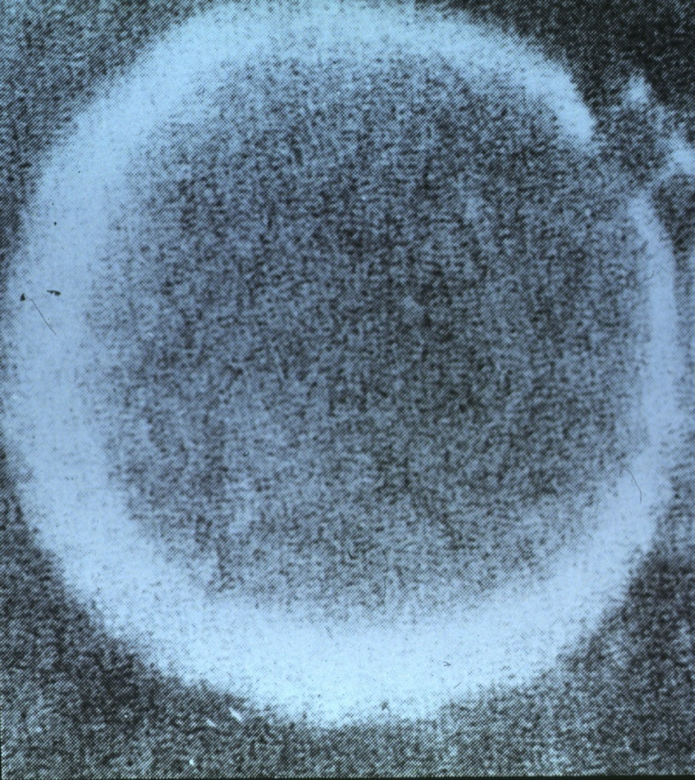
MEMBRANE ATTACK COMPLEX .
C6
C8
C7
C5
b
C
9
C
9
C
9
C
9

Slide 37
Other circulating effecter proteins :
1. Mannose- binding lectin .
2. C – reactive protein
.
3. Coagulation factors.
4. Cytokines .

Slide 38
Cytokines of natural immunity coordinate
body responses to infection :
The cytokines IL-1 , IL-6 & TNF-alpha
act on various organs which include :
1. the liver to induce the synthesis of acute phase proteins.
2. the bone marrow to stimulate mobilization of neutrophils .

Slide 39
3. the hypothalamus to increase body temperature.
( induce fever )
4. Fat & muscle to supply proteins & energy.
5. acts on T- & B- Lymphocytes to become activated and ready to produce adaptive immune responses.

Slide 40
Summary .
1. Natural Immunity is the first line
of defense.
2. It influence & stimulate subsequent
adaptive immune responses .
3. The immune response is a :
* Protective.
* Sub clinical .
* Localized reaction.

