Slide 1
Cell Mediated Immunity
(CMI)
Prof. Dr. Zahid Shakoor
MBBS, Ph D (London)
College of Medicine
King Saud University

Slide 2
Cell-Mediated Immunity (CMI)
Antigen
T-lymphocytes
Immune responses
Notes:
2

Slide 3
Cell Mediated Immunity
Cell-mediated immunity (CMI).
T cells (lymphocytes) bind to the surface of other cells (Antigen Presenting Cells) that display the antigen and trigger a response

Slide 4
Antigen Presenting cells
Monocytes : Peripheral blood
Macrophages : Tissues
Dendritic cells : Lymphoid tissues
Langerhans cells : Epidermis
B-cells : Lymphoid tissue, Blood
Notes:
4

Slide 5
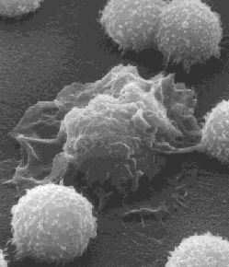
Lymphocyte
Macrophage
Lymphocyte

Slide 6
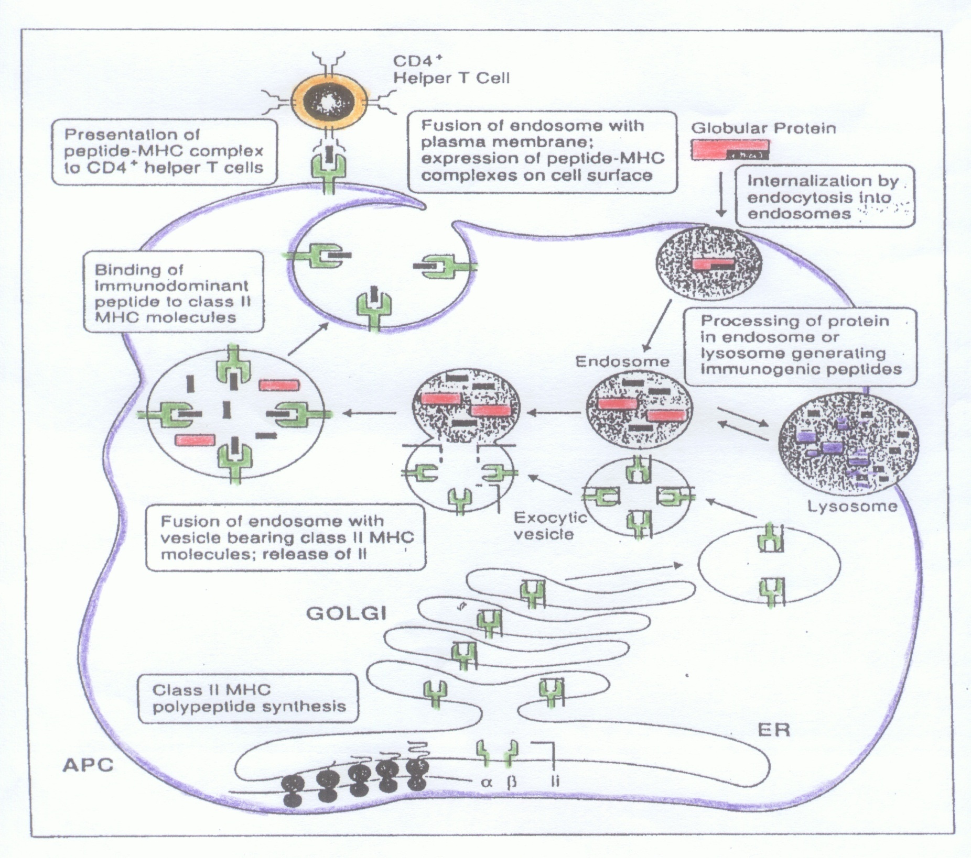
6
1
5
4
2
3
Invariant chain(Ii)

Slide 7
T cell Activation Antigen Presentation

Slide 8
T cell Activation Antigen Presentation

Slide 9
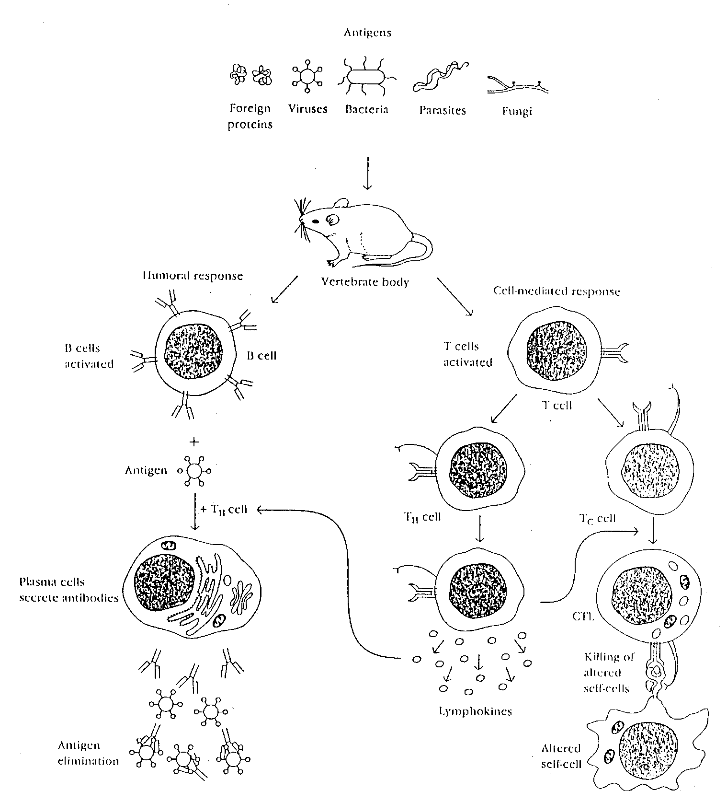
CMI
T lymphocytes
Other cells
Notes:
9

Slide 10
1. Endogenous antigen
2. Exogenous antigen

Slide 11
Virus
Target cell

Slide 12
Target cell

Slide 13
Target cell

Slide 14
Target cell
Host cell
Transcription
Translation
Viral protein

Slide 15
Exogenous antigen
Microbes
Proteins
Cell-mediated immunity
Notes:
15

Slide 16
Exogenous antigen
CD4+ T-lymphocytes
(CD4+ cells)
Class II MHC
APC
CMI
APC
Antigen presenting cells
Monocytes/Macrophages
Dendritic cells
Langerhans cells
B-cells
Notes:
16

Slide 17
6
1
5
4
2
3
Invariant chain(Ii)

Slide 18
TCR-MHC interaction
T cells
T cells
T cells
TCR
TCR
TCR
X
X
Y
MHC
MHC
MHC
APC
APC
APC
Recognition
No Recognition

Slide 19
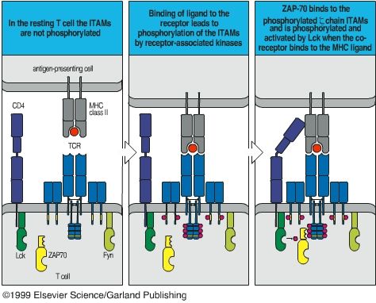
CD4-MHC class II interaction
Antigen presenting cell
Antigen presenting cell
Antigen presenting cell
CD4
MHC class II
CD4
CD4
TCR
T cell
T cell
T cell

Slide 20
Cell-Mediated Immunity
Lymphocytes: (B & T lymphocytes)
B lymphocytes ("B cells"): These are responsible for making antibodies (humoral immunity)
T lymphocytes ("T cells"): CMI
Subsets include:
CD8+ cytotoxic T lymphocytes (CTLs) that kill virus-infected and tumor cells
CD4+ helper T cells enhance CMI and production of antibodies by B cells

Slide 21
Cell-Mediated Immunity
Examples of Cell-Mediated Immunity
Delayed-Type Hypersensitivity (DTH): the tuberculin test (or Mantoux test)
Tuberculosis: a chronic disease, caused by Mycobacterium tuberculosis
The response to tuberculin is called "delayed" because of the time it takes to occur (in contrast to the "immediate" responses characteristic of many antibody-mediated sensitivities like an allergic response to a bee sting).

Slide 22
Cell Mediated Immunity
DTH is a cell-mediated response
Anti-tuberculin antibodies are rarely found in tuberculin-positive people
The T cells responsible for DTH are members of the CD4+ subset

Slide 23
Cell-Mediated Immunity
Contact Sensitivity
Many people develop rashes on their skin following contact with certain chemicals such as nickel, certain dyes, and the active ingredient of the poison ivy plant
The response takes some 24 hours to occur, and like DTH, is triggered by CD4+ T cells
The actual antigen is probably created by the binding of the chemical to proteins in the skin
The fragments of antigen are then presented to CD4+ T cells by phagocytic cells in the skin by antigen presentation

Slide 24
Activation of helper T cells
Requires recognition of antigen complex on the surface of antigen-presenting cells eg, macrophages consisting of both antigen and class II MHC proteins
Viral antigens are recognized in association with class I MHC proteins
This is called MHC restriction

Slide 25
Cellular Basis of Immune Response
Two signals are required to activate T cells
First signal
Class II MHC + antigen – TCR
IL-1, LFA-1 with ICAM
Second signal (Costimulatory signal)
B7 on APC interacts with CD28 on lymphocyte

Slide 26
T cell Activation
In the absence of co-stimulatory signal state of unresponsiveness called “anergy” develops
Production of co-stimulatory protein depends on activation of the toll like receptor on antigen presenting cell
Foreign antigens such as bacterial proteins induce B7 protein where as self proteins do not

Slide 27
T cell Activation
Consequent to antigen recognition by TCR, signal is transmitted through CD3 molecule
This results in influx of calcium into the cell
Calcium activates calcineurin
Calcineurin activates gene for IL-2 and its receptor

Slide 28
Out come of T helper cell activation
Production of IL-2 and its receptor
IL-2 is also know as T cell growth factor
Proliferation of antigen specific T cells
Effector and regulatory cells are produced along with “memory” cells
IL-2 also stimulates CD8 cytotoxic cells

Slide 29
Out come of T helper cell activation
Production of Gamma Interferon (IFγ)
It increases expression of Class II MHC proteins
It enhances the ability of APC to present antigen to T cells
It enhances the microbicidal activity of macrophages
Enhances immune response

Slide 30
Out come of T helper cell activation
Memory T cells
Respond rapidly for many years after initial exposure to antigen
A large number of memory cells are produced so that the secondary response is greater than the primary
Memory cells live for many years and have the capacity to multiply
They are activated by smaller amount of antigen
They produce greater amounts of interleukins

Slide 31
Effector functions of T cells
Delayed type of hypersensitivity mediated by Th-1 type of CD4 positive cells
Cytotoxicity: mediated by CD8 +ve cells.
Directed against virus infected cells, tumor cells and allografts

Slide 32
Killing by cytotoxic cells
Perforins
Granzymes – degrading enzymes
Fas-Fas Ligand interaction - apoptosis
Antibody dependent cellular cytotoxicity
Immune surveillance
Allograft rejection

Slide 33
Killing Mechanisms of Cytotoxic T cells

Slide 34
Activation of B cells
B cell functions as APC
Multivalent antigen binds to surface IgM
Cross links adjacent Ig molecules
Igs aggregate to form “patches” and migrate to one pole to form a cap
Capped material is endocytosed
Antigen is processed and epitopes appear on the cell surface in association with Class II MHC proteins

