Slide 1
Hypersensitivity reactions.
Prof. Mohamed Osman GadElRb.
College of Medicine & KKUH.

Slide 2
Immune reactions leading to pathological damage .( intense inflammatory responses ).
- Occur as :
1.Secondary heightened (increased) immune
responses .
OR:
2.Secndary inappropriate (abnormal ) immune
responses.
Introduction :

Slide 3
Four major categories according to Coombs and Gell classification :
Type I : Immediate H/S.
Type II : Cytotoxic H/S.
Type III : Immune – complex H/S.
Type IV : Delayed H/S.

Slide 4
Types I , II and III :
are mediated by antibodies .
( The complement system become activated & contribute to tissue damage ).
Type IV :
Is generated by cell-mediated immune
responses.
( no complement activation )

Slide 5
Time course ; Hypersensitivity reactions differ in the rate at which they occur :
Type I : Can occur within minutes after exposure
to allergens .
Type II and III : time course , (4-8) hours to days .
Type IV : require 2 - 4 days. ( delayed ).

Slide 6
Clinical presentation:
Hypersensitivity reactions :
- can occur as isolated reactions,
OR :
- more than one reaction may occur
in the same patient.
e.g. : Type I and Type III.

Slide 7
Type I Hypersensitivity.
Also termed :
*Immediate H/S ( can literally occur within minutes to hours ).
* Anaphylactic reactions .
OR :
* Allergic reactions.

Slide 8
Features :
Antibody isotype : IgE .(less frequently may be due to
STS IgG .)
- Cellular components:
Mast cells , basophiles & eosinophils.
- Antigens :
termed allergens ( antigens with low
molecular weight & highly soluble.)

Slide 9
Type I H/S.
Evolved as a defense against parasitic infections.
( the hygiene theory ? )
* However , many reactions in some predisposed individuals are directed towards harmless molecules (allergens) and these individuals are said to be :
“atopic.”
( atopy : from the Greek atopos , meaning out of place ).

Slide 10
Atopy.
Occur in certain genetically predisposed
individuals who develop one or more of the atopic diseases :
allergic rhinitis, asthma, and atopic dermatitis .
They comprise approx. 15 – 20 % of the
population .
Atopy tend to run in families .

Slide 11
The likelihood to generate a strong IgE response is
determined by :
- genetic factors .
- environmental factors.
these factor depend on exposure to allergens of diverse nature :
( pollens , foods , drugs
fungal spores , bee - sting venoms ,
house dust mites and animal dander).

Slide 12
Response to allergens in non-atopic individuals:
Adults and children without atopy mount a low – grade
response , they produce allergen-specific IgG1 & IgG4.
Persons with atopy ,by contrast, produce an exaggerated
response characterized by production of :
allergen –specific IgE antibodies.

Slide 13
Type I Reaction occur in 2 phases:
Phase I :
- Sensitization phase .
Allergen enter tissues , induce an
immune response . B – cells transform
to plasma cells & produce IgE.
- IgE bind to receptors on Mast cells and
basophiles ( F c ЄRI - high affinity receptors).
individuals become :
“ Sensitized . “

Slide 14
Phase II :
Challenge phase .
- Subsequent encounter with same allergen cross – link IgE on Mast cells .
- This generate an intracellular signal that prompts the Mast cells to:
“ Degranulate”.
(release mediators into the area of reaction).

Slide 16
Degranulation :
The release of a wide variety of mediators of inflammation .
These exert effects on surrounding target tissues.
There are 2 types :
1. primary mediators.
2. secondary mediators.

Slide 17
Primary mediators.
1. Histamine , heparin.
2. Serotonin .
3. Eosinophil chemotactic factor.
( ECF).
4. Neutrophil chemotactic factor (NCF ).
5. Proteases .

Slide 18
Secondary mediators :
1. Platelet activating factor .
2. Leukotriens ( slow reacting substance of anaphylaxis).
3. Prostaglandins .
4. Bradykinin.
5. Cytokines .( IL-1,TNF-a , IL-2 , 3, 4, 5, 6, )

Slide 19
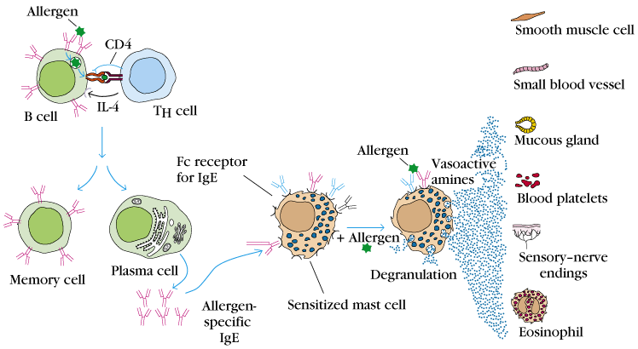
Type 1 H/S. ( immediate hypersensitivity ).

Slide 20
Type 1 reactions result in :
* Vasodilatation and increased capillary
permeability .
* Edema.
* Vasoconstriction ( arteries and arterioles ).
* Bronchoconstriction.
* Increased mucus secretion.

Slide 21
Symptoms of type I reactions are determined by site of location of the allergens :
Inhaled allergens : →
deposit in nasopharyngeal and bronchial tissues result in :
- Allergic rhinitis.
- Allergic asthma.
Ingested allergens (oral route ) :
food allergy (G.I.T symptoms).

Slide 22
Bee sting allergens → Injected into the blood.
→ Systemic inflammation.
→ Anaphylactic shock.
(life - threatening).
Anaphylactoid reactions:-
are non - IgE mediated.
may result from contrast media or
local anesthetics.

Slide 23
Diagnosis:-
1. Skin prick test (SPT).
2. Intradermal test.
3. Specific IgE measurement (RAST).
4. Challenge test ( Nasal , Bronchial).
5. Elimination / Provocation test (Food allergy).

Slide 24
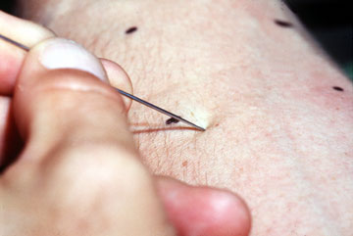
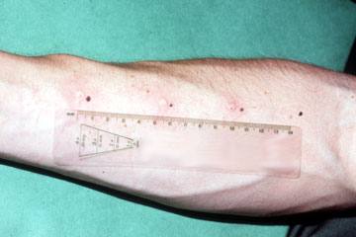
Skin prick test ( diagnosis of type 1 hypersensitivity ).

Slide 25
Type II Hypersensitivity. (Cytotoxic H/S).
Features:-
- IgG.
- Antigens ( Bound to cell membranes
or extra cellular matrix).
- source of antigens :
- Self - antigens.
- Exogenous antigens. (microbial ).
- Complement activation (Invariable).

Slide 26
Mechanisms of tissue damage in type 11:-
IgG (from blood) fix to tissue - bound antigen.
- Activate complement.
- Complement generate
chemotactic agents (C5a).
- Attract neutrophils and other
inflammatory cells.

Slide 27
Neutrophils bind to target through:-
A. Complement receptors -(immune -adherence).
B. Antibody receptors - (Opsonic -adherence).
- They secrete their enzymes to the
outside (Exocytosis).
- They cause direct damage.

Slide 28
Complement - mediated damage (type11):-
Activation of complement → C8 , C9.
- Membrane attack complex
(MAC).
- Direct lytic damage on target
\ tissues.

Slide 29
Mechanism of damage in type II H/S.

Slide 30
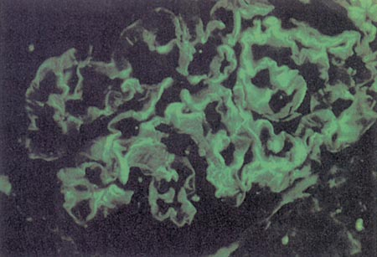
Type 11 H/S.( Glomerulonephritis anti-GBM ).

Slide 31
Clinical Examples ( type 11):-
1, Incompatible blood transfusion (ABO).
-massive intravascular hemolysis of RBC.
-Immediate reactions-IgM mediated.
-Delayed reactions-(2-6 days ),IgG mediated.
2. Hemolytic disease of the new -born (HDN).

Slide 32
Diagnosis:-
- Detection of antibodies and antigens by Immunofluoresence in tissue biopsy specimens e.g. kidney , skin etc.

Slide 33
Type III Hypersensitivity ( immune – complex H/S .)
Features:-
- IgG or IgM.
- Soluble antigens.
- Immune – Complex formation.
- Complement activation.
(invariable).

Slide 34
Mechanism of tissue damage (type 111):-
Immune - Complexes are continuously forming.
- Depend on the nature and conc. of
antigens and antibodies.
- As long as they are not :-
- Extremely large.
- Numerous.
they are readily cleared.

Slide 35
Immune complex clearance :
1. The mononuclear- Phagocyte system.
- Macrophages and dendritic cells
degrade particles and debris.
2. Erythrocytes bind complexes via FcR1
receptors and release them in the liver.

Slide 36
When size and quantity over whelm the normal clearance mechanism:-
1. Complexes accumulate and deposit in
blood vessels and tissues.
2. They activate complement.
Therefore : induce immune - complex
disease.

Slide 37
Mechanism of tissue damage (type 111):
Complexes deposit in blood vessels and tissues and result in vasculitis , arthritis …et
.
Two main types :
1. Complexes with antibody excess ,
are termed Arthus – type reactions .
( localized ).
2. Complexes with antigen excess ,
are termed serum – sickness reactions .
( systemic ). .

Slide 38
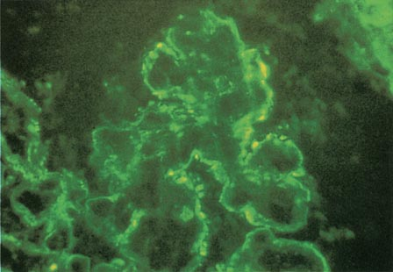
Type 111 H/S.( Glomerulonephritis ).

Slide 39
Clinical examples (type 111) :
1. Autoimmune disease ,(self – antigens ).
2. Chronic infections ,(microbial antigens)
.
3. Cancer , (tumor antigens).
4. Drug reactions , (chemical haptens ).

Slide 40
Diagnosis (type 111) :
Demonstration of specific immune complexes in the blood or tissues by:
Immunofluoresence .

Slide 41
Type IV hypersensitivity ( delayed H/S ):
Features :
- cell-mediated (CD 4 T-cells).
- activated macrophages .
- delayed- onset (2 – 4 days).
- secondary abnormal cellular responses .
- granuloma formation .

Slide 42
Type IV H/S.
Four subtypes :
1. Basophil H/S ( Jones-mote reaction ).
2. Contact sensitivity ( chemical antigens )
.
3. Tuberculin reactions ( mantoux test )
4. Granuloma formation .

Slide 43
Mechanism of tissue damage (type 1v ):
Sensitized CD 4 Th1-cells recognize antigen.
Become activated and secrete cytokines .
Attract and activate macrophages .
This lead to intense inflammation that
cause permanent damage .

Slide 44
DTH responses to persistent antigen :
Lead to formation of a granuloma .
This prevent spread of infection e.g. T.B. tubercle .
May cause local mechanical pressure on adjacent tissues e.g. leprosy .

Slide 45
Type 1V H/S. (granuloma .)

Slide 46
Clinical examples( type 1v ):
1. Chronic infections :
- T.B.
- leprosy .
- fungal infections .
-parasitic infections.
2. Contact dermatitis .

Slide 47
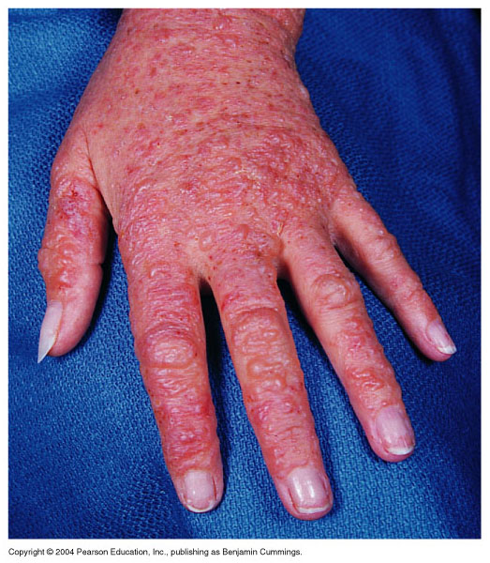
Type 1V H/S. ( contact dermatitis ).

Slide 48
Diagnosis (type 1v ):
1. Delayed skin test .
2. Patch test.
3. Lymphocyte transformation test.
( detection of activation markers by flow cytometry ).

Slide 49
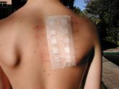
Patch test .

