Slide 1
Reparatory tract infection
Dr. Fawzia AL-Otaibi

Slide 2
Pneumonia
Your body has mechanisms to protect your lungs from infection. In fact, you're frequently exposed to bacteria and viruses that can cause pneumonia, but your body normally prevents most of these organisms from invading and overwhelming your airways. For example, the nasal cilia screen out a lot of organisms but can't stop all from getting into your airways. Sometimes — for reasons that aren't always well understood — these microorganisms can get past your body's defenses, finally finding their way into your lungs' air sacs.

Slide 3
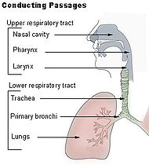

Slide 4
Upper respiratory tract infections, (URTI or URI), are the illnesses caused by an acute infection which involves the upper respiratory tract: nose, sinuses, pharynx or larynx.

Slide 5
Signs and symptoms
Acute upper respiratory tract infections include rhino-sinusitis (Common cold), sinusitis, pharyngitis/tonsillitis, ear infection, laryngitis and sometimes bronchitis. Symptoms of URTI's commonly include cough, sore throat, runny nose, blocked nose, phlegm, headache, fever, facial pressure, extreme sensibility to cold and warm weather and sneezing. Onset of the symptoms usually begins after 1-3 days after

Slide 6
exposure to a microbial pathogen, most commonly a virus. The duration of the symptoms is typically 7 to 10 days but may persist longer.
Up to 15% of acute pharyngitis cases may be caused by bacteria, commonly Group A streptococcus in Streptococcal pharyngitis ("Strep Throat"). Generally, patients with strep throat start with a sore throat as their first symptom and usually do not have runny nose or cough or sneezing.
Pain and pressure of the ear caused by a middle ear infection (Otitis media) and the reddening of the eye caused by Viral Conjunctivitis are often associated with upper respiratory infections.
Influenza (the flu) is a more systemic illness which can also involve the upper respiratory tract.

Slide 7
Viral pharyngitis
These comprise about 40-60% of all infectious cases and can be a feature of many different types of viral infections.^{[2]}
Adenovirus - the most common of the viral causes. Typically the degree of neck lymph node enlargement is modest and the throat often does not appear red, although is very painful.
Orthomyxoviridae which cause influenza - present with rapid onset high temperature, headache and generalised ache. A sore throat may be associated.
Infectious mononucleosis ("glandular fever") caused by the Epstein-Barr virus. This may cause significant lymph gland swelling and an exudative tonsillitis with marked redness and swelling of the throat. The heterophile test can be used if this is suspected.
Herpes simplex virus can cause multiple mouth ulcers.
Measles
Common cold virus: rhinovirus, coronavirus, respiratory syncytial virus, parainfluenza virus can cause infection of the throat, ear, and lungs causing standard cold-like symptoms and often extreme pain.
Primary HIV

Slide 8
Bacterial pharyngitis
A number of different bacteria can infect the human throat. The most common is Group A streptococcus, however others include, Corynebacterium diphtheriae, Neisseria gonorrhoeae, Chlamydophila pneumoniae, and Mycoplasma pneumoniae.^{[3]}

Slide 9
Causes
2.1 Viral pharyngitis
2.2 Bacterial pharyngitis
2.2.1 Streptococcal pharyngitis
2.2.2 Diphtheria

Slide 10
Pneumonia
There, white blood cells (leukocytes), a key part of your immune system, begin to attack the invading organisms. The accumulating pathogens, white cells and immune proteins cause the air sacs to become inflamed and filled with fluid, leading to the difficult breathing that characterizes many types of pneumonia

Slide 11
Classifications of pneumonia Pneumonia is sometimes classified according to the cause of pneumonia:
Community-acquired pneumonia.
This refers to pneumonia you acquire in the course of your daily life — at school, work or the gym, for instance.
Hospital-acquired (nosocomial) pneumonia.
If you're hospitalized, you're at a higher risk of pneumonia, especially if you are on a mechanical ventilator, are in the intensive care unit or have a compromised immune system. This type of pneumonia can be extremely serious, especially for older adults, young children and people with chronic obstructive pulmonary diseases (COPD) or HIV/AIDS.

Slide 12
Aspiration pneumonia.
This type of pneumonia occurs when foreign matter is inhaled (aspirated) into your lungs — most often when the contents of your stomach enter your lungs after you vomit. This commonly happens when a brain injury or other condition affects your normal gag reflex.

Slide 13
Pneumonia caused by opportunistic organisms.
This type of pneumonia strikes people with compromised immune systems. Organisms that aren't harmful for healthy people can be extremely dangerous for people with AIDS, organ transplantation and other conditions that impair the immune system. For example, P. carinii pneumonia almost never occurs in otherwise healthy people. Medications that suppress your immune system, such as corticosteroids or chemotherapy also can put you at risk of opportunistic pneumonia.

Slide 14
Emerging pathogens.
Outbreaks of the H1N1 influenza (swine flu) virus has caused serious, sometimes deadly pneumonia infections, even in otherwise healthy people.

Slide 15
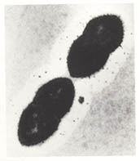
Etiology
The most common cause of a bacterial pneumonia is Streptococcus pneumoniae.
In this form of pneumonia, there is usually an abrupt onset of the illness with shaking chills, fever, and production of a rust-colored sputum. The infection spreads into the blood in 20%-30% of cases, and if this occurs, 20%-30% of these patients die

Slide 16
Pneumococcal pneumonia
Two vaccines are available to prevent pneumococcal disease; the pneumococcal conjugate vaccine (PCV7; Prevnar) and the pneumococcal polysaccharide vaccine (PPV23; Pneumovax). The pneumococcal conjugate vaccine is part of the routine infant immunization schedule in the U.S. and is recommended for all children < 2 years of age and children 2-4 years of age who have certain medical conditions. The pneumococcal polysaccharide vaccine is recommended for adults at increased risk for developing pneumococcal pneumonia including the elderly, people who have diabetes, chronic heart, lung, or kidney disease, those with alcoholism, cigarette smokers, and in those people who have had their spleen removed

Slide 17
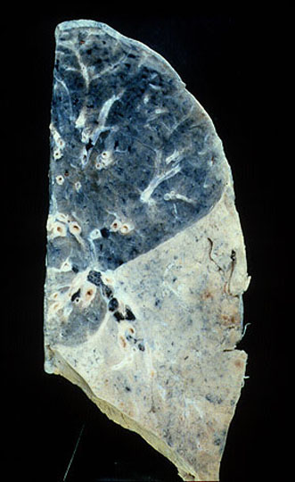
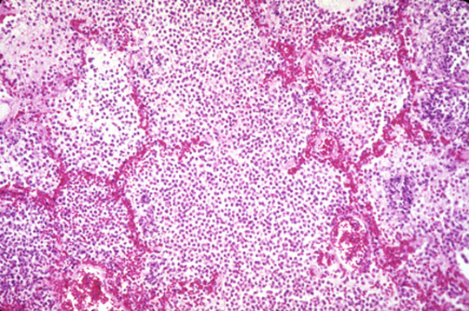
Diagnosis
Clinical
CBC- leukocytosis, left shift
Sputum, blood culture
CXR- lobar pneumonia, consolidation.

Slide 18
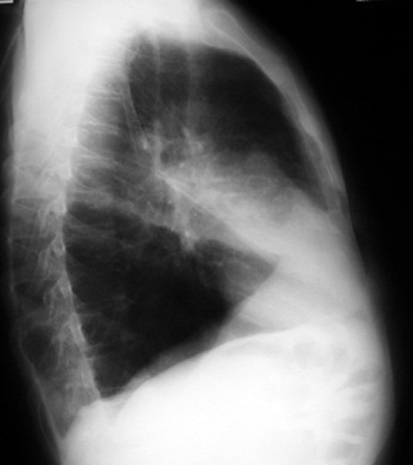

Slide 19
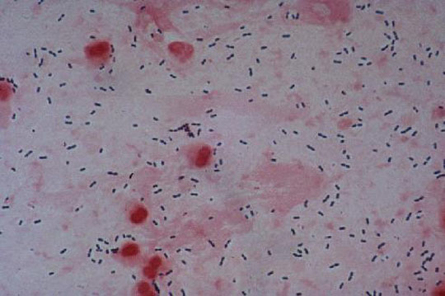
Sputum gram stain-gram positive diplococcic , pus cells

Slide 20
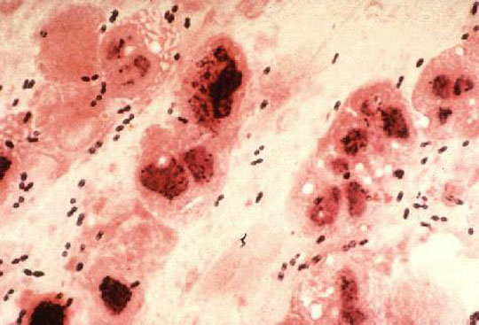
Gram-positive diplococcic

Slide 21
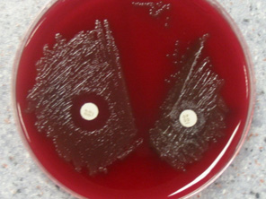

Slide 22
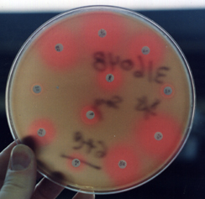

Slide 23
treatment
Antibiotics often used in the treatment of this type of pneumonia include penicillin, amoxicillin and clavulanic acid (Augmentin, Augmentin XR), and macrolide antibiotics including erythromycin, azithromycin (Zithromax, Zmax), and clarithromycin (Biaxin). Penicillin was formerly the antibiotic of choice in treating this infection. With the advent and widespread use of broader-spectrum antibiotics, significant drug resistance has developed. Penicillin may still be effective in treatment of pneumococcal pneumonia, but it should only be used after cultures of the bacteria confirm their sensitivity to this antibiotic

Slide 26
Klebsiella pneumoniae and Hemophilus influenzae
are bacteria that often cause pneumonia in people suffering from chronic obstructive pulmonary disease (COPD) or alcoholism. Useful antibiotics in this case are the second- and third-generation cephalosporins, amoxicillin and clavulanic acid, fluoroquinolones (levofloxacin [Levaquin], moxifloxacin-oral [Avelox], gatifloxacin-oral and sulfamethoxazole and trimethoprim [Bactrim]).

Slide 27
Mycoplasma pneumoniae
is a type of bacteria that often causes a slowly developing infection. Symptoms include fever, chills, muscle aches, diarrhea, and rash. This bacterium is the principal cause of many pneumonias in the summer and fall months, and the condition often referred to as "atypical pneumonia." Macrolides (erythromycin, clarithromycin, azithromycin, and fluoroquinolones) are antibiotics commonly prescribed to treat Mycoplasma pneumonia.

Slide 28
Legionnaire's disease
is caused by the bacterium Legionella pneumoniae that is most often found in contaminated water supplies and air conditioners. It is a potentially fatal infection if not accurately diagnosed. Pneumonia is part of the overall infection, and symptoms include high fever, a relatively slow heart rate, diarrhea, nausea, vomiting, and chest pain. Older men, smokers, and people whose immune systems are suppressed are at higher risk of developing Legionnaire's disease. Fluoroquinolones are the treatment of choice in this infection. This infection is often diagnosed by a special urine test looking for specific antibodies to the specific organism.

Slide 29
Mycoplasma, Legionnaire's, and another infection, Chlamydia pneumoniae, all cause a syndrome known as "atypical pneumonia." In this syndrome, the chest x-ray shows diffuse abnormalities, yet the patient does not appear severely ill. These infections are very difficult to distinguish clinically and often require laboratory evidence for confirmation.

Slide 30
Pneumocystis carinii pneumonia is another form of pneumonia that usually involves both lungs. It is seen in patients with a compromised immune system, either from chemotherapy for cancer, HIV/AIDS, and those treated with TNF (tumor necrosis factor), such as for rheumatoid arthritis. Once diagnosed, it usually responds well to sulfa-containing antibiotics. Steroids are often additionally used in more severe cases.

Slide 31
Recently, one of these resistant organisms from the hospital has become quite common in the community. In some communities, up to 50% of Staph aureus infections are due to organisms resistant to the antibiotic methicillin. This organism is referred to as MRSA (methicillin-resistant Staph aureus) and requires special antibiotics when it causes infection. It can cause pneumonia but also frequently causes skin infections. In many hospitals, patients with this infection are placed in contact isolation

Slide 32
Viral pneumonia
Viral pneumonias do not typically respond to antibiotic treatment. These infections can be caused by adenoviruses, rhinovirus, influenza virus (flu), respiratory syncytial virus (RSV), and parainfluenza virus (that also causes croup). These pneumonias usually resolve over time with the body's immune system fighting off the infection. It is important to make sure that a bacterial pneumonia does not secondarily develop. If it does, then the bacterial pneumonia is treated with appropriate antibiotics. In some situations, antiviral therapy is helpful in treating these conditions

Slide 33
Fungal pneumonia
Fungal infections that can lead to pneumonia include histoplasmosis, coccidiomycosis, blastomycosis, aspergillosis, and cryptococcosis. These are responsible for a relatively small percentage of pneumonias in the United States. Each fungus has specific antibiotic treatments, among which are amphotericin B, fluconazole (Diflucan), penicillin, and sulfonamides.

Slide 34
