Slide 1
ACUTE AND CHRONIC INFLAMMATION
Morphologic Patterns
Systemic manifestation

Slide 2
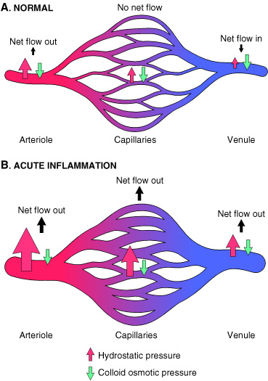

Slide 3
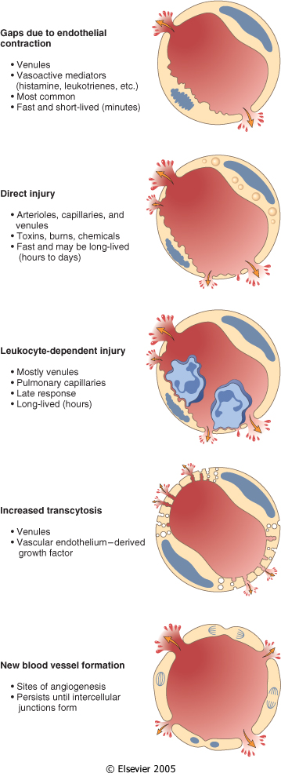

Slide 4
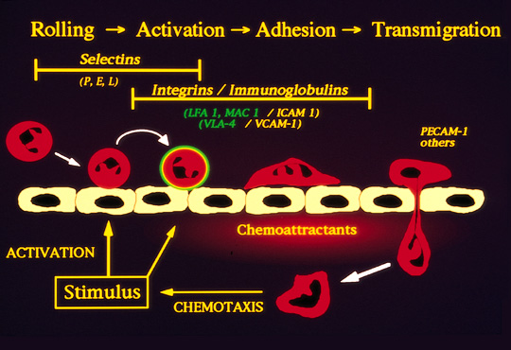

Slide 5
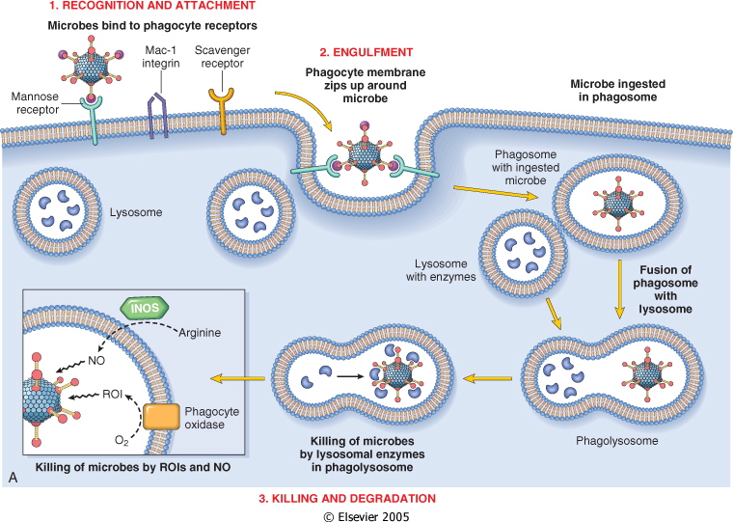

Slide 6
Objectives
Patterns of Acute Inflammation
Outcomes of Acute Inflammation
Patterns of chronic Inflammation
Systemic manifestation

Slide 7
Objectives
Patterns of Acute Inflammation
Outcomes of Acute Inflammation
Patterns of chronic Inflammation
Systemic manifestation

Slide 8
Morphologic Patterns of Acute Inflammation
Several types of inflammation vary in their morphology and clinical correlates. Why?
The severity of the reaction
specific cause
the particular tissue
site involved

Slide 9
Morphologic Patterns of Acute Inflammation
SEROUS INFLAMMATION
FIBRINOUS INFLAMMATION
SUPPURATIVE OR PURULENT INFLAMMATION
ULCERS

Slide 10
Patterns of Acute Inflammation
SEROUS INFLAMMATION:
Serous inflammation is marked by the outpouring of a thin fluid
e.g. the skin blister resulting from a burn or viral infection represents a large accumulation of serous fluid

Slide 11
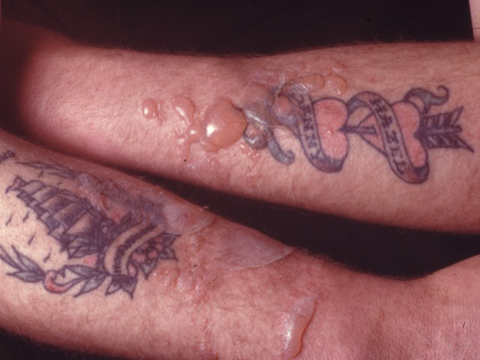

Slide 12
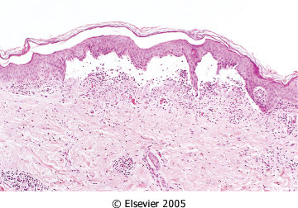

Slide 13
Morphologic Patterns of Acute Inflammation
FIBRINOUS INFLAMMATION
more severe injuries and more greater vascular permeability, larger molecules such as fibrinogen pass the vascular barrier, and fibrin is formed and deposited

Slide 14
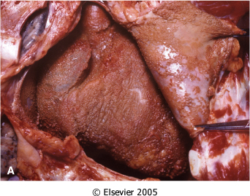
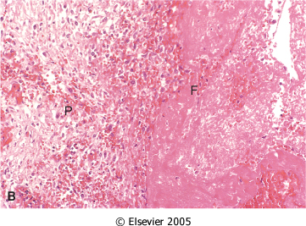
Morphologic Patterns of Acute Inflammation FIBRINOUS INFLAMMATION
A fibrinous exudate is characteristic of inflammation in the lining of body cavities, such as the meninges, pericardium and pleura

Slide 15
Morphologic Patterns of Acute Inflammation
FIBRINOUS INFLAMMATION
Fibrinous exudates may be removed by fibrinolysis
But when the fibrin is not removed, it may stimulate the ingrowth of fibroblasts and blood vessels and thus lead to scarring (organization)

Slide 16
Morphologic Patterns of Acute Inflammation SUPPURATIVE OR PURULENT INFLAMMATION
characterized by the production of large amounts of pus or purulent exudate consisting of neutrophils, necrotic cells, and edema fluid
Certain bacteria (e.g., staphylococci) produce this localized suppuration and are therefore referred to as pyogenic (pus-producing) bacteria

Slide 17
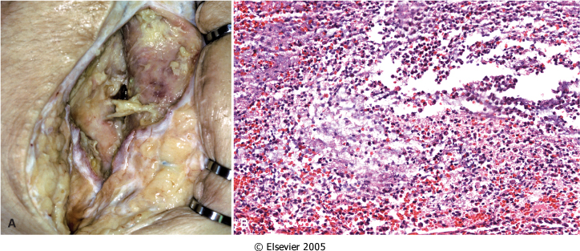
Suppurative inflammation. A, A subcutaneous bacterial abscess with collections of pus. B, The abscess contains neutrophils, edema fluid, and cellular debris.

Slide 18
Purulent inflammation

Slide 19
Morphologic Patterns of Acute Inflammation SUPPURATIVE OR PURULENT INFLAMMATION
Abscesses : localized collections of purulent inflammatory tissue caused by suppuration buried in a tissue, an organ, or a confined space

Slide 20
Brain Abscess

Slide 21
Liver abscess

Slide 22
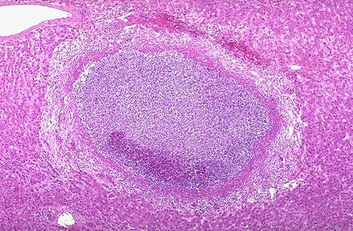
Localized liquefactive necrosis liver abscess
Removal of the dead tissue leaves behind a scar

Slide 23
Morphologic Patterns of Acute Inflammation
ULCERS
An ulcer is a local defect of the surface of an organ or tissue that is produced by the sloughing (shedding) of inflammatory necrotic tissue

Slide 24
Morphologic Patterns of Acute Inflammation
ULCERS
encountered in:
inflammatory necrosis of the mucosa of the mouth, stomach, intestines, or genitourinary tract
subcutaneous inflammation of the lower extremities in older persons who have circulatory disturbances

Slide 25
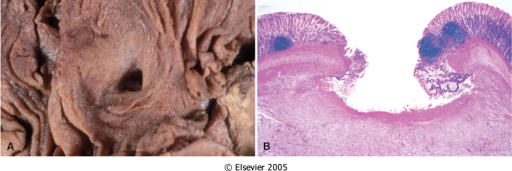
Ulceration can occur only when tissue necrosis and resultant inflammation exist on or near a surface
Epithelial Defect
Necrotic base
Fibrinopurulent exudates
Granulation tissue
Fibrosis

Slide 26
Objectives
Patterns of Acute Inflammation
Outcomes of Acute Inflammation
Patterns of chronic Inflammation
Systemic manifestation

Slide 27
Outcomes of Acute Inflammation
Acute inflammation may have one of the four outcomes:
Complete resolution
Healing by connective tissue replacement (fibrosis)
Progression of the tissue response to chronic inflammation
Abcess formation

Slide 28
Outcomes of Acute Inflammation
Complete resolution
When?
the injury is limited or short-lived
there has been little tissue destruction
the damaged parenchymal cells can regenerate

Slide 29
Outcomes of Acute Inflammation
Complete resolution
Mechanism:
Neutralization and removal of chemical mediators
Normalization of vascular permeability
halting of leukocyte emigration
Clearance of edema (lymphatic drainage) , inflammatory cells and necrotic debris (macrophages).

Slide 30
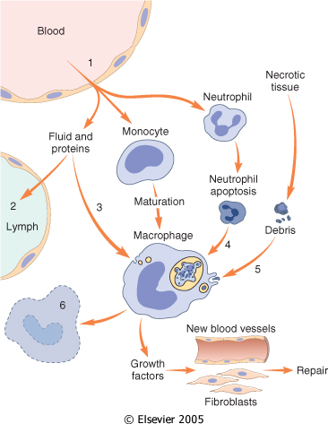
Events in the resolution of inflammation

Slide 31
Outcomes of Acute Inflammation
Healing by connective tissue replacement (fibrosis):
This occurs after substantial tissue destruction
the inflammatory injury involves tissues that are incapable of regeneration
there is abundant fibrin exudation.
The destroyed tissue is resaorbed and eventually replaced by fibrosis.

Slide 32
Outcomes of Acute Inflammation
Progression of the tissue response to chronic inflammation:
occurs when the acute inflammatory response cannot be resolved WHY?
Due to: 1. the persistence of the injurious agent
2. some interference with the normal process of healing

Slide 33
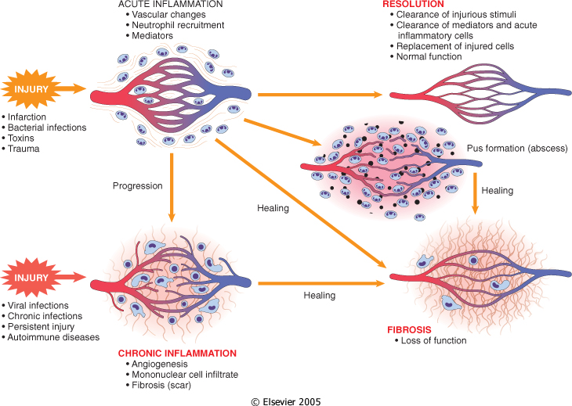

Slide 34
A 36-year-old man has had midepigastric abdominal pain for the past 3 months. An upper gastrointestinal endoscopy shows a 2-cm, sharply demarcated, shallow ulceration of the gastric antrum. A biopsy specimen of the ulcer base shows angiogenesis, fibrosis, and mononuclear cell infiltrates with lymphocytes, macrophages, and plasma cells. Which of the following terms best describes this pathologic process?
(A) Acute inflammation (B) Serous inflammation (C) Granulomatous inflammation (D) Fibrinous inflammation (E) Chronic inflammation

Slide 35
Objectives
Patterns of Acute Inflammation
Outcomes of Acute Inflammation
Patterns of chronic Inflammation
Systemic manifestation

Slide 36
Systemic effects of Inflammation
Acute phase reaction/response
- IL-1 and TNF
- Fever
- Malaise
- Anorexia
Bone marrow
- leukocytosis
- IL-1 + TNF
Lymphoid organs
Liver
-IL-6, IL-1, TNF
-Acute phase proteins
C-reactive protein
Lipopolysaccharide binding protein
Serum amyloid A
a-2 macroglobulin
Haptoglobin
Ceruloplasmin
fibrinogen

Slide 37
Systemic Effects of Inflammation Fever
Fever is produced in response to Pyrogens
What are pyrogens?
act by stimulating prostaglandin synthesis in the vascular and perivascular cells of the hypothalamus.
Bacterial products (called exogenous pyrogens), stimulate leukocytes to release cytokines such as IL-1 and TNF (called endogenous pyrogens) that increase the enzymes (cyclooxygenases) that convert AA into prostaglandins.

Slide 38
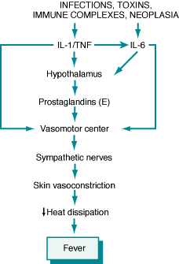
Fever
In the hypothalamus, the prostaglandins, especially PGE₂, stimulate the production of neurotransmitters such as cyclic AMP, which function to reset the temperature set-point at a higher level.
NSAIDs, including aspirin , reduce fever by inhibiting cyclooxygenase and thus blocking prostaglandin synthesis.
fever may induce heat shock proteins that enhance lymphocyte responses to microbial antigens.

Slide 39
Increased erythrocyte sedimentation rate
The rise in fibrinogen causes erythrocytes to form stacks (rouleaux) that sediment more rapidly at unit gravity than do individual erythrocytes.

Slide 40
Inflammation Systemic Manifestations
Leukocytosis:
WBC count climbs to 15,000 or 20,000 cells/μl
most bacterial infection
Lymphocytosis:
Infectious mononucleosis, mumps,
German measles
Eosinophilia: bronchial asthma,
hay fever, parasitic infestations
Leukopenia: typhoid fever,
infection with rickettsiae/protozoa

Slide 41
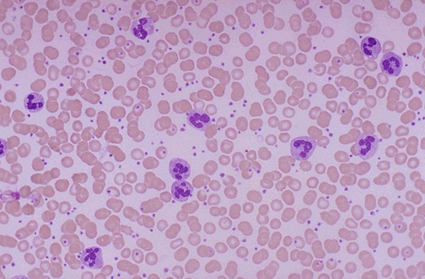
Notes:
Acute inflammation is marked by an increase in inflammatory cells. Perhaps the simplest indicator of acute inflammation is an increase in the white blood cell count in the peripheal blood, here marked by an increase in segmented neutrophils (PMN's).

Slide 42
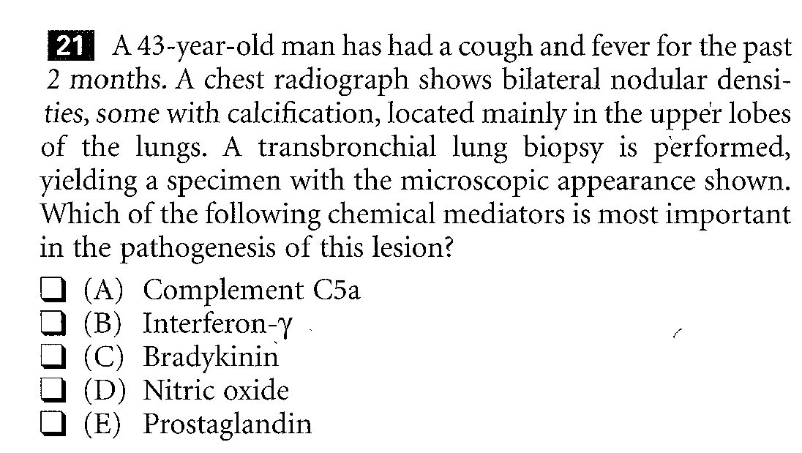

Slide 43
Thank you

Slide 45
An experiment introduces bacteria into a perfused tissue preparation. Leukocytes then leave the vasculature and migrate to the site of bacterial inoculation. The movement of these leukocytes is most likely to be mediated by which of the following substances?
(A) Bradykinin (B) Chemokines (C) Histamine (D) Prostaglandins (E) Complement C3a

Slide 46
Prostaglandins
Histamine
Nitric oxide
Vasodilation
Role of Mediators in Different Reactions of Inflammation
Increased vascular permeability
Vasoactive amines
Bradykinin
Leukotrienes C4, D4, E4
PAF
Substance P
C5a
Leukotriene B4
Chemokines
IL-1, TNF
Bacterial products
Chemotaxis, leukocyte recruitment and activation
Fever
IL-1, TNF, Prostaglandins
Pain
Prostaglandins
Bradykinin
Neutrophil and macrophage lysosomal enzymes
Oxygen metabolites
Nitric oxide
Tissue damage

Slide 47
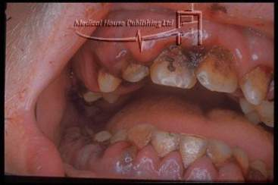
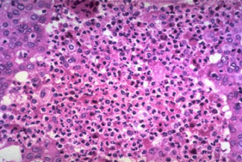
Acute inflammation
Time 4-6 hours to 3-5 days
Vascular involvement
Active hyperemia
Edema, occ.fibrin thrombi
Neutrophils
Cardinal signs of inflammation
Lymphatics
Role to remove exudate
Can lead to inflammation.
Lymphangitis
Lymphadenitis

Slide 48
A 32-year-old woman has had a chronic cough with fever for the past month. On physical examination, she has a temperature of 37.5°C, and on auscultation of the chest, crackles are heard in all lung fields. A chest radiograph shows many small, ill-defined nodular opacities in all lung fields. A transbronchial biopsy specimen shows interstitial infiltrates with lymphocytes, plasma cells, and epithelioid macrophages. Which of the following infectious agents is the most likely cause of this appearance?
(A) Staphylococcus aureus (B) Plasmodium falciparurn (C) Candida albicans (D) Mycobacteriurn tuberculosis (E) Klebsiella pneumoniae (F) Cytomegalovirus

