Slide 1
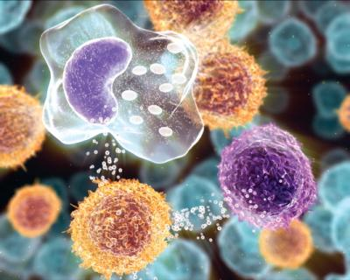
Inflammation and Repair
Dr. Maha Arafah

Slide 2
Learning Objectives:
Define inflammation, its causes and clinical appearance.
Describe the sequence of vascular changes in acute inflammation (vasodilation, increased permeability) and their purpose.
Know the mechanisms of increased vascular permeability.
Define the terms edema, transudate, and exudate.

Slide 3
Learning Objectives:
Define inflammation, its causes and clinical appearance.
Describe the sequence of vascular changes in acute inflammation (vasodilation, increased permeability) and their purpose.
Know the mechanisms of increased vascular permeability.
Define the terms edema, transudate, and exudate.

Slide 4
What is Inflammation?
It is the way the vascularised living tissue reacts to cell injury.
Aim: eliminate the initial cause of cell injury as well as the necrotic cells and tissues resulting from the original insult.
Cause: Infection, trauma, physical injury, chemical injury, immunologic injury, tissue death.

Slide 5
How does inflammation accomplish the protection?
Inflammation serves to:
destroy, dilute or isolate the injurious agent (microbes, toxins), and
eliminate the necrotic cells and tissues.
Then it starts a series of events which leads as far as possible to the healing and reconstitution of the damaged tissue.
➔ Therefore, Inflammation is part of a broader protective response (innate immunity )

Slide 6
Inflammation and repair
During repair, the injured tissue is replaced by:
Regeneration of native parenchyma cells
Filling of the defect by fibroblastic tissue or both
Inflammation and repair are protective response

Slide 7
Can inflammation be harmful ! ?
It can induce harm:
e.g. anaphylactic reaction
rheumatoid arthritis
atherosclerosis

Slide 8
How is inflammation harmful?
The components of the inflammatory reaction that destroy and eliminate microbes and dead tissues are capable of also injuring normal tissues.
This may accompany inflammatory reactions that are:
entirely normal, beneficial (e.g., when the infection is severe),
prolonged (e.g., when the eliciting agent resists eradication)
inappropriate (e.g., when it is directed against self-antigens in autoimmune diseases)
against usually harmless environmental antigens (allergic disorders)

Slide 9
What happens then?
Inflammation is terminated when the offending agent is eliminated and the secreted mediators are broken down or dissipated.
There are active anti-inflammatory mechanisms that serve to control the response and prevent it from causing excessive damage to the host.

Slide 10
Cells & molecules that play important roles in inflammation
blood leukocytes
plasma proteins
cells of vascular walls
cells of the surrounding connective tissue
extracellular matrix (ECM) of the surrounding connective tissue

Slide 11
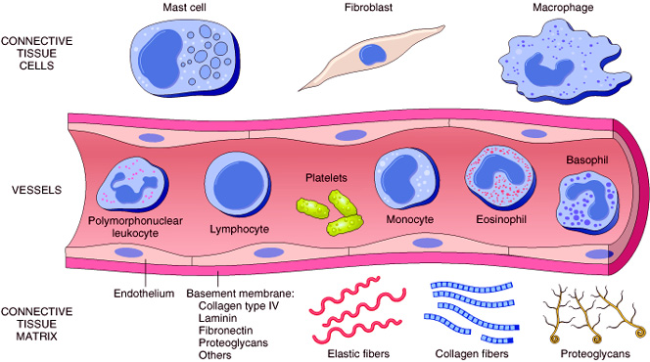
Cells & molecules that play important roles in inflammation
Cells of surrounding C.T.
The circulating cells:
Blood leukocytes
Plasma proteins
Extracellularmatrix of surrounding C.T.
Cells of vascular wall
The extracellular matrix

Slide 12
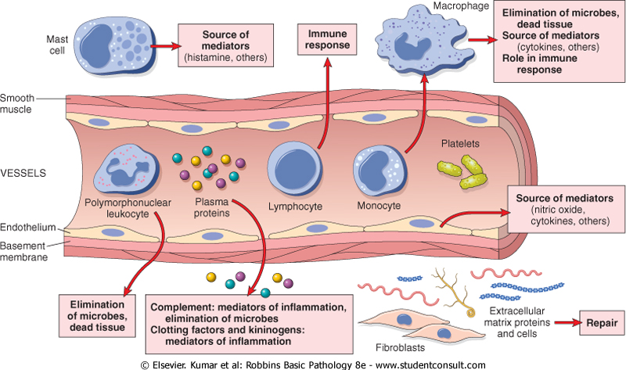

Slide 13
Chemical Mediators
Inflammation is mediated by chemical substances called

Slide 14
What is the source of these chemical mediators?
Phagocytes and other host cells
Leukocyte
Endothelium
Mast cell
Plasma proteins

Slide 15
TYPES OF Inflammation
Acute inflammation
Chronic Inflammation

Slide 16
Types of Inflmmation
Acute Inflammation
Chronic Inflammation
rapid in onset (seconds or minutes)
relatively short duration, lasting for minutes, several hours, or a few days
its main characteristics:
the exudation of fluid and plasma proteins (edema)
the emigration of leukocytes, predominantly neutrophils.
is of longer duration
associated histologically with the presence of lymphocytes and macrophages, the proliferation of blood vessels, fibrosis, and tissue necrosis.
Less uniform.

Slide 17
What are the cardinal signs of inflammation?
Local clinical signs of acute inflammation :
Heat
Redness
Swelling
Pain
Loss of function

Slide 18
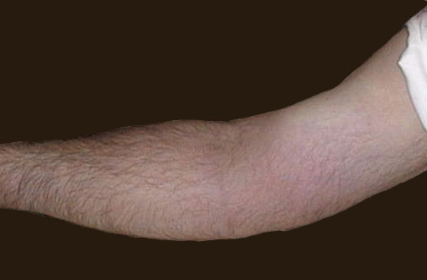
Redness
Notes:
The cardinal signs of inflammation are rubor (redness), calor (heat), tumor (swelling), dolor (pain), and loss of function. Seen here is skin with erythema, compared to the more normal skin at the far right.

Slide 19
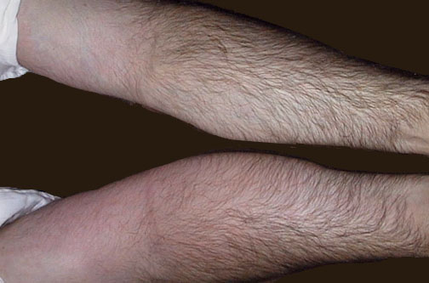
Swelling
Notes:
The arm at the bottom is swollen (edematous) and reddened (erythematous) compared to the arm at the top. Click to determine which areas are painful to touch.

Slide 20
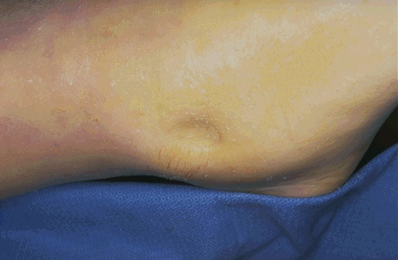
Swelling
Notes:
Here is simple edema, or fluid collection within tissues. This is "pitting" edema because, on physical examination, you can press your finger into the skin and soft tissue and leave a depression.

Slide 21
What are the steps of the inflammatory response?
5 R’s
(1) Recognition of the injurious agent
(2) Recruitment of leukocytes
(3) Removal of the agent
(4) Regulation (control) of the response
(5) Resolution

Slide 22
Learning Objectives:
Define inflammation, its causes and clinical appearance
2. Describe the sequence of vascular changes in acute inflammation (vasodilation, increased permeability) and their purpose.
3. Know the mechanisms of increased vascular permeability.
4. Define the terms edema, transudate, and exudate.

Slide 23
Events of acute Inflammation
Acute inflammation is a rapid response to an injurious agent that serves to deliver mediators of host defense-leukocytes and plasma proteins-to the site of injury.
Acute inflammation has three main events:
(1) Hemodynamic changes
(alterations in vascular caliber that lead to an increase in blood flow)
(2) Increased vascular permeability
(structural changes in the microvasculature that permit plasma proteins and leukocytes to leave the circulation)
(3) Emigration of the leukocytes from the microcirculation
(their accumulation in the focus of injury, and their activation to eliminate the offending agent)
vascular
cellular
Notes:
9

Slide 24
Vascular Changes
(1) Hemodynamic changes
(alterations in vascular caliber that lead to an increase in blood flow)
(2) Increased vascular permeability

Slide 25
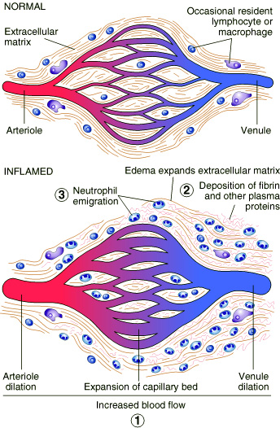

Slide 26
What are the different phases of changes in Vascular Caliber and Flow?

Slide 27
Phases of changes in Vascular Caliber and Flow
1. Transient vasoconstriction of arterioles
- It disappears within 3-5 seconds in mild injuries
- It may last several minutes in more severe injury (burn)

Slide 28
Phases of changes in Vascular Caliber and Flow
2.Vasodilatation:
It involves the arterioles and then results in opening of new microvasculature beds in the area thus leading to increasing blood flow (early hemodynamic change and the cause of inflammation heat and redness).
Increased blood volume lead to increased local hydrostatic pressure leading to transudation of protein-poor fluid into the extravascular space.

Slide 29
Phases of changes in Vascular Caliber and Flow
3. Slowing of the circulation due to increased permeability of the microvasculature, this leads to outpouring of protein-rich fluid in the extravascular tissues.
This results in concentration of the red cells in small vessels and increased viscosity of the blood leadind to stasis
(stasis: slow circulation due to dilated small vessels packed with red cells).

Slide 30
Phases of changes in Vascular Caliber and Flow
4. persistence of stasis
leads to peripheral orientation of leukocytes (mainly neutrophils) along the vascular endothelium [leukocytic margination], then they migrate through the vascular wall into the interstitial tissue [emigration].

Slide 31
A 72-year-old man with severe emphysema has had worsening right ventricular failure for the past 5 years. He has had fever and increasing dyspnea for the past 4 days. A chest radiograph shows an accumulation of fluid in the pleural spaces. Fluid obtained by thoracentesis has a specific gravity of 1.030 and contains degenerating neutrophils.
The most likely cause of this fluid accumulation is an increase in which of the following mechanisms? (A) Colloid osmotic pressure (B) Lymphatic pressure (C) Vascular permeability (D) Renal retention of sodium and water (E) Leukocytic diapedesis

Slide 32
2. Increased Vascular Permeability
A hallmark of acute inflammation (escape of a protein-rich fluid).
It affects small & medium size venules, through gaps between endothelial cells

Slide 33
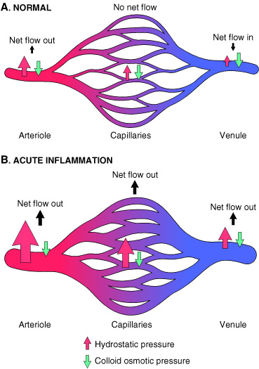
Marked outflow of fluid and its accumulation in the interstitial tissue:
The loss of protein from the plasma reduces the intravascular osmotic pressure and increases the osmotic pressure of the interstitial fluid
the increased hydrostatic pressure
The net increase of extravascular fluid results in edema
Slide 3.3

Slide 34
Learning Objectives:
Define inflammation, its causes and clinical appearance.
Describe the sequence of vascular changes in acute inflammation (vasodilation, increased permeability) and their purpose.
Know the mechanisms of increased vascular permeability.
Define the terms edema, transudate, and exudate.

Slide 35
What is the edema?
Edema
denotes an excess of fluid in the interstitial or serous cavities
it can be either an exudate or a transudate.

Slide 36
What is the difference between transudates and exudates?

Slide 37
Exudate
An inflammatory extravascular fluid that has a high protein concentration, cellular debris, and a specific gravity above 1.020.
It implies significant alteration in the normal permeability of small blood vessels in the area of injury.
Transudate
A fluid with low protein content (most of which is albumin) and a specific gravity of less than 1.012.
It is essentially an ultrafiltrate of blood plasma that results from osmotic or hydrostatic imbalance
No an increase in vascular permeability.
Pus (a purulent exudate)
is an inflammatory exudate rich in leukocytes (mostly neutrophils), the debris of dead cells and microbes.

Slide 39
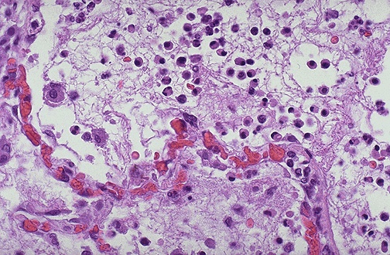
Notes:
Seen here is vasodilation with exudation that has led to an outpouring of fluid with fibrin into the alveolar spaces, along with PMN's. The series of events in the process of inflammation are:
Vasodilation: leads to greater blood flow to the area of inflammation, resulting in redness and heat.
Vascular permeability: endothelial cells become "leaky" from either direct endothelial cell injury or via chemical mediators.
Exudation: fluid, proteins, red blood cells, and white blood cells escape from the intravascular space as a result of increased osmotic pressure extravascularly and increased hydrostatic pressure intravascularly
Vascular stasis: slowing of the blood in the bloodstream with vasodilation and fluid exudation to allow chemical mediators and inflammatory cells to collect and respond to the stimulus.

Slide 40
Learning Objectives:
Define inflammation, its causes and clinical appearance.
Describe the sequence of vascular changes in acute inflammation (vasodilation, increased permeability) and their purpose.
Know the mechanisms of increased vascular permeability.
Define the terms edema, transudate, and exudate.

Slide 41
Phases of Increased Vascular Permeability
(1) an immediate transient response
lasting for 30 minutes or less, mediated mainly by the actions of histamine and leukotrienes on endothelium
(2) a delayed response
starting at about 2 hours and lasting for about 8 hours, mediated by kinins, complement products, and other factors
(3) a prolonged response
that is most noticeable after direct endothelial injury, for example, after burns.

Slide 42
A 72-year-old man with severe emphysema has had worsening right ventricular failure for the past 5 years. He has had fever and increasing dyspnea for the past 4 days. A chest radiograph shows an accumulation of fluid in the pleural spaces. Fluid obtained by thoracentesis has a specific gravity of 1.030 and contains degenerating neutrophils. The most likely cause of this fluid accumulation is an increase in which of the following mechanisms?
(A) Colloid osmotic pressure (B) Lymphatic pressure (C) Vascular permeability (D) Renal retention of sodium and water (E) Leukocytic diapedesis

Slide 43
What are the mechanisms leading to increased vascular permeability in acute inflammation?

Slide 44
Phases of Increased Vascular Permeability
Normal fluid exchange and microvascular permeability are critically dependent on an intact endothelium. How then does the endothelium become leaky in inflammation?
mechanisms proposed are:
Formation of endothelial gaps in venules
This is the most common mechanism of vascular leakage
is elicited by histamine, bradykinin, leukotrienes, the neuropeptide substance P, and many other classes of chemical mediators.
It occurs rapidly after exposure to the mediator and is usually reversible and short-lived (15 to 30 minutes)
it is known as immediate transient response.
- affects venules 20 to 60 μm in diameter, leaving capillaries and arterioles unaffected

Slide 46
Phases of Increased Vascular Permeability
2. Immediate sustained reactions
Direct endothelial injury (necrosis and detachment)
direct damage to the endothelium by the injurious stimulus e.g. severe burns or lytic bacterial infections.
Neutrophils may also injure the endothelial cells.
In most instances, leakage starts immediately after injury and is sustained at a high level for several hours until the damaged vessels are thrombosed or repaired.
All levels of the microcirculation are affected:
venules, capillaries, and arterioles.

Slide 48
Phases of Increased Vascular Permeability
3. Delayed prolonged leakage.
relatively common type of increased permeability that begins after a delay of 2 to 12 hours, lasts for several hours or even days
involves venules as well as capillaries.
Such leakage is caused by mild to moderate thermal injury, x-radiation or ultraviolet radiation, sunburn and certain bacterial toxins.
The mechanism is unclear. It may result from:
the direct effect of the injurious agent, leading to delayed endothelial cell damage
or
the effect of cytokines causing endothelial retraction.

Slide 49
Phases of Increased Vascular Permeability
Leukocyte-mediated endothelial injury.
Leukocytes adhere to endothelium relatively early in inflammation.
such leukocytes may be activated in the process, releasing toxic oxygen species and proteolytic enzymes, which then cause endothelial injury or detachment, resulting in increased permeability.
In acute inflammation, this is largely restricted to vascular sites, such as venules and pulmonary and glomerular capillaries.

Slide 51
Phases of Increased Vascular Permeability
Increased transcytosis across the endothelial cytoplasm
Transcytosis occurs across channels consisting of clusters of interconnected
This mechanism of increased permeability is induced by histamine and most chemical mediators

Slide 52
Transcytosis

Slide 53
Phases of Increased Vascular Permeability
Other mechanisms:
Leakage from new blood vessels.

Slide 54
Mechanisms lead to increased vascular permeability
Endothelial cell contraction 15-30 min
Endothelial injury
immediate sustained response 6-24 hours
delayed prolonged leakage 12 hours- days
Leukocyte-mediated endothelial injury
Transcytosis (occurs via channels formed by fusion of intracellular vesicles)
Leakage from new blood vessels

Slide 56
SUMMARY
Vascular Reactions in Acute Inflammation
Vasodilation is induced by chemical mediators such as histamine , and is the cause of erythema and stasis of blood flow.
Increased vascular permeability is induced by histamine, kinins and other mediators that produce:
gaps between endothelial cells,
by direct or leukocyte-induced endothelial injury
by increased passage of fluids through the endothelium
increased vascular permeability allows plasma proteins and leukocytes to enter sites of infection or tissue damage;
fluid leak through blood vessels results in edema

Slide 57
A 53-year-old woman has had a high fever and cough productive of yellowish sputum for the past 2 days. Her vital signs include temperature of 37.8°C, pulse 83/mm, respirations 17/mm, and blood pressure 100/60 mm Hg. A chest radiograph shows bilateral patchy pulmonary infiltrates. Which of the following inflammatory cell types is most likely to be seen in greatly increased numbers in a sputum specimen?
(A) Macrophages (B) Neutrophils (C) Mast cells (D) Small lymphocytes (E) Langhans giant cells

