Slide 1
Cellular events in acute inflammation
Dr. Maha Arafah

Slide 2
Events of acute Inflammation
(1) Hemodynamic changes
(alterations in vascular caliber that lead to an increase in blood flow)
(2) Increased vascular permeability
(structural changes in the microvasculature that permit plasma proteins and leukocytes to leave the circulation)
(3) Emigration of the leukocytes from the microcirculation
(their accumulation in the focus of injury, and their activation to eliminate the offending agent)
Cellular Events
vascular
cellular

Slide 3
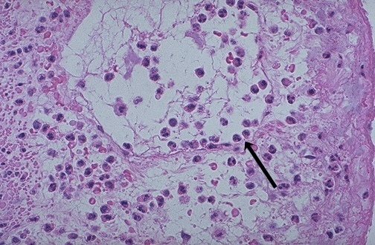
Notes:
As in the preceding diagram, here PMN's that are marginated along the dilated venule wall (arrow) are squeezing through the basement membrane (the process of diapedesis) and spilling out into extravascular space.

Slide 4
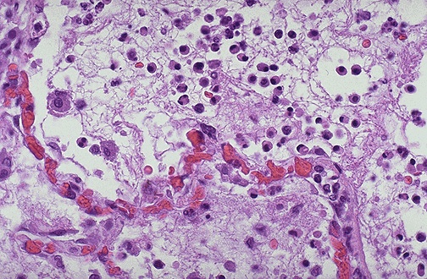
Notes:
Seen here is vasodilation with exudation that has led to an outpouring of fluid with fibrin into the alveolar spaces, along with PMN's. The series of events in the process of inflammation are:
Vasodilation: leads to greater blood flow to the area of inflammation, resulting in redness and heat.
Vascular permeability: endothelial cells become "leaky" from either direct endothelial cell injury or via chemical mediators.
Exudation: fluid, proteins, red blood cells, and white blood cells escape from the intravascular space as a result of increased osmotic pressure extravascularly and increased hydrostatic pressure intravascularly
Vascular stasis: slowing of the blood in the bloodstream with vasodilation and fluid exudation to allow chemical mediators and inflammatory cells to collect and respond to the stimulus.

Slide 5
Acute Inflammation CELLULAR EVENTS: LEUKOCYTE EXTRAVASATION AND PHAGOCYTOSIS
A critical function of inflammation is to deliver leukocytes to the site of injury and to activate the leukocytes to perform their normal functions in host defense.
Leukocytes ingest offending agents, kill bacteria and other microbes, and get rid of necrotic tissue and foreign substances.
they may induce tissue damage and prolong inflammation, since the leukocyte products that destroy microbes and necrotic tissues can also injure normal host tissues.

Slide 6
Acute Inflammation CELLULAR EVENTS: LEUKOCYTE EXTRAVASATION AND PHAGOCYTOSIS
The sequence of events of moving leukocytes from the vessel lumen to the interstitial tissue, called extravasation, can be divided into :
In the lumen:
Margination because blood flow slows early in inflammation (stasis), the endothelium can be virtually lined by white cells (pavementation)
rolling
adhesion to endothelium
Vascular endothelium normally does not bind circulating cells
Transmigration across the endothelium (also called diapedesis)
Migration in interstitial tissues toward a chemotactic stimulus

Slide 7
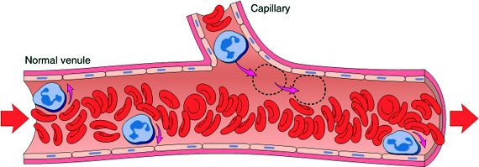
Acute Inflammation CELLULAR EVENTS: LEUKOCYTE EXTRAVASATION AND PHAGOCYTOSIS
Margination
Slide 3.11

Slide 8
Margination
Adhesion receptors
Selectins, consist of
E-selectin (CD62E, ELAM-1) confined to endothelium
P-selectin (CD62P, GMP140 or PADGEM), present in endothelium and platelets
L-selectin (CD62L, LAM-1), expressed on most leukocyte and endothelium.
Selectins bind, through their lectin domain, to sialylated forms of oligosaccharides (e.g., sialylated Lewis X), which themselves are covalently bound to various mucin-like glycoproteins (GlyCAM-1, PSGL-1, ESL-1, and CD34).

Slide 9
rolling
Integrins
are transmembrane heterodimeric glycoproteins, made up of α and β chains
expressed on many cell types and bind to ligands on endothelial cells, other leukocytes, and the extracellular matrix
The β₂ integrins LFA-1 and Mac-1 bind to ICAM-1, and the β₁ integrins bind VCAM-1.

Slide 10
adhesion to endothelium
The immunoglobulin family molecules :
ICAM-1 (intercellular adhesion molecule 1)
VCAM-1 (vascular cell adhesion molecule 1)
induced by TNF and IL-1

Slide 11
Neutrophils, monocytes, lymphocytes, eosinophils, and basophils all use the same pathway to migrate from the blood into tissues.

Slide 12
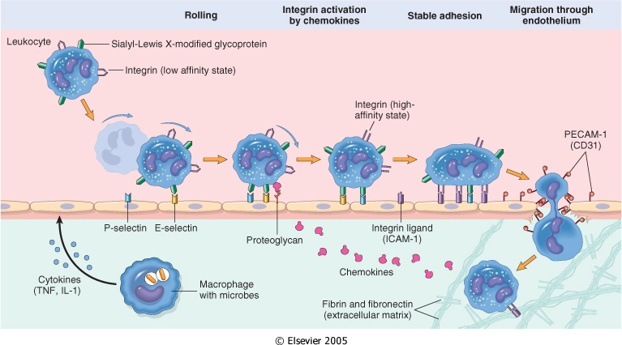
LEUKOCYTE EXTRAVASATION AND PHAGOCYTOSIS
Mucin-like glycoproteins - such as heparan sulfate, serve as ligands for the leukocyte adhesion molecule (CD44) - these glycoproteins are found in the extracellular matrix and on cell surfaces.

Slide 13
Leukocyte Adhesion and Transmigration
Regulated by the binding of complementary adhesion molecules on the leukocyte and endothelial surfaces
The adhesion receptors involved belong to four molecular families:
1. The selectins
2. The immunoglobulin superfamily ➔ ICAM-1 (intercellular adhesion molecule 1) & VCAM-1 (vascular cell adhesion molecule 1).
3. The integrins ➔ β₂ integrins bind to ICAM-1, and
the β₁ integrins bind VCAM-1
4. mucin-like glycoproteins serve as ligands for the leukocyte adhesion molecule called CD44.
- these glycoproteins are found in the extracellular matrix and on cell surfaces.

Slide 14
Recruitment of leukocytes
A multistep process involving attachment of circulating leukocytes to endothelial cells and their migration through the endothelium
The first events are the induction of adhesion molecules on endothelial cells
Resident tissue macrophages, mast cells, and endothelial cells respond to injurious agents by secreting the cytokines TNF, IL-1, and chemokines
TNF and IL-1 act on the endothelial cells of postcapillary venules adjacent to the infection and induce the expression of several adhesion molecules (ligands for integrins, mainly VCAM-1 and ICAM-1). Within 1 to 2 hours, the endothelial cells begin to express E-selectin.

Slide 15
Leukocyte Adhesion and Transmigration
Mediators such as histamine, thrombin, and platelet activating factor (PAF) stimulate the redistribution of P-selectin from its normal intracellular stores in granules (Weibel-Palade bodies) to the cell surface.

Slide 16
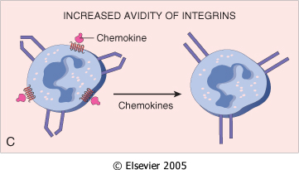
Leukocyte Adhesion and Transmigration
Leukocytes express at the tips of their microvilli carbohydrate ligands for the selectins, which bind to the endothelial selectins.
These are low-affinity interactions with a fast off-rate, and they are easily disrupted by the flowing blood. As a result, the bound leukocytes detach and bind again, and thus begin to roll along the endothelial surface.

Slide 17
Leukocyte Adhesion and Transmigration
Activation of integrins on the leukocytes results in firm integrin-mediated binding of the leukocytes to the endothelium at the site of infection. The leukocytes stop rolling, their cytoskeleton is reorganized, and they spread out on the endothelial surface.

Slide 18
Leukocyte Adhesion and Transmigration
Migration of the leukocytes through the endothelium is called transmigration or diapedesis.
Chemokines act on the adherent leukocytes and stimulate the cells to migrate through interendothelial spaces toward the chemical concentration gradient, (toward the site of injury or infection)
Diapedesis occurs predominantly in the venules

Slide 19
Leukocyte Adhesion and Transmigration
The type of emigrating leukocyte varies with the age of the inflammatory response and with the type of stimulus.
In most forms of acute inflammation, neutrophils predominate in the inflammatory infiltrate during the first 6 to 24 hours, then are replaced by monocytes in 24 to 48 hours
Several reasons account for this sequence:
neutrophils are more numerous in the blood, they respond more rapidly to chemokines,
after entering tissues, neutrophils are short-lived; they undergo apoptosis and disappear after 24 to 48 hours, whereas monocytes survive longer.

Slide 20
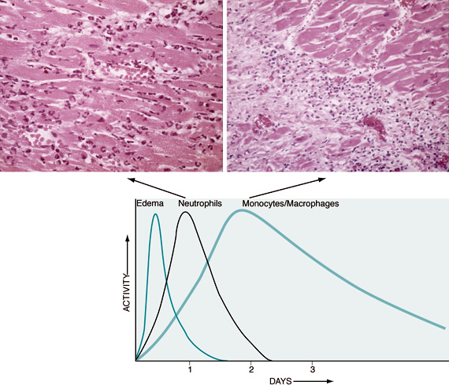
Slide 3.19

Slide 21
Leukocyte Adhesion and Transmigration
In viral infections, lymphocytes may be the first cells to arrive
In some hypersensitivity reactions, eosinophil may be the main cell type

Slide 22
Chemotaxis
After extravasation, leukocytes emigrate in tissues toward the site of injury by a process called chemotaxis, defined as locomotion oriented along a chemical gradient.
Which cells?
All granulocytes, monocytes and, to a lesser extent, lymphocytes respond to chemotactic stimuli with varying rates of speed.

Slide 23
Chemotaxis
Both exogenous and endogenous substances can act as chemoattractants.
The most common exogenous agents are bacterial products. Some of these are peptides that possess an N-formyl-methionine terminal amino acid. Others are lipid in nature.
Endogenous chemoattractants include several chemical mediators:
components of the complement system, particularly C5a
products of the lipoxygenase pathway, mainly leukotriene B₄ (LTB₄)
cytokines, particularly those of the chemokine family (e.g., IL-8).

Slide 24
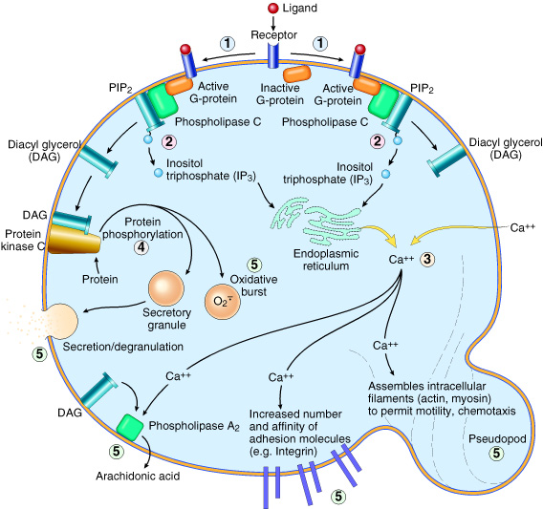
All these chemotactic agents bind to specific seven-transmembrane G-protein-coupled receptors (GPCRs) on the surface of leukocytes.

Slide 25
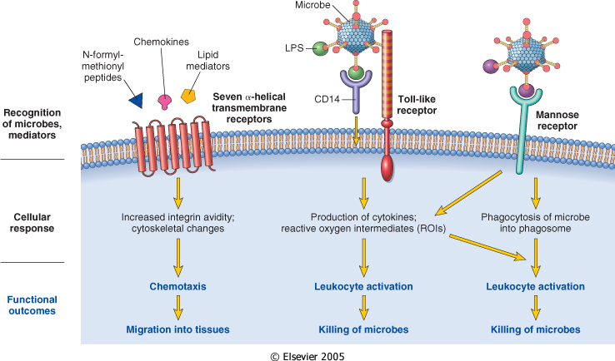

Slide 26
Leukocyte activation opsonization
The process of coating a particle, such as a microbe, to target it for phagocytosis is called opsonization, and substances that do this are opsonins.
These substances include antibodies (IgG), complement proteins (C3), and lectins (mannose-binding lectin (MBL), fibronectin, fibrinogen, and C-reactive protein
These can coat microbes and are recognized by receptors on phagocytes.

Slide 27
Phagocytosis
Phagocytosis and the release of enzymes by neutrophils and macrophages are responsible for eliminating the injurious agents
Phagocytosis involves three distinct but interrelated steps
(1) recognition and attachment of the particle to be ingested by the leukocyte
(2) its engulfment, with subsequent formation of a phagocytic vacuole
(3) killing or degradation of the ingested material.

Slide 28
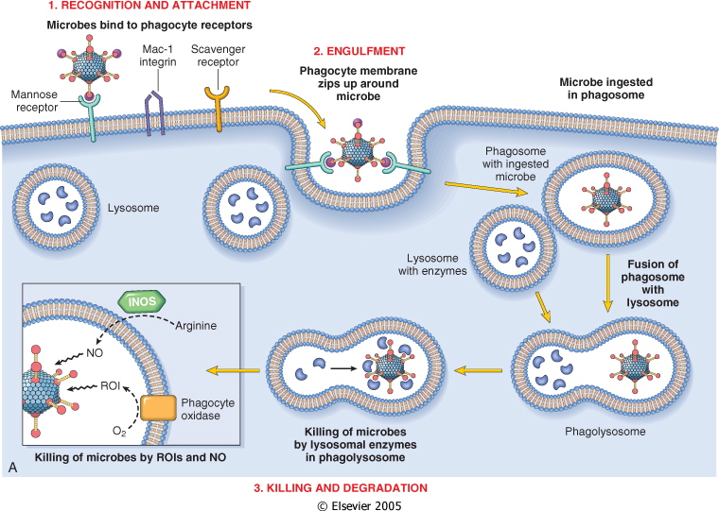

Slide 29
Phagocytosis Recognition and Attachment
Phagocytosis of microbes and dead cells is initiated by recognition of the particles by receptors expressed on the leukocyte surface:
Mannose receptors
Scavenger receptors
The efficiency of phagocytosis is greatly enhanced when microbes are opsonized

Slide 30
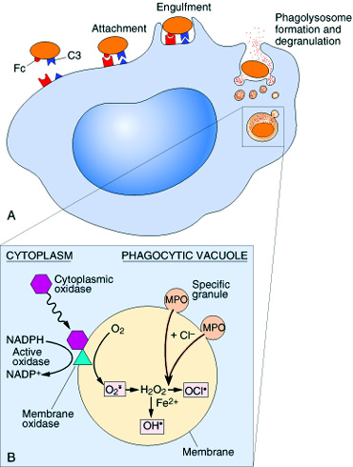
Phagocytosis Engulfment
During engulfment, extensions of the cytoplasm (pseudopods) flow around the particle to be engulfed, eventually resulting in complete enclosure of the particle within a phagosome
The limiting membrane of this phagocytic vacuole then fuses with the limiting membrane of a lysosomal granule, resulting in discharge of the granule's contents into the phagolysosome
During this process, the neutrophil and the monocyte become progressively degranulated.

Slide 31
Phagocytosis Killing and Degradation
2 mechanisms for Microbial killing:
1. Oxygen-dependent mechanisms
2. Oxygen-independent mechanisms

Slide 32
Phagocytosis Killing and Degradation
Microbial killing is accomplished largely by oxygen-dependent mechanisms
is due to the rapid activation of an oxidase (NADPH oxidase), which oxidizes NADPH (reduced nicotinamide-adenine dinucleotide phosphate) and, in the process, reduces oxygen to superoxide anion. Superoxide is then converted into hydrogen peroxide
(H₂O₂ ) combine with azurophilic granules of neutrophils, contain the enzyme myeloperoxidase (MPO), which, in the presence of a halide such as Cl⁻, converts H₂O₂ to hypochlorite (HOCl).
hypochlorite is potent antimicrobial agent that destroys microbes by halogenation or by oxidation of proteins and lipids (lipid peroxidation).

Slide 33
The H₂O₂-MPO-halide system is the most efficient bactericidal system in neutrophils

Slide 34
Phagocytosis Killing and Degradation
Oxygen-independent mechanisms
through the action of substances in leukocyte granules. These include:
bactericidal permeability increasing protein (BPI
lysozyme,
lactoferrin,
major basic protein,
defensins,
In addition, neutrophil granules contain many enzymes, such as elastase, that also contribute to microbial killing

Slide 35
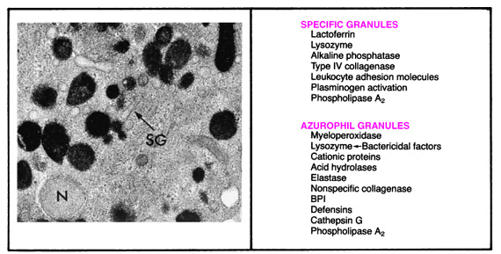

Slide 36
Phagocytosis
In summary
During activation and phagocytosis, leukocytes release microbicidal and other products not only within the phagolysosome but also into the extracellular space.
The most important of these substances in neutrophils and macrophages are lysosomal enzymes, present in the granules; reactive oxygen intermediates; and products of arachidonic acid metabolism, including prostaglandins and leukotrienes.
These products are capable of causing endothelial injury and tissue damage and may thus amplify the effects of the initial injurious agent
After phagocytosis, neutrophils rapidly undergo apoptotic cell death and are ingested by macrophages

Slide 37
Clinical Examples of Leukocyte-Induced Injury
Acute
Acute respiratory distress syndrome
Acute transplant rejection
Reperfusion injury
Septic shock
Vasculitis
Chronic
Arthritis
Asthma
Atherosclerosis
Glomerulonephritis
Chronic lung disease
Chronic rejection

Slide 38
Defects in Leukocyte Function
Defects in leukocyte function, both genetic and acquired, lead to increased vulnerability to infections:
Defects in leukocyte adhesion
Defects in microbicidal activity. The importance of oxygen-dependent bactericidal mechanisms is seen in a group of congenital disorders with defects in bacterial killing called chronic granulomatous disease
Defects in phagolysosome function. One such disorder is Chédiak-Higashi syndrome, an autosomal recessive condition characterized by neutropenia (decreased numbers of neutrophils), defective degranulation, and delayed microbial killing`

Slide 39
Defects in Leukocyte Function
Genetic
Leukocyte adhesion deficiency 1
β chain of CD11/CD18 integrins
Leukocyte adhesion deficiency 2
Fucosyl transferase required for synthesis of sialylated oligosaccharide (receptor for selectin)
Chronic granulomatous disease
Decreased oxidative burst
X-linked
NADPH oxidase (membrane component)
Autosomal recessive
NADPH oxidase (cytoplasmic components)
Myeloperoxidase deficiency
Absent MPO-H2O2 system
Chédiak-Higashi syndrome
Protein involved in organelle membrane fusion

Slide 40
Defects in Leukocyte Function
Acquired
Thermal injury, diabetes, malignancy, sepsis, immunodeficiencies
Chemotaxis
Hemodialysis, diabetes mellitus
Adhesion
Leukemia, anemia, sepsis, diabetes, neonates, malnutrition
Phagocytosis and microbicidal activity

Slide 41
MORPHOLOGIC FEATURES OF CHRONIC INFLAMMATION
Infiltration with mononuclear cells include
Macrophages
Lymphocytes
Plasma cells
Eosinophils
Tissue destruction
induced by the persistent offending agent or by the inflammatory cells.
Healing
by connective tissue replacement of damaged tissue, accomplished by proliferation of small blood vessels (angiogenesis) and, in particular, fibrosis

Slide 42
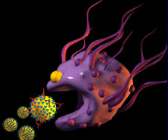
MORPHOLOGIC FEATURES OF CHRONIC INFLAMMATION
MONONUCLEAR CELL INFILTRATION
Macrophages
the dominant cellular player in chronic inflammation
The mononuclear phagocyte system (sometimes called reticuloendothelial system) consists of closely related cells of bone marrow origin, including blood monocytes and tissue macrophages

Slide 43
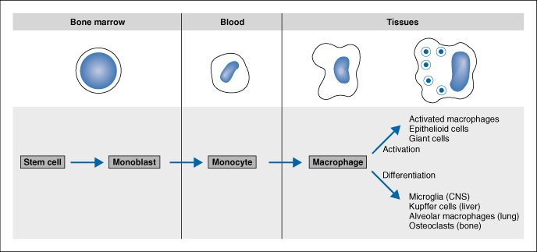
mononuclear phagocyte system
monocytes begin to emigrate into extravascular tissues quite early in acute inflammation and within 48 hours they may constitute the predominant cell type

Slide 44
MONONUCLEAR CELL INFILTRATION Macrophages
Macrophages may be activated by a variety of stimuli, including
cytokines (e.g., IFN-γ) secreted by sensitized T lymphocytes and by NK cells
bacterial endotoxins
other chemical mediators
Activation results in
increased cell size
increased levels of lysosomal enzymes
more active metabolism
greater ability to phagocytose and kill ingested microbes.
Activated macrophages secrete a wide variety of biologically active products that, if unchecked, result in the tissue injury and fibrosis

Slide 45
.
Products of macrophages
1.Acid and neutral proteases
2.Chemotactic factors
3.Reactive oxygen metabolites
4.Complement components
5. Coagulation factors
6.Growth promoting factors for fibroblasts, blood vessels and myeloid progenitor cells
7.Cytokines : IL-1, TNF
8.Other biologic active agents ( PAF, interferon, AA metabolites)
to eliminate injurious agents such as microbes
to initiate the process of repair
It is responsible for much of the tissue injury in chronic inflammation
Function?!!..

Slide 46
MONONUCLEAR CELL INFILTRATION
Macrophages may be activated by a variety of stimuli, including
cytokines (e.g., IFN-γ) secreted by sensitized T lymphocytes and by NK cells
bacterial endotoxins
other chemical mediators
Activation results in
increased cell size
increased levels of lysosomal enzymes
more active metabolism
greater ability to phagocytose and kill ingested microbes.
Activated macrophages secrete a wide variety of biologically active products that, if unchecked, result in the tissue injury and fibrosis

Slide 47
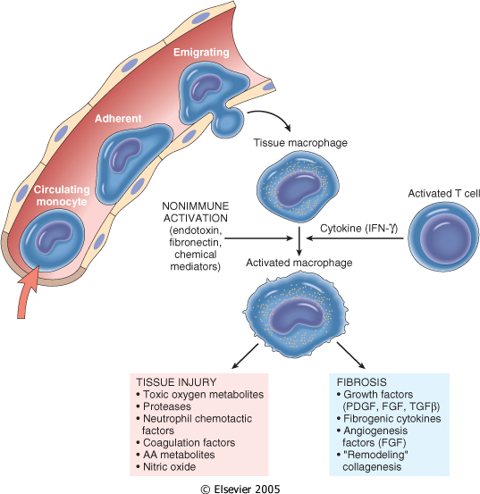
The roles of activated macrophages in chronic inflammation.
Products of macrophages
1.Acid and neutral proteases
2.Chemotactic factors
3.Reactive oxygen metabolites
4.Complement components
5. Coagulation factors
6.Growth promoting factors for fibroblasts, blood vessels and myeloid progenitor cells
7.Cytokines : IL-1, TNF
8.Other biologic active agents ( PAF, interferon, AA metabolites)

Slide 48
Macrophages
In chronic inflammation, macrophage accumulation persists, this is mediated by different mechanisms:
Recruitment of monocytes from the circulation, which results from the expression of adhesion molecules and chemotactic factors
Local proliferation of macrophages after their emigration from the bloodstream
Immobilization of macrophages within the site of inflammation

Slide 49
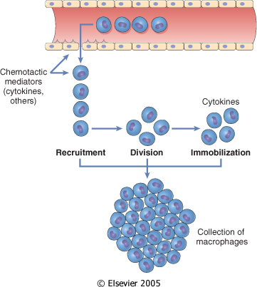

Slide 50
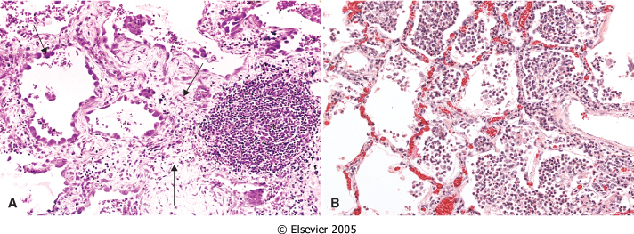
OTHER CELLS IN CHRONIC INFLAMMATION
Lymphocytes
Both T & B Lymphocytes migrates into inflammation site

Slide 51
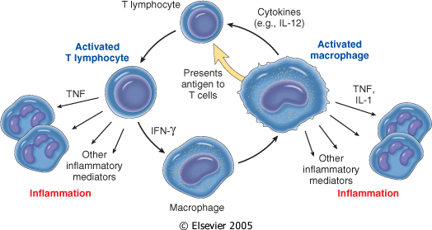
Lymphocytes and macrophages interact in a bidirectional way, and these reactions play an important role in chronic inflammation
Activated lymphocytes and macrophages influence each other and also release inflammatory mediators that affect other cells.

Slide 52
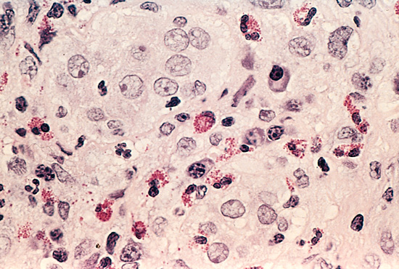
Eosinophils
are abundant in immune reactions mediated by IgE and in parasitic infections
respond to chemotactic agents derived largely from mast cells
Granules contain major basic protein: toxic to parasites and lead to lysis of mammalian epithelial cells

Slide 53
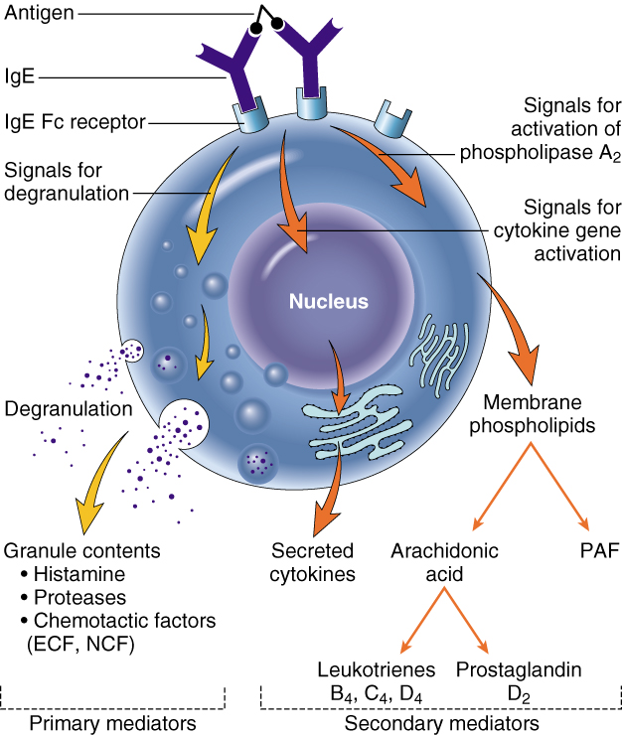
Mast cells
are widely distributed in connective tissues
express on their surface the receptor that binds the Fc portion of IgE antibody ,
the cells degranulate and release mediators, such as histamine and products of AA oxidation

Slide 54
OTHER CELLS IN CHRONIC INFLAMMATION Epithelioid macrophages
GRANULOMATOUS INFLAMMATION
Granulomatous inflammation is a distinctive pattern of chronic inflammatory reaction characterized by focal accumulations of activated macrophages, which often develop an epithelial-like (epithelioid) appearance

Slide 55
Causes of Granulomatous Inflammations
Infections
Bacterial
Parasitic
Fungal
Inorganic dusts
Foreign bodeis
unknown

Slide 56
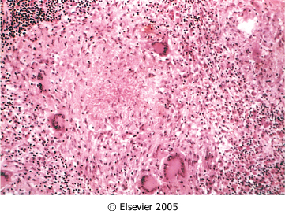

Slide 57
Examples of Diseases with Granulomatous Inflammations
Disease | Cause | Tissue Reaction
Tuberculosis | Mycobacterium tuberculosis | Noncaseating tubercle Caseating tubercles
Leprosy | Mycobacterium leprae | Acid-fast bacilli in macrophages; noncaseating granulomas
Syphilis | Treponema pallidum | Gumma: wall of histiocytes; plasma cell
Cat-scratch disease | Gram-negative bacillus | Rounded or stellate granuloma
Sarcoidosis | Unknown etiology | Noncaseating granulomas
Crohn disease | Immune reaction against intestinal bacterial | dense chronic inflammatory infiltrate with noncaseating granulomas

Slide 58
Role of lymphatic and Lymph Nodes in Inflammation
Represents a second line of defense
Delivers antigens and lymphocytes to the central lymph nodes
Lymph flow is increased in inflammation
May become involved by secondary inflammation (lymphangitis, reactive lymphadenitis)

