Slide 1
Chemical mediators
Acute and Chronic Inflammation

Slide 2
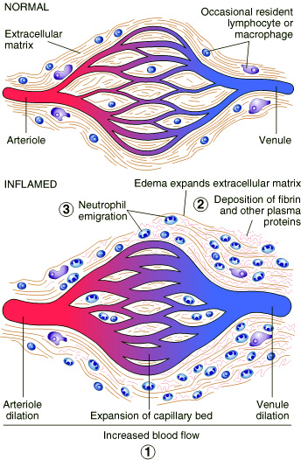

Slide 3
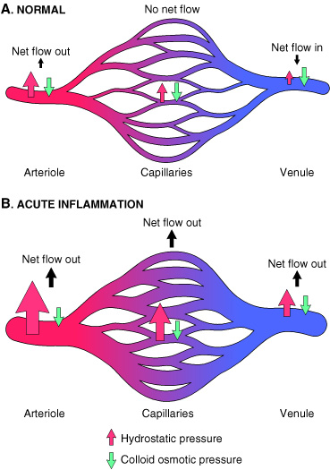
Acute Inflammation
Increased vascular permeability

Slide 4
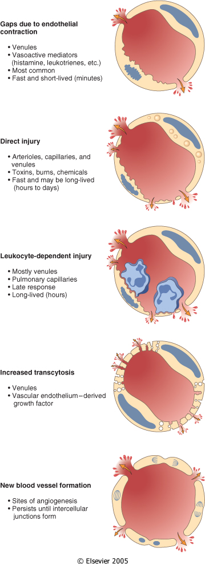

Slide 5
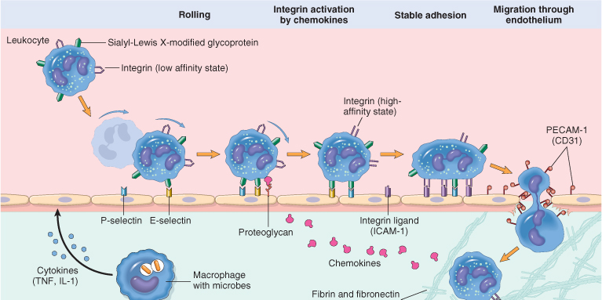
LEUKOCYTE EXTRAVASATION AND PHAGOCYTOSIS

Slide 6
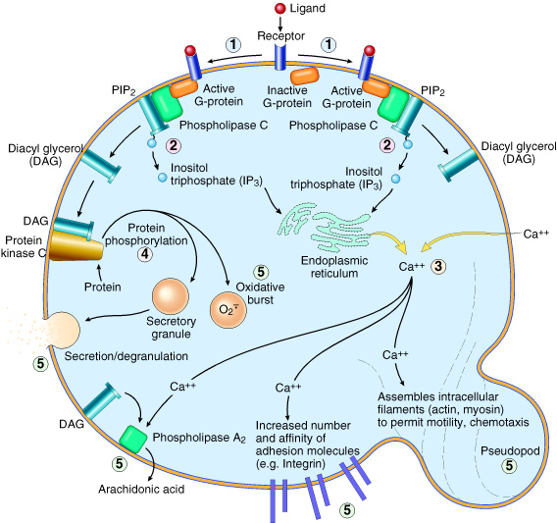

Slide 7
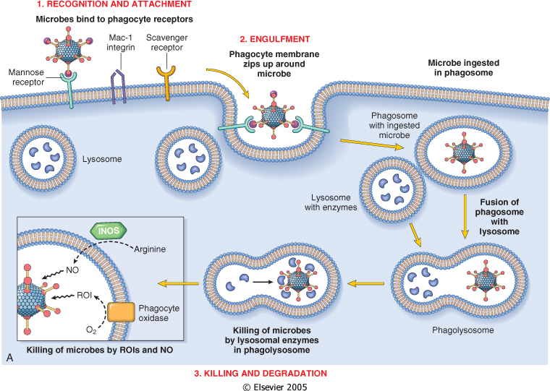

Slide 8
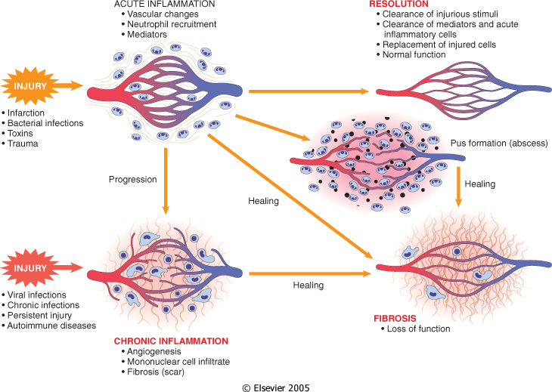

Slide 9
Learning Objectives
To know chemical mediators of inflammation
  You should learn the cellular sources and major effects of the mediators and, conversely, list the most likely mediators of each of the steps of inflammation (There is no need to memorize all the information.)

Slide 10
What are mediators?
A mediator is a substance or structure that mediates a specific response in a bodily tissue

Slide 11
General principles for chemical mediators
- The chemical mediators are responsible for the events in acute inflammation
The production of active mediators is triggered by:
  microbial products
  host proteins, such as the proteins of the complement, kinin and coagulation systems ( these are themselves activated by microbes and damaged tissues)
- Mediators derived from plasma or from cells.
- Most mediators perform their activity by initially binding to specific receptors on target cells. However, some have direct enzymatic or toxic activities.

Slide 12
General principles for chemical mediators
Mediators may stimulate target cells to release secondary effector molecules, which may have activities similar (amplifying) or opposing (counter-regulating) the initial stimulus.
- Mediators may act on only one or a very few targets, or may have a widespread activity
- Mediator function is tightly regulated by:
1. decay (e.g. AA metabolites)
2. inactivated by enzymes (kininase inactivates bradykinin)
3. eliminated ( antioxidants scavenge toxic oxygen metabolites)
- A major reason for the checks and balances is that most mediators have the potential to cause harmful effects.

Slide 13
Exogenous mediators: Bacterial products
Endogenous: host origin

Slide 14
Notes:
Cell-derived (AKA local) are: sequestered in intracellular granules, secreted upon cellular activation (e.g. Histamine in mast cells). OR synthesized de novo in response to a stimulus (e.g. PG and cytokines)
Plasma-Protein-Derived (AKA circulating mediators) : acquire their biologic activities by proteolytic cleavage.

Slide 15
Chemical mediators
Plasma-derived:
  Complement
  kinins
  coagulation factors
  Many in “pro-form” requiring activation (enzymatic cleavage)
Cell-derived:
  Synthesized as needed (prostaglandin)
  Preformed, sequestered and released (mast cell histamine)

Slide 16
Notes:
.

Slide 18
Cell-derived Chemical Mediators

Slide 19
Cell-Derived Mediators
Producing cells:
Tissue macrophages
Mast cells
Endothelial cells
Leukocytes
Notes:
Endothelial cells at the site of inflammation
Leukocytes recruited to the site form the blood

Slide 20
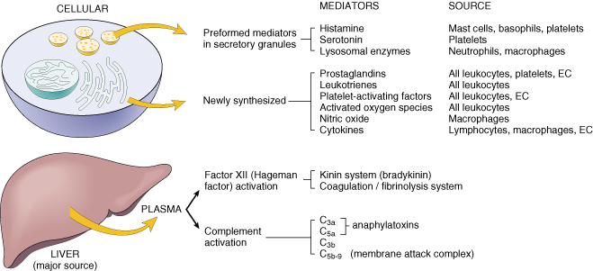
Cell-derived Chemical Mediators

Slide 21
Notes:
.

Slide 22
Vasoactive Amines
Histamine
&
Serotonin
Notes:
Amines are decarboxylated amino acids

Slide 23
Vasoactive Amines
Among first mediators in acute inflammatory reactions
Preformed mediators in secretory granules

Slide 24
Histamine
Source:
many cell types, esp. mast cells, circulating basophils, and platelets
Actions:
ARTERIOLAR DILATION
INCREASED VASCULAR PERMEABILITY (venular gaps)
ENDOTHELIAL ACTIVATION
Inactivated by:
Histaminase
Notes:
Histamine is the principal mediator of the immediate phase of increased vascular permeability, inducing venular endothelial contraction and interendothelial gaps.

Slide 25
Histamine
Stimuli of Release:
Physical injury
Immune reactions
C3a and C5a fragments of complement (anaphylatoxins)
Leukocyte-derived histamine-releasing proteins
Neuropeptides (e.g. substance P)
Certain Cytokines (e.g. IL-1 and IL-8)
Notes:
Trauma, heat
Binding of IgE antibodies to Fc receptors on mast cells

Slide 26
Serotonin
(5-HT)
Source:
Platelets
Action:
Similar to histamine
Stimulus:
Platelet aggregation

Slide 27
Notes:
.

Slide 28
Eicosanoids
Eicosanoids
=
Arachidonic Acid (AA) Metabolites
=
Prostaglandins (PG),
Leukotrienes,
and Lipoxins

Slide 29
Eicosanoids
May be thought of as hormones but they differ from hormones by:
    Produced in all tissues
    Act locally rather than after transport in blood to distant sites
    Decay spontaneously OR enzymatically
    Have short half-life

Slide 30
Eicosanoids
Source:
Leukocytes
Mast cells
Endothelial cells
Platelets

Slide 31
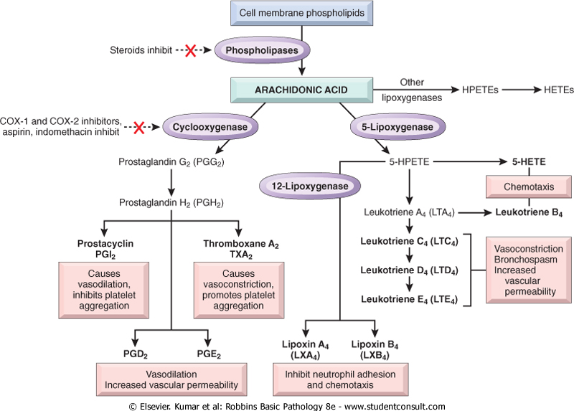
Notes:
COX: Some enzymes in this pathway have restricted tissue distribution. Note opposing effects of PGI2(endothelial cells) and TXA2(platelets). PGD2 and PGE2 (mast cells). PGs involved in pathogenesis of pain and fever in inflammation, esp. PGE2. CLINICAL IMPORTANCE: There are 2 forms of COX: COX 1 and COX 2. COX 1 is present in gastric mucosa, PGs it protect against acid damage. Aspirin and NSAIDS (ibuprofen) inhibit COX 1 and COX 2, thus all PGs synthesis → treat fever and pain BUT predispose to gastric ulceration. Selective COX 2 inhibitors (rofecoxib and celecoxib) can avoid gastric ulceration BUT may induce a prothrombotic state (because they inhibit PGI2 synthesis more than TXA2)
LTB4 (neutrophils and macrophages). LTC4, D4, & E4 (mast cells)
Lipoxins function mainly as inhibitors of inflammation.

Slide 32
Notes:
.

Slide 33
Platelet Activating Factor
(PAF)
Another phospholipid derivative
Very potent bioactive molecule
Source: membranes of
Neutrophils, monocytes, basophils, endothelial cells, & platelets
Notes:
100 to 1000 times more potent that histamine

Slide 34
Action of PAF
Platelet activation (aggregation & degranulation)
Vasoconstriction
Bronchoconstriction
Leukocyte adhesion
Leukocyte degranulation
Chemotaxis
Synthesis of other mediators, esp. Eicosanoids

Slide 35
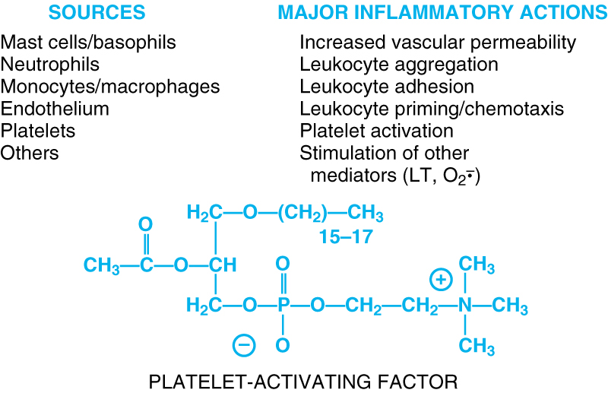

Slide 37
Notes:
.

Slide 38
Cytokines
Polypeptides
Actions:
Involved in early immune and inflammatory reactions
Some stimulate bone marrow precursors to produce more leukocytes
Notes:
Producing leukocytes and thus replacing the ones being consumed during inflammation and immune responses

Slide 39
Cytokines
Interleukins (IL)
Tumor Necrosis Factor (TNF)
Interferon-γ (INF- γ)
Acute inflammation:
IL-1 & TNF
Chronic Inflammation:
INF- γ & IL-12
Notes:
Interleukins are called so in reference to their ability to mediate communications between leukocytes. However, many IL act on cells other than leukocytes, and many cytokines that act on leukocytes are not called IL, for historical reasons.

Slide 40
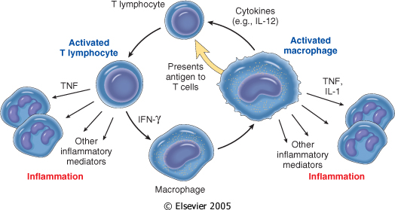
  Lymphocytes and macrophages interact in a bidirectional way, and these reactions play an important role in chronic inflammation
Activated lymphocytes and macrophages influence each other and also release inflammatory mediators that affect other cells.

Slide 41
Cytokines: TNF and IL-1
Source:
Activated macrophages
Mast cells
Endothelial cells
Stimulation:
Bacterial endotoxins
Immune complexes
Products of T-lymphocytes (adaptive immune response)

Slide 42
Cytokines: TNF and IL-1
Actions:
Endothelial Activation
Both: 1. Stimulate expression of molec. on endothelial cells →
2. Increased leukocyte binding and recruitment
3. Enhanced production of additional cytokines (notably chemokines) and eicosanoids

Slide 43
Cytokines: TNF and IL-1
Actions:
TNF :
Thrombogenicity of endothelium
Neutrophil activation
IL-1:
Tissue fibroblasts activation → increased ECM
N.B. TNF and IL-1 may enter the circulation and induce systemic acute-phase reaction
Notes:
Although TNF and IL-1 are secreted at the site of inflammation, they may enter circulation… reaction that is often associated with infection and inflammatory disease. Components of this reaction are: fever, lethargy, hepatic syn. of acute-phase proteins, metabolic wasting (cahcexia), neutrophil release to the circ., and release of adrenocorticotropic hormone (inducing corticosteroid syn. And release)

Slide 44
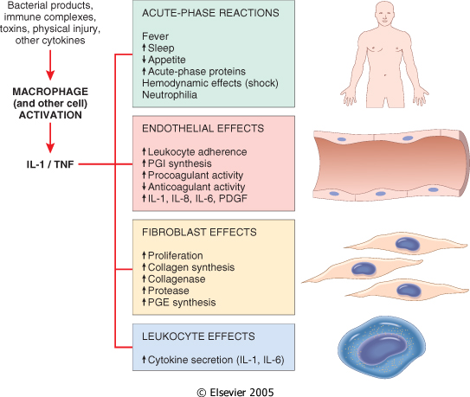

Slide 45
Notes:
.

Slide 46
Chemokines
Small proteins
They are chemoattractants for leukocytes
Main functions:
Leukocyte recruitment & activation in inflammation
Normal anatomic organization of cells in lymphoid and other tissues
Notes:
Leukocyte activation increases the affinity of the leukocyte integrin to its ligand on endothelial cells.

Slide 47
Notes:
.

Slide 48
Reactive Oxygen Species
Synthesized via
NADPH oxidase pathway
Source:
Neutrophils and Macrophages
Stimuli of release:
Microbes
Immune complexes
Cytokines
Action:
Microbicidial (cytotoxic) agent

Slide 49
Notes:
.

Slide 50
Nitric Oxide ( NO)
Short-lived
SOLUBLE
Free-radical gas
Notes:
iNOS induced by a number of inflammatory cytokines (IL-1, TNF, & IFN-y) and bacterial endotoxin

Slide 51
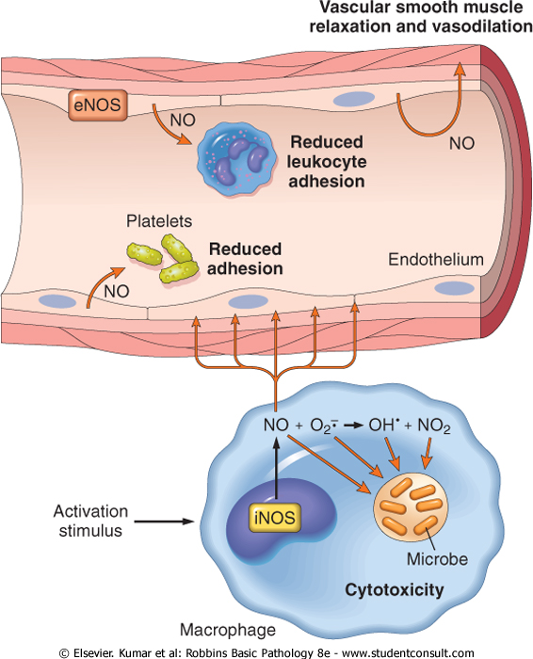

Slide 52
NO
Functions:
Vasodilation
Antagonism of platelet activation (adhesion, aggregation, & degranulation)
Reduction of leukocyte recruitment
Microbicidial (cytotoxic) agent (with or without ROS) in activated macrophages

Slide 53
Notes:
.

Slide 54
Lysosomal Enzymes of Leukocytes
Leukocytes:
Neutrophils & Monocytes
Enzymes:
Acid proteases
Neutral proteases (e.g. elastase, collagenase, & cathepsin)
Their action is checked by:
Serum antiproteases (e.g. α1-antitrypsin)

Slide 55
Notes:
.

Slide 56
Neuropeptides
Small proteins
Secreted by nerve fibers mainly in lung & GIT
Initiate inflammatory response
Substance P :
Transmits pain signals
Regulates vessel tone
Modulates vascular permeability

Slide 57
Plasma protein-derived Chemical Mediators

Slide 58
PLASMA PROTEASES
A variety of phenomena in the inflammatory response are mediated by plasma proteins that belong to three interrelated systems
1. Kinin
2. the complement
3. clotting systems

Slide 59
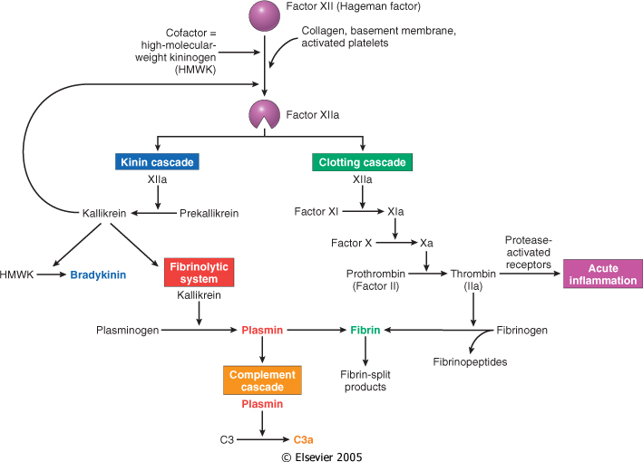
increases vascular permeability, pain
increases vascular permeability, Chemotaxis

Slide 60
Clotting System
Thrombin binds to receptors that are called protease-activated receptors (PARs)
found on platelets, endothelial and smooth muscle cells
This triggers several responses that induce inflammation by:
  mobilization of P-selectin, production of chemokines, and expression of endothelial adhesion molecules for leukocyte integrins
  induction of cyclooxygenase-2 and production of prostaglandins
  production of PAF and nitric oxide
  These responses promote the recruitment of leukocytes and many other reactions of inflammation

Slide 61
Complement System
The complement system consists of 20 component proteins (and their cleavage products)
This system functions in both innate and adaptive immunity for defense against microbial agents
Complement proteins are present as inactive forms in plasma ( numbered C1 through C9)

Slide 62
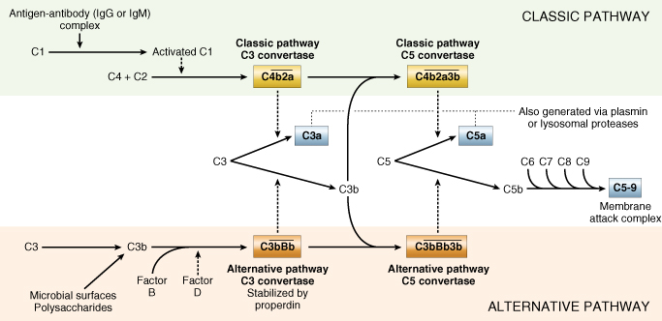
Many of these proteins are activated to become proteolytic enzymes that degrade other complement proteins, thus forming a cascade

Slide 63
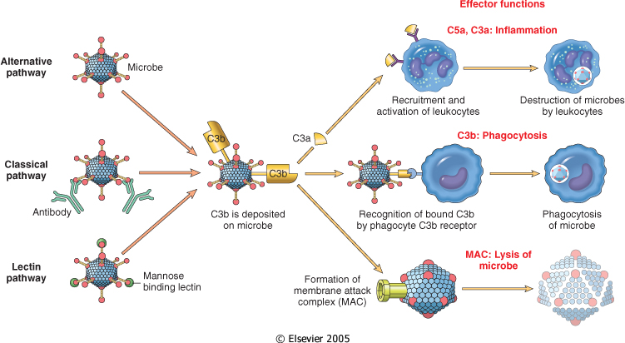

Slide 64
Complement protein
C3a & C5a ➔ Increase vascular permeability (^ histamine)
anaphylatoxins
C5a ➔ Chemotaxis
C3b ➔ Opsonization
C5-9 ➔ membrane attack complex

Slide 65
Vasodilation | Prostaglandins Histamine Nitric oxide
Increased vascular permeability | Vasoactive amines Bradykinin Leukotrienes C4, D4, E4 PAF Substance P
Chemotaxis, leukocyte recruitment and activation | C5a Leukotriene B4 Chemokines IL-1, TNF Bacterial products
Fever | IL-1, TNF Prostaglandins
Pain | Prostaglandins Bradykinin
Tissue damage | Neutrophil and macrophage lysosomal enzymes Oxygen metabolites Nitric oxide
Role of Mediators in Different Reactions of Inflammation

