Slide 1
PEDIATRIC DISEASES
many diseases of infancy and childhood are of genetic origin.
Others, though not genetic, either are unique to children or take distinctive forms in this stage of life

Slide 2
PEDIATRIC DISEASES
diseases of infancy (i.e., the first year of life) pose the highest risk of mortality
The cause of pediatric diseases is different in different age group.

Slide 3
Causes of Death by Age Under 1 Year: 727.4 /100,000
Congenital malformations, deformations, and chromosomal anomalies
Disorders related to short gestation and low birth weight
Sudden infant death syndrome (SIDS)
Newborn affected by maternal complications of pregnancy
Newborn affected by complications of placenta, cord, and membranes
Respiratory distress of newborn
Accidents (unintentional injuries)
Bacterial sepsis of newborn
Intrauterine hypoxia and birth asphyxia
Diseases of the circulatory system

Slide 4
Causes of Death by Age 1-4 Years: 32.6/100,000
Accidents and adverse effects
Congenital malformations, deformations, chromosomal abnormalities
Malignant neoplasms
Homicide and legal intervention
Disease of the heart
Influenza and pneumonia

Slide 5
Causes of Death by Age 5-14 Year: 18.5/100,000
Accidents and adverse effects
Malignant neoplasms
Homicide and legal intervention
Congenital malformations, deformations, chromosomal abnormalities
Suicide
Diseases of the heart

Slide 6
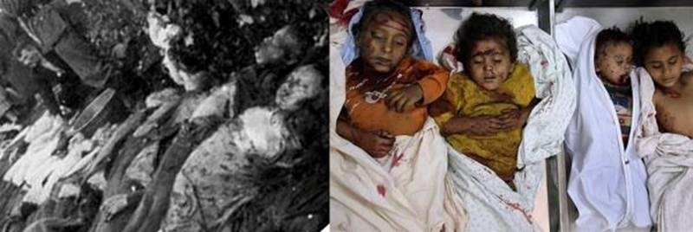

Slide 7
Causes of Death by Age Under 1 Year: 727.4 /100,000
Congenital malformations, deformations, and chromosomal anomalies
Disorders related to short gestation and low birth weight
Sudden infant death syndrome (SIDS)
Newborn affected by maternal complications of pregnancy
Newborn affected by complications of placenta, cord, and membranes
Respiratory distress of newborn
Accidents (unintentional injuries)
Bacterial sepsis of newborn
Intrauterine hypoxia and birth asphyxia
Diseases of the circulatory system

Slide 8
Congenital Anomalies
Terms used to describe errors in morphogenesis:
Malformations
primary errors of morphogenesis, abnormal developmental process.
Malformations are usually multifactorial
They may present in several patterns:
single body systems may be involved: such as congenital heart diseases
multiple malformations involving many organs and tissues may coexist

Slide 9
Congenital Anomalies
Terms used to describe errors in morphogenesis:
Disruptions
result from secondary destruction of an organ or body region that was previously normal in development; thus, in contrast to malformations, disruptions arise from an extrinsic disturbance in morphogenesis.
Amniotic bands, denoting rupture of amnion with resultant formation of "bands" that encircle, compress, or attach to parts of the developing fetus, are the classic example of a disruption

Slide 10
Congenital Anomalies
Terms used to describe errors in morphogenesis:
Deformations
represent an extrinsic disturbance of development rather than an intrinsic error of morphogenesis.
Deformations are common problems, affecting approximately 2% of newborn infants to various degrees.
Fundamental to the pathogenesis of deformations is localized or generalized compression of the growing fetus by abnormal biomechanical forces, leading eventually to a variety of structural abnormalities.
The most common cause of such deformations is uterine constraint.

Slide 11
Sequence

Slide 12
Congenital Anomalies
Other Terms used to describe errors in morphogenesis:
Agenesis refers to the complete absence of an organ or its anlage
Aplasia and hypoplasia are used to indicate incomplete development or underdevelopment of an organ.
Atresia describes the absence of an opening, usually of a hollow visceral organ or duct such as intestines and bile ducts.

Slide 14
Causes of malformations
three major categories:
genetic
Environmental
Multifactorial
Almost half have no recognized cause.

Slide 15
Graphic illustration of the causes of human congenital anomalies or birth defects. Note that the causes of most anomalies are unknown and that 20% to 25% of them are caused by a combination of genetic and environmental factors (multifactorial inheritance).

Slide 16
CAUSE %
Genetic :
Chromosomal aberrations 10-15
Mendelian inheritance 2-10
Environmental
Maternal/placental infections 2-3
Rubella
Toxoplasmosis
Syphilis
Cytomegalovirus infection
Human immunodeficiency virus infection
Maternal disease states 6-8
Diabetes
Endocrinopathies
Drugs and chemicals 1
Alcohol
Folic acid antagonists
Androgens
Phenytoin
Thalidomide
Irradiation ∼1
Multifactorial 20-25
Unknown 40-60

Slide 17
bilateral cleft lip

Slide 18
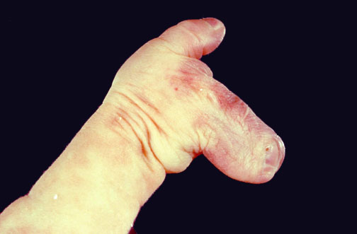
Syndactyly represents fusion of two or more digits.
It can be an isolated finding or part of syndromes that define patterns of anomalies.
Most of these syndromes do not have a specific genetic defect yet defined.

Slide 19
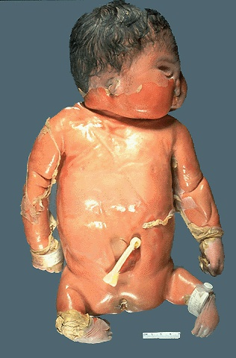
Note the shortened lower extremities, known as phocomelia.
It was idiopathic in this case, but in the 1950's the drug thalidomide was responsible for many cases when pregnant women took it.
Thus, it is very important that pregnant mothers be advised that drugs (including cigarette smoking and alcohol consumption) may have profound effects on the fetus.

Slide 20
Congenital Anomalies Summary
Congenital anomalies result from:
intrinsic abnormalities (malformations)
extrinsic disturbances (deformations).
Congenital anomalies can result from:
genetic (chromosomal abnormalities, gene mutations)
environmental (infections, drugs, alcohol)
multifactorial causes.
The timing of the in utero insult has profound influence on the extent of congenital anomalies, with earlier events usually demonstrating greater impact.

Slide 21
The presence of one anomaly suggests that additional anomalies may be present, including internal anomalies such as congenital cardiac defects that may be life-threatening.

Slide 22
RESPIRATORY DISTRESS SYNDROME OF THE NEWBORN
hyaline membrane disease
Cauases:
excessive sedation of the mother
fetal head injury during delivery
aspiration of blood or amniotic fluid
intrauterine hypoxia brought about by coiling of the umbilical cord about the neck.

Slide 23
RESPIRATORY DISTRESS SYNDROME OF THE NEWBORN
Pathogenesis RDS
is a disease of premature infants.
It occurs in about 60% of infants born at less than 28 weeks of gestation
Other contributing influences are maternal diabetes, cesarean section before the onset of labor, and twin gestation.

Slide 24
Pathogenesis RDS
The fundamental defect in RDS is the inability of the immature lung to synthesize sufficient surfactant. Surfactant is a complex of surface-active phospholipids
Surfactant is synthesized by type II pneumocytes and, with the healthy newborn's first breath, rapidly coats the surface of alveoli, reducing surface tension and thus decreasing the pressure required to keep alveoli open
In a lung deficient in surfactant, alveoli tend to collapse, and a relatively greater inspiratory effort is required with each breath to open the alveoli. The infant rapidly tires from breathing, and generalized atelectasis occur

Slide 25
Surfactant synthesis is regulated by hormones. Corticosteroids stimulate the formation of surfactant lipids and associated proteins.
Surfactant synthesis can be suppressed by the compensatory high blood levels of insulin in infants of diabetic mothers, which counteracts the effects of steroids.
Labor is known to increase surfactant synthesis; hence, cesarean section before the onset of labor may increase the risk of RDS.

Slide 28
Treatment of RDS
Ventlation
Prophylactic administration of exogenous surfactant at birth to extremely premature infants (gestational age <28 weeks) has been shown to be very beneficial
antenatal glucocorticoid therapy

Slide 29
Complications of RDS
In affected infants oxygen is required. BUT BE CAREFULL
High concentration of ventilator-administered oxygen for prolonged periods is associated with two well-known complications :
retrolental fibroplasia (also called retinopathy of prematurity) in the eyes
bronchopulmonary dysplasia (BPD).
Fortunately, both complications are now significantly less common as a result of gentler ventilation techniques, antenatal glucocorticoid therapy, and prophylactic surfactant treatments.

Slide 30
NECROTIZING ENTEROCOLITIS

Slide 31
NECROTIZING ENTEROCOLITIS
Necrotizing enterocolitis (NEC) most commonly occurs in premature infants, with the incidence of the disease being inversely proportional to the gestational age.
It occurs in approximately one out of 10 very-low-birth-weight infants (<1500 gm).

Slide 32
NECROTIZING ENTEROCOLITIS
The cause of NEC is controversial, but in all likelihood it is multifactorial:
Intestinal ischemia is a prerequisite and may result from either generalized hypoperfusion or selective reduction of blood flow to the intestines to divert oxygen to vital organs such as the brain.
Other predisposing conditions include:
bacterial colonization of the gut
administration of formula feeds,
both of which aggravate mucosal injury in the immature bowel

Slide 33
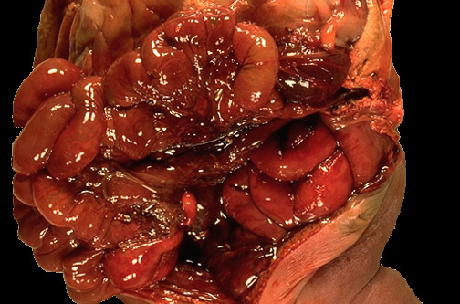
Necrotizing Enterocolitis (NEC)
NEC typically involves the terminal ileum, cecum, and right colon, although any part of the small or large intestine may be involved.
The involved segment is distended, friable, and congested

Slide 34
Microscopically, mucosal or transmural coagulative necrosis, ulceration, bacterial colonization, and submucosal gas bubbles are all features associated with NEC. Reparative changes, such as granulation tissue and fibrosis, may be seen shortly after the acute episode

Slide 35
Necrotizing Enterocolitis (NEC)
The clinical course is fairly typical, with the onset of bloody stools, abdominal distention, and development of circulatory collapse.
Abdominal radiographs often demonstrate gas within the intestinal wall (pneumatosis intestinalis).

Slide 36
Necrotizing Enterocolitis (NEC)
When detected early NEC can be often managed conservatively, but many cases (20% to 60%) require operative intervention and resection of the necrotic segments of bowel.
NEC is associated with high perinatal mortality; infants who survive often develop post-NEC strictures from fibrosis caused by the healing process.

Slide 37
SUDDEN INFANT DEATH SYNDROM (SIDS)

Slide 38
SUDDEN INFANT DEATH SYNDROM (SIDS)
Sudden infant death syndrome (crib death or cot death). is a disease of unknown cause.
The National Institute of Child Health and Human Development defines SIDS as "the sudden death of an infant under 1 year of age which remains unexplained after a thorough case investigation, including performance of a complete autopsy, examination of the death scene, and review of the clinical history.“

Slide 39
Pathogenesis Of SIDS
is a multifactorial condition, A "triple-risk" model of SIDS has been proposed:
a vulnerable infant,
a critical developmental period in homeostatic control
an exogenous stressor(s).
According to this model, several factors make the infant vulnerable to sudden death during the critical developmental period (i.e., 1 month to 1 year). These vulnerability factors may be attributable to the parents or the infant, while the exogenous stressor(s) is attributable to the environment.

Slide 40
Factors Associated with Sudden Infant Death Syndrome
Parental
Young maternal age (<20 years of age)
Maternal smoking during pregnancy
Drug abuse in either parent, specifically paternal marijuana and maternal opiate, cocaine use
Short intergestational intervals
Late or no prenatal care
Low socioeconomic group
African American and American Indian ethnicity (? socioeconomic factors)

Slide 41
Factors Associated with Sudden Infant Death Syndrome
Infant
Brain stem abnormalities associated defective arousal and cardiorespiratory control
Prematurity and/or low birth weight
Male sex
Product of a multiple birth
SIDS in an earlier sibling
Antecedent respiratory infections
?Gastroesophageal reflux

Slide 42
Factors Associated with Sudden Infant Death Syndrome
Environment
Prone sleep position
Sleeping on a soft surface
Hyperthermia
Postnatal passive smoking

Slide 43
Pathogenesis Of SIDS
Although numerous factors have been proposed to account for a vulnerable infant, the most compelling hypothesis is that SIDS reflects a delayed development of arousal and cardiorespiratory control.
Among the potential environmental causes, prone sleeping position, sleeping on soft surfaces, and thermal stress are possibly the most important modifiable risk factors for SIDS.
The prone position predisposes to hypoxia, hypercarbia, and thermal stress

Slide 44
SUMMARY of SIDS
Sudden Infant Death Syndrome SIDS is a disease of unknown cause,
defined as the sudden death of an infant younger than 1 year of age, which remains unexplained after a thorough case investigation including performance of an autopsy.
Most cases occur between 2 and 4 months of age.
The most likely basis for SIDS is a delayed development in arousal reflexes and cardiorespiratory control.
Numerous risk factors have been proposed, of which the prone sleeping position is best recognized; hence the success of the "Back to Sleep" program in reducing SIDS

