Slide 1
TUMORS AND TUMOR-LIKE LESIONS OF INFANCY AND CHILDHOOD

Slide 2
Malignant neoplasms are the second most common cause of death in children between the ages of 4 and 14 years inUSA
only accidents exact a higher toll.
Benign tumors are even more common than are cancers.

Slide 3
Benign Tumors
any tumor may be encountered in the pediatric age group
occur commonly in childhood are:
Hemangiomas
Lymphangiomas
sacrococcygeal teratomas

Slide 4
Hemangiomas
are the most common tumors of infancy.
Type: cavernous and capillary hemangiomas
In children most hemangiomas are located in the skin, particularly on the face and scalp
Appear as flat to elevated, irregular, red-blue masses; the flat, larger lesions are referred to as port wine stains.
The vast majority of superficial hemangiomas have no more than a cosmetic significance

Slide 5
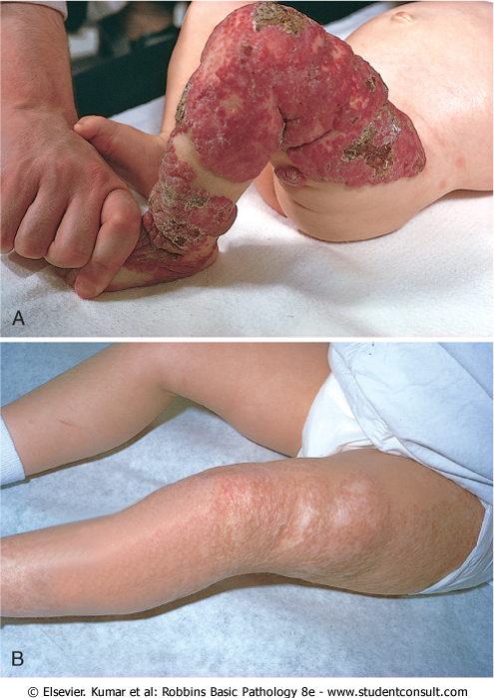
Congenital capillary hemangioma at birth
at 2 years of age after the lesion had undergone spontaneous regression

Slide 6
Hemangiomas
Rarely, they may be the manifestation of a hereditary disorder associated with disease within internal organs, such as the von Hippel-Lindau and Sturge-Weber syndromes

Slide 7
Lymphangiomas

Slide 8
Lymphangiomas
Represent the lymphatic counterpart of hemangiomas.
They are characterized by cystic and cavernous spaces lined by endothelial cells and surrounded by lymphoid aggregates
They may occur on the skin but, more importantly, are also encountered in the deeper regions of the neck, axilla, mediastinum, and retroperitoneum.
Though histologically benign, they tend to increase in size after birth and may encroach on mediastinal structures or nerve trunks in axilla.

Slide 9
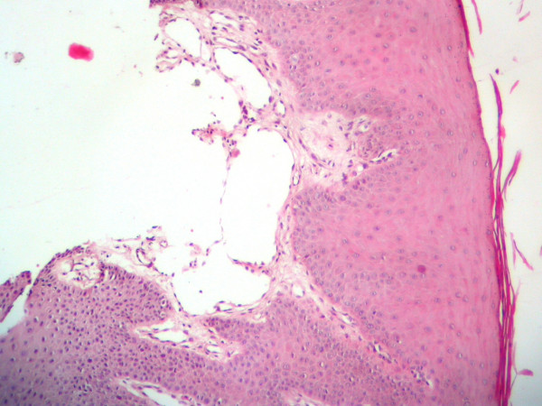

Slide 10
Sacrococcygeal teratomas

Slide 11
Sacrococcygeal teratomas
are the most common germ cell tumors of childhood, accounting for 40% or more of cases
approximately 10% of sacrococcygeal teratomas are associated with congenital anomalies, primarily defects of the hindgut and cloacal region and other midline defects
Approximately 75% of these tumors are histologically mature with a benign course, and about 12% are unmistakably malignant and lethal
Most of the benign teratomas are encountered in younger infants (<4 months), whereas children with malignant lesions tend to be somewhat older.

Slide 12
Sacrococcygeal teratomas

Slide 13
Malignant Tumors
The organ systems involved in infancy and childhood:
the hematopoietic system
neural tissue
soft tissues
(common adults tumors: lung, heart, prostate, and colon)

Slide 14
Biological differences between malignant tumors of childhood from those in adults
Relatively frequent demonstration of a close relationship between abnormal development (teratogenesis) and tumor induction (oncogenesis)
Prevalence of constitutional genetic abnormalities or syndromes that predispose to cancer
Tendency of fetal and neonatal malignancies to spontaneously regress
Improved survival or cure of many childhood tumors

Slide 15
Histological differences between malignant tumors of childhood from those in adults
Many malignant pediatric neoplasms tend to have a primitive (embryonal) rather than pleomorphic-anaplastic
Because of their primitive histologic appearance, many childhood tumors have been collectively referred to as small, round, blue cell tumors, include:
neuroblastoma
lymphoma
Rhabdomyosarcoma
Ewing sarcoma (peripheral neuroectodermal tumor)
Wilms' tumor.
There are usually sufficient distinctive features to render a definitive diagnosis on the basis of histologic examination alone, but when necessary, clinical and radiographic findings, combined with ancillary studies (e.g., chromosome analysis, immunoperoxidase stains, and electron microscopy) are used.

Slide 16
Common Malignant Neoplasms of Infancy and Childhood
Age: 0-4 year | 5-9 year | 9-13 year
Leukemia | Leukemia | Hepatocellular carcinoma
Retinoblastoma | Retinoblastoma | Soft tissue sarcoma
Neuroblastoma | Neuroblastoma | Osteogenic sarcoma
Wilms’ tumor | Hepatocellular carcinoma | Yhyroid carcinoma
Hepatoblastoma | Soft tissue sarcoma | Hodgkin lymphoma
Soft tissue sarcoma | CNS tumors Ewing Sarcoma
Teratomas | Lymphoma
CNS tumors

Slide 17
Malignant Tumors
Neuroblastoma
Retinoblastoma
Wilms' tumor

Slide 18
Neuroblastoma
Neuroblastomas and related tumors (ganglioneuroblastomas and ganglioneuromas) arise from neural crest-derived cells in the sympathetic ganglia and adrenal medulla.
Neuroblastomas are undifferentiated neoplasms, whereas ganglioneuroblastomas and ganglioneuromas demonstrate evidence of differentiation (Schwannian stroma and ganglion cells).
Neuroblastomas secrete catecholamines, whose metabolites (VMA/HVA) can be used for screening patients.

Slide 19
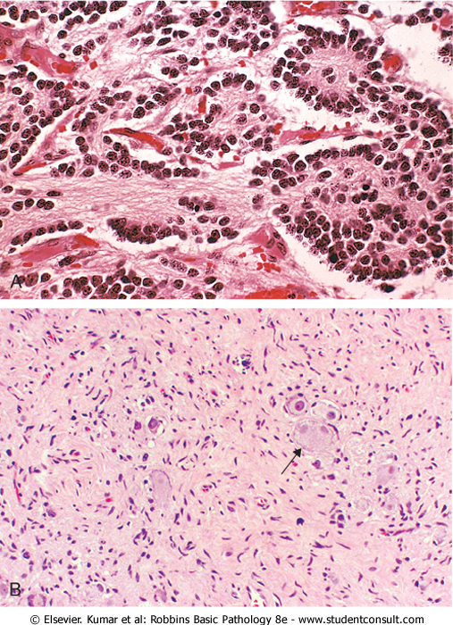
Neuroblastoma
Neuroblastoma is composed of small cells embedded in a finely fibrillar matrix (neuropil). with Homer-Wright pseudo-rosette.
Ganglioneuromas, arising from spontaneous or therapy-induced maturation of neuroblastomas, are characterized by clusters of large cells with vesicular nuclei and abundant eosinophilic cytoplasm (arrow), representing neoplastic ganglion cells. Spindle-shaped Schwann cells are present in the background stroma.

Slide 20
Neuroblastoma
Age and stage are the most important prognostic features; infants usually have a better prognosis than older children, while children with higher stage tumors fare worse.

Slide 21
Neuroblastoma
Children younger than 2 years with neuroblastomas generally present with protuberant abdomen resulting from an abdominal mass, fever, and weight loss.
In older children the neuroblastomas may remain unnoticed until metastases cause hepatomegaly, ascites, and bone pain.

Slide 22
Staging of Neuroblastomas
Stage 1 | Localized tumor with complete gross excision, with or without microscopic residual disease
Stage 2A | Localized tumor with incomplete gross resection; ipsilateral non- adherent lymph nodes negative for tumor microscopically.
Stage 2B | Localized tumor with or without complete gross excision, ipsilateral non-adherent lymph nodes positive for tumor; enlarged contralateral lymph nodes are negative
Stage 3 | Unresectable unilateral tumor infiltrating across the midline with or without regional lymph node involvement; or localized unilateral tumor with contralateral regional lymph node involvement
Stage 4 | Any primary tumor with dissemination to distant lymph nodes, bone, bone marrow, liver, skin, and/or other organs
Stage 4S (limited to infants <1yr) | Localized primary tumor (stages 1, 2A, or 2B) with dissemination limited to skin, liver, and/or bone marrow ( >10% involvement of bone marrow is considered as stage 4)

Slide 23
Retinoblastoma

Slide 24
Retinoblastoma
is the most common malignant eye tumor of childhood.
Retinoblastoma frequently occurs as a congenital tumor
it can be multifocal and bilateral
it undergoes spontaneous regression
patients have a high incidence of second primary tumors.
The incidence decreases with age, most cases being diagnosed before the age of 4 years.

Slide 25
Retinoblastoma
Occur in both familial and sporadic patterns
Familial cases
develop multiple tumors that are bilateral, although they may be unifocal and unilateral.
increased risk for developing osteosarcoma and other soft tissue tumors
Sporadic cases
All of the sporadic nonheritable tumors are unilateral and unifocal.

Slide 26
Retinoblastoma
Approximately 60% to 70% of the tumors are associated with a germline mutation in the RB1 gene and are hence heritable. The remaining 30% to 40% of the tumors develop sporadically, and these have somatic RB1 gene mutations.

Slide 27
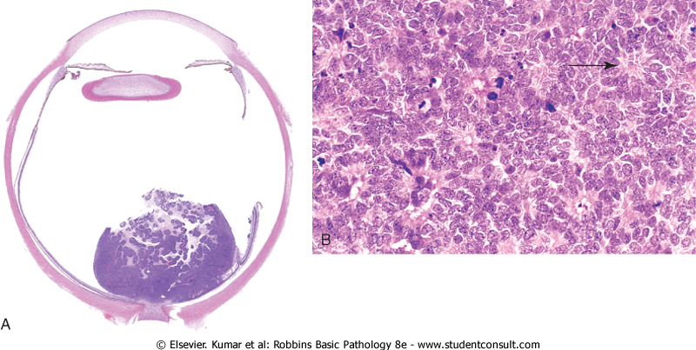
Retinoblastoma
High power view showing Flexner-Wintersteiner rosettes (arrows) and numerous mitotic figures.
cohesive tumor in retina abutting optic n

Slide 28
Retinoblastoma Clinical features
The median age at presentation is 2 years, although the tumor may be present at birth.
The presenting findings include poor vision, strabismus, a whitish hue to the pupil and pain and tenderness in the eye.
Untreated, the tumors are usually fatal, but after early treatment with enucleation, chemotherapy, and radiotherapy, survival is the rule.
Some tumors may spontaneously regress
patients with familial retinoblastoma are at increased risk for developing osteosarcoma and other soft tissue tumors.

Slide 29
Wilms' tumor (nephroblastoma)

Slide 30
Wilms' tumor
Wilms' tumor, or nephroblastoma, is the most common primary tumor of the kidney in children.
Most cases occur in children between 2 and 5 years of age.
This tumor illustrates several important concepts of childhood tumors:
the relationship between congenital malformation and increased risk of tumors
the histologic similarity between tumor and developing organ
the remarkable success in the treatment of childhood tumors

Slide 31
Wilms' tumor
Three groups of congenital malformations are associated with an increased risk of developing Wilms' tumor:
Patients with the WAGR syndrome: aniridia, genital abnormalities, and mental retardation
Denys-Drash syndrome (DDS): gonadal dysgenesis and renal abnormalities
Beckwith-Wiedemann syndrome (BWS)
enlargement of individual body organs (e.g., tongue, kidneys, or liver) or entire body segments (hemihypertrophy); enlargement of adrenal cortical cells (adrenal cytomegaly)

Slide 32
Wilms' tumor
WAGR and DDS are associated with WT1 inactivation, while BWS arises through imprinting abnormalities at the WT2 locus.

Slide 33
Wilms' tumor in the lower pole of the kidney
Tumor shows the characteristic tan to gray color and well-circumscribed margins

Slide 35
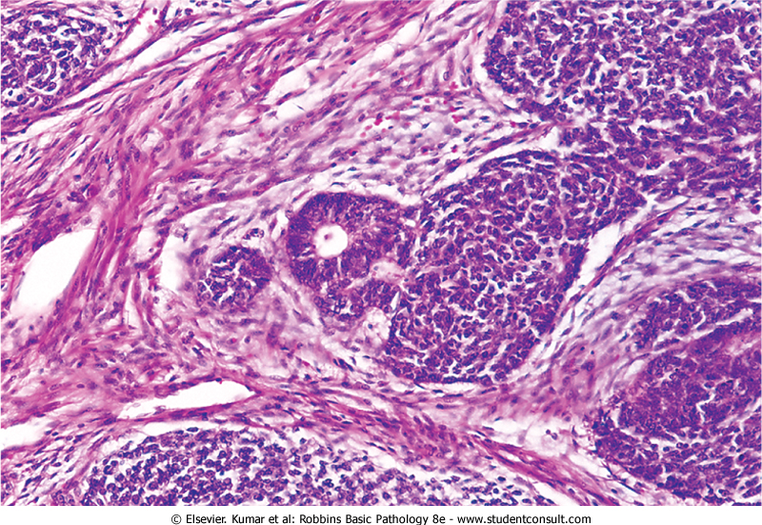
Triphasic histology of Wilms' tumor:
the stromal component is composed of spindle-shaped cells
the immature tubule of the epithelial component
the blastema :
the tightly packed
blue cells
Nephrogenic rests are precursor lesions of Wilms' tumors

Slide 36
Wilms' tumor
palpable abdominal mass
fever
abdominal pain
hematuria

Slide 37
Prognosis of Wilms' tumor
is generally very good, and excellent results are obtained with a combination of nephrectomy and chemotherapy.
Diffuse anaplasia is a harbinger of adverse prognosis

