Slide 1
Skin Pathology
Inflammatory Skin Disorder
Skin Tumors

Slide 2
The skin has three layers:
1. The epidermis
2. The dermis
3. The deep subcutis.

Slide 3
Cutaneous disorders are extremely common and range from irritating acne to life-threatening melanoma.
Cutaneous disorders:
intrinsic to the skin
manifestations of systemic disease
e.g. systemic lupus erythematosus

Slide 4
Macroscopic Terms in Skin

Slide 5
Macule
Flat, circumscribed area of any size distinguished from surrounding skin by coloration

Slide 6
Papule
Elevated solid area 5 mm or less in diameter

Slide 7
Nodule
Elevated solid area more than 5 mm in diameter

Slide 8
Plaque
Elevated flat-topped area, usually more than 5 mm in diameter

Slide 9
Vesicle
Fluid-filled raised area 5 mm or less in diameter e.g. Herpes

Slide 10
Bulla
Fluid-filled raised area more than 5 mm in diameter (a large vesicle)

Slide 11
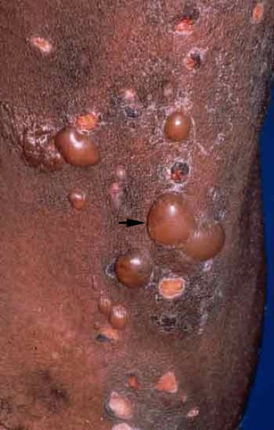
Macroscopic Terms in Skin
Blister: Common term used for vesicle or bulla

Slide 12
Pustule
Discrete, pus-filled raised area

Slide 13
Excoriation
A traumatic lesion characterized by breakage of the epidermis, causing a raw linear area usually due to scratching.

Slide 14
Scale
Dry, horny, plate-like excrescence

Slide 15
Lichenification
Thickened and rough skin characterized by prominent skin markings
usually the result of repeated rubbing in susceptible persons

Slide 16
Microscopic Terms

Slide 17
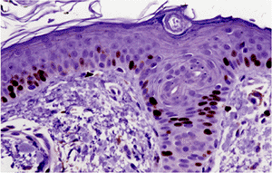
Hyperkeratosis
Hyperplasia of the stratum corneum, often associated with a qualitative abnormality of the keratin

Slide 18
Parakeratosis
Mode of keratinization characterized by retention of the nuclei in the stratum corneum

Slide 19
Acanthosis
Epidermal hyperplasia preferentially involving the stratum spinosum

Slide 20
Dyskeratosis
Abnormal keratinization occurring prematurely within individual cells or groups of cells below the stratum granulosum

Slide 21
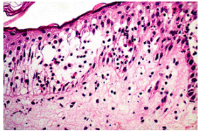
Acantholysis
Loss of intercellular connections resulting in lack of cohesion between keratinocytes

Slide 22
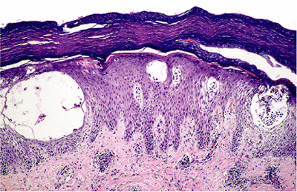
Spongiosis
Intercellular edema of the epidermis

Slide 23
Inflammatory conditions Acute Eczematous Dermatitis Psoriasis Lichen Planus
Neoplastic conditions
Squamous Cell Carcinoma
Basal Cell Carcinoma
Melanoma

Slide 24
Acute Eczematous Dermatitis
Eczema is a clinical term characterized by red, papulovesicular, oozing, and crusted lesions at an early stage
Chronic lesion is raised, scaling plaques
It embraces a number of conditions with different underlying etiologies:
Clinical coditions:
(1) allergic contact
(2) atopic
(3) drug-related eczematous
(4) photoeczematous
(5) primary irritant forms
resolve completely when the offending stimulus is removed

Slide 25
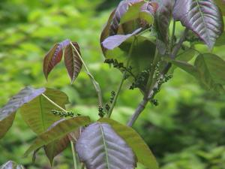
Contact Dermatitis
External application of antigen (such as poison ivy) or reaction to an internal circulating antigen (such as ingested food or drug)

Slide 26
Only 1 nanogram (billionth of a gram) is needed to cause rash
1/4 ounce of urushiol is all that is needed to cause a rash in every person on earth
500 people could itch from the amount covering the head of a pin
1 to 5 years is normal for urushiol oil to stay active on any surface including dead plants
Derived from urushi, Japanese name for lacquer

Slide 27
Pathogenesis of Contact Dermatitis
initial exposure to an environmental contact sensitizing agent
self-proteins modified by the agent are processed by epidermal Langerhans cells
These migrate to draining lymph nodes and present the antigen to naive T cells
This sensitization event leads to acquisition of immunologic memory
LN
T cell
on re-exposure to the antigen, CD4+ T lymphocytes migrate to the affected skin
they release cytokines that recruit additional inflammatory cells

Slide 28
Acute eczematous dermatitis
Lesions are pruritic (itchy), edematous, oozing plaques, often containing vesicles and bullae

Slide 29
Acute eczematous dermatitis
reddening (erythema) of the skin and numerous tiny vesicles, some of which have burst as a result of scratching because of severe itch.
The histological basis of erythema and of vesicle formation:
Spongiosis
Spongiotic vesicle
Dilated dermal capillaries
Lymphocytic infiltrate

Slide 30
Acute eczematous dermatitis
Spongiosis
Spongiotic vesicle
Dilated dermal capillaries
Lymphocytic infiltrate

Slide 31
eczematous dermatitis
With persistent antigen stimulation, lesions may become progressively scaly (hyperkeratotic) as the epidermis thickens (acanthosis) and can become chronic

Slide 32
Atopic dermatitis
Atopic dermatitis is often inherited and this form can be more chronic, although it sometimes improves with age.
Atopic individuals often suffer from asthma

Slide 33
CHRONIC INFLAMMATORY DERMATOSES
Persistent inflammatory dermatoses for long time (months to years)
Psoriasis
Lichen Planus

Slide 34
Psoriasis
A common chronic inflammatory dermatosis affecting 1% to 2% of people in the United States.
In rare cases it is associated with systemic features:
arthritis
myopathy
Enteropathy
spondylitic heart disease.

Slide 35
Pathogenesis of Psoriasis
an immunologic disease with contributions from genetic susceptibility and environmental factors

Slide 36
Pathogenesis of Psoriasis
Sensitized populations of T cells ( CD4+ T_{H}1 cells and CD8+ T cells ) accumulate in the epidermis
T cells homing to the skin secrete cytokines and growth factors that induce proliferation of keratinocyte

Slide 37
With advances in our understanding of T-cell biology, Various clinically useful agents are used to block:
T-cell activation and proliferation
T cell trafficking and keratinocyte interaction with T cells
binding of tumor necrosis factor to its receptor thus inhibiting T cell functions
Reserved for use in severe psoriatic arthritis

Slide 38
Pathogenesis of Psoriasis
Trauma may induce a local inflammatory response that promotes development of psoriasis in susceptible individuals
(Koebner phenomenon)

Slide 39
Clinical Features of Psoriasis
Site: skin of the elbows, knees (extensor surfaces), scalp, lumbosacral areas, intergluteal cleft, and glans penis
Appearance: a well-demarcated, pink to salmon-colored plaque covered by loosely adherent silver-white scale
Chronic plaques of psoriasis show silvery-white scale on the surface of erythematous plaques.

Slide 40
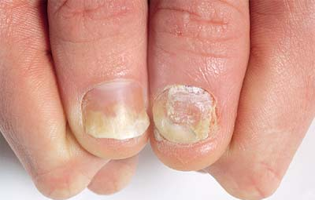
Clinical Features of Psoriasis
Nail changes: occur in 30% of cases of psoriasis and consist of yellow-brown discoloration, with pitting, thickening, and crumbling and separation of the nail plate from the underlying bed (onycholysis).

Slide 41
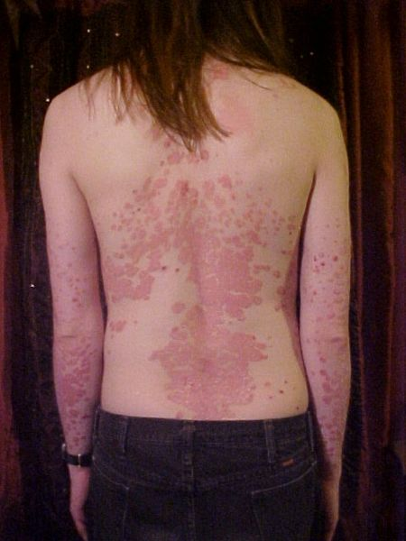
Clinical Features of Psoriasis
In most cases, psoriasis is limited in distribution, but it can be widespread and severe on occasion.

Slide 43
Morphology of Psoriasis
There is marked epidermal thickening (acanthosis )
Increased epidermal cell turnover and lack of maturation results extensive overlying parakeratotic scale
There is thinning of the epidermal cell layer overlying the tips of dermal papillae
(thinning of suprapapillary plates)
The blood vessels within the papillae are dilated and tortuous. These vessels bleed readily when the scale is removed, giving rise to multiple punctate bleeding points (Auspitz sign).
Neutrophils form small aggregates within both the spongiotic superficial epidermis (pustules of Kogoj) and the parakeratotic stratum corneum (Munro microabscesses).

Slide 44
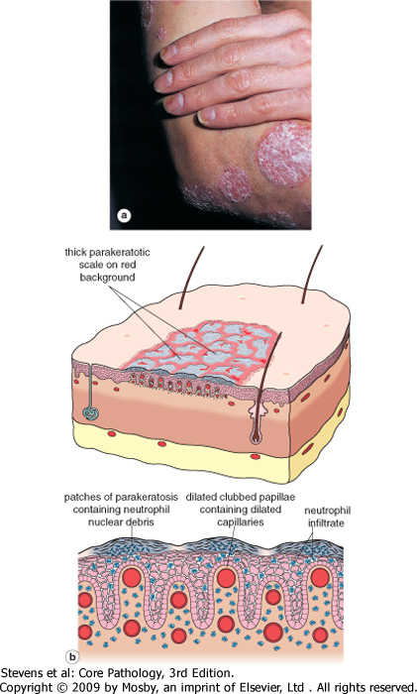

Slide 45
Lichen Planus

Slide 46
Lichen Planus
Pruritic, purple, polygonal, planar papules, and plaques
disorder of skin and mucosa.

Slide 47
Pathogenesis of Lichen planus
Not known.
Expression of altered antigens at the level of the basal cell layer and the dermoepidermal junction may elicit a CD8+ Tcell-mediated cytotoxic immune response.
The altered antigens could be due to viral infection or perhaps drug treatment.

Slide 49
Morphology
Interface dermatitis, is characterized by a dense, continuous infiltrate of lymphocytes along the dermoepidermal junction
The lymphocytes are associated with basal keratinocytes that show degeneration
This pattern of inflammation causes the dermoepidermal interface to assume an angulated, zigzag contour ("sawtoothing").
Anucleate, necrotic basal cells are seen in the inflamed papillary dermis and are referred to as colloid bodies or Civatte bodies

Slide 50
Clinical Features
Cutaneous lesions consist of pruritic, violaceous,
flat-topped papules or plaques
With white dots or lines, called Wickham's striae.
Hyperpigmentation may result from melanin loss

Slide 51
Clinical Features
Multiple lesions are symmetrically distributed, particularly on the extremities, often about the wrists and elbows, and on the glans penis.
In 70% of cases, oral lesions are present as white, reticulated, or netlike areas involving the mucosa.

Slide 52
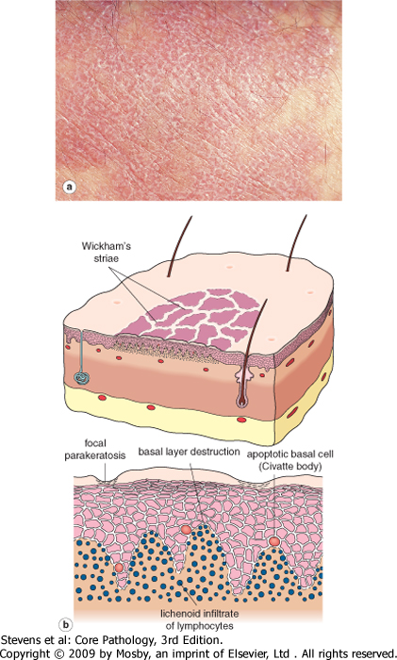

Slide 53
SUMMARY
Inflammatory Dermatoses
There are many specific inflammatory dermatoses
they may be mediated by IgE antibodies (urticaria) and antigen-specific T cells (eczema and psoriasis)
The histologic features can be grouped into patterns of inflammation such as spongiotic dermatits (eczema), interface dermatitis (lichen planus), or psoriasiform hyperplasia (psoriasis)

Slide 54
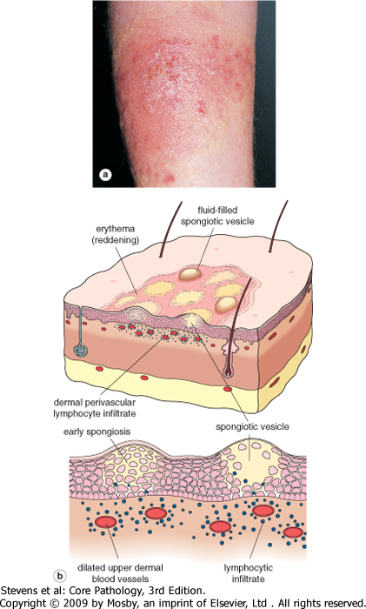
Lichen planus
Contact dermatitis
Psoriasis

Slide 56
Tumors of Skin
SCC
BCC
Melanoma

Slide 57
Premalignant Epithelial Lesions
Actinic Keratosis
Skin dysplasia results of chronic exposure to sunlight and is associated with hyperkeratosis

Slide 58
Does all actinic keratoses would result in carcinoma with time?
Many lesions regress or remain stable.
However, some cases do become malignant so need local eradication.

Slide 59
Pathogenesis
Mutation of p53 is often an early event with molecular changes suggestive of ultraviolet light injury.

Slide 60
Clinical Features
Lesions of actinic keratosis, very common in fair-skinned individuals, are usually less than 1 cm in diameter; tan-brown, red, or skin colored; and have a rough, sandpaper-like consistency
Site: There is a predilection for sun-exposed areas (face, arms, dorsum of the hands), and the lesions accumulate with age and degree of sun exposure.
The lesions can be treated with local cryotherapy
(superficial freezing) or topical chemotherapeutic
and other agents.

Slide 61
Morphology
Lower portions of the epidermis show cytologic atypia, often with hyperplasia of basal cells
The dermis contains thickened, blue-gray elastic fibers (solar elastosis), the result of chronic sun damage & lymphocytes
The stratum corneum is thickened with retained nuclei (parakeratosis)

Slide 62
Actinic Keratosis

Slide 64
Summary
Actinic Keratosis
Present on sun-exposed skin, they show cytologic atypia in lower parts of epidemis, that can infrequently progress to carcinoma in situ

Slide 65
Malignant Epidermal Tumors
Squamous Cell Carcinoma

Slide 66
Squamous Cell Carcinoma (SCC)
A common tumor arising on sun-exposed sites in older people
Except for lesions on the lower legs, these tumors have a higher incidence in men than in women.
Other predisposing factors include:
industrial carcinogens (tars and oils),
chronic ulcers
old burn scars
ingestion of arsenicals
ionizing radiation.

Slide 67
As with squamous cell carcinomas at other sites, those in the skin may be preceded by in situ lesions.

Slide 68
Pathogenesis of SCC
The most common exogenous cause of cutaneous squamous cell carcinoma is UV light exposure, with subsequent unrepaired DNA damage
Who are the most commonly affected individuals?
Individuals who are immunosuppressed as a result of chemotherapy or organ transplantation, or who have xeroderma pigmentosum, are at increased risk.

Slide 69
Pathogenesis of SCC UV light
In addition to inducing mutations, UV light (UVB in particular) may have a transient immunosuppressive effect on skin by impairing antigen presentation by Langerhans cells. This may contribute to tumorigenesis by weakening immunosurveillance
Mutations associated UV:
p53 mutations
Activating mutations in RAS

Slide 70
Squamous Cell Carcinoma (SCC)
Immunosuppressed patients, particularly organ transplant recipients, are likely to be associated with high-risk HPV types.

Slide 71
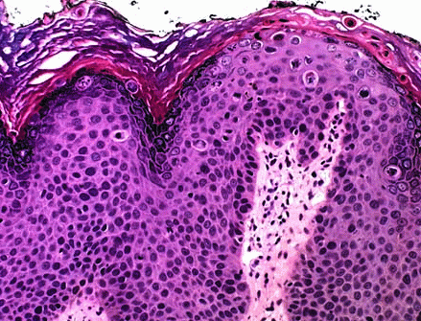
Morphology of SCC
Squamous cell carcinoma in situ is characterized by highly atypical cells at all levels of the epidermis, with nuclear crowding and disorganization.
The squamous dyplasia is broad and occupies the full thickness of the epithelium.

Slide 72
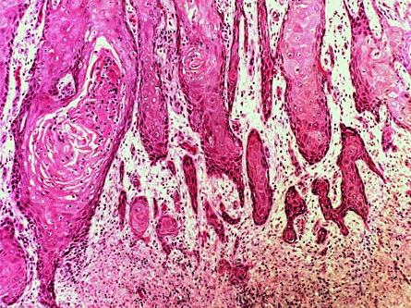
When these cells break through the basement membrane, the process has become invasive

Slide 73
Invasive squamous cell carcinomas exhibit variable differentiation

Slide 74
Clinical Features of SCC
invasive lesions are nodular, show variable scale, and may ulcerate
The likelihood of metastasis
is related to the thickness of
the lesion and degree of
invasion into the subcutis

Slide 75
Prognosis of SCC
Tumors arising in the context of actinic keratoses may behave in a less aggressive fashion
SCC arising in burn scars, ulcers, and skin not exposed to the sun tend to behave less predictably.

Slide 76
Prognosis of SCC
Invasive squamous cell carcinomas of the skin are often discovered while small and resectable; less than 5% have metastases to regional nodes at diagnosis.
Mucosal squamous cell carcinomas (oral, pulmonary, esophageal, etc.) are generally a much more aggressive

Slide 77
Basal Cell Carcinoma

Slide 78
Basal cell carcinoma
The most common human cancer, is a slow-growing tumor that rarely metastasizes.
It tends to occur at sites subject to chronic sun exposure and in lightly pigmented people.
As with squamous cell carcinoma, the incidence of basal cell carcinoma increases with:
immunosuppression
in individuals with inherited defects in DNA
repair

Slide 79
Pathogenesis of BCC
Basal cell carcinoma has been associated with dysregulation of the hedgehog , or PTCH, pathway. Inherited defects the familial basal cell carcinoma syndrome, Gorlin syndrome.
Thus, PTCH functions as a classic tumor suppressor.
Since the PTCH pathway is also important in embryonic development, subtle developmental anomalies are also noted in these individuals.
Some component of the PTCH pathway is also mutated in the great majority of sporadic
basal cell carcinomas
mutations in p53 are also common.

Slide 80
Clinical Features of BCC
Clinically, these tumors present as pearly papules, often containing prominent, dilated subepidermal blood vessels (telangiectasia)

Slide 81
Clinical Features of BCC
Advanced lesions may ulcerate, and extensive local invasion of bone or facial sinuses may occur after many years of neglect.
Rodent ulcer

Slide 82
Morphology of BCC
Tumor cells resemble the normal epidermal basal cell layer from which they are derived.
Peripheral tumor cell nuclei align in the outermost layer (palisading) with separation from the stroma

Slide 83
Basal Cell Carcinoma
Microscopic:
High Power
Clinical Appearance
Microscopic:
Low Power

Slide 84
Basal Cell Carcinoma
Two growth pattern

Slide 85
Treatment of BCC
usually treated with complete local excision
immunomodulatory therapies that direct the innate immune response against the tumor are currently being tested

Slide 86
Summary Malignant Epidermal Tumors
The incidence of both basal cell and squamous cell carcinoma is strongly correlated with increasing lifetime sun exposure.
Basal cell carcinoma, the most common malignant tumor world-wide, is a locally aggressive tumor associated with mutations in the PTCH pathway. Metastasis is exquisitely rare.

Slide 87
Summary Malignant Epidermal Tumors
Cutaneous squamous cell carcinoma can pro-gress from actinic keratoses but most arise from chemical exposure, at thermal burn sites, or in association with HPV infection in the setting of immunosuppression.
Cutaneous squamous cell carcinoma has potential for metastasis, but is much less aggressive than squamous cell carcinoma at mucosal sites.

Slide 88
Tumors and Tumor-Like Lesions of Melanocytes

Slide 89
Tumors of Melanocytes
Melanocytic Nevi
Any benign congenital or acquired neoplasm of melanocytes

Slide 90
Melanocytic nevi
tan-to-brown, uniformly pigmented, small (usually ≤5 mm across), solid regions of elevated skin (papules) with well-defined, rounded borders
lesions are of cosmetic interest only
they can become irritating or mimic
melanoma and thus may be surgically removed

Slide 92
Intradermal nevus

Slide 93
Maturation of nevus

Slide 94
Dysplastic nevi
may occur sporadically or in a familial form (autosomal dominant fashion and are considered precursors of melanoma)
In the sporadic form, the risk of malignant transformation seems very low.

Slide 95
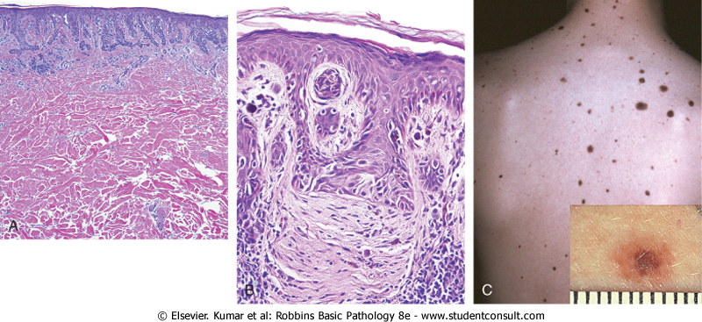
Dysplastic nevi
Nevus cell nests within the epidermis may be enlarged and exhibit abnormal fusion or coalescence with adjacent nests.

Slide 96
Clinical Feature of Dysplastic Nevi
usually larger than most acquired nevi (often >5 mm across) and may occur as hundreds of lesions on the body surface in familial cases
They are flat macules to slightly raised plaques, with a "pebbly" surface.
They usually show variable pigmentation (variegation) and irregular borders

Slide 97
Unlike ordinary nevi, dysplastic nevi have a tendency to occur on body surfaces not exposed to the sun as well as on sun-exposed body surfaces

Slide 98
Melanoma

Slide 99
Melanoma
Melanoma is less common but much more deadly than basal or squamous cell carcinoma. Today, as a result of increased public awareness of the earliest signs of skin melanomas, most melanomas are cured surgically.

Slide 100
Incidence of Melanoma
The incidence has increased dramatically over the last several decades, at least in part a result of increasing sun exposure
sunlight plays an important role in the development of melanoma
the presence of preexisting nevi and hereditary predisposition also play
a role

Slide 101
Pathogenesis of malignant transformation
is a multistep process with activating mutations in proto-oncogenes and loss of tumor suppressor genes
Germ-line mutations in the CDKN2A gene (located on 9p21) are found in as many
as 40% of individuals with familial
melanoma

Slide 102
Other molecular changes
Sporadic activating mutations in either NRAS or BRAF
Suppression of the PTEN gene on 10q23.3

Slide 103
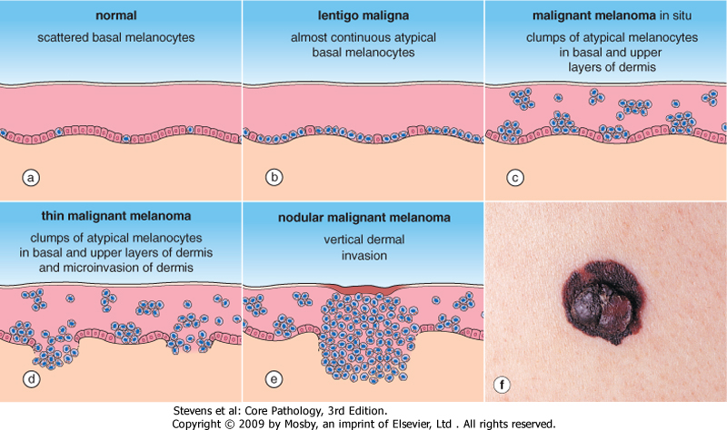
Morphology
Malignant cells grow as poorly formed nests or individual cells at all levels of the epidermis
radial and vertical growth

Slide 105
Lentigo maligna
is a pattern of junctional melanocyte proliferation affecting the faces of the elderly
Clinically the lesions appear as flat, variegated, brown-black areas of pigmentation
They gradually increase in size and have an irregular outline.
Histologically, the basal layer of the epidermis is largely replaced by an almost continuous line of large atypical melanocytes, which sometimes partially extend down skin appendages such as hair follicles.
Occasionally the lesion form a solid, raised nodule:
nodular malignant melanoma (lentigo maligna melanoma)

Slide 106
Morphology of Melanoma
Individual melanoma cells are usually considerably larger than nevus cells.

Slide 107
Clinical feature of Melanoma
Site:
most of these lesions arise in the skin
other less common sites of origin include :
the oral and anogenital mucosal surfaces
the esophagus
the meninges
the eye

Slide 108
Clinical feature of Melanoma
usually asymptomatic, although itching may be an early manifestation.
The most important clinical sign of the disease is a change in the color or size of a pigmented lesion.
Unlike benign nevi, melanomas exhibit striking variations in pigmentation,
appearing in shades of black,
brown, red, dark blue, and gray

Slide 109
The probability of metastasis is predicted by:
measuring the depth of invasion in millimeters of this vertical growth phase nodule below the top of the granular cell layer of the overlying epidermis (Breslow thickness)
lymphatic density
mitotic rate
overlying ulceration

Slide 110
The main clinical warning signs of melanoma are:
enlargement of a preexisting mole
itching or pain in a preexisting mole
development of a new pigmented lesion during adult life
irregularity of the borders of a pigmented lesion
variegation of color within a pigmented lesion.
These principles are expressed in the so-called ABCs of melanoma:
asymmetry, border, color, diameter, and evolution (change of an existing nevus).

Slide 111
Metastases
regional lymph nodes
liver
Lungs
Brain
any other site that can be seeded by the hematogenous route.
In some cases, metastases may appear for the first time many years after complete surgical excision of the primary tumor, suggesting a long phase of dormancy

Slide 112
Prognosis
It is vitally important to recognize and intervene in melanoma as rapidly as possible.
The vast majority of superficial lesions are cured surgically
melanomas that become metastatic have a virtually uniformly poor prognosis, with no effective therapy in most cases.

Slide 113
Summary Melanocytic Lesions Benign and Malignant

Slide 114
Summary Melanocytic Lesions, Benign and Malignant
Most melanocytic nevi are benign, tend to show activating mutations in just one gene, usually BRAF or less often NRAS, but the vast majority of nevi never undergo malignant transformation.

Slide 115
Summary Melanocytic Lesions, Benign and Malignant
Most dysplastic nevi are best regarded as markers of melanoma risk rather than premalignant lesions
They are compound nevi with
cytologic atypia

Slide 116
Summary Melanocytic Lesions, Benign and Malignant
Melanoma is a highly aggressive malignancy; tumors only a few millimeters in thickness can give rise to metastasis and ultimately the death of the patient.
In most cases, melanoma progresses from an intraepithelial (in situ) to invasive (dermal) form.
Characteristics of the dermal tumor such as thickness and mitotic activity correlate
strongly with overall survival

Slide 117
Thank you
See you next semester

