Slide 1
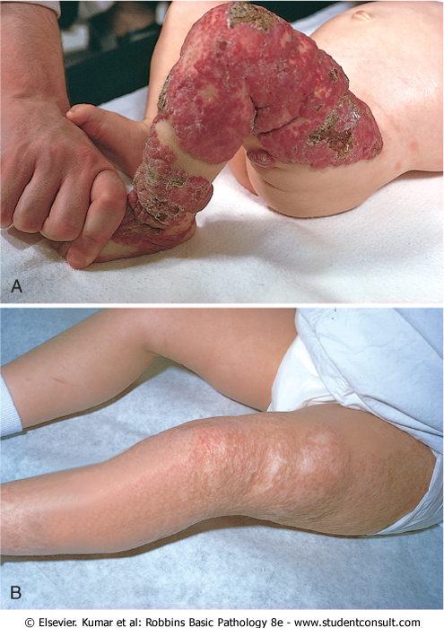
Congenital capillary hemangioma at birth
at 2 years of age after the lesion had undergone spontaneous regression

Slide 2
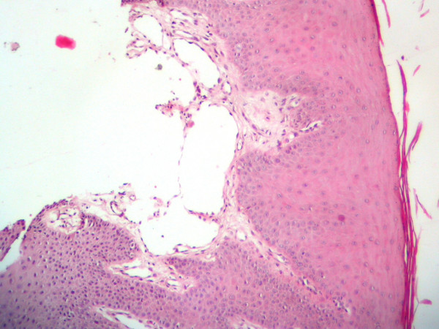

Slide 3
Sacrococcygeal teratomas

Slide 4
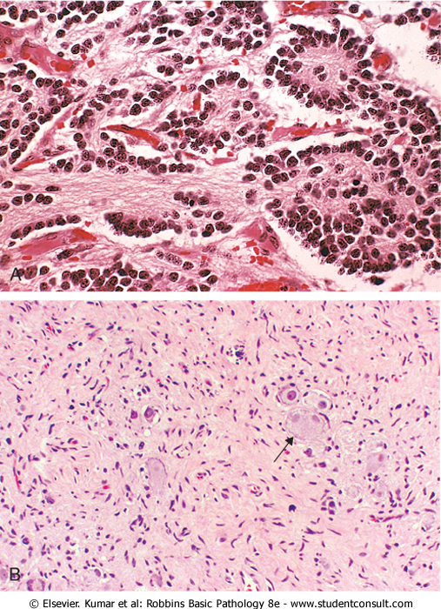
Neuroblastoma
Neuroblastoma is composed of small cells embedded in a finely fibrillar matrix (neuropil). with Homer-Wright pseudo-rosette.
Ganglioneuromas, arising from spontaneous or therapy-induced maturation of neuroblastomas, are characterized by clusters of large cells with vesicular nuclei and abundant eosinophilic cytoplasm (arrow), representing neoplastic ganglion cells. Spindle-shaped Schwann cells are present in the background stroma.

Slide 5
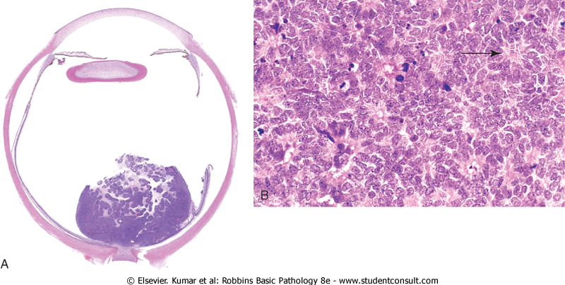
Retinoblastoma
High power view showing Flexner-Wintersteiner rosettes (arrows) and numerous mitotic figures.
cohesive tumor in retina abutting optic n

