Slide 1
Skin Pathology
Clinical and pathologic terms
Inflammatory Skin Disorder
Skin Tumors

Slide 2
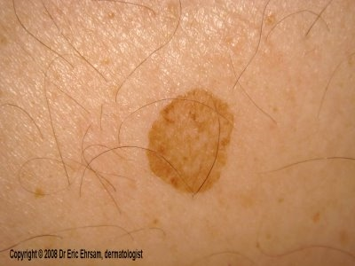
Flat lesion
Clinical terms
Macule : Flat, circumscribed area distinguished from surrounding skin by coloration

Slide 3
Clinical terms
Elevated solid area
papule
nodule
= < 5 mm
> 5 mm

Slide 4
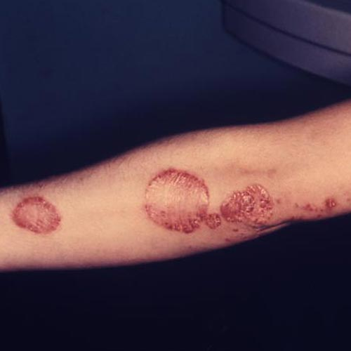
Clinical terms
Plaque: Elevated flat-topped area, usually more than 5 mm

Slide 5
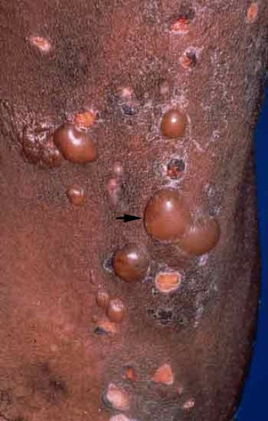
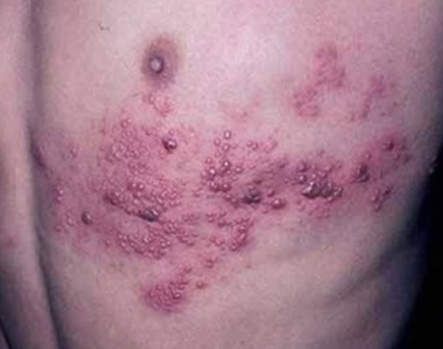
Blister Fluid-filled raised area
Clinical terms
Vesicle
Bulla
= < 5 mm
e.g. Herpes
> 5 mm

Slide 6
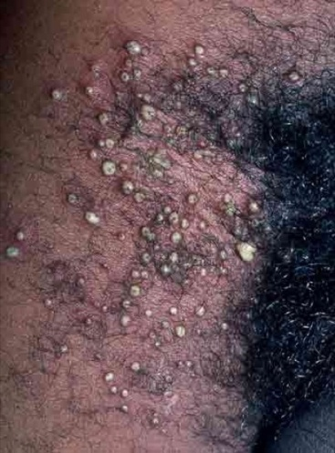
Pustule
Clinical terms
Discrete, pus-filled raised area

Slide 7
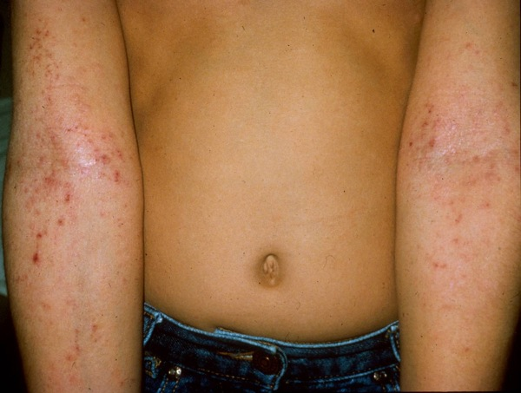
Excoriation
Clinical terms
A traumatic lesion characterized by breakage of the epidermis, causing a linear area usually due to scratching.

Slide 8
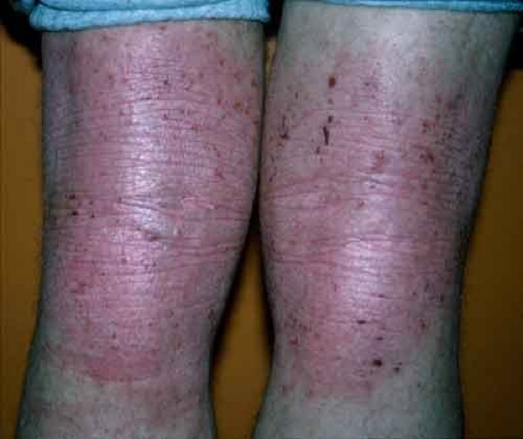
Lichenification
Clinical terms
Thickened skin characterized by prominent skin markings
usually the result of repeated rubbing

Slide 9
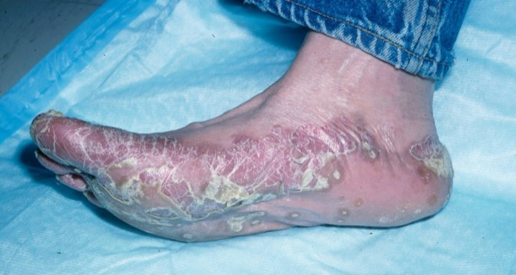
Scale
Clinical terms
Dry, horny, plate-like excrescence

Slide 10
pathologic terms

Slide 11
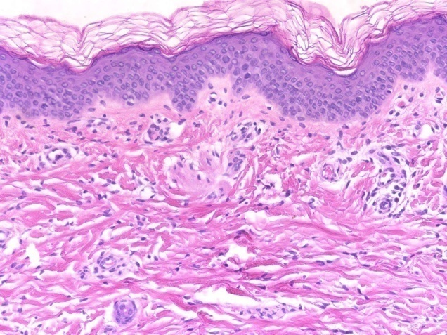
pathologic terms
KERATINOCYTES
Epidermis :
Stratum corneum( keratin layer )
Stratum granulosum ( granuler layer )
Stratum spinosum( spinous layer )
Stratum basalis ( basal layer)
Dermis

Slide 12
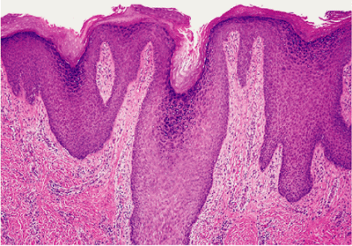
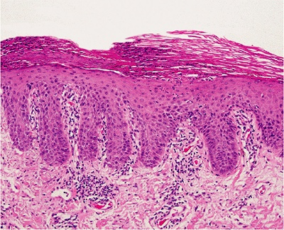
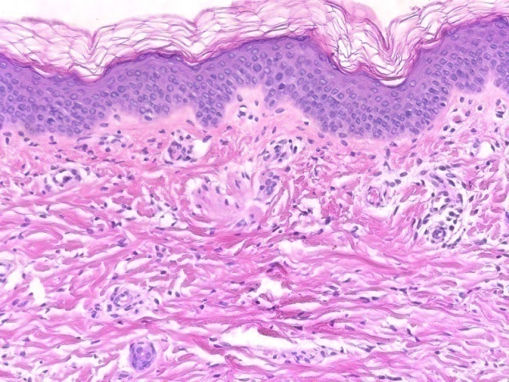
Thickening of stratum corneum
pathologic terms
Hyperkeratosis
Parakeratosis
retention of the nuclei
normal

Slide 13
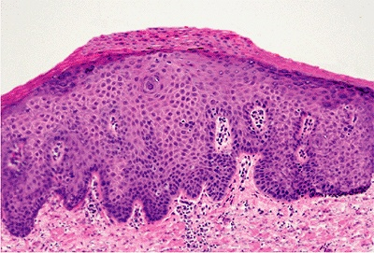
Acanthosis
pathologic terms
Epidermal hyperplasia preferentially involving the stratum spinosum

Slide 14
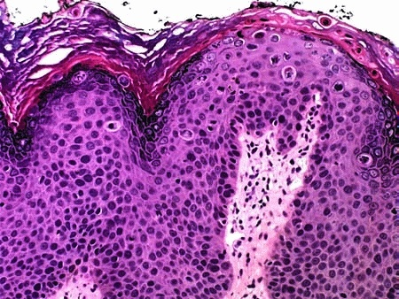
Dyskeratosis
pathologic terms
Abnormal keratinization occurring prematurely within individual cells below the stratum granulosum

Slide 15
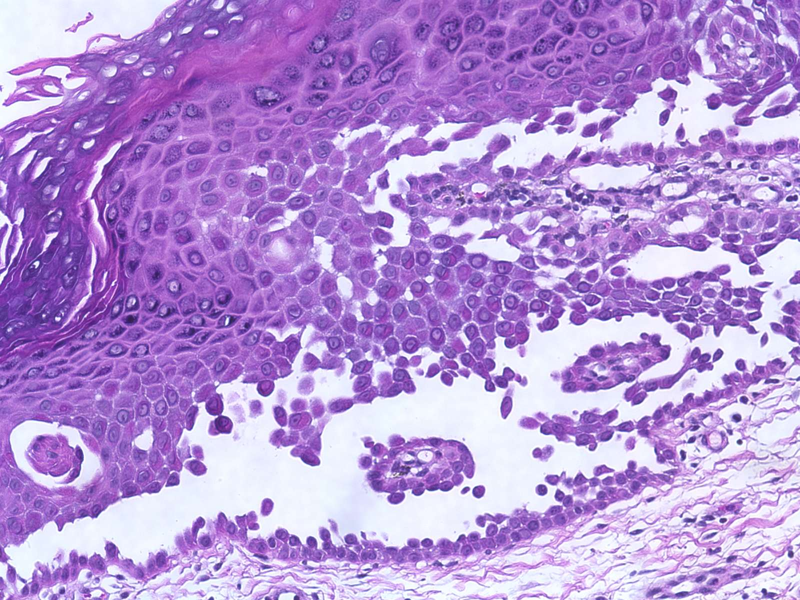
Acantholysis
pathologic terms
Loss of cohesion between keratinocytes

Slide 16
Spongiosis
pathologic terms
Intercellular edema of the epidermis

Slide 17
Skin Pathology
Clinical and pathologic terms
Inflammatory Skin Disorder
Skin Tumors

Slide 18
Skin Pathology
Clinical and pathologic terms
Inflammatory Skin Disorder
Eczema
Lichen planus
Psoriasis
Skin Tumors

Slide 19
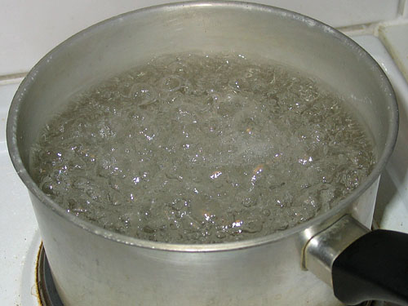
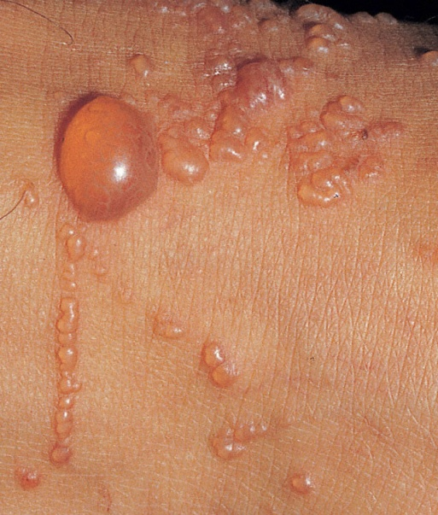
Eczema
The word ‘eczema’ comes from the Greek ‘boiling’ a reference to the tiny vesicles that are often seen in the early acute stages of the disorder, but less often in its later stage
غليان

Slide 20
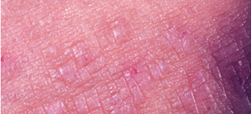
Eczema clinical features
Acute : pruritic (itchy), edematous, plaques, often containing small and large blisters (vesicles and bullae)
Chronic: persistent antigen stimulation, lesions may become less "wet" and progressively scaly as the epidermis thickens.

Slide 21
Histology
Spongiotic dermatitis

Slide 22
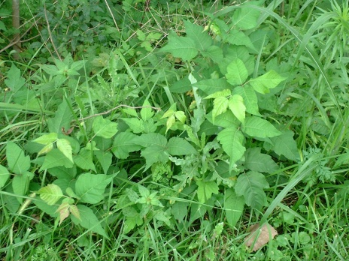
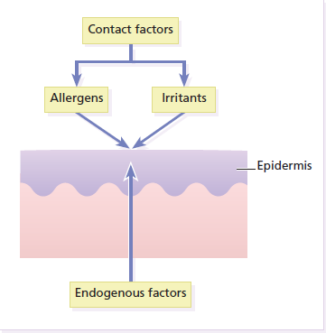
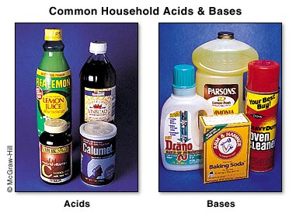
Causes of eczema
Poison Ivy
acids, bases
drug , food

Slide 23
Clinical conditions
Atopic dermatitis
Allergic contact dermatitis
irritant contact dermatitis
Drug-related
Photoallergic dermatitis

Slide 24
Atopic dermatitis
Pathogenesis:
Immune dysfunction resulting in IgE sensitization
The skin of a patient with atopic dermatitis reacts abnormally and easily to irritants, food, and environmental allergens

Slide 25
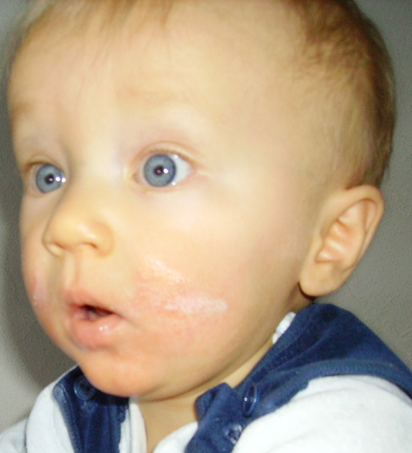
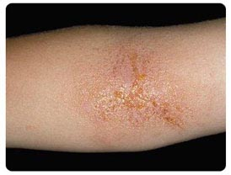
Atopic eczema
Cheeks and flexural surfaces of the joints are the most commonly affected regions.
Family history of eczema and bronchial asthma

Slide 26
Allergic Contact Dermatitis Pathogenesis
initial exposure to an environmental contact sensitizing agent
processed by epidermal Langerhans cells
DELAYED TYPE HYPERSENSITIVITY
migrate to draining lymph nodes and present the antigen to T cells
Memory T cell
LN
T cell
on re-exposure to the antigen, CD4+ T lymphocytes migrate to the affected skin
they release cytokines that recruit additional inflammatory cells

Slide 27
CHRONIC INFLAMMATORY DERMATOSES
Psoriasis
Lichen Planus

Slide 28
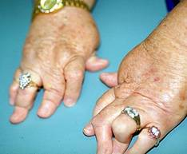
Psoriasis
A common chronic inflammatory dermatosis affecting 2% of people in the United States.
Sometimes, it is associated with arthritis, myopathy, enteropathy, and heart disease.

Slide 29
Pathogenesis of Psoriasis
immunologic + genetic susceptibility + environmental factors
Sensitized T cells secrete cytokines and growth factors that induce keratinocyte hyper-proliferation

Slide 30
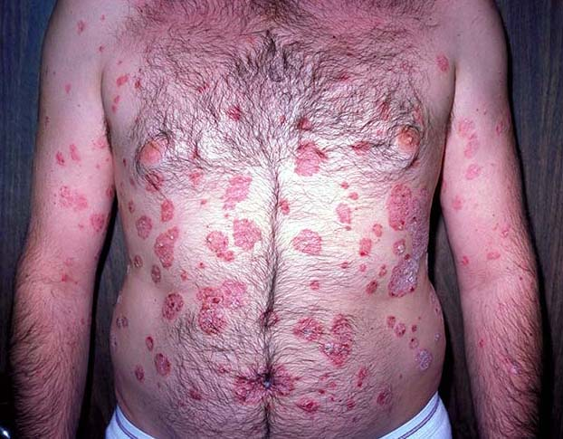
Clinical Features of Psoriasis
Site: skin of the elbows, knees, scalp, lumbosacral areas, intergluteal cleft, and glans penis
Appearance: a well-demarcated pink plaque covered by loosely adherent silver-white scale

Slide 31
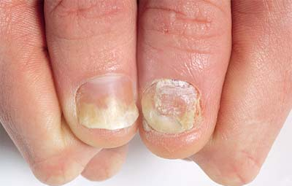
Clinical Features of Psoriasis
Nail changes: occur in 30% of cases of psoriasis

Slide 32
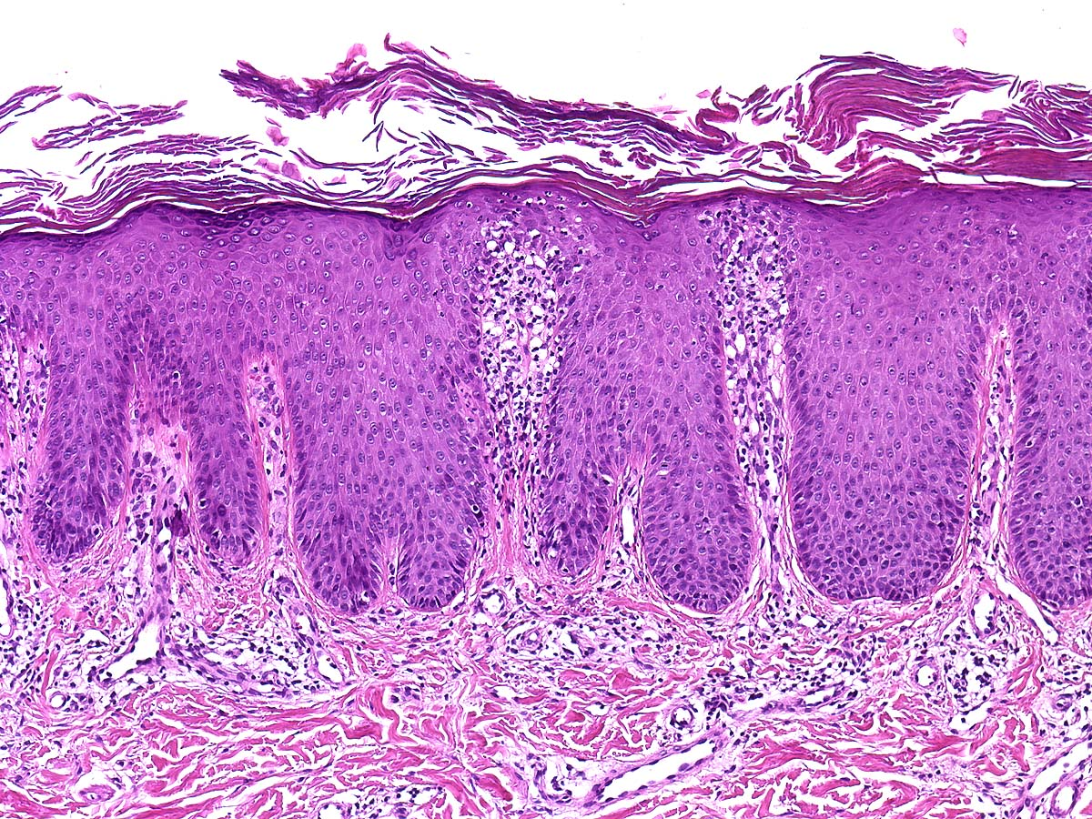
parakeratosis
thinning of suprapapillary plates)
acanthosis
epidermal thickening (acanthosis )
parakeratosis
thinning of suprapapillary plates)
The blood vessels within the papillae are dilated and tortuous. These vessels bleed readily when the scale is removed, giving rise to multiple punctate bleeding points (Auspitz sign).
Neutrophils
epidermis (pustules of Kogoj)
stratum corneum (Munro microabscesses).

Slide 33
CHRONIC INFLAMMATORY DERMATOSES
Persistent inflammatory dermatoses that exhibit their most characteristic features over many months to years
Psoriasis
Lichen Planus

Slide 34
Lichen Planus clinical
Pruritic, purple, polygonal, papules
white lines, called Wickham's striae
disorder of skin and mucous membrane.
In 70% of cases, oral lesions are present

Slide 35
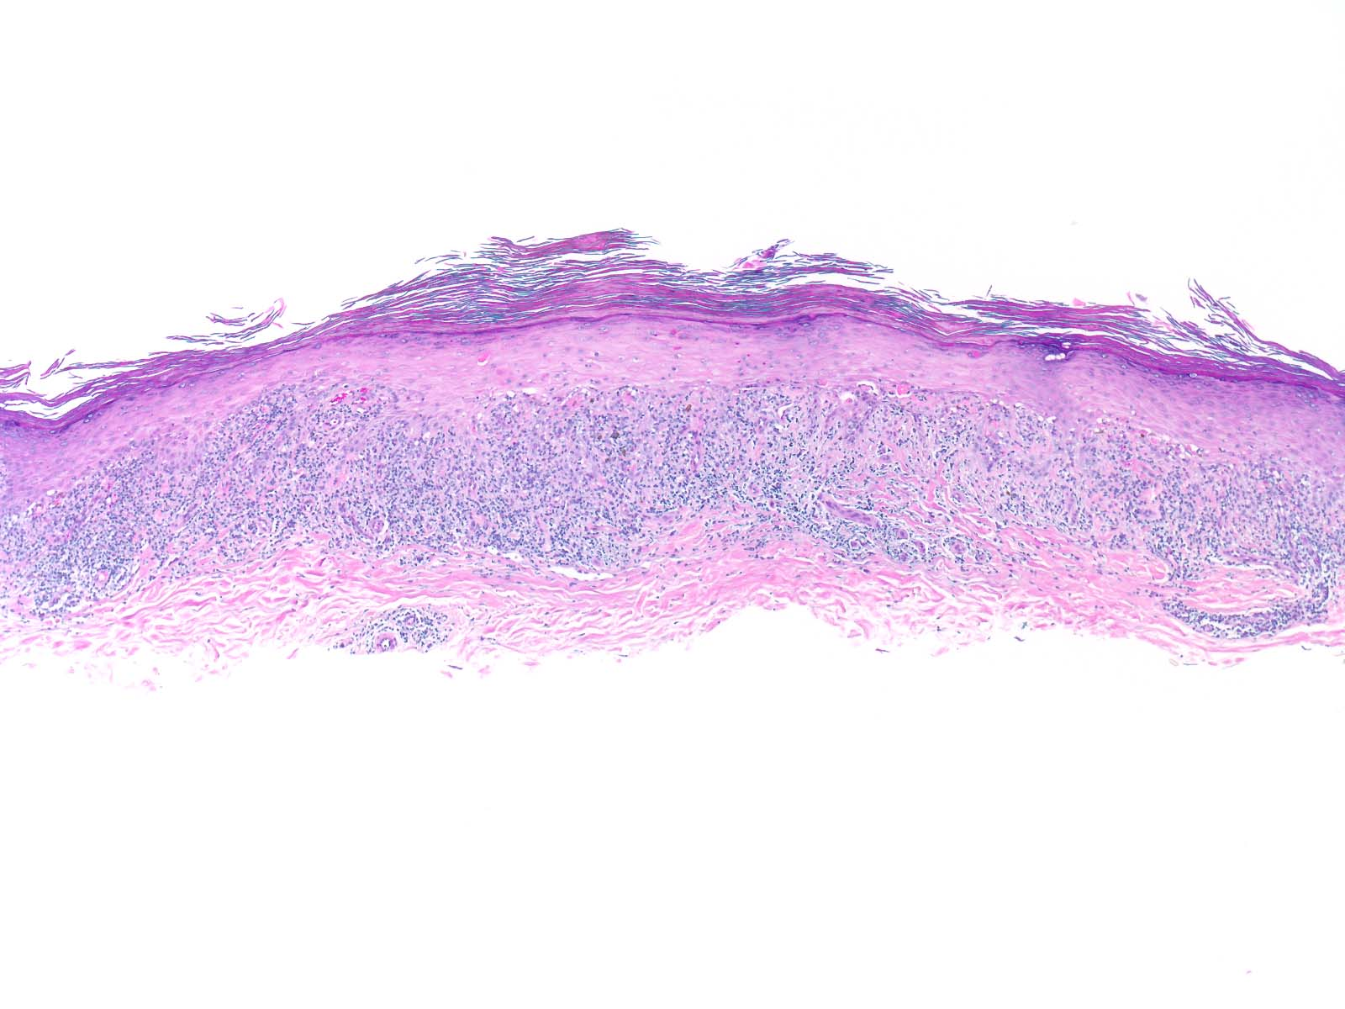
Morphology
Interface dermatitis, is characterized by a dense, continuous infiltrate of lymphocytes along the dermoepidermal junction
basal keratinocytes show degeneration and apoptosis
This pattern of inflammation causes the dermoepidermal interface to assume an angulated contour ("sawtoothing").
Interface dermatitis,
basal keratinocytes that show degeneration
sawtoothing.

Slide 36
Tumors of Skin
Squamous Cell Carcinoma
basal cell carcinoma
Melanoma

Slide 37
Premalignant Epithelial Lesions
Actinic Keratosis
Skin dysplasia results of chronic exposure to sunlight and is associated with hyperkeratosis

Slide 38
Clinical Features
Actinic Keratosis
Site: sun-exposed areas (face, arms, dorsum of the hands).
The lesions can be treated with local cryotherapy
(superficial freezing) or topical chemotherapeutic
and other agents.

Slide 39
Morphology
Lower portions of the epidermis show cytologic atypia,
The dermis contains thickened, blue-gray elastic fibers (solar elastosis), the result of chronic sun damage & lymphocytes
The stratum corneum …….parakeratosis

Slide 40
Squamous Cell Carcinoma (SCC)
sun-exposed sites in older people
lightly pigmented people.
Other predisposing factors include:
industrial carcinogens (tars and oils),
chronic ulcers
old burn scars
ionizing radiation.

Slide 41
Pathogenesis of SCC
The most common exogenous cause of cutaneous squamous cell carcinoma is UV light exposure,
immunosuppressed patients as a result of chemotherapy or organ transplantation,
xeroderma pigmentosum [inherited defects in DNA repair].
p53 mutations
Increase risk

Slide 42
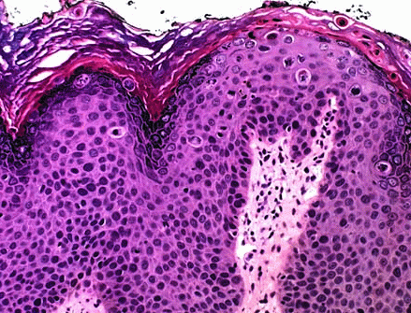
Morphology of SCC
Squamous cell carcinoma in situ is characterized by atypical cells at all levels of the epidermis, with nuclear crowding and disorganization.

Slide 43
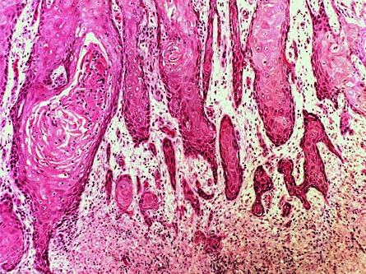
When these cells break through the basement membrane, the process has become invasive

Slide 44
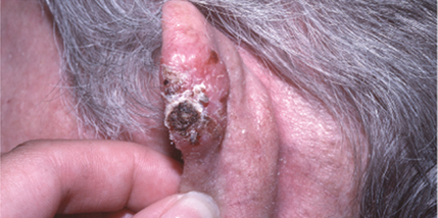
Clinical Features of SCC
invasive lesions are nodular, show variable scale, and may ulcerate

Slide 45
Prognosis of SCC
Invasive squamous cell carcinomas of the skin are often discovered while small and resectable; less than 5% have metastases to regional nodes at diagnosis.
Mucosal squamous cell carcinomas (oral, pulmonary, esophageal, etc.) are generally a much more aggressive

Slide 46
Tumors of Skin
Squamous Cell Carcinoma
basal cell carcinoma
Melanoma

Slide 47
Basal cell carcinoma
The most common human cancer,
slow-growing tumor that rarely metastasizes.
chronic sun exposure and in lightly pigmented people.
Increase risk [same as squamous cell carcinoma]
immunosuppressed patients as a result of chemotherapy or organ transplantation,
xeroderma pigmentosum [inherited defects in DNA repair].

Slide 48
Pathogenesis of BCC
dysregulation of PTCH pathway.
PTCH functions as a classic tumor suppressor.
mutations in p53 are also common.
Nevoid Basal Cell Carcinoma Syndrome [GORLIN SYNDROM]

Slide 49
Clinical Features of BCC
Papule or nodule, often containing prominent, dilated subepidermal blood vessels (telangiectasia)

Slide 50
Morphology of BCC
Tumor cells resemble the normal epidermal basal cell layer .
Peripheral tumor cell nuclei align in the outermost layer (palisading) with separation from the stroma

Slide 51
Tumors of Melanocytes

Slide 52
Tumors of Melanocytes
Melanocytic Nevi
Any benign congenital or acquired neoplasm of melanocytes

Slide 53
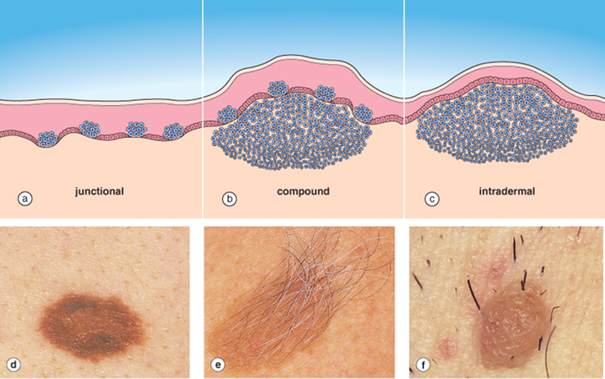

Slide 54
Dysplastic nevi
Sporadic form Not precursors of melanoma
familial form autosomal dominant fashion and is considered precursors of melanoma

Slide 55
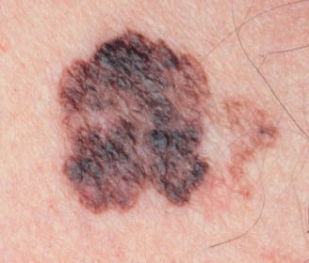
Clinical Feature of Dysplastic Nevi
usually larger than most acquired nevi (often >5 mm across) and may occur as hundreds of lesions on the body surface in familial cases
They usually show variable pigmentation (variegation) and irregular borders

Slide 56
Melanoma malignant tumor of melanocytes
Melanoma is less common but much more deadly than basal or squamous cell carcinoma.

Slide 57
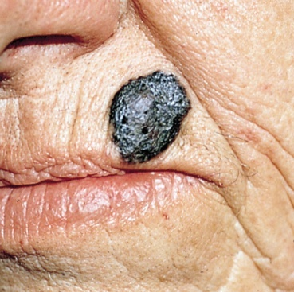
Melanoma
sunlight plays an important role in the development of melanoma
More common in fair skinned persons

Slide 58
Clinical feature of Melanoma
Site:
most of these lesions arise in the skin
other less common sites of origin include :
oral and anogenital mucosal surfaces
esophagus
meninges
eye

Slide 59
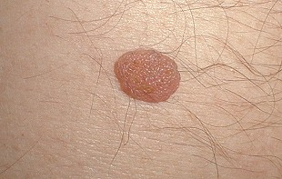
Clinical feature of Melanoma
The most important clinical sign of the disease is a change in the color or size of a pigmented lesion.
Unlike benign nevi, melanomas exhibit striking variations in pigmentation,
ABCD principle
asymmetry, border, color, diameter.
Melanoma
nevus

Slide 60
Pathogenesis of malignant transformation
is a multistep process with activating mutations in proto-oncogenes and loss of tumor suppressor genes
Germ-line mutations in the CDKN2A gene (located on 9p21) are found in 40% of individuals with familial melanoma

Slide 61
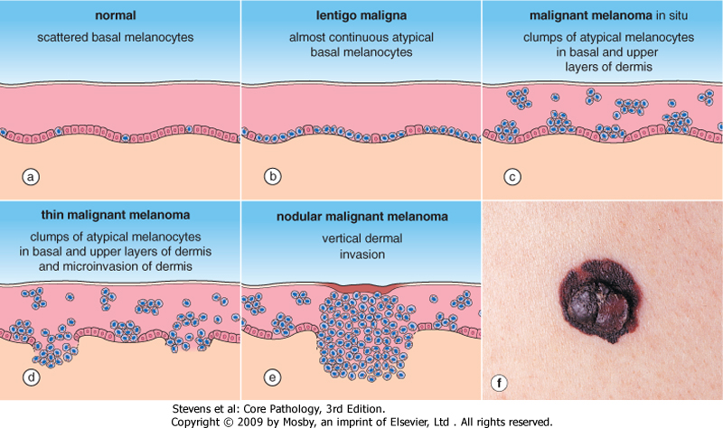
Morphology
Malignant cells grow as poorly formed nests or individual cells at all levels of the epidermis
rarely metastasized
radial growth
vertical growth
Commonly metastasized

Slide 62
Morphology of Melanoma
Individual melanoma cells are usually considerably larger and more atypical than nevus cells.

Slide 63
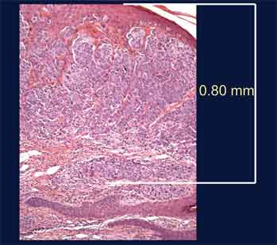
The probability of metastasis is predicted by:
measuring the depth of invasion in millimeters of vertical growth phase nodule below the top of the granular cell layer of the overlying epidermis (Breslow thickness).
overlying ulceration
mitotic rate

Slide 64
Metastases
In some cases, metastases may appear for the first time many years after complete surgical excision of the primary tumor, suggesting a long phase of dormancy

Slide 65
Prognosis
It is vitally important to recognize melanoma as early as possible.
Depend on Breslow thickness ( > 1mm , bad prognosis)
The vast majority of superficial lesions are cured surgically [radial growth phase]
melanomas that become metastatic have a virtually uniformly poor prognosis, with no effective therapy in most cases.

Slide 66
Break for 5 minutes
Then
Test

Slide 67
Macule
Papule
Plaque
Blister Vesicle, Bulla,
Pustule
Scale
Discrete, pus-filled raised area
Elevated solid area = < 5 mm
Elevated flat-topped area
Dry, horny, platelike excrescence;
Flat, circumscribed area
Fluid-filled raised area

Slide 68
Hyperkeratosis
Parakeratosis
Acanthosis
Dyskeratosis
Acantholysis
Spongiosis
Epidermal hyperplasia
Intercellular edema of the epidermis
Abnormal keratinization occurring prematurely within individual cells
Thickening of stratum corneum
Hyperkeratosis with retintion of nuclei
Loss of cohesion between keratinocytes

Slide 69
Clinical features
associated with arthritis
Atopic dermatitis
Auspitz sign
Nail changes occur in 30% of cases
Pruritic, purple, polygonal, papules
elbows, knees
Family history bronchial asthma
Eczema
Lichen planus
Psoriasis

Slide 70
Histological features
Sawtoothing
Apoptosis in basal keratinocytes
Spongiotic dermatitis
Neutrophil infiltration of epidermis
Interface dermatitis
Dilated blood vessels in papillary dermis
Eczema
Lichen planus
Psoriasis

Slide 71
Premalignant Epithelial Lesions
Breslow thickness
slow-growing tumor that very rarely metastasizes
Lentigo maligna
sun-exposed areas
dysregulation of PTCH pathway
lightly pigmented people
variations in pigmentation
Actinic Keratosis
Squamous Cell Carcinoma
basal cell carcinoma
Melanoma
Melanocytic Nevi

Slide 72
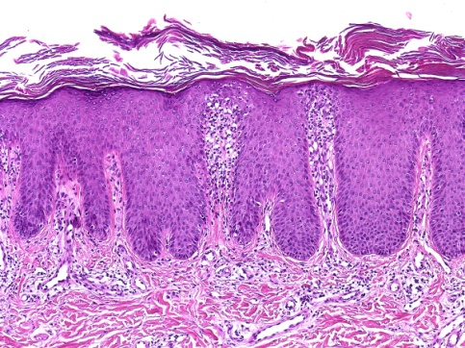
Describe the lesion What is your diagnosis
Macule
Papule
Plaque
Blister Vesicle, Bulla,
Pustule
Scale

Slide 73
What is your diagnosis? which area in body you want to examine other than skin?

Slide 75
ABCD principle

Slide 76
C
A
B
Macule
Papule
Plaque
Blister Vesicle, Bulla,
Pustule
Scale
D

