Slide 1
Limbic system
By
Esssam Eldin AbdlHady Salama

Slide 2
Objectives
At the end of the lecture, you should be able to:
Describe the components of the limbic system.
Describe the input, general circuitry, and output of the limbic system.
Discuss the function of the limbic system and its relation to memory, visceral function and emotion.

Slide 3
Limbic system
The limbic system earns its title from its position on the medial rim of the brain.
It consists of a number of structures with complex and often looped connections that all ultimately project to the hypothalamus.

Slide 4
Function of Limbic System
Controls Mood and attitude.
Stores emotional memories.
Controls appetite and sleep cycles.

Slide 5
Structure of Limbic System
Limbic lobe.
Cingulate gyrus
Amygdala.
Septum.
Fornix.
Hippocampal formation.
Thalamus (mainly anterior nuclei).
Hypothalamus (mamillary body).

Slide 6
Limbic system
Entry of the information into the limbic system is either:
1- Directly to the Amygdala.
2- Indirectly to the hippocampal formation via the entorhinal area.

Slide 7
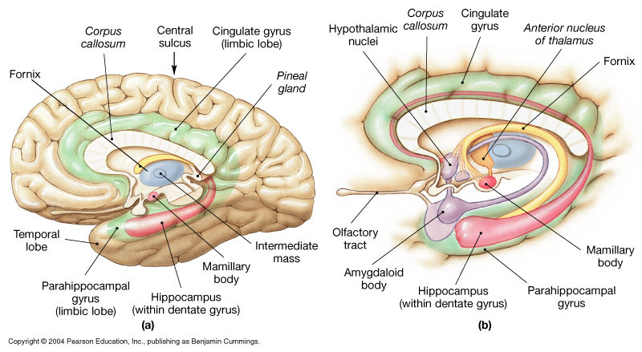
LIMBIC LOBE

Slide 8
LIMBIC LOBE
Limbic cortex
Located at the medial edge (“limbus”) of the cerebral hemispheres.
Cingulate gyrus
A strip of limbic cortex lying along the lateral walls of the groove separating the cerebral hemispheres, just above the corpus callosum.

Slide 9
AMYGDALA
It lies in the interior of the rostral part of the temporal lobe (pole).
Between the inferior horn of lateral ventricle and lentiform nucleus, rostral to tail of caudate.
Containing a set of nuclei as a part of the limbic system.

Slide 10
FUNCTION OF AMYGDALA
It is concerned with emotional and behavioral functions.
It is responsible for strong affective reactions as fear & anger and emotions associated with sexual behavior.
Lesion: lack of emotional responses.

Slide 11
SEPTUM (septal region)
Lies beneath the rostral part of corpus callosum.
Main connections:
To hypothalamus through medial forebrain bundle.
To habenular nuclei through stria medullaris thalami.

Slide 12
HIPPOCAMPAL FORMATION
It consists of:
Hippocampus
Dentate gyrus: Which lies between hippocampus & parahippocampal gyrus
Most of parahippocampal gyrus.

Slide 13
THE HIPPOCAMPUS
It is formed by infolding of inferomedial part of the temporal lobe into the lateral ventricle.

Slide 14
HIPPOCAMPUS
Its principal efferent pathway is called:
THE FORNIX:
It is C-shaped group of fibers connecting the hippocampus with mamillary body, it consists of:
Fimbria,
Crus,
Body &
Column.
The Fornix is an important component of PAPEZ CIRCUIT

Slide 15
Papez circuit
Cingulate Gyrus
Parahippocampal Gyrus
anterior nucleus of the thalamus
Mammillothalamic tract
Mammillary body
Fornix
Hippocampus

Slide 16
FUNCTION OF HIPPOCAMPUS
The hippocampus & its connections are necessary for consolidation of new short-term memories.
When the hippocampi or the circuit of Papez are no longer functional, memories of earlier events are retained.

Slide 17
Lesions associated with limbic lobe disorders
Wernicke's encephalopathy and Korsakoff’s psychosis (Retrograde & anterogdrade amnesia)
Temporal lobe epilepsy
Alzheimer’s disease
Schizophrenia

