Slide 1
Blood supply of Brain
Essam Ealdin Abdelhady Salama

Slide 2
Arterial supply of the brain
Four arteries enter into the cranial cavity to supply the brain;
Two vertebral arteries.
Two internal carotid arteries.

Slide 3
Vertebral arteries.
Aries from 1st part of the subclavian artery.
Entering the cranial cavity through foramen magnum .
Ventral to pons the vertebral arteries unite to form the basilar artery.
Branches;
Anterior spinal
Posterior spinal.
Medullar.
Posterior inferior cerebellar.

Slide 4
Basilar artery
Ascends in the basilar groove of pons.
Ends at upper border of pons by dividing into two posterior cerebral arteries.
Branches;
Pontine .
Labyrinthine .
Anterior inferior cerebellar.
Superior cerebellar .
Posterior cerebral .

Slide 5
Internal carotid artery
Entering the cranial cavity through the carotid canal
On the lateral side of optic chiasma terminating into
Anterior cerebral artery
Middle cerebral artery.
Before termination giving
Posterior communicating .
Anterior choroidal.

Slide 6
Circle of Willis
Hexagonal arterial circle lies on the base of the brain
It is formed by;
Anterior communicating.
Proximal portion of anterior cerebral.
Internal carotid.
Posterior communicating.
Proximal portion of posterior cerebral.

Slide 7
Branches of circle of Willis
Cortical branches
Anterior cerebral artery
Middle cerebral artery
Posterior cerebral artery
Central branches
Anteromedial group
Posteromedial group
Poaterolateral group
Anterolateral group
Choroidal

Slide 8
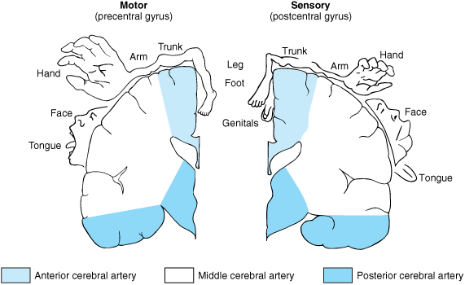
Anterior cerebral artery
One of two terminal branches of internal carotid.
It runs on the medial surface above corpus callosum.
Cortical branches supplying;
Medial part of orbital surface
Media surface except occipital lope.
Upper inch of superiolateral surface.

Slide 9
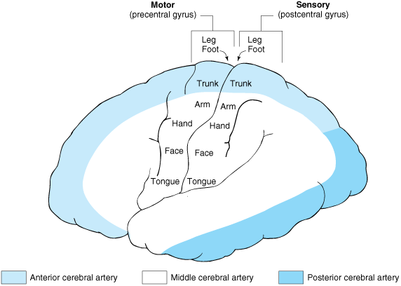
Middle cerebral artery
One of two terminal branches of internal carotid.
It runs in the stem of the lateral sulcus.
Cortical branches supplying;
Lateral part of orbital surface
Temporal pole
Superiolateral surface except upper and lower inches, occipital lobe.

Slide 10
Posterior cerebral artery
One of two terminal branches of basilar artery.
It runs on the side of mid brain.
Cortical branches supplying;
Tentorial surface.
All aspects of occipital lope.
Lower inch of superiolateral surface.

Slide 11
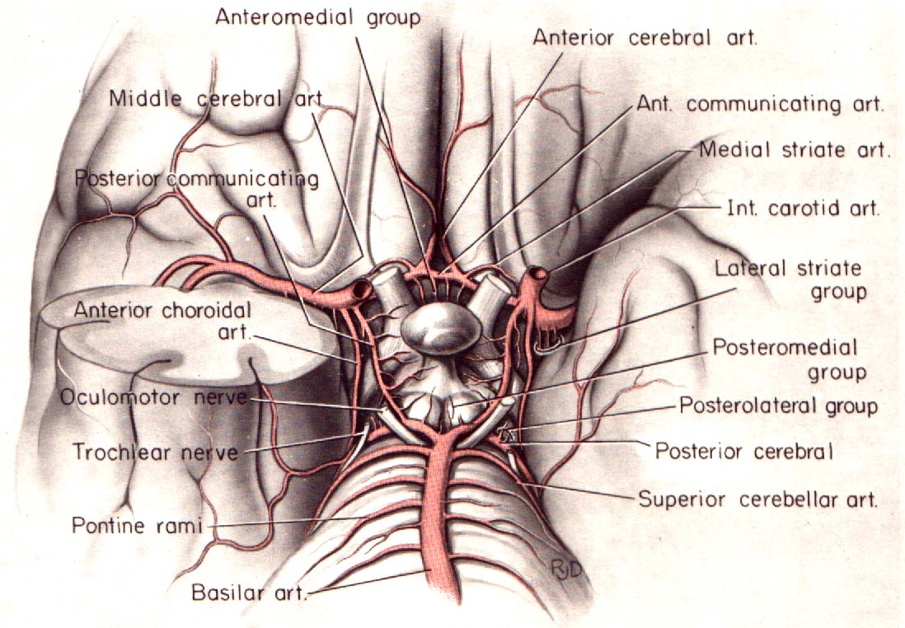
Central group
Consist of :
-Anteromedial group
-Posteromedial group
-Poaterolateral group
-Anterolateral group
-Choroidal a.

Slide 12
Anteromedial branches
: supply
Hypothalamus.
Preoptic area.
Supraoptic area.

Slide 13
Posteromedial branches
Supply;
Pituitary gland.
Hypothalamus.
Thalamus.
Midbrain.

Slide 14
Posterolateral (thalamogeniculate artery)
supply
Posterior half of thalamus.
Geniculate body.
Pulvinar.
Lateral nuclear group.
Most of ventral thalamic nuclei.

Slide 15
Anterolateral branches (striate artery)
Medial striate arteries; supply to;
Head of caudate nucleus.
Putamen.
Internal capsule.
Lateral striate a. supply to
Caudate.
Putamen.
Globus pallidus.
Internal capsule.

Slide 16
Choroid arteries Anterior choroidal artery
: supply to
choroid plexus in lateral ventricle.
hippocampal formation.
globus pallidus.
posterior limb of internal capsule.
amygdaliod nucleus.
tail of caudate nucleus.
ventrolateral part of thalamus .

Slide 17
Choroid arteries Posterior choroidal artery
Supply to
Thalamus.
Choroid plexus of third and lateral ventricle.

Slide 18
Blood supply to Corpus striatum
Striatum : from lateral striate a.
Head of caudate : from medial striate a.
Tail of caudate and putamen : from anterior choroidal a.
Globus pallidus : from lateral striate a, anterior choroidal a. And posterior communicating a.

Slide 19
Blood supply to internal capsule
Anterior cerebral
Middle cerebral
Anterior choroid

Slide 20
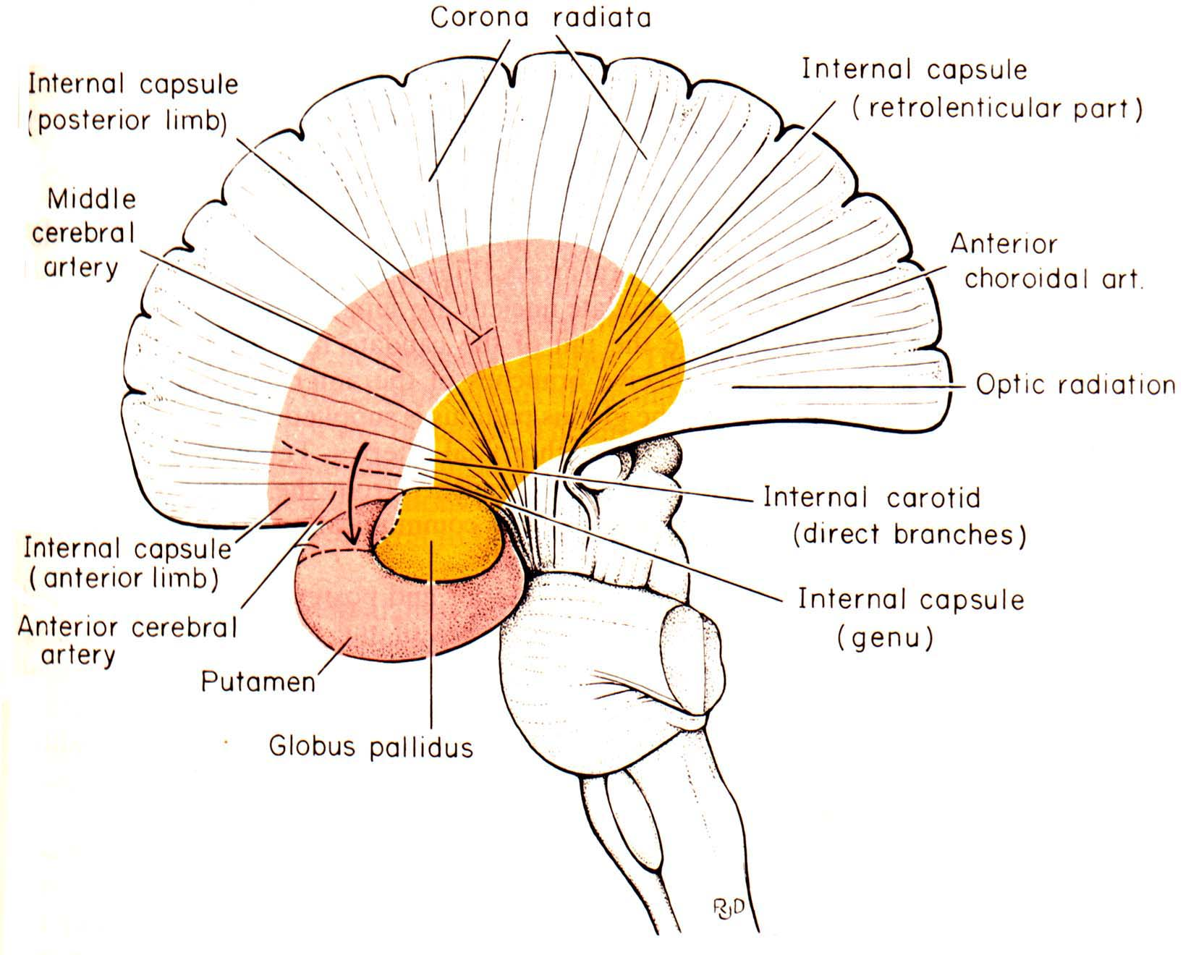

Slide 21
Arterial supply of the Midbrain, Pons & Medulla
Midbrain : Branches from basilar a.
Pons and Medulla : Anterior spinal a., Posterior spinal a., Posterior inferior cerebellar a., basilar a. and Vertebral a.

Slide 22
Cerebral veins and Venous sinus
Venules in brain form venous plexus in pia mater.
Then drain to superficial vein in subarachnoid space.
And drain to dural venous sinus.

Slide 23
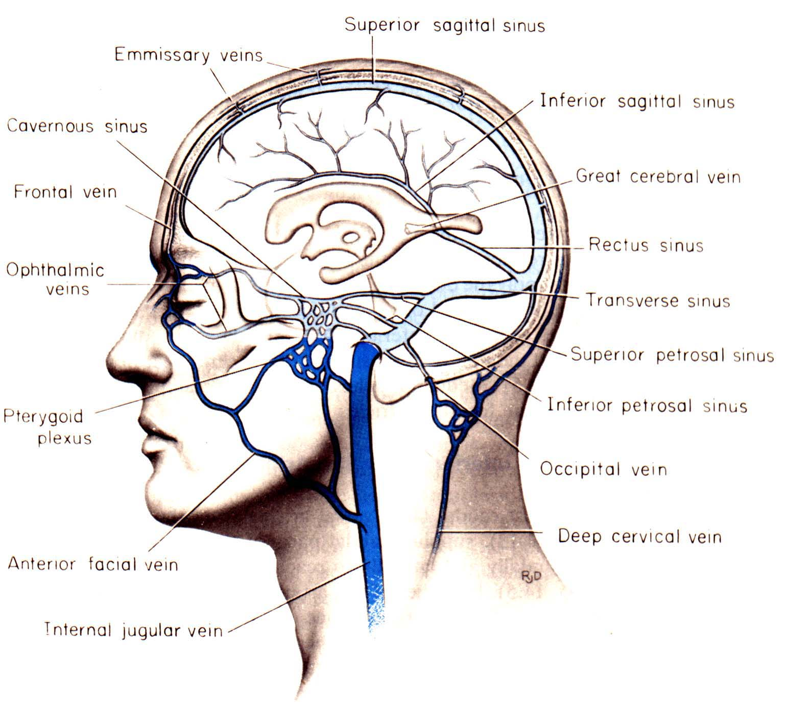

Slide 24
Classification of cerebral vein
Superficial cerebral veins
Superior cerebral veins
Inferior cerebral veins
Superficial middle cerebral veins
Deep cerebral veins
Internal cerebral vein
Basal vein (Rosenthal)
Great cerebral vein (Of Galen)

Slide 25
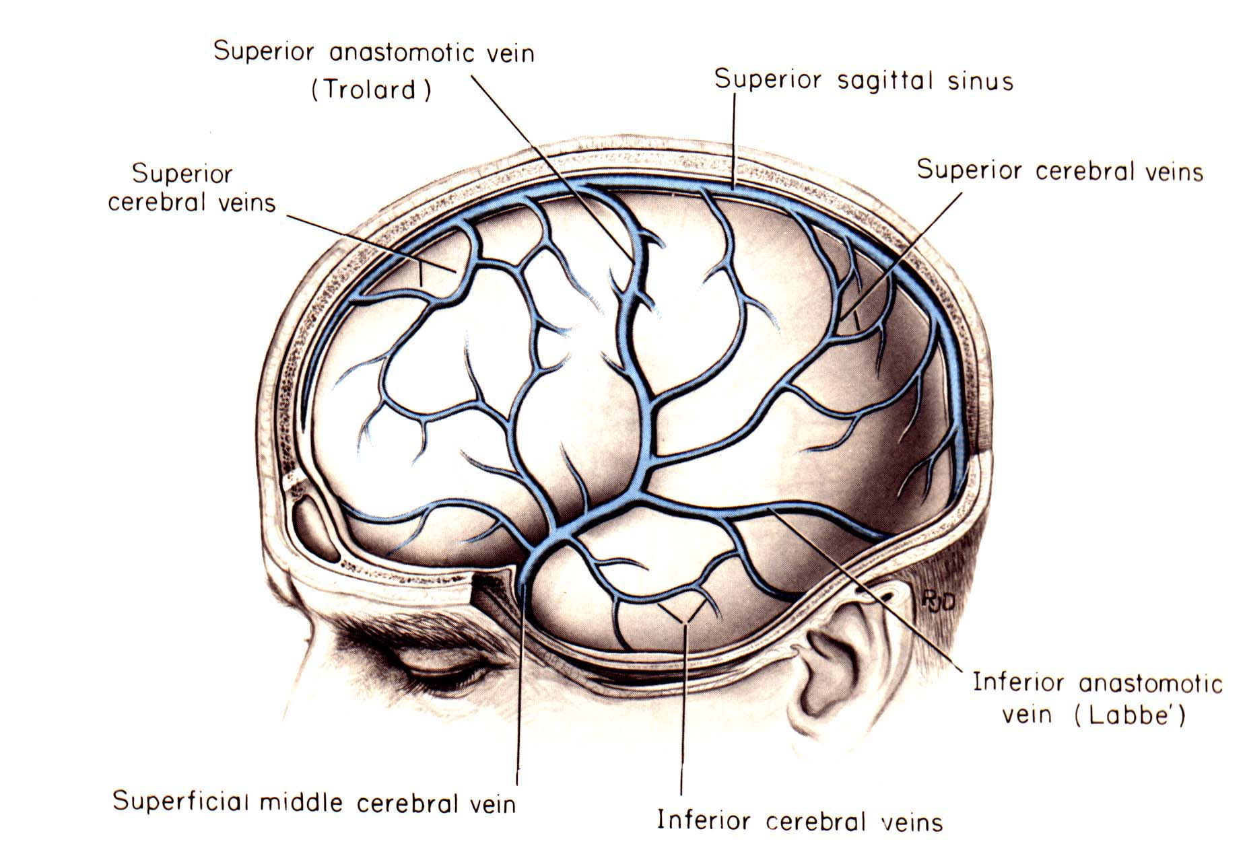

Slide 26
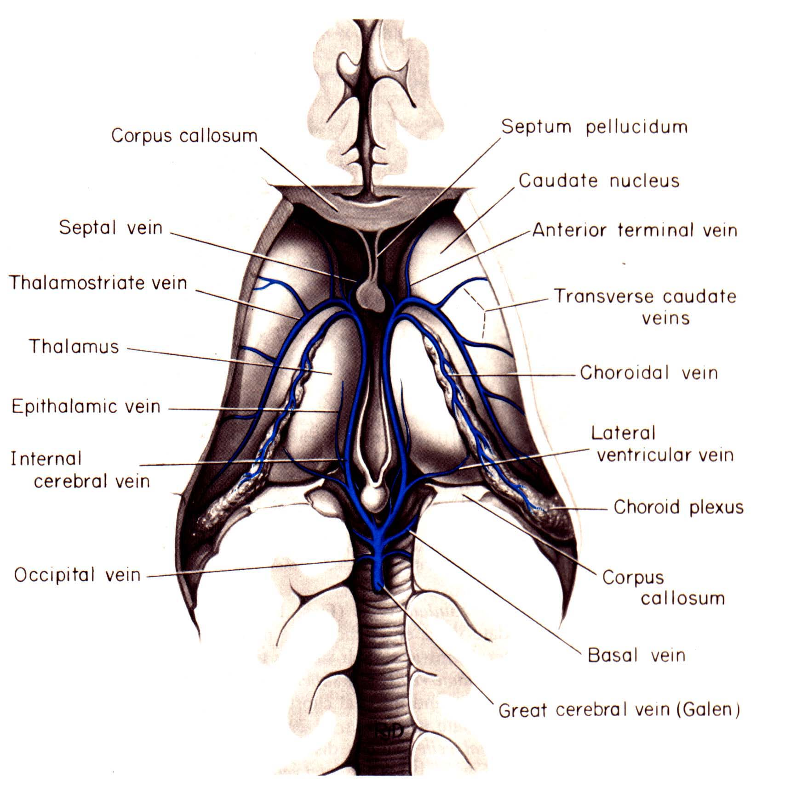

Slide 27
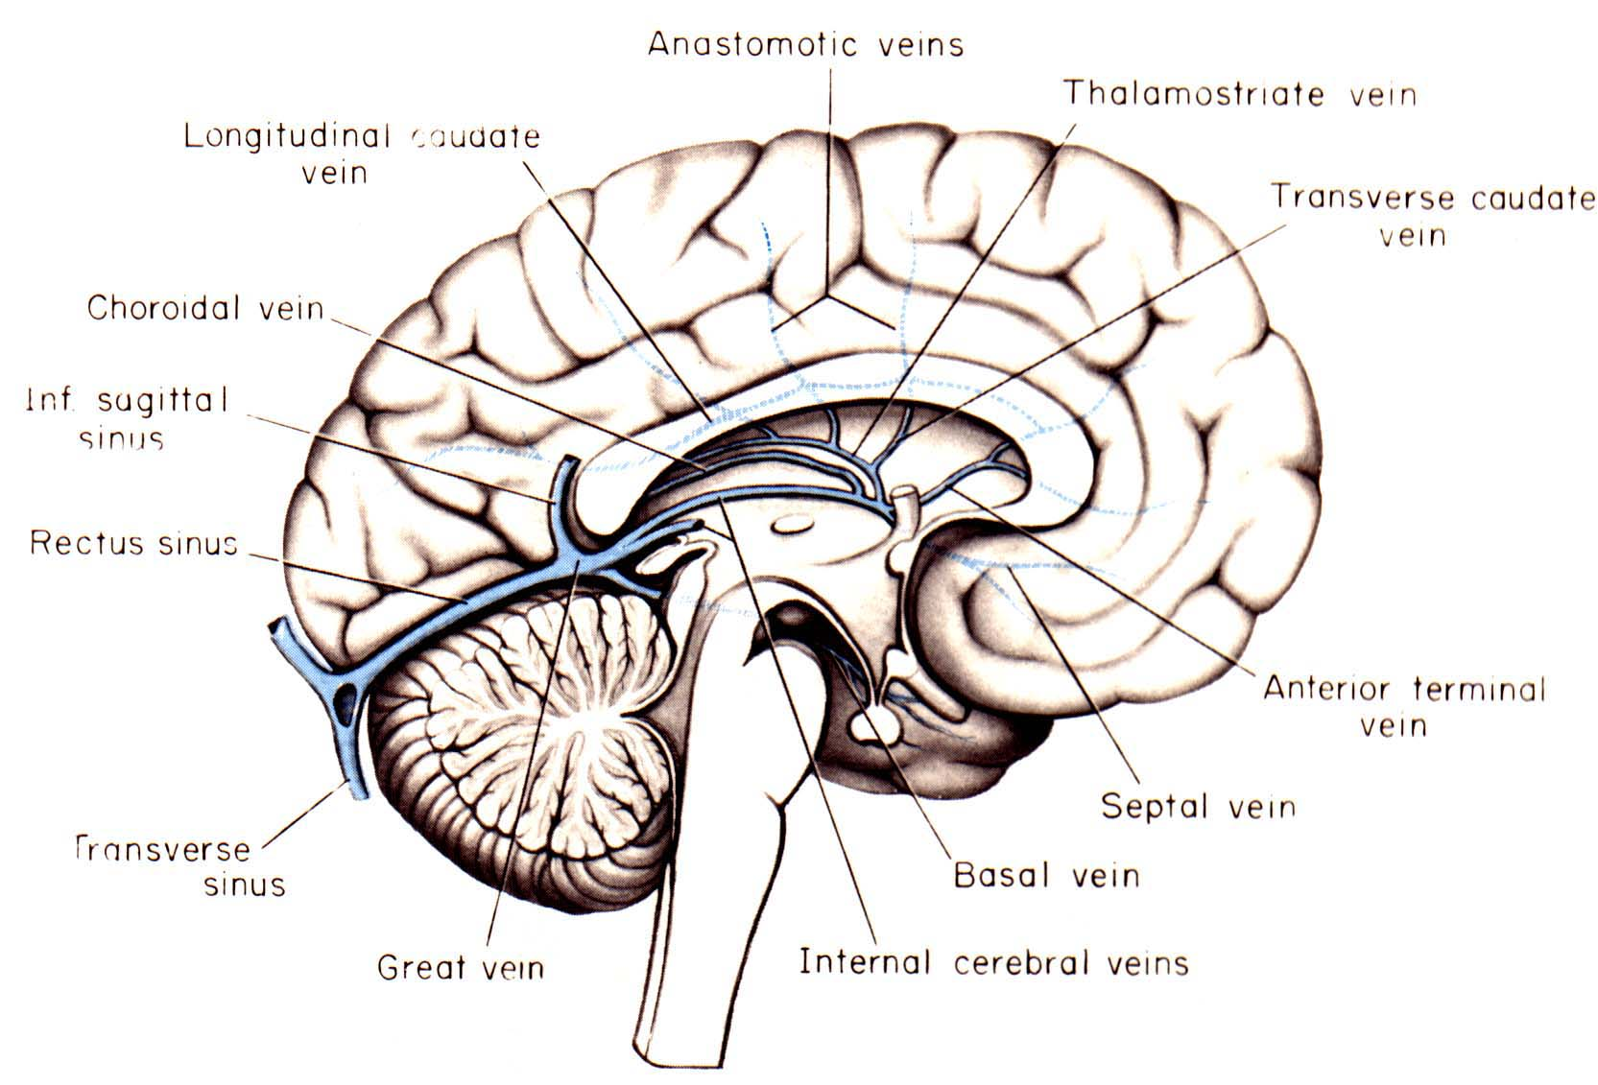

Slide 28
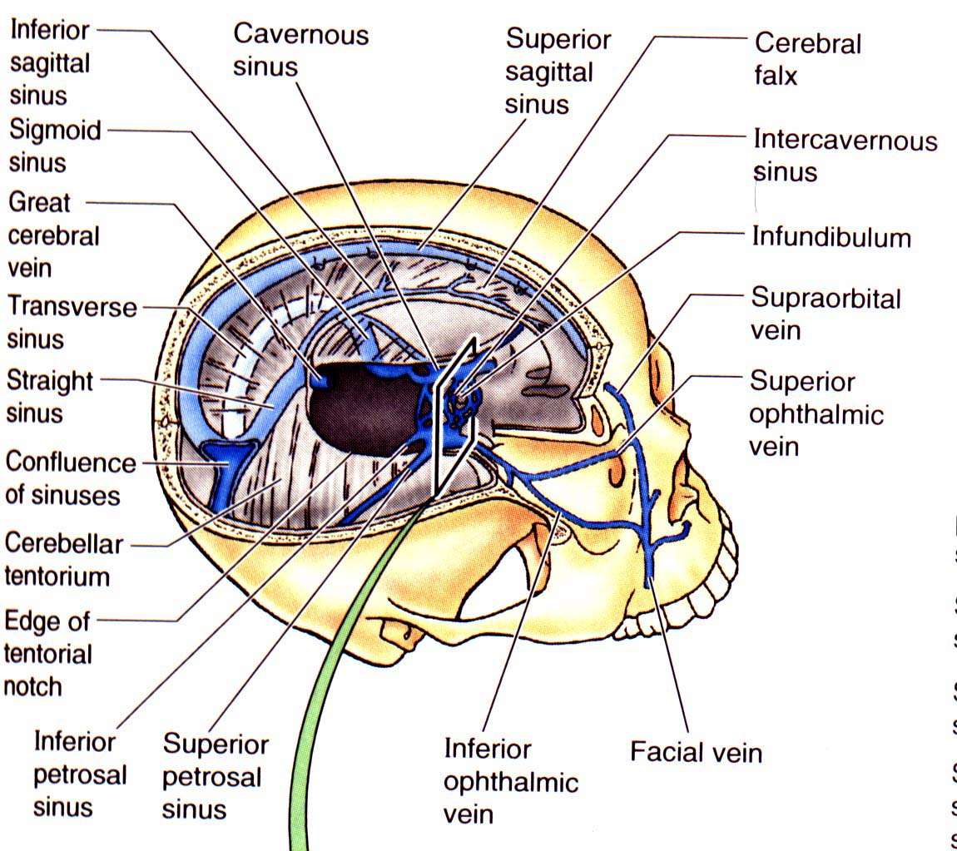

Slide 29
