Slide 1
Auditory pathway
Essam Eldin AbdelHady Salama

Slide 2
The vestibulocochlear nerve
It is a sensory nerve conveys impulses from the inner ear, it has two component parts;
The vestibular nerve carries information related to position and movements.
The cochlear nerve carries auditory information.
Both (with facial nerve) pass through the internal auditory meatus to join the brain stem at cerebellopontine angle

Slide 3
Auditory pathway
The organ of corti is the hearing sense organ.
Lies within the cochlear duct of the inner ear, on the basement membrane (BM).
It consists of supporting cells and hair cells
two groups of hair cells: inner and outer hair cells.

Slide 4
Auditory nerve
Cochlear nerve the axon fibres of neurons whose cell bodies are in the spiral ganglion of the cochlea.
Dendrites (afferent neurons) of these neurons synapse with the hair cells.
Its central fibres join the brain stem at rostral medulla.

Slide 5
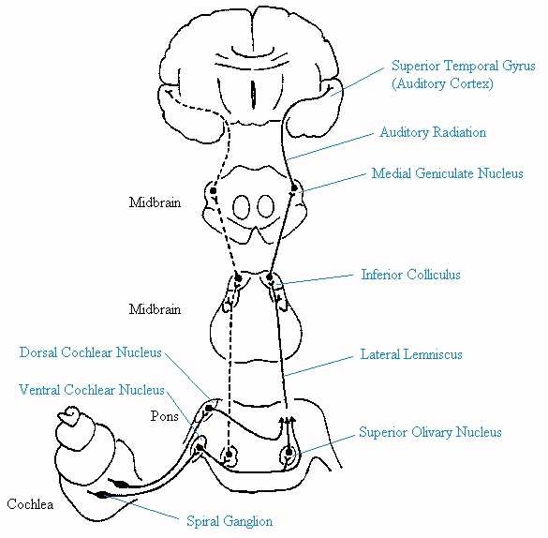
THE AUDITORY PATHWAY: Diagram

Slide 6
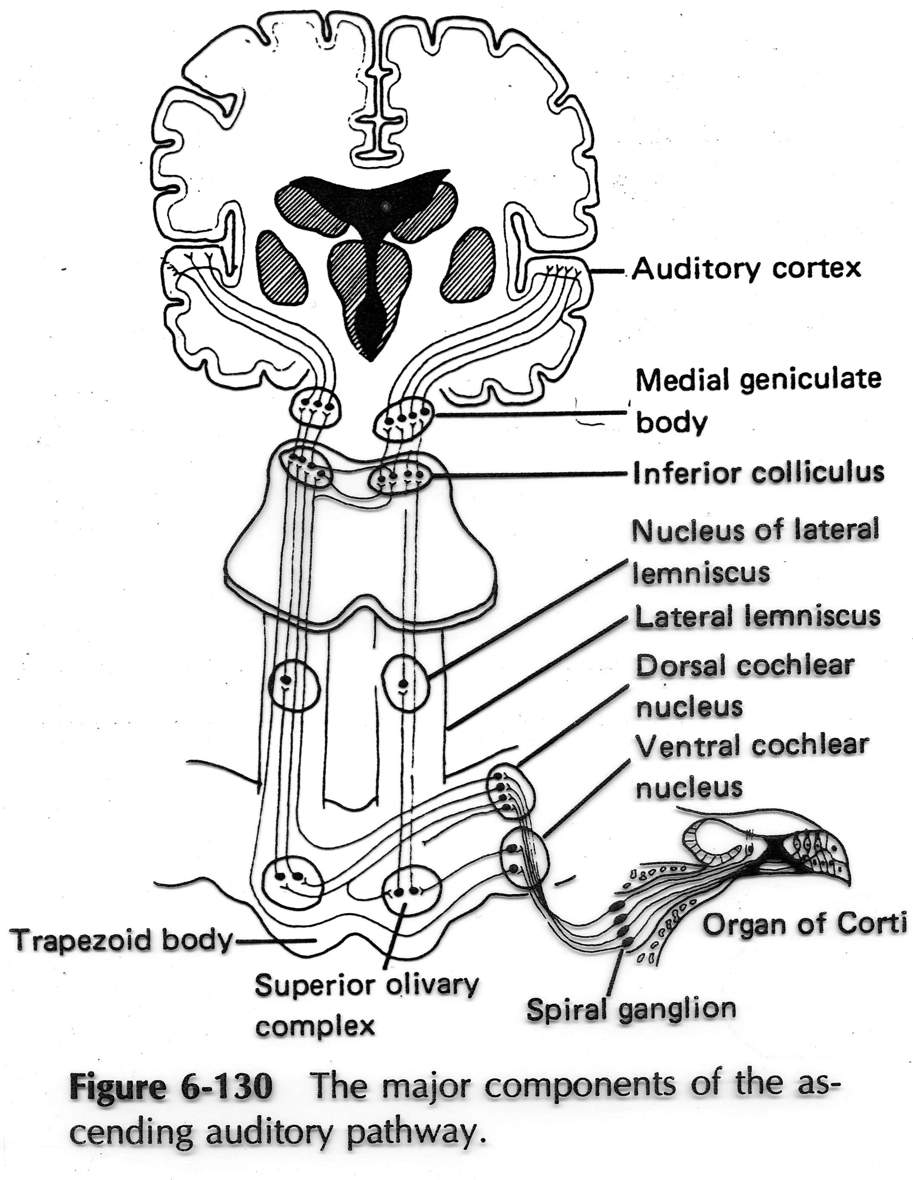
Auditory pathway
The auditory nerve carries signals from the cochlea to end in the dorsal and ventral cochlear nuclei, in the medulla, close to inferior cerebellar peduncle.
Second order neurone ascend into the Pons.
Decussating of some fibres to the other side forming (trapezoid body) .
Finally terminate in the superior olivary nucleus.

Slide 7
Auditory pathway
The ascending fibres comprise the lateral lemniscus.
The lateral lemniscus runs through the pontine tegmentum to end in the inferior colliculus of the midbrain.
Some axons terminate in the nucleus of the lateral lemniscus.

Slide 8
Auditory pathway
The inferior colliculus send axons to the medial geniculate nucleus of thalamus.
Axons from the medial geniculate nucleus pass through the internal capsule to end in the primary auditory cortex of the temporal lope.
It is situated on the dorsal surface of the superior temporal gyrus (hidden within lateral fissure).

Slide 9
Auditory pathway
the primary auditory cortex is hidden within lateral fissure.
The auditory association cortex (wernicke‘s area) is the region of the temporal lope surrounding the primary auditory cortex
The auditory association cortex is responsible for interpretation of auditory information and the processing of language by the brain.

Slide 10
The auditory pathway (N.B)
Olivochoclear fibres have an inhibitory function to modulate the auditory information to the cochlear nerve.
Fibres from Superior olivary nucleus and the nucleus of the lateral lemniscus establish reflex connection with trigeminal and facial nerves (contraction of tensor tympani and stapedius)in response to laude noise.
Tonotopic organisation has a relationship between position of nerve fibers and frequency.

Slide 11
The auditory pathway (N.B)
Binaural, is the convergence of the inputs from both ears.
Binaural perceptions, is our ability to localise sounds depends on the interaction of information from both ears.

Slide 12
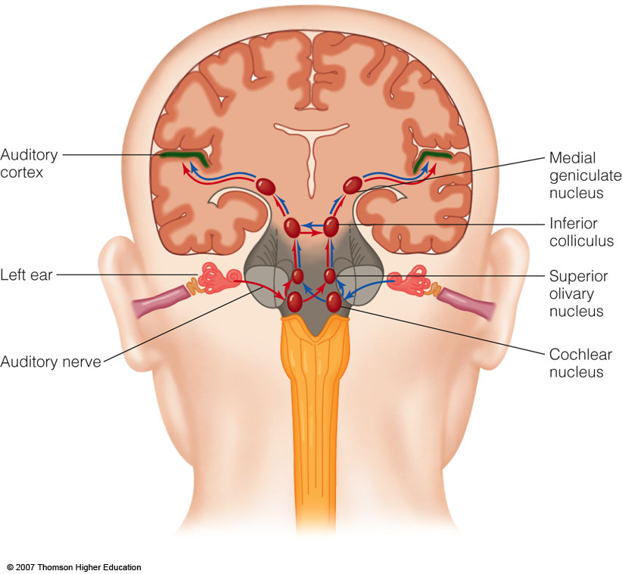

Slide 13
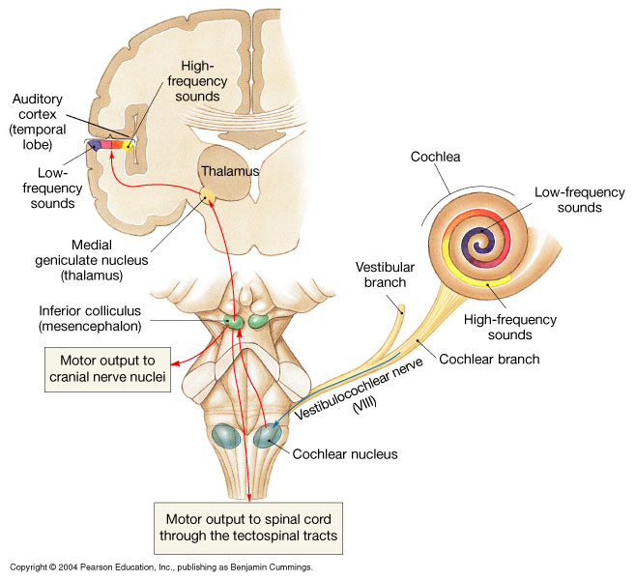
Figure 17.29 Sound and Hearing
Figure 17.29

Slide 14
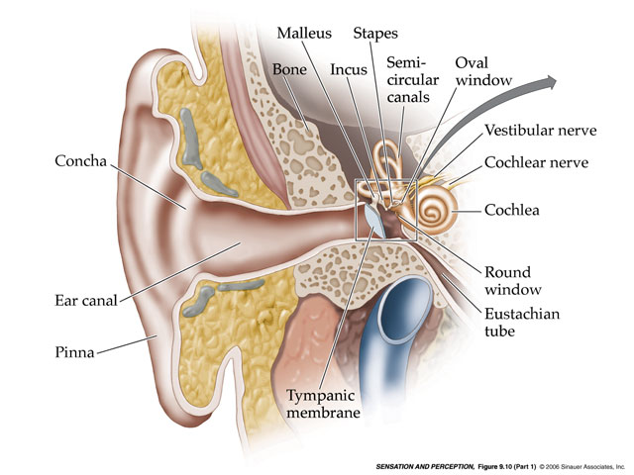

Slide 15
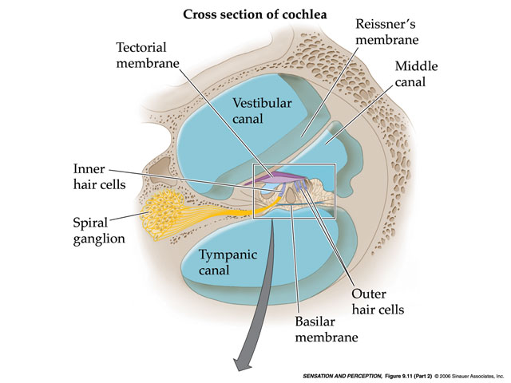

Slide 16
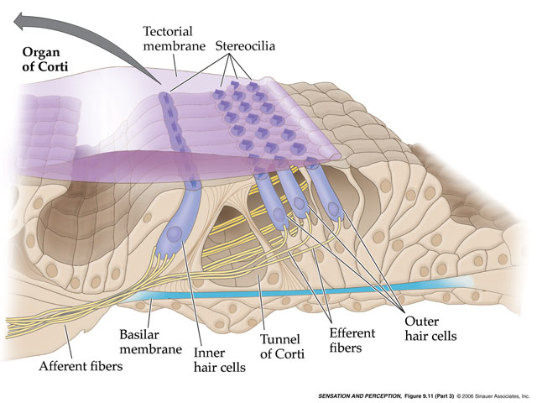

Slide 17
Thank you

