Slide 1
Olfactory pathway
Essam Eldin Abdel Hady Salama

Slide 2
Sense of Smell
The olfactory epithelium is the organ of smell.
It covers the superior nasal conchae and roof of the nasal cavity.
Olfactory receptor cells are bipolar neurons with radiating olfactory cilia.

Slide 3
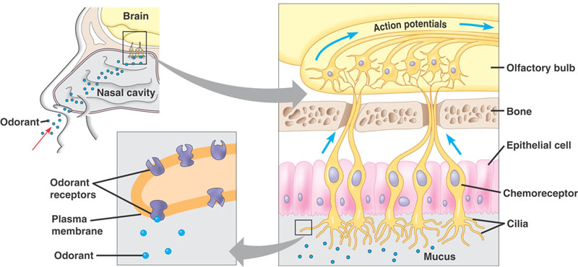
The Olfactory Pathway

Slide 4
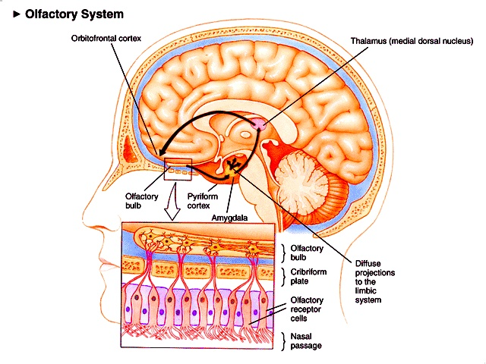
Outline of the Olfactory System

Slide 5
The Olfactory Pathway
Olfactory bulb
Olfactory tract
Lateral olfactory stria

Slide 6
The Olfactory cortex

Slide 7
The Olfactory Pathway
Stimulated Receptors pass signal on to the Olfactory Nerves (I) which run through cribriform plate of ethmoid bone, attach to the olfactory bulbs on the inferior surface of the frontal lobe.
Olfactory information reach the mitral cells in the olfactory bulbs, their axons form the olfactory tracts.
Olfactory tracts on the inferior surface of the frontal lobe deflect laterally, in the lateral olfactory stria.

Slide 8
The Olfactory Pathway
Terminate into the primary olfactory area in the temporal lobe (uncus).
Then to olfactory association cortex (anterior part of parahippocampal gyrus or entorinal area).
The primary olfactory area and olfactory association cortex are referred to as the pyriform cortex.
It is responsible for the appreciation of olfactory stimuli.

Slide 9
The Olfactory Pathway (N.B)
Chemicals must be dissolved in mucus for detection
The olfactory pathway is consisting of a sequence of only two neurons There is no synapse in the thalamus for arriving information.
The mitral cells send information to the hypothalamus, amygdala, and limbic system.
Olfaction is a link between smell, memory, and emotion.
In rodents it response to sex pheromones.

Slide 10
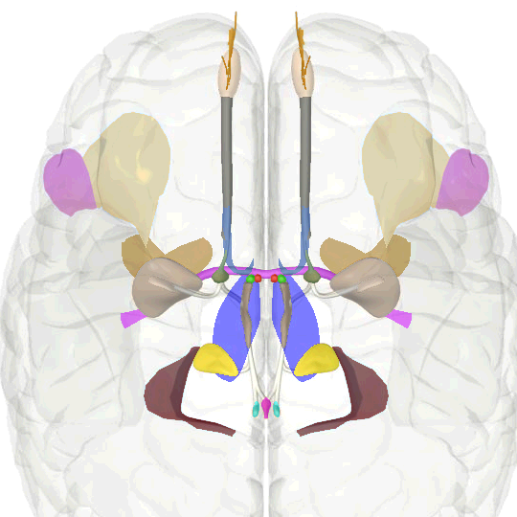
Central Olfactory Pathways

Slide 11
Central Olfactory Pathways

Slide 12
Central Olefactory Pathways

Slide 13
Central Olefactory Pathways

Slide 14
Central Olefactory Pathways

Slide 15
Central Olefactory Pathways

Slide 16
Thank you

