Slide 1
Ascending tracts
Essam Eldin AbdelHady Salama

Slide 2
White Matter in the Spinal Cord
Divided into three funiculi (columns) posterior, lateral, and anterior
Each column (funiculus) contains either
Ascending (sensory)
Descending (motor)

Slide 3
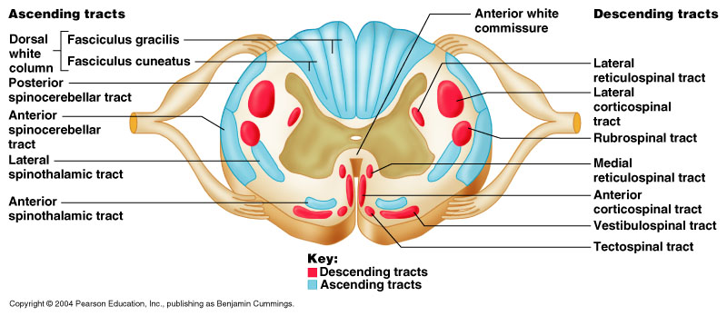
White Matter in the Spinal Cord

Slide 4
Ascending Tracts
Carry sensory signals up to the spinal cord.
Typically uses 3 neurons
1st order neuron, detects stimulus and carries it to spinal cord.
2nd order neuron, continues within spinal cord to the thalamus (the sensory relay station).
3rd order neuron, carries signal from thalamus to sensory region of cerebral cortex.
Most have names with prefix spino-

Slide 5
Ascending Tracts
The first order neurone ,enters the spinal cord through the dorsal root, its cell body lies in the dorsal root ganglion.
The central process may make synaptic connections that mediate intersegmental coordination, the main fibres on the ipsilateral side terminate in synaptic contact with the second neurone in the spinal gray matter or in the medulla of brain stem.
The second order neurone , its cell body in the spinal cord or the medulla the axons decussate and ascend to the thalamus where terminate upon the third neurone.
The third neurone , has its cell body in the thalamus, the axons pass to the somatosensory cortex of cerebral hemisphere.

Slide 6
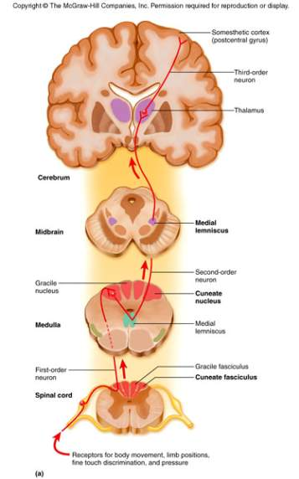
Dorsal column
Two tract are recognised
Fasciculus gracilis
Fasciculus cuneatus
They carry, vibration, and proprioception and discriminative touch
Receptors are free never ending, muscle spindle , and joint receptors.
Cell body of the 1st order neurone lies in the dorsal root ganglion .
The central process enters the spinal cord through the dorsal root .

Slide 7
Dorsal column
Fasciculus gracilis carries sensation from below T6
Fasciculus cuneatus carries sensation from T6 or higher.
They ascend in the spinal cord to relay in;
The 2nd order neurone are nucleus gracilis and nucleus cuneatus,
Their axons decussate forming the internal arcuate fibers and ascend as the medial lemniscus

Slide 8
Dorsal column
The medial lemniscus ascends through the brainstem to relay in ;
Ventral posterior (VP) nucleus of thalamus (the 3rd order neuron) then project to the somatosensory cortex of cerebral hemisphere.

Slide 9
Lesion of the posterior column
Tables dorsalis
Late manifestation of syphilitic CNS
Affects lumbosacral dorsal spinal roots and dorsal column of spinal cord.
Loss of proprioception leads to unsteady gait (sensory ataxia) exacerbated with closing of eyes.
Subacute combined degeneration.
Systemic disease due to vitamin B12 deficiency
Degeneration of dorsal column causes sensory ataxia
Combined with lateral column causes weakness and spasticity of limbs
Multiple sclerosis
Immune disease affects fasciculus cuneatus of cervical region
Leads to loss of proprioception in hands and fingers (asteriognosis)

Slide 10
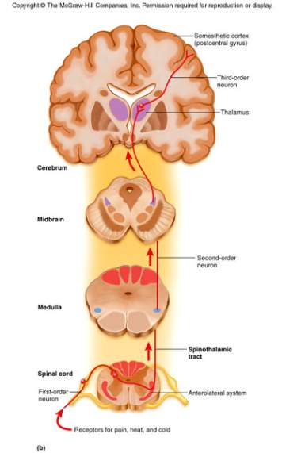
Spinothalamic Pathway
Located in the anterior and lateral columns.
Carries sensations of pain, temperature, light touch, and pressure.
Cell body of the 1st order neurone lies in the dorsal root ganglion .
The central process enters the spinal cord through the dorsal root.
The 2nd order neuron cell bodies lie in the contralateral dorsal hone.
The axons decussate through the ventral white commissure.
The axons ascending as spinothalamic tract .

Slide 11
Spinothalamic Pathway
In the brain stem it is known as spinal lemniscus, terminate in
The ventral posterior nucleus of thalamus as the 3rd order neurone.
Finally project to somatosensory cortex.

Slide 12
Spinoreticulothalamic system
It is concerned with dull aching pain (slow pain)
The sensory impulses from the 2nd neuron ascend and terminate in brain stem reticular formation.
Reticulothalamic fibres ascend to intralaminar thalamic nuclei, that in turn activate the cerebral cortex

Slide 13
Spinothalamic tract lesion
Syrigomyelia
Enlargement of the central canal compressing the adjacent nerve fibres the 2nd order neuron conveying pain and temperature as decussating the ventral white commissure
Leads to selective loss of pain and temperature with retaining of light touch and prorioceptive sensation (dissociated sensory loss) with Charcotُs joint .
Selective cordotomy or tractotomy is performed to relief intractable pain.

Slide 14
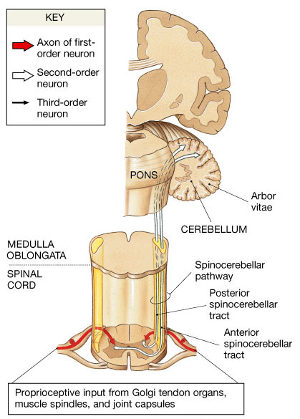
Spinocerebellar tracts ventral &dorsal
Carry information from muscle spindle, Golgi tendon organ and tactile receptors to the cerebellum.
To control posture and coordination of movement.
The dorsal root ganglion is 1st order neuron.
The 2nd order neuron cell bodies lie in the base of dorsal horn (Clark ُs) .
Terminate directly in the cerebellar cortex (vermis)

Slide 15
Spinocerebellar tracts ventral &dorsal
Fibres of dorsal spinocerebellar tract ascend ipsilateral, and enter the cerebellum through the inferior cerebellar peduncle.
Fibres of ventral spinocerebellar tract , decussate and ascend on contralateral side enter the cerebellum via the superior cerebellar peduncle.

Slide 16
Spinocerebellar tracts lesion
Frederic's ataxia
Inherited degenerative disease affecting the Spinocerebellar tracts leads to intention tremors ,(involuntary) ,ataxia,

Slide 17
Spino-Olivary Tracts
Project to accessory olivary nuclei and cerebellum.
Contribute to coordination of movement associated primarily with balance.

Slide 18
Spinotectal Tracts
Project to superior colliculi of midbrain.
Involved in reflexive turning of the head and eyes toward a point of cutaneous stimulation.

Slide 19
Thank you

