Slide 1
The Diseases of the Respiratory System
Bronchial Asthma
Obstructive Lung Diseases
Restrictive Pulmonary Diseases
Pulmonary infection
Lung Tumors
Diseases of the Pleura

Slide 2
Bronchial Asthma

Slide 3
Objective
1. Introduction to respiratory system
Contrast obstructive vs restrictive lung disease. Understand the use of the FEV₁/FVC ratio in classifying lung diseases.
(FEV₁ = forced expiratory volume at 1 second; FVC = forced vital capacity)
2. Asthma
a. Define asthma.
b. Compare and contrast immune-mediated and nonimmune-mediated forms of asthma in terms of initiating factors and pathogenic mechanisms.
c. Understand the term bronchial hyperresponsiveness and its relationship to types of asthma.
d. Describe the morphologic changes in chronic asthma, and discuss the clinical course.
3. Define bronchiectasis. Describe the gross anatomic lesion, and list the conditions that predispose to its development.
4.Define atelectasis

Slide 4
Introduction: Anatomy

Slide 5
Introduction: Physiology

Slide 7
Spirometer
is an equipments used for measuring the volume of air inspired and expired by the lungs ( Pulmonary Function Tests)

Slide 8
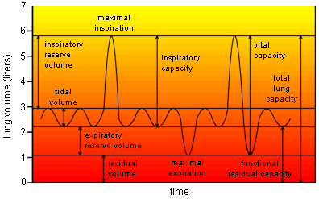
Introduction: Physiology

Slide 9
Introduction: Physiology

Slide 10
Flow volume loop
FEV₁/FVC ratio is used in classifying lung diseases.
(FEV₁ = forced expiratory volume at 1 second; FVC = forced vital capacity)

Slide 11
Obstructive and Restrictive Pulmonary Diseases
Diffuse pulmonary diseases are divided into:
1. Obstructive disease:
characterized by limitation of airflow owing to partial or complete obstruction at any
level from trachea to respiratory bronchioles.
Pulmonary function test:
limitation of maximal
airflow rate during forced expiration (FEVI).
2. Restrictive disease: characterized by reduced expansion of lung parenchyma with decreased total lung capacity while the expiratory flow rate is near normal.
Occur in:
1. Chest wall disorder.
2. Acute or chronic, interstitial and infiltrative diseases,
e.g. ARDS and pneumoconiosis.

Slide 12
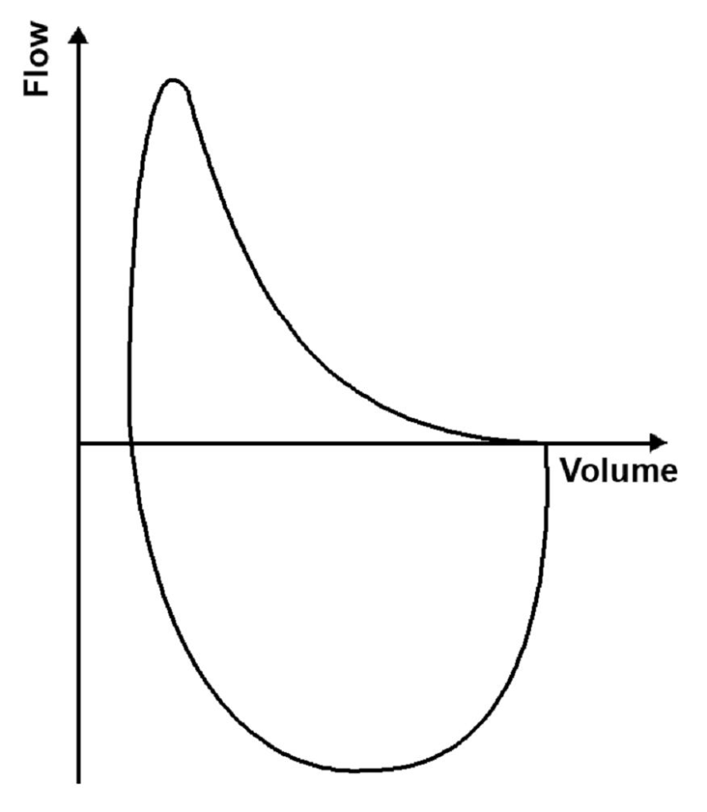
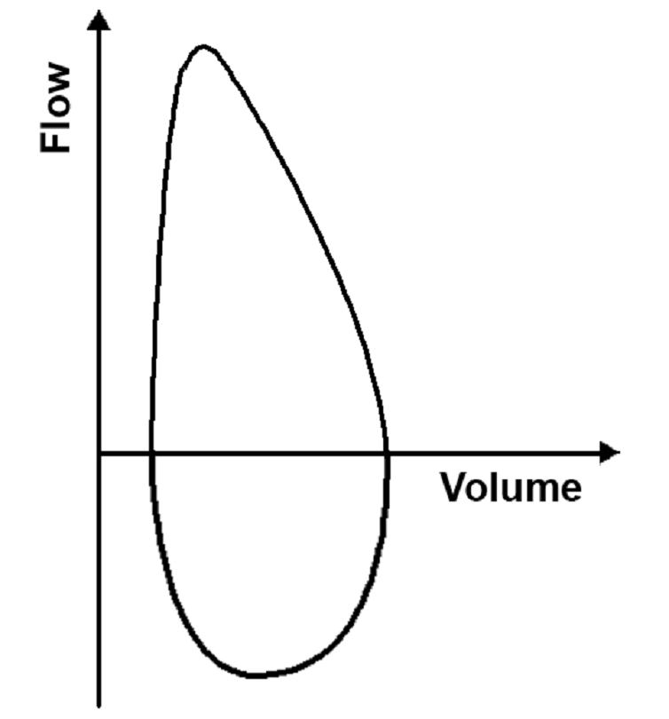
Obstructive disease
Restrictive disease

Slide 13
Pathology of lung diseases
Very important in clinical medicine
Complication of air pollution
Common symptoms:
Dyspnea: difficulty with breathing
Decrease compliance, fibrosis
Increased airway resistance , ch. bronchitis
Chest wall disease: kyphoscoliosis, obesity
Fluid accumulation, left sided heart failure
Cough
Postnasal discharge, GERD, Br. Asthma, ch. Bronchitis, pneumonia, bronchiectasis, drug induced
Hemoptysis
Ch. Bronchitis, pneumonia, TB, bronchiectasis, aspergilloma

Slide 14
Atelectasis (collapse)
Incomplete expansion of the lungs or collapse of previously inflated lung substance.
Significant atelectasis reduce oxygenation and predispose to infection.

Slide 15
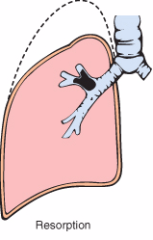
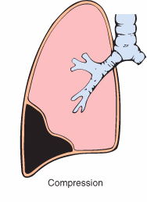
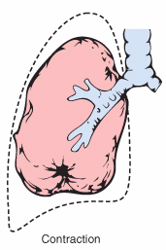
Types of Atelectasis
Resorption atelectasis.
Compression atelectasis.
Contraction atelectasis.

Slide 16
Atelectasis
Atelectatic lung is prone to develop superimposed infection.
It is reversible disorder except for contraction atelectasis.
It should be treated promptly to prevent hypoxemia.

Slide 17
Chronic Obstructive Pulmonary Disease
Bronchiectasis
Emphysema
Chronic Obstructive Pulmonary Disease
Chronic Bronchitis
Asthma

Slide 18
Bronchial asthma
Chronic relapsing inflammatory disorder characterized by hyperactive airways leading to episodic, reversible bronchoconstriction owing to increased responsiveness of the tracheobronchial tree to various stimuli.
triad of:
intermittent and reversible airway obstruction
chronic bronchial inflammation with eosinophils
bronchial smooth muscle cell hypertrophy and hyperreactivity

Slide 19
Bronchial asthma
triggered by environmental antigens, such as:
dusts
Pollen
animal dander
Foods
potentially any antigen is implicated
Drugs, aspirin
sulfur dioxide, ozone, and nitrogen dioxide

Slide 21
Bronchial asthma
It has been divided into two basic types:
1. Extrinsic asthma.
2. Intrinsic asthma.

Slide 22
Extrinsic Asthma 70%
CLASSIFICATION OF ASTHMA
Intrinsic Asthma 30%
Initiated by diverse, non-immune mechanisms, including:
ingestion of aspirin
pulmonary infections,
cold
inhaled irritant
stress
exercise.
No personal or family history of allergic reaction.
Develop later in life
Initiated by type 1 hypersensivity reaction induced by exposure to extrinsic antigen.
Subtypes include:
a. atopic (allergic) asthma.
b. occupational asthma.
c. allergic bronchopulmonary aspergillosis.
Develop early in life

Slide 23
Extrinsic Asthma
Atopic (allergic) asthma is the most common form, begins in childhood
Other allergic manifestation: allergic rhinitis, urticaria, eczema.
Skin test with antigen result in an immediate wheel and flare reaction
Other family member is also affected
Serum IgE and eosinophil are increased
immune related, TH2 subset of CD4+ T cells

Slide 24
Pathogenesis of Bronchial Asthma
EXAGGERATED BROCHOCONTRICTION
Two components:
1. Chronic airway inflammation.
2. Bronchial hyperresponsiveness.
The mechanisms have been best studied in atopic asthma.

Slide 25
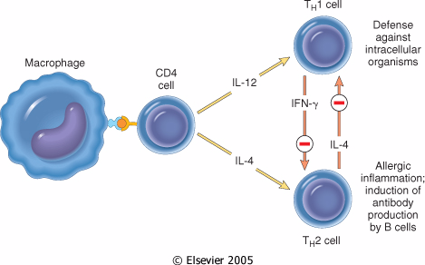
Pathogenesis of Atopic Asthma
A classic example of type 1 IgE-mediated hypersensitivity reaction.
In the airway – initial sensitization to antigen (allergen) with stimulation of TH2 type T cells and production of cytokines (IL-4, IL- 5, and IL-13).
Cytokines promote:
1. IgE production by B cell.
2. Growth of mast cells.
3. Growth and activation of eosinophils.

Slide 26
Pathogenesis of Atopic Asthma
IgE-mediated reaction to inhaled allergens elicits:
1. acute response (within minutes)
2. a late phase reaction (after 4-8 hours)

Slide 28
Pathogenesis of Atopic Asthma
Acute-phase response
Begin 30 to 60 minutes after inhalation of antigen.
Mast cells on the mucosal surface are activated.
Mediator produced are :
Leukotrienes C4, D4 & E4 (induce bronchospasm, vascular permeability & mucous production)
Prostaglandins D2, E2, F2 (induce bronchospasm and vasodilatation)
Histamine ( induce bronchospasm and increased vascular permeability)
Platelet-activating factor (cause aggregation of platelets and release of histamine)
Mast cell tryptase (inactivate normal bronchodilator).
Mediators induce bronchospasm, vascular permeability & mucous production.

Slide 29
Pathogenesis of Atopic Asthma
Late phase reaction:
recruitment of leukocytes mediated by product of mast cells including:
1. Eosinophil and neutophil chemotactic factors
2 . IL-4 & IL-5 and induceTH2 subset ofCD4+ T cells
3. Platelet-activating factor
4. Tumor necrosis factor.
Other cell types are involved: activated epithelial cells, macrophages and smooth muscle.

Slide 30
Pathogenesis of Atopic Asthma
Late phase reaction:
The arrival of leukocytes at the site of mast cell degranulation lead to:
1. Release of more mediators to activate more mast cells
2. Cause epithelial cell damage .
Eosinophils produce major basic protein, eosinophilic cationic protein and eosinophil peroxidase ( toxic to epithelial cells).
These amplify and sustains injury without additional antigen.

Slide 31
Non-Atopic Asthma
Triggered by respiratory tract infection including viruses and inhaled air pollutants e.g. sulfur dioxide, ozone.
Positive family history is uncommon.
Serum IgE – normal.
No other associated allergies.
Skin test – negative.
Hyperirritability of bronchial tree.
Subtypes:
1. Drug-induced asthma.
2. Occupational asthma.

Slide 32
Morphology of Asthma
Grossly: - lung over distended (over inflation), occlusion of bronchi and bronchioles by thick mucous.
Histologic finding:
Thick BM.
Edema and inflammatory infiltrate in bronchial wall.
mucous contain Curschmann spirals, eosinophil and Charcot-Leyden crystals.
Submucosal glands increased.
Hypertrophy of the bronchial wall muscle.

Slide 33
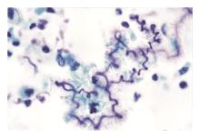
Curschmann spirals
Coiled, basophilic plugs of mucus formed in the lower airways and found in sputum and tracheal washings

Slide 34
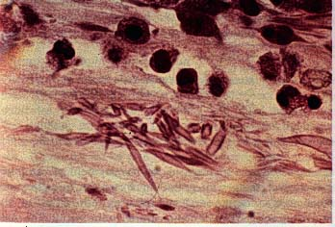
Charcot-Leyden crystals.
Eosinophilic needle-shaped crystalline structures.

Slide 35
Clinical Coarse
Classic asthmatic attack – dyspnea, cough, difficult expiration, progressive hyperinflation of lung and mucous plug in bronchi. This may resolve spontaneously or with Rx.
Status asthmaticus – severe cyanosis and persistent dyspnea, may be fatal
Superimposed bacterial infection
May progress to emphysema or chronic bronchitis
Asthmatic bronchitis: chronic bronchitis with superimposed asthma

Slide 37
Bronchiectasis

Slide 38
Chronic Obstructive Pulmonary Disease
Bronchiectasis
Emphysema
Chronic Obstructive Pulmonary Disease
Chronic Bronchitis
Asthma

Slide 39
Bronchiectasis
Chronic necrotizing infection of the bronchi and bronchioles leading to or associated with abnormal dilatation of these airways.
Bronchial dilatation should be permanent.

Slide 40
Conditions associated with Bronchiectasis
Bronchial obstruction
Congenital or hereditary conditions:
Necrotizing pneumonia
Localized:
- tumor, foreign bodies or mucous impaction
Generalized:
- bronchial asthma
- chronic bronchitis
- Congenital bronchiactasis
- Cystic fibrosis.
- Intralobar sequestration of the lung.
- Immunodeficiency status.
- Immotile cilia and kartagner syndrome
Caused by TB, staphylococci or mixed infection.

Slide 41
Kartagener Syndrome
Inherited as autosomal recessive trait.
Patient develop bronchiactasis, sinusitis and situs invertus.
Defect in ciliary motility due to absent or irregular dynein arms.
Lack of ciliary activity interferers with bronchial clearance.
Males have infertility.

Slide 42
Bronchiectasis
Etiology and pathogenesis
Obstruction and infection.
Bronchial obstruction (athelectasis of airway distal to obstruction) – bronchial wall inflammation.
These changes become irreversible:
1. If obstruction persist.
2. If there is added infection.

Slide 43
Morphology of Bronchiectasis
Usually affects lower lobes bilaterally (vertical airways).
Dilated airways up to four times of normal, reaching the pleura.
Acute and chronic inflammation, extensive ulceration of lining epithelium with fibrosis.

Slide 44
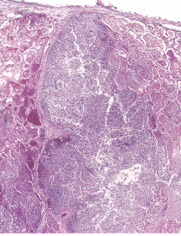

Slide 45
Bronchiectasis

Slide 46
Bronchiectasis
Clinical course:
Sever persistent cough with sputum (mucopurulent, fetid sputum) sometime with with blood.
Clubbing of fingers.
If sever, obstructive pulmonary function develop.
Rare complications: metastatic brain abscess and amyloidosis.

Slide 47
Summary
Asthma
Bronchiectasis

Slide 48
Asthma: Dyspnea and wheezing
Types
1. Extrinsic asthma: Type 1 Hypersensitivity reaction, IgE, childhood, family Hx of allergy.
Morphology
Hypertrophy of bronchial smooth muscle & hyperplasia of goblet cells e eosinophils
Mucous plug e Curschmann spirals & Charcot-Leyden crystals.
Complication
Superimposed infection
2. Intrinsic asthma: associated e bronchial asthma, aspirin, exercise, cold induced. No Hx of allergy
Chronic bronchitis
Pulmonary emphysema
Status asthmaticus

Slide 49
Bronchiectasis:
Chronic necrotizing infection of the bronchi
and bronchioles leading to permenant dilatation of these airways
Causes
Infection
Congenital (Cystic fibrosis, Kartagener’s Syndrome)
Clinical features
Sever persistent cough with sputum (mucopurulent sputum) sometime with blood.
complications
Rare complications: metastatic brain abscess and amyloidosis.
Obstruction
Clubbing of fingers.
Lung Abscess
If sever, obstructive pulmonary function develop.

Slide 50
Questions
What triggers an attack of asthma?

Slide 51
Questions
What triggers an attack of asthma?
Extrinsic, or allergic, asthma is triggered by environmental allergens, including dusts, pollens, dander, foods, etc.
b. The most common provocative agents of intrinsic (nonimmune) or idiosyncratic asthma are infections of the respiratory tract, especially viral.
Other types of intrinsic asthma include drug-induced asthma (many drugs, especially aspirin); occupational asthma, provoked by fumes, organics, chemicals; and exercise-, cold-, and emotional stress-induced asthma.

Slide 52
What is the mechanism of the early symptoms, and what are the causes of effects that appear several hours after exposure to an allergen?

Slide 53
What is the mechanism of the early symptoms, and what are the causes of effects that appear several hours after exposure to an allergen?
Acute early-phase reaction:
Exposure of presensitized IgE-coated mast cells to the same or cross-reacting antigens results in an acute early-phase reaction from the release of:
histamine (which causes bronchospasm)
leukotrienes (which attract leukocytes and eosinophils and release mucus)
platelet activating factor (which causes more release of histamine and serotonin from platelets).
Late-phase effects:
Cytokines released by leukocytes, eosinophils, and basophils recruited during the early phase contribute to the late-phase effects.
Histamine from basophils causes bronchoconstriction and edema
neutrophils cause inflammatory damage;
and the major basic protein of eosinophils causes epithelial damage and shedding and contributes to bronchoconstriction.

Slide 54
Are all forms of asthma associated with type I hypersensitivity reactions?
No. Intrinsic asthma is not triggered by type I hypersensitivity. The precise causes of hyperreactive airways in intrinsic asthma are not known.

Slide 55
What is responsible for the accumulation of eosinophils?
Eosinophils are attracted by chemotactic factors released by mast cells and also by the chemokine eotaxin. The latter is produced by bronchial epithelial cells. Eosinophil accumulation is also favored by IL-5, a T-cell-derived cytokine.

Slide 56
What role do eosinophils play in causing tissue damage? Major basic protein of eosinophils causes epithelial damage and shedding.

Slide 57
Are mucous plugs diagnostic of bronchial asthma?
No

Slide 58
What are the causes of bronchiectasis?
The most common conditions are:
a. Bronchial obstruction (tumors; foreign bodies), diffuse obstructive airway diseases (atopic asthma; chronic bronchitis)
b. Congenital or hereditary conditions (congenital bronchiectasis; cystic fibrosis)
c. Necrotizing or suppurative pneumonias.
Those conditions predispose to chronic necrotizing infections and consequent destruction of muscle and elastic support tissue of bronchi and bronchioles.

Slide 59
Why does it seem to affect the lower lobes preferentially?
Inhaled materials and secretions tend to gravitate to the lower lobes.

Slide 60
What type of inflammatory cells might you expect? Compare with asthma.
Acute inflammatory cells, especially PMNs, are present, although evidence of chronic inflammation is also likely to be present.
By comparison, in asthma, the inflammatory cells are composed of CD4+ lymphocytes, eosinophils, mast cells, and a few neutrophils.

Slide 61
What is the definition of asthmatic bronchitis?
Some patients with a clinical definition of chronic bronchitis have hyperresponsive airways with intermittent bronchospasm.

Slide 62
END OF LECTURE

