Slide 1
Chronic Obstructive Pulmonary Diseases (COPD)

Slide 2
Chronic Obstructive Pulmonary Disease
Bronchiectasis
Emphysema
Chronic Obstructive Pulmonary Disease
Chronic Bronchitis
Asthma
A group of conditions characterized by limitation of airflow
Emphysema and chronic bronchitis often co-exist.

Slide 3
Learning Objectives
Emphysema
a. Define emphysema.
b. Describe the gross and microscopic changes in emphysema.
c. Discuss the typical clinical presentation and causes of death.
c. Describe the most likely mechanism of emphysema (the protease-antiprotease mechanism). Include a discussion of alpha₁-antitrypsin deficiency.
e. Describe the pathophysiologic mechanisms of airway obstruction in emphysema
Chronic Bronchitis
a. Define chronic bronchitis.
b. Describe the pathogenesis and the morphologic changes of chronic bronchitis.
c. Describe the mechanism of airway obstruction in a patient with chronic bronchitis. Understand that when severe obstruction is present in chronic bronchitis, significant emphysema is nearly always present
Explain why emphysema and bronchitis are both considered to be examples of chronic obstructive pulmonary disease (COPD). Compare and contrast the major clinical and functional differences between predominant chronic bronchitis versus predominant emphysema in patients with COPD.
Define cor pulmonale and its significant.

Slide 4
Bronchial asthma

Slide 5
Chronic Obstructive Pulmonary Disease (COPD)
Share a major symptom: dyspnea with chronic or recurrent obstruction to airflow within the lung.
The incidence of COPD has increased dramatically in the past few decades.

Slide 6
Chronic Obstructive Pulmonary Disease
Bronchiectasis
Emphysema
Chronic Obstructive Pulmonary Disease
Chronic Bronchitis
Asthma
A group of conditions characterized by limitation of airflow
Emphysema and chronic bronchitis often co-exist.

Slide 7
COPD

Slide 8
Chronic Bronchitis

Slide 9
Chronic Bronchitis
Common among cigarette smokers and urban dwellers, age 40 to 65
The diagnosis of chronic bronchitis is made on clinical grounds.
Persistent productive cough for at least 3 consecutive months in at least 2 consecutive years.
Can occur in several forms:
1. Simple chronic bronchitis.
2. Chronic mucopurulent bronchitis.
3. Chronic asthmatic bronchitis.
4. Chronic obstructive bronchitis.

Slide 10
Chronic bronchitis
Causative factor are:
cigarette smoking and pollutants.
Infection

Slide 11
Chronic bronchitis
Pathogenesis
Hypersecretion of mucus that starts in the large airways.
Inflammation
Morphology
Enlargement and marked hyperplasia of the mucus-secreting glands, increased number of goblet cells, loss of ciliated epithelial cells, squamous metaplasia, dysplastic changes and bronchogenic carcinoma.
Inflammation, fibrosis and resultant narrowing of bronchioles.
Coexistent emphysema.

Slide 12
Reid Index > 0.4

Slide 13
Chronic bronchitis
Clinical Course
Prominent cough and the production of sputum.
COPD with hypercapnia, hypoxemia and cyanosis.
Cardiac failure (Cor pulmonale).

Slide 14
Cor pulmonale
is right ventricular dilation and hypertrophy-(right heart failure )-develops following pulmonary hypertension caused by diseases of the lung or pulmonary vasculature.
Usually there are changes in the pulmonary arteries and arterioles
It is manifested by distended neck veins and enlarged tender liver.
It is a manifestation of typical features of severe chronic bronchitis : (blue bloater)
Increased sleepiness reflects CO2 narcosis; cyanosis reflects very poor oxygenation; and elevated red cell counts (secondary polycythemia) result from chronic hypoxemia.

Slide 15
Chronic Obstructive Pulmonary Disease
Bronchiectasis
Emphysema
Chronic Obstructive Pulmonary Disease
Chronic Bronchitis
Asthma

Slide 16
Emphysema

Slide 17
Emphysema
Is characterized by permanent enlargement of the airspaces distal to the terminal bronchioles accompanied by destruction of their walls, without obvious fibrosis.
Over inflation.
Types of emphysema:
1. Centriacinar (20x)
2. Panacinar
3. Distal acinar
4. Irregular

Slide 19
Emphysema
Incidence
Emphysema is present in approximately 50% of adults who come to autopsy.
Pulmonary disease was considered to be responsible for death in 6.5% of these patients.

Slide 20
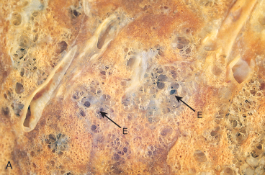
Centriacinar (centrilobular) emphysema
Occur in heavy smoker in association with chronic bronchitis
The central or proximal parts of the acini are affected, while distal alveoli are spared
More common and severe in upper lobes (apical segments)
The walls of the emphysematous
space contain black pigment.
Inflammation around bronchi & bronchioles.

Slide 21
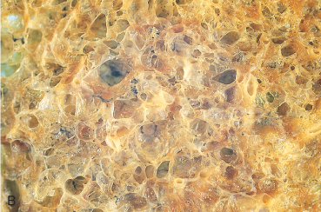
Panacinar (panlobular) emphysema
Occurs in α₁-anti-trypsin deficiency.
Acini are uniformly enlarged from the level of the respiratory bronchiole to the terminal blind alveoli.
More commonly in the lower lung zones.

Slide 22
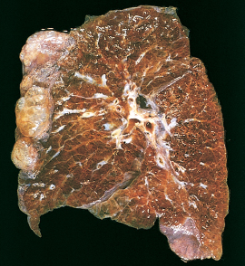
Distal acinar (paraseptal) emphysema
The proximal portion of the acinus is normal but the distal part is dominantly involved.
Occurs adjacent to areas of fibrosis, scarring or atelectasis.
More severe in the upper half of the lungs.
Sometimes forming multiple cyst-like structures with spontaneous pneumothorax.

Slide 24
Irregular Emphysema
The acinus is irregularly involved, associated with scarring.
Most common form found in autopsy.
Asymptomatic.

Slide 25
Why is emphysema considered to be an obstructive airway disease? (Is there any mechanical obstruction?)
Because emphysema affects the peripheral airways, it is not, anatomically speaking, an obstructive disease, and there is no mechanical obstruction. However, it is functionally an obstructive disease, because destruction of the septal walls prevents the elastic recoil that is necessary to push air out of the lungs. Thus, in effect, there is limitation of airflow, just as there would be if there were mechanical obstruction.

Slide 26
Pathogenesis of Emphysema
Is not completely understood.
Alveolar wall destruction and airspace enlargement invokes excess protease or elastase activity unopposed by appropriate antiprotease regulation (protease-antiprotease hypothesis)
2 key mechanisms:
1. excess cellular proteases with low antiprotease level
2. excess ROS from inflammation
Element of ch. Bronchitis coexists

Slide 27
Pathogenesis of Emphysema
Protease-antiprotease imbalance occur in 1% of emphysema
α₁-antitrypsin, normally present in serum, tissue fluids and macrophages, is a major inhibitor of proteases secreted by neutrophils during inflammation.
Encoded by codominantly expressed genes on the proteinase inhibitor (Pi) locus on chromosome 14.
Pi locus is extremely pleomorphic (M , Z)
Any stimulus that increase neutrophil or macrophages in the lung with release of protease lead to elastic tissue damage.

Slide 28
Pathogenesis of Emphysema
The protease-antiprotease hypothesis explains the effect of cigarette smoking in the production of centriacinar emphysema.

Slide 29
Pathogenesis of Emphysema
Smokers have accumulation of neutrophils in their alveoli.
Smoking stimulates release of elastase.
Smoking enhances elastase activity in macrophages, macrophage elastase is not inhibited by α₁-antitrypsin.
Tobacco smoke contains reactive oxygen species with inactivation of proteases.

Slide 30
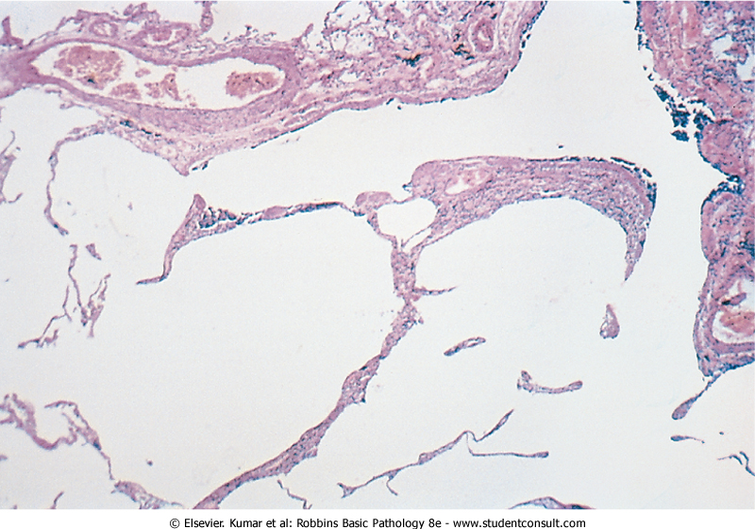
Emphysema
Morphology
The diagnosis depend largely on the macroscopic appearance of the lung.
The lungs are pale, voluminous.
Histologically, thinning and destruction of alveolar walls creating large airspaces.
Loss of elastic tissue.
Reduced radial traction on the small airways.
Alveolar capillaries is diminished.
Accompanying bronchitis and bronchiolitis.

Slide 31
What is the difference between overinflation and emphysema?
Overinflation refers to expansion of all or part of a lung due to mechanical obstruction and consequent trapping of air in the lung. Obstruction may be caused by a tumor or foreign body, as well as by bronchoconstriction and mucus. In emphysema, there is no mechanical obstruction; instead, there is functional obstruction of airflow.

Slide 32
Emphysema: Clinical course
Cough and wheezing.
Weight loss.
Barrell chest ( anteroposterior diameter of chest)
Pulmonary function tests reveal reduced FEV1
Advanced: hypoxia, cyanosis, respiratory acidosis

Slide 33
Emphysema: Complications
Coexistent chronic bronchitis
Interstitial emphysema
Pneumothorax
Death from emphysema is related to:
Pulmonary failure with respiratory acidosis, hypoxia and coma.
Cor pulmonale : (Right-sided heart failure induced by pulmonary disease)

Slide 34
How does cor pulmonale develop?
Cor pulmonale--right ventricular dilation and hypertrophy--develops following pulmonary hypertension caused by diseases of the lung or pulmonary vasculature.
Changes in the pulmonary arteries and arterioles are usually present.

Slide 35
Chronic bronchitis vs. Emphysema

Slide 37
Emphysema and Chronic Bronchitis
 | Predominant Bronchitis | Predominant Emphysema
Appearance Age Dyspnea Cough Infection Respiratory Insufficiency Cor pulmonale Airway resistance Elastic recoil Chest radiography | “Blue bloaters” 40-45 Mild, late Early, copious sputum Common Repeated Common Increased Normal Prominent vessels, large heart | “Pink Puffers” 50-75 Severe, early Late, scanty sputum Occasional Terminal Rare, terminal Normal or slightly increased Low Hyperinflation, small heart

Slide 38
Summary: Athelectasis
Chronic Obstructive Pulmonary Disease
Asthma
Emphysema
Types
Pathogenesis
Pathology
Clinical features
Definition
Causes
Pathogenesis
classification
Clinical Features
Chronic Obstructive Pulmonary Disease
Bronchiectasis
Chronic Bronchitis
Definition
Causes
Pathogenesis
Pathology
Clinical Features
Definition
Causes
Pathogenesis
Pathology
Clinical Features

Slide 39
Chronic Bronchitis:
Persistent productive cough for at least 3 consecutive months in at least 2 consecutive years, smoking related
forms:
1. Simple chronic bronchitis.
Morphology
Enlargement of the mucus glands, increased number of goblet cells, loss of ciliated epithelial cells, squamous metaplasia, dysplastic changes and bronchogenic carcinoma.
Clinical features
Prominent cough and the production of sputum.
2. Chronic mucopurulent bronchitis.
3. Chronic asthmatic bronchitis.
4. Chronic obstructive bronchitis.
Inflammation, fibrosis and resultant narrowing of bronchioles.
Coexistent emphysema
COPD with hypercapnia, hypoxemia and cyanosis.
Cardiac failure

Slide 40
Emphysema:
Dilated air spaces beyond respiratory arteriols
Types
Centriacinar: Smoking
Clinical features
Cough and wheezing. Respiratory acidosis
Complications
Pneumothorax
Panacinar: deficiency of α1 AT
Paraseptal
Irregular: scar
Weight loss.
Pulmonary function tests reveal reduced FEV1.
Pulmonary failure with respiratory acidosis, hypoxia and coma.
Right-sided heart failure ( Cor pulmnale)
Death from emphysema is related to:

Slide 41
Questions
What is the definition of chronic bronchitis?
What is the definition of asthmatic bronchitis?
How do asthmatic bronchitis differ from those seen in a typical case of allergic asthma?
How do they differ from those seen in bronchiectasis?
What x-ray features may be present in cor pulmonale?
What is the definition of emphysema?
Is this a clinical or an anatomic term?
What are the major forms of emphysema? Can they always be distinguished from each other? What are the usual distribution and histopathologic features of centrilobular emphysema?

Slide 42
What is the definition of chronic bronchitis? Chronic bronchitis is a clinical definition: a persistent cough with sputum production for at least three months in two consecutive years.
What is the definition of asthmatic bronchitis? Some patients with a clinical definition of chronic bronchitis have hyperresponsive airways with intermittent bronchospasm. This condition is called asthmatic bronchitis.

Slide 43
How do asthmatic bronchitis differ from those seen in a typical case of allergic asthma?
Patients with asthmatic bronchitis has mucous gland hyperplasia In typical allergic asthma, which also has mucous gland hyperplasia, the bronchial wall has an inflammatory infiltrate in which eosinophils are prominent. There is also hypertrophy and hyperplasia of smooth muscle cells in asthma.
How do they differ from those seen in bronchiectasis? Infection-related destruction of the bronchial wall is the characteristic appearance of bronchiectasis.

Slide 44
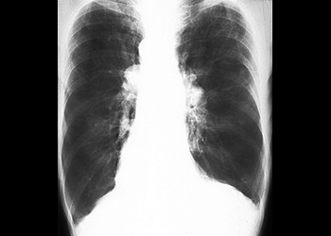
What x-ray features may be present in cor pulmonale? In chronic cor pulmonale, right ventricular dilation and hypertrophy, as well as increased vascular markings at the hilum, are seen in a chest x-ray.

Slide 45
What is the definition of emphysema? Emphysema is a lung condition characterized by abnormal permanent enlargement of the airspaces distal to the terminal bronchiole, accompanied by destruction of their walls without obvious fibrosis.
Is this a clinical or an anatomic term? Anatomic.

Slide 46
What are the major forms of emphysema? Can they always be distinguished from each other? What are the usual distribution and histopathologic features of centrilobular emphysema?
The forms of emphysema are defined by their anatomic nature. In centriacinar (centrilobular) emphysema, the central or proximal parts of the acini, formed by respiratory bronchioles, are affected, whereas the distal alveoli are spared. This is the usual form associated with COPD, and it usually is more severe in the upper lobes. Panacinar (panlobular) emphysema is characterized by uniform enlargement of the acini from the level of the respiratory bronchioles to the terminal blind alveoli. It affects the lower lobes more severely, and it is associated with alpha1-antitrypsin deficiency. In advanced cases, the distinction may be impossible to make.

Slide 47
What lung function tests are useful in distinguishing obstructive vs restrictive lung diseases? Obstructive lung diseases have increased resistance to airflow, usually measured by the forced expiratory volume at one second (FEV1). Restrictive lung diseases have reduced total lung capacity, usually measured by the forced vital capacity (FVC) test. Many conditions have both obstructive and restrictive features.

Slide 48
What is the most likely cause of septal wall destruction in emphysema? The most plausible explanation is protease-antiprotease imbalance. The proteases (eg, elastase) are derived from neutrophils and macrophages that accumulate in the lungs of smokers. The principal antiprotease is alpha1-antitrypsin. The activity of this antiprotease is reduced by the effects of smoking.

Slide 49
What does the term "pan" refer to in panacinar emphysema? The emphysematous changes involve the entire acinus (and not the entire lung).
With what inherited disease is this condition frequently associated? Alpha1-antitrypsin deficiency.

Slide 50
How does cor pulmonale develop? Cor pulmonale--right ventricular dilation and hypertrophy--develops following pulmonary hypertension caused by diseases of the lung or pulmonary vasculature. Changes in the pulmonary arteries and arterioles are usually present.
How is cor pulmonale manifested?
right heart failure is manifested by distended neck veins and enlarged tender liver.
Manifestation of typical features of severe chronic bronchitis : (so-called blue bloater). Increased sleepiness reflects CO2 narcosis; cyanosis reflects very poor oxygenation; and elevated red cell counts (secondary polycythemia) result from chronic hypoxemia.

