Slide 1
Tumors of the Lung and Upper Respiratory Tract

Slide 2
Lung Tumors
Lungs are frequently the site of metastases.
Primary lung cancer is a common disease.
95% of primary lung tumors arise from the bronchial epithelium.
5% are miscellaneous group.
The most common benign lesions are hamartomas.

Slide 3
Bronchogenic carcinoma
The number one cause of cancer-related deaths in industrialized countries.
Accounting for about one third of cancer deaths in men.
In 1950 (USA), death rate in male – 19.9/100,000
death rate in female-4.5/100,000
In 1997 (USA), death rate in male – 74/100,000
death rate in female-31/100,00
(13% of all cancer deaths in men and women).
The incidence rate is declining significantly in men, from a high of 86.5 per 100,000 in 1984 to 69.8 in 1998. In the 1990s, the increase among women reached a plateau, with incidence in 1998 at 43.4 per 100,000.
Occurs between ages 40 and 70 years.

Slide 4
Etiology of bronchogenic carcinoma
1. Tobacco smoking:
Positive relationship between tobacco smoking and lung cancer.
Statistical association between the frequency of lung cancer and:
1. Amount of daily smoking.
2. Tendency to inhale.
3. The duration of smoking habit.
Increased risk becomes 20 times greater among habitual heavy smokers.
Cessation of cigarette smoking for at least 15 years brings the risk down.
Passive smoking increases the risk to approximately twice than non-smokers.
Progressive alterations in the lining epithelium.
Experimental evidence – more than 1200 carcinogenic and promoter substances.

Slide 5
Etiology of brochogenic carcinoma
2. Industrial hazards:
Certain industrial exposures increase the risk of developing lung cancer.
All types of radiation may be carcinogenic.
Uranium miners (4x)
Uranium miners and smoking (10x).
Asbestos worker (5x).
Asbestos worker and smoking (50-90x).
Others: persons who work in nickel, chromates, coal, mustard gas, arsenic, iron and in newspaper workers.

Slide 6
Etiology of bronchogenic carcinoma
3. Air pollution:
May play some role in increased incidence.
Indoor air pollution especially by radon.
4. Scarring:
Due to old infarcts, wounds, scar, granulomatous infections are associated with adenocarcinoma.

Slide 7
Precursor Lesions.
Three types of precursor epithelial lesions are recognized:
(1) squamous dysplasia and carcinoma in situ
(2) atypical adenomatous hyperplasia
(3) diffuse idiopathic pulmonary neuroendocrine cell hyperplasia.
It should be noted that the term "precursor" does not imply that progression to invasion will occur in all cases.

Slide 8
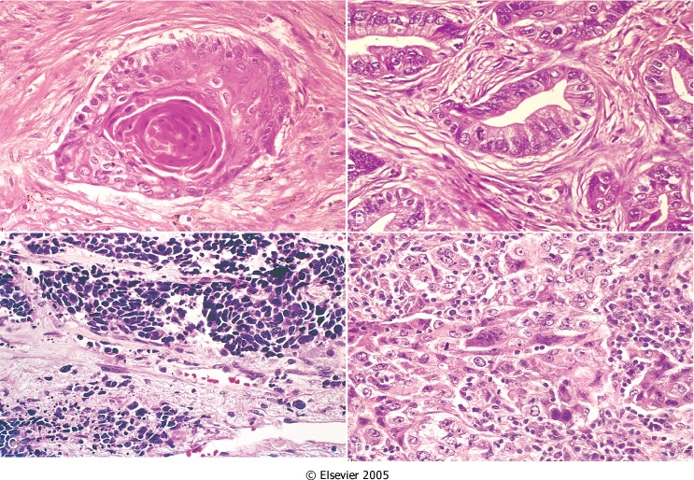
Classification of brochogenic carcinoma
Histologic classification of bronchogenic carcinoma and
approximate incidence:
1. Squamous cell (epithelium) carcinoma (25%-40%)
2. Adenocarcinoma, including bronchioloalveolar carcinoma
(25%-40%).
3. Large cell carcinoma (10%-15%).
4. Small cell lung carcinoma (SCLC) (20%-25%).
5. Combine patterns (5%-10%).
- Most frequent patterns:
- Mixed squamous cell ca
and adenocarcinoma.
- Mixed squamous cell ca
and SCLC.

Slide 9
Classification of brochogenic carcinoma
For therapeutic purposes, bronchogenic carcinoma are classified into:
Non- Small cell lung carcinoma (NSCLC)
Small cell lung carcinoma (SCLC)
(includes squamous cell, adenocarcinomas, and large-cell carcinomas).

Slide 10
Classification of brochogenic carcinoma
Differences between SCLC and NSCLC:
Histology
Small cell lung carcinoma:
Scant cytoplasm; small, hyperchromatic nuclei with fine chromatin pattern; nucleoli indistinct; diffuse sheets of cells
Non- Small cell lung ca:
Abundant cytoplasm; pleomorphic nuclei with coarse chromatin pattern; nucleoli often prominent; glandular or squamous architecture

Slide 11
Differences between SCLC and NSCLC: Markers
Small cell lung carcinoma
non Small cell lung carcinoma
Neuroendocrine Markers
Usually present
(dense core granules on electron microscopy; expression of chromogranin, neuron-specific enolase and synaptophysin)
Epithelial Markers:
Usually absent
Mucin: Absent
Usually absent
Usually present
Present in adenoarcinoma

Slide 12
Classification of brochogenic carcinoma
Differences between SCLC and NSCLC:
Peptide Hormone Production
Small cell lung carcinoma:
Adrenocorticotropic hormone, antidiuretic hormone, gastrin-releasing peptide, calcitonin
Non- Small cell lung ca:
Parathyroid hormone-related peptide (PTH-rp) in squamous cell carcinoma

Slide 13
Classification of brochogenic carcinoma
Genetic differences between SCLC and NSCLC:
Small cell lung carcinoma:
high frequency of TP53 and RB gene mutation
deletion of the short arm of chromosome 3
Non- Small cell lung ca:
p16/CDKN2A is commonly inactivated
K-RAS oncogene mutation occur in adenocarcinoma
MYC family overexpression occur in both

Slide 14
Classification of brochogenic carcinoma
Genetic differences between SCLC and NSCLC:
Small cell lung carcinoma:
Tumor Suppressor Gene:
3p deletions >90%
RB mutations ∼90%
p16/CDKN2A ∼10%
p53 mutations >90%
Dominant Oncogene Abnormalities:
KRAS mutations Rare
EGFR mutations Absent
Non- Small cell lung ca:
>80%
∼20%
>50%
>50%
∼30% adenocarcinomas
∼20% (adenocarcinomas, nonsmokers, women)

Slide 15
Classification of brochogenic carcinoma
Differences between SCLC and NSCLC:
Response to Chemotherapy and Radiotherapy
Non- Small cell lung ca:
Uncommonly complete response
NSCLCs are curable by surgery (if limited to the lung).
Small cell lung carcinoma:
Often complete response to but recur invariably

Slide 16
Among the major histologic subtypes of lung cancer, squamous and small-cell carcinomas show the strongest association with tobacco exposure.

Slide 17
Morphology of bronchogenic carcinoma
Arise in the lining epithelium of major bronchi.
All are aggressive.
All varieties have the capacity to synthesize bioactive products.
Small mucosal lesions, firm and gray-white, form intraluminal masses, invade into adjacent lung parenchyma, central necrosis, areas of hemorrhage, extend to the pleura, invade the pleural activity.
Spread to trachial and mediastinal lymph nodes.

Slide 18
Morphology of bronchogenic carcinoma
Spread of bronchogenic carcinoma
Lymphatic spread.
* successive chains of nodes (scalene nodes).
* involvement of the supraclavicular node
(Virchow’s node).
Extend into the pericardial or pleural spaces. Infiltrate the superior vena cava. May invade the brachial or cervical sympathetic plexus (Homer’s Syndrome).
Distant metastasis to liver (30-50%), adrenals (>50%), brain (20%) and bone (20%).

Slide 19
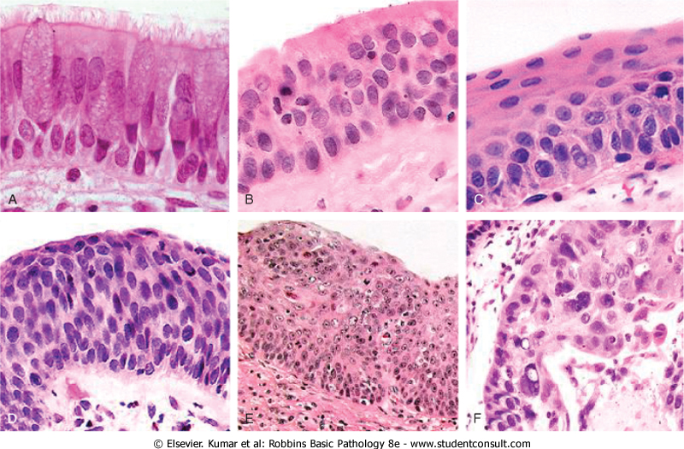
Morphology of bronchogenic carcinoma
Squamous cell carcinoma(SCC)
More common in men and closely correlated with smoking.
Arise centrally in major bronchi.
Preceded
for years
by atypical
metaplasia
or dysplasia

Slide 20
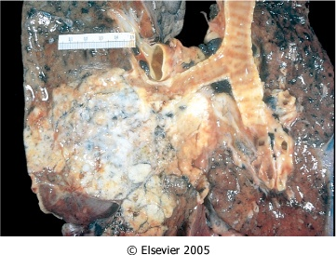
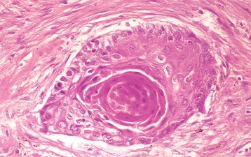
Morphology of bronchogenic carcinoma
Squamous cell carcinoma (SCC)
Histologically, these tumors range from well-differentiated squamous cell neoplasm to poorly differentiated neoplasm.

Slide 21
Morphology of bronchogenic carcinoma
Adenocarcinomas
Two forms:
Bronchial – derived carcinoma.
Most common in patients under the age of 40, women and non-smokers.
May occur as central lesions but are usually more peripherally, many arising in relation to peripheral lung scars.
Tend to metastasize widely at an early stage.
Bronchioloalveolar carcinoma
Involve peripheral parts as a single nodule or more often as multiple diffuse nodules.

Slide 22
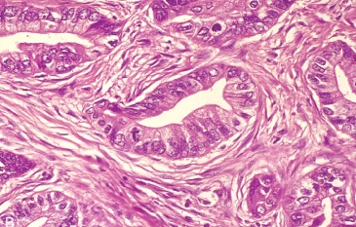
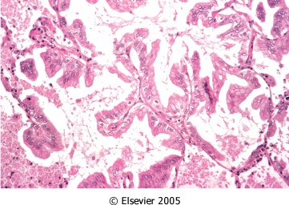
Bronchial – derived
adenocarcinoma
Histologically, they assume a variety of forms, including typical adenocarcinoma with mucus secretion and papillary or bronchioloalveolar patterns.
Bronchioloalveolar carcinoma
Malignant cells spread along alveolar wall

Slide 23
Morphology of bronchogenic carcinoma
Small cell carcinomas (oat cell carcinoma)
Highly malignant tumor, rarely resectable.
More common in men.
Strongly associated with cigarette smoking.
Appear as pale gray, centrally located masses with extension into the lung parenchyma.
Early involvement of the hilar and mediastinal nodes.

Slide 24
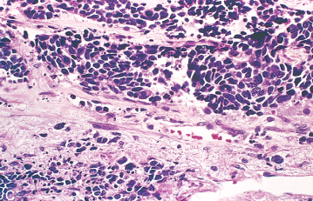
Small cell carcinomas (oat cell carcinoma)
Composed of small, dark, round to oval, lymphocyte-like cells.
Derived from neuroendocrine cells of the lung.
EM dense-core neurosecretory granules.
Ability to secrete a host of polypeptide hormones (ACTH), calcitonin, gastrin-releasing peptide and chromogranin.

Slide 25
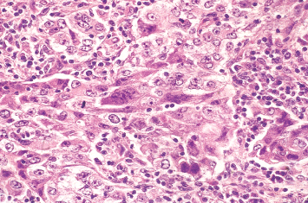
Morphology of bronchogenic carcinoma
Large cell carcinoma
Anaplastic carcinoma with large cells probably represent SCC or adenocarcinoma.
Poor prognosis.

Slide 26
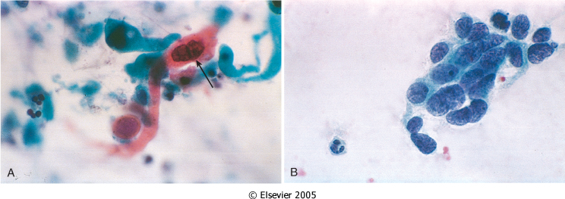

Slide 27
Morphology of bronchogenic carcinoma
Secondary pathology
Partial obstruction – emphysema.
Total obstruction – atelectasis and chronic bronchitis.
Pulmonary abscess.
Pleuritis.

Slide 28
Clinical features of bronchogenic carcinoma

Slide 29
Clinical features of bronchogenic carcinoma
Apical neoplasms may invade the brachial or cervical sympathetic plexus to cause severe pain in the distribution of the ulnar nerve
or
to produce Horner syndrome (ipsilateral enophthalmos, ptosis, miosis, and anhidrosis).
Such apical neoplasms are sometimes called Pancoast tumors, and the combination of clinical findings is known as Pancoast syndrome.
Pancoast tumor is often accompanied by destruction of the first and second ribs and sometimes thoracic vertebrae.

Slide 30
Clinical course of bronchogenic carcinoma
Silent, insidious lesions, chronic cough and expectoration.
Hoarseness, chest pain, superior vena cava syndrome, pericardial or pleural effusion.
Symptoms due to metastatic spread.
NSCLC have a better prognosis than SCLC.
Outlook is poor for most patients.

Slide 31
Paraneoplastic syndrome
3% to 10% develop overt paraneoplastic syndromes.
Neuromuscular syndromes.
Clubbing of the fingers.
Hematologic manifestations.
Endocrine

Slide 32
Paraneoplastic syndrome
Antidiuretic hormone (ADH), inducing hyponatremia owing to inappropriate ADH secretion
Adrenocorticotropic hormone (ACTH), producing Cushing syndrome
Parathormone, parathyroid hormone-related peptide, prostaglandin E, and some cytokines, all implicated in the hypercalcemia often seen with lung cancer
Calcitonin, causing hypocalcemia
Gonadotropins, causing gynecomastia
Serotonin and bradykinin, associated with the carcinoid syndrome
Hypercalcemia is most often encountered with squamous cell neoplasms, the hematologic syndromes with adenocarcinomas. The remaining syndromes are much more common with small-cell neoplasms,

Slide 33
Neuroendocrine tumors
Bronchial carcinoid
Tumor with neuroendocrine differentiation arising from Kulchitsky cells in the bronchial mucosa.
Appear at an early age (mean 40 years) with equal sex incidence.
1-5% of all pulmonary neoplasms.
Often resectable and curable.
No relation with cigarette smoking or other environmental factor.
Carcinoid syndrome ( intermittent attacks of diarrhea, flushing, and cyanosis)

Slide 34
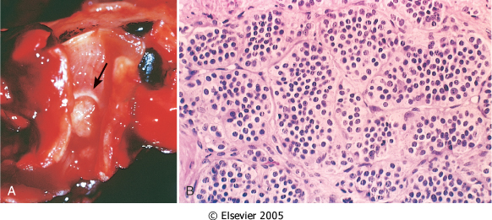
Morphology of Neuroendocrine tumors
Originate in mainstem bronchi.
Two patterns:
- an obstructing polypoid, spherical
intraluminal mass;
- a mucosal plaque penetrating the
bronchial wall.
Composed of uniform cuboidal cells that have regular round nuclei with few mitoses and little or no anaplasia.

Slide 35
E/M of Neuroendocrine tumors

Slide 36
Nasopharyngeal carcinoma
Strong epidemiologic links to EBV.
High frequency in Chinese people.
* Histological variants are squamous cell carcinoma, non-
keratinizing carcinoma and undifferentiated carcinoma.
* Characterized by large epithelial cells having indistinct cell
borders and prominent nucleoli surrounded by
lymphocytes.
* Nasopharyngeal carcinomas invade locally, spread to cervical
lymph nodes and then metastasize to distant sites.
* Tend to be radiosensitive.
* 5-year survival rate is 50%.

Slide 37
Laryngeal tumors
Vocal cord nodules
Less than 0.5 cm. in diameter located on the true vocal cords.
Composed of fibrous tissue and covered by stratified squamous mucosa.
Occur in heavy smokers or singers.
Laryngeal papilloma
Benign neoplasm on the true vocal cords.
Histologically, it consists of multiple, slender, finger-like projections supported by central fibrovascular cores covered
by stratified squamous epithelium.
Juvenile laryngeal papillomatosis.
Caused by human papillomavirus types 6 and 11.
Tend to recur after excision

Slide 38
Carcinoma of the larynx
Represents only 2% of all cancers.
Occurs after age 40 years and more common in men (7:1).
All cases occur in smokers
alcohol and asbestos exposure may also play roles.
95% of laryngeal carcinomas are typical squamous cell lesions.
Develops directly on the vocal cords ( glottic: 60 to5%), but it may arise above (supraglottic: 25 to40%) or below the cords (subglottic:less than 5%).
Morphology: similar to growth pattern of squamous cell carcinomas.
In situ lesions, plaques, ulcerating and fungating.
Histology, squamous cell carcinoma with variable degree of anaplasia.

Slide 39
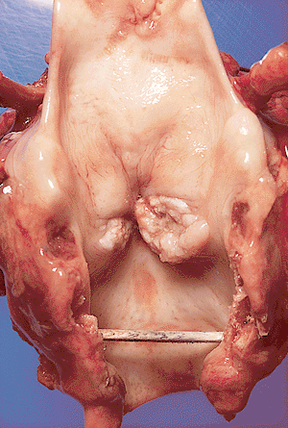

Slide 40
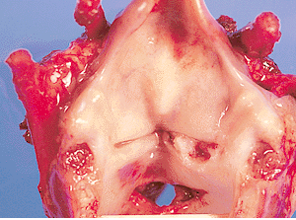
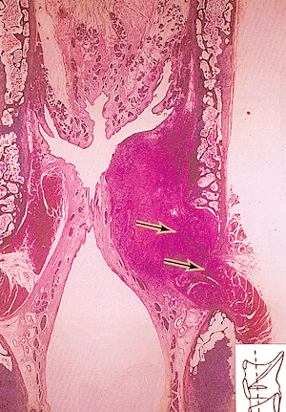

Slide 41
Carcinoma of the larynx
Clinical course
Persistent hoarseness.
About 90% of these cancers are confined to the larynx.
Prognosis is good.
Many patients can be cured by surgery, radiation or combined therapeutic treatments.
About 1/3 die of the disease.
Usual cause of death is infection of the respiratory tract or wide spread metastasis

