Slide 1
Diseases of Central Nervous System
Infections
Tumors
Dr. Maha Arafah

Slide 2
Infections of Central Nervous System

Slide 3
Infections of Central Nervous System
Meningitis refers to an inflammatory process of the leptomeninges and CSF within the subarachnoid space.
Meningoencephalitis refers to inflammation of the meninges and brain parenchyma.
Encephalitis refers to inflammation of the brain parenchyma.

Slide 4
There are four principal routes by which infectious microbes enter the nervous system:
Hematogenous spread
the most common means of entry
infectious agents enter through the arterial circulation
retrograde venous spread through anastomotic connections between veins of the face and cerebral circulation.
Direct implantation of microorganisms:
is almost invariably traumatic or in congenital CNS malformation (Neural tube defect)
Local extension
occurs secondary to an established infection in an air sinus, most often the mastoid or frontal, an infected tooth or middle ear
Through the peripheral nervous system into the CNS:
E.g. rabies and herpes zoster.

Slide 5
Infections of Central Nervous System
Bacterial
VIRAL
FUNGAL
(including Candida albicans, Mucor, Aspergillus fumigatus, and Cryptococcus neoformans. In endemic areas, pathogens such as Histoplasma capsulatum, Coccidioides immitis, and Blastomyces dermatitidis
Protozoal diseases
(including malaria, toxoplasmosis, amebiasis, and trypanosomiasis), rickettsial infections (such as typhus and Rocky Mountain spotted fever), and metazoal diseases (especially cysticercosis and echinococcosis)
Prion Diseases

Slide 6
INFECTIOUS MENINGITIS An inflammatory process of the leptomeninges and CSF within the subarachnoid space
Acute Pyogenic (Bacterial) Meningitis
ACUTE LYMPHOCYTIC (VIRAL) MENINGITIS
Chronic Meningitis: tuberculous, spirochetal, or cryptococca

Slide 7
Acute Pyogenic (Bacterial) Meningitis
Important cause of morbidity and mortality at any age (Medical emergency)
Pathogen reach CNS via blood after colonizing the nasopharynx
The microorganisms vary with the age of the patient:
Neonates: Escherichia coli and the group B streptococci
Old age: Streptococcus pneumoniae and Listeria monocytogenes
Among adolescents and in young adults, Neisseria meningitidis
immunization against Haemophilus influenzae has markedly reduced the incidence of meningitis associated with this organism
S. aureus and gram negative rods are common after placement of surgical shunts

Slide 8
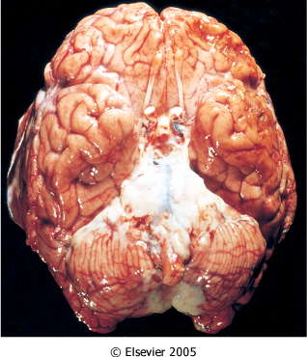
Acute Pyogenic (Bacterial) Meningitis
Morphology
In acute meningitis, an exudate is evident within the leptomeninges over the surface of the brain
neutrophils fill the entire subarachnoid space in severely affected areas and are found predominantly around the leptomeningeal blood vessels in less severe cases.

Slide 9
Pyogenic meningitis CSF Findings in spinal tap
cloudy or frankly purulent CSF
as many as 90,000 neutrophils /mm
a raised protein level
a markedly reduced glucose content
Bacteria may be seen on a Gram stained
smear or can be cultured

Slide 10
Acute Pyogenic (Bacterial) Meningitis
Clinical Features
Systemic signs of infection superimposed on clinical evidence of meningeal irritation and neurologic impairment, including headache, photophobia, irritability, clouding of consciousness, and neck stiffness.
Untreated, pyogenic meningitis can be fatal.
Effective antimicrobial agents markedly reduce mortality associated with meningitis.

Slide 11
Acute Pyogenic (Bacterial) Meningitis Complications
Phlebitis, that may also lead to venous occlusion and
hemorrhagic infarction of the underlying brain
Leptomeningeal fibrosis and consequent hydrocephalus
Septicemia with hemorrhagic infarction of the adrenal
glands and cutaneous petechiae (known as Waterhouse-
Friderichsen syndrome, particularly common with
meningococcal and pneumococcal meningitis)
Focal cerebritis & seizures
Cerebral abscess
Cognitive deficit
Deafness

Slide 12
ACUTE LYMPHOCYTIC (VIRAL) MENINGITIS

Slide 13
ACUTE LYMPHOCYTIC (VIRAL) MENINGITIS Acute Aseptic Meningitis
Aseptic meningitis is a misnomer, but it is a clinical term referring to the absence of recognizable organisms in an illness with meningeal irritation, fever, and alterations of consciousness of relatively acute onset.
It may be associated with encephalitis.
The disease is caused by virus
Echovirus, coxsackievirus, mumps virus and HIV.

Slide 14
ACUTE LYMPHOCYTIC (VIRAL) MENINGITIS
The clinical course is less fulminant than that of pyogenic meningitis, and the CSF findings also differ between the two conditions.
CSF findings in aseptic meningitis:
predominant cells are lymphocte
the protein elevation is only moderate
the sugar content is nearly always normal
The viral meningitides are usually self-limiting and are treated symptomatically.

Slide 15
Chronic Meningitis
Bacterial: Tuberculosis and Neurosyphilis
Fungal: Cryptococcus neoformans (in HIV Pt.)

Slide 16
INFECTION OF BRAIN PARENCHYMA
Brain Abscess
Tuberculosis
Toxoplasmosis
Viral Encephalitis
Spongiform Encephalitis

Slide 17
Brain Abscess

Slide 18
Brain Abscess
may arise by: 1. direct implantation of organisms
2. local extension (mastoiditis, paranasal sinusitis) 3. hematogenous spread (from the heart, lungs, or distal bones or after tooth extraction)
Streptococci and staphylococci are the most common organisms in non immunosuppressed populations
Predisposing conditions:
acute bacterial endocarditis ( usually give multiple microabscess)
cyanotic congenital heart disease in which there is a right-to-left shunt
loss of pulmonary filtration of organisms ( e.g. chronic pulmonary sepsis, bronchiectasis)

Slide 19
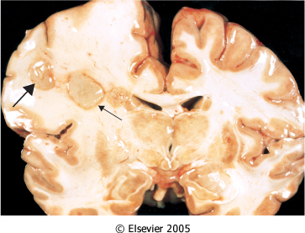
Brain Abscess
Most common on cerebral hemispheres
Liquefactive necrosis
Clinical presentation: progressive focal deficits in addition to the general signs of raised intracranial pressure
Complications:
Herniation
Rupture of abscess into subarachnoid space or ventricle

Slide 20
Tuberculosis Toxoplasmosis

Slide 21
Tuberculosis
Tuberculoma well-circumscribed intraparenchymal mass
may be associated with meningitis.
A tuberculoma may be up to several centimeters in diameter, causing significant mass effect.
Microscopic examination:
there is usually a central core of caseous necrosis surrounded by a typical tuberculous granulomatous reaction

Slide 22
CSF in TB
There is only a moderate increase in cellularity
of the CSF (pleiocytosis) made up of mononuclear cells, or a mixture of polymorphonuclear and mononuclear cells
The protein level is elevated
The glucose content typically is moderately reduced or normal

Slide 23
Fungal infection
Candida albicans, Mucor, Aspergillus fumigatus, and Cryptococcus neoformans are the most common fungi that can cause encephalitis
Parenchymal invasion, usually in the form of granulomas or abscesses
often coexists with a meningitis

Slide 24
Cryptococcal meningitis and meningoencephalitis
– Observed often in association with AIDS. It can be
fulminant and fatal in as little as 2 weeks, or indolent,
or it can evolve over months or years

Slide 25
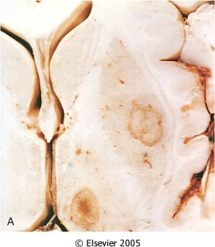
Toxoplasmosis
Infection of the brain by Toxoplasma gondii is one of the most common causes of neurologic symptoms and morbidity in patients with AIDS.
The clinical symptoms are subacute
Toxoplasma abscesses in the putamen and thalamus (multiple abscesses in gray matter

Slide 26
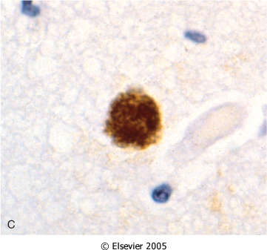
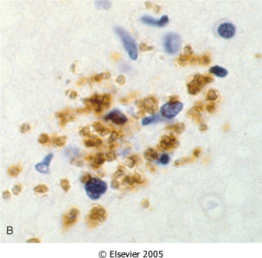
Toxoplasmosis
Toxoplasma pseudocyst with bradyzoites highlighted by immunostaining
Free tachyzoites demonstrated by immunostaining

Slide 27
VIRAL ENCEPHALITIS

Slide 28
VIRAL ENCEPHALITIS
The most common cause of encephalitis
Almost invariably associated with meningeal inflammation
General features:
Perivascular inflammatory infiltrates(mononuclear cells)
Microglial nodules
Inclusion bodies

Slide 29
VIRAL ENCEPHALITIS
Arthropod-Borne Viral Encephalitis (Arboviruses)
Herpes Simplex Virus Type 1 (HSV-1)
Varicella-Zoster Virus (Herpes Zoster)
Cytomegalovirus
Poliomyelitis
Rabies
Subacute sclerosing panencephalitis
HIV encephalitis
Progressive Multifocal Leukoencephalopathy

Slide 30
VIRAL ENCEPHALITIS
The CSF Finding:
is usually colorless but with a slightly elevated pressure and, initially, a neutrophilic pleocytosis that rapidly converts to lymphocytes
the protein level is elevated
sugar content is normal

Slide 31
VIRAL ENCEPHALITIS

Slide 32
VIRAL ENCEPHALITIS Herpes Simplex Virus Type 1 (HSV-1)
HSV-1 produces an encephalitis that occurs in any age group but is most common in children and young adults.
Clinical symptoms: alterations in mood, memory, and behavior

Slide 33
HIV encephalitis (Subacute Encephalitis)
Patients affected with this remarkable neurologic disorder with dementia referred to as AIDS-dementia complex (ADC)
The dementia begins insidiously, with mental slowing, memory loss, and mood disturbances, such as apathy and depression.
Motor abnormalities, ataxia, bladder and bowel incontinence, and seizures can also be present.

Slide 34
HIV encephalitis (Subacute Encephalitis)
Morphology
On macroscopic examination
the meninges are clear, and there is some ventricular dilation with sulcal widening but normal cortical thickness.
Microscopically:
a chronic inflammatory reaction with widely distributed infiltrates of microglial nodules, sometimes with associated foci of tissue necrosis and reactive gliosis

Slide 35
HIV encephalitis (Subacute Encephalitis)
An important component of the microglial nodule is the macrophage-derived multinucleated giant cell

Slide 36
Progressive Multifocal Leukoencephalopathy
is a viral encephalitis caused by the JC polyomavirus
demyelination is its principal pathologic effect because the virus preferentially infects oligodendrocytes
occurs almost invariably in immunosuppressed individuals in various clinical settings, including:
chronic lymphoproliferative or myeloproliferative illnesses
immunosuppressive chemotherapy
granulomatous diseases
AIDS

Slide 37
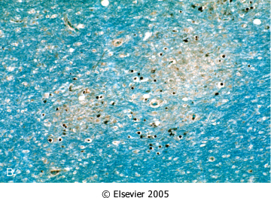
Progressive Multifocal Leukoencephalopathy
Morphology
The lesions consist of patches of irregular destruction of the white matter

Slide 38
Transmissible Spongiform Encephalopathies
(Prion Diseases)

Slide 39
Transmissible Spongiform Encephalopathies (Prion Diseases)
group of diseases includes:
in humans:
Creutzfeldt-Jakob disease (CJD), Gerstmann-Sträussler-Scheinker syndrome (GSS), fatal familial insomnia, and kuru
in sheep and goats: scrapie
mink transmissible encephalopathy
chronic wasting disease of deer and elk
bovine spongiform encephalopathy (BSE)
They are all associated with abnormal forms of a specific protein, termed prion protein (PrP),

Slide 40
Pathogenesis and Molecular Genetics of Prion Diseases
Disease occurs when the prion protein undergoes a conformational change from its normal α-helix-containing isoform (PrP^{c}) to an abnormal β-pleated sheet isoform, usually termed either PrP^{sc} (for scrapie) or PrPres (for protease resistant)
The conformational change resulting in PrP^{sc} may occur spontaneously at an extremely low rate (resulting in sporadic cases) or at a higher rate if various mutations are present in PrP^{c}, such as occurs in familial forms of CJD and in GSS and fatal familial insomnia.
PrP^{sc} then facilitates, in a cooperative fashion, comparable transformation of other PrP^{c} molecules

Slide 41
Molecular Genetics of Prion Diseases
The infectious nature of PrP^{sc} molecules comes from this ability to disrupt the integrity of normal cellular components through conformational changes

Slide 42
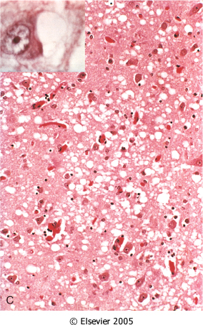
Transmissible Spongiform Encephalopathies (Prion Diseases)
Morphology
The pathognomonic finding is a spongiform transformation of the cerebral cortex and, often, deep gray matter structures (caudate, putamen)
In advanced cases, there is severe neuronal loss, reactive gliosis, and sometimes expansion of the vacuolated areas into cystlike spaces
No inflammatory infiltrate is present
Accumulation of PrP^{sc} in neural tissue appears to be the cause of the pathology in these diseases but how this material causes the development of cytoplasmic vacuoles and eventual neuronal death is still unknown

Slide 43
Creutzfeldt-Jakob Disease
a rare but well-characterized disease that manifests clinically as a rapidly progressive dementia and diffuse atrophy of the brain.
It is primarily sporadic (about 85% of cases) in its occurrence, with a worldwide annual incidence of about 1 per million
familial forms also exist
The disease has a peak incidence in the seventh decade.
There are well-established cases of iatrogenic transmission, notably by corneal transplantation, deep implantation of neural electrodes, and contaminated preparations of human growth hormone.
The disease is uniformly fatal, with an average duration of only 7 months

Slide 44
Variant Creutzfeldt-Jakob Disease (vCJD)
Starting in 1995, a series of cases with a CJD-like illness came to medical attention in the United Kingdom
It has been linked to the ingestion of tissues from cattle with bovine spongioform encephalopathy
The disease affected young adults with behavioral disorders and the neurologic syndrome progressed more slowly than in patients with other forms of CJD
The neuropathologic findings and molecular features of these new cases were similar to those of CJD

Slide 45
THE END

