Slide 1
Tumours of the CNS

Slide 2
Tumours of the CNS
Histological distinction between benign and malignant lesions may be more subtle
The anatomic site of the neoplasm can have lethal consequences irrespective of histological classification
The pattern of spread of primary CNS neoplasms
differs from that of other tumors:
rarely metastasize outside the CNS
the subarachnoid space does provide a pathway for spread

Slide 3
General manifestations
Seizures, headaches, vague symptoms
Focal neurologic deficits related to the
anatomic site of involvement
Rate of growth may correlate with history

Slide 4
CNS tumors
May arise from:
cells of the coverings (meningiomas)
cells intrinsic to the brain (gliomas, neuronal tumors, choroid plexus tumors)
other cell populations within the skull (primary CNS lymphoma, germ-cell tumors)
they may spread from elsewhere in the body (metastases)

Slide 5
Tumours of the CNS
Gliomas:
Astrocytomas
Oligodendrogliomas
Ependymomas

Slide 6
Astrocytomas
Fibrillary:
4th to 6th decade
Commonly cerebral hemisphere
Variable grades:
Diffuse astrocytoma
Anaplstic astrocytoma
Glioblastoma
Pilocytic:
Children and young adults
Commonly cerebellum
Relatively benign

Slide 7
Fibrillary Astrocytoma
Well differentiated “diffuse astrocytoma” ( WHO grade II) :
Static or progress slowly (mean survival of more than 5 years)
Moderate cellularity
Variable nuclear pleomorphism
Less differentiated (higher-grade) :
Anaplstiac astrocytoma ( WHO grade III)
More cellular
Greater nuclear pelomrophism
Mitosis
Glioblastoma ( WHO grade IV)
With treatment, mean survival of 8-10 months
Necrosis and/or vascular or endothelial cell proliferation

Slide 8
Diffuse astrocytoma
Note that diffuse astrocytoma are poorly demarcated

Slide 9
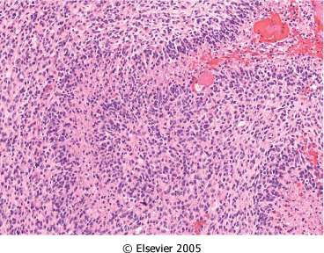
Glioblastoma Multiforme (GBM)
GBM
– Pseudopalisading necrosis AND/OR
– Vascular proliferation

Slide 10
Genetics
In addition to other markers, it became clear that secondary glioblastomas
shared p53 mutations that characterized low grade gliomas
While primary glioblastomas were
characterized by amplification of the
epidermal growth factor receptor (EGFR) gene

Slide 11
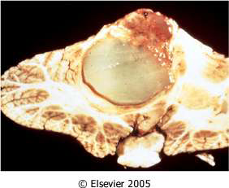
Pilocytic Astrocytoma
Often cystic, with a mural nodule
Well circumscribed
"hairlike“=pilocytic processes that are GFAP positive Rosenthal fibers & hyaline granular bodies
Necrosis and mitoses are
typically absent

Slide 12
Oligodendroglioma
The most common genetic findings are loss of heterozygosity for chromosomes 1p and 19q
Fourth and fifth decades
Cerebral hemispheres, with a predilection for white matter
Better prognosis than do patients with
astrocytomas (5 to 10 years with Rx)
Anaplastic form do worse

Slide 13
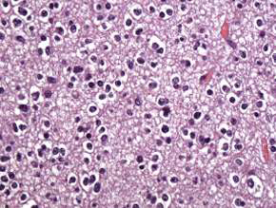
Oligodendroglioma
In oligodendroglioma tumor cells have round nuclei, often with a cytoplasmic halo
Blood vessels in the background are thin and can form an interlacing pattern

Slide 14
Ependymoma
Most often arise next to the ependyma-lined ventricular system, including the central canal of the spinal cord
The first two decades of life, they typically occur near the fourth ventricle
In adults, the spinal cord is their most
common location

Slide 15
Ependymomas
Tumor cells may form round or elongated structures (rosettes, canals) perivascular pseudo-rosettes
Anaplastic ependymomas show increased cell density, high mitotic rates, necrosis and less evident ependymal differentiation

Slide 16
Tumours of the CNS
Meningioma:
Predominantly benign tumors of adults
Origin: meningothelial cell of the arachnoid

Slide 17
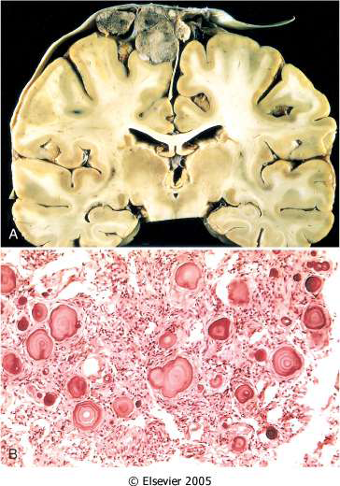
Meningioma:
Well demarcated
Attached to the dura with
compression of underlying
brain
Whorled pattern of cell
growth and psammoma
bodies

Slide 18
Meningioma:
Main subtypes:
Syncytial
Fibroblastic
Transitional
Also note:
Atypical meningiomas
Anaplastic (malignant) meningiomas

Slide 19
Medulloblastoma
Children and exclusively in the cerebellum
Neuronal and glial markers may be expressed, but the tumor is often largely undifferentiated

Slide 20
Medulloblastoma
exclusively in the cerebellum

Slide 21
Medulloblastoma
extremely cellular, with
sheets of anaplastic
("small blue") cells
with little
cytoplasm and
hyperchromatic nuclei;
mitoses are abundant.

Slide 22
Medulloblastoma Prognosis
The tumor is highly malignant, and the
prognosis for untreated patients is dismal;
however, it is exquisitely radiosensitive
With total excision and radiation, the 5-year survival rate may be as high as 75%

Slide 23
Haemangioblastoma
Commonly cerebellar tumor
Aslo the retina and others
Can occur in association with Von Hippel-Lindau Disease (cyst in pancreas, liver & kideny and renal cell carcinoma)
Highly vascular neoplasm that occurs as a mural nodule associated with a large fluid-filled cyst

Slide 24
Schwannoma
They are often encountered within the cranial vault, in the cerebellopontine angle, where they are attached to the vestibular branch of the eighth nerve acoustic schwannoma
tinnitus and hearing loss

Slide 25
Schwannoma
Sporadic schwannomas are associated with mutations in the NF2 gene
Bilateral acoustic schwannoma is associated with NF2
Attached to the nerve but can be separated from it

Slide 26
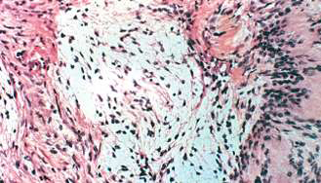
Schwannoma Morphology
Cellular Antoni A
pattern and less
cellular Antoni B
nuclear-free zones
of processes that
lie between the
regions of nuclear
palisading are
termed Verocay
bodies

Slide 27
Neurofibroma
Examples: (cutaneous neurofibroma) or in
peripheral nerve (solitary neurofibroma)
These arise sporadically or in association with type 1 neurofibroma, rarely malignant
plexiform neurofibroma, mostly arising in
individuals with NF1, potential malignancy
Neurofibromas cannot be separated from
nerve trunk (in comparison to shcwannoma)

Slide 28
Metastatic tumours
About half to three-quarters are primary tumors, and the rest are metastatic
Lung, breast, skin (melanoma), kidney, and gastrointestinal tract are the commonest

Slide 29
End of CNS tumors

Slide 30
Thank you
See you as a
Great Doctors

