Slide 1
Lymphoid pathology

Slide 2
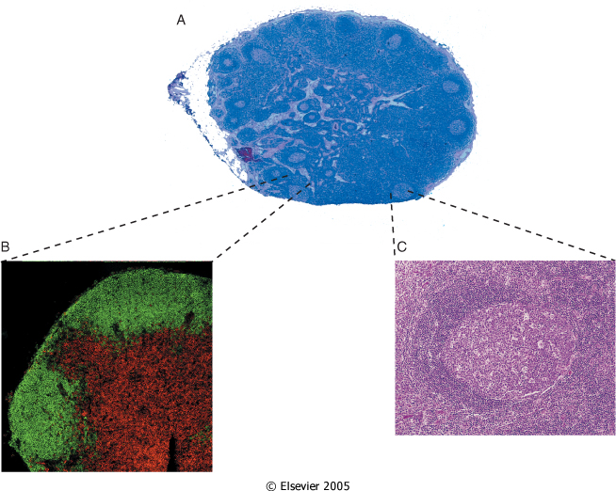

Slide 3
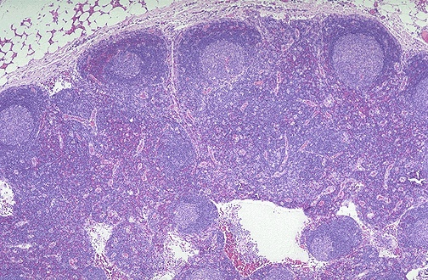

Slide 4
Locations of Lymphoid Tissue
lymph nodes
Tonsils and adenoids (Waldeyer's ring)
Peyer's patches and appendix
White pulp of the spleen

Slide 5
Lymphadenopathy :
Localized (e.g., infection) or generalized (Systemic disease).
May be due to inflammatory, reactive or neoplastic disorders
Patients younger than 30 years old Nodal enlargement is usually benign disease (80% of cases).
Patients older than 30 years old Nodal enlargement is usually malignant disease (60% of cases).
Neoplastic disorders may be primary (e.g. lymphoma) or secondary (e.g. metastatic carcinoma)

Slide 6
Investigation:
Clinical history
Blood work
Serology test
FNA
Core ,incisional biopsy , or excision ( gold standard.
Imaging studies.

Slide 7
Types of reactive lymphadenitis
Acute Nonspecific Lymphadenitis
Chronic Nonspecific Lymphadenitis:
Follicular Hyperplasia
Paracortical Lymphoid Hyperplasia
Sinus Histiocytosis
Granulomatous lymphadenitis
Specific disorder.

Slide 8
Acute Nonspecific Lymphadenitis
This form of lymphadenitis can be confined to a local group of nodes draining a focal infection
Can be generalized in systemic bacterial or viral infections.
When the cause is a pyogenic organism, a neutrophilic infiltrate is seen with severe infections, abscess is formed.
Affected nodes are tender and, when abscess formation is extensive, become fluctuant.

Slide 9
Chronic Nonspecific Lymphadenitis
Follicular Hyperplasia a predominantly B-cell response with germinal centre hyperplasia which may be associated with marginal zone hyperplasia
Paracortical Lymphoid Hyperplasia a predominantly T-cell response with paracortical expansion
Sinus Histiocytosis a macrophage response which is associated with sinus hyperplasia

Slide 10
Granulomatous lymphadenitis
Can occur in a variety of clinical settings
Due to infection (commonest cause), foreign bodies, secondary response to malignancy
Common etiologies
TB, atypical mycobacteria is common, cat-scratch fever, actinomycosis, sarcoidosis
These lymph nodes should be cultured
Helpful diagnostic features include presence and type of necrosis; presence and type of giant cells; size, shape and distribution of granulomas; other associated changes

Slide 11
BCG in lymph nodes
Patients with normal immunity have complete recovery after postvaccination bCG
Post vaccination Bacille Calmette-Guerin infection occurs in 1% of infants,
Immunosuppressed patients may require anti-TB therapy to avoid fatal disseminated infection

Slide 12
Specific disorder.
Infectious Mononucleosis
Cat Scratch Disease
Toxoplasmosis
Kikuchi’s disease
Lymphoadenopathy in HIV

Slide 13
Infectious Mononucleosis glandular fever
An acute, self-limited disease of adolescents and young adults
Caused EBV, a member of the herpesvirus family.
The infection is characterized by fever, sore throat, and generalized lymphadenitis;
an increase of lymphocytes in blood, many of which have an atypical morphology

Slide 14
Laboratory finding of EBV antibodies:Paul Bunnell Test =Monospot test.
LM: the enlarged nodes are flooded by atypical lymphocytes, which occupy the paracortical areas. Occasionally, cells resembling Reed-Sternberg cells, the hallmark of Hodgkin lymphoma.
EBV is a potent transforming virus that plays a role in a number of human malignancies, including several types of B-cell lymphoma

Slide 15
Cat Scratch Disease
Cat scratch disease is a self-limited lymphadenitis caused by the bacterium Bartonella henselae.
harbored by kittens and young cats; transmitted between cats by cat flea (but not from cats to humans)
Adults or children (85% under age 18) infected by cat claws contaminated with infected flea feces;
Area of scratch: red papule 7-12 days after contact that may become crusted or pustular, with enlargement of cervical or axillary nodes
Usually resolves spontaneously; erythromycin or other macrolides may be given

Slide 16
Toxoplasmosis in lymph nodes
Common obligate intracellular parasite (Toxoplasma gondii)
Presentation: either asymptomatic, causes lymphadenitis or produces an acute infection during pregnancy that may damage fetus
Transmitted from cat feces or undercooked meat
Commonly involves posterior cervical nodes of young women
LM: florid reactive follicular hyperplasia, clusters of epithelioid histiocytes (microgranulomas).

Slide 17
Kikuchi’s disease
Also called histiocytic necrotizing lymphadenitis, Kikuchi-Fujimoto’s disease
Initially described in Japan and other Asian countries; now worldwide
Young women with cervical lymphadenopathy (tender or painless), fever.
Usually benign and self-limited
paracortical, well-circumscribed necrotic lesions, also karryorhexis, fibrin deposits, plasmacytoid monocytes no/rare plasma cells, no neutrophils, no follicular hyperplasia, no atypia.

Slide 18
Lymphoadenopathy in HIV
mycobacterial infections
fungal infections
Chronic lymphadenopathy syndrome/ persistant generalized ymphadenopathy unexplained enlargement of nodes, Micro: florid reactive hyperplasia
Nodes may also show eventual profound lymphocyte depletion
lymphoma
Kaposi’s sarcoma,

Slide 19
Malignant Lymphoma

Slide 20
Overview
Primary neoplasms of the lymph nodes are all malignant
They are divided into non-Hodgkin's, lymphomas (NHL), and Hodgkin's disease (HD)
Can be simply divided into indolent, or slow growing types, and aggressive types
Malignant Iymphomas represent clonal malignancies in which the majority of cells are frozen at a single stage of normal Iymphocyte differentiation

Slide 21
A practical way to think of lymphoma
Category
Survival of untreated patients
Curability
To treat or not to treat
Non-Hodgkin lymphoma
Indolent
Years
Generally not curable
Generally defer Rx if asymptomatic
Aggressive
Months
Curable in some
Treat
Very aggressive
Weeks
Curable in some
Treat
Hodgkin lymphoma
All types
Variable – months to years
Curable in most
Treat

Slide 22
Epidemiology of lymphomas
5th most frequently diagnosed cancer overall for both males and females
males > females
incidence
NHL increasing over time
Hodgkin lymphoma stable

Slide 23
Lymphoma classification (based on 2001 WHO)
B-cell neoplasms
Precursor B-cell neoplasms
Mature B-cell neoplasms (19)
B-cell proliferations of uncertain malignant potential
T-cell & NK-cell neoplasms
Precursor T-cell neoplasms
Mature T-cell and NK-cell neoplasms (14)
T-cell proliferation of uncertain malignant potential
Hodgkin lymphoma
Nodular lymphocyte predominant Hodgkin lymphoma
Classical Hodgkin lymphomas (4)

Slide 24
Clinical Differences Between Hodgkin and Non-Hodgkin Lymphomas
Hodgkin Lymphoma | Non-Hodgkin Lymphoma
More often localized to a single axial group of nodes (cervical, mediastinal, para-aortic) | More frequent involvement of multiple peripheral nodes
Orderly spread by contiguity | Noncontiguous spread
Mesenteric nodes and Waldeyer ring rarely involved | Mesenteric nodes and Waldeyer ring commonly involved
Extranodal involvement uncommon | Extranodal involvement common

Slide 25
Hodgkin's Lymphoma
Accounts for 40% of adult lymphomas
Slightly more common in men ,Exception-nodular sclerosing type is more common in women
More common in adults than children
Bimodal age distribution :First large peak in the third decade ,Second smaller peak in individuals older than 45 to 50 years of age
EBV association
Involves localized groups of nodes and has contiguous spread
Differences from NHL :Less commonly involves Waldeyer's ring, mesenteric nodes, and extranodal sites

Slide 26
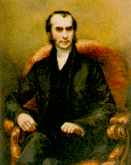
Hodgkin lymphoma WHO classification
Nodular lymphocyte predominant Hodgkin lymphoma
Classical Hodgkin lymphoma
Nodular sclerosis Hodgkin lymphoma
Mixed cellularity Hodgkin lymphoma
Lymphocyte-rich classical Hodgkin lymphoma
Lymphocyte depleted Hodgkin lymphoma
Thomas Hodgkin
(1798-1866)

Slide 27
Hodgkin's Disease - Classification
Type | Histologic Features | Frequency | Prognosis
Nodular sclerosis | Bands of fibrosis, lacunar cells | Most frequent type, more common in women | Good, most are stage I or II
Mixed cellularity | Composed of many different cells | Most frequent in older persons, second most frequent overall | Fair, most are stage III
Lymphocyte predominance | Mostly B-cells and few Reed-Sternberg variant cells | Uncommon | Good, most are stage I or II
Lymphocyte depletion | Many Reed-Sternberg cells and variants | Uncommon | Poor, most are stage III or IV

Slide 28
Hodgkin lymphoma
Reed-Sternberg cells (or RS variants) in the affected tissues
The neoplastic R-S cell constitute a minor component 1%-5% of the total tumor cell mass
cell of origin: germinal centre B-cell
RS variants :popcorn cell or Lacunar cells
RS are CD15, CD30 positive
Classic RS cell :Two mirror image nuclei, each with an eosinophilic nucleolus surrounded by a clear halo
most cells in affected lymph node are polyclonal reactive lymphoid cells, not neoplastic cells
Accumulation of histiocytes ,lymphocytes, and PMN

Slide 29
Staging
Predictive of prognosis and guide the choice of therapy
Include :clinical exam, radiologic immaging, and biopsy of bone marrow
Constitutional symptoms (fever, night sweet, and weight loss) is charecteristic of HL but can also be seen in other lymphoid neoplasms

Slide 30
Hodgkin's Disease - Staging
Stage | Characteristics
I | Only a single lymph node site or extranodal site is involved
II | Two or more lymph node sites on one side of the diaphragm are involved, or limited contiguous extranodal site involvement
III | Lymph node sites on both sides of the diaphragm are involved, with splenic or limited contiguous extradodal site involvement, or both
IV | Extensive involvement of extranodal sites, with or without lymph node involvement
Stage I
Stage II
Stage III
Stage IV

Slide 31
Hodgkin’s Lymphoma Nodular Sclerosis type
Most common form 65% to 70% of cases
Two features : Lacunar type R-S cells and collagen bands
R-S cells positive for CD30,CD15, and negative for CD45 and B-cell and T-cell markers
Mediastinal ,adolescents or young adults is a typical history ,Prognosis is excellent

Slide 32
Hodgkin’s Lymphoma Mixed cellularity Type
20% to 25% of cases, older age group
Diffuse involvement by a heterogenous cellular infiltrate
Diagnostic R-S cells are plentiful
Same immunophenotype as nodular sclerosis
More in males ,strongly associated with EBV

Slide 33
Hodgkin’s Lymphoma Lymphocytes-Rich type
Uncommon form
Reactive lymphocytes makeup the vast majority of cells
Same immunophenotype as MC and NS
Has a very good to excellent prognosis

Slide 34
Hodgkin’s Lymphoma Lymphocytes predominance type
Rare form ,5% of cases
R-S cells are extremely hard to find
R-S cells has distinctive morphology called popcorn cell
In contrast to other forms of HL,RS cells are positive for CD20 ,and negative for CD30 and CD15

Slide 35
Hodgkin’s Lymphoma Lymphocytes Depleted type
High grade type
Few lymphocytes present
The majority of the cells are abnormal R-S cells and R-S like cells
Confused with other malignancy .

Slide 36
Non-Hodgkin's Lymphomas (NHL)
NHL frequently extra-nodal ,HD is nodal.
Account for 60% of adult lymphomas :Over 80% are of B-cell origin and derive from the germinal follicle.
Childhood lymphomas :NHL accounts for 60% of cases :Usually T-cell lymphoblastic lymphoma or Burkitt's lymphoma ,Generally more aggressive than adult lymphomas
The most common are diffuse large B-cell lymphoma, follicular lymphoma and Hodgkin lymphoma.

Slide 37
Diffuse large B-cell lymphoma
Follicular
lymphoma
Other NHL

Slide 38
Risk factors for NHL
Viruses
Epstein-Barr virus (EBV) :Burkitt's lymphoma ,Diffuse large B-cell lymphoma
Human T-cell leukemia virus type I :Adult T-cell lymphoma or leukemia
Helicobacter pylori
Malignant lymphoma derives from mucosa-associated lymphoid tissue in the stomach.
Autoimmune disease
Sjögren's syndrome :Predisposes to salivary gland and gastrointestinal lymphomas
Immunodeficiency syndromes e.g. Acquired immunodeficiency syndrome (AIDS)
Immunosuppressive therapy :Recipients of organ or bone marrow transplants

Slide 39
Clinical manifestations
Variable
severity: asymptomatic to extremely ill
time course: evolution over weeks, months, or years
Systemic manifestations
fever, night sweats, weight loss, anorexia, pruritis
Local manifestations
lymphadenopathy, splenomegaly most common
any tissue potentially can be infiltrated

Slide 40
Other complications of lymphoma
bone marrow failure (infiltration)
CNS infiltration
immune hemolysis or thrombocytopenia
compression of structures (eg spinal cord, ureters) by bulky disease
pleural/pericardial effusions, ascites

Slide 41
Small lymphocytic lymphoma (SLL)
Patients usually > 60 years of age
Neoplasm of small, mature B lymphocytes SLL if confined to lymph nodes/CLL if leukemic phase is present
Small and well-differentiated B lymphocytes, with diffuse effacement of nodal architecture and no follicles
disease tends to be generalized but with indolent course and prolonged survival; some may transform to more aggressive lymphomas

Slide 42
Diffuse large B-cell lymphoma
50% of adults with NHL;
elderly and childhood populations
Derives from germinal center
Localized disease with extranodal involvement: GI tract, brain (EBV association with AIDS)
Cells are large, with prominent nucleoli and abundant cytoplasm and many mitoses.

Slide 43
Follicular lymphoma
40% of adults with NHL;
elderly patients
Derives from germinal center
t(14;18) causing overexpression of BCL2 antiapoptosis gene
Generalized lymphadenopathy
Nodal architecture is effaced by monotonous, crowded follicles composed of monomorphous small cleaved B-lymphocytes
Bone marrow involvement

Slide 44
Follicular lymphoma
most common type of “indolent” lymphoma
usually widespread at presentation
often asymptomatic
not curable (some exceptions)
associated with BCL-2 gene rearrangement [t(14;18)]
cell of origin: germinal center B-cell

Slide 45
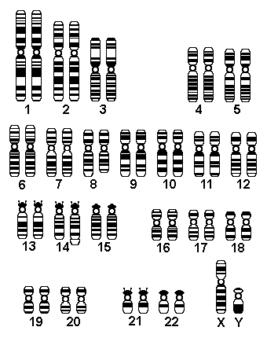

Slide 46
Burkitt's lymphoma
affects mainly children and young adults 30% of children with non-Hodgkin's lymphoma (NHL)
EBV relationship with t(8;14)
Intermediate sized B-lymphocytes (small-noncleaved cells)
"Starry sky" appearance with neoplastic B cells (dark of night) and macrophages (stars)
Endemic in Africa with mandibular and abdominal involvement; sporadic elsewhere with abdominal involvement;
Leukemic phase common

Slide 47
Extranodal marginal zone lymphoma
Seen in middle aged adults;
Derives from MALT
Low-grade malignant lymphoma
Small to medium sized B cells
typically arises in areas of immune activation (Hashimoto thyroiditis, Sjogren syndrome, H. pylori gastritis);
may transform to diffuse large B-cell lymphoma

Slide 48
Precursor T or B-cell Lymphoblastic Lymphoma/Leukemia (Lymphoblastic Lymphoma)
Seen in children and adolescents;
T-cell type often in mediastinum; very aggressive and can progress to acute lymphocytic leukemia
Intermediate sized lymphocytes in a diffuse pattern

Slide 49
Mantle Cell Lymphoma
Seen in adults in middle age;
often advanced at diagnosis and may be extranodal, including multifocal submucosal nodules in bowel
Small to medium sized B cells

Slide 50
Mycosis Fungoides/Sezary Syndrome
Mycosis fungoides and Sézary syndrome
Epidemiology
Both conditions involve neoplastic peripheral CD4 TH cells.
Usually involves adults 40 to 60 years of age
Mycosis fungoides
Begins in skin (rash to plaque to nodular masses)
Progresses to lymph nodes, lung, liver, and spleen
Groups of neoplastic cells in the epidermis are called Pautrier's microabscesses.
Sézary syndrome
Mycosis fungoides with a leukemic phase
Circulating cells are called Sézary cells (prominent nuclear cleft).

Slide 51
Mycosis Fungoides/Sezary Syndrome
Both conditions involve neoplastic peripheral CD4 TH cells.
Usually involves adults 40 to 60 years of age
indolent ,survival rate of 8 to 9 years.
Marked predeliction to involve the skin
Three distinct stages ,inflammatory Premycotic stage ,Plaque stage ,and Tumor stage
Sezary syndrome it is Mycosis fungoides with a leukemic phase with Circulating cells are called Sézary cells (prominent nuclear cleft).

Slide 52
Anaplastic Large Cell Lymphoma
T-cell or NK-cell neoplasm
Unique biology and strong association with rearrangement of ALK gene on chromosome 2p23 ,specific for the entity
Large anaplastic cells ,pleomorphic nuclei

