Slide 1
Aquired Heamolytic Anemia

Slide 2
Acquired hemolytic anemia (HA):
Immune:
Alloimmune
Autoimmune (Cold & Warm)
Non –immune
Mechanism of Immune HA.
Warm AIHA:
Antibody involved.
Clinical features.
Laboratory features.
Classification (Etiology)
Cold AIHA:
Antibody involved.
Clinical features.
Laboratory features.
Classification.

Slide 3
Heamolytic Aneamia
Classification of Haemolytic Anaemias
------------------------------------------------------------------------------------------------------------------------------------------------------------------------------ ------------------------
Hereditary Acquired
--------------------------------------------------------------------------------------------------------------------- ---------------------------------------------------------------------------------
Membrane Immune
Hereditary spherocytosis, Autoimmune
hereditary elliptocytosis Warm antibody type
Cold antibody type
Metabolism Alloimmune
G6PD deficiency, Haemolytic transfusion reaction
pyruvate kinase deficiency Haemolytic disease of the
newborn

Slide 4
Hemolysis:
Premature destruction of RBCs.
Hemolysis could be due to:
Defect in the RBCs (intra - corpuscular) as in congenital hemolytic anemia.
Defect in the surrounding environment
(extra-corpuscular) as in acquired anemia.

Slide 6
Extravascular hemolysis
Extravascular hemolysis happens in the RES (spleen & liver mainly).
Macrophages engluf RBCs, degrade hemoglobin, releasing amino acids from globin and bilirubin from heme (والباقي من البايو)

Slide 7
Intravascular hemolysis
Compliment mediated degradation of RBCs releasing free hemoglobin that is either:-
Forms methemoglobin
Bind to haptoglobin
Bind to Albumin
Released in urine as free hemoglobin (hemoglobinuria

Slide 8
Causes of intravascular haemolysis
_______________________________________________________________________________________________________________
Mismatched blood transfusion (usually ABO)
G6PD deficiency with oxidant stress
Red cell fragmentation syndromes
Some autoimmune haemolytic anaemias
Some drug-and infection-induced haemolytic anaemias
Proxysmal nocturnal haemoglobinuria
March haemoglobinuria
Unstable haemoglobin
_______________________________________________________________________________________________________________

Slide 9
Manifestations due to Hemolysis
____________________________________________________________________________________________________________________________________________________
Biochemical consequences of extravascular haemolysis
Hyperbilirubinaemia (unconjugated)
Reduced serum haptoglobin
Biochemical consequences of intravascular haemolysis
Reduced serum haptoglobin
Haemoglobinaemia
Haemoglobinuria
Methaemalbuminaemia *
Reduced haemopexin levels *
Morphological evidence of damage of red cells
Microspherocytes, red cell fragments, sickle cells
Reduced red cell life-span
* Now rarely used in investigating a patient.
_______________________________________________________________________________________________________________

Slide 10
Manifestations due to increased RBC production
_______________________________________________________________________________________________________________
Peripheral blood
Reticulocytosis and erythroblastoaemia;
Macrocytosis
Bone marrow
Erythroid hyperplasia; reduced
Myeloid/erythroid ratio
normal reatio: myeloid 3 : erythroid 1 (3:1)
Bone
Changes in the skull and tubular bones
_______________________________________________________________________________________________________________

Slide 12
The lifespan of the RBC becomes 20 days in hemolytic aneamia
(normal = 120 days of course ^_^)

Slide 13
Gallstone (cholestasis)
- due to increased bilirbuin
- causes obstructive jaundice

Slide 14
ACQUIRED HEMOLYTIC ANEMIAS
Immune hemolytic Anemia: due to deposition of immunoglobulins and/or complement.
It could be:
Erythrocytes are destroyed
a] Alloimmune: “Foreign” antibodies are destroying RBCs e.g. hemolytic transfusion reaction or hemolytic disease of the newborn.
b] Autoimmune:

Slide 15
AUTOIMMUNE HEMOLYTIC ANAEMIAS
Group of hemolytic anaemias in which there is development of antibodies directed against antigens on the surface of the patients own RBCs. The antibodies are usually IgG or less commonly IgM and some bind complement.
Classification of Autoimmune Hemolytic Anaemia:
According to the temperature at which the antibody reacts with the RBCs:
1. Warm : at 37ºC.
2. Cold : < 37ºC.
Mechanism of AIHA:
Destruction of RBCs can be either: cell mediated or complement mediated.
Cell mediated: Destruction is through macrophages with receptors for:
1. FC portion of immunoglobulin. or
2. Complement bound to RBCs.
B. Complement mediated: Destruction or (Lysis) of the cell is directly by complement.

Slide 16
Receptor for FC Portion
IgG FC Portion receptor
RBC
FC portion
Macrophages
- Important in warm type.
- Causes phagocytosis (associated extravascular hemolysis).
- Spleen play a major role in the destruction of RBCs. Liver to a lesser extent because of rapid circulation.

Slide 17
C3 Receptor
RBC
C3 Receptor
C3
Macrophages
- Important in cold type.
- Causes Phagocytosis.
- Liver plays a major role because of abundance of C3 receptor
holding macrophages. Spleen plays a lesser role unless it is enlarged.

Slide 18
Classification of immune haemolytic anaemias
Autoimmune haemolytic anaemia
Warm antibody type
Idiopathic
Associated with
- auto immune disease
- lymphoproliferative disorders
- infections
- some cancers
- drugs
Cold antibody type
Cold agglutinin syndromes
Cold haemagglutinin disease (idiopathic)
Associated with
- infections
- lymphoproliferative disorders
Paroxysmal cold haemoglobinuria

Slide 19
Classification of immune haemolytic anaemias (Continued)
Alloimmune haemolytic anaemia
Induced by red cell antigens
Haemolytic transfusion reactions
Haemolytic disease of the newborn
Allograft associated
Drug induced
Antibody/macrophage mediated
Antibody/complement mediated

Slide 20
Autoimmune haemolytic anaemias: classification
-------------------------------------------------------------------------------------------------------------------------------------------------------------------
Warm type Cold type
-------------------------------------------------------------------------------------------------------------------------------------------------------------------
Idiopathic Idiopathic
Secondary Secondary
SLE, other ‘autoimmune’ diseases Infections – Mycoplasma
CLL, lymphomas pneumonia, infectious
Drugs, e.g. methyldopa, fludarabine mononucleosis
Lymphoma
Paroxysmal cold
haemoglobinuria
Rare, sometimes associated with
infections, e.g. syphilis
-------------------------------------------------------------------------------------------------------------------------------------------------------------------

Slide 21
WARM AUTOIMMUNE HEMOLYTIC ANAEMIA
Etiology (Classification)
A. Idiopathic: 30% of the cases (Primary)
B. Secondary:
1. Autoimmune diseases: e.g. systemic lupus erythematosis (SLE), rheumatoid arthritis.
2. Lymphoproliferative diseases: e.g. Chronic lymphocytic leukemia, lymphoma.
3. Malignancies: e.g. ovarian carcinoma.
4. Post viral infections.
5. Drugs: e.g. methyldopa (Aldomet).
Antibody Features:
* Warm antibody (37ºC)
* Usually IgG
* Usually has Rh specificity.

Slide 22
Clinical Features of Warm AIHA:
* Lethargy, Pallor.
* Jaundice due to cholestasis (galllstones)
* Splenomegaly, hepatomegaly.
Laboratory Features of Warm AIHA:
* Peripheral Blood: * Anaemia
* Polychromasia.
* Spherocytes
* Nucleated RBCs
* Reticulocyte count: ↑
* Bone Marrow: Erythroid hyperplasia.
* Chemistry: ↑ Bilirubin, mostly indirect.
* Coombs test (Direct antiglobulin test): to detect antibodies covering the RBCs by using an anti-immunoglobulin (i.e. antibody vs. the attached anti-immunoglobulin). This reaction causes agglutination.

Slide 24
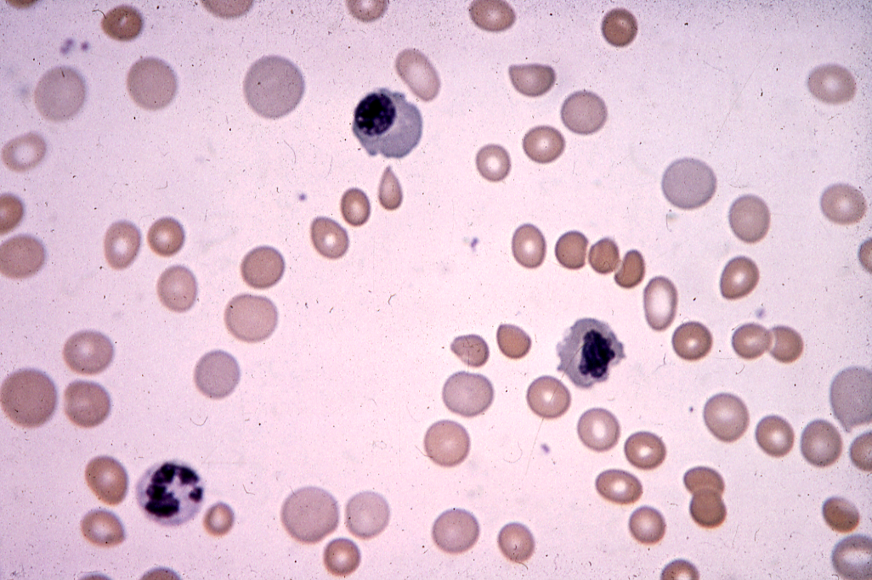

Slide 25
COOMB’S TEST
Antiglobulin Test
RBC
Red cell with bound antibody to Anti-immunoglobulin
memebrane antigen
RBC
RBC
Agglutination

Slide 26
Quinidine: Complement & antibody mediated
Penicillin: antibodies attack RBC-drug complex
Methyldopa: antibodies attack RBCs

Slide 27
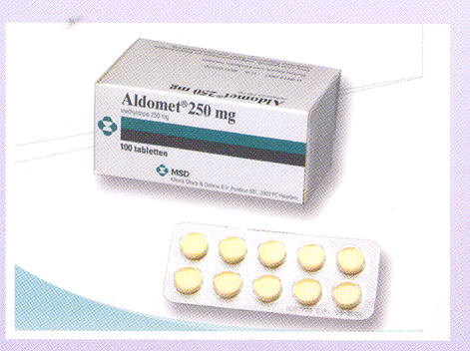
.

Slide 28
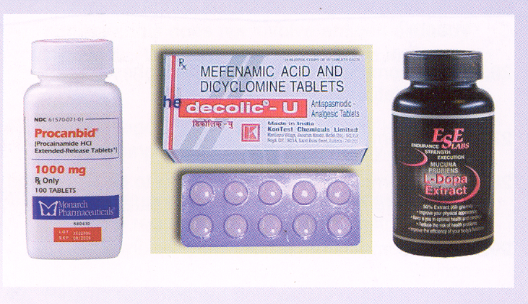
.

Slide 29
Treatment of Auto-immune hemolytic anaemia (Warm)
1. Removal of the underlying cause.
2. Corticosteroids.
3. Splenectomy to decrease extravascular hemolysis
4. Immuno-suppression: e.g. with azathioprine.
➔ monolonal anti-CD20 (retriximab)
this kills the CD-20 that is responsible for autoimmunity.

Slide 30
COLD AIHA
Class: /Cold agglutinin syndrome.
\Paroxysmal cold hemoglobinurea.
Cold agglutinin syndrome:
Characterized by the presence of cold agglutinins in the patient’s serum. These are antibodies that cause agglutination of RBCs at cold temperature.
Mechanism:
Cell-mediated by macrophages with receptors for complement (extravascular)
Occur more in western (cold) countries and in winter

Slide 31
Mechanism of cold automimmune hemolysis
By 1 of 2 mechanisms:
1. Cell mediated by macrophages with receptors for complement:
IgM cold agglutinins bind RBCs in peripheral circulation, where the temperature 10-20ºC causing complement activation. Complement bind to RBCs.
RBCs, with complement attach to macrophages through the complement receptor causing phagocytosis. The destruction is mainly extra vascular, in the liver because it contains a large number of macrophages with complement receptors. Spleen plays a lesser role unless it is enlarged. This mechanism is important in the cold type.

Slide 32
2. Complement Mediated
RBC → Complement → Hemolysis
* Direct lysis by complement, causes intravascular hemolysis. Seen in paroxysmal cold hemoglobin urea (a type of cold autoimmune hemolytic anemia).
* Causes intravascular hemolysis.
Usually Cold AIHA especially in paroxymal cold hemoglobinurea (a type of cold AIHA).

Slide 33
.

Slide 34
Cold Agglutinin Disease:
Antibody characteristics:
* Usually IgM
* React with RBCs (agglutinate) on cooling (below 37º)
* Complement mediated.
* Complement can be detected using complement specific Coombs.
* Specificity for RBCs surface antigens (group) can be anti P, anti I, anit I depending on associated disease.
* Antibody usually binds RBCs in peripheral circulation (10-20ºC) causing activation of complement.
Classification of Cold Agglutinin syndrome:
* Primary - idiopathic (Cold hemagglutinin disease) (CHAD)
* Secondary – due to infection (polyclonal)
Idiopathic:
Seen in elderly, run a chronic course. Usually a benign course. But many terminate in a B cell lymphoma.
Monoclonal proliferation of B cells (Malignancy)

Slide 35
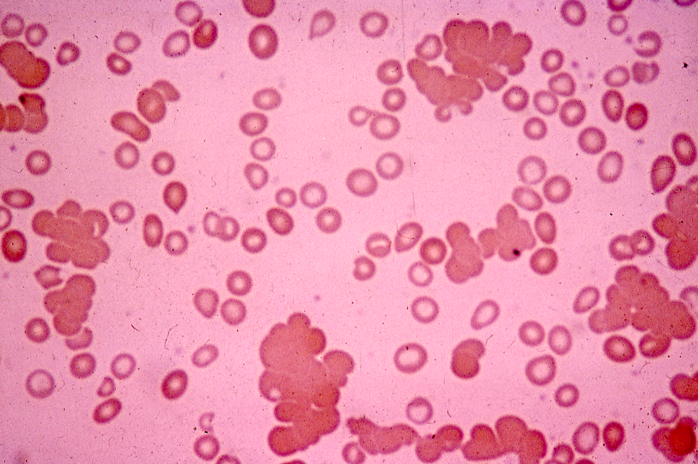

Slide 36
Serological characteristics of cold agglutinins in the cold agglutinin syndromes
---------------------------------------------------------------------------------------------------------------------------
Anti-I Anti-i
---------------------------------------------------------------------------------------------------------------------------
Idiopathic (CHAD)* M
Secondary to lymphoproliferative disorders M M
Secondary to infection:
Mycoplasma pneumonia P
Infectious mononucleosis P P
(EBV)
---------------------------------------------------------------------------------------------------------------------------
M = Monoclonal P = Polyclonal
* Rarely anti-P monoclonal

Slide 37
Laboratory Findings:
* Hemoglobin: low.
* Agglutination of RBCs: (clumping) seen in the tube or on film.
* MCV ↑ MCH ↑ due to clumbing of RBCs
* Coomb’s test: + for complement but not IgM because IgM dissociates from the cells in vitro.
* Antibody, Screen for specificity e.g. Anti I.
* Serum protein electrophoresis for mononclonal band (para-protein) in CHAD.

Slide 39
NON-IMMUNE HEMOLYTIC ANAEMIAS
Hemolytic anaemias due to mechanisms or agents other than antibodies +/ or complement e.g.:
- Mechanical (traumatic) (fragmentation)
- Toxins
- Infections
- Splenomegaly (hypersplenism)
- Burn (physical).
- Renal failure and liver failure.
- Chemical.

Slide 40
All of the following types are non-immune
Mechanical (Traumatic) (Fragmentation):
This is due to direct trauma (stress) to the RBCs causing fragmentation of the RBCs and intravascular hemolysis. The fragmented cells can be seen on peripheral blood smears and are called (schistocytes).
Types:
1. Cardiac – most common type
Due to: 1. Prosthetic valves
2. Patches.
3. Valvular disease e.g. stenosis.
2. Microangiopathic: Mechanical hemolysis due to contact between the RBCs and the abnormal intema of thrombosed, narrowed, necrotic small vessels or fibrin strand formation.
Caused by many diseases e.g. DIC (Disseminated Intravascular Coagulation), malignant hypertension, disseminated malignancies especially mucin secreting adenocarcinomas, TTP (Thrombotic Thrombocytopenic Purpura), hemolytic uremic syndrome (HUS).
Causes intravascular hemolysis →
* Hemoglobinuria
* Hemoglobinemia
* ↓ haptoglobin.
* Fragmented RBCs (Schistocytes) on peripheral blood film.
* Hemosidrinurea.

Slide 41
Chemical: e.g. some toxins e.g. spider venom, snake venom, bacterial toxins, arsenic (As), (Cu).
Physical: Burn: Characterized by the presence many spherocytes in the peripheral blood.
Splenomegaly:
Renal Failure and Liver Failure: Due to change in the metabolic structure of the RBCs.
March hemoglobinuria:- Hemoglobinuria following running. Mechanical destruction occurs in the feet. Seen in joggers and soldiers. Benign condition.
Infections:- Many infectious agents can cause hemolytic anaemias due to various mechanisms, e.g.
Malaria: due to:
* direct invasion causing intravascular lysis, or/and extravascular lysis.
* immune complex formation.
* splenomegaly.
Black water fever: is an example of severe intravascular hemolysis due to faloparum sp.
Clostridium Perfringens: due to action of lipase and proteinase enzymes produced by the organism.
Meningococcal: due to DIC

