Slide 1
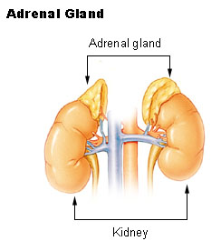
The Adrenal Cortex
Adrenal steroids are
glucocorticoids
mineralocortioids
Sex hormones
hydrocortisone
corticosterone
Aldosterone: affects water and electrolyte balance

Slide 2
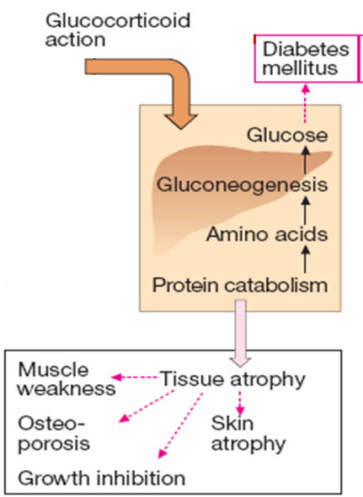
Glucocorticoids affect carbohydrate & protein metabolism & have anti-inflammatory & immunosuppressive action.

Slide 3
Adrenal cortex diseases
Addison’s disease
Cushing’s disease
Conn’s syndrome
Deficiency in corticosteroids
Characteristics
Muscle weakness
hypoglycemia
depression
Low BP
Excessive glucocorticoids
Excessive mineralocorticoids

Slide 4
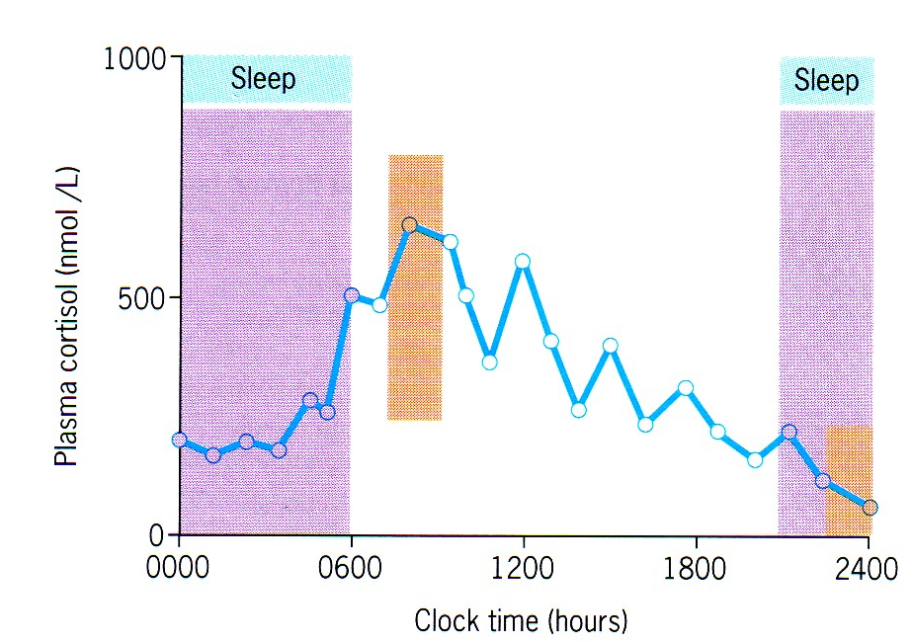
Circadian rhythm of corticosteroids
Note the increase in cortisol levels during the morning

Slide 5
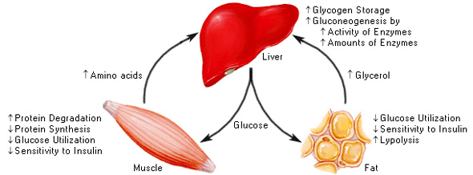
Glucocorticoids action
1- Metabolic action

Slide 6
2- Anti-Inflammatory action
↓ cytokines including interleukins , TNF-α, GM-CSF
Inhibit phospholipase A₂ → ↓generation of PG and leukotriene (eicosanoids)
Inhibit COX2
decreased generation of IgG
decrease in complement components in the blood.
Decrease histamine by interfering in mast cell degranulation
Decrease all leukocytes except neutrophils.

Slide 7
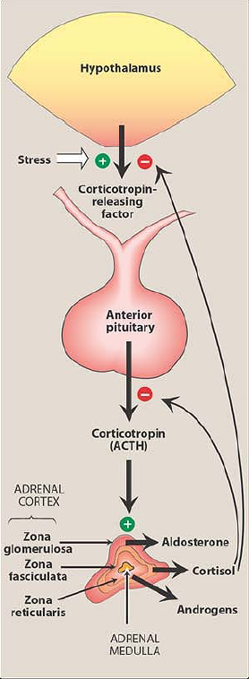
Regulation of corticosteroids

Slide 8
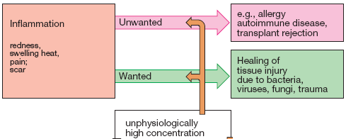
Anti-inflammatory effect:-
glucocorticoids

Slide 9
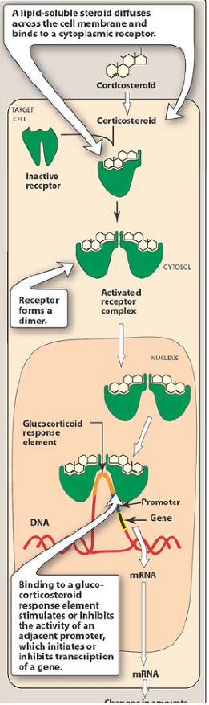
Mechanism of action
1
Corticosteroids bind to intracellular receptor
1
2
(Activated receptor complex) goes inside the nucleus
2
3
The complex binds to glucocorticoid response element (GRE) in the DNA → transcription → translation → protein
3
* Also the complex interact with transcription factors for example: activator protein-1 (AP-1)
Don’t forget that in blood, steroids bind to corticosteroid-binding globulin (CBG)

Slide 10
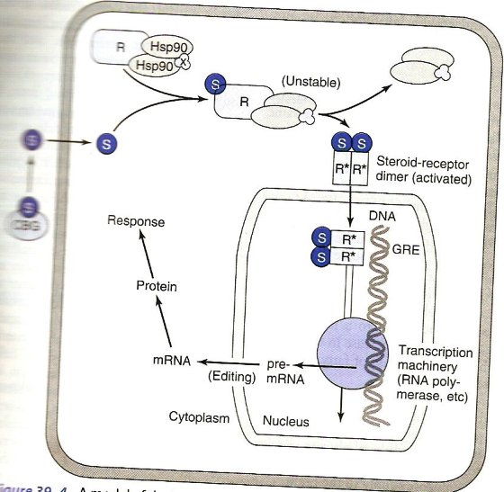
CBG: corticosteroid binding globulin. S: steroid. R: receptor. GRE:glucocortioid response element

Slide 11
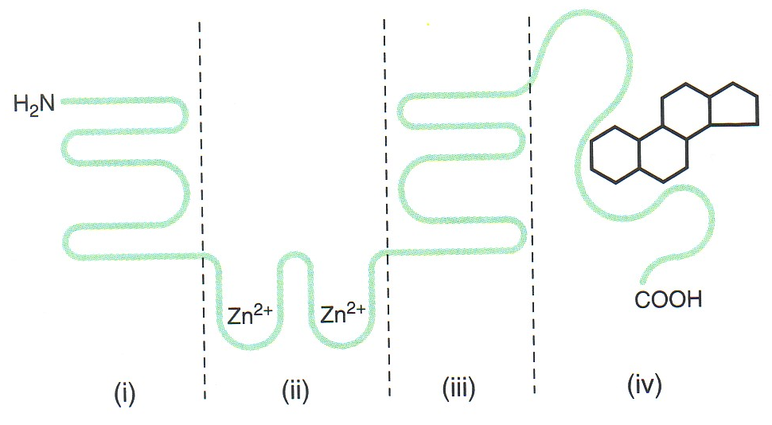
Glucocorticoid receptor domains
GRE binding domain
This domain increase the specificity of the receptor
Glucocorticoid binding domain

Slide 12
Pharmacokinetics of glucocorticoids
Administration can be oral, topical and parenteral (IV , IM)
to decrease the unwanted effects of glucocorticoid you have 2 options:
1- administer on alternate days.
2- circadian administration (give drug in the morning) see next slide

Slide 14
Individual glucocorticoids
Name of the drug | Anti-inflammatory activity¹ | salt retaining activity¹ | Duration of action | notes
Hydrocortisone (topical, IV, IM) | 1 | 1 | 8-12 hours | Drug of choice for replacement therapy
Cortisone (IM) | 0.8 | 0.8 | 8-12 hours | Cheap Converted to hydrocortisone Not used as antiinflammatory
Prednisolone (IV & IM) | 4 | 0.8 | 12-36 hours | Drug of choice in antiinflammatory and immunosuppressive
Dexamethasone (topical) | 30 | minimal | 36-72 hours
Anti-inflammatory and immunosuppressive.
Used when water retention is undesirable
Drug of choice to suppress ACTH production
¹ : potency relative to hydrocortisone

Slide 15
Cont’d
betamethasone | 30 | negligable | long | Anti-inflammatory and immunosuppressive. Used when water retention is undesirable
Triamcinolone (IM, aerosol, topical) | 5 | None | 12-36 hours | More toxic than the others
(Beclomethasone diproprionate) & Budesonide (aerosol & topical) |  |  |  | Anti-inflammatory and immunosuppressive Taken topically or as an aerosol
All corticosteroids can be administered orally

Slide 16
T_{1/2} of hydrocortisone = 90 min
Biological effect of the drug occurs after 2-8 hours.
Inactivation occurs in liver and elsewhere.
Cortisone _{(prodrug)} → hydrocorisone
Prednisone _{(prodrug)} → prednisolone

Slide 17
Adverse effects
Occurs when using these drugs as anti-inflammatory or immunosuppressive
Not seen if you use it as hormone replacement therapy
The most important are:
suppression of response to infection.
suppression of endogenous glucocorticoid synthesis

Slide 18
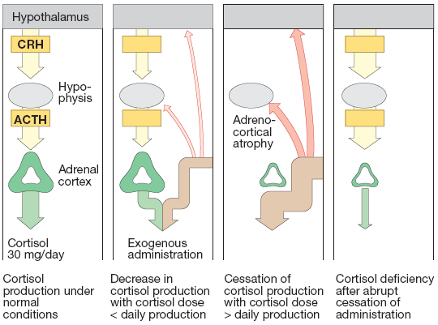

Slide 19
Cont’d
Metabolic actions (weight gain, muscle wasting, and hyperglycemia)
Osteoporosis
Peptic ulcers
Acute psychosis
Cataracts
Increased intraocular pressure
Iatrogenic Cushing's syndrome

Slide 20
Clinical uses
(Addison’s disease)
Chronic
Acute
Give 20-30 mg of hydrocortisone daily with increased amounts during stress
Or you can give fludrocortisone
Correction of fluid and electrolytes anormalities.
Treatment of precipitating factors.
Parenteral hydrocortisone

Slide 21
Clinical uses cont’d
Anti-inflammatory/immunosuppressive therapy
asthma
topically in various inflammatory conditions of skin, eye, ear or nose (e.g. eczema, allergic conjunctivitis or rhinitis)
in hypersensitivity states (e.g. severe allergic reactions)

Slide 22
Cont’d
In miscellaneous diseases with autoimmune and inflammatory components e.g. rheumatoid arthritis and other connective tissue diseases, inflammatory bowel diseases etc.
To prevent graft-versus-host disease
In neoplastic diseases
As a treatment in hodgkin’s disease & acute lymphocytic leukemia
Reduce cerebral edema in primary or metastatic brain tumors (dexamethasone)
As antiemetic (decrease nausea and vomiting)

Slide 23
Cont’d
Simulation of lung maturation
Lung maturation in fetus is regulated by cortisol.
Administration of glucocortiocoids to the mother → ↓ incidence of RDS
Betamethasone is chosen because maternal protein binding and placental metabolism of this corticosteroid is less than that of cortisol.

Slide 24
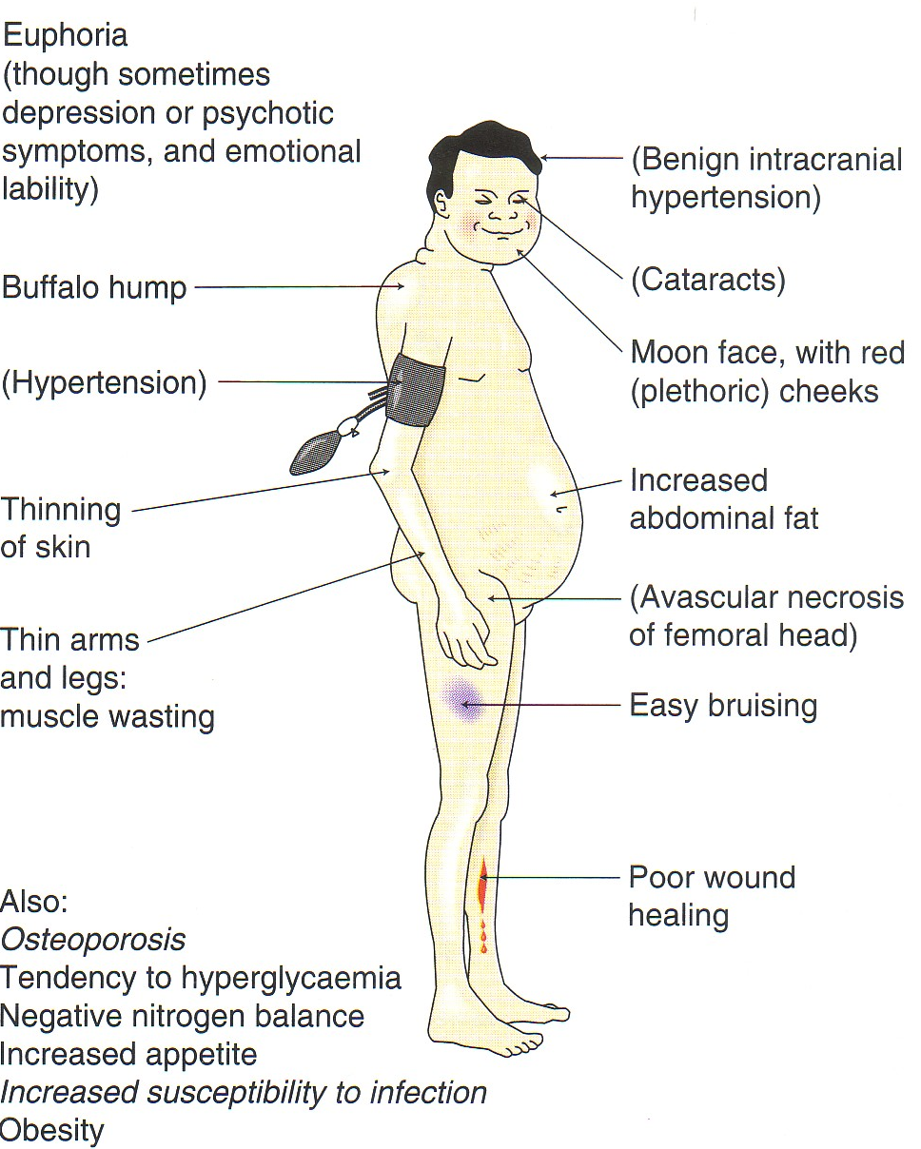
Cushing’s syndrome

Slide 25
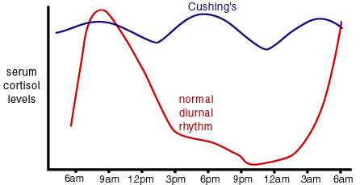
(cushing’s syndrome)
Is treated by surgical removal of the tumor producing ACTH or cortisol, irradiation of the pituitary tumor, or resection of one or both adrenal glands.
These patients must receive large doses of cortisol during and following the surgical procedure.

Slide 26
Diagnostic uses
(Dexamethasone suppression test)
This test measure the response of adrenal glands to ACTH.
There are 2 types of this test:
Low dose
High dose
Low dose test
We give low dose of dexamethasone and measure cortisol in blood
↓corisol = no disease
unchanged levels of cortisol = cushing’s syndrome or cushing’s disease

Slide 27

Cont’d
What’s the difference between them ??
Cushing’s syndrome
Cushing’s disease
A tumor in adrenal gland that produces cortisol or a tumor elsewhere in the body that produces ectopic ACTH
A tumor in the pituitary gland that produces ACTH
How can we differentiate between them??
High dose test
We give high dose of dexamethasone and measure cortisol in blood
unchanged levels of cortisol = cushing’s syndrome
↓corisol = cushing’s disease

Slide 28
Precautions
Patients receiving glucorticoids must be monitored carefully for the development of:-
hyperglycemia
glycosuria
sodium retention with edema or hypertension
hypokalemia
peptic ulcer
osteoporosis
Hidden infections e.g. TB or Varicella virus

Slide 29
Contraindications
peptic ulcer
heart disease or hypertension with heart failure
certain infectious illnesses such as varicella and tuberculosis
psychoses
diabetes
osteoporosis
glaucoma

Slide 30
Mineralocorticoids

Slide 31
Mineralocorticoids:- Fludrocortisone is given orally to produce a mineralocorticoid effect.
This agent-:
Increases Na⁺ reabsorption in distal tubules and increases K⁺ and H⁺ excretion
Acts on intracellular receptors → DNA transcription → protein synthesis
Is used with a glucocorticoid in replacement therapy.

Slide 32
Fludrocortisone
Relative Anti-inflammatory: 15
Relative sodium retaining: 150
Duration of action after oral dose:- short [36-72 hours]
Drug of choice for mineralocorticoid effects i.e. mineralocorticiod therapy and after adrenalectomy

Slide 33
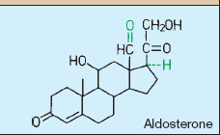
aldosterone
Relative Anti-inflammatory: none
Relative sodium retaining: 500
Endogenous mineralocorticoid
Synthesized mainly in the zona glomerulosa
Has a short half-life

Slide 34
Mineralocoticoids antagonists
Synthesis inhibitor
Receptor blocker

Slide 35
I- Synthesis Inhibitor
The starting substance for synthesis is cholesterol.
The first step in the synthesis is regulated by ACTH, which is the rate- limiting step.
Metyrapone prevents the β-hydroxylation at C11 , used to test ACTH production in Cushing’s syndrome.
Trilostane: ↓ 3β-dehydrogenase, used in Cushing’s syndrome & primary hyperaldosteronism.
Others:- aminoglutethimide & ketoconazole.

Slide 36
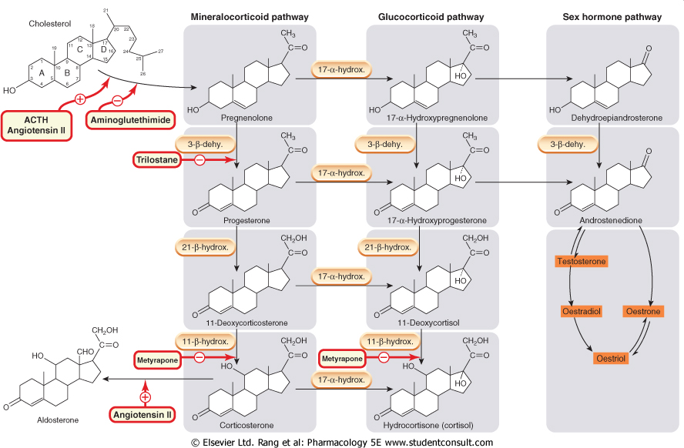

Slide 37
Metyrapone
A relatively selective inhibitor of steroid synthesis.
Interferes with cortisol and corticosterone synthesis
Metyrapone can reduce cortisol production to normal levels in some patients with endogenous Cushing's syndrome.

Slide 38
Useful in the management of severe manifestations of cortisol excess while the cause of this condition is being determined or in conjunction with radiation or surgical treatment.
It is the only adrenal-inhibiting medication that can be administered to pregnant women with Cushing's syndrome.
ADRs:- salt and water retention, hirsutism, transient dizziness and GIT disturbances.

Slide 39
Ketoconazole
An antifungal imidazole derivative, which is a potent and rather nonselective inhibitor of adrenal and gonadal steroid synthesis.
Also it inhibits P450 enzymes
Its inhibitory effects on steroid biosynthesis are seen only at high doses.
Ketoconazole has been used for the treatment of patients with Cushing's syndrome due to several causes.
Has some hepatotoxicity

Slide 40
II- Receptor Blocker
Spironolactone
Onset of action is slow, and the effects last for 2–3 days after the drug is discontinued
Used in the treatment of primary aldosteronism
Used diagnostically for the detection of aldosteronism in hypokalemic patient with hypertension.
Prepares the above patients for surgery.
Androgen antagonist and as such is used in treatment of hirsutism in women

Slide 41
ADRs
GI disturbance
gynecomastia
Sedation
Skin rashes
hyperkalemia
cardiac arrhythmia
menstrual abnormalities

Slide 42
Questions
Pharmacological effects of exogenous glucocorticoids include:
  Increased muscle mass
  Hypoglycemia
  Inhibition of leukotriene synthesis
  Improved wound healing
  Increased excretion of salt and water

Slide 43
Toxic effects of long term administration of glucocorticoid include:
  A lupus-like syndrome
  Adrenal gland neoplasm
  Hepatotoxicity
  Osteoporosis
  Precocious puberty in children

Slide 44
A 46-year-old male patient has Cushing's syndrome that is due to the presence of an adrenal tumor. Which of the following drugs would be expected to reduce the signs and symptoms of this man’s disease?
  Betamethasone
  Cortisol
  Fludrocortisone
  Ketoconazole
  Triamcinolone

Slide 45
In the treatment of congenital adrenal hyperplasia in which there is excess production of cortisol precursors because of a lack of 21-β-hydroxylase activity, the purpose of the administration of a synthetic glucocorticoid is
  Inhibition of aldosterone synthesis
  Normalization of renal function
  Prevention of hypoglycemia
  Recovery of normal immune function
  Suppression of ACTH secretion

Slide 46
A glucocorticoid response element is
  A protein regulator that controls the interaction between an activated steroid receptor and DNA
  A short DNA sequence that binds tightly to RNA polymerase
  A small protein that binds to an unoccupied steroid receptor protein and prevents it from becoming denatured
  A specific nucleotide sequence that is recognized by a steroid hormone receptor-hormone complex
  The portion of the steroid receptor that binds to DNA

Slide 47
Glucocorticoids have proved useful in the treatment of:
  Chemotherapy induced emesis
  COPD
  Hyperprolactinemia
  Parkinson’s disease
  Type II diabetes

Slide 48
For patients who have been on long term therapy with glucocorticoid and who now wish to discontinue the drug, gradual tapering of glucocorticoid is needed to allow recovery of:
  Depressed release of insulin
  Hematopoiesis in the bone marrow
  Normal osteoblast function
  The control by ADH of water excretion
  The hypothalamic-pituitary-adrenal system

Slide 49
A 54-year-old man with advanced T.B has developed signs of severe acute adrenal insufficiency.

Slide 50
This patient is likely to exhibit:
  Moon face
  Dehydration
  Hyperglycemia
  Hypertension
  Hyperthermia

Slide 51
The patient should be treated immediately. Which of the following combination is most rational?
  Aldosterone and fludrocortisone
  Cortisol and fludrocortisone
  Dexamethasone and metyrapone
  Triamcinolone and dexamethasone

