Slide 1
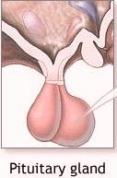
Anti-fertility drugs
1)GnRH
2)FSH
LH
OVARY
3)ESTROGENS (β-ESTRADIOL)
AND
PROGESTERONE

Slide 2
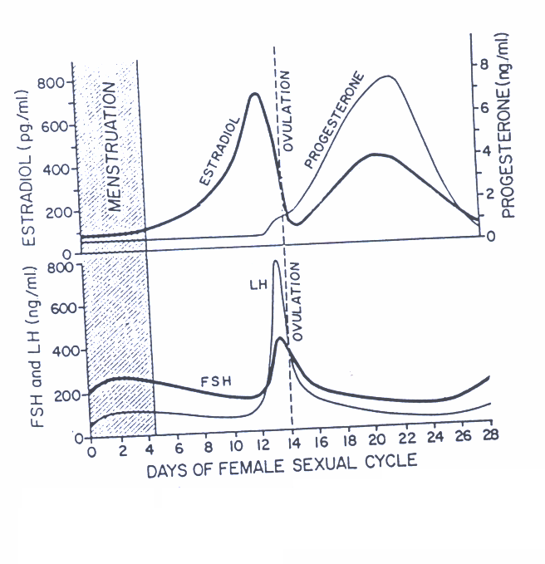
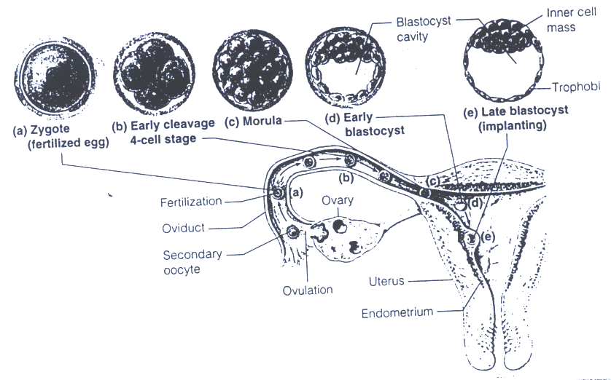
Notes:
FSH stimulates follicles inside the ovaries.
LH rises to induce the rupture of the follicle and ovulation.
Granulosa cells secrete estrogen.
Corpus luteum secretes progesterone.

Slide 3
In the 26th day of the menstrual cycle there is sudden vasoconstriction of the endometrial vessels and shedding of the endometrium, corpus luteum at this point is converted to corpus albicans.

Slide 4
Types of Progestogens
Progesterone (IM) ineffective orally
Hydroxyprogesterone (IM)
Dydrogesterone (tablets)
Medroxyprogesterone (IM & tablets)
Norethindrone (tablets)
شباب يقول الدكتور لا تحفظونها
Uses of progestogens
contraception
along with estrogen
Dysmenorrhea (uterine pain during menustration)
Infertility due to inadequate luteal phase

Slide 5
Types of estrogen
Natural and semi synthetic
Estradiol (main estrogen)(natural)
Estrone (natural)
Synthetic
Diethylstilbestrol
Estriol (natural)
Ethynilestradiol (semi)
Mestranol (3- methyl ester of semi))ethynilestradiol)
Proestrogens (e.g. chlorotrianisene)
We don’t use them for treatment because of their ↓ t_{1/2}

Slide 6
Uses of estrogen
Contraception
Along with progestrone
dysmenorrhia
Hypogonadism (estrogen-deficient patient)
menopause
osteoporosis
Prostatic cancer
Replacement therapy
Hot flushes, muscle cramps, anxiety, over breathing
Increase Ca⁺⁺ deposition in the bone
Anti-androgenic effect

Slide 7
ADVERSE EFFECTS A. Estrogen Related 1. Nausea and breast tenderness 2. Worsening of migraine headache 3. Increase Skin Pigmentation 4. Impair glucose tolerance (hyperglycemia) 5. increase incident of breast, vaginal, and cervical cancer 6. Cardiovascular most concern: a. Thromboembolism (platelet aggregation) b. Hypertension (salt & water retention) 7. Increase Frequency of gall bladder disease (using estrogen in post menopause) .
*Estrogen is nowadays used in microamounts in oral contraceptives to counteract its adverse effects.

Slide 8
ADVERSE EFFECTS (cont’d)
B. Progestin Related 1. Nausea, vomiting 2. Headache (very common) 3. Fatigue, depression of mood 4. Menstrual irregularities (unique for progesterone)
5. Prolonged menstrual bleeding(8 days or more) 5. Weight gain(fluid retention) 6. Hirsutism: (increased facial or body hair growth) 7. Masculinization (Norethindrone) if pregnant use it the child will be masculine (in case of female). 8. Ectopic pregnancy (unique for progesterone)
If vomiting occurs within 2 hours of taking the pill, you have take another tablet.

Slide 9
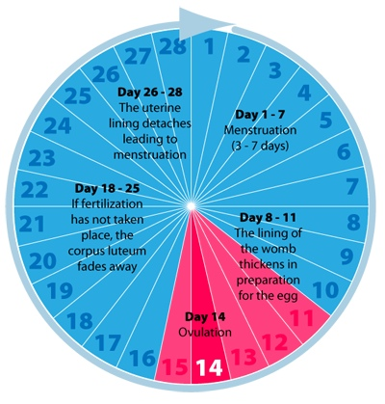
Oral contraceptives
They are combination of progesterone and estrogen (100 % effective).
The concentration of estrogen is very low (to minimize the side effect).
Pills are taken for 21 days starting from the 5th day of the menstrual cycle.
The tablets should be taken at approximately the same time each day (time is important) .
Phase formulation (different progesterone conc.) mimic the normal endogenous hormonal activity.

Slide 10
 | Estrogen (mg) |  | Progestin (mg)
Monophasic combination tablets
Loestrin 21 1/20 | Ethinyl estradiol | 0.02 | Norethindrone acetate | 1.0
Desogen, Apri, Ortho-Cept | Ethinyl estradiol | 0.03 | Desogestrel | 0.15
Brevicon, Modicon, Necon 0.5/35 | Ethinyl estradiol | 0.035 | Norethindrone | 0.5
Demulen 1/35 | Ethinyl estradiol | 0.035 | Ethynodiol diacetate | 1.0
Nelova 1/35 E, Ortho-Novum 1/35 | Ethinyl estradiol | 0.035 | Norethindrone | 1.0
Ovcon 35 | Ethinyl estradiol | 0.035 | Norethindrone | 0.4
Demulen 1/50 | Ethinyl estradlol | 0.05 | Ethynodiol dlacetate | 1.0
Ovcon 50 | Ethinyl estradlol | 0.05 | Norethindrone | 1.0
Ovral-28 | Ethinyl estradiol | 0.05 | _{D,L}-Norgestrel | 0.5
Norinyl 1/50, Ortho-Novum 1/50 | Mestranol | 0.05 | Norethindrone | 1.0
Biphasic combination tablets
Jenest-28, Ortho-Novum 10/11, Necon 10/11, Nelova 10/11
Days 1—10 | Ethinyl estradiol | 0.035 | Norethindrone | 0.5
Days 11—21 | Ethinyl estradlol | 0.035 | Norethlndrone | 1.0

Slide 11
 | Estrogen (mg) | Progestin (mg)
Triphaslc combination tablets
Triphasil, Tri-Levlen, Trivora
Days 1—6 | Ethinyl estradlol | 0.03 | _{L}-Norgestrel | 0.05
Days 7—11 | Ethinyl estradiol | 0.04 | _{L}-Norgestrel | 0.075
Days 12—21 | Ethinyl estradiol | 0.03 | _{L}-Norgestrel | 0.125
Ortho-Novum 7/7/7, Necon 7/7/7
Days 1—7 | Ethiriyl estradiol | 0.035 | Norethindrone | 0.5
Days 8—14 | Ethinyl estradiol | 0.035 | Norethindrone | 0.75
Days 15—21 | Ethinyl estradiol | 0.035 | Norethindrone | 1.0
Ortho-TrI-Cyclen
Days 1—7 | Ethinyl estradiol | 0.035 | Norgestimate | 0.18
Days 8—14 | Ethinyl estradiol | 0.035 | Norgestlmate | 0.215
Days 15—21 | Ethinyl estradiol | 0.035 | Norgestimate | 0.25
The butter of these tables:
Phasic formulations are 3 types (mono, bi, triphasic)
In all of them estrogen concentration is constant.
Progestin is constant in mono only.
Don’t memorize any of these drugs

Slide 12
Contraceptives (Cont’d)
Contraceptives containing only a progestin are also available (progesterogen only pill or minipill” P.O.P).
Most effective 4-5 hrs of taking it.

Slide 13
Indications
When it is desirable to eliminate estrogen: 1. During breast feeding (estrogen suppress postpartum lactation by competing with prolactin) 2. Contraindications to estrogen (e.g. hypertension or breast cancer) 3. Older users & smokers more than 35 years old Disadvantages of P.O.P 1. Slightly higher failure rate (efficacy 97%) 2. Irregular bleeding
3. Should be taken every day, 365 days of the year
4. Risk of ectopic pregnancy

Slide 14
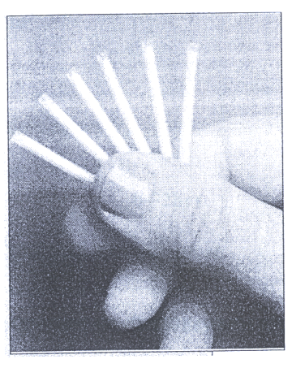
Contraceptives containing only a progestin
1. Oral tablets Name Progestin (mg) Micronor ----- Norethindrone 0.35 NOR — QD ----- Norethindrone 0.35 Ovrette ----- dl- Norgestrel 0.075 2. Intramuscular injection e.g. medroxyprogesterone acetate 150 mg (large dose), IM every 3 months (unknown long term safety also, pregnancy will take a long time) 3. Implantable progestine preparation e.g. Norplant — L- Norgestrel (6 tubes of 36 mg each) ( 5 years protection ).

Slide 15
Emergency Postcoital (after intercourse) Contraception ( morning-after pill )
Indications: When conception is undesirable e.g.
Rape
Unsuccessful withdrawal before ejaculation
Condom torn during intercourse
Exposure to teratogen e.g. live vaccine, cytotoxic drug
Regimen | Timing of 1st dose after intercourse | Reported efficacy
100 µg ethinyl estadiol & 0.5 mg levonorgestrel (Yuzpe regimen) given twice, with 12hr between doses(total 4 tablets) | Within 72hrs | 75%
High-dose of estrogen (e.g., 50 µg ethinylestradiol daily for 5 days) | Within 72 hrs | 75 - 85%
Mifepristone ,needed 600 mg (200mg tabx3) ±Misoprostol (400 µg) | Within l20 hrs | 85 - 100%
Mifepristone causes abortion.
If mifepristone alone didn’t cause abortion use misoprostol

Slide 16
Mechanism of contraception
1. Inhibition of ovulation
2. Abnormal transport time through Fallopian tube
3. Abnormal characteristics of cervical mucus
4. Abnormal contraction of the Fallopian tubes and
uterine musculature.

Slide 17
Contraindication of oral contraceptives
1. Thromboembolic disorders
2. Markedly impaired hepatic function
3. Suspected carcinoma of the breast
4. Undiagnosed genital bleeding

Slide 18
Factors Limiting the Effectiveness of Oral Contraceptives
Vomiting and diarrhea
Drugs interfere with absorption ( eg. Ampicillin )
Inducers of hepatic enzymes( eg. Barbiturates, phenytoin )

Slide 19
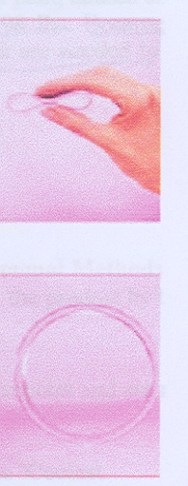
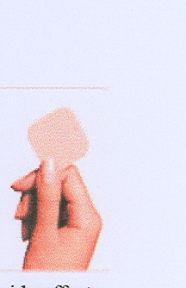
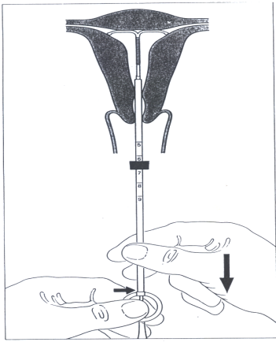
Long-acting Hormonal Methods
Vaginal ring
The patch
Injectables
Implants( Norplant)
Intrauterine device( IUD)

Slide 20
Natural Birth Control
Fertility awareness
2. Withdrawal
3. Lactational amenorrhea method
4. Sympto-thermal method
5. Ovulation method (mucus method )
6. Fertility computers

Slide 21
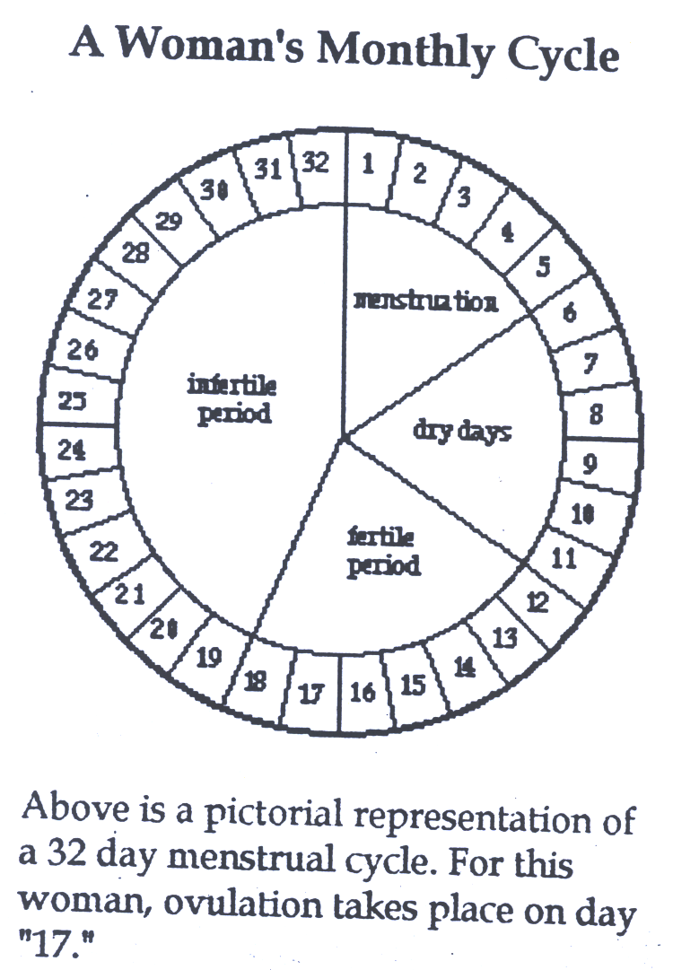

Slide 22
FERTILITY DRUGS
Antiestrogens
Bromocriptine
hCG
Gonadotropin - Releasing Hormone (GnRH)
Human Menopausal Gonadotropin (HMG)

Slide 23
OVULATION INDUCING AGENTS 1. Antiestrogens e.g. (Clomiphene &Tamoxifen) Mechanism of Action: a weak estrogen that act as competitive partial agonist inhibitor of estradiol at the estrogen receptor
And prevent natural estrogen from binding →increase FSH and LH
Indications: Women infertility not due to pituitary failure or ovarian failure.
Success rate: - ovulation = 80% - pregnancy = 40%

Slide 24
Dosage:
Do it for three consecutive month and if that doesn’t work
50 mg/d for 5 days from day 5th of the cycle to 10th
100 mg/d for 5 days from day 5th to 10th

Slide 25
Clomiphene &
Tamoxifen prevent the negative feedback mechanism
HYPOTHALAMUS
GnRH
ANTERIOR PITUITARY
FSH
LH
OVARY
ESTROGENS (β-ESTRADIOL)
AND
PROGESTERONE

Slide 26
ADVERSE EFFECTS OF CLOMIPHENE 1. Hot flushes 2. Gastric upset (nausea and vomiting) 3. Visual disturbances (reversible) 4. Skin rashes 5. Increase nervous tension 6. Depression 7. Fatigue 8. Weight gain 9. Breast tenderness 10. Hair loss (reversible) - occasional 11. Hyper stimulation of the ovaries and high
incidence of multiple birth.(IMP)

Slide 27
Tamoxifen
Similar & alternative to clomiphene…
Difference:
Not a steroidal agent (not hormone).
Used in palliative treatment of advanced breast cancer with estrogen receptor- positive tumor
N.B. In this case avoid using clomiphene . Because it is a weak estrogen

Slide 28
2. GONADOTROPIN RELEASING HORMONE (GnRH)
Uses:
Induction of ovulation in patients with
hypothalmic amenorrhea (GnRH deficient)
Analgoues with agonist activity: Leuprolin, goserelin
GnRH and agonists, given S.C. in a pulsatile (drip)
form to stimulate gonadotropin release
(1 – 10 µg / 60 – 120 min)
Given continuously, when gonadal suppression is
desirable e.g. precocious puberty and
advanced breast cancer in women and prostatic cancer
in men

Slide 29
HYPOTHALAMUS
GnRH
Agonists
GnRH
Continuous
Pulsatile
-
+
+
GnRHR
ANTERIOR PITUITARY
FSH
LH

Slide 30
Side effects of GnRH agonists:
Hypo-oestrogenism (long term use) Hot flashes Decreased libido Osteoporosis
N.B. these side effects are more likely occurs if a drug given continuously

Slide 31
3. Human menopausal gonadotropin (HMG) (or menotropins)
the first commercial gonadotropin product was xtraced from the urin of postmenopausal women, which contain substance with FSH-like & LH-like
Mechanism of Action
FSH-like & LH-like (the 2 hormones collaborate to induce ovulation)
Indications Women infertility due to pituitary insufficiency
for 10 days followed by human chorionic gonadotropin (hCG)
Adverse effects of HMG Fever Ovarian enlargement (hyper stimulation) Multiple Pregnancy (approx. 20%)

Slide 32
4. Human Chorionic Gonadotropin (hCG)
hCG is produced by human placenta and excreted into urine, whence it can be extracted & purified
Mechanism of action Similar to LH
(supports the corpus luteum during the early stages of pregnancy, by activating LH receptors)
Indications Adjunct in treatment of infertility
Adverse effects 1. Headache 2. Oedema

Slide 33
5. Bromocriptine
Indication Infertility in women with elevated level of prolactin
(during breast feeding) Mechanism of action Inhibits prolactin secretion from anterior pituitary
gland Adverse effects:
1. Nausea, vomiting and dizziness 2. Orthostatic hypotension 3. Constipation 4. Dry mouth 5. Leg cramp 6. Insomnia 7. Involuntary movement 8. Nasal congestion

Slide 34
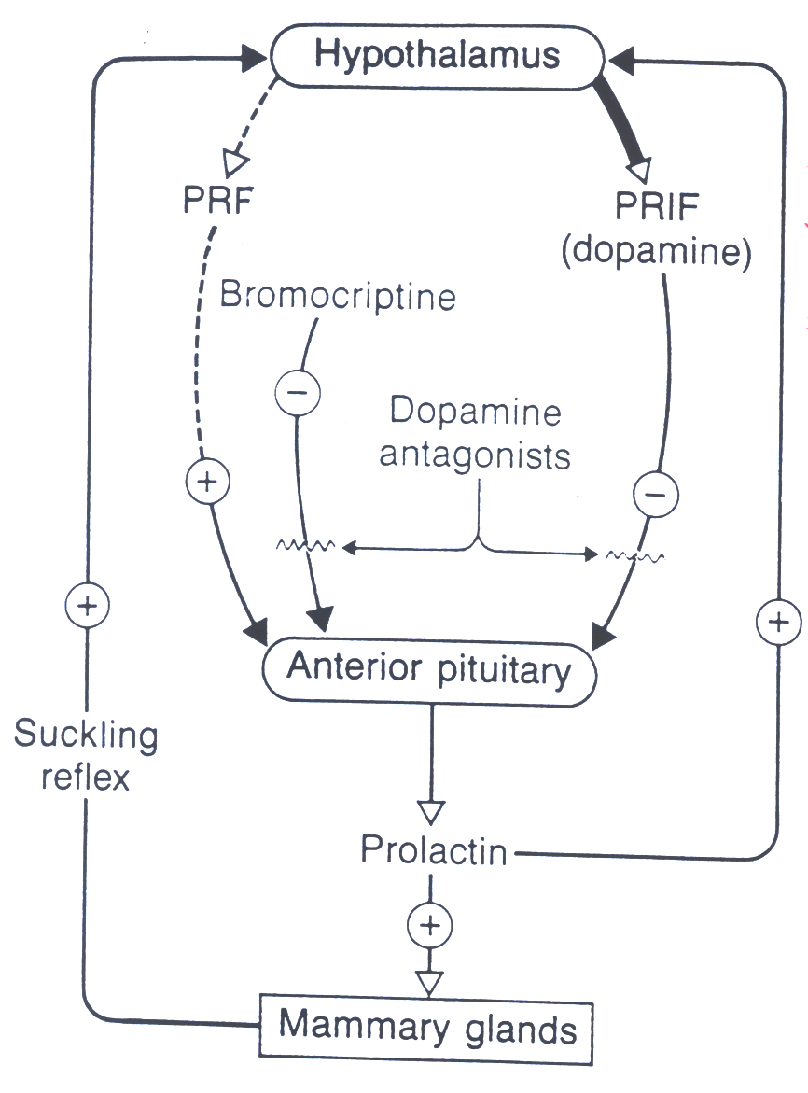
Prolactin releasing factor (PRF)
Prolactin release inhibiting factor (PRIF)

Slide 35
questions
The estrogen used in most combined contraceptives is:
Clomiphene
Ethinyl estradiol
Estrone
DES
Norgestrel

Slide 36
A 50-year-old woman undergoes a lumpectomy and a small carcinoma is removed, biochemical analysis of the cancer reveals the presence of estrogen and progestrone receptor. After the procedure, she will probably receive:
Danazol
Flutamide
Leuprolide
Mifepristone
Tamoxifen

Slide 37
A young woman complains of abdominal pain at the time of menstruation. Careful evaluation indicates the presence of significant endometrial deposits on the pelvic peritonium. The most appropriate therapy is:
Flutamide, orally
Medroxyprogestrone acetate by I.M injection
Norgestrel as an IUD
Oxandrolone by I.M injection
Raloxifene, orally

