Slide 1
Prescription writing
Prescription (Medical Prescription)
is the prescriber’s order to prepare or dispense a specific treatment - usually medication - for a specific patient.
A written direction for the preparation & administration of a remedy

Slide 2
Prescription writing
Steps
Make a Specific diagnosis.
Consider the Pathophysiological implications of the diagnosis.
Select a specific therapeutic objective.
Select a drug of choice.
Determine the appropriate dosing regimen.
Devise a plan for monitoring the drug’s action & determine an end point for therapy.
Plan a program of patient education.
In the hospital setting, drug are prescribed on (physician’s order sheet/Chart order)

Slide 3
Prescription writing
Who can prescribe?
Physicians
Dentists
Podiatrists (foot specialist)
Veterinarians
Osteopaths
Pharmacists (specialized Pharmacists)
Nurse practitioners
Physician’s Assistants
Optometrists

Slide 4
Outpatient prescription
Prescriber’s name license classification (Professional degree) Adress Office telephone numbers
Patient’s name | Date
Address
Drug name and strength Quantity SIG:
REFILL TIMES
OR UNTIL
NO CHILD PROOF CONTAINER
WARNING | PRESCIBER’S SIGNATURE
 | Presciber’s other identification data

Slide 5
Outpatient Prescription
Parts of prescription
Prescriber’s office information
Name
License classification (Professional degree)
Adress
Office telephone numbers

Slide 6
Outpatient Prescription
Cont’d
Date
Patients information
Name
Age ----- especially extremes of age, children & old aged
Weight --- especially children
Body surface area
Sex

Slide 7
Outpatient Prescription
Elements
Symbol
An abbreviation for “recipe” means: take thou.
Prescriber’s information
date
Patient’s information
superscription
symbol

Slide 8
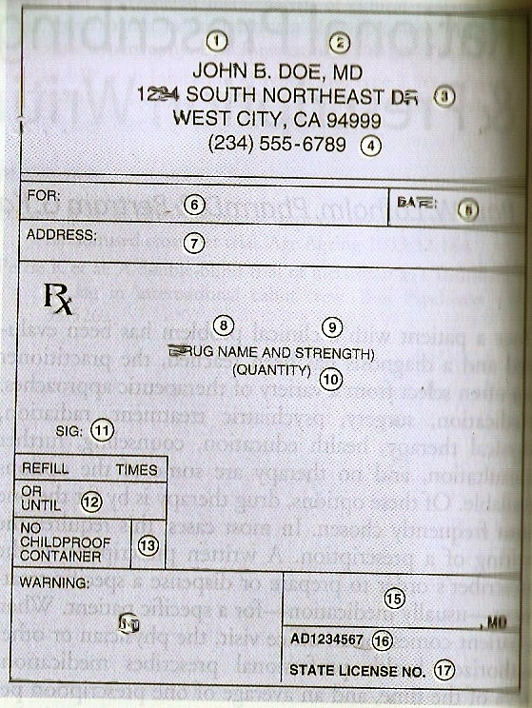
superscription

Slide 9
inscription
1- name and strength of each drug
You can use either the brand name (proprietary name) or the generic name (nonproprietary name)
2- dosage form

Slide 10
subscription
Dispensing directions to Pharmacist or Nurses.
Also the quantity to be dispensed
e.g. make a solution
mix & place into 30 capsules
dispense 30 tablets
Purpose of medication
e.g. For control of blood pressure

Slide 11
Signatura (sig) or transcription
Direction for patient.
The directions should be simple and the doses should be fewer.
Instruction for the patient as to how to take the prescription interpreted by the pharmacist
- Use of abbreviations or symbol is discouraged
- Instruction “Take as directed” should be avoided
Route of administration
- for oral dosage forms --- “take” or “give”
- for externally applied products --- “Apply”
- for suppositories ---- “Insert”
- for eye, ear, nose drops ----
“Place” is preferable to “instill”

Slide 12
How & when to take medication
Duration of therapy
Purpose of medication
Must be explained by both the physician & pharmacist
transcription

Slide 13
Dose always should be listed by metric measurements
of weight & volume.
Should be avoided
Older system of measure e.g. grains for weight &
Household measurements e.g. “dropperful” & “teaspoon”
Arabic (decimal) numerals (e.g. 1,2,3) are preferable to Roman numerals(I, II, III), & in some instances it is preferable for the numbers to be spelled out (e.g. Zero)

Slide 14
12 Refill information
13 Waiver of the requirement for childproof containers
14 Additional labeling instructions
e.g. warnings such as
“may cause drowsiness,”
“do not drink alcohol”
14

Slide 15
Pharmacist --- must place the expiration date of the drug on the label
15 Prescriber's signature
16 and 17 Any other identification of the prescriber

Slide 16
Prescription writing
Abbreviation | Meaning
tab | tablet
cap | capsule
PO | by mouth
PR | per rectum
SL | sublingual
IM | intramuscular
IV | intravenous
SC, SQ | subcutaneous
Abbreviation | Meaning
OTC | over-the-counter
pc | after meals
ac | before meals
prn | when needed
q | every
q6h | every 6 hours
qhs | every night at bed time
stat | at once
hs is latin for: hora somnia, ie, at the time of sleeping

Slide 17
Prescription writing
Abbreviation | Meaning
bid | twice a day
tid | three times a day
qid | four times a day
hs | at bed time
sos | if needed

Slide 18
Physician order sheet (POS) / chart order
Elements
Date
Time
Name & strength of medication , dose , route &
frequency of administration
Signature of prescriber

Slide 19
Prescribing errors
Illegible hand writing
Drugs with similar names
Acetazolamide ---- Acetohexamide
Methotrexate --- Metolazone

Slide 20
Prescribing errors
Poor presciption writing
Other errors
Error | Risk of being misread as: | Correct
.1 | 1 | 0.1
1.0 | 10 | 1
/ | 1 | Abandoned
10U | 100 | 10 units
IU | 10 or 14
µg | mg | mcg
Use leading zeros
Never use trailing zeros

Slide 21
Prescribing errors
Poor presciption writing
Other errors
Error | Risk of being misread as:
OD (everyday) | OD (right eye)
QD (every day) | QID (four times a day)
qod (every-other-day) | od (everyday / right eye)
qhs (once daily at bed time) | qhr (every hour)

Slide 22
Prescribing errors
Poor prescription writing
Other errors
Using acronyms for drugs e.g. ASA (aspirin), 6MP(6-mercaptopurine)
Inappropriate Drug Prescription
Drug interactions
Contraindications
Adverse effects

Slide 23
Compliance (adherence)
The extent to which patients follow treatment instructions.
Noncompliance --- Failure to follow drug regimen

Slide 24
Controlled Substance Schedules
(These are used when the drugs have high potential for abuse)
Schedule I
Examples: heroin
1. Potential for abuse: High
2. No accepted medical use or lacks accepted safety
May be used for research purposes by properly registered individuals.

Slide 25
Controlled Substance Schedules
Schedule II
Examples: morphine
1. Potential for abuse: High.
2. Has a currently accepted medical use (as a pain killer)
3. Abuse may lead to severe psychological or
physical dependence.

Slide 26
Controlled Substance Schedules
Schedule III
Examples: anabolic steroids
Abuse potential less than substances in schedule I or schedule II.
2. Has a currently accepted medical use.
3. Abuse may lead to moderate or low physical dependence or high psychological dependence.

Slide 27
Controlled Substance Schedules
Schedule IV
Examples: Alprazolam
1. Abuse potential less than substances in
schedule III.
2. Has a currently accepted medical use
3. Abuse may lead to
limited physical or psychological dependence
relative to substances in schedule III.

Slide 28
Controlled Substance Schedules
Schedule V
Examples: buprenorphine
1. Low potential for abuse relative to schedule IV.
2. Has a currently accepted medical use
3. Some schedule V products may be sold in limited
amounts without a prescription at the discretion
of the pharmacist; however, if a physician wishes
a patient to receive one of these products, it is
preferable to provide a prescription
4. Limited dependence possible

Slide 29
Controlled Substance
- All prescriptions must be written in ink; this practice
is compulsory for schedule II drugs
- Date
- Prescriber’s name & address
- Patient’s name, age, & address
- Diagnosis
- No abbreviations
- All doses, number of ampules, tablets, etc. should be
written in words (letters) & in figures (numbers)
- Prescriber’s signature
- Prescription is dispensed once, & is kept by pharmacist

Slide 30
-Refill
- Refill prn (refill as needed) --- is inappropriate
- If no refill is desired, “Zero” (not 0) --- should be
written in the refill space
- For schedule II drug: no refill
- For schedule III &IV drug:not to exceed 5 refills or 6 months after the issue date, whichever comes first
- For schedule V drug ---- no restriction

