Slide 1
Anti anaemic Drugs Dr. Saeed Ahmed Department of Pharmacology KSU

Slide 2
Anti anaemic Drugs
Hematopoiesis: it is the production of erythrocytes, platelets, and leukocytes from undifferentiated stem cells.
It occurs in bone marrow
Requirement for hematopoiesis
iron
Vitamin B12
Folic acid
Hematopoietic growth factor

Slide 3
Anti anaemic Drugs
Small RBC and insufficient Hb
microcytic hypochromic anaemia
Iron is required for Hb synthesis
↓iron
Impaired production and abnormal maturation of RBC
Megaloblastic anemia
Vit.B12 and folic acid required for DNA synthesis
↓vit.B12 or folic acid
Erythropoeitin and colony stimulating factors are hormones that regulate blood cell development and proliferation in the bone marrow.

Slide 4
Anemia: anemia is a common clinical condition that is caused by an acquired or hereditary abnormality of RBCS or it precursor, or it may be a manifestation of an underlying non hematologic disorder.
Anemia = ↓RBC mass
Hb= ≤ 12g/dl in women
<14g/dl in men
Classification of anemia
Anemia with ↓RBC production
Iron* deficiency anemia
Megaloblastic anemia
Anemia with ↑RBC destruction
Hemolytic anemia
thalassemias
Chronic disease and renal failure
Sickle cell anemia
Notes:
* Microcytic , the most common cause of chronic anemia

Slide 5
Iron in body = 4 or 5G
65% in the form of Hb
4% myoglobin
1% various heme compound
15% stored as ferritin or hemosiderin in:
liver
Intestinal mucosa
Reticuloendothelial system
spleen
Bone marrow

Slide 6
Sign and symptoms of anemia
Signs and symptoms Hb≤7g/dl
fatigue
pallor
dyspnea
headache
angina
syncopy
Visual imapirment
tachycardia
lymphadenopathy
Bone tenderness
hepatomegalyor splenomegaly
Blood loss in feces
Neurologic symptoms

Slide 7
Pharmacokinetics of iron
Iron absorption
Absorption in duodenum and jejunum
Plasma protein
Intestinal cell
Transferrin + Fe⁺⁺⁺
Fe⁺⁺ (ferrous)
Fe⁺⁺ → Fe⁺⁺⁺ (ferric)
Only 10-20% of ingested iron is actually absorbed
Transported to tissues
Primary as ferritin
Iron stored as
hemosiderin
↑requirement → ↑absorption (in pregnancy, menstruation, children)

Slide 8
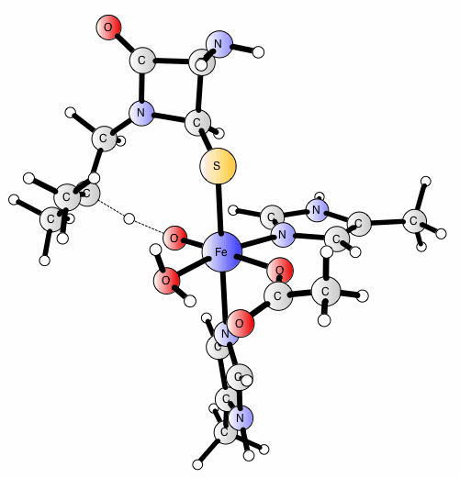
Use of iron in erythropoiesis
Transferrin receptor
Iron stores
Fe⁺⁺⁺
Transferrin + Fe⁺⁺⁺
Developing red cell
Transferrin and its receptor are recycled
RBC containing Hb
Developing red cells
Transferrin + (Fe⁺⁺⁺ )+ receptor
Elimination of iron (1mg/day)
sweat
saliva
Exfoliated skin
Intestinal mucosal cells
O₂ binds to Hb in the lungs and is transported to the tissues
With globin
Iron forms
Heme
Hemoglobin

Slide 9
Clinical pharmacology
Clinical use of iron:
Iron deficiency anemia is the only indication for the use of iron
Chief source of iron is meat*ه
Causes of iron deficiency
Inadequate dietary intake
Blood loss in women because of menstruation
↑iron requirement
vegetarians
Malnourished patients
pregnancy
Growing children
*B/C iron in the vegetables & grains are tightly bound to the organic compound which makes it less absorpable

Slide 10
Iron deficiency commonly seen in
Premature infant
Children during rapid growth
Pregnant and lactating mothers
Patients with small bowel disease that ↓absorption
Iron deficiency develops
↓storage iron
↓serum ferritin
↓serum iron
↑total iron binding capacity (TIBC)
Most common cause of iron deficiency is blood loss

Slide 11
Anti anaemic Drugs
treatment
Oral iron
Parenteral iron
Ferrous sulfate
Tablet size: 325mg
Ferrous gluconate
320mg
37mg
Ferrous fumarate
325mg or (100mg)
106mg or (33)
Elemental iron: 65mg
Iron dextran (ferric hydroxide + dextran):
50mg elemental iron/ml
(means concentration of iron is 50 mg in 1 ml solution)
Means that iron in this tablet = 65mg and the rest is other substances

Slide 12
In iron deficient individuals 50-100 mg of iron incorporated in Hb daily
But remember that only 25% of iron is absorbed
So you should give the patient 200-400mg of elemental iron daily
For example: in ferrous sulfate there is 65mg of elemental iron so we give the patient 3-4 tablets daily 65 × 4= 260mg
Treatment should be continue for 3-6 months, this not only correct the anemia but will replenish iron stores.
Hb should reach normal level in 1-3 months.
Failure to respond to oral iron therapy may be due to incorrect diagnosis.

Slide 13
Adverse effects of oral therapy
Adverse effects
Epigastric discomfort
Abdominal cramps
constipation
diarrhea
Black stool
Since these effects are dose related, it can often be overcomed by lowering the daily dose or by taking iron tablets immediately after or with meals.

Slide 14
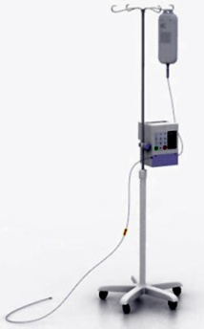
Parenteral iron therapy
Used for
Patients unable to tolerate or absorb iron
Patients with gastrectomy
With small bowel resection
Patients with chronic blood loss witch can’t be maintained by oral iron
Malabsorption syndrome
IV infusion
Iron dextran:
Route of administration: I/M, or by I/V infusion in 1-2 hours.
Most adults need about 1-2 G (20-40ml) iron dextran for iron deficiency anemia.
Test dose : test dose of small amount should be given before I/M or I/V (to make sure the patient doesn’t have allergy

Slide 15
Adverse effects
Tissue staining at the site injection
headache
fever
arthralgia
Nausea/ vomiting
bronchospasm
urticaria
It may lead to anaphylaxis and death
Iron toxicity: it is seen in young children who have ingested a multiple iron tablets (more than 10 tablets). Adults are able to tolerate large doses of iron.
Large amounts of oral iron (toxicity) cause: necrotizing gastroenteritis, vomiting, abdominal pain, bloody diarrhea, dyspnea, metabolic acidosis, coma, and death

Slide 16
Treatment of acute toxicity
Whole bowel irrigation (to flush out unabsorbed pills)
Deferoxamine
A Potent iron chelator
Binds to iron and promote its excretion in urine and feces
Supportive therapy for GIT bleeding , metabolic acidosis and shock
Chronic toxicity: known as Hemochromatosis, when excess iron is deposited in the heart, liver, pancreas, and other organs cause organ failure and death.

Slide 17
hemochromatosis
Inherited:
Excessive iron absorption
Acquired:
Patients who receive many red cell transfustion
treatment
Intermittent phlebotomy:
1 unit of blood removed every week
deferoxamine
Notes:
Deferasirox is oral iron chelator

Slide 18
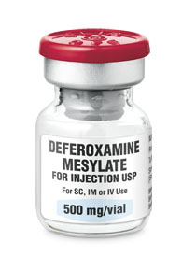
pharmacokinetics
Poorly absorbed orally and may ↑absorption of iron by this route
Given IM or preferably IV
Metabolized and excreted in urine (change urine color to orange)
Adverse effects
IV→ hypotension
Flushing, erythema, aurticaria, intestinal irritation
Acute respiratory distress syndrome after 24 hours infusion
neurotoxicity
deferoxamine

Slide 19
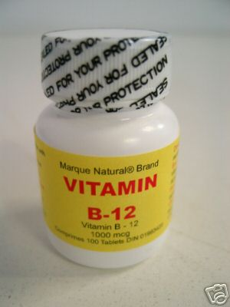
Anti anaemic Drugs
Vitamin B₁₂
Vitamin B₁₂ (cobalamine), a cobalt containing molecule along with folic acid. Vitamin B12 is a cofactor in the transfer of 1- carbon unit, a step necessary for the synthesis of DNA.
Impairment of DNA synthesis affects all cells, but because red blood cells must be produced continuously, a deficiency of either vitamin B12 or folic acid usually manifests first as anemia (megaloblastic anemia)

Slide 20
Anti anaemic Drugs
In addition Vit. B12 deficiency can cause neurologic defects, which may become irreversible if not treated promptly
Pharmacokinetics: Vit B12 is synthesized only by bacteria. It is absorbed from the GI tract in the presence of intrinsic factor, a product of the parietal cells of the stomach.
Plasma transport is accomplished by binding to transcobalamin II.

Slide 21
Anti anaemic Drugs
Vit B12 is stored in the liver in large amounts; a normal individual has enough to last 5 years.
Pharmacodynamics:
Vitamin B12 IS ESSENTIAL IN 2 REACTIONS:
Available in 2 forms
cyanocobalamine
Hydroxycobalamine:
Longer half life

Slide 22
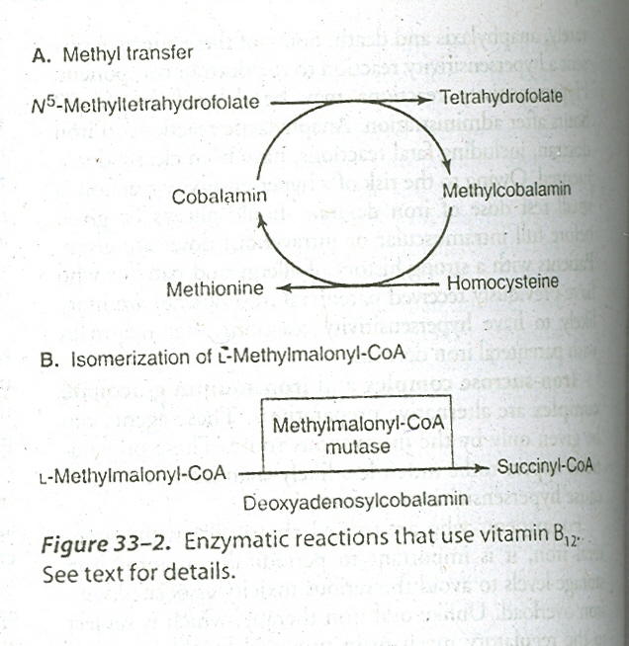
1- Conversion of homocysteine to methionine
2- Conversion of methylmalonyl CoA to sccinyl CoA
The 1st reaction is related to folic acid metabolism and the synthesis of dTMP (see next slide)

Slide 23
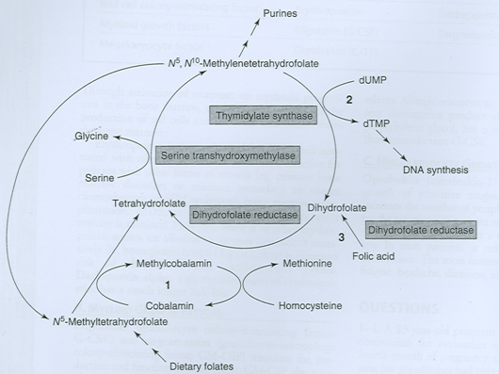

Slide 24
Anti anaemic Drugs
Vit. B12 deficiency
Folates accumulate as N-methyltetrahydrofolate
↓tetrahydrofolate
The production of RBC slows
administration of folic acid to patients With Vitamin B12 deficiency helps in resupplying the tetrahydrofolate pool and partially or even fully correcting anemia
However exogenous folic acid does not correct the neurologic defects of Vitamin B12 deficiency

Slide 25
Anti anaemic Drugs
Clinical uses and toxicity:
Both agents have equivalent effects. Slide # 21
1. Prevent deficiency
2. Treatment of naturally pernicious anemia
3. Anemia caused by gastric resection
Because Vit B12 def. anemia is almost always caused by inadequate absorption, therapy should be by replacement of VitB12,using parenteral therapy. No significant toxicity of VitB12 occurred

Slide 26
Anti anaemic Drugs
Folic acid:
Like Vitamin B12 folic acid is required for normal DNA synthesis, and its deficiency usually presents as megaloblastic anemia.
In addition deficiency of folic acid during pregnancy increases the risk of the formation of neural tube defects in fetuses.

Slide 27
Anti anaemic Drugs
Pharmacokinetics:
Folic acid is readily absorbed from the GI tract. Only modest amounts are stored in the body, so a decrease in dietary intake is followed by anemia within few months
Pharmacodynamics:
Folic acid is converted to tetrahydrofolate by the action of dihydrofolate reductase.

Slide 28
Anti anaemic Drugs
One important set of reactions involving tetrahydrofolate and dihydrofolate constitutes the dTMP cycle, which supplies the dTMP required for DNA synthesis. (see slide 23)
Rapidly dividing cells are highly sensitive to folic acid deficiency. For this reason, antifolate drugs are useful in the treatment of various infections and cancers

Slide 29
Anti anaemic Drugs
Clinical use and toxicity:
Folic acid deficiency is most often caused by dietary insufficiency and malabsorption.
Anemia resulting from folic acid deficiency is readily treated by oral folic acid.
Maternal folic acid deficiency: folic acid supplementation required prior and during pregnancy.

Slide 30
Anti anaemic Drugs
Vitamin B12 deficiency must be ruled out before one selects folic acid as the sole therapeutic agent in the treatment of patients with megaloblastic anaemia.
Folic acid has no recognized toxicity.

Slide 31
Anti anaemic Drugs
Erythropoietin:
erythropoietin is produced by the kidney
Reduction in its synthesis is responsible for anemia of renal failure
Functions:
1. Activation of receptors on erythroid progenitors in the bone marrow.
2. It stimulates the production of red cells and increases their release from the bone marrow.

Slide 32
Erythropoietin used for
Anemia 2ry to
Chemotherapy and HIV treatment
Bone marrow transplantation
Anemia of chronic renal failure
AIDS or cancer
Anemia in primary bone disorder
Toxicity: thrombosis ,cardiovascular events when used along with some other erythropoietic agents

